Slide 1
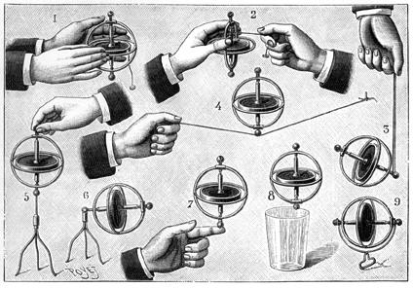
Collective Neutrino Oscillations
Collective Neutrino Oscillations
Georg G. Raffelt
3rd Schrödinger Lecture, Thursday 19 May 2011

Slide 2
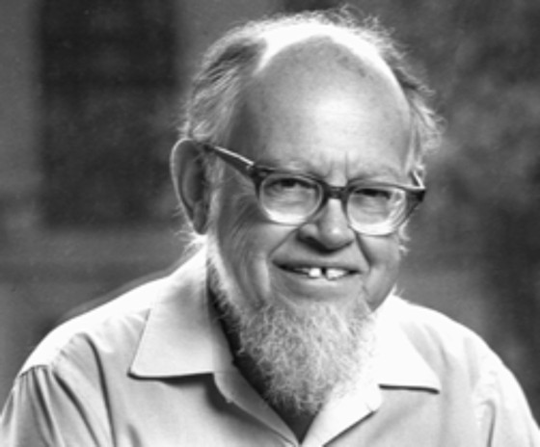
Neutrino Oscillations in Matter
3300 citations
Neutrinos in a medium suffer flavor-dependent
refraction
W, Z
f
ν
ν
ν
Z
ν
f
$V_{\text{weak}}=\sqrt{2}G_{\text{F}}×\left\{\begin{matrix}N_{\text{e}}−{N_{\text{n}}}/2 \\ {{−N}_{\text{n}}}/2\end{matrix} \begin{matrix}\text{f}\text{or} { ν}_{\text{e}} \\ \text{f}\text{or} ν_{μ}\end{matrix}\right.$
Lincoln Wolfenstein
Typical density of Earth: 5 g/cm³
$$ΔV_{\text{weak}}≈2×{10}^{−13} \text{eV}=0.2 \text{peV}$$

Slide 3
Neutrino Oscillations in Matter
2-flavor neutrino evolution as an effective 2-level problem
$$\text{i}\frac{∂}{∂z}\left(\begin{matrix}ν_{e} \\ ν_{μ}\end{matrix}\right)=H\left(\begin{matrix}ν_{e} \\ ν_{μ}\end{matrix}\right)$$
Negative
for $\overline{ν}$
With a 2×2 Hamiltonian matrix
$H=\frac{1}{2E}\left(\begin{matrix}\cos{θ} & \sin{θ} \\ −\sin{θ} & \cos{θ}\end{matrix}\right)\left(\begin{matrix}m_{1}^{2} & 0 \\ 0 & m_{2}^{2}\end{matrix}\right)\left(\begin{matrix}\cos{θ} & −\sin{θ} \\ \sin{θ} & \cos{θ}\end{matrix}\right)±\sqrt{2}G_{F}\left(\begin{matrix}N_{e}−\frac{N_{n}}{2} & 0 \\ 0 & −\frac{N_{n}}{2}\end{matrix}\right)$
Mass-squared matrix, rotated by
mixing angle θ relative to interaction
basis, drives oscillations
Weak potential difference
$ΔV_{weak}=\sqrt{2}G_{F}N_{e}∼0.2 \text{peV}$
for normal Earth matter, but
large effect in SN core
(nuclear density 3×10¹⁴ g/cm³)
$$ΔV_{weak}∼10 \text{eV}$$
$$\frac{Δm^{2}}{2E}∼\left\{\begin{matrix} 4 \text{p}\text{eV} & \text{for}\text{ 12 }\text{mass} \text{splitting} \\ 120 \text{peV} & \text{for}\text{ 13 }\text{mass} \text{splitting}\end{matrix}\right.$$
Solar, reactor and supernova neutrinos:
E $∼$ 10 MeV

Slide 4
Suppression of Oscillations in Supernova Core
Effective mixing angle in matter
$$\tan{2θ_{m}=}\frac{\sin{2θ}}{\cos{2θ}−{N_{e}2E\sqrt{2}G_{F}}/{Δm^{2}}}$$
Supernova core
$ρ=3×{10}^{14} \text{g} {\text{cm}}^{−3}$
$Y_{e}=0.35$
$N_{e}=6×{10}^{37} {\text{cm}}^{−3}$
$E∼100 \text{MeV}$
Solar mixing
$Δm^{2}∼75 {\text{meV}}^{2}$
$\sin{2θ∼0.94}$
Matter suppression effect
${N_{e}2E\sqrt{2}G_{F}}/{Δm^{2}∼2×{10}^{13}}$
• Inside a SN core,
flavors are “de-mixed”
• Very small oscillation
amplitude
• Trapped e-lepton
number can only
escape by diffusion

Slide 5
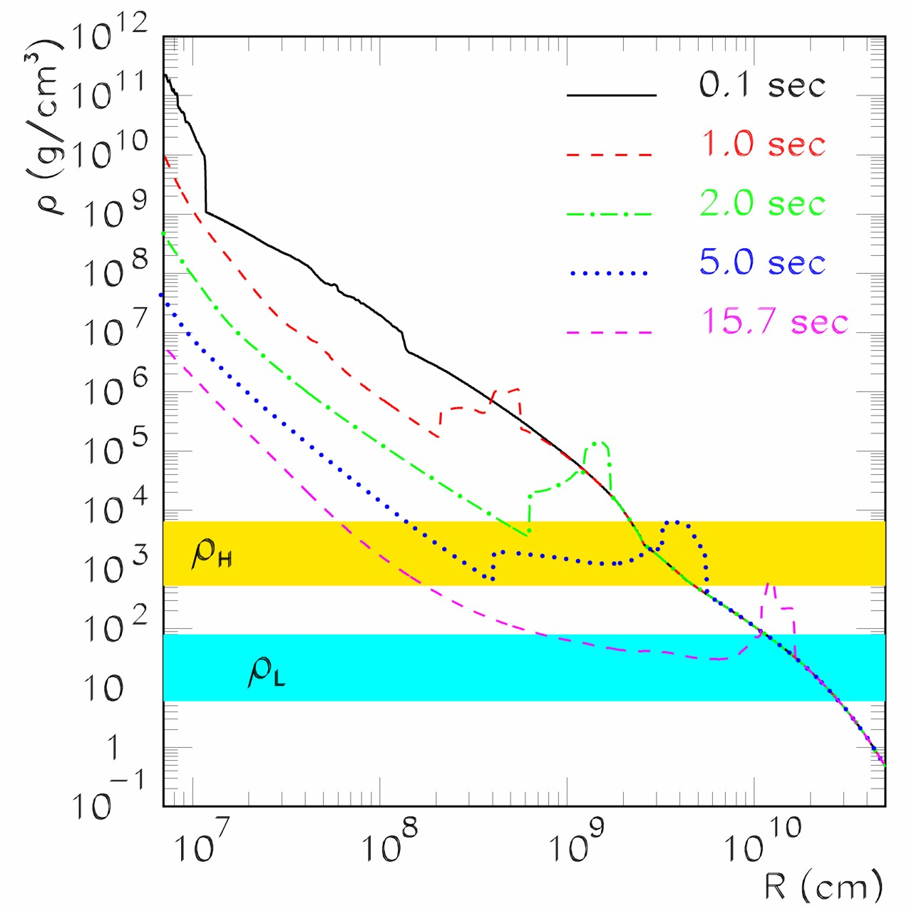
Snap Shots of Supernova Density Profiles
astro-ph/0407132
• ${\overline{ν}}_{e}$-${\overline{ν}}_{μ,τ}$ conversions,
driven by small mixing
angle $θ_{13}$ and
“atmospheric” mass
difference $Δm_{13}^{2}$
• May reveal neutrino
mass hierarchy
H-resonance (13 splitting)
L-resonance (12 splitting)

Slide 6
Mikheev-Smirnov-Wolfenstein (MSW) effect
Eigenvalue diagram of 2×2 Hamiltonian matrix for 2-flavor oscillations
Antineutrinos
Neutrinos
$${\overline{ν}}_{x}$$
Propagation through
density gradient:
adiabatic conversion
$$ν_{e}$$
$${m_{2}^{2}}/{2E}$$
$${m_{1}^{2}}/{2E}$$
$$ν_{x}$$
$${\overline{ν}}_{e}$$
“Negative density”
represents antineutrinos
in the same diagram
Vacuum
Density

Slide 7
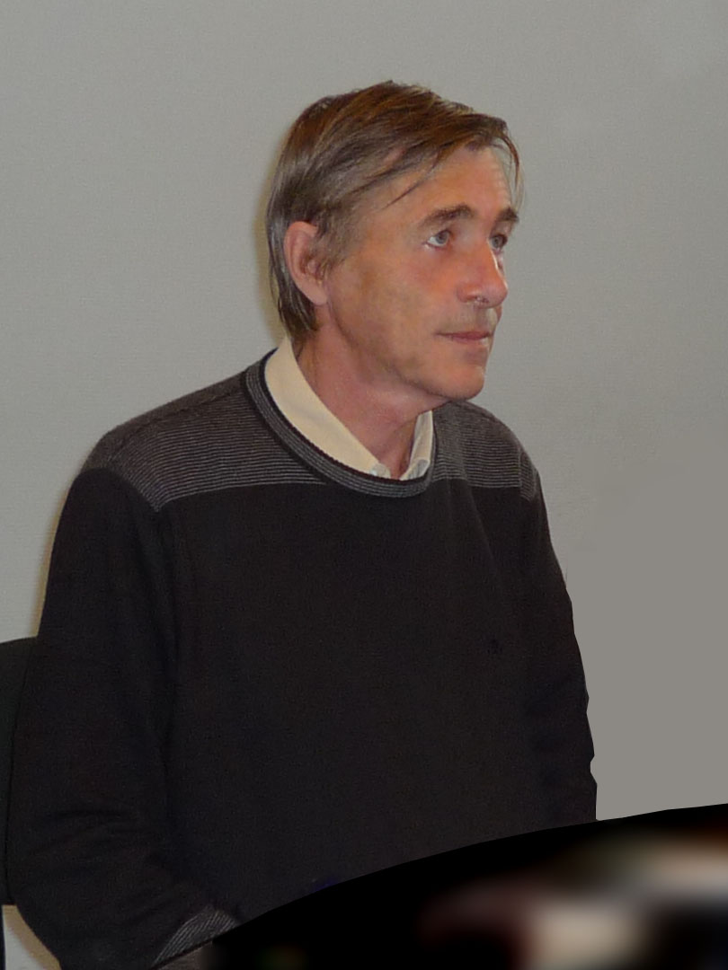
Stanislaw Mikheev († 23 April 2011)

Slide 8
Citations of Wolfenstein’s Paper on Matter Effects
Atm nu oscillations
SNO, KamLAND
MSW effect
SN 1987A
Annual citations of Wolfenstein, PRD 17:2369, 1978
in the SPIRES data base (total of 3278 citations 1978–2010)

Slide 9
Three-Flavor Neutrino Parameters
Three mixing angles $θ_{12}$, $θ_{13}$, $θ_{23}$ (Euler angles for 3D rotation), $c_{ij}=\cos{θ_{ij}}$,
a CP-violating “Dirac phase” $δ$, and two “Majorana phases” $α_{2}$ and $α_{3}$
v
$$\left(\begin{matrix}ν_{e} \\ ν_{μ} \\ ν_{τ}\end{matrix}\right)=\left(\begin{matrix}1 & 0 & 0 \\ 0 & c_{23} & s_{23} \\ 0 & −s_{23} & c_{23}\end{matrix}\right)\left(\begin{matrix}c_{13} & 0 & {e^{−iδ}s}_{13} \\ 0 & 1 & 0 \\ {{−e}^{iδ}s}_{13} & 0 & c_{13}\end{matrix}\right)\left(\begin{matrix}c_{12} & s_{12} & 0 \\ −s_{12} & c_{12} & 0 \\ 0 & 0 & 1\end{matrix}\right)\left(\begin{matrix}1 & 0 & 0 \\ 0 & e^{i\frac{α_{2}}{2}} & 0 \\ 0 & 0 & e^{i\frac{α_{3}}{2}}\end{matrix}\right)\left(\begin{matrix}ν_{1} \\ ν_{2} \\ ν_{3}\end{matrix}\right)$$
$${39}^{∘}<θ_{23}<{53}^{∘}$$
$$θ_{13}<{11}^{∘}$$
$${33}^{∘}<θ_{12}<{37}^{∘}$$
Relevant for
0ν2β decay
Atmospheric/LBL-Beams
Reactor
Solar/KamLAND
v
Normal
Inverted
Tasks and Open Questions
Precision for θ₁₂ and θ₂₃
How large is θ₁₃ ?
CP-violating phase δ ?
Mass ordering ?
(normal vs inverted)
Absolute masses ?
(hierarchical vs degenerate)
Dirac or Majorana ?
3
μ
τ
2
e
μ
τ
$Δm^{2}$
72–80 meV²
Atmosphere
Sun
1
e
μ
τ
Atmosphere
2180–2640 meV²
2
e
μ
τ
Sun
1
e
μ
τ
3
μ
τ

Slide 10
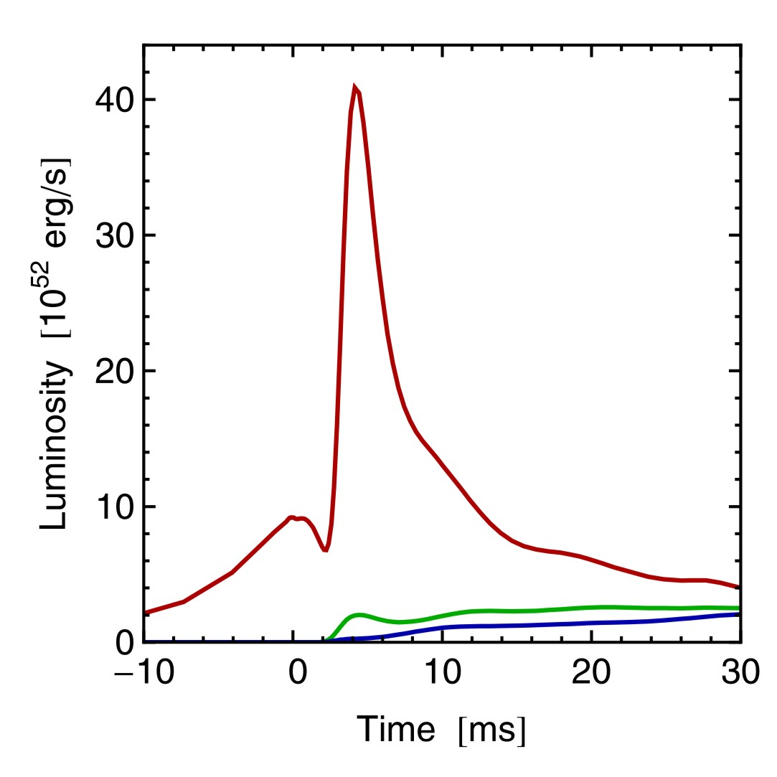
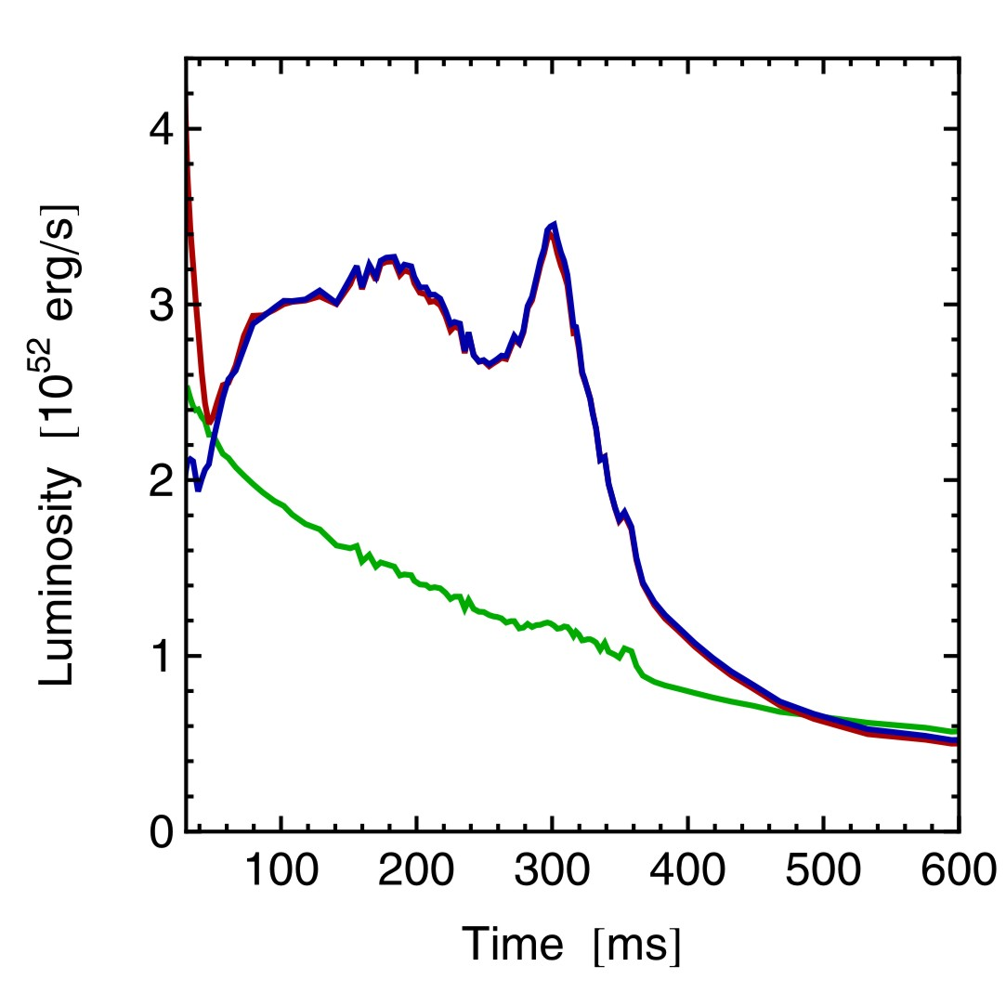
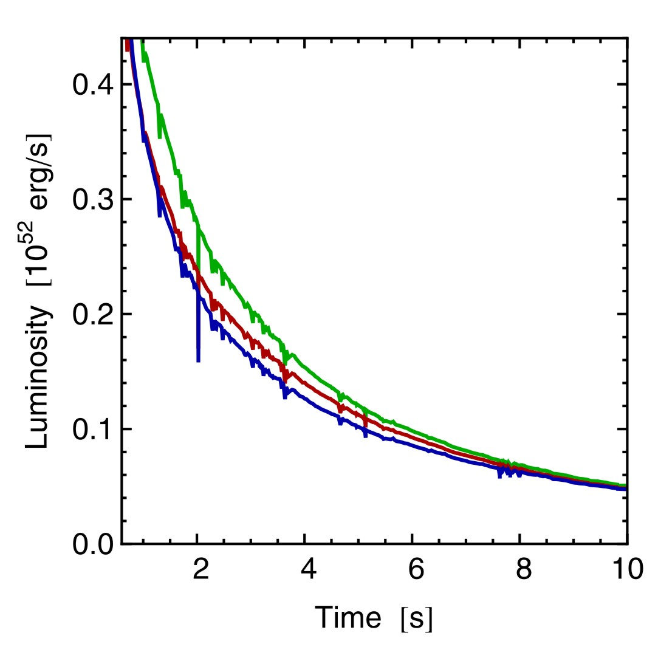
Three Phases of Neutrino Emission
Prompt ν_{e} burst
Accretion
Cooling
Shock breakout
De-leptonization of
outer core layers
Shock stalls $\sim$ 150 km
Neutrinos powered by
infalling matter
Cooling on neutrino
diffusion time scale
No large $ν_{e}$ detector
available
Large fluxes and large
${\overline{ν}}_{e}$-${\overline{ν}}_{x}$ flux differences
Smaller fluxes and small
${\overline{ν}}_{e}$-${\overline{ν}}_{x}$ flux differences
Spherically symmetric model (10.8 M⊙) with Boltzmann neutrino transport
Explosion manually triggered by enhanced CC interaction rate
Fischer et al. (Basel group), A&A 517:A80, 2010 [arxiv:0908.1871]

Slide 11
Level-Crossing Diagram in a Supernova Envelope
Normal mass hierarchy
Inverted mass hierarchy
Vacuum
Vacuum
Dighe & Smirnov, Identifying the neutrino mass spectrum from a supernova
neutrino burst, astro-ph/9907423

Slide 12
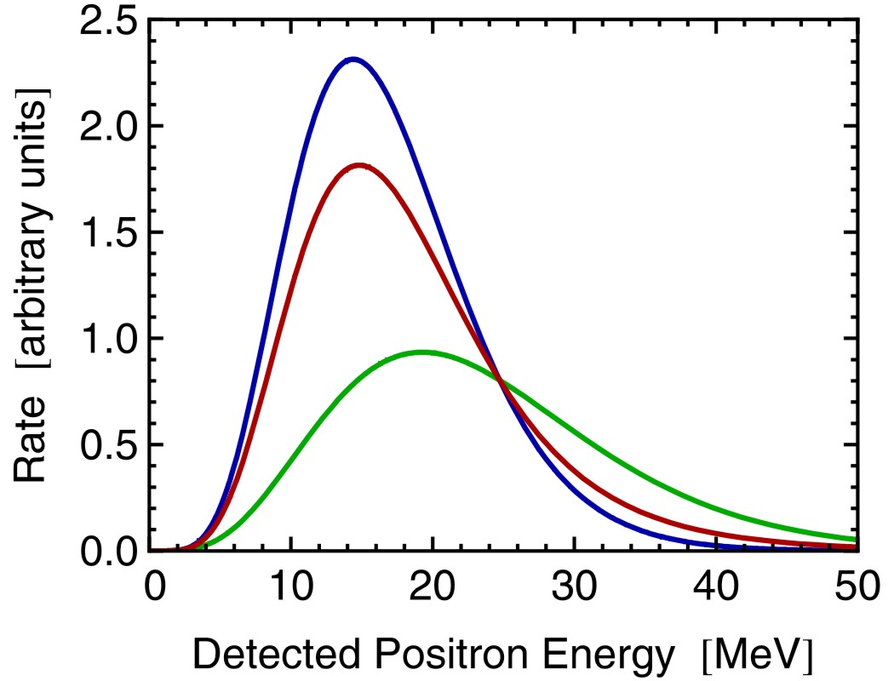
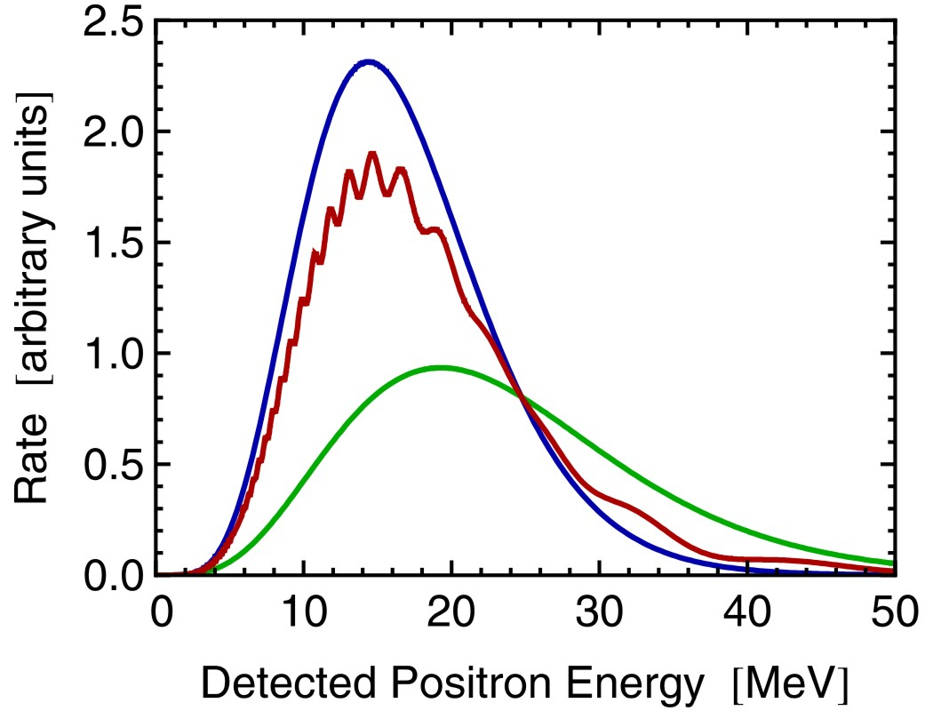
Oscillation of Supernova Anti-Neutrinos
Basel accretion phase
model ($10.8 M_{⊙}$)
Detection spectrum
by ${\overline{ν}}_{e}+p→n+e^{+}$
(water Cherenkov or
scintillator detectors)
Original ${\overline{ν}}_{e}$ spectrum
(no oscillations)
Partial swap
(Normal hierarchy)
Partial swap
(Normal hierarchy)
w/ Earth effects
Full swap${\overline{ν}}_{e}↔{\overline{ν}}_{x}$
(Inverted Hier.)
8000 km path length
in Earth assumed
Detecting Earth effects requires good energy resolution
(Large scintillator detector, e.g. LENA, or megaton water Cherenkov)

Slide 13
Signature of Flavor Oscillations (Accretion Phase)
1-3-mixing scenarios
A
B
C
Mass ordering
Normal (NH)
Inverted (IH)
Any (NH/IH)
$\sin^{2}{θ_{13}}$
$≳{10}^{−3}$
$$≲{10}^{−5}$$
MSW conversion
adiabatic
non-adiabatic
$ν_{e}$ survival prob.
0
$$\sin^{2}{θ_{12}}≈0.3$$
$$\sin^{2}{θ_{12}}≈0.3$$
${\overline{ν}}_{e}$ survival prob.
$$\cos^{2}{θ_{12}}≈0.7$$
0
$$\cos^{2}{θ_{12}}≈0.7$$
${\overline{ν}}_{e}$Earth effects
Yes
No
Yes
May distinguish mass ordering
Assuming collective effects are not important during accretion phase
(Chakraborty et al., arXiv:1105.1130v1)

Slide 14
Snap Shots of Supernova Density Profiles
astro-ph/0407132
Accretion-phase luminosity
$L_{{\overline{ν}}_{e}}∼3×{10}^{52}{\text{erg}}/{\text{s}}$
Corresponds to a neutrino
number density of
$3×{10}^{33}{\text{cm}}^{−3}{\left(\frac{10 km}{R}\right)}^{2}$
Equivalent
neutrino
density ∝ R⁻²
H-resonance (13 splitting)
L-resonance (12 splitting)

Slide 15
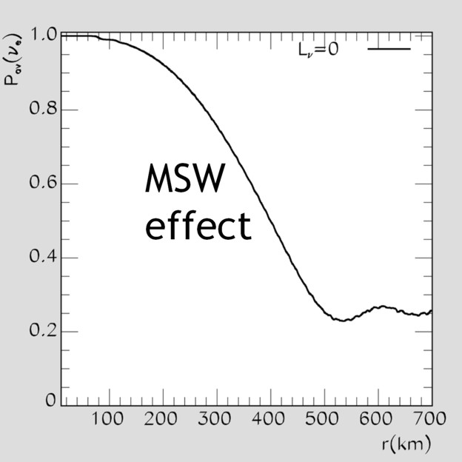
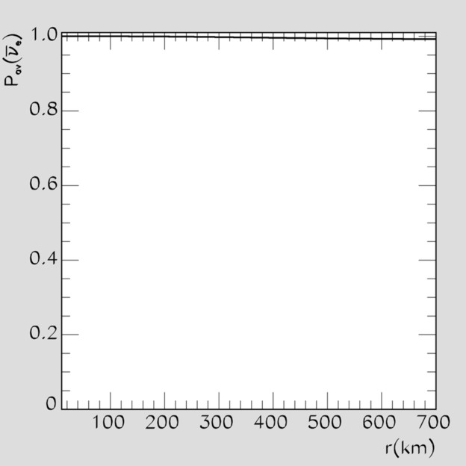
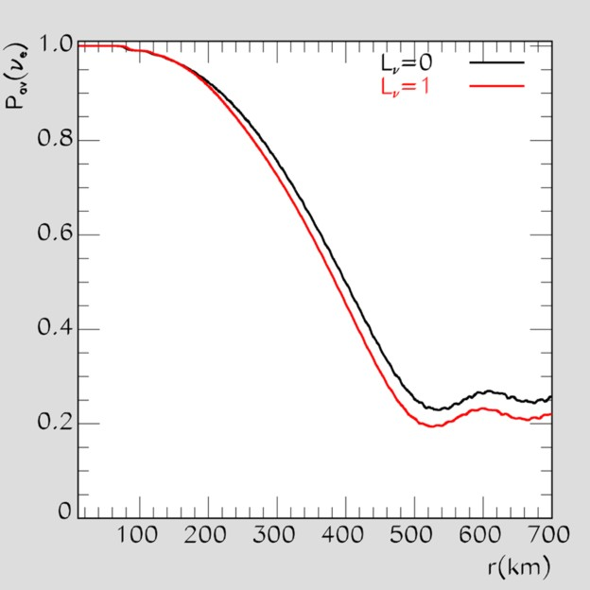
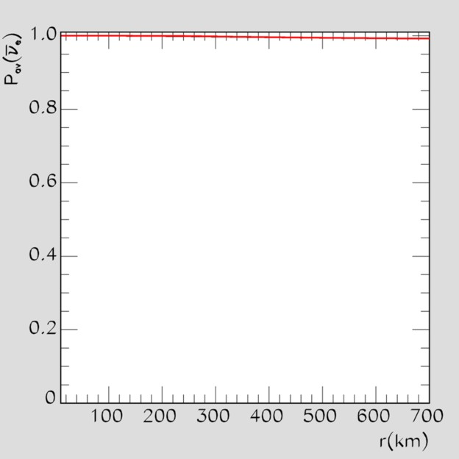
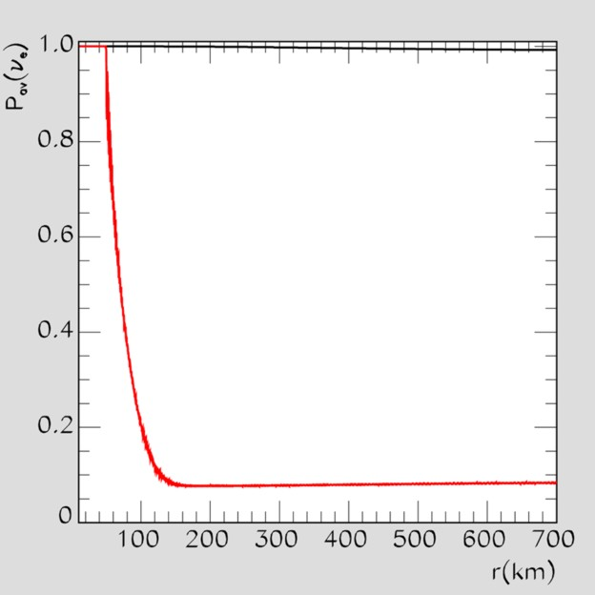
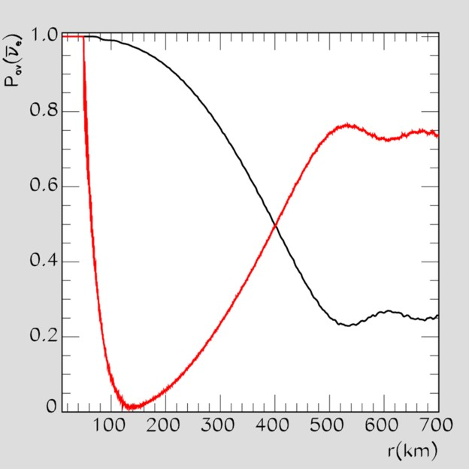
Self-Induced Flavor Oscillations of SN Neutrinos
Survival probability $ν_{e}$
Survival probability ${\overline{ν}}_{e}$
Normal
Hierarchy
atm Δm²
θ₁₃ close
to Chooz
limit
Realistic
nu-nu effect
MSW
effect
No
nu-nu effect
Inverted
Hierarchy
Realistic
nu-nu effect
Collective
oscillations
(single-angle
approximation)
MSW
No
nu-nu effect

Slide 16
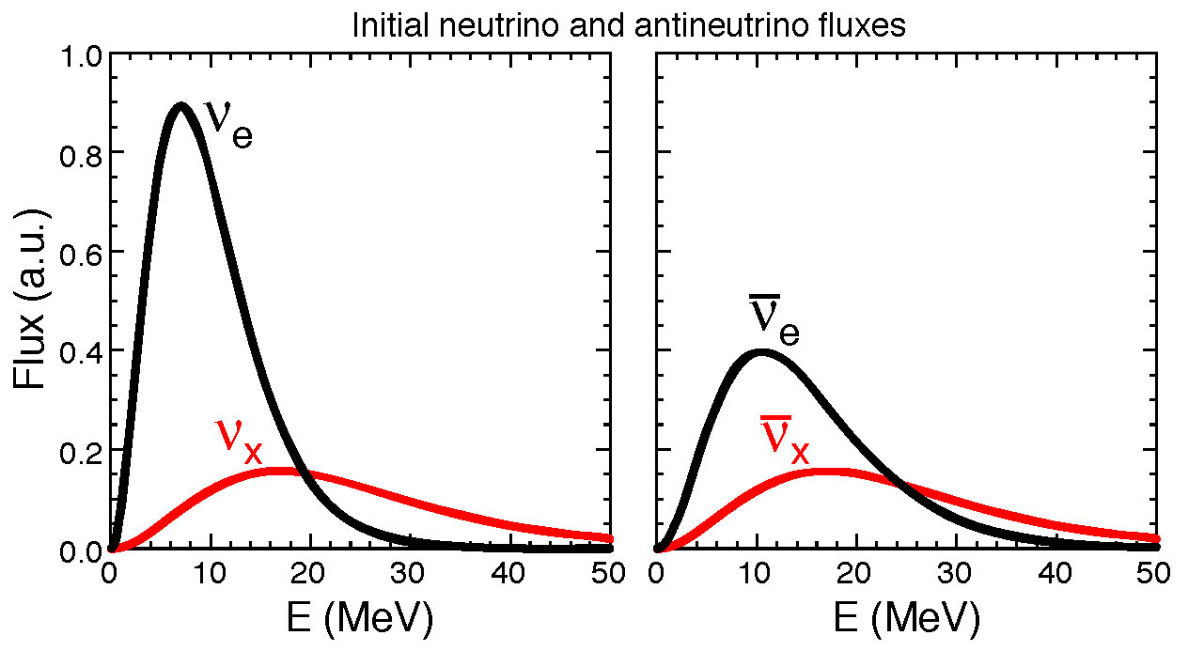
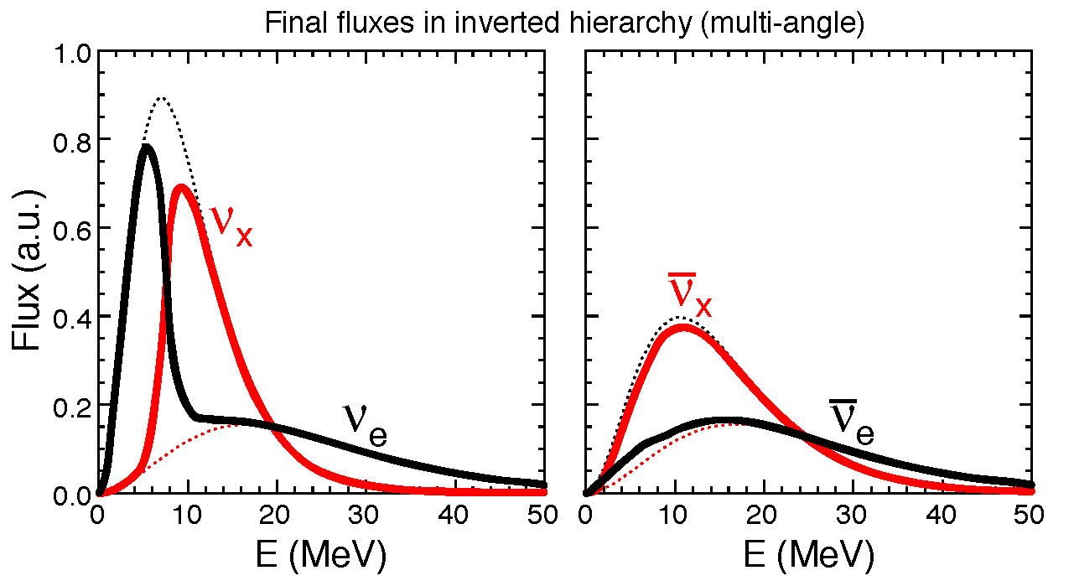
Spectral Split
Initial
fluxes at
neutrino
sphere
Figures from
Fogli, Lisi,
Marrone & Mirizzi,
arXiv:0707.1998
Explanations in
Raffelt & Smirnov
arXiv:0705.1830
and 0709.4641
Duan, Fuller,
Carlson & Qian
arXiv:0706.4293
and 0707.0290
After
collective
trans-
formation

Slide 17
Collective Supernova Nu Oscillations since 2006
Two seminal papers in 2006 triggered a torrent of activities
Duan, Fuller, Qian, astro-ph/0511275, Duan et al. astro-ph/0606616
Balantekin, Gava & Volpe, arXiv:0710.3112. Balantekin & Pehlivan, astro-ph/0607527. Blennow, Mirizzi & Serpico, arXiv:0810.2297. Cherry, Fuller, Carlson, Duan & Qian, arXiv:1006.2175. Chakraborty, Choubey, Dasgupta & Kar, arXiv:0805.3131. Chakraborty, Fischer, Mirizzi, Saviano, Tomàs, arXiv:1104.4031, 1105.1130. Choubey, Dasgupta, Dighe & Mirizzi, arXiv:1008.0308. Dasgupta & Dighe, arXiv:0712.3798. Dasgupta, Dighe & Mirizzi, arXiv:0802.1481. Dasgupta, Dighe, Mirizzi & Raffelt, arXiv:0801.1660, 0805.3300. Dasgupta, Mirizzi, Tamborra & Tomàs, arXiv:1002.2943. Dasgupta, Dighe, Raffelt & Smirnov, 0904.3542. Dasgupta, Raffelt, Tamborra, arXiv:1001.5396. Duan, Fuller, Carlson & Qian, astro-ph/0608050, 0703776, arXiv:0707.0290, 0710.1271. Duan, Fuller & Qian, arXiv:0706.4293, 0801.1363, 0808.2046, 1001.2799. Duan, Fuller & Carlson, arXiv:0803.3650. Duan & Kneller, arXiv:0904.0974. Duan & Friedland, arXiv:1006.2359. Duan, Friedland, McLaughlin & Surman, arXiv:1012.0532. Esteban-Pretel, Pastor, Tomàs, Raffelt & Sigl, arXiv:0706.2498, 0712.1137. Esteban-Pretel, Mirizzi, Pastor, Tomàs, Raffelt, Serpico & Sigl, arXiv:0807.0659. Fogli, Lisi, Marrone & Mirizzi, arXiv:0707.1998. Fogli, Lisi, Marrone & Tamborra, arXiv:0812.3031. Friedland, arXiv:1001.0996. Gava & Jean-Louis, arXiv:0907.3947. Gava & Volpe, arXiv:0807.3418. Galais, Kneller & Volpe, arXiv:1102.1471. Galais & Volpe, arXiv:1103.5302. Gava, Kneller, Volpe & McLaughlin, arXiv:0902.0317. Hannestad, Raffelt, Sigl & Wong, astro-ph/0608695. Wei Liao, arXiv:0904.0075, 0904.2855. Lunardini, Müller & Janka, arXiv:0712.3000. Mirizzi, Pozzorini, Raffelt & Serpico, arXiv:0907.3674. Mirizzi & Tomàs, arXiv:1012.1339. Pehlivan, Balantekin, Kajino, Yoshida, arXiv:1105.1182. Raffelt, arXiv:0810.1407, 1103.2891. Raffelt & Tamborra, arXiv:1006.0002. Raffelt & Sigl, hep-ph/0701182. Raffelt & Smirnov, arXiv:0705.1830, 0709.4641. Sawyer, hep-ph/0408265, 0503013, arXiv:0803.4319, 1011.4585. Wu & Qian, arXiv:1105.2068.

Slide 18
Flavor-Off-Diagonal Refractive Index
2-flavor neutrino evolution as an effective 2-level problem
$$\text{i}\frac{∂}{∂t}\left(\begin{matrix}ν_{e} \\ ν_{μ}\end{matrix}\right)=H\left(\begin{matrix}ν_{e} \\ ν_{μ}\end{matrix}\right)$$
$$ν$$
Effective mixing Hamiltonian
ν
Z
ν
$$H=\frac{M^{2}}{2E}+\sqrt{2}G_{F} \left(\begin{matrix}N_{e}−\frac{N_{n}}{2} & 0 \\ 0 & −\frac{N_{n}}{2}\end{matrix}\right)+\sqrt{2}G_{F}\left(\begin{matrix}N_{ν_{e}} & N_{{〈ν}_{e}|ν_{μ}〉} \\ N_{{〈ν}_{μ}|ν_{e}〉} & N_{ν_{μ}}\end{matrix}\right)$$
Mass term in
flavor basis:
causes vacuum
oscillations
Wolfenstein’s weak
potential, causes MSW
“resonant” conversion
together with vacuum
term
Flavor-off-diagonal potential,
caused by flavor oscillations.
(J.Pantaleone, PLB 287:128,1992)
Flavor oscillations feed back on the Hamiltonian: Nonlinear effects!

Slide 19
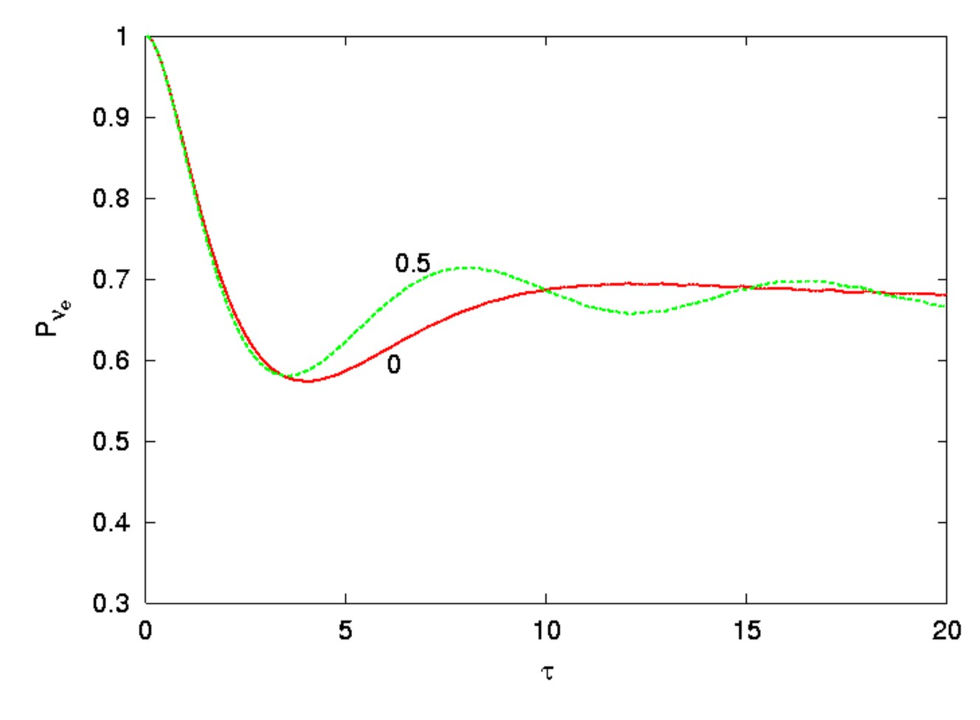
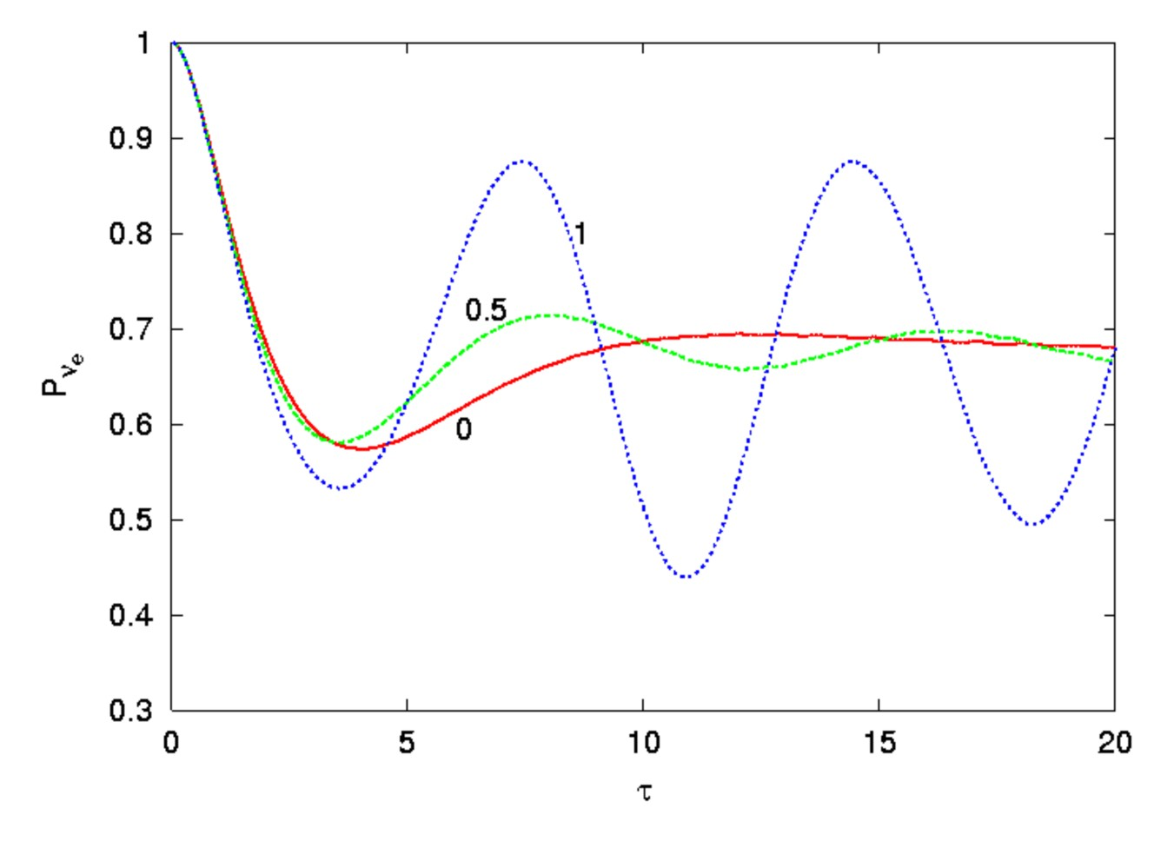
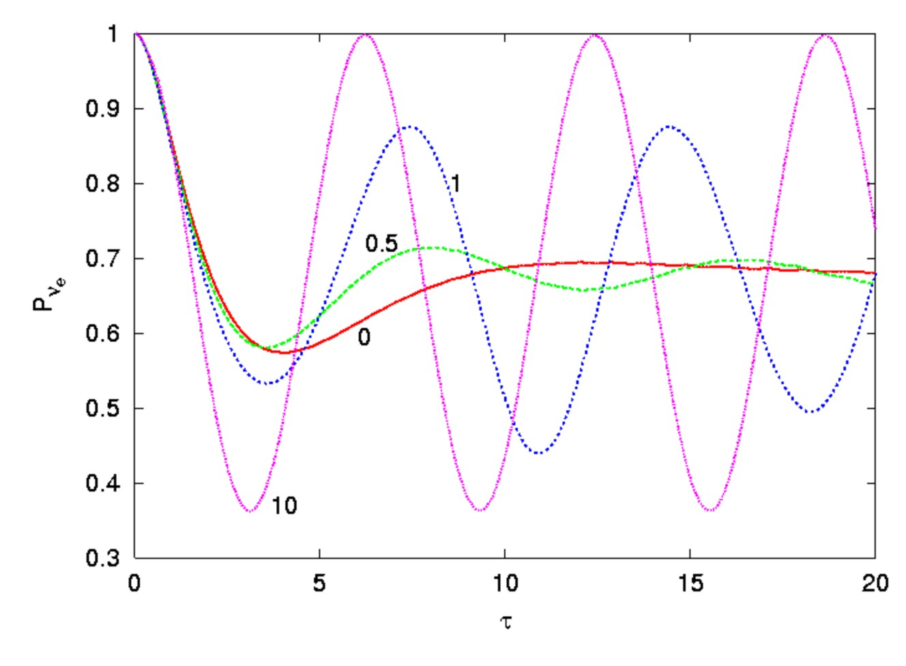
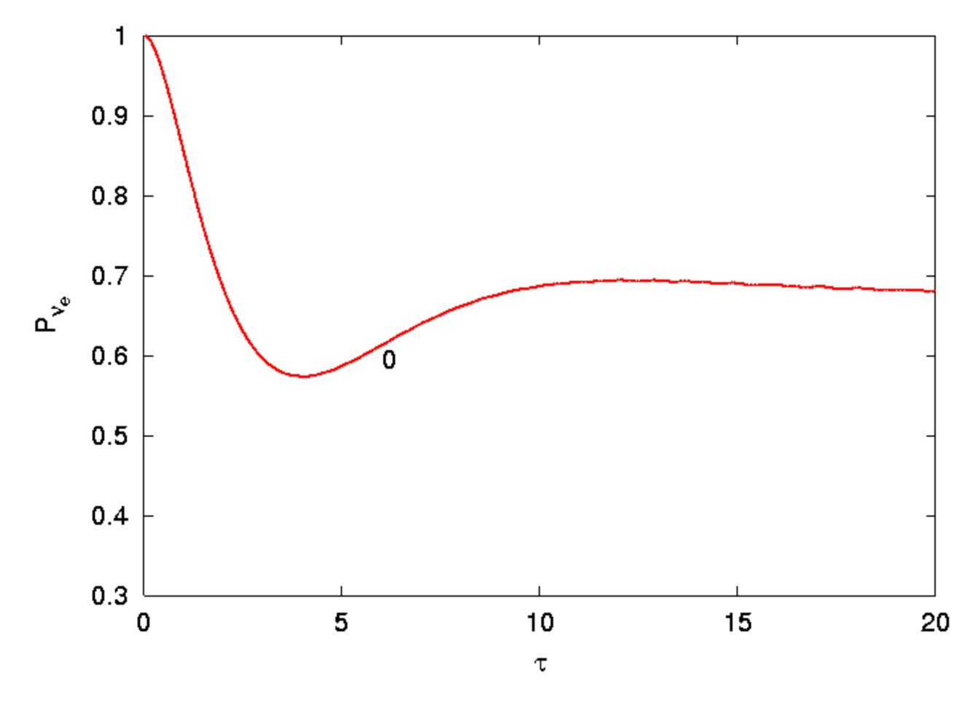
Synchronizing Oscillations by Neutrino Interactions
• Vacuum oscillation frequency depends on energy $ω={Δm^{2}}/{2E}$
• Ensemble with broad spectrum quickly decoheres kinematically
• ν-ν interactions “synchronize” the oscillations: $ω_{sync}={〈Δm^{2}}/{2E}〉$
Average e-flavor
component of
polarization vector
Time
Pastor, Raffelt & Semikoz, hep-ph/0109035

Slide 20
Vacuum Flavor Oscillations
2-flavor neutrino evolution a 2-level problem
$$\text{i}∂_{t}\left(\begin{matrix}ν_{e} \\ ν_{μ}\end{matrix}\right)=\frac{M^{2}}{2E}\left(\begin{matrix}ν_{e} \\ ν_{μ}\end{matrix}\right)=H\left(\begin{matrix}ν_{e} \\ ν_{μ}\end{matrix}\right)$$
Hamiltonian provided by neutrino mass matrix
$$H=\frac{1}{2E}\left(\begin{matrix}\cos{θ} & \sin{θ} \\ −\sin{θ} & \cos{θ}\end{matrix}\right)\left(\begin{matrix}m_{1}^{2} & 0 \\ 0 & m_{2}^{2}\end{matrix}\right)\left(\begin{matrix}\cos{θ} & −\sin{θ} \\ \sin{θ} & \cos{θ}\end{matrix}\right)$$
$$=\underset{\begin{aligned}\text{Contributes} \text{global} \text{phase} \\ \text{Can} \text{be} \text{ignored}\end{aligned}}{\underbrace{\frac{m_{1}^{2}+m_{2}^{2}}{2E}\left(\begin{matrix}\cos{2θ} & 0 \\ 0 & \cos{2θ}\end{matrix}\right)}}+\frac{Δm^{2}}{2E}\left(\begin{matrix}\cos{2θ} & \sin{2θ} \\ \sin{2θ} & −\cos{2θ}\end{matrix}\right)$$

Slide 21
Three Ways to Describe Flavor Oscillations
Schrödinger equation in terms of “flavor spinor”
$${ \text{i}∂}_{t}\left(\begin{matrix}ν_{e} \\ ν_{μ}\end{matrix}\right)=H\left(\begin{matrix}ν_{e} \\ ν_{μ}\end{matrix}\right)=\frac{Δm^{2}}{2E}\left(\begin{matrix}\cos{2θ} & \sin{2θ} \\ \sin{2θ} & −\cos{2θ}\end{matrix}\right)\left(\begin{matrix}ν_{e} \\ ν_{μ}\end{matrix}\right)$$
Neutrino flavor density matrix
$$ρ=\left(\begin{matrix}〈ν_{e}|ν_{e}〉 & 〈ν_{e}|ν_{μ}〉 \\ 〈ν_{μ}|ν_{e}〉 & 〈ν_{μ}|ν_{μ}〉\end{matrix}\right)$$
Equivalent commutator form of Schrödinger equation
$${ \text{i}∂}_{t}ρ=\left[H,ρ\right]$$
Expand 2×2 Hermitean matrices in terms of Pauli matrices
$ρ=\text{Tr}\left(ρ\right)+\frac{1}{2}P⋅σ$ and $H=\frac{Δm^{2}}{2E}B⋅σ$ with $B=(\sin{2θ,0,\cos{2θ)}}$
Equivalent spin-precession form of equation of motion
$\dot{P}=ωB×P$ with $ω=\frac{Δm^{2}}{2E}$
$P$ is “polarization vector” or “Bloch vector”

Slide 22
Flavor Oscillation as Spin Precession
Flavor
direction
Mass
direction
$$z$$
↑ Spin up $ν_{e}$
↓ Spin down $ν_{μ}$
$$B$$
Flavor polarization vector precesses around the mass direction with
frequency $ω={Δm^{2}}/{2E}$
$$P$$
$$2θ$$
Twice the vacuum
mixing angle
$$y$$
$$x$$

Slide 23
Adding Matter
Schrödinger equation including matter
${\text{i}∂}_{t}\left(\begin{matrix}ν_{e} \\ ν_{μ}\end{matrix}\right)=\left[\frac{Δm^{2}}{2E}\left(\begin{matrix}\cos{2θ} & \sin{2θ} \\ \sin{2θ} & −\cos{2θ}\end{matrix}\right)+\sqrt{2}G_{F}\left(\begin{matrix}N_{e}−\frac{N_{n}}{2} & 0 \\ 0 & −\frac{N_{n}}{2}\end{matrix}\right)\right]\left(\begin{matrix}ν_{e} \\ ν_{μ}\end{matrix}\right)$
Corresponding spin-precession equation
$\dot{P}=\underset{H_{eff}}{\underbrace{\left(ωB+λL\right)}}×P$ with $ω={Δm^{2}}/{2E}$ and $λ=\sqrt{2}G_{F}N_{e}$
$B$ unit vector in mass direction
$L=e_{z}$ unit vector in flavor direction
$$z$$
$$H_{eff}=ωB+λL$$
$$H_{matter}=\sqrt{2}G_{F}N_{e}L$$
$$H_{vac}=\frac{Δm^{2}}{2E}B$$
$$2θ_{matter}$$
$$2θ_{vac}$$
$$x$$

Slide 24
MSW Effect
Adiabatically decreasing density: Precession cone follows $H_{eff}$
$$H_{matter}$$
Large initial matter density:
• $ν$ begins as flavor eigenstate
• Ends as mass eigenstate
$$H_{eff}$$
$$H_{vac}$$
Matter Density

Slide 25
Adding Neutrino-Neutrino Interactions
Precession equation for each $ν$ mode with energy $E$, i.e. $ω={Δm^{2}}/{2E}$
${\dot{P}}_{ω}=\underset{H_{eff}}{\underbrace{\left(ωB+λL+μP\right)}}×P_{ω}$ with $λ=\sqrt{2}G_{F}N_{e}$ and $μ=\sqrt{2}G_{F}N_{ν}$
Total flavor spin of entire ensemble
$P=\sum_{ω}{P_{ω}}$ normalize $|P_{t=0}|=1$
Individual spins do not remain aligned – feel “internal” field $H_{νν}=μP$
$$z$$
$$B$$
Synchronized oscillations for large
neutrino density $μ≫δω$
$P$ precesses with $ω_{sync}$ for large $ν$ density
Individual $P_{ω}$ “trapped” on precession cones
Precess around $P$ with frequency $∼μ$
$$x$$

Slide 26
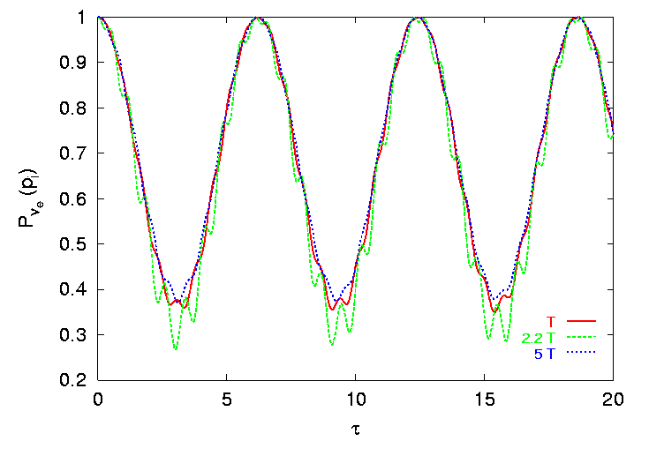
Synchronized Oscillations by Nu-Nu Interactions
For large neutrino density, individual modes precess around large common
dipole moment
Pastor, Raffelt & Semikoz, hep-ph/0109035

Slide 27
Two Spins Interacting with a Dipole Force
Simplest system showing $ν$-$ν$ effects:
Isotropic neutrino gas with 2 energies $E_{1}$ and $E_{2}$, no ordinary matter
${\dot{P}}_{1}=(ω_{1}B+μP)×P_{1}$ with $P=P_{1}+P_{2}$ and $ω_{1,2}={Δm^{2}}/{2E}$
${\dot{P}}_{2}=\left(ω_{2}B+μP\right)×P_{2}$
Go to “co-rotating frame” around $B$ direction
${\dot{P}}_{1}=(ω_{c}B−ωB+μP)×P_{1}$
${\dot{P}}_{2}=(ω_{c}B+ωB+μP)×P_{2}$
with $ω_{c}=\frac{1}{2}\left(ω_{2}+ω_{1}\right)$ and $ω=\frac{1}{2}\left(ω_{2}−ω_{1}\right)$
No interaction ($μ=0$)
$P_{1,2}$ precess in opposite directions
Strong interactions ($μ→∞$)
$P_{1,2}$ stuck to each other
(no motion in co-rotating frame, perfectly
synchronized in lab frame)
Mass
direction
$$B$$
$$P_{1}$$
$$P_{2}$$
$$y$$
$$x$$

Slide 28
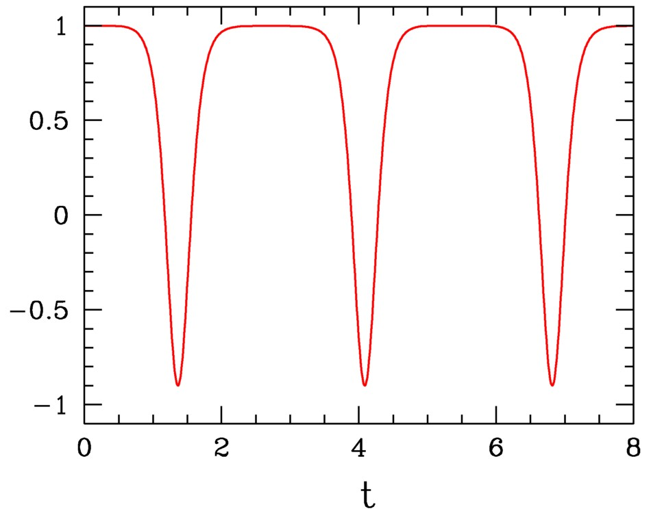
Two Spins with Opposite Initial Orientation
No interaction ($μ=0$)
Free precession in
opposite directions
Even for very small mixing angle,
large-amplitude flavor oscillations
$$B$$
$$P_{2}$$
$$P_{1}$$
$$P_{1}$$
$$P_{2}$$
$${−P}_{1}^{z}, { P}_{2}^{z}$$
Time
Strong interaction
($μ→∞$)
Pendular motion

Slide 29
Instability in Flavor Space
Two-mode example in co-rotating frame, initially $P_{1}= ↓$, $P_{2}= ↑$ (flavor basis)
${\dot{P}}_{1}=[−ωB+μ (P_{1}+P_{2})]×P_{1}$
${\dot{P}}_{2}=[+ωB+μ \underbrace{(P_{1}+P_{2})}]×P_{2}$
0 initially
$$B$$
$$B$$
$$P=P_{1}+P_{2}$$
Matter effect transverse to
mass and flavor directions
Both $P_{1}$and $P_{2}$tilt around $P$
if $μ$ is large
$$P_{1}$$
$$P_{1}$$
$$P_{2}$$
$$P_{2}$$
$$y$$
$$x$$
• Initially aligned in flavor
direction and $P=0$
• Free precession $±ω$
After a short time,
transverse $P$ develops
by free precession

Slide 30
Collective Pair Annihilation
Gas of equal abundances of $ν_{e}$ and ${\overline{ν}}_{e}$, inverted mass hierarchy
Small effective mixing angle (e.g. made small by ordinary matter)
1
$$ν_{e}{\overline{ν}}_{e}$$
$$ν_{e}{\overline{ν}}_{e}$$
0.75
0.5
Survival probability
0.25
$$ν_{μ}{\overline{ν}}_{μ}$$
$$ν_{μ}{\overline{ν}}_{μ}$$
$$ν_{μ}{\overline{ν}}_{μ}$$
0
Time
Dense neutrino gas unstable in flavor space: $ν_{e}{\overline{ν}}_{e}↔ν_{μ}{\overline{ν}}_{μ}$
Complete pair conversion even for a small mixing angle

Slide 31
Flavor Matrices of Occupation Numbers
Neutrinos described by Dirac field
$Ψ\left(t,x\right)=\int{\frac{d^{3}p}{{\left(2π\right)}^{3}}} \left[a_{p}\left(t\right)u_{p}+b_{−p}^{† }\left(t\right) v_{−p}\right]{ e}^{ip⋅x}$
in terms of the spinors in flavor space, providing spinor of flavor amplitudes
$Ψ=\left(\begin{matrix}Ψ_{1} \\ Ψ_{2} \\ Ψ_{3}\end{matrix}\right)$, $a=\left(\begin{matrix}a_{1} \\ a_{2} \\ a_{3}\end{matrix}\right)$, $b=\left(\begin{matrix}b_{1} \\ b_{2} \\ b_{3}\end{matrix}\right)$ and $\left|\begin{matrix}ν_{1}(t,p) \\ ν_{2}(t,p) \\ ν_{3}(t,p)\end{matrix}\right\rangle =\left(\begin{matrix}a_{1}^{†}(t,p) \\ a_{2}^{†}(t,p) \\ a_{3}^{†}(t,p)\end{matrix}\right) |0〉$
Measurable quantities are expectation values of field bi-linears $〈Ψ^{†}Ψ〉$,
therefore use “occupation number matrices” to describe the ensemble and
its kinetic evolution (Boltzmann eqn for oscillations and collisions)
($ν$) $ρ_{ij}=〈a_{j}^{†}a_{i}〉$
($\overline{ν}$) ${\overline{ρ}}_{ij}=〈b_{j}^{}b_{i}^{†}〉=1−〈b_{i}^{†}b_{j}〉$
Describe $\overline{ν}$ with negative occupation numbers, reversed order of flavor indices
(holes in Dirac sea)
Drops out in commutators

Slide 32
Equations of Motion for Occupation Number Matrices
Ordinary matter effect caused by
matrix of charged lepton densities
Non-linear effect caused by nu-nu
interactions has the same structure.
In isotropic medium $1−\cos{θ_{pq}}→1$
and $\sum_{q}{\left(ρ_{q}+{\overline{ρ}}_{q}\right)}$ is matrix of net
neutrino densities (not diagonal)
$$L=\left(\begin{matrix}N_{e}−N_{\overline{e}} & 0 & 0 \\ 0 & N_{μ}−N_{\overline{μ}} & 0 \\ 0 & 0 & N_{τ}−N_{\overline{τ}}\end{matrix}\right)$$
${\dot{ρ}}_{p}=+\frac{1}{2E}\left[M^{2},ρ_{p}\right]+ \sqrt{2}G_{F}\left[L,ρ_{p}\right]+\sqrt{2}G_{F}\sum_{q}{(1−\cos{θ_{pq}})}\left[(ρ_{q}+{\overline{ρ}}_{q}),ρ_{p}\right]$
${\dot{\overline{ρ}}}_{p}=−\frac{1}{2E}\left[M^{2},{\overline{ρ}}_{p}\right]+\sqrt{2}G_{F}\left[L,{\overline{ρ}}_{p}\right]+\sqrt{2}G_{F}\sum_{q}{(1−\cos{θ_{pq}})}\left[(ρ_{q}+{\overline{ρ}}_{q}),{\overline{ρ}}_{p}\right]$
• Vacuum oscillations driven by mass-squared matrix in flavor basis
• Opposite sign for $ν$ and $\overline{ν}$
• Treat $\overline{ν}$ modes as $ν$ modes with negative energy:
$ω={Δm^{2}}/{2E}→−ω$ for same momentum $p$

Slide 33
Flavor Pendulum
Classical Hamiltonian for two spins
interacting with a dipole force $μ$
$$H=ωB⋅\left(P_{2}−P_{1}\right)+\frac{μ}{2}P^{2}$$
Angular-momentum Poisson brackets
$\left\{P_{i},P_{j}\right\}=ε_{ijk}P_{k}$
Total angular momentum
$P=P_{1}+P_{2}$
Precession equations of motion
${\dot{P}}_{1,2}=(∓ωB+μP)×P_{1,2}$
Lagrangian top (spherical pendulum
with spin), moment of inertia $I$
$$H=ωB⋅Q+\frac{P^{2}}{2I}$$
Total angular momentum $P$, radius
vector $Q$, fulfilling
$\left\{P_{i},P_{j}\right\}=ε_{ijk}P_{k}$, $\left\{Q_{i},Q_{j}\right\}=0$
$\left\{P_{i},Q_{j}\right\}=ε_{ijk}Q_{k}$
Pendulum EoMs
$\dot{Q}=I^{−1}P×Q$ and $\dot{P}=ωB×Q$
EoMs and Hamiltonians identical (up to a constant) with the identification
$Q=P_{2}−P_{1}−\frac{ω}{μ}B$ and $μ=I^{−1}$
Constants of motion: $P_{1}^{2}$, $P_{2}^{2}$, $B⋅P$, $P⋅Q$, $Q^{2}$ and $H$

Slide 34
Pendulum in Flavor Space
Polarization vector
for neutrinos plus
antineutrinos
Precession
(synchronized oscillation)
Nutation
(pendular
oscillation)
Very asymmetric system
- Large spin
- Almost pure precession
- Fully synchronized oscillations
Perfectly symmetric system
- No spin
- Plane pendulum
Spin
(Lepton asymmetry)
Mass direction
in flavor space
Hannestad, Raffelt, Sigl, Wong: astro-ph/0608695]

Slide 35
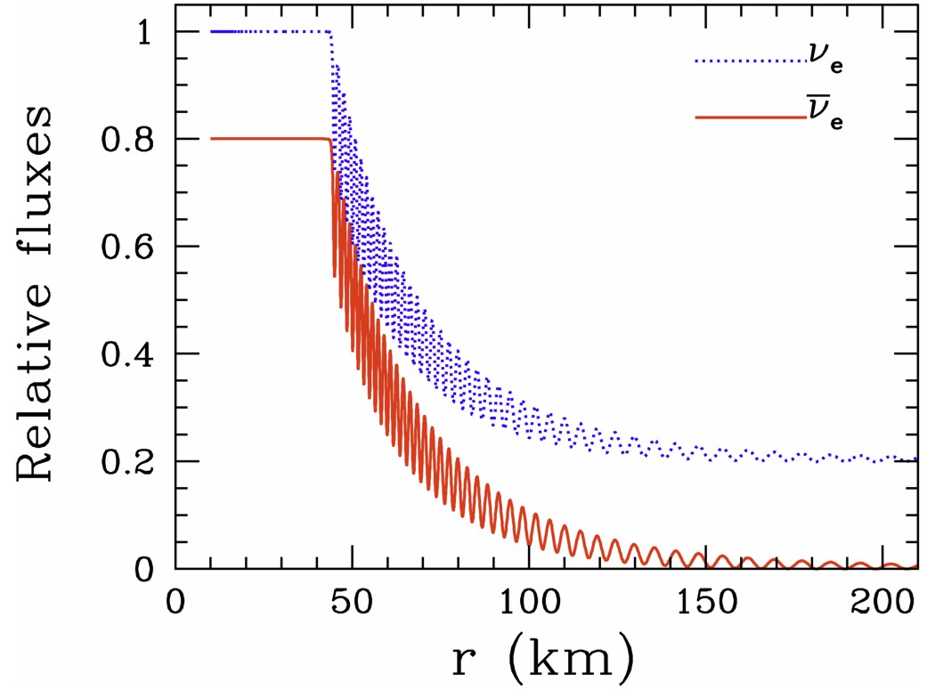
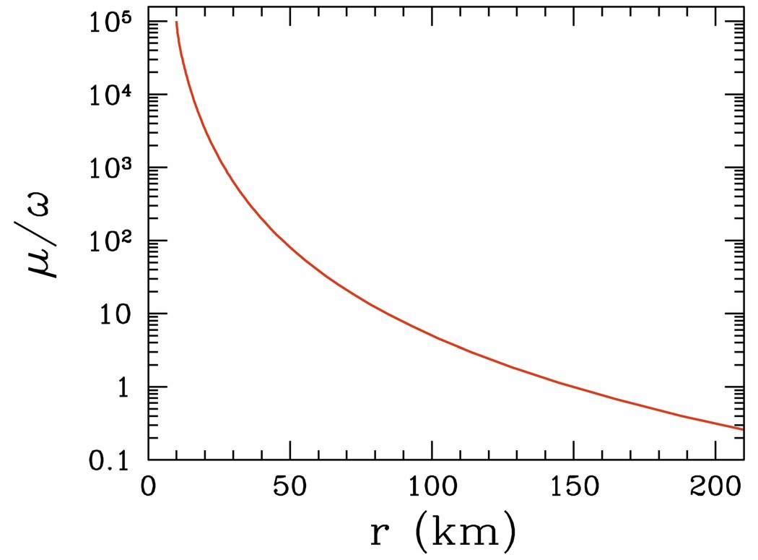
Flavor Conversion in a Toy Supernova
astro-ph/0608695
Two modes with $ω=±0.3 {\text{km}}^{−1}$
Assume 80% anti-neutrinos
Sharp onset radius
Oscillation amplitude declining
Neutrino-neutrino interaction
energy at nu sphere ($r=10 \text{km}$)
$μ=0.3×{10}^{5} {\text{km}}^{−1}$
Falls off approximately as $r^{−4}$
(geometric flux dilution and nus
become more co-linear)

Slide 36
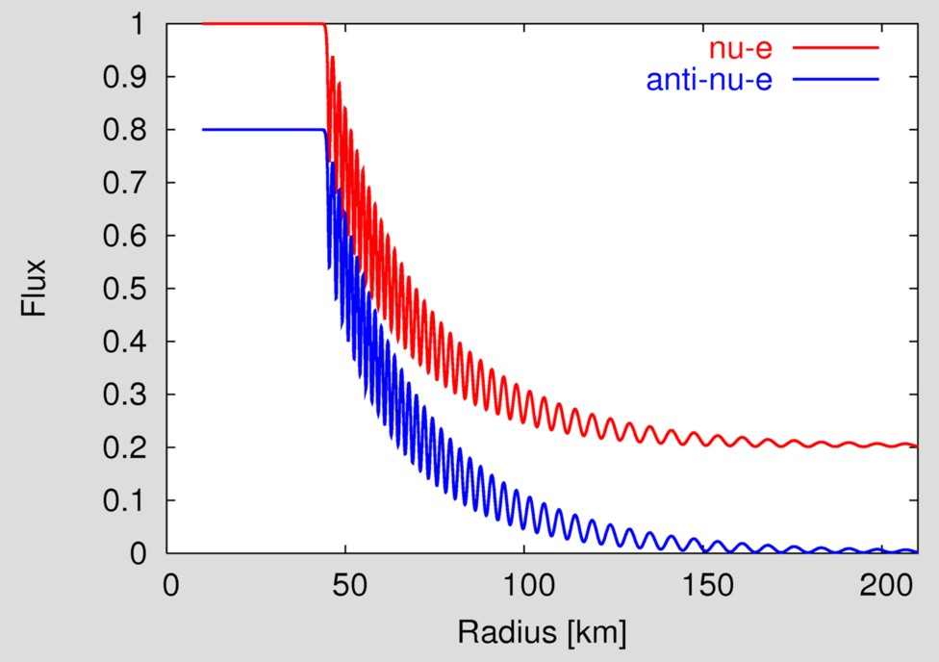
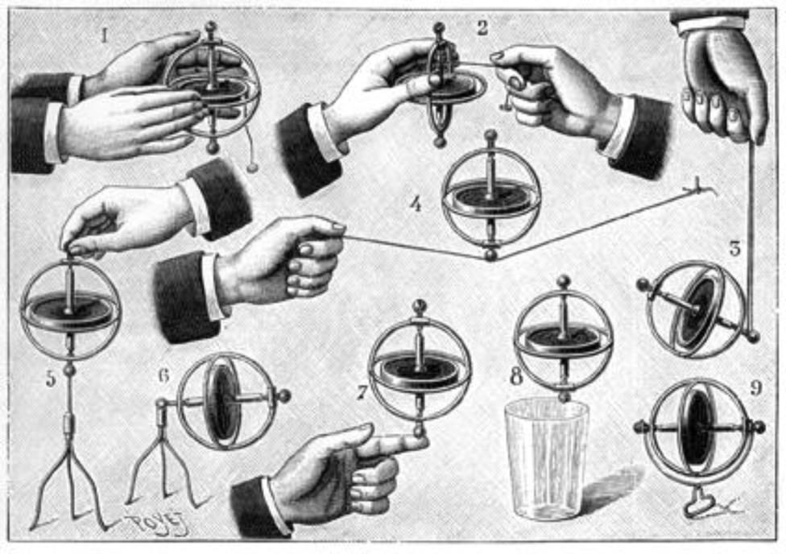
Neutrino Conversion and Flavor Pendulum
1
2
3
Sleeping
top
Precession
and nutation
Ground
state
1
2
3

Slide 37
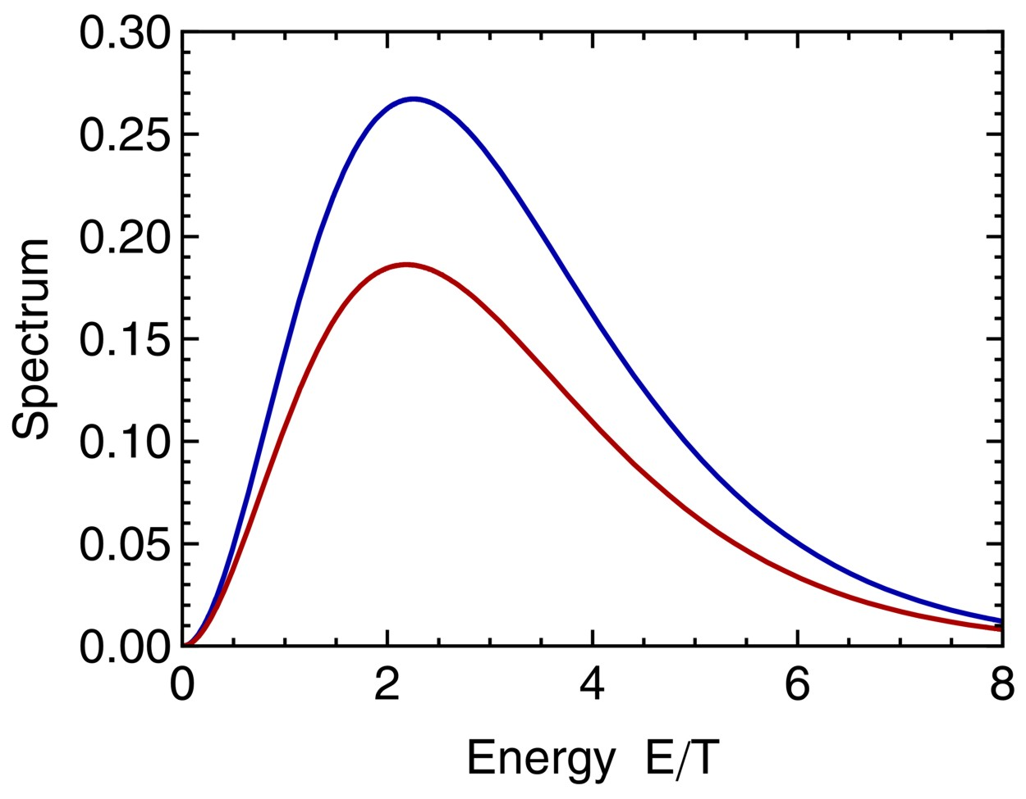
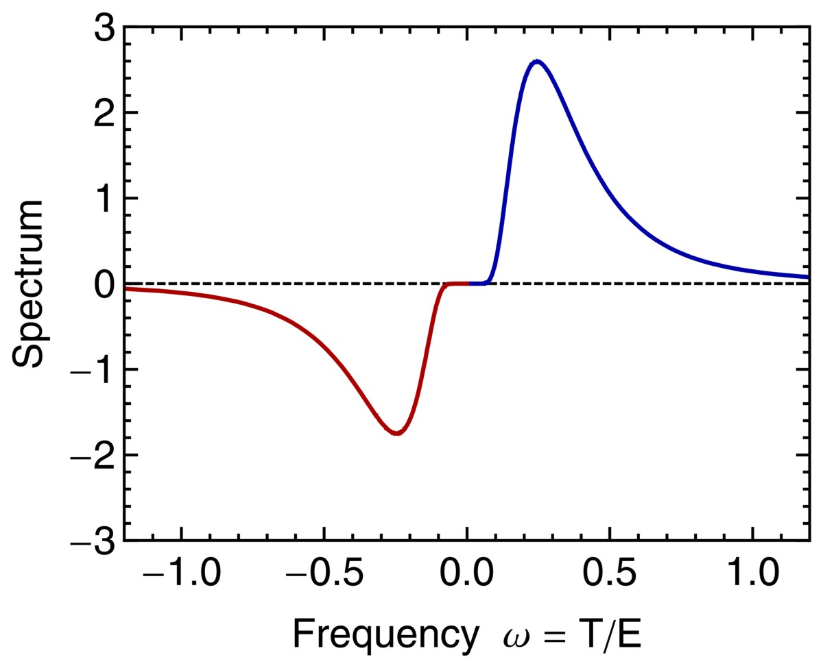
Fermi-Dirac Spectrum
Fermi-Dirac energy spectrum
$\frac{dN}{dE}∝\frac{E^{2}}{e^{E/T−η}+1}$
$η$ degeneracy parameter, $−η$ for $\overline{ν}$
Same spectrum in terms of ω = T/E
Antineutrinos E → −E
and dN/dE negative
(flavor isospin convention)
$ω>0$: $ν_{e}= ↑$ and $ν_{μ}= ↓$
$ω<0$: ${\overline{ν}}_{e}= ↓$ and ${\overline{ν}}_{μ}= ↑$
$$ν_{e}$$
$$ν_{e}$$
$$η=0.2$$
infrared
infrared
$${\overline{ν}}_{e}$$
High-E tail
$${\overline{ν}}_{e}$$

Slide 38
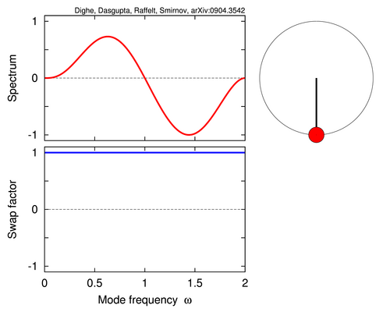
Flavor Pendulum
Single “positive” crossing
(potential energy at a maximum)
Single “negative” crossing
(potential energy at a minimum)
Dasgupta, Dighe, Raffelt & Smirnov, arXiv:0904.3542
For movies see http://www.mppmu.mpg.de/supernova/multisplits

Slide 39
General Stability Condition
Spin-precession equations of motion for modes with $ω={Δm^{2}}/{2E}$
${\dot{P}}_{ω}=ωB×P_{ω}$
Small-amplitude expansion: x-y-component described as complex number S
(off-diagnonal ρ element), linearized EoMs
$−i{\dot{S}}_{ω}=ωS_{ω}−μ\int{dω^{′}}g_{ω^{′}}^{}S_{ω^{′}}^{}$
Fourier transform $S_{ω}=F_{ω}e^{iΩt}$, with $Ω=γ+iκ$ a complex frequency
$\left(ω−Ω\right)F_{ω}=μ\int{dω′}g_{ω^{′}}^{}S_{ω^{′}}^{}$
Eigenfunction is $F_{ω}∝{\left(ω−Ω\right)}^{−1}$ and eigenvalue $Ω=γ+iκ$ is solution of
$$μ^{−1}=\int{dω}\frac{g_{ω}}{ω−Ω}$$
Instability occurs for
$κ=Im Ω≠0$
Exponential run-away solutions become pendulum for large amplitude.
Banerjee, Dighe & Raffelt, work in progress

Slide 40
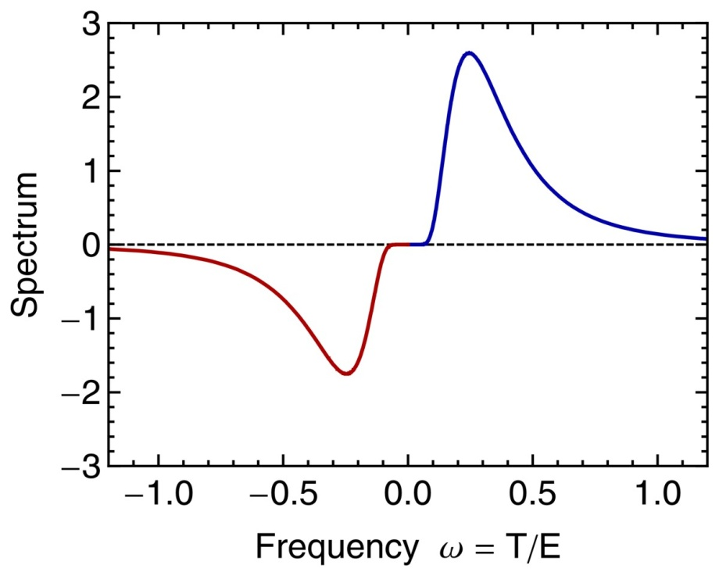
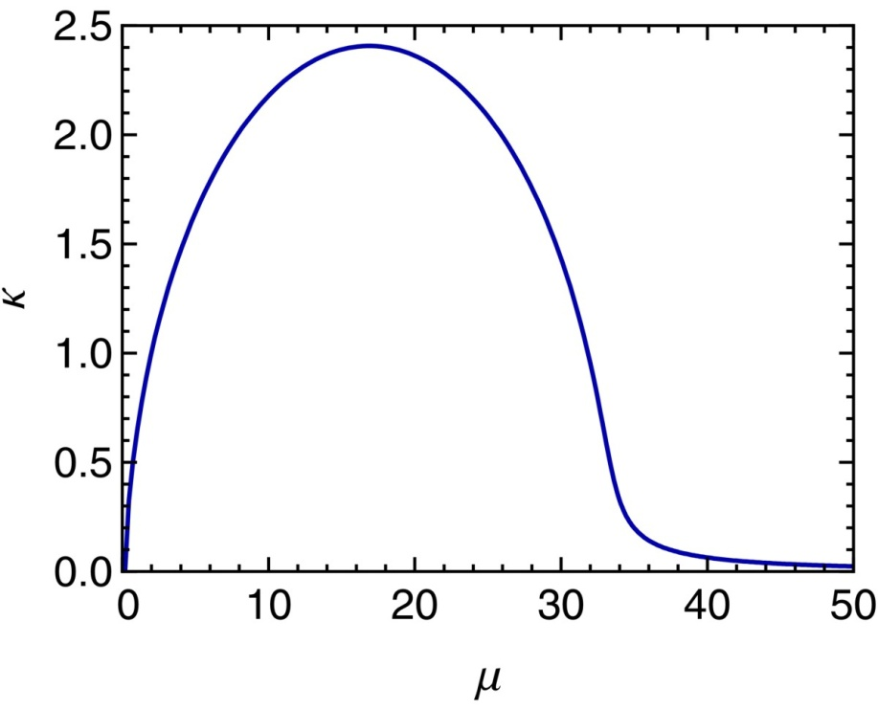
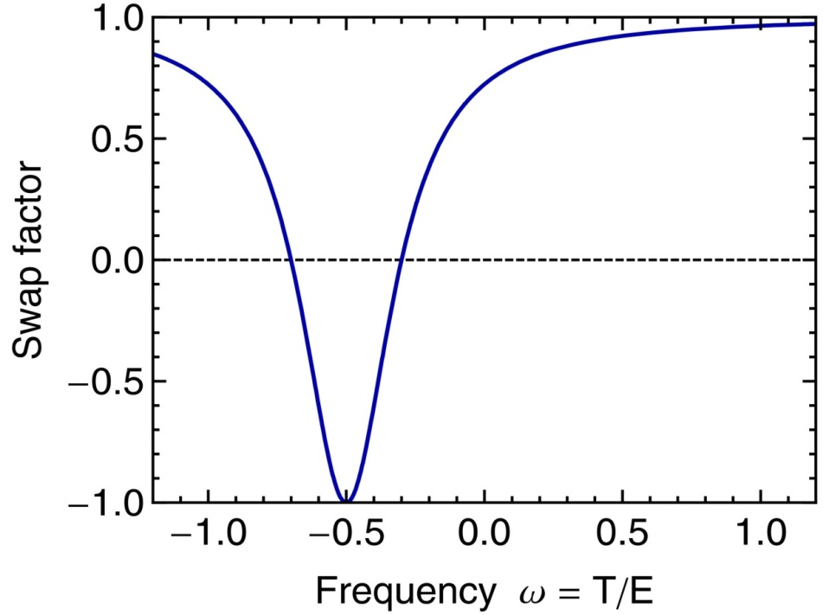
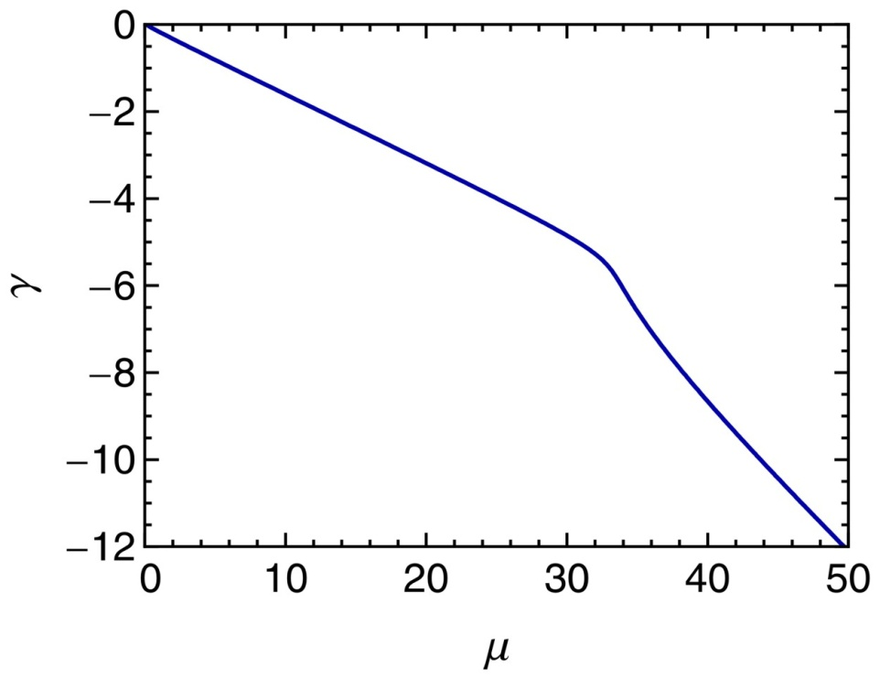
Stability of Fermi-Dirac Spectrum
$$ν$$
$$\overline{ν}$$
$$2κ$$
$$γ$$
Banerjee, Dighe & Raffelt, work in progress

Slide 41
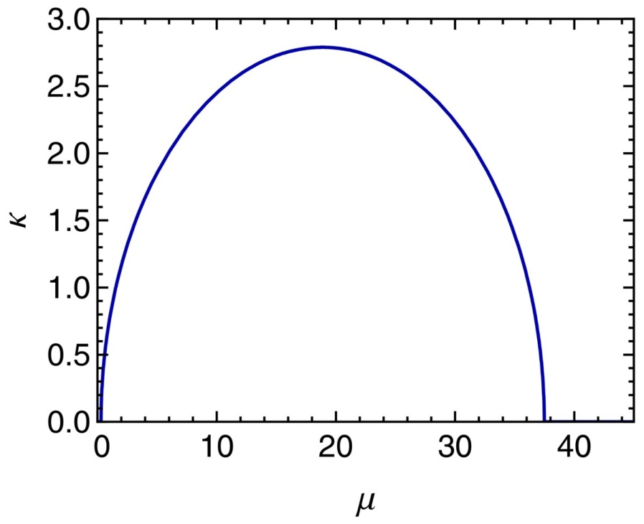
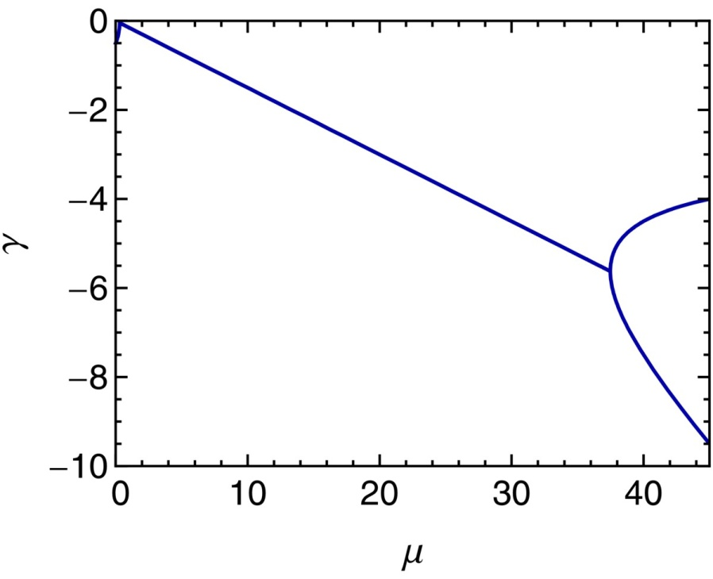
Stability of Schematic Double Peak
$$ν$$
$$\overline{ν}$$
Spectrum is unstable in the range
$\frac{1}{{\left(\sqrt{a}+1\right)}^{2}}<μ<\frac{1}{{\left(\sqrt{a}−1\right)}^{2}}$
where $a={N_{\overline{ν}}}/{N_{ν}}$.
With $a=0.7$, system is unstable for
$0.296<μ<37.5$
Otherwise the system is stuck.
Banerjee, Dighe & Raffelt, work in progress

Slide 42
Decreasing Neutrino Density
Certain initial neutrino density
Four times smaller
initial neutrino density
Dasgupta, Dighe, Raffelt & Smirnov, arXiv:0904.3542
For movies see http://www.mppmu.mpg.de/supernova/multisplits

Slide 43
Spectral Split
Initial
fluxes at
neutrino
sphere
Figures from
Fogli, Lisi,
Marrone & Mirizzi,
arXiv:0707.1998
Explanations in
Raffelt & Smirnov
arXiv:0705.1830
and 0709.4641
Duan, Fuller,
Carlson & Qian
arXiv:0706.4293
and 0707.0290
After
collective
trans-
formation

Slide 44
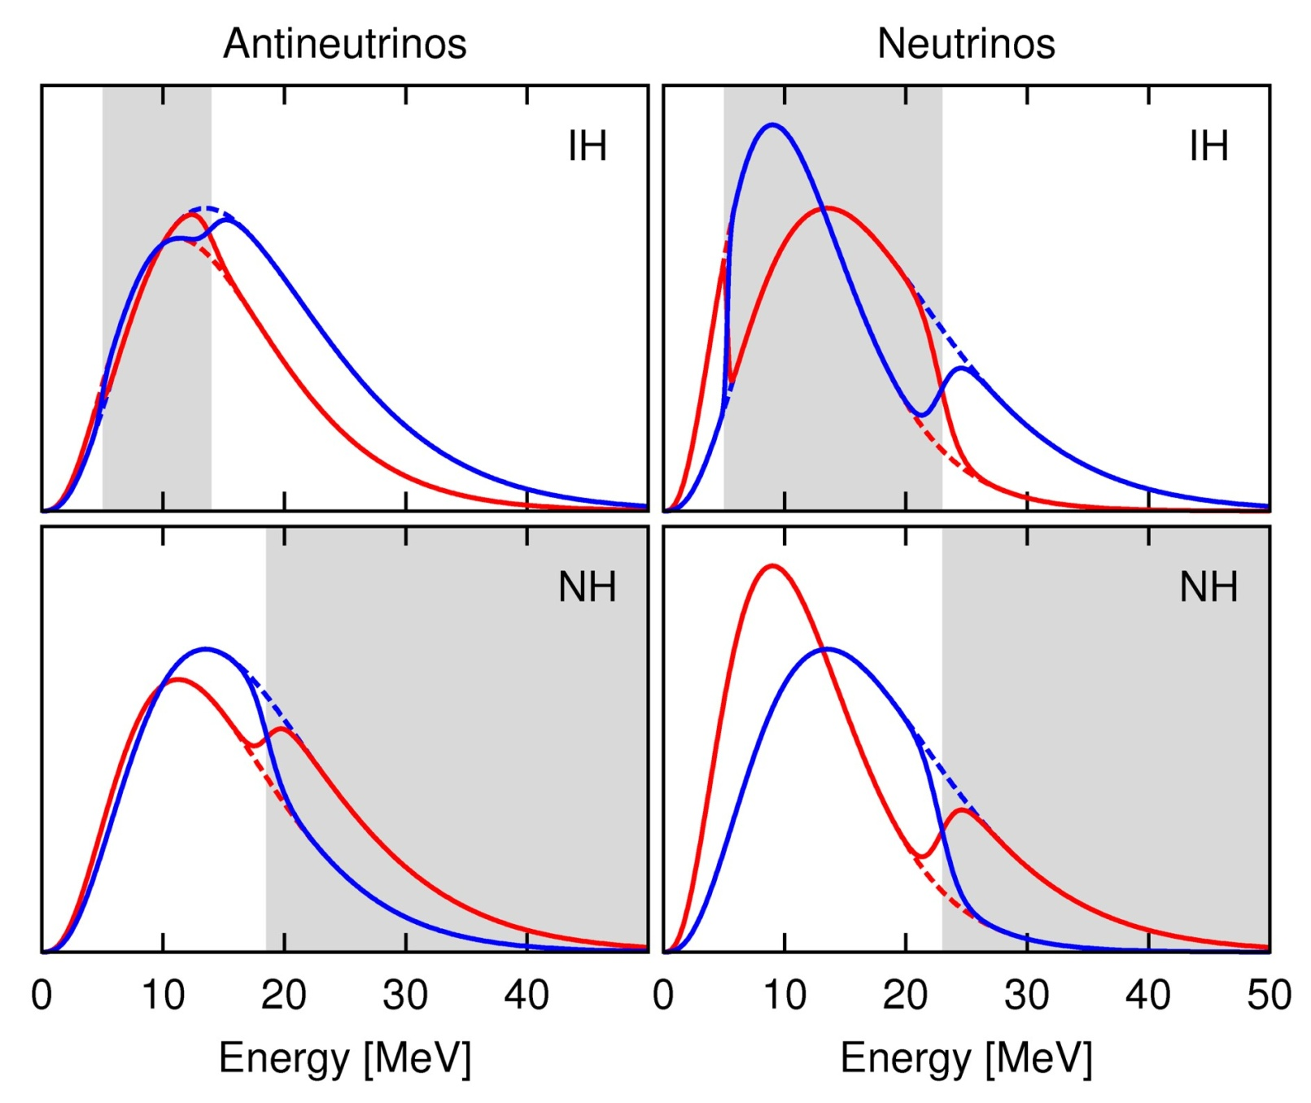
Multiple Spectral Splits
Inverted
Hierarchy
$$ν_{e}$$
$${\overline{ν}}_{x}$$
$${\overline{ν}}_{e}$$
$$ν_{x}$$
Normal
Hierarchy
Dasgupta, Dighe, Raffelt & Smirnov, arXiv:0904.3542

Slide 45
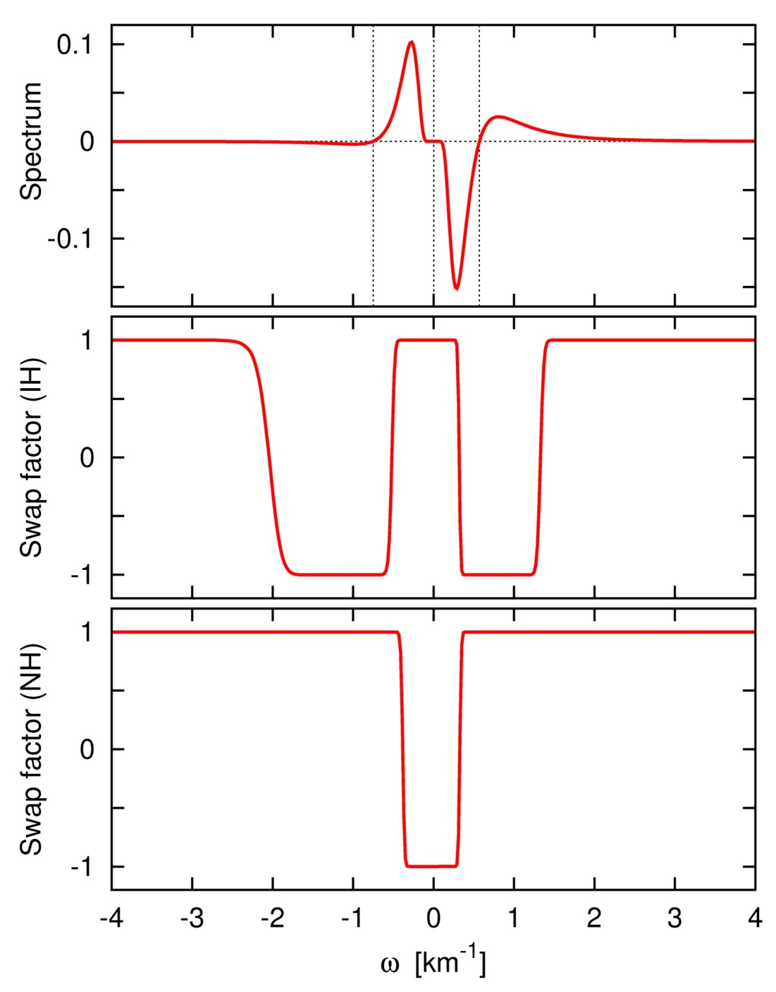
Multiple Spectral Splits in the ω Variable
$${\overline{ν}}_{x}$$
• Given is the flux spectrum f(E) for
each flavor
• Use $ω={Δm^{2}}/{2E}$ to label modes
• Label anti-neutrinos with $−ω$
• Define “spectrum” as
$$g\left(ω\right)∝\left\{\begin{matrix}f_{ν_{e}}\left(E\right)−f_{ν_{x}}(E) & \\ f_{{\overline{ν}}_{x}}\left(E\right)−f_{{\overline{ν}}_{e}}(E) & \end{matrix}\right.$$
• Swaps develop around every
“postive” spectral crossing
• Each swap flanked by two splits
$$ν_{e}$$
$${\overline{ν}}_{e}$$
$$ν_{x}$$
anti-neutrinos
neutrinos
Dasgupta, Dighe, Raffelt & Smirnov,
arXiv:0904.3542

Slide 46
Supernova Cooling-Phase Example
Normal Hierarchy
Inverted Hierarchy
Dasgupta, Dighe, Raffelt & Smirnov, arXiv:0904.3542
For movies see http://www.mppmu.mpg.de/supernova/multisplits

Slide 47
Multi-Angle Decoherence
Precession eqns for modes with vacuum oscillation frequency $ω={Δm^{2}}/{2E}$
(negative for $\overline{ν}$), and velocity $v$ (direction of motion), homogeneous system
${\dot{P}}_{ω,v}=ωB×P_{ω,v}+μ\sum_{ω^{′},v^{′}}{ \left(1−\cos{θ_{vv^{′}}}\right)}P_{ω^{′},v^{′}}×P_{ω,v}$
Axial symmetry around some direction (e.g. SN radial direction), measure
velocities against that direction: $v=\cos{θ }$
${\dot{P}}_{ω,v}=ωB×P_{ω,v}+μ\underbrace{\sum_{ω^{′},v^{′}}{P_{ω^{′},v^{′}}}}×P_{ω,v}−μ\underbrace{\sum_{ω^{′},v^{′}}{v^{′}}P_{ω^{′},v^{′}}}×vP_{ω,v}$
• Flux term vanishes in isotropic gas
• Can grow exponentially even with only a small initial seed fluctuation
• Symmetric $ν\overline{ν}$ system decoheres in both hierarchies
$$P$$
$F$ (Flux)
Raffelt & Sigl, Self-induced decoherence in dense neutrino gases, hep-ph/0701182

Slide 48
Multi-Angle Decoherence
Homogeneous ensemble of $ν_{e}{\overline{ν}}_{e}$ (symmetric distribution)
Normal hierarchy
Inverted hierarchy
isotropic
isotropic
half-isotropic
half-isotropic
Raffelt & Sigl, Self-induced decoherence in dense neutrino gases, hep-ph/0701182

Slide 49
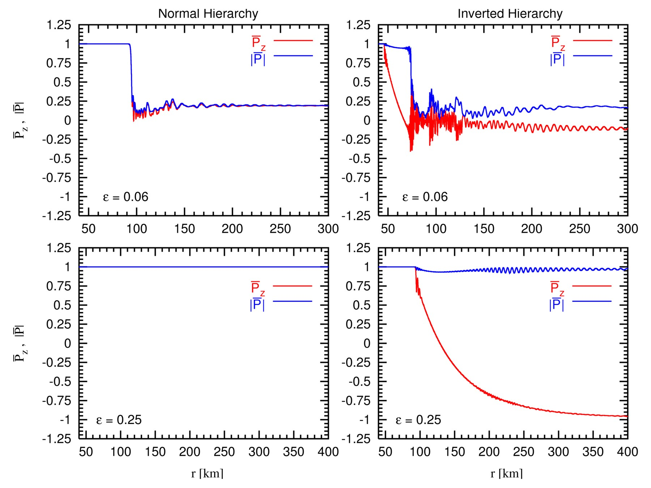
Multi-Angle Decoherence of Supernova Neutrinos
Small
asymmetry
Large
asymmetry

Slide 50
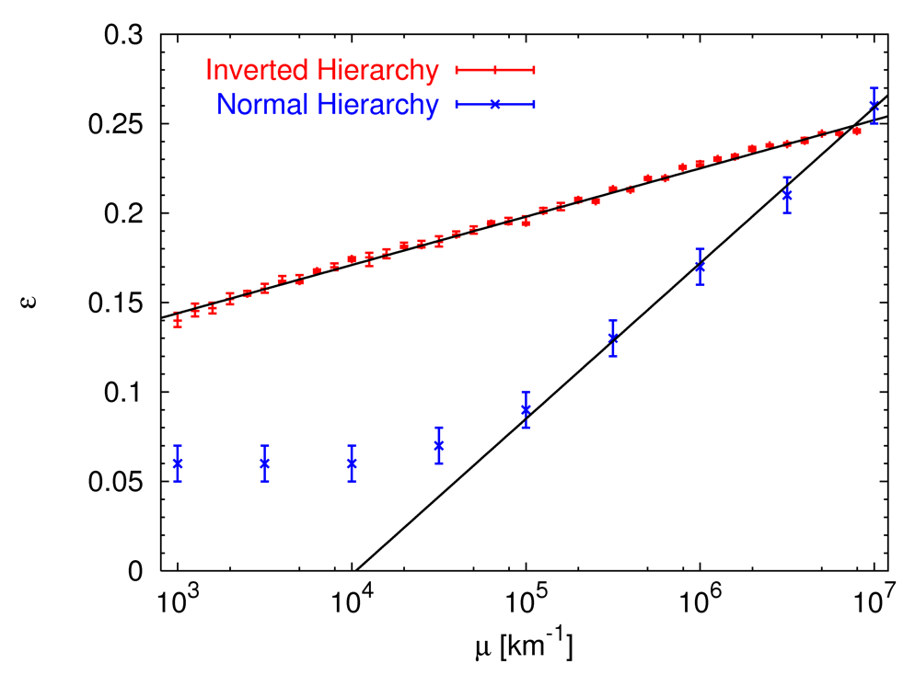
Critical Asymmetry for Multi-Angle Decoherence
Required
$ν_{e}{\overline{ν}}_{e}$ asymmetry
to suppress
multi-angle
decoherence
Effective $ν$ flux
Esteban-Pretel, Pastor, Tomàs, Raffelt & Sigl: Decoherence in supernova
neutrino transformations suppressed by deleptonization, astro-ph/0706.2498

Slide 51
Multi-Angle Matter Effect
Precession equation in a homogeneous ensemble
$∂_{t}P_{ω,v}=\left(ωB+λL+μP\right)×P_{ω,v}$, where $λ=\sqrt{2}G_{F}N_{e}$ and $μ=\sqrt{2}G_{F}N_{ν}$
Matter term is “achromatic”, disappears in a rotating frame
Neutrinos streaming from a SN core, evolution along radial direction
$(v⋅∇_{r}) P_{ω,v}=\left(ωB+λL+μP\right)×P_{ω,v}$
Projected on the radial direction, oscillation pattern compressed:
Accrues vacuum and matter phase faster than on radial trajectory
Matter effect can suppress collective conversion unless $N_{ν}≳N_{e}$
Esteban-Pretel, Mirizzi, Pastor, Tomàs, Raffelt, Serpico & Sigl, arXiv:0807.0659

Slide 52
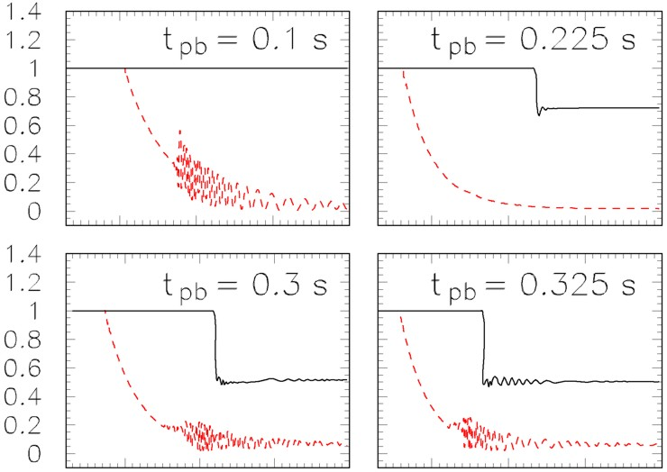
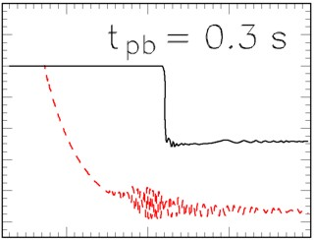
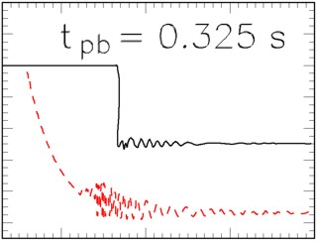
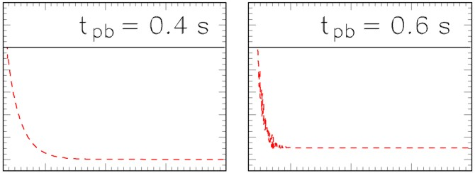
Multi-Angle Matter Effect in Basel (10.8 M_{sun}) Model
Schematic single-energy, multi-angle simulations with realistic density profile
no matter
500
1000
1500
500
1000
1500
500
1000
1500
Distance [km]
Distance [km]
Distance [km]
Chakraborty, Fischer, Mirizzi, Saviano & Tomàs, arXiv:1105.1130

Slide 53
Signature of Flavor Oscillations (Accretion Phase)
1-3-mixing scenarios
A
B
C
Mass ordering
Normal (NH)
Inverted (IH)
Any (NH/IH)
$\sin^{2}{θ_{13}}$
$≳{10}^{−3}$
$$≲{10}^{−5}$$
MSW conversion
adiabatic
non-adiabatic
$ν_{e}$ survival prob.
0
$$\sin^{2}{θ_{12}}≈0.3$$
$$\sin^{2}{θ_{12}}≈0.3$$
${\overline{ν}}_{e}$ survival prob.
$$\cos^{2}{θ_{12}}≈0.7$$
0
$$\cos^{2}{θ_{12}}≈0.7$$
${\overline{ν}}_{e}$Earth effects
Yes
No
Yes
May distinguish mass ordering
Assuming collective effects are not important during accretion phase
(Chakraborty et al., arXiv:1105.1130v1)

Slide 54
Coalescing Neutron Stars and Short Gamma-Ray Bursts
Gamma rays
Annihilation rate strongly suppressed if
$ν_{e}{\overline{ν}}_{e}$ pairs transform to $ν_{x}{\overline{ν}}_{x}$ pairs
Collective effects important?
$$e^{+}e^{−}$$
plasma
$${\overline{ν}}_{e}ν_{e}$$
Density of torus relatively small:
$ν_{μ}$ and $ν_{τ}$ not efficiently produced
Large $ν_{e}{\overline{ν}}_{e}$ pair abundance
Accretion disk or torus
100−200 km

Slide 55
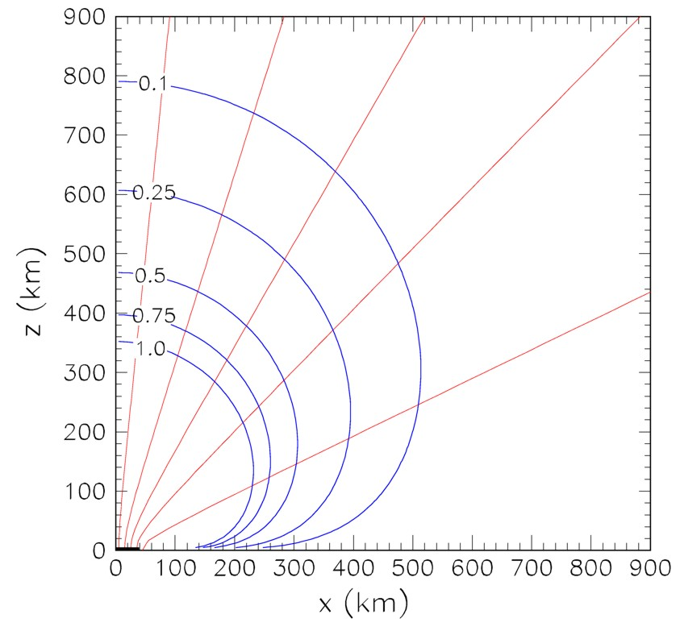
Oscillation Along Streamlines
$νe$ survival probability for a disk-like
source (coalescing neutron stars)
No neutrino-neutrino interactions:
Oscillations along trajectories
like a “beam”
Self-maintained coherence:
Oscillation along “flux lines” of
overall neutrino flux.
Dasgupta, Dighe, Mirizzi & Raffelt, arXiv:0805.3300

Slide 56
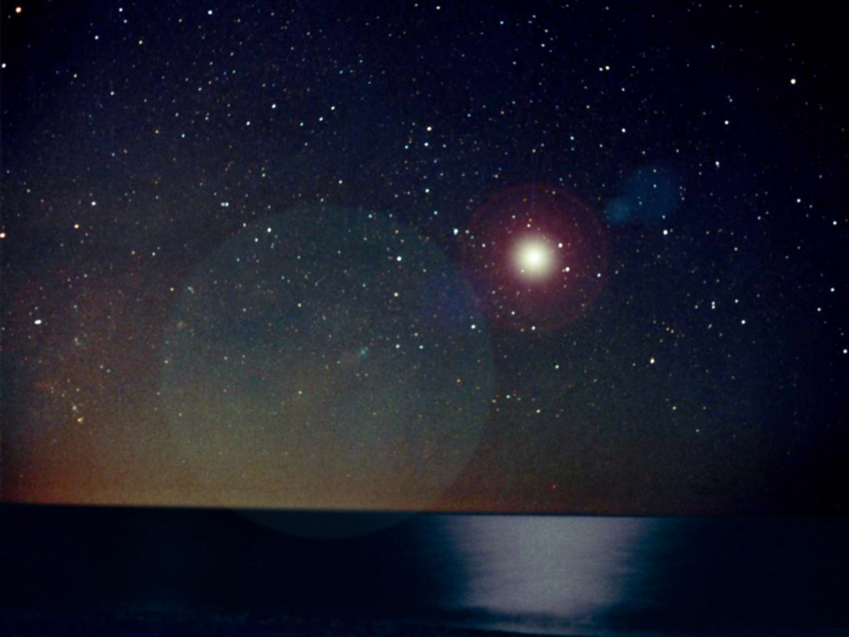
Looking forward to the next galactic supernova
May take a long time
Lots of theoretical work to do!
Looking forward to the next galactic supernova
No problem

