Slide 1
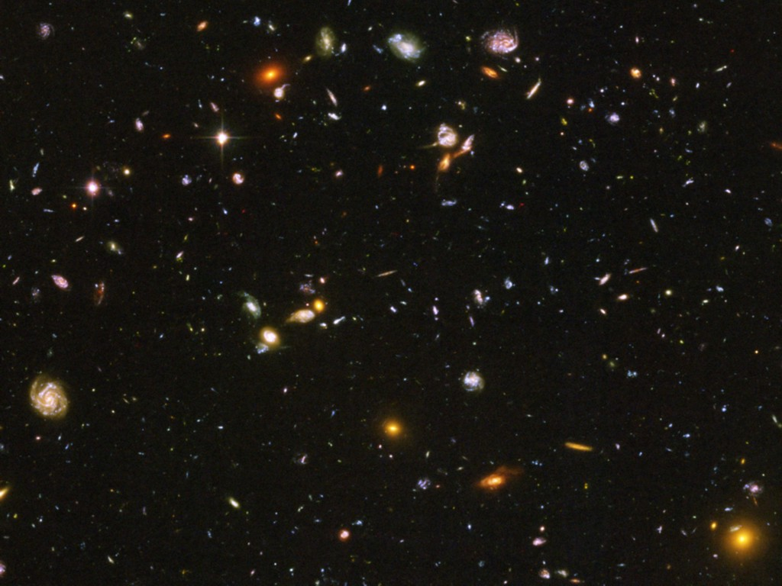
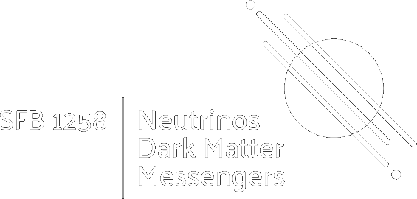
Hubble Deep Field
Neutrino
Cosmology
Georg G. Raffelt, Max-Planck-Institut für Physik, Garching

Slide 2
Pie Chart of Dark Universe
Dark Energy ~70%
(Cosmological Constant)
Neutrinos
0.14%
Ordinary Matter ~5%
(of this only about
10% luminous)
Dark Matter
~25%

Slide 3
Basics of Cosmology
• How Many Neutrinos?
(Dark radiation/sterile neutrinos?)
• Absolute mass determination and limits
• Big Bang Nucleosynthesis – BBN
(Origin of light elements)
• Leptogenesis
(Origin of Matter Abundance)

Slide 4
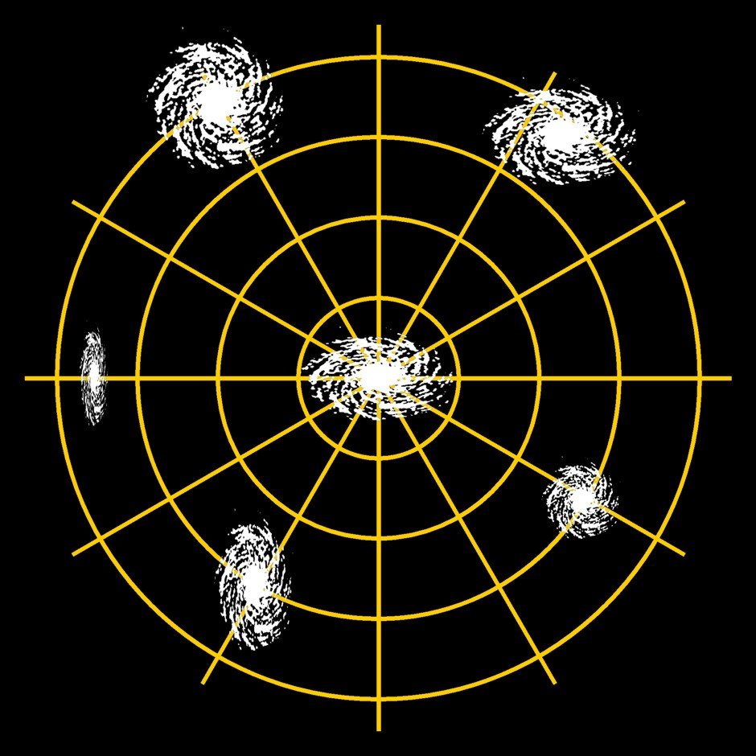
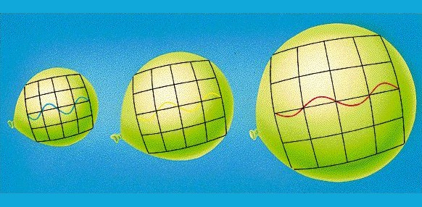
Cosmic Expansion
Cosmic Scale Factor
Cosmic Redshift
Space between galaxies grows
Galaxies (stars, people) stay the same
(dominated by local gravity
or by electromagnetic forces)
Cosmic scale factor today: $a=1$
Wavelength of light is “stretched”
Suffers redshift $z+1=\frac{λ_{today}}{λ_{then}}$
Redshift today: $z=0$
$$z+1=\frac{λ_{\text{today}}}{λ_{\text{then}}}=\frac{a_{\text{today}}}{a_{\text{then}}}$$

Slide 5
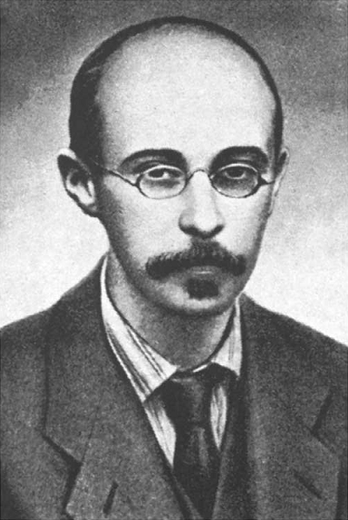
Friedmann Equation
Evolution of cosmic scale factor a, for flat geometry
$$H^{2}={\left(\frac{\dot{a}}{a}\right)}^{2}=\frac{8π}{3}G_{N}ρ$$
Unique relation between expansion rate and gravitating density
$$ρ=\frac{3H^{2}}{8πG_{N}}=\frac{3}{8π}{\left(Hm_{Pl}\right)}^{2}$$
A. Friedmann
1888−1925
Planck mass $1.221×{10}^{19} GeV$
With the present-day Hubble parameter $H_{0}=67.4 km s^{−1} Mpc^{−1}$
$${ ρ}_{ }=0.85×10^{−29}g cm^{−3}=4.8 GeV m^{−3}={\left(2.5 meV\right)}^{4}$$
Most of this in the form of “dark energy”

Slide 6
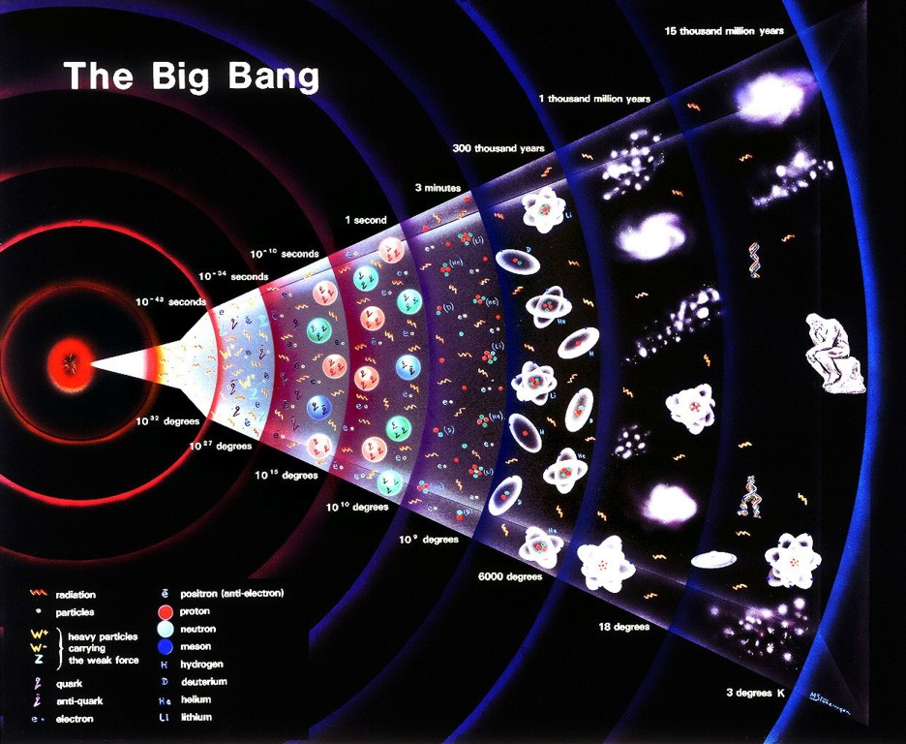
Big Bang

Slide 7
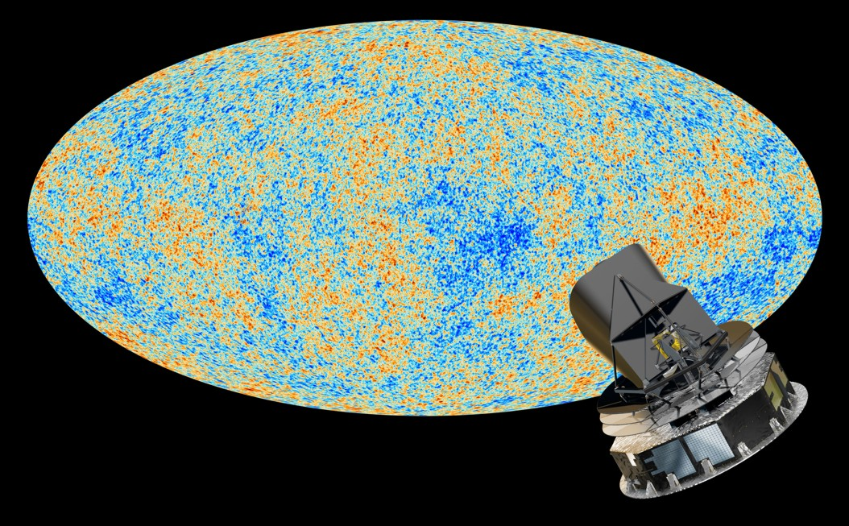
Cosmic Microwave Background (Planck 2013)

Slide 8
Big Bang Nucleosynthesis
The Cosmic
Neutrino Sea

Slide 9
Neutrino Thermal Equilibrium
Neutrino reaction rate
Cosmic expansion rate
Examples for neutrino processes
Friedmann equation (flat universe)
$$e^{+}+e^{−}↔\overline{ν}+ν$$
$$\overline{ν}+ν↔\overline{ν}+ν$$
$$ν+e^{±}↔ν+e^{±}$$
$$H^{2}=\frac{8π}{3}\frac{ρ}{m_{Pl}^{2}}$$
$$\left(G_{N}=\frac{1}{m_{Pl}^{2}}\right)$$
G_{F}
Radiation dominates
$$ρ∼T^{4}$$
Dimensional analysis of reaction rate
in a thermal medium for T ≪ m_{W,Z}
Expansion rate
$$H∼\frac{T^{2}}{m_{Pl}}$$
$$Γ∼G_{F}^{2}T^{5}$$
Condition for thermal equilibrium: $Γ>H$
$$T>{\left(m_{Pl}G_{F}^{2}\right)}^{−1/3}∼{\left[{10}^{19}GeV {\left({10}^{−5}GeV^{−2}\right)}^{2}\right]}^{−1/3}=1 MeV$$
Neutrinos are in thermal equilibrium for T ≳ 1 MeV
corresponding to t ≲ 1 sec

Slide 10
Thermal Radiations
General
Bosons
Fermions
Number density n
$$g\int{\frac{d^{3}p}{{\left(2π\right)}^{3}}}\frac{1}{e^{{E_{p}}/T}±1}$$
$$g_{B}\frac{ζ_{3}}{π^{2}} T^{3}$$
$$\frac{3}{4} g_{F}\frac{ζ_{3}}{π^{2}} T^{3}$$
Energy density ρ
$$g\int{\frac{d^{3}p}{{\left(2π\right)}^{3}}}\frac{E_{p}}{e^{{E_{p}}/T}±1}$$
$$g_{B}\frac{π^{2}}{30} T^{4}$$
$$\frac{7}{8} g_{F}\frac{π^{2}}{30} T^{4}$$
Energy density ρ
$$g\int{\frac{d^{3}p}{{\left(2π\right)}^{3}}}\frac{E_{p}}{e^{{E_{p}}/T}±1}$$
Pressure p
$$\frac{ρ}{3}$$
Entropy density s
$$\frac{ρ+p}{T}=\frac{4}{3} \frac{ρ}{T}$$
$$g_{B}\frac{{2π}^{2}}{45} T^{3}$$
$$\frac{7}{8} g_{F}\frac{{2π}^{2}}{45} T^{3}$$
Riemann Zeta Function
$$ζ_{3}=1.2020569…$$

Slide 11
Present-Day Neutrino Density
Neutrino decoupling
(freeze out)
$H∼Γ$
$T≈2.4 MeV$ (electron flavor)
$T≈3.7 MeV$ (other flavors)
$$\frac{dn_{ν\overline{ν}}}{dE}=\frac{1}{π^{2}}\frac{E^{2}}{e^{E/T}+1}$$
Redshift of Fermi-Dirac
distribution (“nothing
changes at freeze-out”)
Temperature
scales with redshift
$$T_{ν}=T_{γ}∝\left(z+1\right)$$
Electron-positron
annihilation beginning
at T ≈ m_{e} = 0.511 MeV
QED plasma is “strongly” coupled
Stays in thermal equilibrium (adiabatic process)
Entropy of e⁺e⁻ transfered to photons
$$g_{∗}T_{γ}^{3}{\left.​\right|}_{before}=g_{∗}T_{γ}^{3}{\left.​\right|}_{after}$$
$$\}$$
$$T_{γ}^{3}{\left.​\right|}_{before}=\frac{4}{11}T_{γ}^{3}{\left.​\right|}_{after}$$
$\overbrace{2+\frac{7}{8}4=\frac{11}{2}}$
$\overbrace{2}$
Redshift of
neutrino and photon
thermal distributions
so that today we have
$n_{ν\overline{ν}}\left(1 flavor\right)=\frac{4}{11}×\frac{3}{4}×n_{γ}=\frac{3}{11}n_{γ}≈112 cm^{−3}$
$T_{ν}={\left(\frac{4}{11}\right)}^{1/3}T_{γ}≈1.95 K$ for massless neutrinos

Slide 12
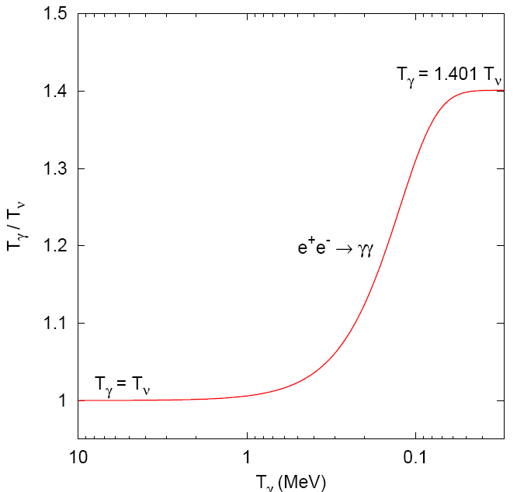
Photon Heating by Electron-Positron Annihilation
$$T_{γ}={\left(\frac{11}{4}\right)}^{1/3}T_{ν}=1.401 T_{ν}$$
$$m_{e}$$
T_{γ} (MeV)

Slide 13
Cosmic radiation density after e⁺e⁻ annihilation
Radiation density for N_{ν} = 3 standard neutrino flavors
$$ρ_{rad}=ρ_{γ}+ρ_{ν}=\frac{π^{2}}{15}\left(T_{γ}^{4}+N_{ν}\frac{7}{8} T_{ν}^{4}\right)=\left[1+N_{ν}\frac{7}{8} {\left(\frac{4}{11}\right)}^{4/3}\right]ρ_{γ}$$
Cosmic radiation density is expressed in terms of
“effective number of thermally excited neutrino species” N_{eff}
$$ρ_{rad}=\left[1+N_{eff} \frac{7}{8} {\left(\frac{4}{11}\right)}^{4/3}\right]ρ_{γ}=\left[1+N_{eff} 0.2271\right]ρ_{γ}$$
N_{eff} is a measure for the radiation density, not necessarily related to neutrinos
Residual neutrino heating by e⁺e⁻ annihilation and corrections for plasma
effects and neutrino flavor oscillations implies
$N_{eff}=3.0440(2)$ Standard value
$${ ρ}_{rad}=\left(1+0.6918+{0.2271 ΔN}_{eff}\right) ρ_{γ}$$
Of course, the number of known neutrino species $ν_{e}$, $ν_{μ}, { ν}_{τ}$ is exactly 3

Slide 14
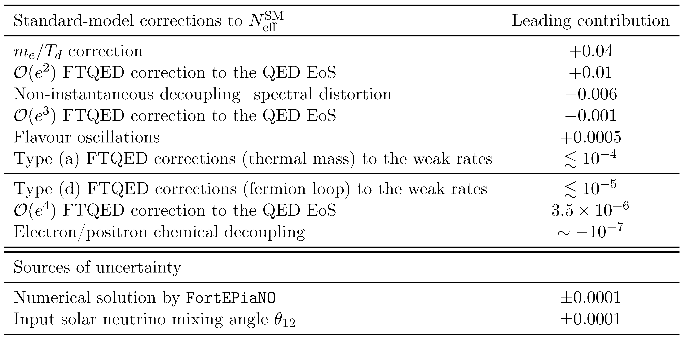
Precision Calculations of Neff
$N_{eff}=3.0440(2)$
Drewes et al., https://arxiv.org/abs/2411.14091

Slide 15
Measured Cosmic Radiation Density
J. Lesgourgues & L. Verde, Neutrinos in Cosmology, in: Review of Particle Properties,
https://pdg.lbl.gov/2024/reviews/rpp2024-rev-neutrinos-in-cosmology.pdf
[24] Planck 2018, https://arxiv.org/abs/1807.06209
Constraints on Neutrino Physics from DESI DR2 BAO and DR1 Full Shape
https://arxiv.org/abs/2503.14744
DESI DR2 BAO + CMB
$Λ$CDM + Neff
${3.23}_{−0.34}^{+0.35}$ (95% CL)

Slide 16
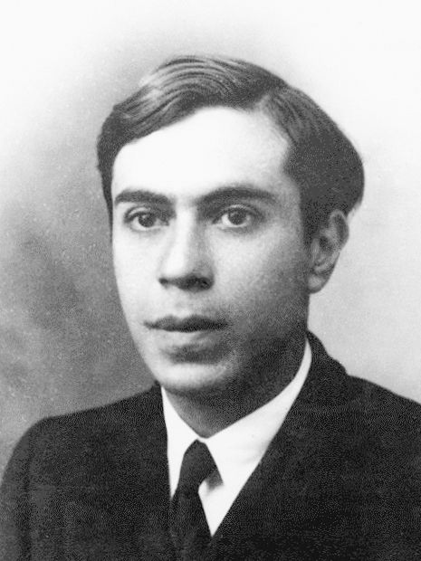
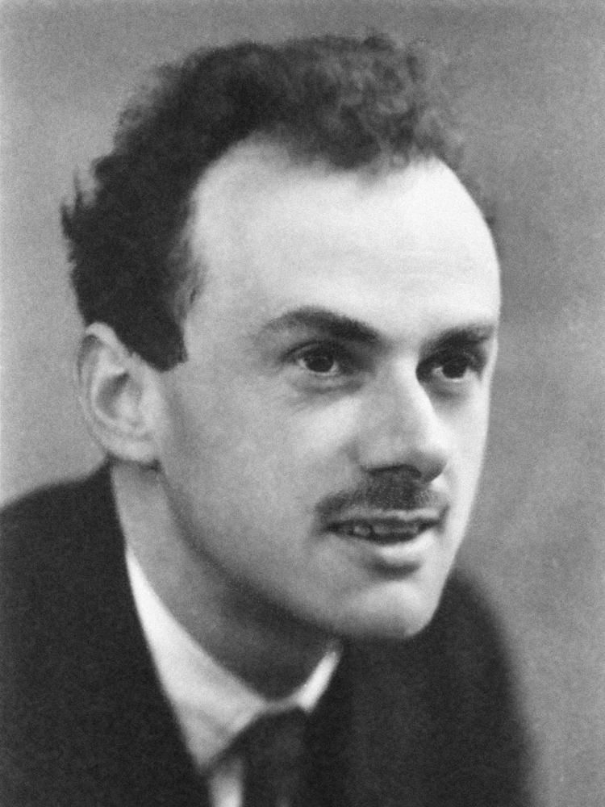
Two or four components?
}
Two states (Majorana neutrino)
Spin
• Neutral spin ½ fermion
• No “charge” distinguishing
particle from antiparticle
• No magnetic moment
• Relativistically acts as $ν$ or $\overline{ν}$
depending on helicity
$$\overline{ν}/ν$$
E.Majorana
}
P.A.M.Dirac
Spin
Four states (Dirac neutrino)
• Neutral spin ½ fermion
• Lepton number distinguishes
particle from antiparticle
• Non-zero magnetic moment
• Relativistically is active or sterile
depending on helicity
$$ν$$
$$\overline{ν}$$
P.A.M.Dirac

Slide 17
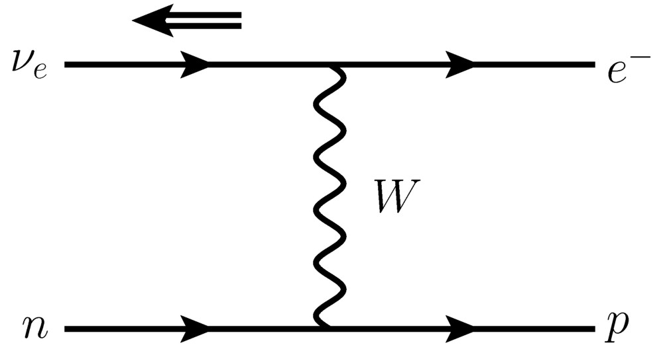
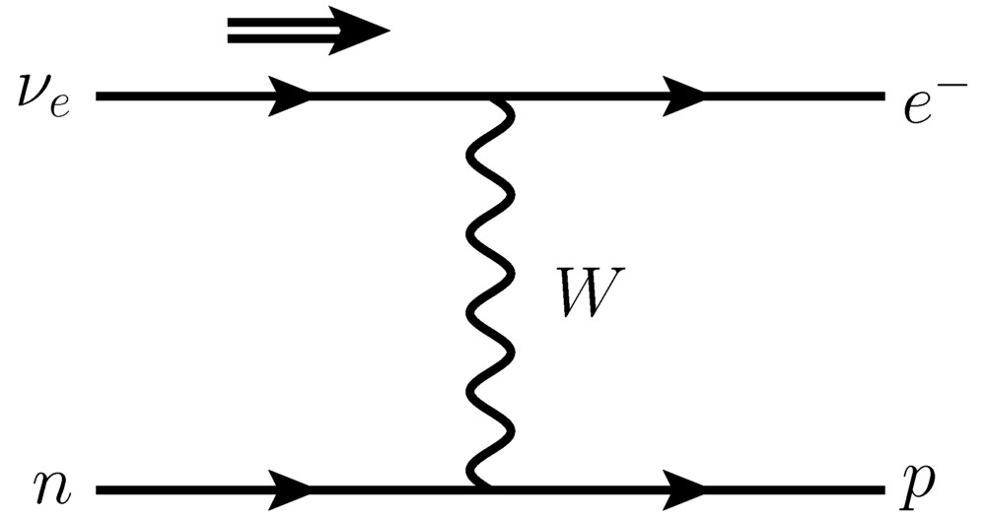
Role of Mass
Massless,
left-handed
neutrino with
E ≫ m_{e}
Relativistic electron
is strongly, but not
perfectly polarized
“Wrong” helicity
state with probability
~ (m_{e}/E)²
Right-handed
neutrino with
small mass
E ≫ m_{ν}
Rate smaller by
~ (m_{ν}/E)²

Slide 18
Neutrino Thermal Equilibrium for Dirac Neutrinos
Neutrino reaction rate
Cosmic expansion rate
Examples for neutrino processes
Friedmann equation (flat universe)
$$e^{+}+e^{−}↔\overline{ν}+ν$$
$$\overline{ν}+ν↔\overline{ν}+ν$$
$$ν+e^{±}↔ν+e^{±}$$
$$H^{2}=\frac{8π}{3}\frac{ρ}{m_{Pl}^{2}}$$
$$\left(G_{N}=\frac{1}{m_{Pl}^{2}}\right)$$
G_{F}
Radiation dominates
$$ρ∼T^{4}$$
Dimensional analysis of reaction rate
in a thermal medium for T ≪ m_{W,Z}
Expansion rate
$$H∼\frac{T^{2}}{m_{Pl}}$$
$$Γ∼G_{F}^{2}T^{5}×{\left({m_{ν}}/T\right)}^{2}$$
Condition for thermal equilibrium: $Γ>H$
$${ m}_{ν}>G_{F}^{−1}{\left(m_{Pl}T\right)}^{{−1}/2}$$
To avoid excessive dilution at quark-hadron phase transition: $T<T_{QCD}∼170 MeV$
$${ m}_{ν}>60 keV$$
For eV-scale Dirac neutrinos, r.h. helicity degrees not thermally excited

Slide 19
Present-Day Neutrino Distribution
Minimal neutrino masses
from oscillation experiments
Normal
Inverted
m₃ ≳ 50 meV
m₁ ≈ m₂ ≳ 50 meV
m₂ ≳ 8 meV
m₁ ≥ 0
m₃ ≥ 0
Temperature of massless
cosmic background neutrinos
T = 1.95 K = 0.17 meV
Cosmic redshift of momenta
(not energies)
$$\frac{dn_{ν\overline{ν}}}{dp}=\frac{1}{π^{2}}\frac{p^{2}}{e^{p/T}+1}$$
Not a thermal
distribution
unless T ≫ m
Average velocity for m ≫ T
$$\left\langle v\right\rangle ≈\frac{3T}{m}$$
Normal hierarchy neutrinos
$$\left\langle v_{3}\right\rangle <1×{10}^{−2}c \left\langle v_{2}\right\rangle <6×{10}^{−2}c$$
Nonrelativistic, but too fast to be trapped in galaxies $v∼{10}^{−3}c$

Slide 20
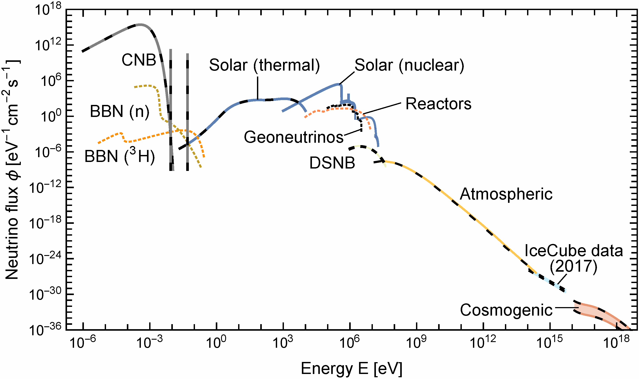
Primordial Neutrino Spectrum at Earth
Vitagliano, Tamborra & Raffelt, arXiv:1910.11878

Slide 21
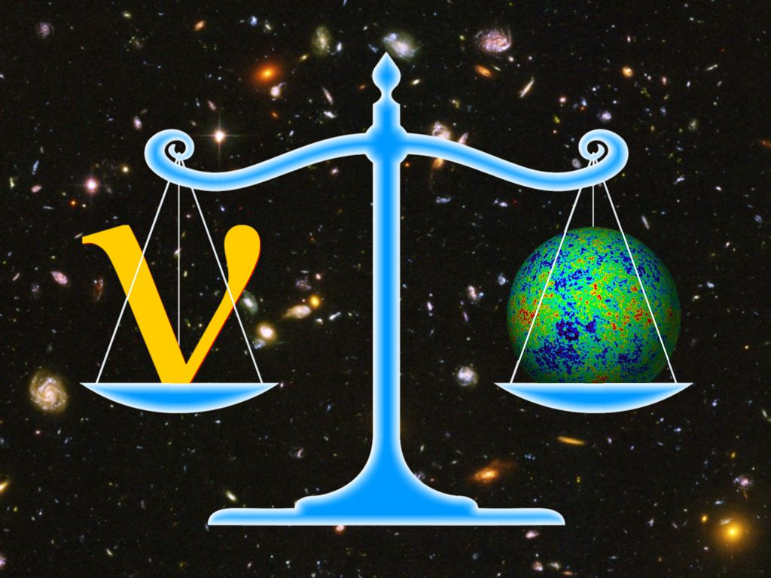
Weighing Neutrinos with the Universe

Slide 22
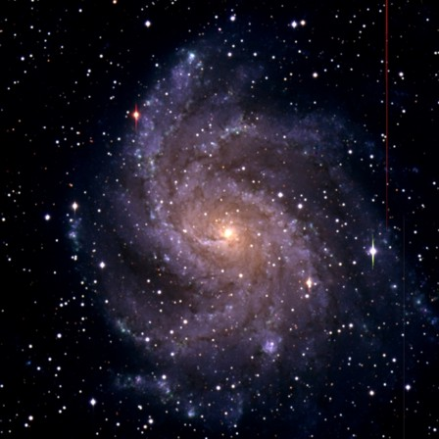
What is wrong with neutrino dark matter?
Galactic Phase Space (“Tremaine-Gunn-Limit”)
Maximum mass density of a degenerate
Fermi gas
Spiral galaxies
m_{ν} > 20–40 eV
Dwarf galaxies
m_{ν} > 100–200 eV
$$ρ_{max}=m_{ν}\underset{n_{max}}{\underbrace{\frac{p_{max}^{3}}{3π^{2}}}}=\frac{m_{ν}{\left(m_{ν}v_{escape}\right)}^{3}}{3π^{2}}$$
Neutrino Free Streaming (Collisionless Phase Mixing)
At T < 1 MeV neutrino scattering in early universe is ineffective
Stream freely until non-relativistic
Wash out density contrasts on small scales
Neutrinos
Neutrinos
Neutrinos are “Hot Dark Matter”
Ruled out by structure formation
Over-density

Slide 23
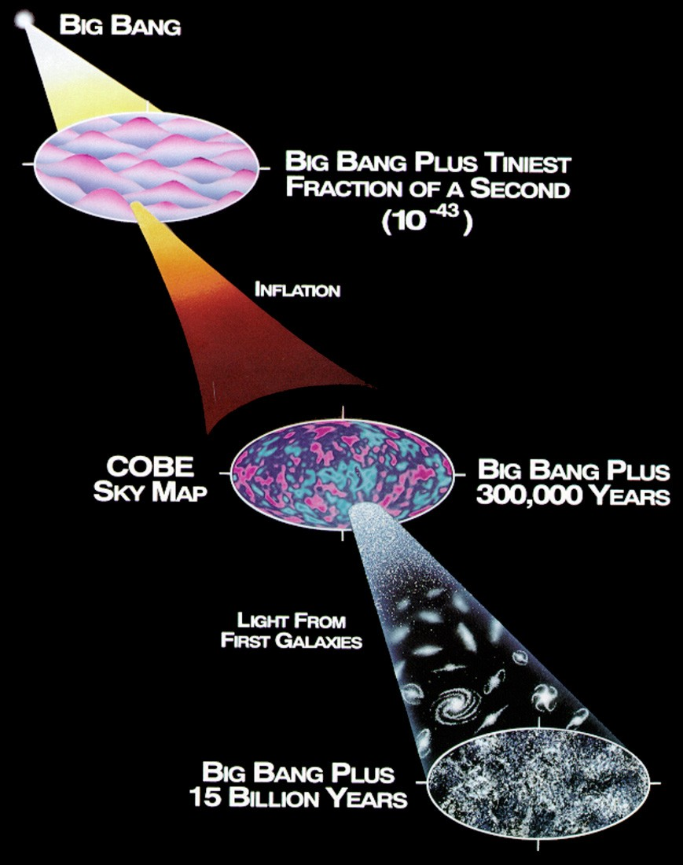
Structure Formation in the Universe
Early phase of exponential expansion
(Inflationary epoch)
Zero-point fluctuations of quantum
fields are stretched and frozen
Structure grows by gravitational
instability
Cosmic density fluctuations are
frozen quantum fluctuations

Slide 24
Structure Formation with Hot Dark Matter
Standard ΛCDM Model
Neutrinos with Σm_{ν} = 6.9 eV
(pre-KATRIN Limit of 2.3 eV)
Structure fromation simulated with Gadget code
Cube size 256 Mpc at zero redshift
Troels Haugbølle, University Aarhus, ca. 2006

Slide 25
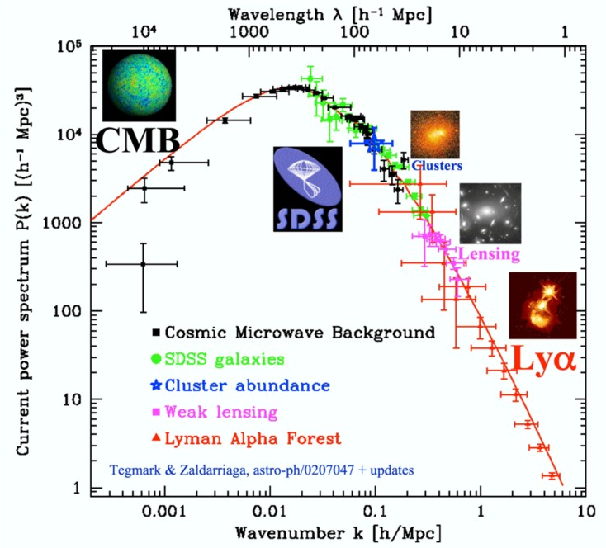
Power Spectrum of Cosmic Density Fluctuations
Tegmark, TAUP 2003

Slide 26
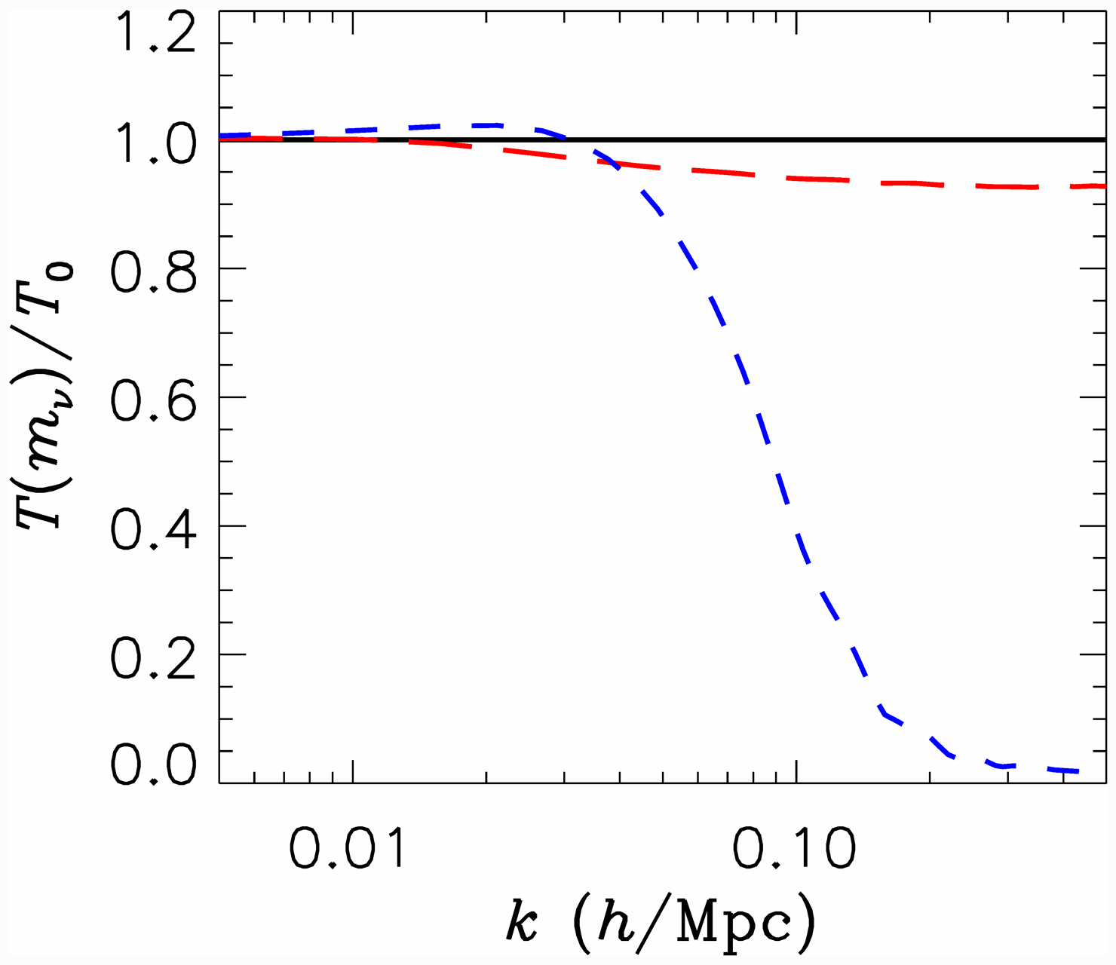
Neutrino Free Streaming: Transfer Function
Power suppression for λ_{FS} ≳ 100 Mpc/h
(k_{FS} = 2π/λ_{FS})
hep-ph/0404239
Transfer function
P(k) = T(k) P₀(k)
Effect of neutrino free
streaming on small scales
T(k) = 1 − 8 Ω_{ν}/Ω_{M}
valid for 8Ω_{ν}/Ω_{M} ≪ 1
Power suppression much
larger (factor 8) than
corresponds to neutrino
mass fraction!
m_{ν} = 0
m_{ν} = 0.3 eV
m_{ν} = 1 eV
0.50

Slide 27
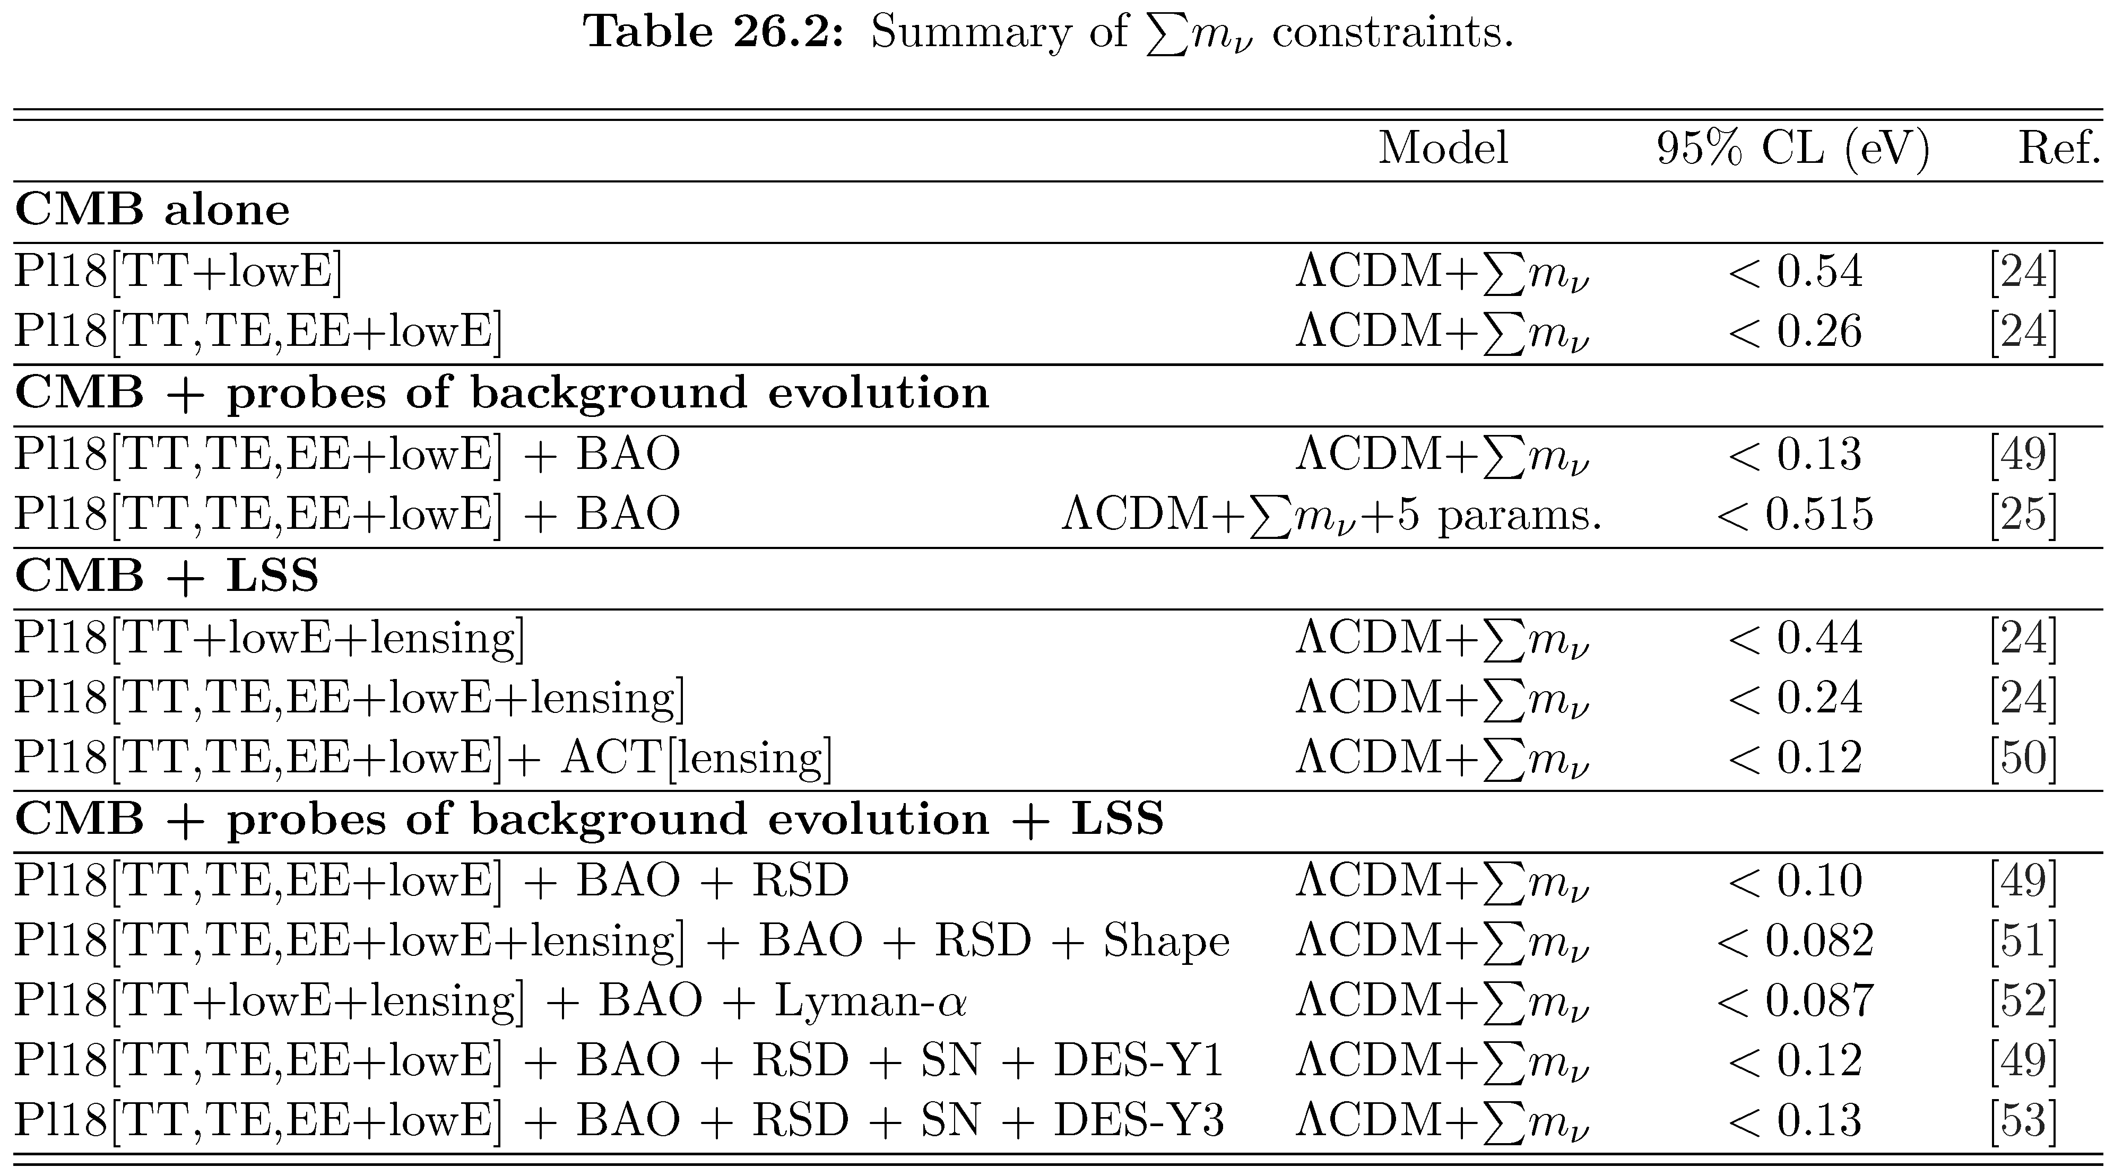
Cosmological Neutrino Mass Limits (8/2023)
[24] Planck 2018, https://arxiv.org/abs/1807.06209
J. Lesgourgues & L. Verde, Neutrinos in Cosmology, in: Review of Particle Properties,
https://pdg.lbl.gov/2024/reviews/rpp2024-rev-neutrinos-in-cosmology.pdf

Slide 28
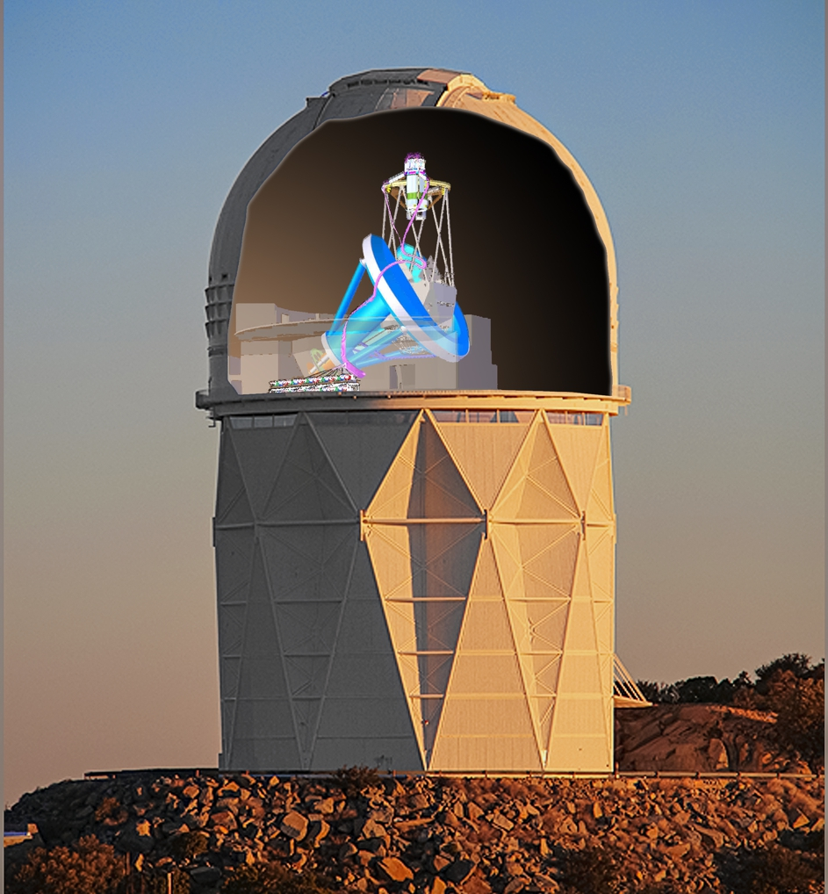
DESI (Dark Energy Spectroscopic Instrument)
DESI installed on the Mayall 4-meter Telescope at Kitt Peak Observatory, Arizona
• Produce largest 3D map of the universe
(20 million galaxies, quasars and stars)
• Main purpose: Precise expansion history
(Is dark energy evolving?)
• Data Release 2 (3 years data) March 2025
• Tension (around 3σ) with ΛCDM
• Or formally best-fit “negative” $∑m_{ν}$
https://arxiv.org/abs/2503.14738
https://arxiv.org/abs/2503.14744
Image Wikipedia
See also DESI at https://www.desi.lbl.gov

Slide 29
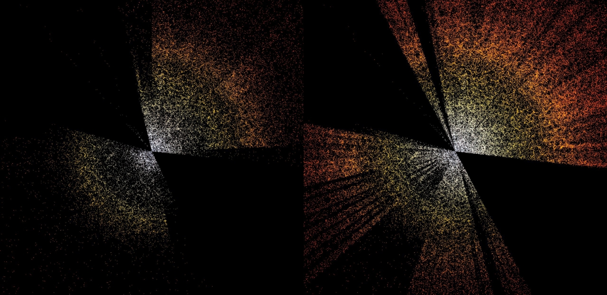
Thanks
Sloan Digital Sky Survey (SDSS)
DESI (First 7 months)
Image Wikipedia

Slide 30
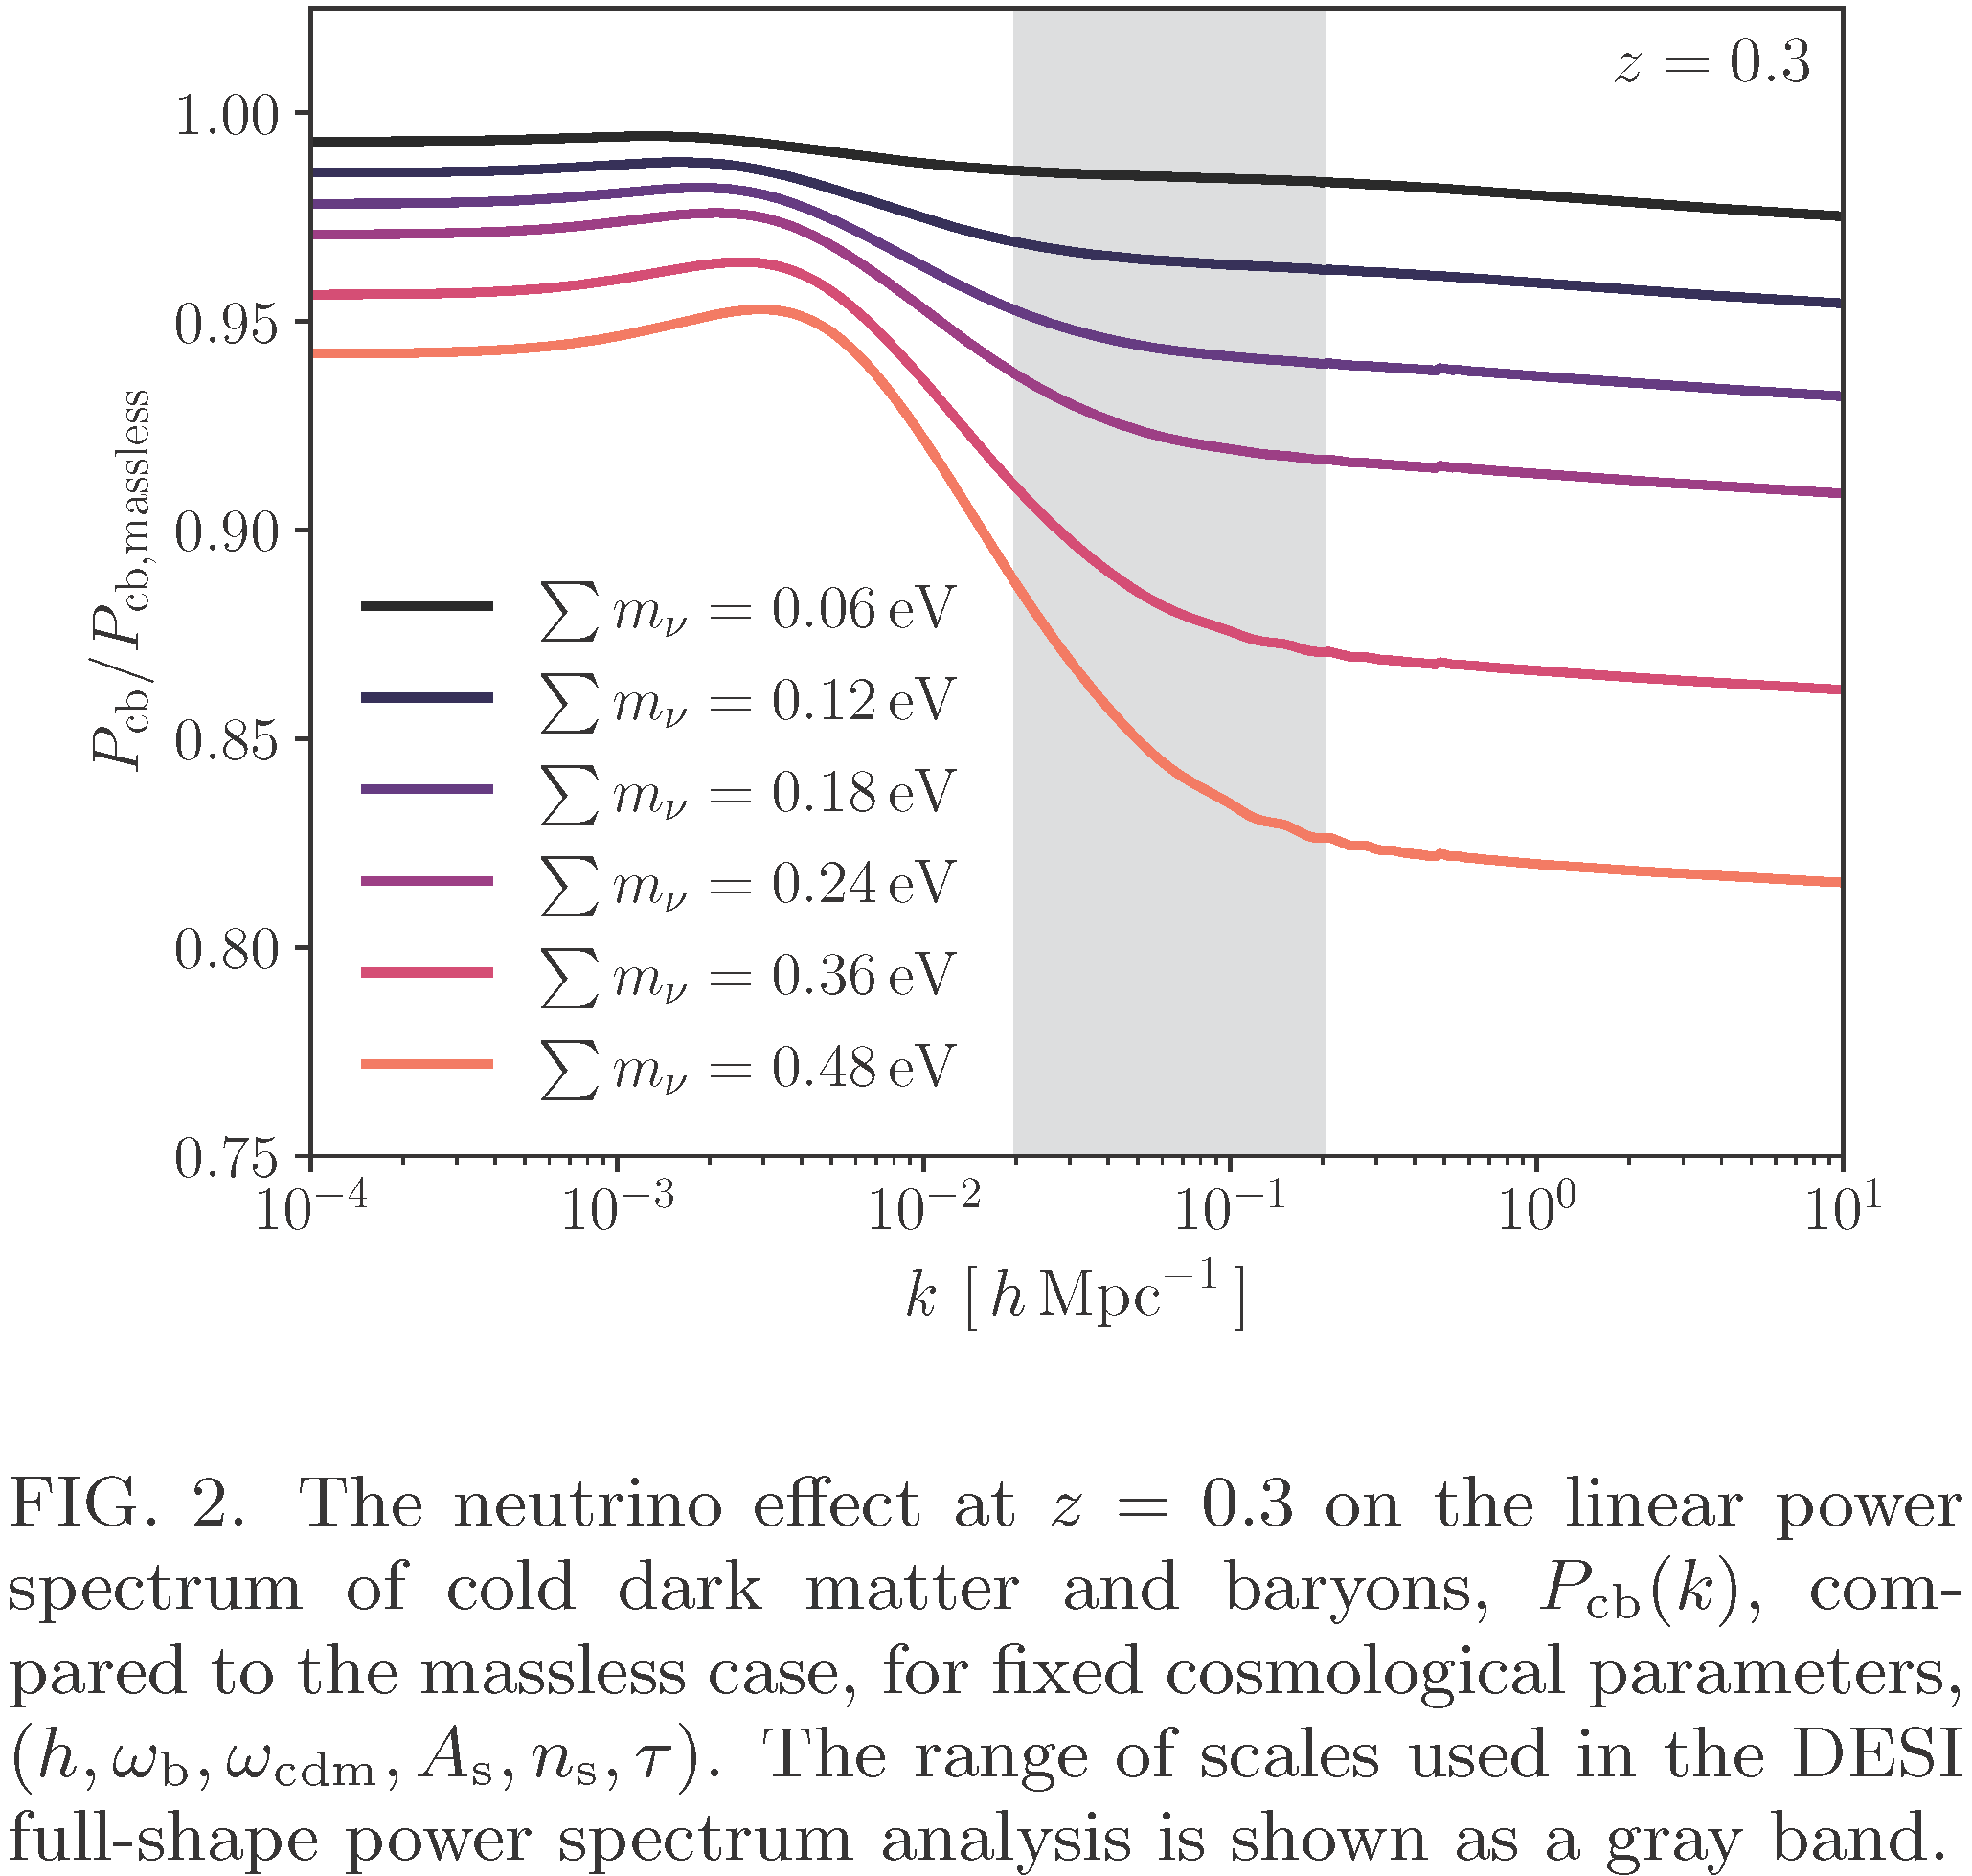
Transfer Function with Massive Neutrinos
DESI
Range
Constraints on Neutrino Physics from DESI DR2 BAO and DR1 Full Shape
https://arxiv.org/abs/2503.14744

Slide 31
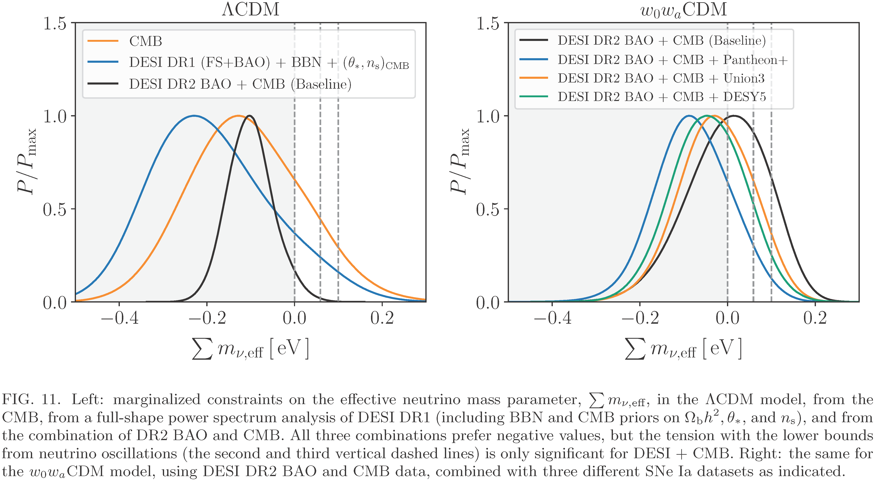
DESI Best Fit for Effective Neutrino Masses
N or I mass ordering
Constraints on Neutrino Physics from DESI DR2 BAO and DR1 Full Shape
https://arxiv.org/abs/2503.14744

Slide 32
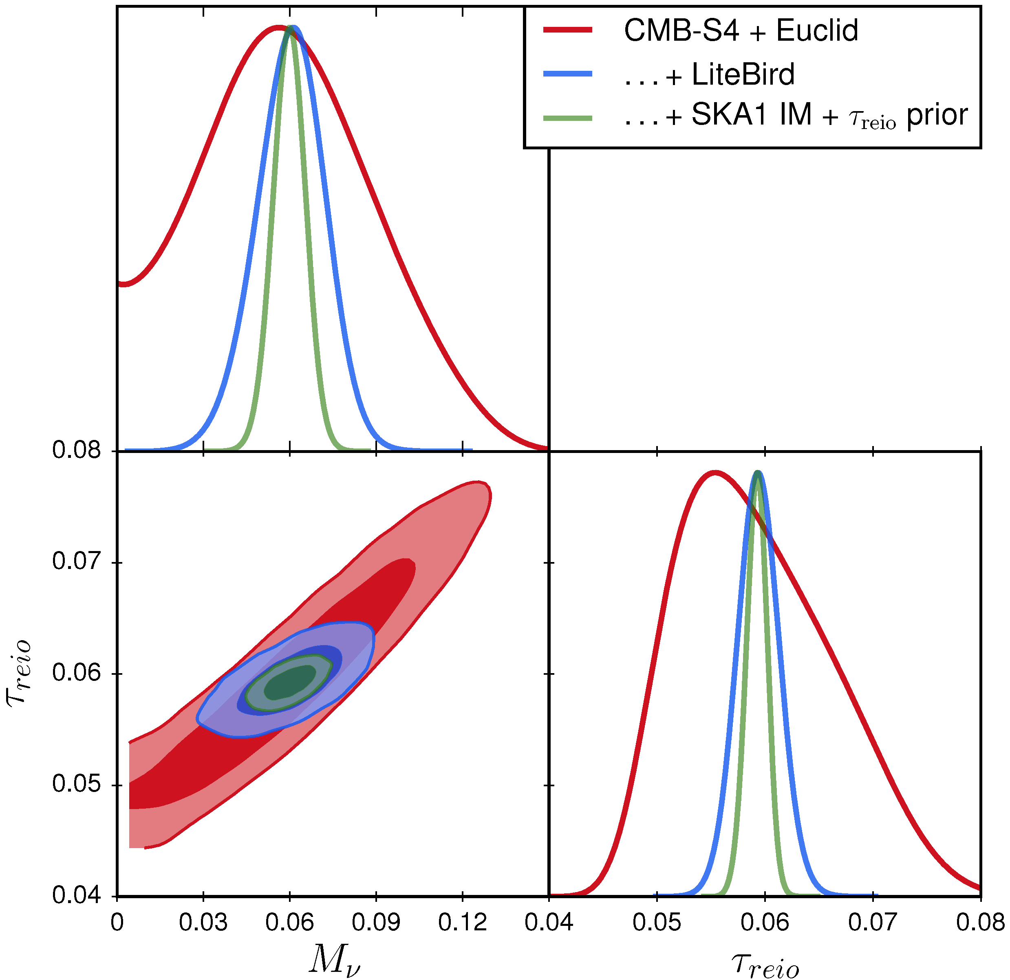
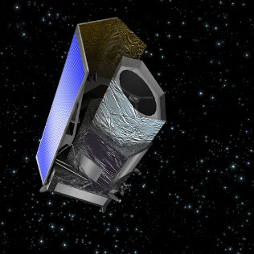
Future Cosmological Neutrino Mass Sensitivity
ESA’s Euclid satellite
Launched on 1 Juli 2023
Precision measurement of the
universe out to redshift of 2
Brinckmann+, https://arxiv.org/abs/1808.05955

Slide 33
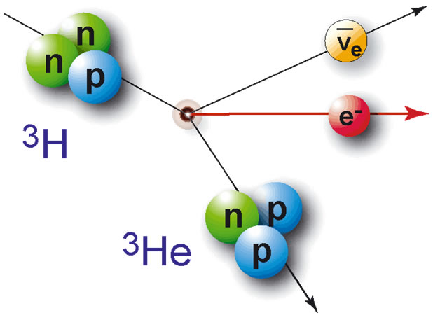
“Weighing” Neutrinos with KATRIN
Tritium β decay
Sensitive to common mass scale m
for all flavors because of small mass
differences from oscillations
Data taking began in mid 2018
Latest constraint
m < 0.45 eV (90% CL)
Science 388 (2025) 180–185
Can reach 0.3 eV (2025–2026)
$${}_{ }^{3}H→{}_{ }^{3}{He+e^{−}+{\overline{ν}}_{e}}$$
Electron spectrum
Endpoint
Energy
18.6 keV
E
m
https://www.katrin.kit.edu/

Slide 34
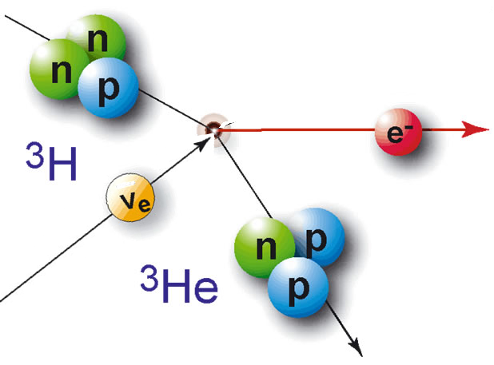
Cosmic Neutrino Capture in Tritium Beta Decay
Electron
spectrum
Tritium β decay
Tritium inverse β decay
capturing cosmic neutrinos
$${}_{ }^{3}H→{}_{ }^{3}{He+{\overline{ν}}_{e}+e^{−}}$$
$$ν_{e}+{}_{ }^{3}H→{}_{ }^{3}{He+e^{−}}$$
Events above
endpoint energy
m
m
Energy
Ptolemy project (Chris Tully et al.)

Slide 35
Dirac vs. Majorana Neutrinos
Mass in tritium decay
and $ν$ capture purely kinematical:
No Dirac/Majorana difference
Cosmic background neutrinos:
• Are produced ultra-relativistic
• 2 active states per flavor
{
}
$$ν=\overline{ν}$$
Majorana
both “active” for capture
{
{
}
active
redshift
Spin
{
{
}
$ν$ active
for capture
sterile
(Dirac)
Dirac
}
$\overline{ν}$ sterile
for capture
For Majorana neutrinos twice the capture rate!
• Long, Lunardini & Sabancilar, arXiv:1405.7654
• Hernandez-Molinero, Jimenez & Peña-Garay, arXiv:2205.00808

Slide 36
Big Bang Nucleosynthesis
Big Bang
Nucleosynthesis

Slide 37
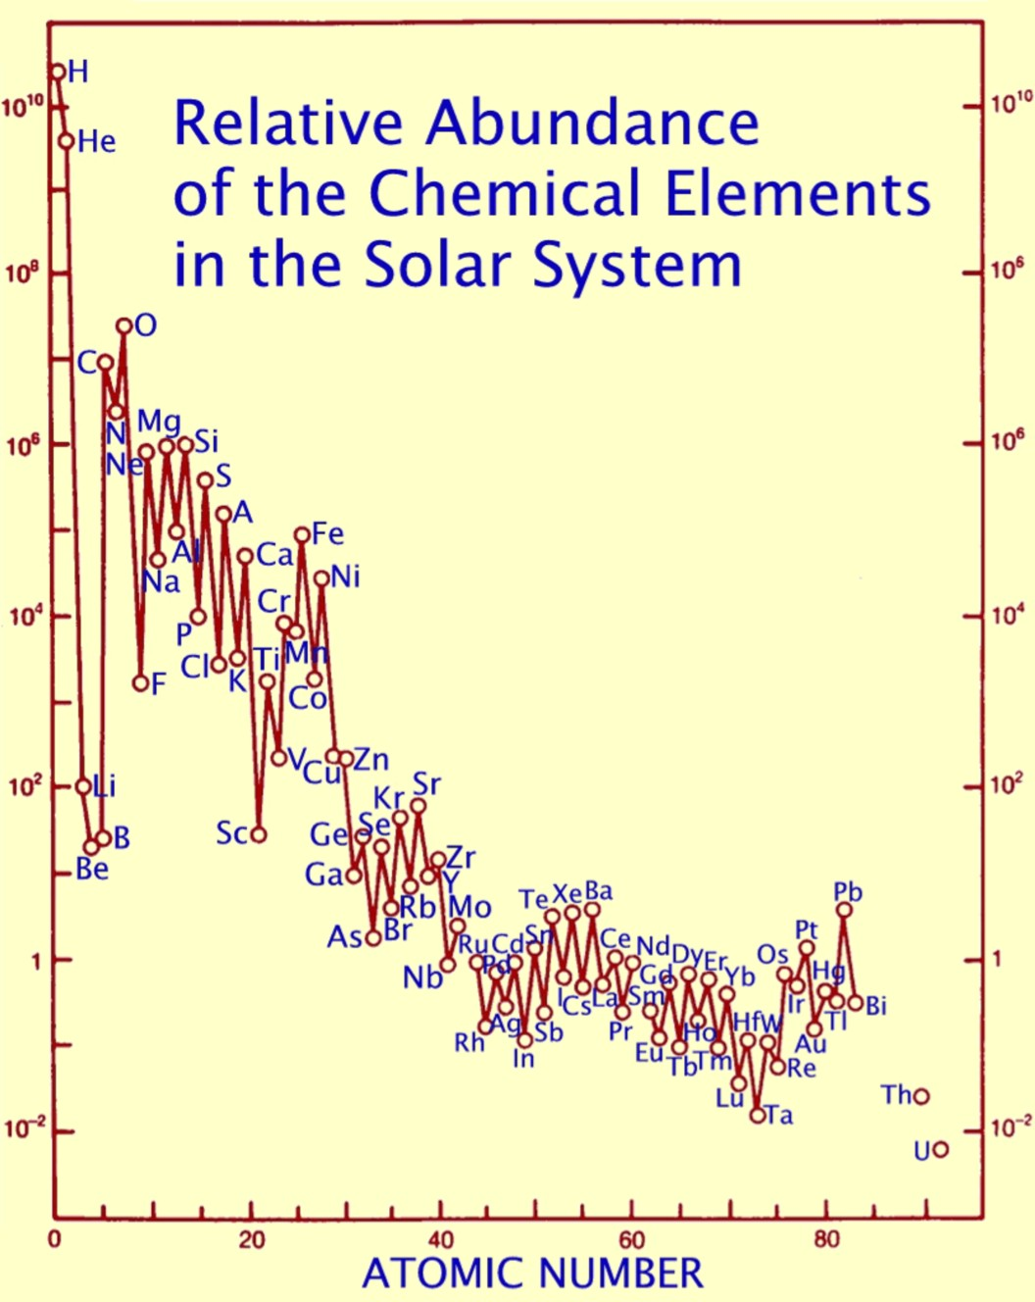
Origin of Elements
$$\}$$
Mass fraction of helium $\sim$ 25%
everywhere in the universe
Most of it not produced in stars
(far too little star light from
liberated energy)
Big-bang nucleosynthesis (BBN)
is a pillar of modern cosmology
Neutrinos play a crucial role
Produced in stars
(Fusion liberates
energy up to
iron-group nuclei)

Slide 38
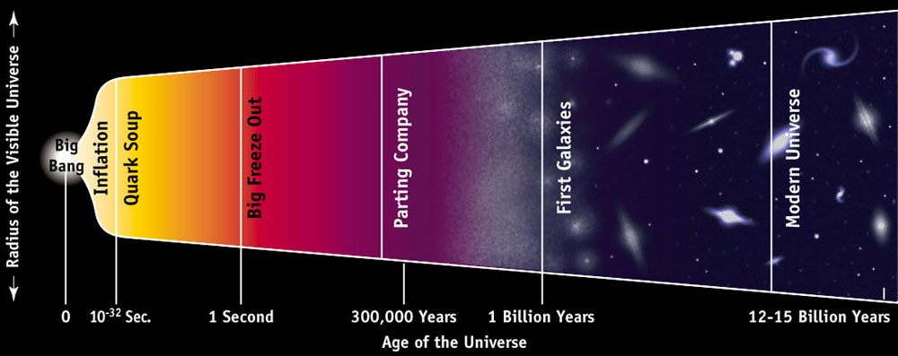
Where, When, and What?
Epoch:
1 sec – 3 minutes
Temperature:
1 MeV – 30 keV
Constituents:
Photons, neutrinos, e⁺e⁻
Baryon density:
0.07 g cm⁻³ (at 1 sec)

Slide 39
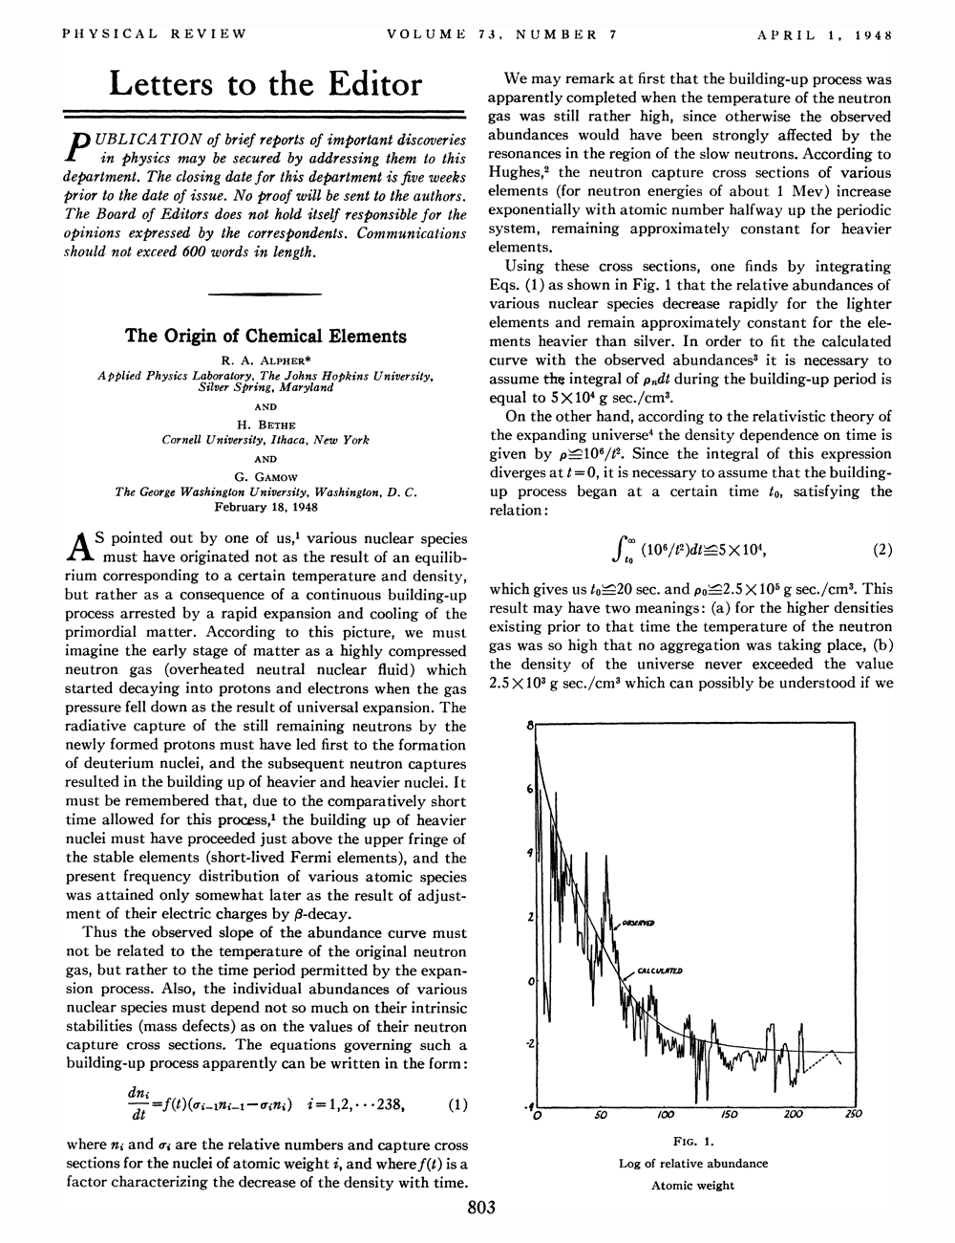
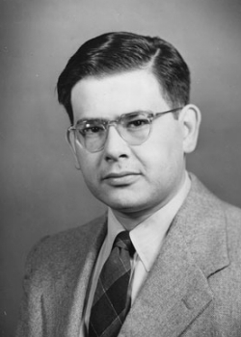
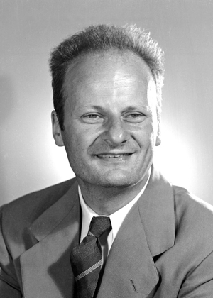
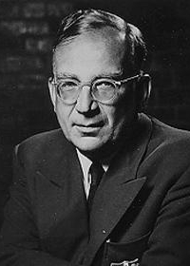
Alpha-Beta-Gamma
Alpher’s PhD work
Ralph Alpher
1921–2007
Bethe included
as a joke ($αβγ$)
Hans Bethe
1906–2005
George Gamow
1904–1968

Slide 40
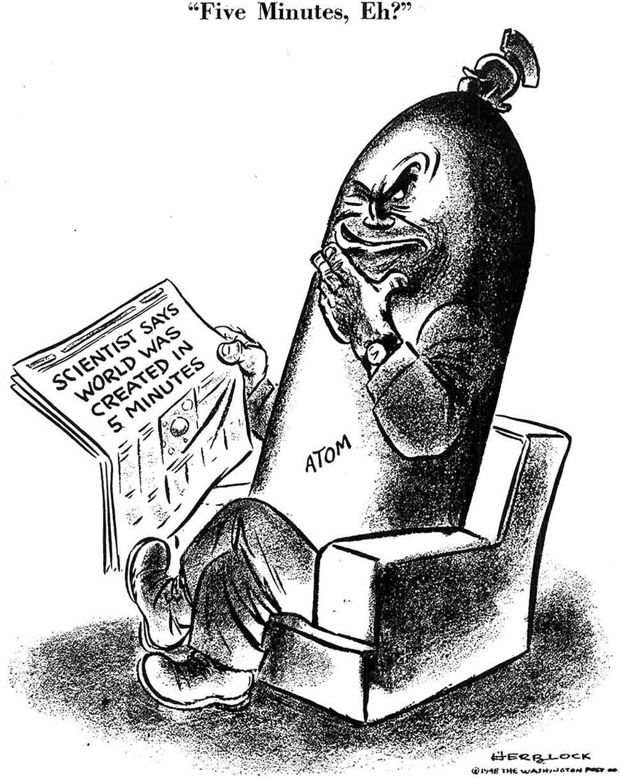
Herb Block Cartoon
This cartoon, published in the
Washington Post (April 16, 1948),
was inspired by a statement in
Alpher's dissertation to the effect that the period of nucleosynthesis in the early universe lasted about 5 minutes.
© The Herb Block Foundation.

Slide 41
Helium Synthesis – Three Easy Steps
t
sec
T
MeV
β equilibrium
$$p+e^{−}↔n+ν_{e}$$
$$p+{\overline{ν}}_{e}↔n+e^{+}$$
$\frac{n}{p}=\exp\left(−\frac{m_{n}−m_{p}}{T}\right)≈1$
$$m_{n}−m_{p}=1.293 MeV$$
β freeze-out
$$\frac{n}{p}≈\frac{1}{6}$$
β rates fall below
expansion rate H
1
1
Neutron decay
Nuclear statist.
equilibrium
$n_{n}∝\exp\left(−\frac{t}{τ_{n}}\right)$
$τ_{n}≈880 sec$
$$2p+2n↔{}_{ }^{4}{He}+γ$$
Helium suppressed
by large entropy
Neutrons freeze
in helium
$$\frac{n}{p}≈\frac{1}{7}$$
Helium mass fraction
Y_{P} ≈ 25%
100
0.1
Thermonuclear
reaction chains
Production and destruction of traces of
D, ³He, ⁶Li, ⁷Li, ⁷Be
All done
10⁴
0.01

Slide 42
Why do nuclei form so late?
Thermal equilibrium → all nuclei present
Binding energies much larger than MeV, so why are they still dissociated
at weak-interaction freeze-out? Why not everything in iron?
Basic answer: High-entropy environment with $\sim 109$photons per baryon
$Nn+Zp↔\left(A,Z\right)+photons$
High-E tail of photon distribution enough to keep nuclei dissociated
B
(MeV)
B/A
(MeV)
D
2.23
1.1
³H
6.92
2.3
³He
7.72
2.6
⁴He
28.30
7.1
⁶Li
31.99
5.3
⁷Li
39.25
5.6
⁷Be
37.60
5.4
¹²C
92.2
7.7

Slide 43
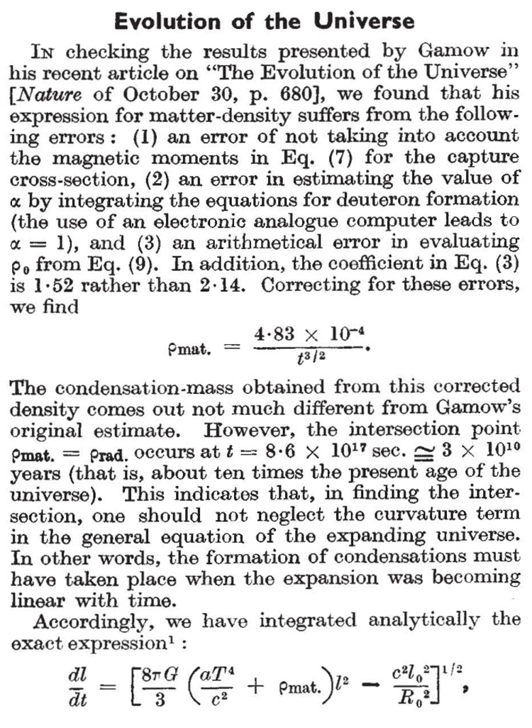
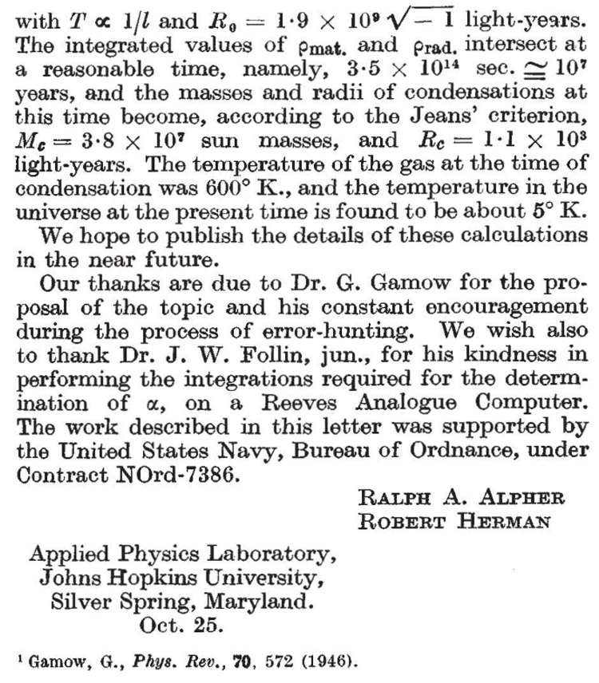
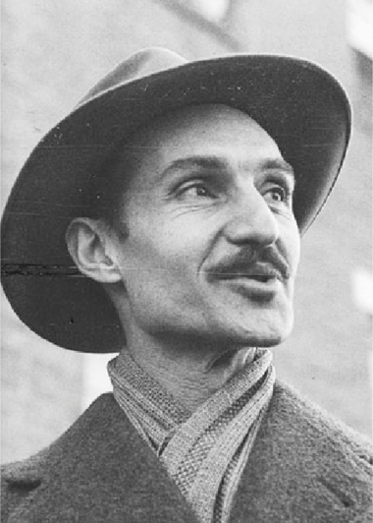
Predicting the Cosmic Microwave Background
Nature 162 (1948) 774–775
Ralph Alpher
1921–2007
Robert Herman
1914–1997
See also Alpher & Herman, Reflections on Early Work on Big Bang Cosmology
Physics Today, August 1988, pp 24–34

Slide 44
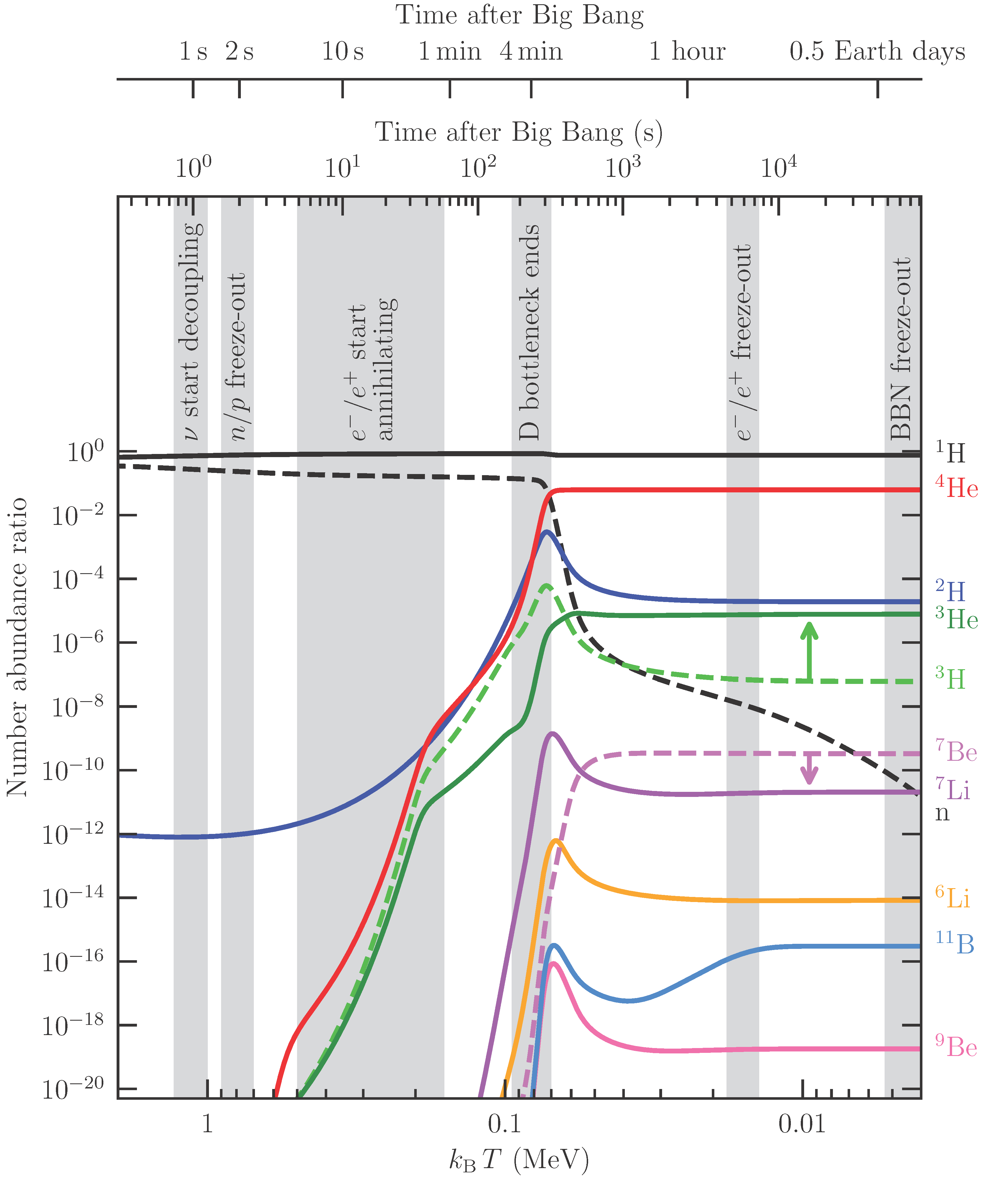
Formation of Light Elements
Protons
Helium 4
Deuterium
Lithium
R.Cooke,
Big Bang Nucleosynthesis
arXiv:2409.06015

Slide 45
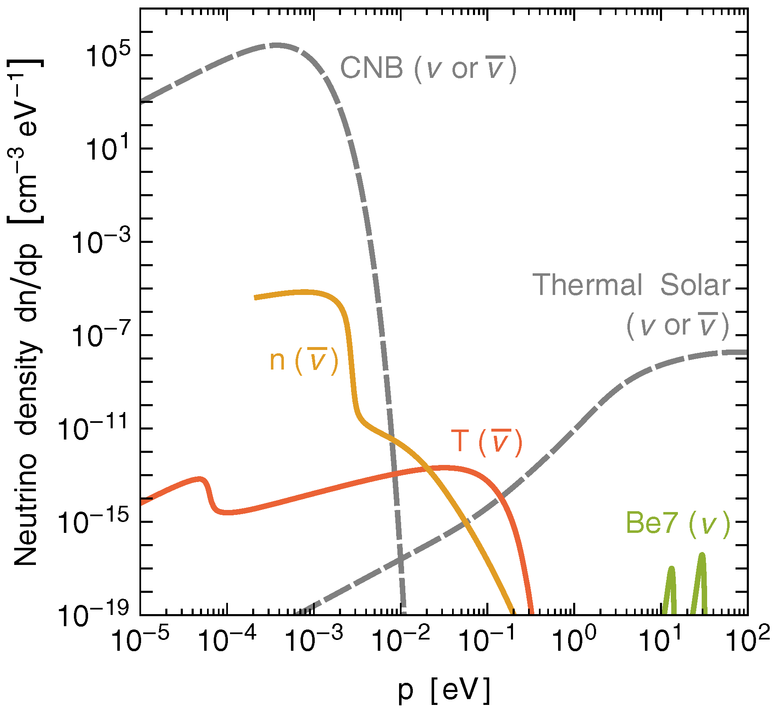
Neutrinos from Decay of Light BBN Nuclei
Vitagliano et al., arXiv:1910.11878
Khatri & Sunyaev
arXiv:1009.3932
Ivanchik & Yurchenko
arXiv:1809.03349

Slide 46
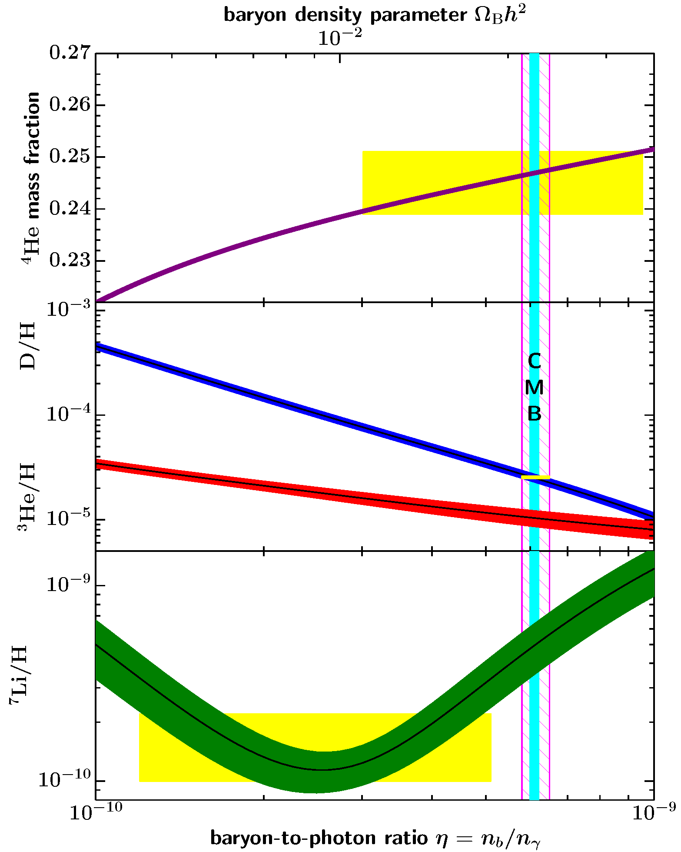
BBN Theory vs Observations
• He-4 and H-2 (deuterium)
main reliable probes
• Come mostly from BBN
Review of Particle Properties (2023)
Precision
cosmology
Primordial He-3 difficult to measure, heavily processed
Lithium processed in stars,
but discrepancy hard to explain.
Unresolved “Lithium problem”
1
2
3
4
5
6
7
10
Baryon/Photon $η×{10}^{10}$

Slide 47
Neutrino Impact on BBN
• Radiation density $ρ$
Determines expansion rate $H^{2}=\frac{8π}{3}G_{N}ρ$
Faster expansion → less time for neutron decay → more He
$Y_{P}≈0.2485+0.013 ΔN_{eff}$
Historically first way to “count flavors”
Still of interest for sterile neutrinos
• Chemical potential $μ_{ν_{e}}$ modifies β equilibrium
$\frac{n}{p}=\exp\left(−\frac{m_{n}−m_{p}}{T} −\frac{μ_{ν_{e}}}{T}\right)$
Modifies frozen neutron abundance
Bounds on $ν_{e}$-${\overline{ν}}_{e}$ asymmetry
(But probably very small, similar to matter-antimatter)

Slide 48
Sterile Neutrino Oscillations
Sterile (right-handed) neutrinos $ν_{s}$ may exist
Not the Dirac partner of ordinary (active) neutrino $ν_{a}=ν_{e}$, $ν_{μ}$, or $ν_{τ}$
(White Papers arXiv:1204.5379, 1602.04816, 2203.07323)
Unknown mass $ms$
Unknown mixing angles with ordinary neutrinos $Θ_{es}$, $Θ_{μs}$, and $Θ_{τs}$
Some experimental “anomalies” explained by $ν_{s}$
Experimental constraints imply that mixing angle must be small
Production in the early universe?
Naïve average population $\left\langle p_{ν_{a}→ν_{s}}\right\rangle =\frac{1}{2}\sin^{2}\left(2θ_{as}\right)≪1$(ignoring matter effects)
Probability $ν_{a}→ν_{s}$
$$sin2(2θ_{as})$$
t

Slide 49
Flavor Relaxation in a Medium
Active neutrinos suffer collisions in a medium (rate $Γ$), but not $ν_{s}$
Mixed state “collapses” to $ν_{a}$ or $ν_{s}$
Flavor content is “measured” by the medium
at intervals $τ∼Γ^{−1}$
Oscillations begin again
Average oscillation probability $1/2\sin^{2}(2Θ)$
}
Flavor conversion rate
$$\frac{1}{2}\sin^{2}\left(2Θ\right) Γ$$
prob(ν_{a})
Single
energy
With energy
distribution
With collisions

Slide 50
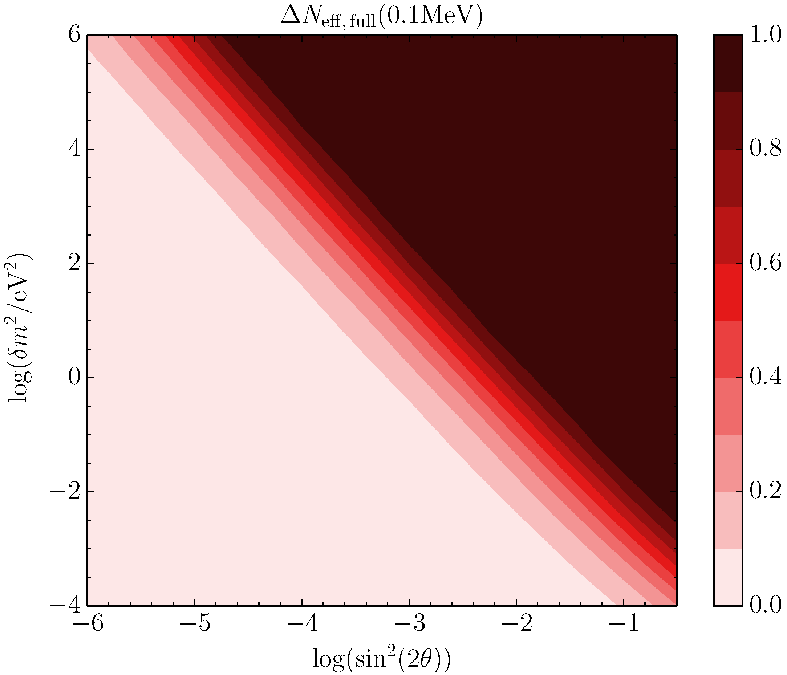
Parameters for Thermalisation
Fully thermalized
Hannestad, Hansen, Tram & Wong, arXiv:1506.05266

Slide 51
BBN and Neutrino Chemical Potentials
Expansion rate effect
(all flavors)
Energy density in one neutrino flavor with
degeneracy parameter ξ = η/T
$${ ρ}_{ν\overline{ν}}=\frac{7π^{2}}{120} T_{ν}^{4} \left[1+\underbrace{\frac{30}{7}{\left(\frac{ξ}{π}\right)}^{2}+\frac{15}{7}{\left(\frac{ξ}{π}\right)}^{4}}\right]$$
$$ΔN_{eff}$$
Beta equilibrium effect
for electron flavor
$$n+ν_{e}↔p+e^{−}$$
Helium abundance essentially fixed by n/p ratio
at beta freeze-out
$$\frac{n}{p}=e^{−{\left(m_{n}−m_{p}\right)}/{T_{F}}−ξ_{ν_{e}}}$$
Effect on helium equivalent to
$$ΔN_{eff}∼−18 ξ_{ν_{e}}$$
ν_{e} beta effect can compensate expansion-rate effect of ν_{μ,τ}
Naively, no significant BBN limit on neutrino number density
However, flavor oscillations equalize chemical potentials before BBN

Slide 52
Chemical Potentials and Flavor Oscillations
Flavor mixing
(neutrino oscillations)
Flavor equilibrium before n/p freeze out
assured because all mixing angles not
small
Our knowledge of the cosmic neutrino
density depends on measured oscillation
parameters!
Flavor lepton numbers
not conserved
Only one common neutrino
chemical potential
Stringent ξ_{νe} limit
applies to all flavors
|ξ_{νe,μ,τ}| < 0.07
Extra neutrino density
ΔN_{eff} < 0.0064
arXiv:hep-ph/0012056 , hep-ph/0201287,
astro-ph/0203442, hep-ph/0203180,
arXiv:0808.3137, 1011.0916, 1110.4335
Most recently
Froustey & Pitrou, arXiv:2405.06509
Cosmic neutrino density
close to standard value

Slide 53
BBN Summary
• BBN accounts well for He and D abundance
• Lithium remains in tension
• Large neutrino asymmetries not possible
• Cosmic neutrino background exists
with roughly the predicted abundance
• Agrees well with CMB and LSS data
• BBN remains valuable probe for BSM physics,
dark matter decay, or similar

Slide 54
Leptogenesis
Leptogenesis

Slide 55
Basics of Cosmology
• More matter than anti-matter in the universe
(BAU – Baryon Asymmetry of the Universe)
• Not from initial conditions (inflationary universe)
• Should be generated by physical process:
“Baryogenesis”
• Requires an absolute difference between matter
and anti-matter in laws of physics

Slide 56
Cosmic Matter-Antimatter Asymmetry
• No substantial regions of antimatter in the universe (gamma rays!)
• Baryon densiy relative to CMB photons today
$${ η}_{B}=\frac{n_{B}}{n_{γ}}=\left(6.12±0.04\right)×{10}^{−10}$$
• Universe electrically neutral ($n_{p}≃n_{e})$, but how much $L$ in neutrinos?
(for Majorana neutrinos $L$ not even defined)
• Matter-antimatter asymmetry $≃$ Baryon asymmetry
• Hot early universe: 1 extra quark per ${10}^{9}$ thermal quark-antiquark pairs

Slide 57
Baryogenesis in the Early Universe
Sakharov conditions for creating the
Baryon Asymmetry of the Universe (BAU)
C and CP violation
Baryon number violation
Deviation from thermal equilibrium
JETP Lett. 5 (1967) 24
Particle-physics standard model
Violates C and CP
Violates B and L by EW sphaleron effects
(B − L conserved)
Expanding universe provides deviation from
thermal equilibrium
Andrei Sakharov
1921−1989
However, electroweak baryogenesis not quantitatively possible
within Standard Model (not enough CP violation)
→ Cosmic matter/antimatter asymmetry requires new physics
A.Riotto & M.Trodden: Recent progress in baryogenesis, Ann. Rev. Nucl. Part. Sci. 49 (1999) 35
arXiv:hep-ph/9901362 • D.Bödeker & W.Buchmüller: Baryogenesis from the weak scale to the
grand unification scale, Rev. Mod. Phys. 93 (2021) 3 arXiv:2009.07294

Slide 58
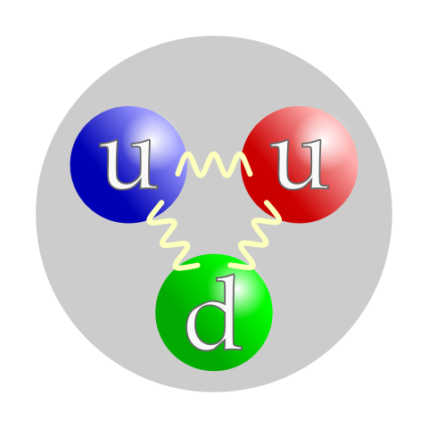
Baryon & Lepton Number
Baryon number (B)
Lepton number (L)
$$q$$
$$ℓ^{−}$$
$+\frac{1}{3}$ quarks
$+1$ charged leptons
$$\overline{q}$$
$−\frac{1}{3}$ antiquarks
$$ν$$
$+1$ Dirac neutrino
$+1$ proton etc.
• Accidentally conserved in Standard Model
(No fundamental symmetry, not a “conserved charge”
but no normal process that violates B or L)
• Violation never observed
Violation expected
• Baryon-lepton unification (Grand unification of all forces)
• Generate matter-antimatter asymmetry in the universe (“baryogenesis”)
• Small neutrino masses motivate Majorana nature (see-saw mechanism)

Slide 59
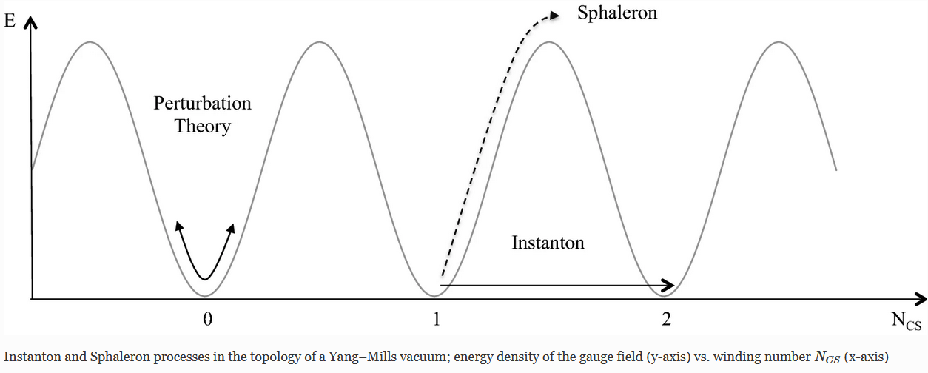
B and L Violation in the Standard Model
• Ground state (vacuum) not unique in electroweak standard model (non-Abelian)
• Different topologies (winding number $N_{CS}$)
• $B$ and $L$ perturbatively conserved
• Tunneling (instantons) violates $B$ and $L$ (“chiral anomaly”)
• Sphaleron (unstable classical solution at maximum, elongated blob of energy)
$E_{S}≃\frac{m_{W}}{α_{W}}≃10 TeV$ size $m_{W}^{−1}≃{10}^{−2} fm$
• Decays into many baryons and leptons
Winding number of gauge-field topology
Figure from https://arxiv.org/abs/2012.09120

Slide 60
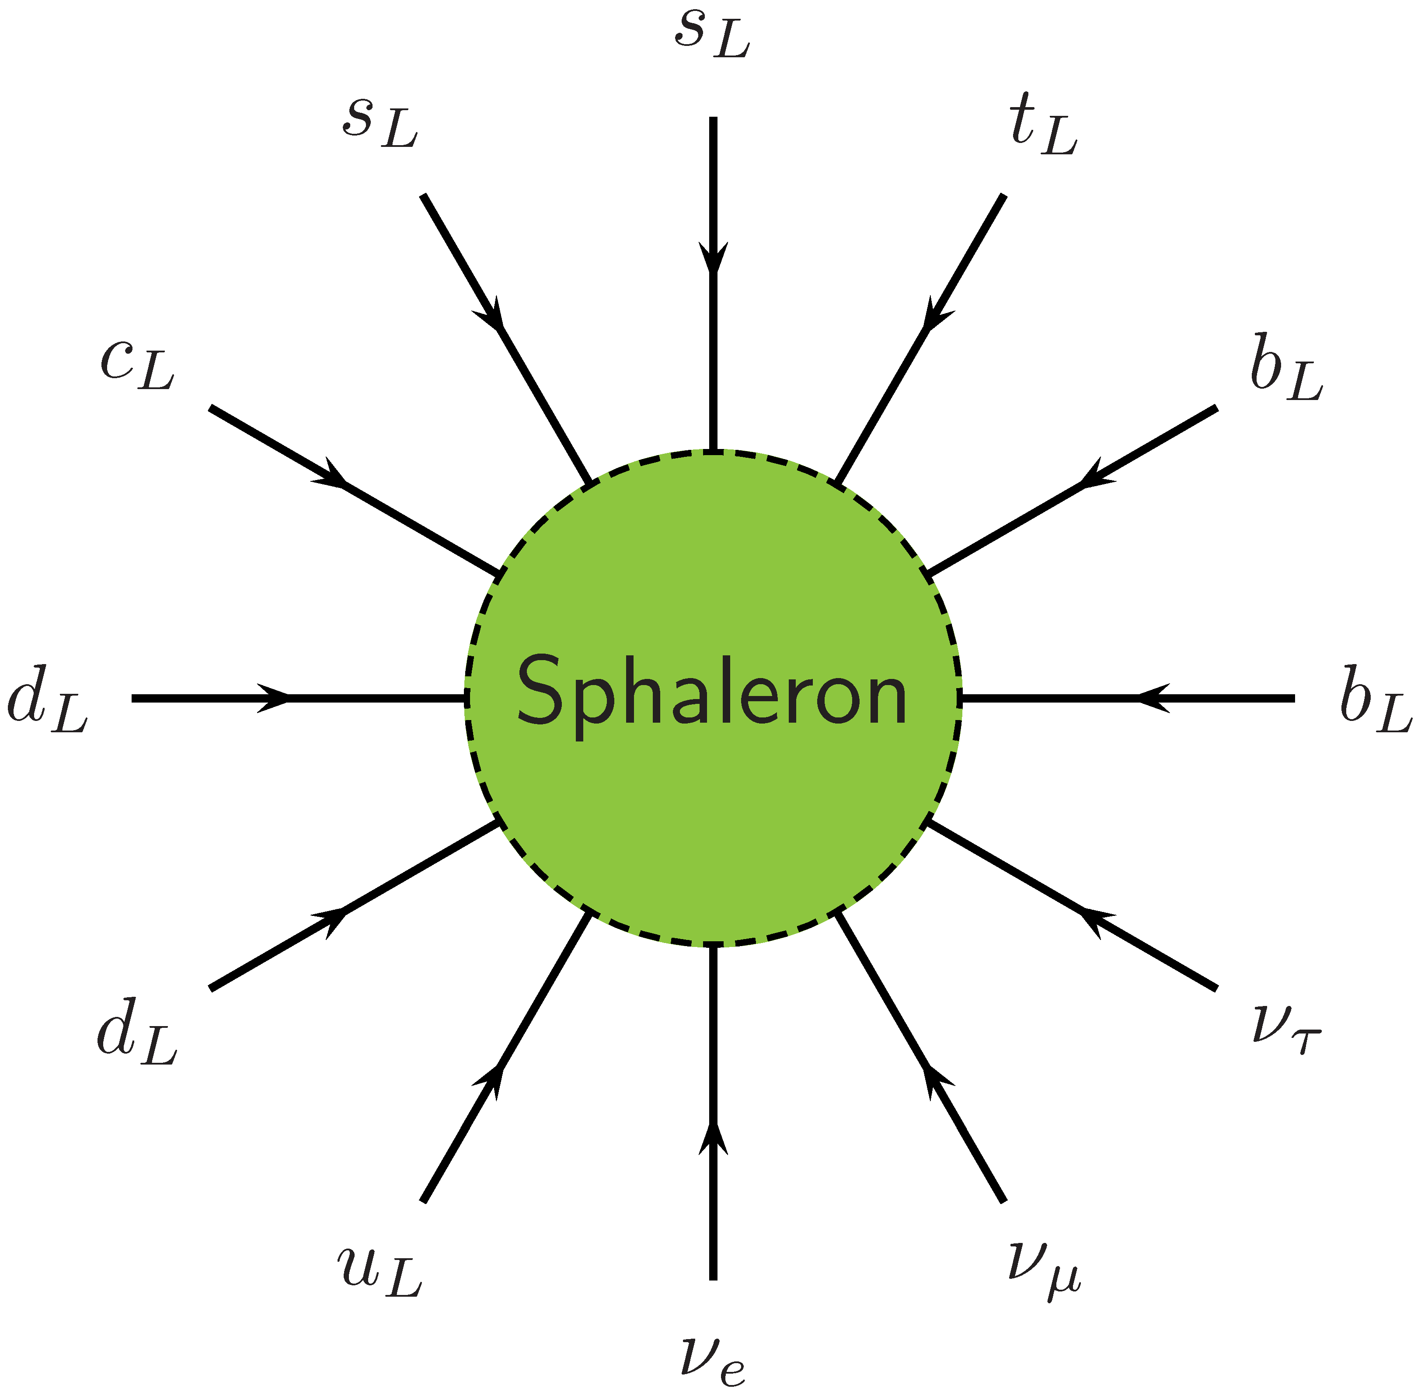
Sphalerons in the Early Universe
Sphaleron process: $Δ\left(B−L\right)=0$
$\underbrace{Δ\left(B+L\right)}=2N_{fam}×ΔN_{CS}=6$ (for $ΔN_{CS}=1$)
Change of fermion number
One of the 12 sphaleron processes that are
in thermal equilibrium in the early universe
Figure from arXiv:hep-ph/0406014
Early universe: • Sphalerons in thermal equilibrium for $T>few 100 GeV$
• Pre-existing $B+L$ erased
Kuz’min, Rubakov & Shaposhnikov: On anomalous electroweak baryon-number
non-conservation in the early universe, Phys. Lett. B 155 (1985) 36 (thousands of citations)

Slide 61
See Saw Mechanism for Neutrino Mass
Mass terms on the Lagrangian level
$$ℒ_{mass}=− {\overline{ν}}_{L}m^{D}N_{R}−\frac{1}{2} {\overline{ν}}_{L}m_{L}^{M}{\left(ν_{L}\right)}^{c}−\frac{1}{2} \overline{{\left(N_{R}\right)}^{c}}m_{R}^{M}N_{R}+h.c.$$
Dirac mass
term couples
L with R fields
Majorana mass terms
couple only L with L
and R with R fields
{
{
}
}
Dirac mass $m^{D}$
combines them
to a single
Dirac neutrino
active
Majorana mass $m_{L}^{M}$
Dirac mass $m^{D}$
mixes them to form
two modified
Majorana neutrinos
Spin
{
}
sterile
Majorana mass $m_{R}^{M}$
Assume $m_{L}^{M}=0$ (no Majorana mass for active neutrino)
and ${M_{R}≡m}_{R}^{M}≫m^{D}≡m_{D}$ (Dirac mass a small perturbation)
$$ℒ_{mass}≃\left(\begin{matrix}{\overline{ν}}_{L} \\ {\overline{N}}_{R}\end{matrix}\right)\left(\begin{matrix}0 & m_{D} \\ m_{D} & M_{R}\end{matrix}\right)\left(\begin{matrix}ν_{L} \\ N_{R}\end{matrix}\right) \underset{→}{\text{diagonalize}} ≃\left(\begin{matrix}{\overline{ν}}_{L}^{ ′} \\ {\overline{N}}_{R}^{ ′}\end{matrix}\right)\left(\begin{matrix}m_{D}^{2}/M_{R} & 0 \\ 0 & M_{R}\end{matrix}\right)\left(\begin{matrix}ν_{L}^{′} \\ N_{R}^{′}\end{matrix}\right)$$
$$m_{D}≪M_{R}$$
Light neutrino $ν^{′}=ν+θN≃ν$ with Majorana mass $m_{ν}≃m_{D}^{2}/M_{R}$

Slide 62
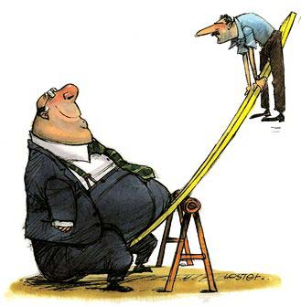
See-Saw Model for Neutrino Masses
Cosmological
constant
QCD
scale
Electroweak
scale
GUT
scale
Planck
mass
$${10}^{−6}$$
$${10}^{−3}$$
$$1$$
$${10}^{3}$$
$${10}^{6}$$
$${10}^{9}$$
$${10}^{12}$$
$${10}^{15}$$
$${10}^{18}$$
$${10}^{21}$$
$${10}^{24}$$
$${10}^{27}$$
eV
$$m_{ν}={m_{D}^{2}}/{M_{R}}$$
$$m_{D}$$
$$M_{R}$$
$$M_{R}={m_{D}^{2}}/{m_{ν}}≃{10}^{14}GeV≃M_{GUT}$$
100 GeV
100 meV

Slide 63
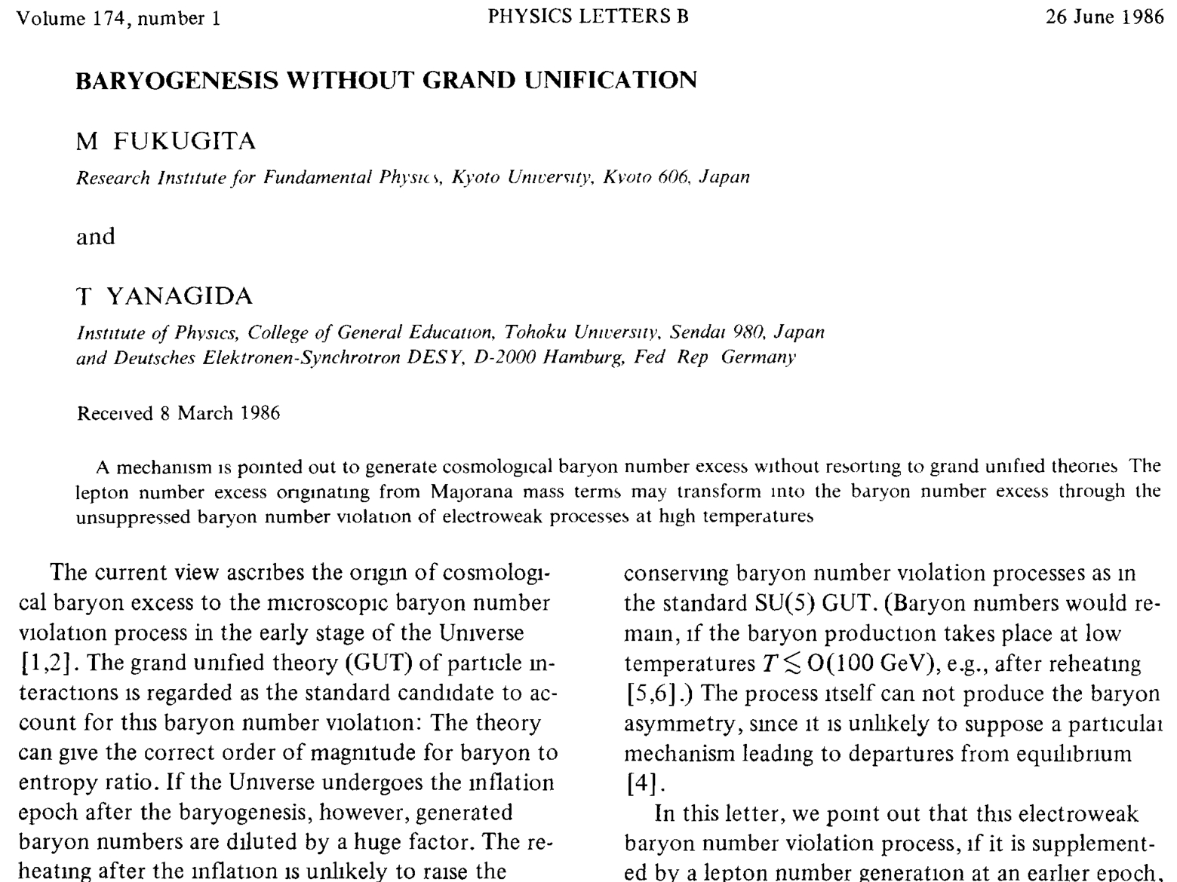
Leptogenesis by Majorana Neutrino Decays
}
• Heavy Majorana decay $N_{R}→ℓ_{L}+\overline{φ}$ (standard Higgs)
$N_{R}→\overline{ℓ_{L}}+φ$
• Reprocessed to $B$ by sphalerons
• “To achieve this, however, all neutrino mass matrix elements (Majorana mass) should be
smaller than ~0.1 eV. If the double beta decay experiment would observe a Majorana mass
greater than this value, this scenario fails.”
Different rates from CP violating
phase in $N_{R}$ mass matrix

Slide 64
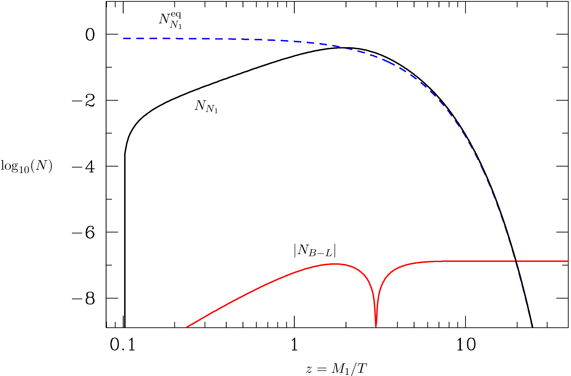
Leptogenesis by Out-of-Equilibrium Decay
arXiv:hep-ph/0406014
Equilibrium lightest $N_{R}$
$$Γ_{N→ν+φ}=\frac{y_{ν}^{2}M_{R}}{8π}$$
$$=\frac{m_{ν}M_{R}^{2}}{8π {〈φ〉}^{2}}$$
$N_{R}$builds up by interactions
See-saw mass
$$m_{ν}=\frac{y_{ν}^{2} {〈φ〉}^{2}}{M_{R}}$$
Asymmetry
Wash out
Time
Optimal window for neutrino Majorana masses
$1<m_{i}<100 meV$
Bödeker & Buchmüller: Baryogenesis from the weak scale to the grand unification scale
Rev. Mod. Phys. 93 (2021) 3 arXiv:2009.07294

Slide 65
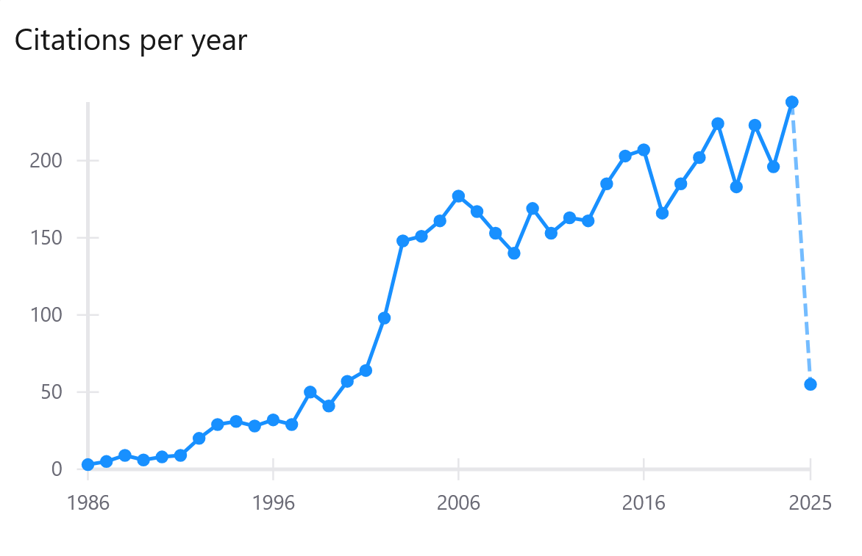
Leptogenesis by Majorana Neutrino Decays
Nu oscillations
accepted

Slide 66
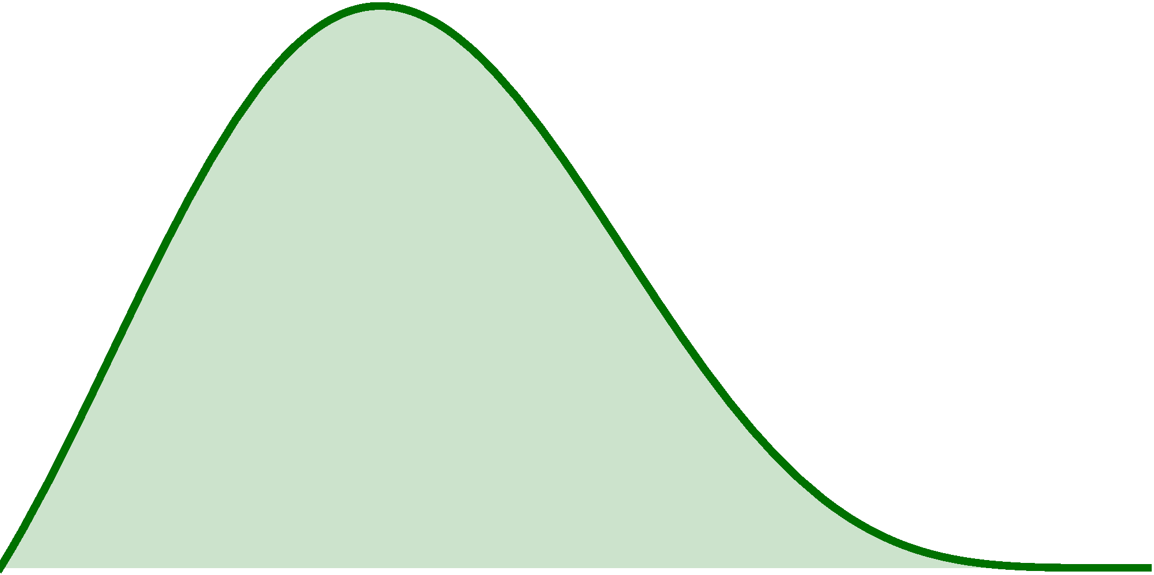
Neutrinoless ββ Decay
Some nuclei decay only by
the ββ mode, eg Ge-76
p
p
p
p
$${\overline{ν}}_{e}$$
e
e
⁷⁶As
2⁻
$$ν_{e}$$
⁷⁶Ge
e
$${\overline{ν}}_{e}$$
e
0⁺
⁷⁶Se
$${\overline{ν}}_{e}$$
2⁺
n
n
n
n
0⁺
Standard 2ν mode
0ν mode, enabled
by Majorana mass
Half life $\sim$ 2×10²¹ yr
$$2ν$$
$$0ν$$
$$m_{ee}=\left|\sum_{i=1}^{N}{U_{ei}^{2} m_{i}}\right|$$
Measured
quantity
Spectrum
Best limits from
¹³⁶Xe and ⁷⁶Ge
$m_{ee}$ < 86 meV
Sum of 2$β$ Energies
[arXiv:2503.07752]

Slide 67
Maria
Goeppert-Mayer
1906−1972
$$2ν2β$$
$$0ν2β$$
Nuovo Cim.
14 (1937) 322
Florence Univ.
Giulio Racah
1909−1965
$$0ν2β$$
Wendell Hinkle
Furry
1907−1984

Slide 68
Effective Majorana Mass in 0$ν$2$β$ Decay
https://pdg.lbl.gov/2022/reviews/rpp2022-rev-neutrino-mixing.pdf
Inverted
Exp. Limits
Normal
$$m_{light}$$
Majorana phases
Dirac phase
$$U_{ei}$$
e
$$m_{ee}=\left|e^{i{2α}_{1}}{\left|U_{e1}\right|}^{2}m_{1}+e^{i{2α}_{2}}{\left|U_{e2}\right|}^{2}m_{2}+{e^{i2δ}\left|U_{e3}\right|}^{2}m_{3}\right|$$
n
p
$$ν_{i}={\overline{ν}}_{i}$$
n
p
$$c_{13}^{2}c_{12}^{2}≃0.66$$
$$c_{13}^{2}s_{12}^{2}≃0.32$$
$$s_{13}^{2}≃0.02$$
$$U_{ei}$$
e

Slide 69
Leptogenesis Summary
• See-saw model for small Majorana masses
provides a generic way for BAU generation
• Preferred mass range < 100 meV
• Observing lepton-number violation
(neutrinoless double beta decay)
and leptonic CP violation (LBL oscillation)
would provide strong support (not proof)
for this scenario

Slide 70
Neutrino Mass Summary
Neutrino masses are in the sub-eV range
• Most restrictive limits from cosmology
• Should be seen “in the sky” in next round of precision data
Smallness suggests Majorana masses:
• Naturally explained by see-saw paradigm
• Requires new particles/fields
• Lepton number violation detectable in 0𝜈2β
• 1−100 meV mass range ideal for leptogenesis
• Corresponds to oscillation-implied range
}
Rather
compelling
package

Slide 71
Hubble Deep Field
Thank you!
Georg G. Raffelt, Max-Planck-Institut für Physik, Garching

Slide 72
Thanks

Slide 73
Helium Mass Fraction from HII Regions
Extrapolation to zero metalicity
in many HII regions
Recent Y_{P} determinations
(PDG Review on BBN 2023)
$$Y_{P}=0.245±0.003$$
Determination from metal-poor galaxies (EMPRESS arXiv:2203.09617)
Aver et al., arXiv:2109.00178
$$Y_{P}=0.237±0.003$$

Slide 74
Extrapolations to Primordial He-4
Variation of
zero-metallicity
intercept
The CosmoVerse White Paper:
Addressing observational tensions in cosmology with systematics and fundamental physics
arXiv:2504.01669

Slide 75
Helium-4 Determinations
$$Y_{P}=0.237±0.003$$
future
future
$$Y_{P}=0.245±0.003$$
Escudero, Ibarra & Maura, arXiv:2208.03201

Slide 76
Lyman Alpha Forest
Hydrogen clouds absorb from
QSO continuum emission spectrum
Absorption dips at Ly-α wavelengh
corresponding to redshift
www.astro.ucla.edu/~wright/Lyman-alpha-forest.html
Examples for Lyman-α forest in
low- and high-redshift quasars
http://www.astr.ua.edu/keel/agn/forest.gif

Slide 77
Measuring Primordial Deuterium
Hydrogen absorption spectrum of a background quasar in
high-redshift hydrogen clouds
astro-ph/9903300
Isotopic shift
$$0.33Å\left(1+z_{cloud}\right)$$
Deuterium Lyman-α in the
flank of the saturated
hydrogen Lyman-α line

Slide 78
Primordial Deuterium Determination
CMB
CMB
R.J. Cooke, M. Pettini, C.C. Steidel,
One Percent Determination of the Primordial Deuterium Abundance
arXiv:1710.11129

Slide 79
Thanks

Slide 80
Last Scattering Surface

Slide 81
Friedman-Robertson-Walker-Lemaître Cosmology
On scales ≳ 100 Mpc, space is maximally symmetric
(homogeneous & isotropic)
The corresponding Robertson-Walker metric is
$$ds^{2}=dt^{2}−a^{2}\left(t\right)\left[\frac{dr^{2}}{1−kr^{2}}+r^{2}\left(dθ^{2}+\sin^{2}θ dφ^{2}\right)\right]$$
Clock time
of co-moving
observer
Cosmic
scale
factor
Curvature
k = 0, ±1
Co-moving spherical coordinates
r is dimensionless
k = −1
k = 0
k = +1

Slide 82
Friedman Equation: Newtonian Derivation
Birkhoff’s theorem:
Spherical symmetry implies that only
the mass interior to a radius $R$ is relevant
for the motion of a test mass $m$ at $R$
Energy conservation $V_{pot}+V_{kin}=const$
$$−\frac{G_{N}\frac{4π}{3}R^{3}ρ m }{R}+\frac{1}{2} {\dot{R}}^{2}m=const$$
$${ ⟹ \left(\frac{\dot{R}}{R}\right)}^{2}=\frac{8π}{3} G_{N}ρ+\frac{const}{R^{2}}$$
Rescale $R=a R_{C}$ with cosmic scale factor $a$ and $R_{C}$ radius of curvature today
$$H^{2}={\left(\frac{\dot{a}}{a}\right)}^{2}=\frac{8π}{3}G_{N}ρ−\frac{k}{a^{2}R_{C}^{2}}$$
with $k=0, ±1$
m
R
Density ρ
Friedman Equation

Slide 83
Critical Density and Density Parameter
Evolution of the cosmic scale factor $a(t)$ is governed by the Friedman Equation
$${ H}^{2}={\left(\frac{\dot{a}}{a}\right)}^{2}=\frac{8π}{3}G_{N}ρ−\frac{k}{a^{2}R_{C}^{2}}$$
In a flat universe ($k=0$), the relationship between $H$ and $ρ$ is unique
$${ ρ}_{crit}=\frac{3H^{2}}{8πG_{N}}=\frac{3}{8π}{\left(Hm_{Pl}\right)}^{2}$$
Cosmic density always expressed in terms of density parameters
$$Ω=\frac{ρ}{ρ_{crit}}=\frac{8πG_{N}ρ}{3H^{2}}$$
With the present-day Hubble parameter $H_{0}=67.4 km s^{−1} Mpc^{−1}$ we have
$${ ρ}_{crit}=0.85×10^{−29}g cm^{−3}=4.8 GeV m^{−3}={\left(2.5 meV\right)}^{4}$$
Most of this in the form of “dark energy”
critical density
Planck mass $1.221×{10}^{19} GeV$

Slide 84
Generic Solutions of Friedman Equation
Equation
of state
Behavior of energy-density under
cosmic expansion
Evolution of
cosmic scale factor
Radiation
$$p=\frac{ρ}{3}$$
$$ρ∝a^{−4}$$
Dilution of radiation
and redshift of energy
$$a(t)∝t^{1/2}$$
Matter
$$p=0$$
$$ρ∝a^{−3}$$
Dilution of matter
$$a(t)∝t^{2/3}$$
Vacuum
energy
$$p=−ρ$$
$$ρ=const$$
Vacuum energy not
diluted by expansion
$$a(t)∝e^{\sqrt{Λ/3} t}$$
$$Λ=8πG_{N}ρ_{vac}$$
Energy-momentum tensor of a perfect fluid with density $ρ$ and pressure $p$
$$T^{μν}=\left(\begin{matrix}ρ & & & \\ & p & & \\ & & p & \\ & & & p\end{matrix}\right) T_{vac}^{μν}=ρ g^{μν}\left(\begin{matrix}ρ & & & \\ & −ρ & & \\ & & −ρ & \\ & & & −ρ\end{matrix}\right)$$

Slide 85
Evolution of Cosmic Density Components
Assumed neutrino masses
m₃ = 50 meV
m₂ = 9 meV
m₁ = 0
Photons
Neutrinos
Matter
radiation
equality
CDM
Baryons
Λ
Lesgourgues & Pastor
astro-ph/0603494

Slide 86
Power Spectrum of CMB Temperature Fluctuations
Sky map of CMBR temperature
fluctuations
$$Δ\left(θ,φ\right)=\frac{T\left(θ,φ\right)−〈T〉}{〈T〉}$$
Multipole expansion
$$Δ\left(θ,φ\right)=\sum_{ℓ=0}^{∞}{ \sum_{m=−ℓ}^{ℓ}{a_{ℓm}Y_{ℓm}\left(θ,φ\right)}}$$
Angular power spectrum
$${ C}_{ℓ}=〈a_{ℓm}^{∗}a_{ℓm}〉$$
$$=\frac{1}{2ℓ+1}\sum_{m=−ℓ}^{ℓ}{a_{ℓm}^{∗}a_{ℓm}}$$
Provides “acoustic peaks” and a
wealth of cosmological information
Planck
Acoustic Peaks

Slide 87
Flat Universe from CMBR Angular Fluctuations
Triangulation with acoustic peak
flat (Euclidean)
negative curvature
positive curvature
$Ω_{tot}={0.963}_{−0.049}^{+0.043}$ (CMB alone)
$Ω_{tot}={0.9995}_{−0.0066}^{+0.0065}$ (All data)
(95% ranges from Planck, arXiv:1303.5076)
Known physical
size of acoustic peak
at decoupling (z ≈ 1100)
Measured
angular size
today (z = 0)

Slide 88
Thanks

Slide 89
Mass-Energy-Inventory of the Universe
10⁻³
10⁻²
10⁻¹
1
Ω
Luminous
Baryons
Total
Minimal Neutrinos
Dark Matter
Λ
1.4‰
10⁻²
10⁻¹
1
10 eV
$$∑m_{ν}$$
Oscillations
Tritium (Katrin 2025)
NO
IO
future
Cosmological Data (ΛCDM inconsistent – DESI?)
Future cosmological data may measure/distinguish

Slide 90
CP Violation in Particle Physics
Discrete symmetries in particle physics
C – Charge conjugation, transforms particles to antiparticles
violated by weak interactions
P – Parity, changes left-handedness to right-handedness
violated by weak interactions
T – Time reversal, changes direction of motion (forward to backward)
CPT – exactly conserved in quantum field theory
CP – conserved by all gauge interactions
violated by three-flavor quark mixing matrix
• All measured CP-violating effects derive
from a single phase in the quark mass matrix
(Kobayashi-Maskawa phase),
i.e. from complex Yukawa couplings
• Cosmic matter-antimatter asymmetry
requires new ingredients
M. Kobayashi
Born 1944
T. Maskawa
1940–2021
Physics Nobel Prize 2008

Slide 91
Thanks

Slide 92
Neutrino Counting in Particle Physics
Resonant Z-Boson production at LEP
(Electron-positron collider at CERN before LHC, in the same tunnel)
Cross section follows resonance curve
$$\frac{dσ}{dE}∝\frac{Γ/2}{{\left(E−m_{Z}\right)}^{2}+{\left(Γ/2\right)}^{2}}$$
Contribution to Γ_{invis} of one standard neutrino family
$$Γ_{ν\overline{ν}}=167.2 MeV$$
$$\frac{Γ_{invis}}{Γ_{ν\overline{ν}}}=2.984±0.008$$
No room for weakly interacting particles that couple to the Z unless m > m_{Z}/2
or strongly reduced coupling strength
Or other final states
$q\overline{q}$, $e^{+}e^{−}$, $μ^{+}μ^{−}$, $τ^{+}τ^{−}$
Measured properties
$${ m}_{Z} =\left(91.1876±0.0021\right) GeV$$
$${ Γ}_{tot} =\left(2.4952±0.0023\right) GeV$$
$${ Γ}_{invis}=\left(499.0±1.5\right) MeV$$

Slide 93
Measured Z⁰ Width at LEP (ca 1990)
Cosmological
consequences:
Standard radiation
density fixed
No “trivial” weakly
interacting dark
matter particles

Slide 94
Thanks

