Slide 1
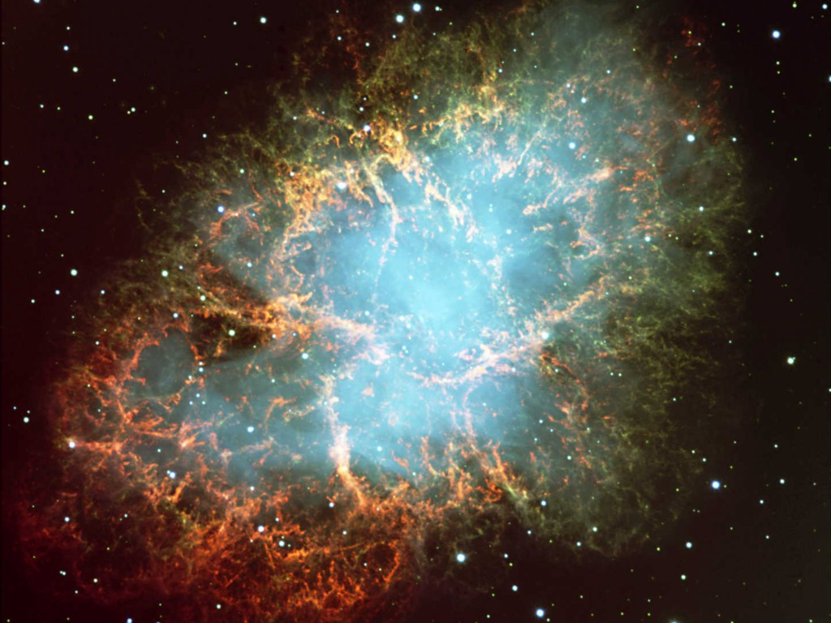


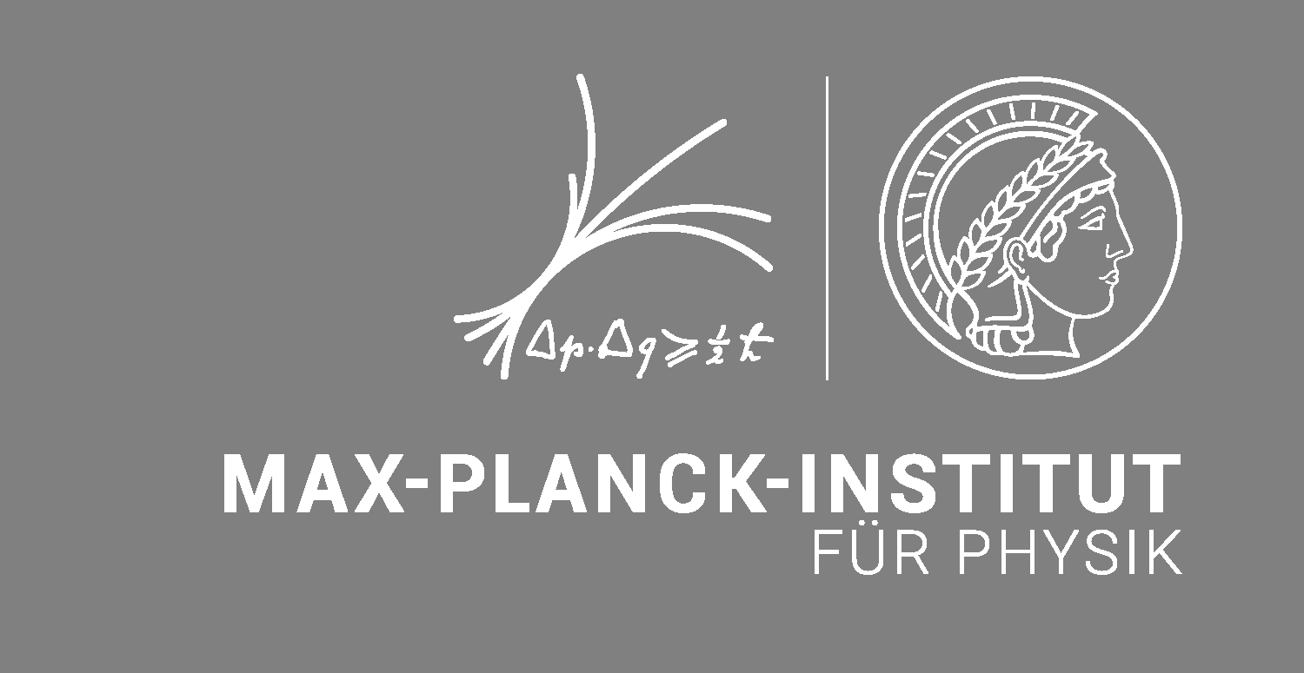
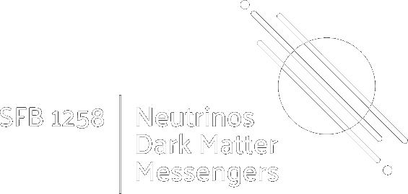
Crab Nebula – Remnant of SN 1054
Dark Matter and Neutrinos, IHP, Paris, 5−9 May 2025
Supernova
Neutrinos
Georg G. Raffelt, Max-Planck-Institut für Physik, Garching

Slide 2
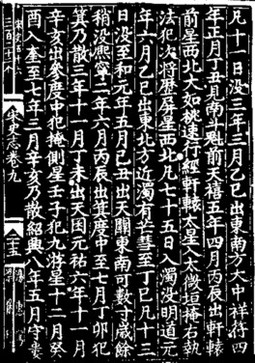
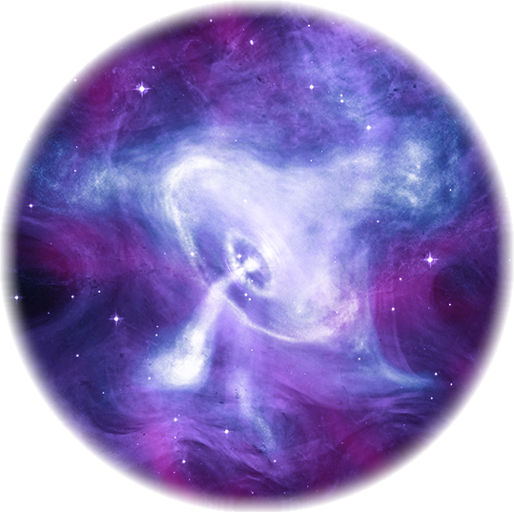
Crab Nebula – Remnant of SN 1054
Crab Nebula – Remnant of SN 1054
Crab Pulsar
Chandra X-ray composite image

Slide 3
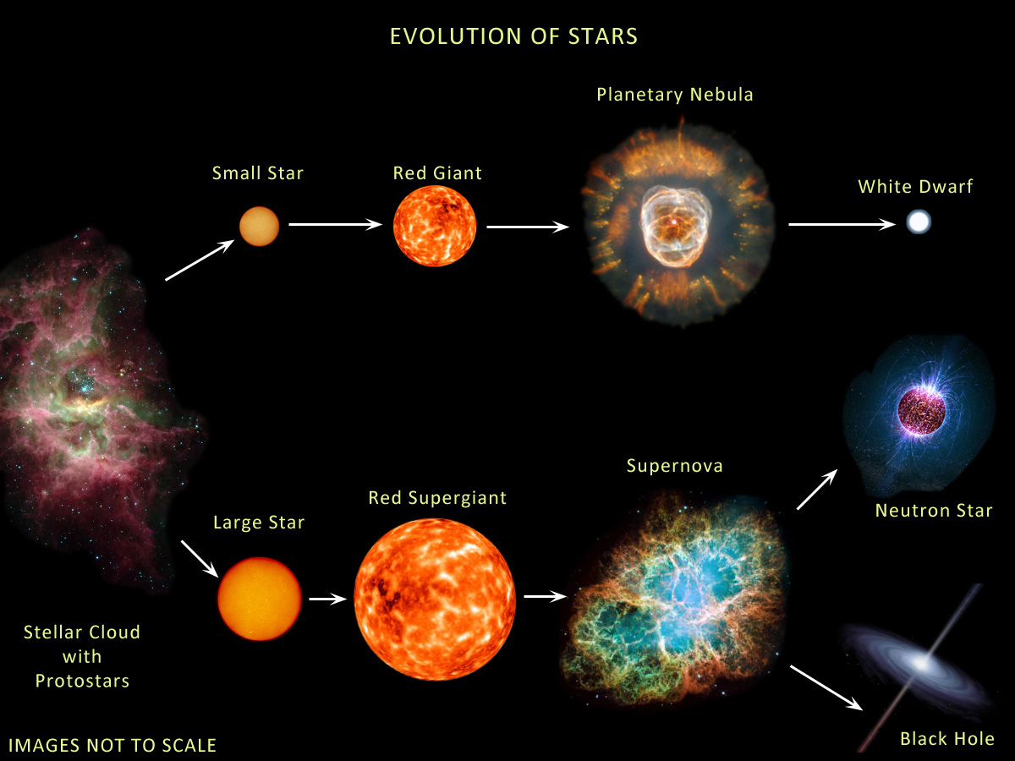
Evolution of Stars
Compact
Remnants:
$$M≲8 M_{⊙}$$
$1 M_{⊙}=2×{10}^{30}$kg
$$M∼0.6 M_{⊙}$$
R $∼$5000 km
$M$ = 1–2$M_{⊙}$
R $∼$12 km
$$M≳8 M_{⊙}$$
few-tens $M_{⊙}$
few km
BR ≈ 25% (?)
http://earthspacecircle.blogspot.com/2013/07/stellar-evolution.html

Slide 4

Stellar Collapse and Explosion
Progenitor Star
Iron Core − “White Dwarf”
Collapsed Core
Shells not to scale
Mass ≈ 1.5 M⊙
Nuclear density (3×10¹⁴ g cm⁻³)
Hydrogen
Helium
Carbon
Neon
Oxygen
Silicon
Iron
Bounce
Shock
$$ν \overline{ν}$$
6×10⁸ km
6000 km
60 km
Gravitational binding energy
E_{b} ≈ 3 × 10⁵³ erg ≈ 15% M_{SUN} c²
This shows up as
99% Neutrinos
1% Kinetic energy of explosion
0.01% Photons, outshine host galaxy

Slide 5
Why No Prompt Explosion?
0.1 M_{sun} of iron has a
nuclear binding energy
≈ 1.7 × 10⁵¹ erg
Comparable to
explosion energy
Undissociated Iron
Collapsed Core
Shock Wave
Dissociated
Material
(n, p, e, ν)
Shock wave forms
within the iron core
Dissipates its energy
by dissociating the
remaining layer of
iron

Slide 6
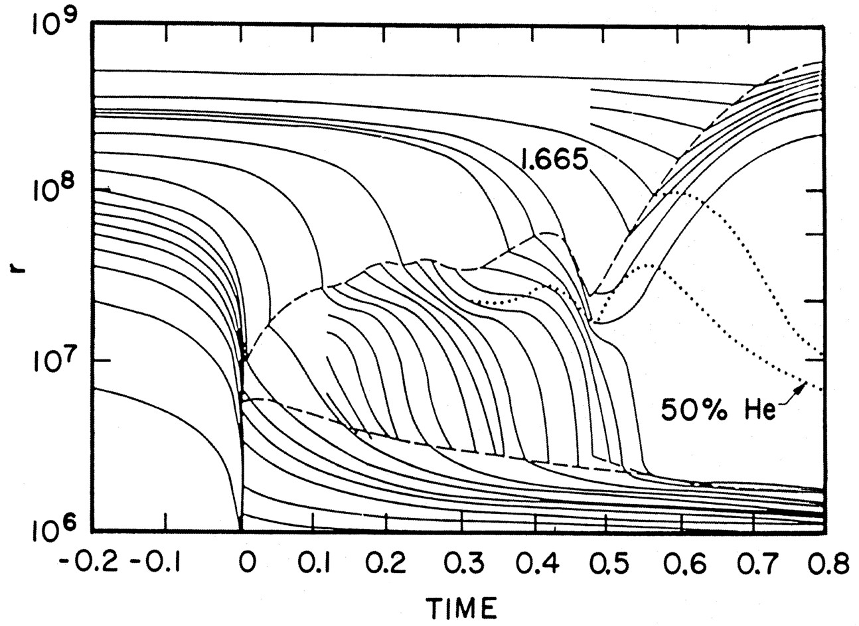
Delayed (Neutrino-Driven) Explosion
Infall
Accretion
Explosion
Shock
Wilson, Proc. Univ. Illinois Meeting on Num. Astrophys. (1982)
Bethe & Wilson, ApJ 295 (1985) 14

Slide 7
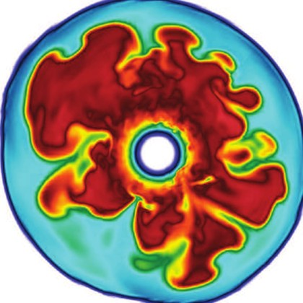
Shock Revival by Neutrinos
Stalled shock wave must
receive energy to start re-expansion against ram pressure of
infalling stellar core
Shock can receive
fresh energy from
neutrinos!
S
O
Si
ν
ν
PNS
ν
Shock
wave
Si
Supernova Neutrinos, ISAPP 2017, 13–24 June 2017
Georg Raffelt, MPI Physics, Munich

Slide 8
Neutrino-Driven Mechanism – Modern Version
• Stalled accretion shock pushed out
to ~150 km as matter piles up on the PNS
• Heating (gain) region develops within
some tens of ms after bounce
• Convective overturn & shock
oscillations (SASI) enhance efficiency
of ν-heating, finally revives shock
• Successful explosions in 1D and 2D
for different progenitor masses
• Details important (treatment of GR,
ν interaction rates, etc.)
• Self-consistent 3D studies are
performed, successful explosions
Shock oscillations
(SASI)
ν heating
Convection
ν cooling
Gain
radius
Shock
3D Model of Princeton Group:
https://youtu.be/i-Ly8aCoF7E
Adapted from B. Müller

Slide 9
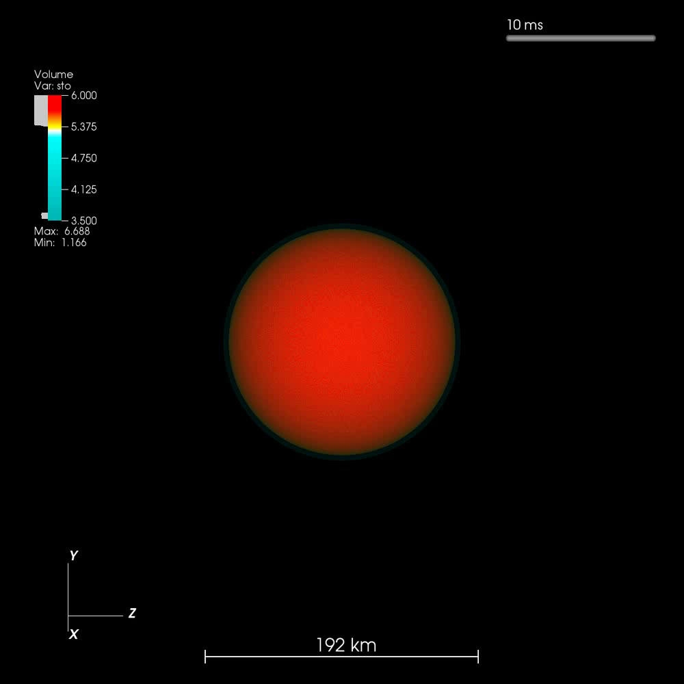
Exploding 3D Simulation (20 ${\text{M}}_{⊙}$ Garching Group)

Slide 10
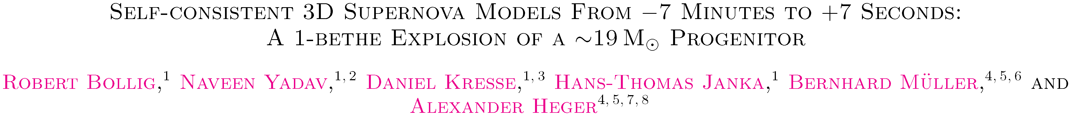
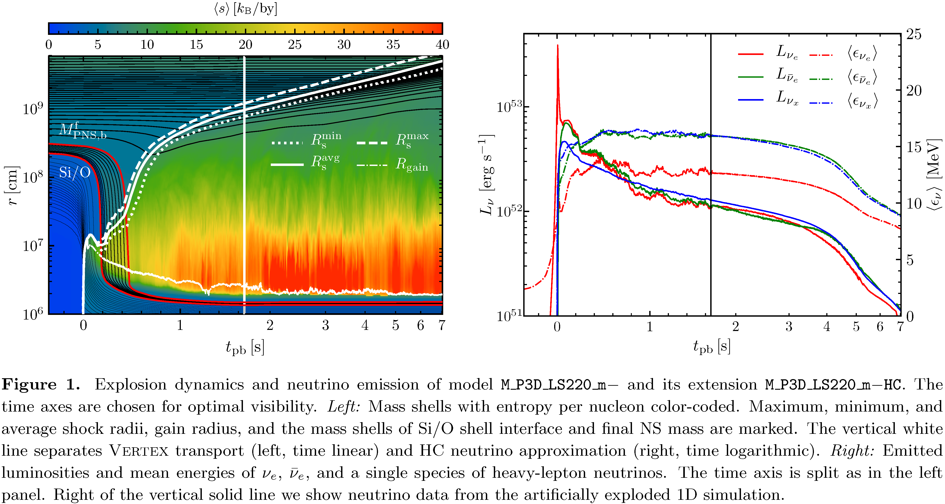
Successful 3D Explosion
ar
arXiv:2010.10506

Slide 11
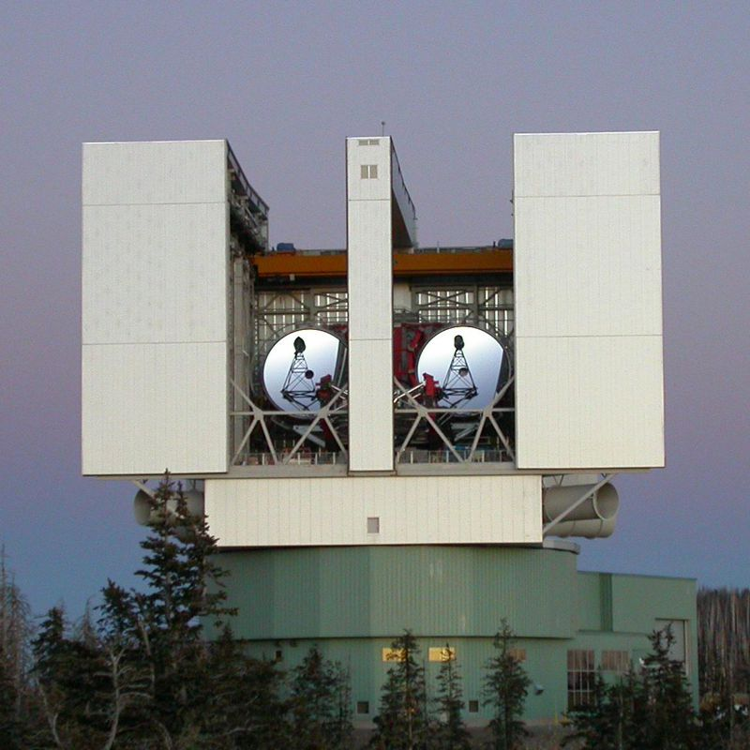
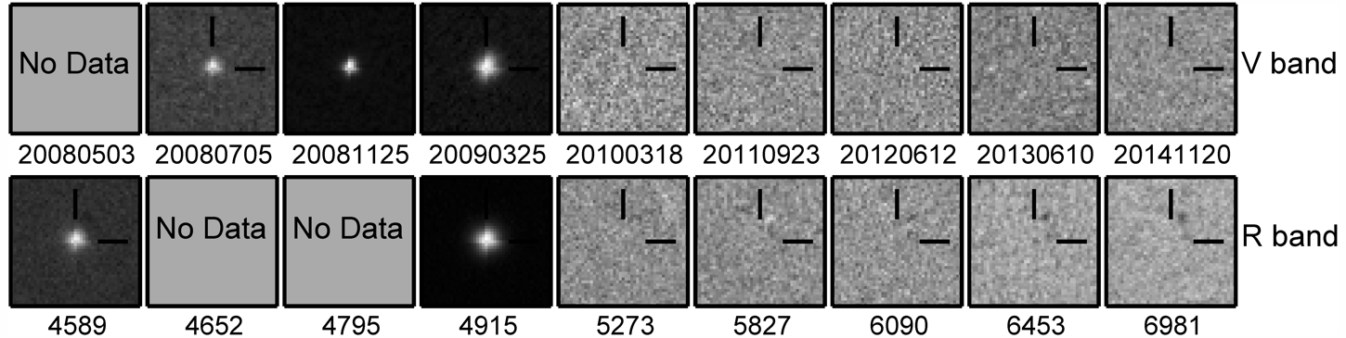
Death Watch of a Million Supergiants
• Monitoring 27 galaxies within 10 Mpc for many years
• Visit typically twice per year
• 10⁶ supergiants (lifetime 10⁶ years)
• Combined SN rate: about 1 per year
First 7 years of survey:
• 6 successful core-collapse SNe
• 1 candidate failed SN
Large Binocular Telescope
Mt Graham, Arizona
Gerke, Kochanek & Stanek, arXiv:1411.1761
Adams, Kochanek, Gerke, Stanek (& Dai), arXiv:1610.02402 (1609.01283)

Slide 12
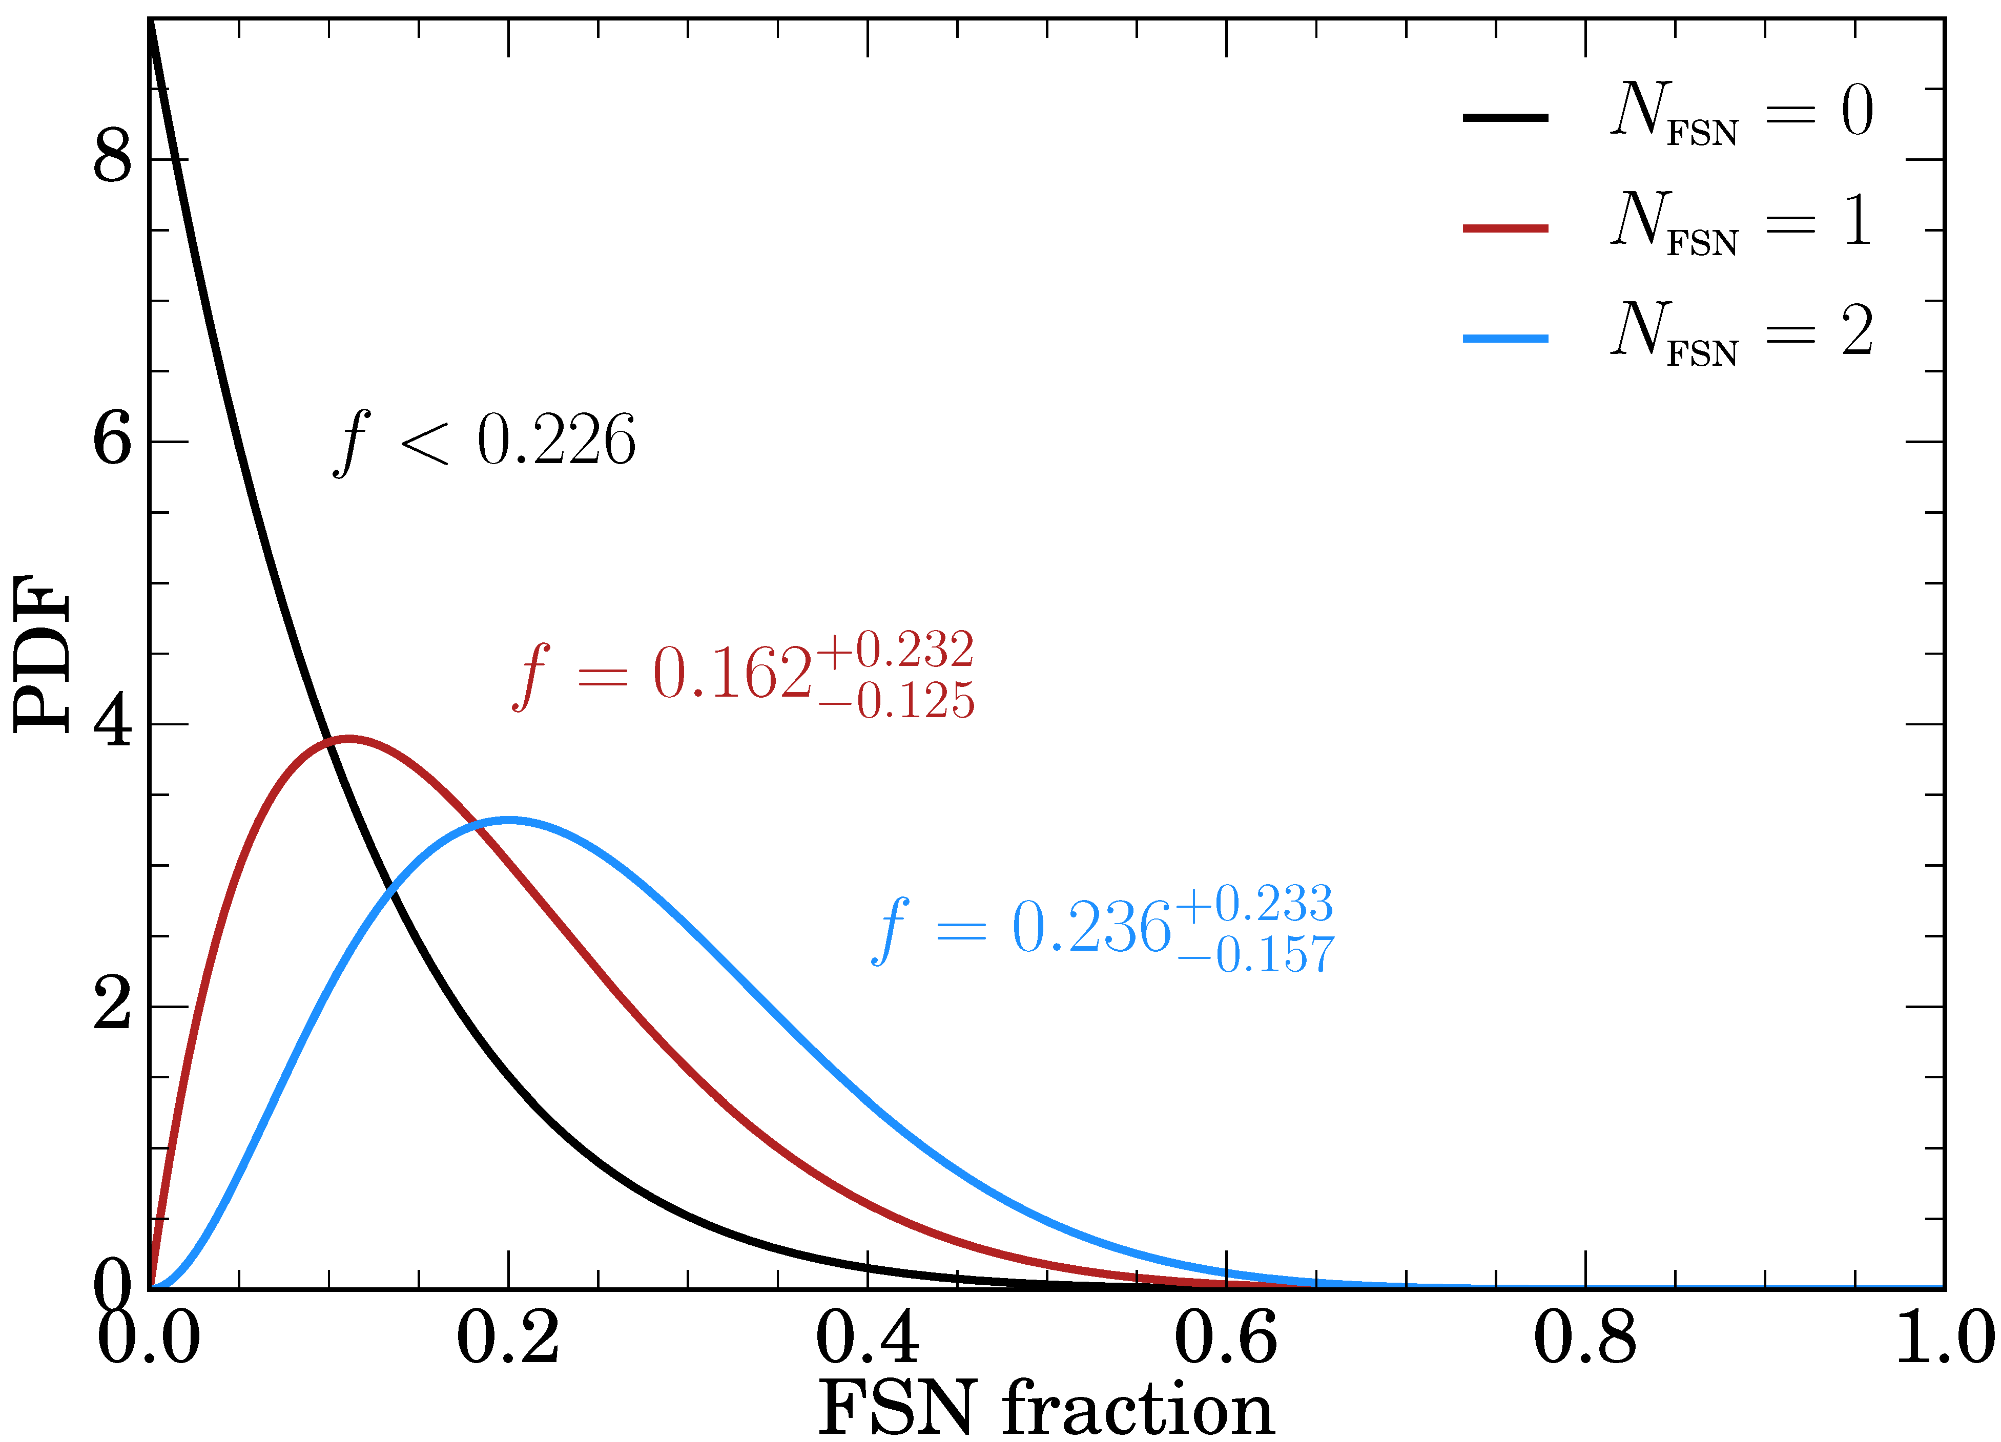
Empirical Fraction of Black-Hole Formation
2020 update: 11 yr baseline, 8 SNe, 1 old & 1 new candidate for failed SN
Neustadt, Kochanek, Stanek, et al., arXiv:2104.03318
Roughly a quarter of all core-collapses could lead to BH formation,
in agreement with theory estimates!

Slide 13
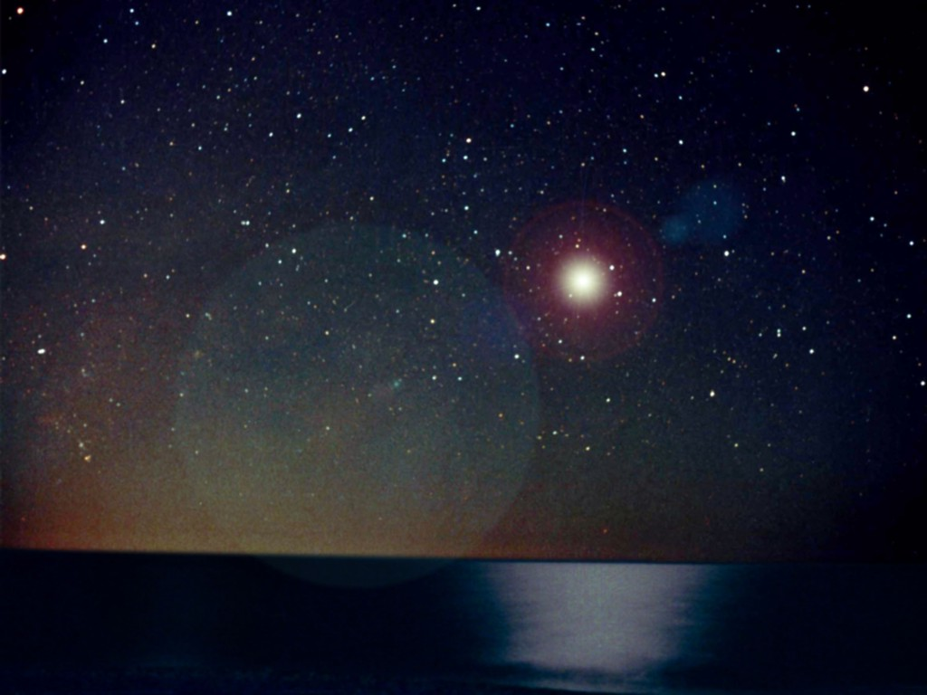
Characteristics of Neutrino Signal
Neutrino Transport

Slide 14
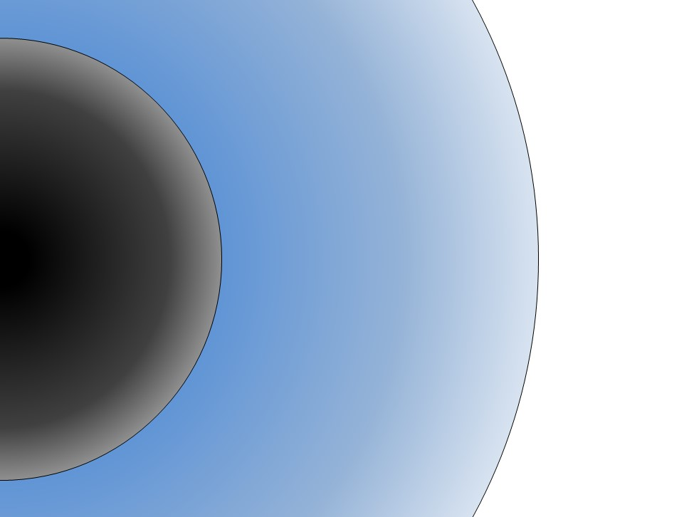

Roles of Different Particles
Radiative transfer
Short mean free
pass (mfp)
Photon
radiation
from surface
Neutrino diffusive
transport
Neutrino emission
from “neutrino sphere”
Thermal graviton
emission (large mfp)
R_{core} ~ few 10 km
R_{star} ~ 10⁹ km
Dark Matter & Neutrinos, Paris IHP, 5−9 May 2025
Georg Raffelt, MPI Physics, Garching

Slide 15
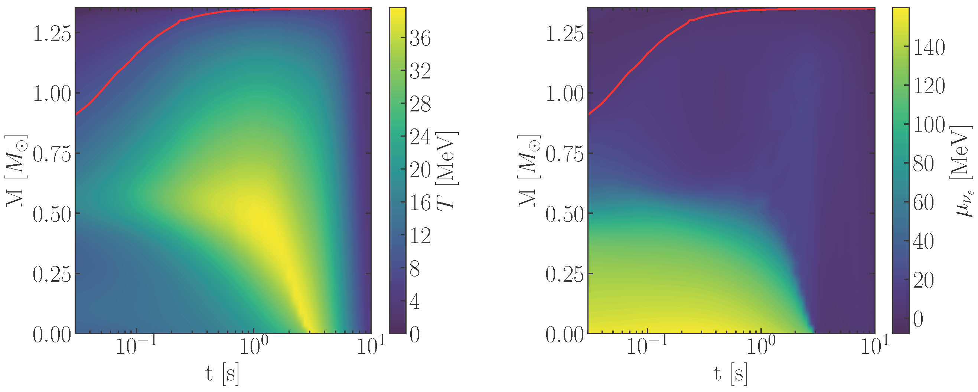


Inner Structure of a Typical Supernova Model
Temperature
$ν_{e}$ Chemical Potential
$$ρ={10}^{12}g/cc$$
SN core starts cold and heats up from outside in as in contracts and deleptonizes
Muonic SN model from Garching group, used in 2005.07141 and 2109.03244
Fiorillo, Raffelt & Vitagliano (arXiv:2209.11773)

Slide 16
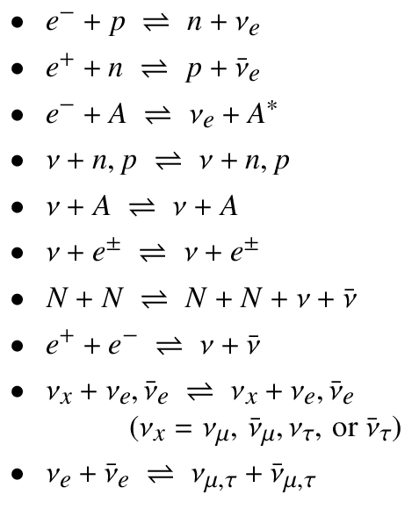
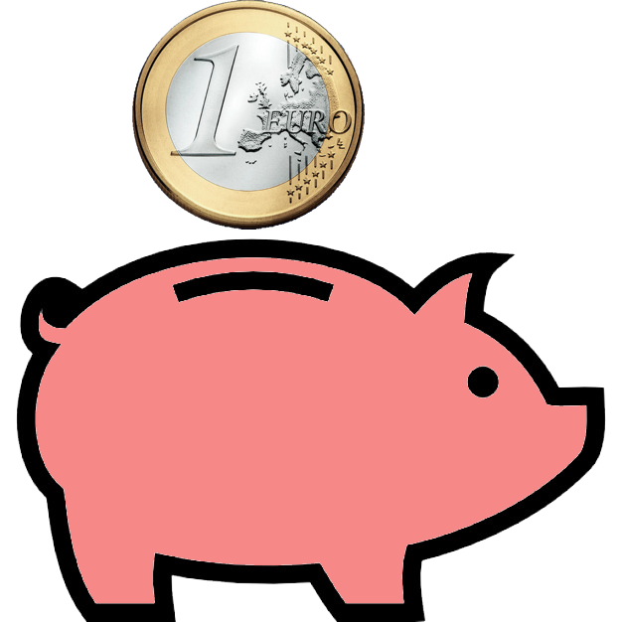

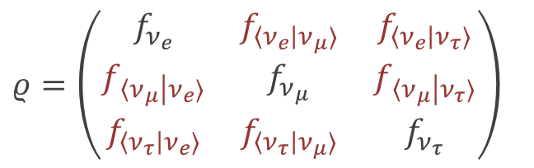

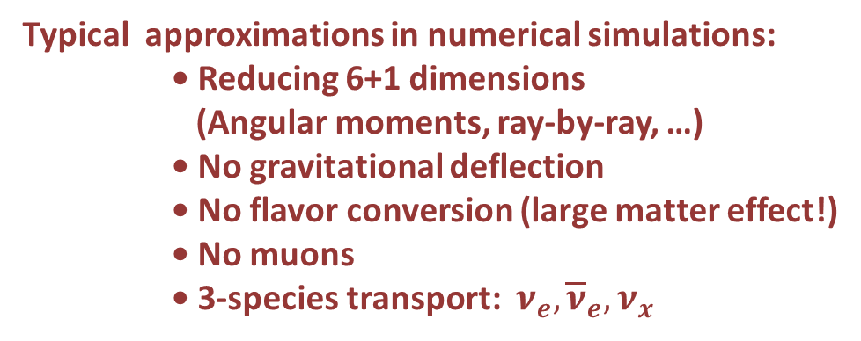



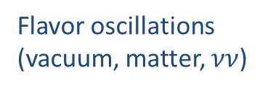
Kinetic Equation for Neutrino Transport
Flavor-dependent phase-space densities (occupation number matrices)
$$ρ=\left(\begin{matrix}f_{ν_{e}} & f_{〈ν_{e}|ν_{μ}〉} & f_{〈ν_{e}|ν_{τ}〉} \\ f_{〈ν_{μ}|ν_{e}〉} & f_{ν_{μ}} & f_{〈ν_{μ}|ν_{τ}〉} \\ f_{〈ν_{τ}|ν_{e}〉} & f_{〈ν_{τ}|ν_{μ}〉} & f_{ν_{τ}}\end{matrix}\right)$$
Diagonal: Usual occupation numbers
Off-diag: Flavor coherence information
and similar for $\overline{ν}$
Transport equation
$$\left(∂_{t}+\vec{v}⋅{\vec{∇}}_{x}−\vec{F}⋅{\vec{∇}}_{p}\right) ρ\left(t, \vec{x},\vec{p}\right)=−\text{i} \left[ℋ\left(t,\vec{x},\vec{p}\right),ρ\left(t,\vec{x},\vec{p}\right)\right]+𝒞\left[ρ\left(t,\vec{x},\vec{p}\right)\right]$$
Streaming
Gravitational forces
(redshift, deflection)
Flavor oscillations
(vacuum, matter, $νν$)
Collisions
β
Typical approximations in numerical simulations:
• Reducing 6+1 dimensions
(Angular moments, ray-by-ray, …)
• No gravitational deflection
• No flavor conversion (large matter effect!)
• No muons
• 3-species transport: $ν_{e}, {\overline{ν}}_{e}, ν_{x}$

Slide 17
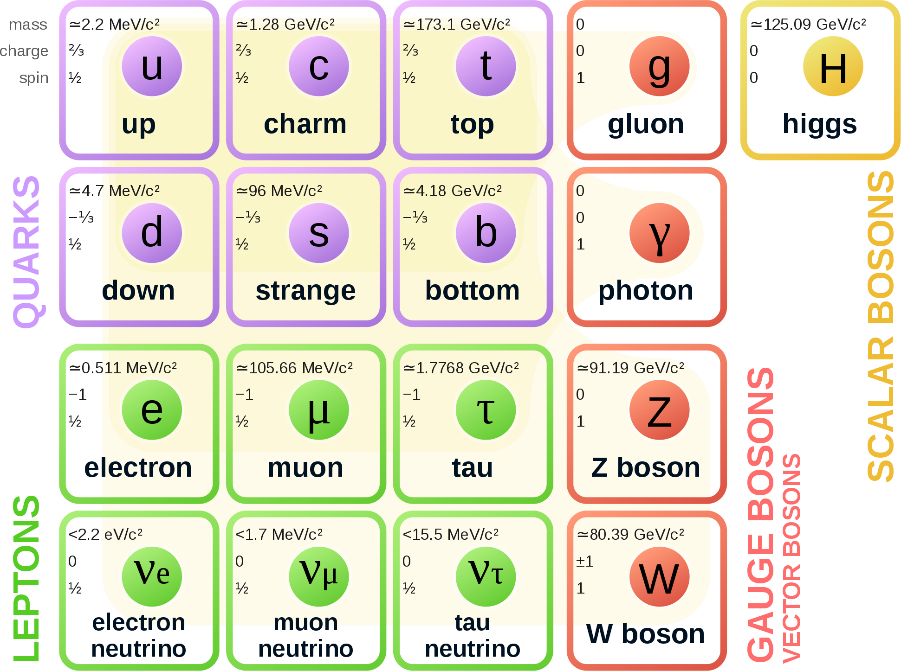
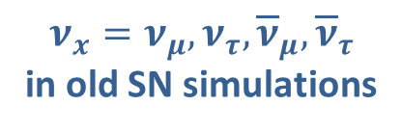
Second & Third Particle Generations in SN Physics
Hyperon Puzzle
• Strange hadrons should be present
• Incompatible with large NS masses
• Muons (mass 105.7 MeV) previously
ignored
• New standard to include muons
Early universe,
stellar collapse &
NS mergers naturally
involve all flavor
neutrinos
• Flavor conversion not
included in SN simulateons
• Six species new standard
Everyday physics and astrophysics
only first family of fermions
$$ν_{x}=ν_{μ}, ν_{τ}, {\overline{ν}}_{μ},{\overline{ν}}_{τ}$$
in old SN simulations

Slide 18
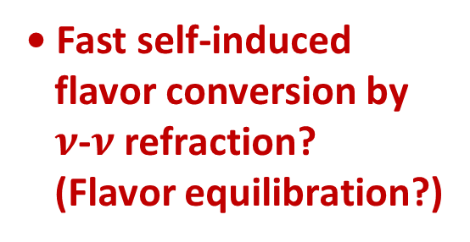
Flavor Conversion in Core-Collapse Supernovae
Next Generation Large-Scale Detectors (2020+)
MSW region
• Adiabatic flavor
conversion
• Flavor eigenstates are
propagation eigenstates
• Flavor oscillations suppressed
(Wolfenstein 1979)
• “Slow” self-induced
flavor conversion?
(Spectral splits …)
$$ν, \overline{ν}$$
Neutrino
sphere
• Fast self-induced
flavor conversion by
$ν$-$ν$ refraction?
(Flavor equilibration?)
Shock wave

Slide 19
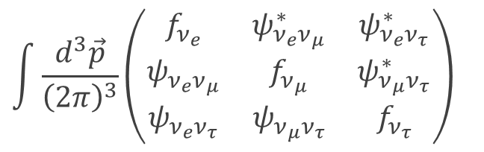
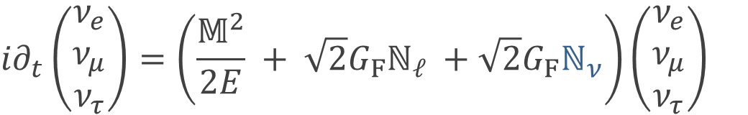
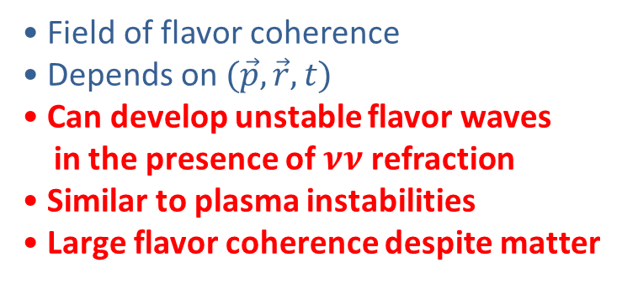
Collective Neutrino Flavor Conversion
Next Generation Large-Scale Detectors (2020+)
Mass
matrix
Charged
lepton
density
Neutrino
neutrino
refraction
$${i∂}_{t}\left(\begin{matrix}ν_{e} \\ ν_{μ} \\ ν_{τ}\end{matrix}\right)=\left(\frac{𝕄^{2}}{2E} + \sqrt{2}G_{F}ℕ_{ℓ} +\sqrt{2}G_{F}ℕ_{ν}\right)\left(\begin{matrix}ν_{e} \\ ν_{μ} \\ ν_{τ}\end{matrix}\right)$$
• Refractive back reaction of
neutrinos on each other in
neutrino-dense environments
(Pantaleone 1992)
• Active research field
ca 40 papers/year recently
$$\int{\frac{d^{3}\vec{p}}{{\left(2π\right)}^{3}}}\left(\begin{matrix}f_{ν_{e}} & ψ_{ν_{e}ν_{μ}}^{∗} & ψ_{ν_{e}ν_{τ}}^{∗} \\ ψ_{ν_{e}ν_{μ}} & f_{ν_{μ}} & ψ_{ν_{μ}ν_{τ}}^{∗} \\ ψ_{ν_{e}ν_{τ}} & ψ_{ν_{μ}ν_{τ}} & f_{ν_{τ}}\end{matrix}\right)$$
Occupation
number
• Field of flavor coherence
• Depends on $(\vec{p},\vec{r},t)$
• Can develop unstable flavor waves
in the presence of $νν$ refraction
• Similar to plasma instabilities
• Large flavor coherence despite matter

Slide 20
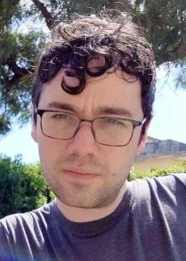
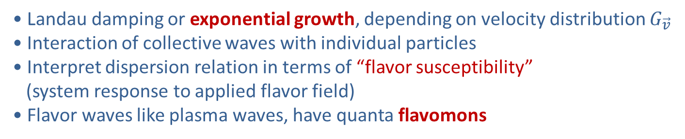

Fast flavor waves in analogy to plasma waves
Linear quantum kinetic equation for flavor coherence $ψ_{\vec{v}}(t,\vec{r})$
$\left(∂_{t}+\vec{v}⋅ {\vec{∇}}_{\vec{r}}\right)ψ_{\vec{v}}=−i\sqrt{2}G_{F}∫d{\vec{v}}^{′}\left(1−\vec{v}⋅{\vec{v}}^{′}\right)\left(G_{\vec{v}}ψ_{{\vec{v}}^{′}}−G_{{\vec{v}}^{′}}ψ_{\vec{v}}\right)$
Vlasov operator
Integral over velocity distribution
In Fourier space
$$\left(ω−\vec{v}⋅ \vec{k}\right)ψ_{\vec{v}}=…$$
Vanishes for Cherenkov condition:
Damiano Fiorillo
Flavor wave $\left(ω,\vec{k}\right)$ on resonance with some neutrinos: $\left(ω−\vec{v}⋅ \vec{k}\right)=0$
• Landau damping or exponential growth, depending on velocity distribution $G_{\vec{v}}$
• Interaction of collective waves with individual particles
• Interpret dispersion relation in terms of “flavor susceptibility”
(system response to applied flavor field)
• Flavor waves like plasma waves, have quanta flavomons
Fiorillo & Raffelt (2023–2024), long list of papers, eg arXiv:2406.06708

Slide 21
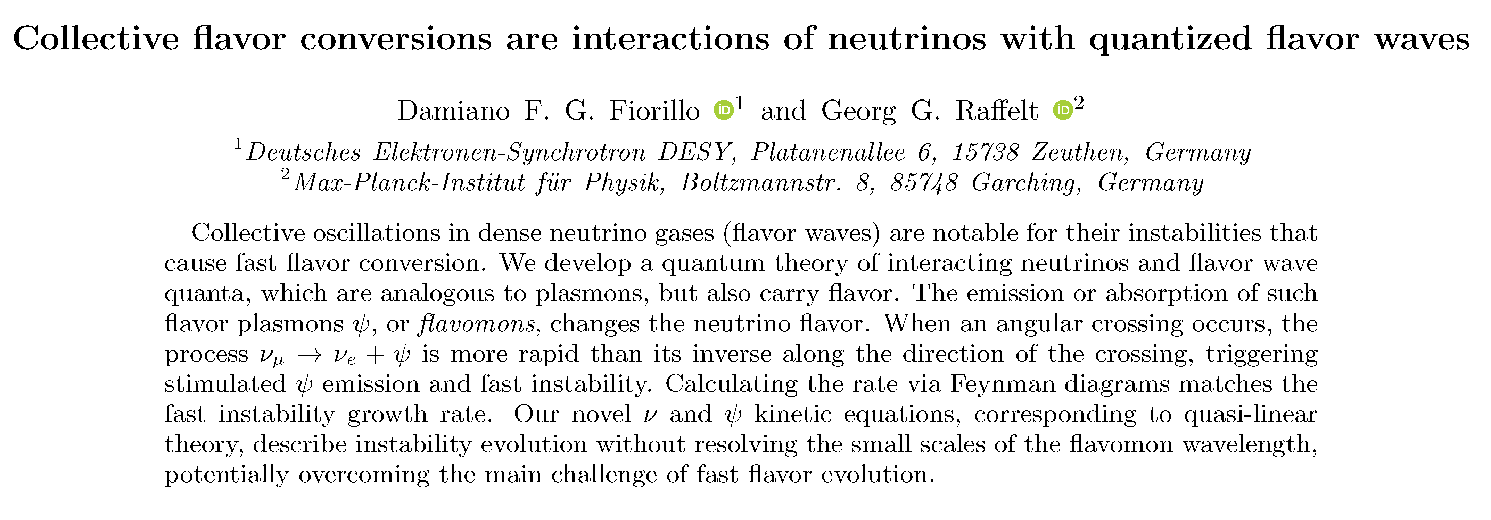
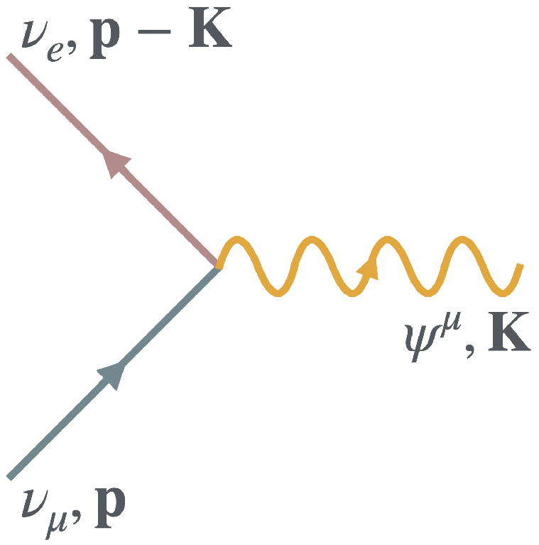
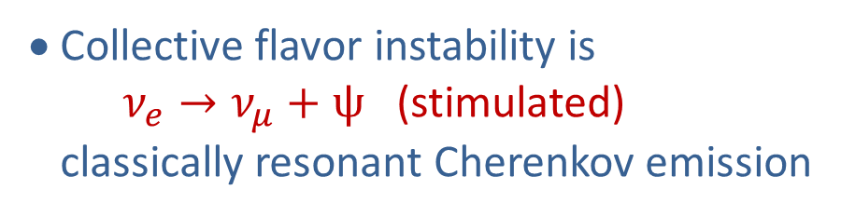
Flavomons
Next Generation Large-Scale Detectors (2020+)
arXiv:2502.06935
• Quanta of flavor waves (flavomons)
analogous to plasmons
• Collective flavor instability is
$ν_{e}→ν_{μ}+ψ$ (stimulated)
classically resonant Cherenkov emission
A new theoretical framework for collective flavor conversion.
Will it be practically useful?

Slide 22
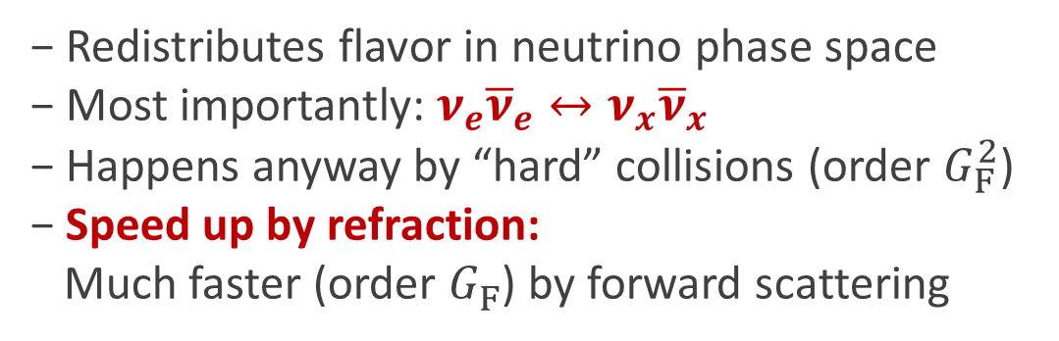
Pair-wise flavor conversion
Next Generation Large-Scale Detectors (2020+)
• True flavor conversion by neutrino masses
− Large mixing angle → large flavor conversion
− Suppressed by matter refraction
− Trapped electron lepton number remains conserved
• Collective flavor conversion
− Redistributes flavor in neutrino phase space
− Most importantly: $ν_{e}{\overline{ν}}_{e}↔ν_{x}{\overline{ν}}_{x}$
− Happens anyway by “hard” collisions (order $G_{F}^{2}$)
− Speed up by refraction:
Much faster (order $G_{F}^{ }$) by forward scattering
• Local equilibrium on “fast” timescales?
− Many recent studies,
fundamental, parametric or numerical

Slide 23
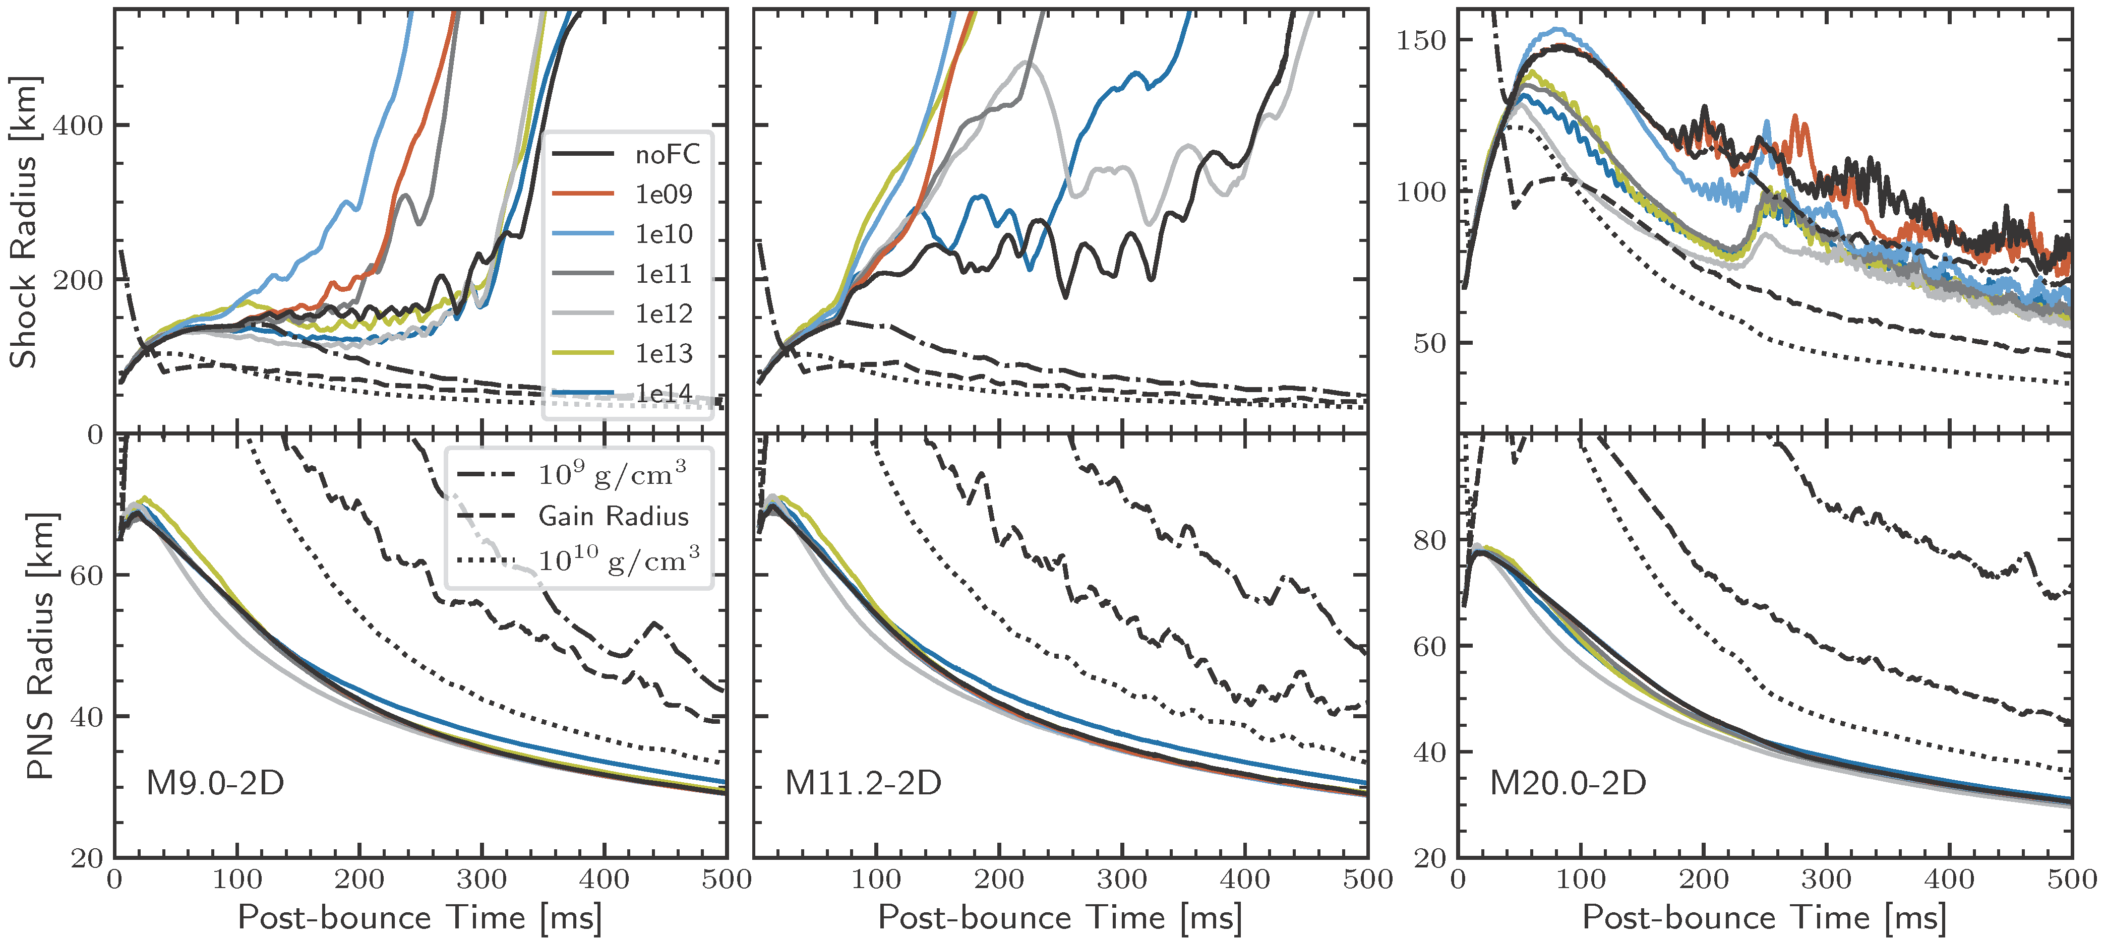
Fast Flavor Conversion – Help or Hinder Explosion
Explosion sets in earlier
Contraction faster
Ehring+, arXiv:2305.11207
See also Wang & Burrows, arXiv:2503.04896

Slide 24
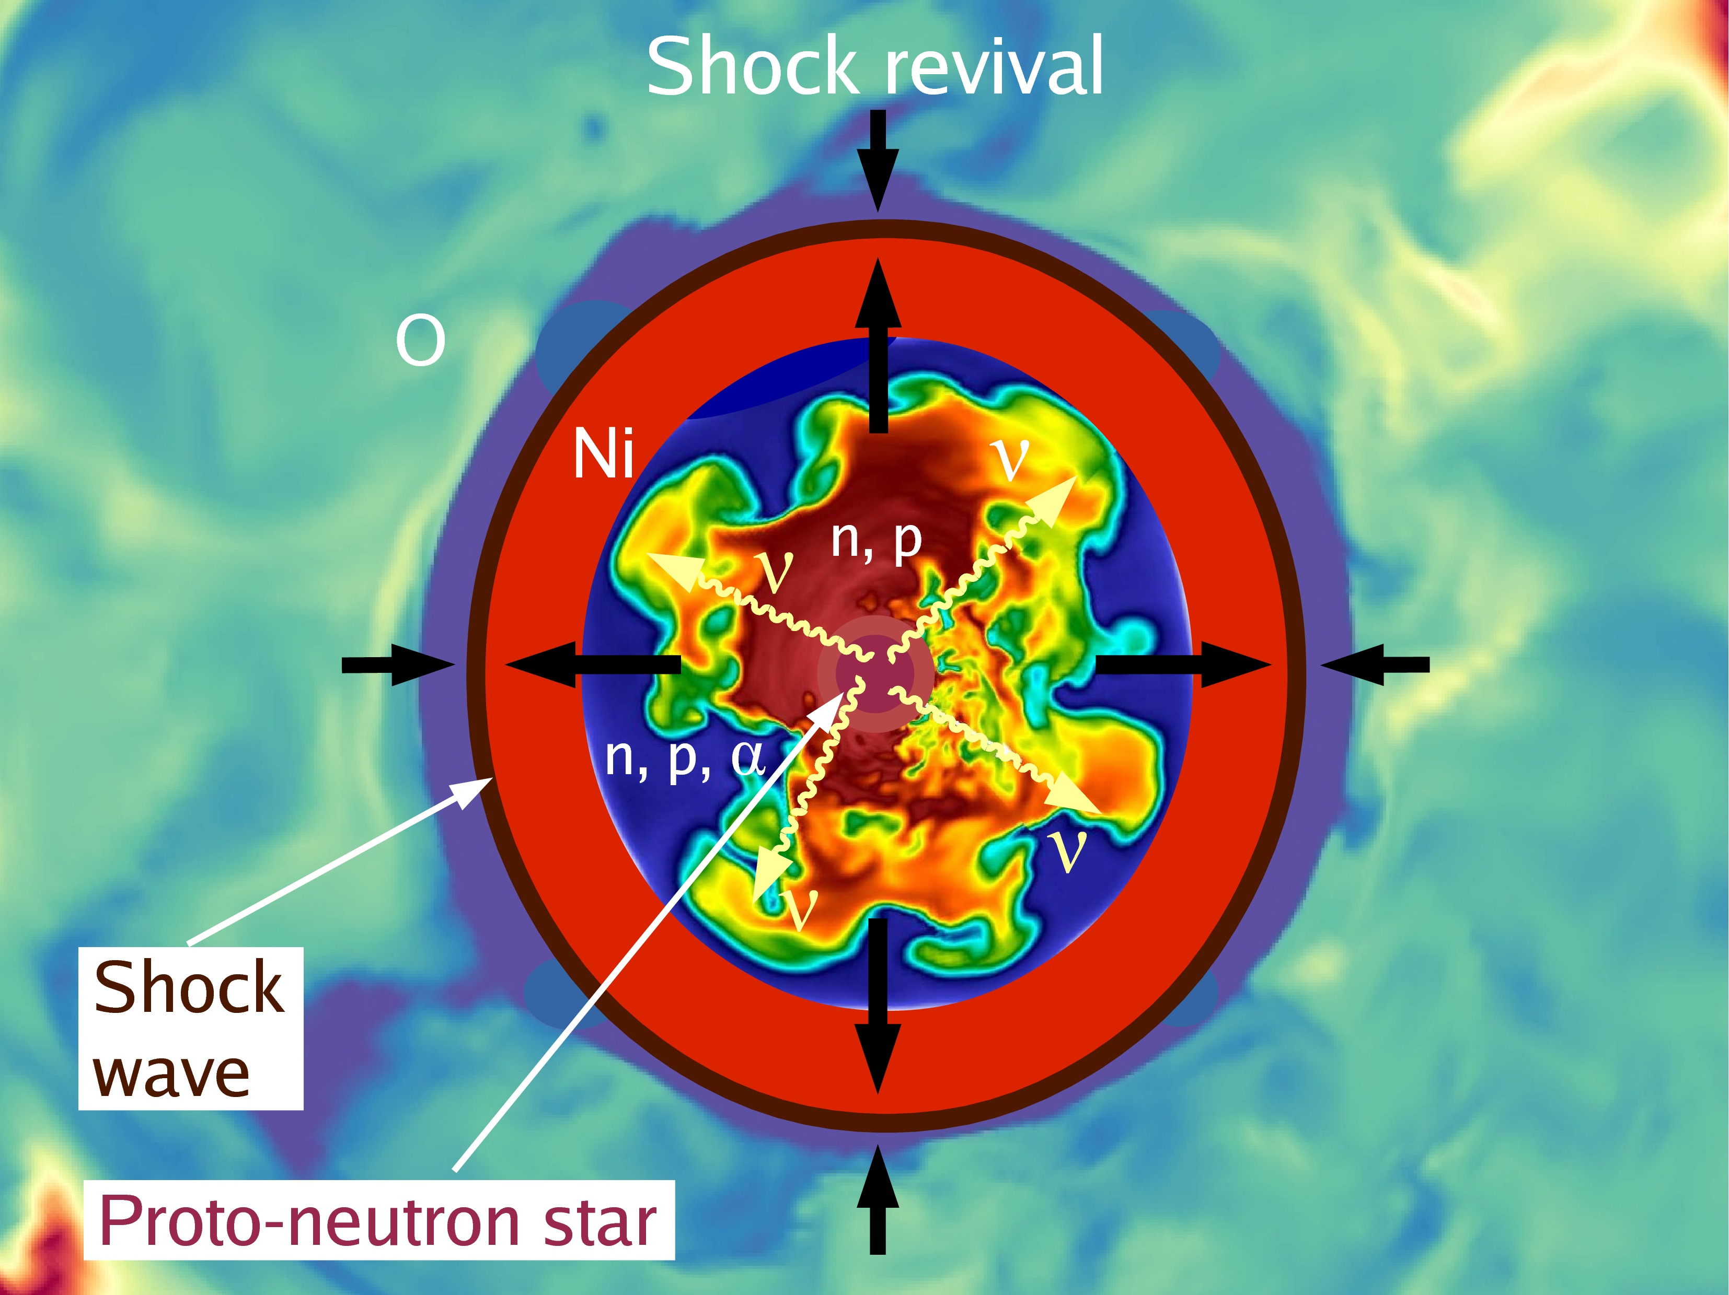

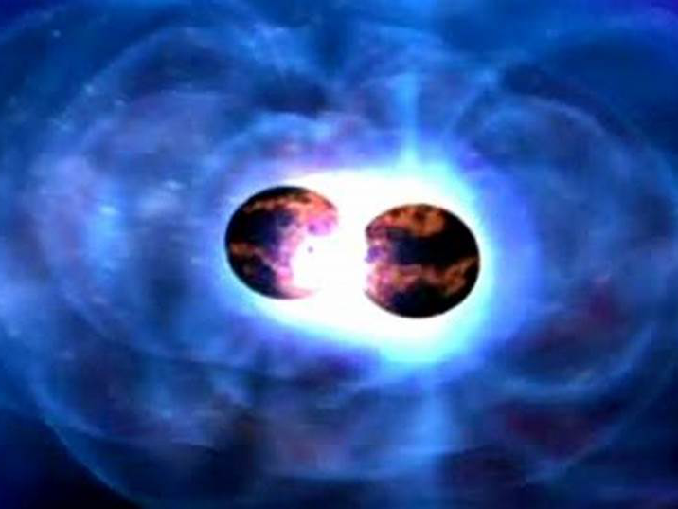
Why worry about detailed neutrino transport?
• Explosion mechanism:
Shock-wave revival by nu energy deposition
• Nucleosynthesis in neutrino irradiated
outflows in SNe and NS-mergers
depends on flavor (beta reactions!)
• Signal interpretation of DSNB and
next nearby SN
• Collective flavor conversion:
interesting theoretical problem
in its own right
• Theoretial frontier within standard physics
NS-NS binary merger

Slide 25
Characteristics of Neutrino Signal
Characteristics of Neutrino Signal

Slide 26
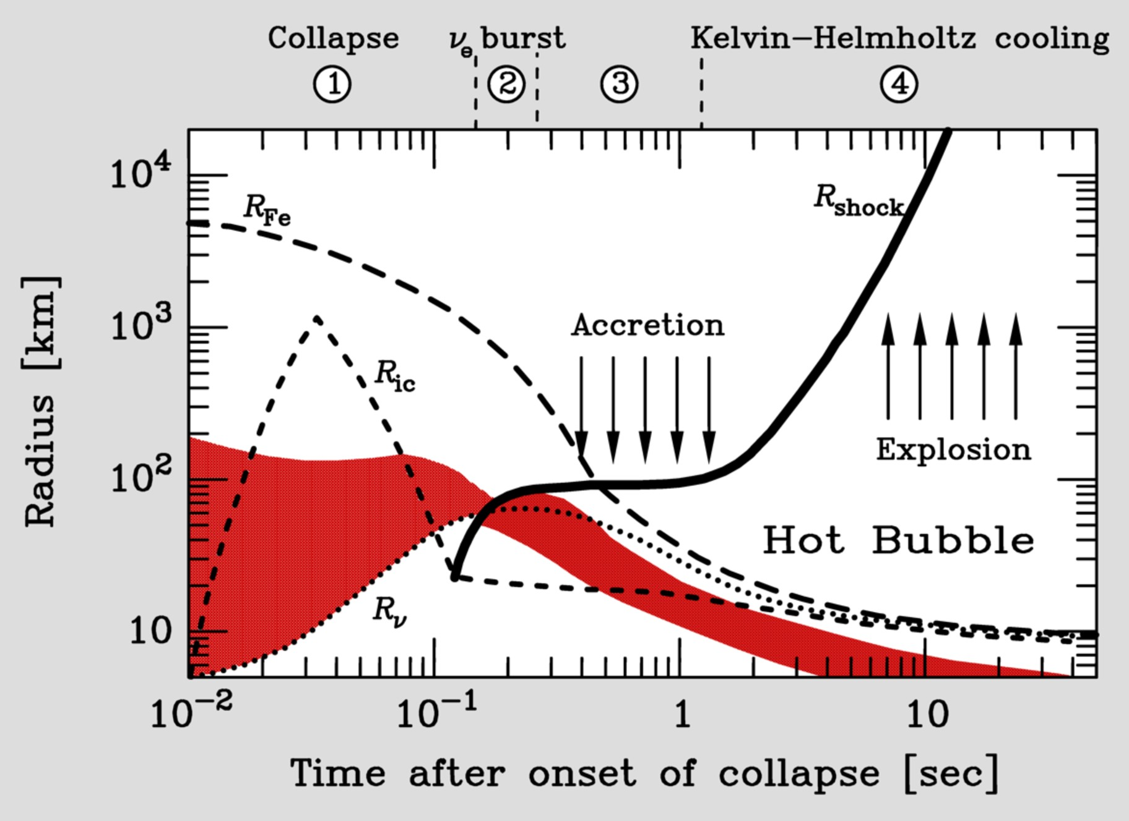
Supernova Delayed Explosion Scenario

Slide 27
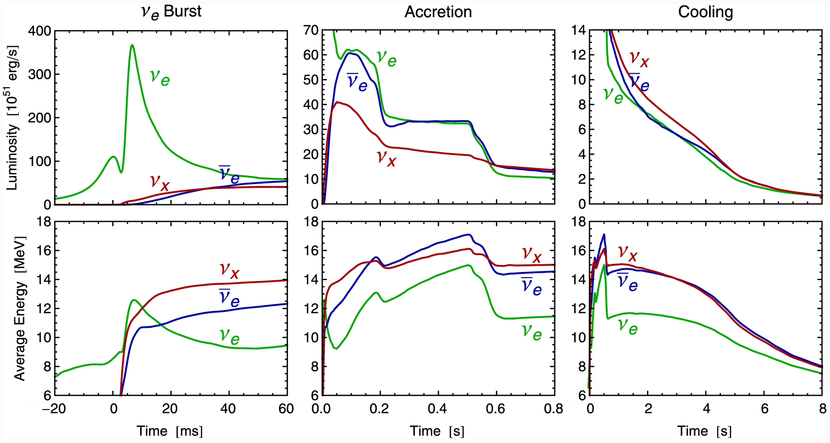
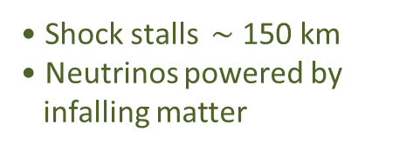
Three Phases of Neutrino Emission
Explosion
triggered
Cooling on neutrino
diffusion time scale
Shock breakout
De-leptonization of
outer core layers
Shock stalls $\sim$ 150 km
Neutrinos powered by
infalling matter
Spherically symmetric Garching model (25 M⊙) with Boltzmann neutrino transport

Slide 28
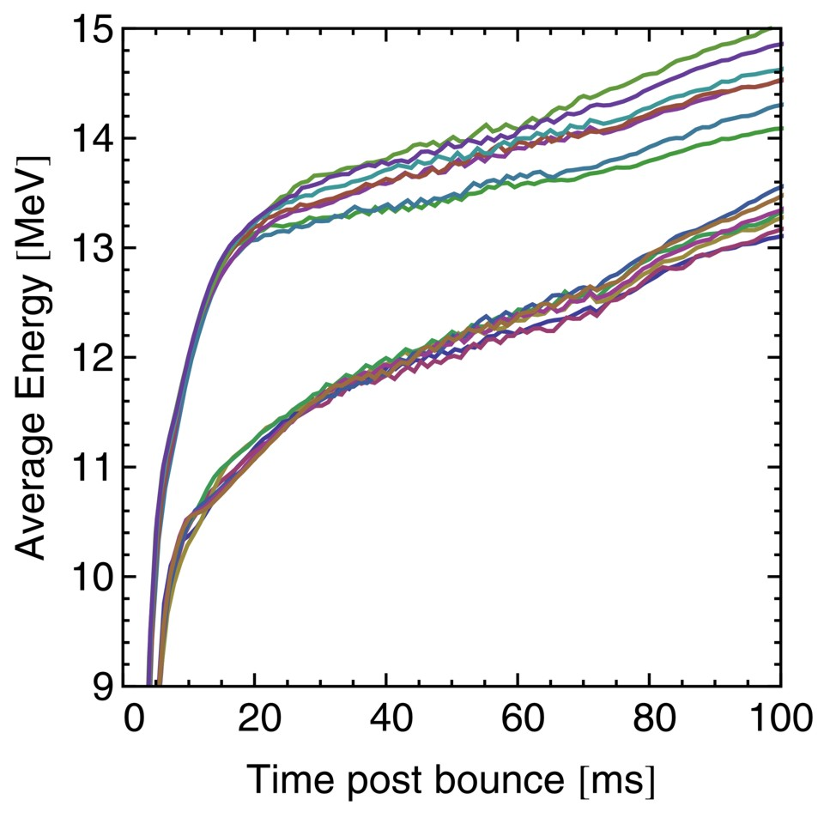
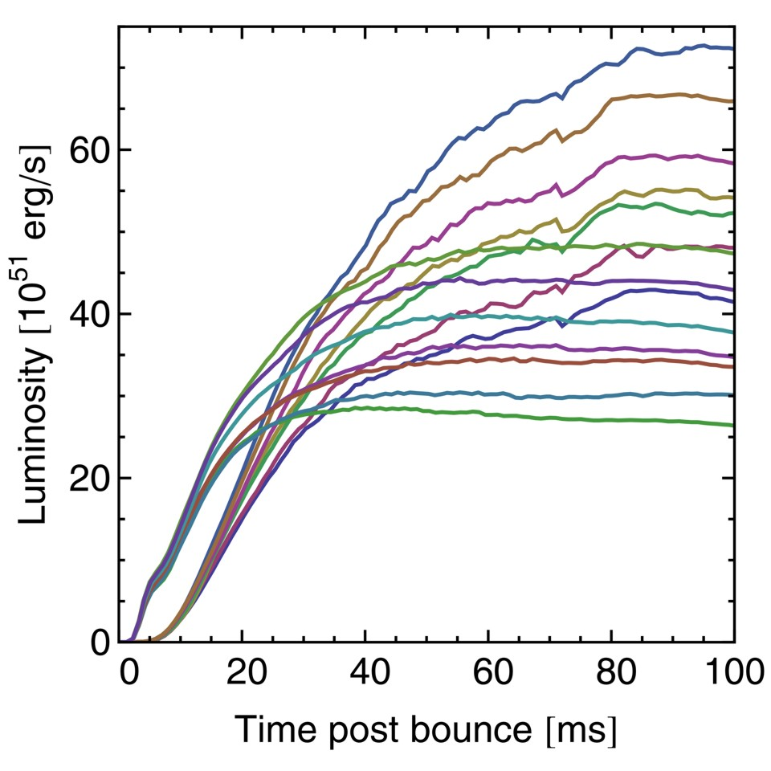
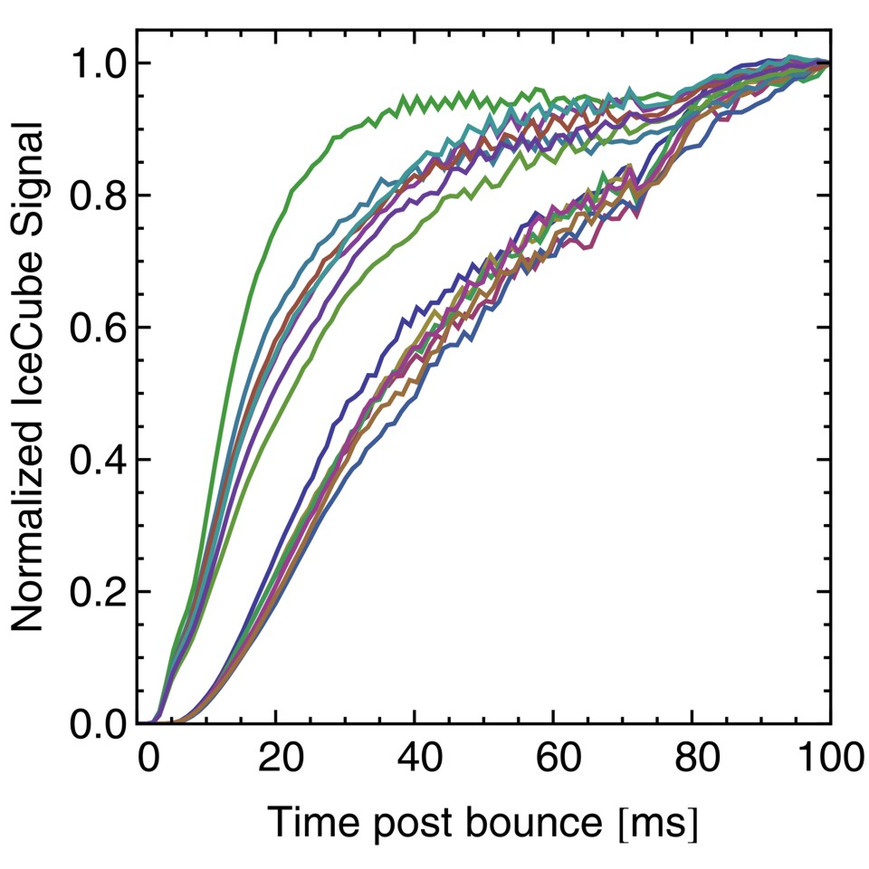






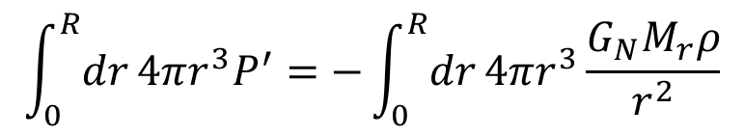
Early-Phase Signal in Anti-Neutrino Sector
Garching Models with M = 12–40 ${\text{M}}_{⊙}$
Average Energy
Luminosity
IceCube Signature
$${\overline{ν}}_{x}$$
$${\overline{ν}}_{x}$$
$${\overline{ν}}_{e}$$
$${\overline{ν}}_{e}$$
$${\overline{ν}}_{x}$$
$${\overline{ν}}_{e}$$
• In principle very sensitive to mass ordering, notably IceCube or HK
• “Standard candle” to be confirmed by other than Garching models
Abbasi et al. (IceCube Collaboration) A&A 535 (2011) A109
Serpico, Chakraborty, Fischer, Hüdepohl, Janka & Mirizzi, arXiv:1111.4483

Slide 29
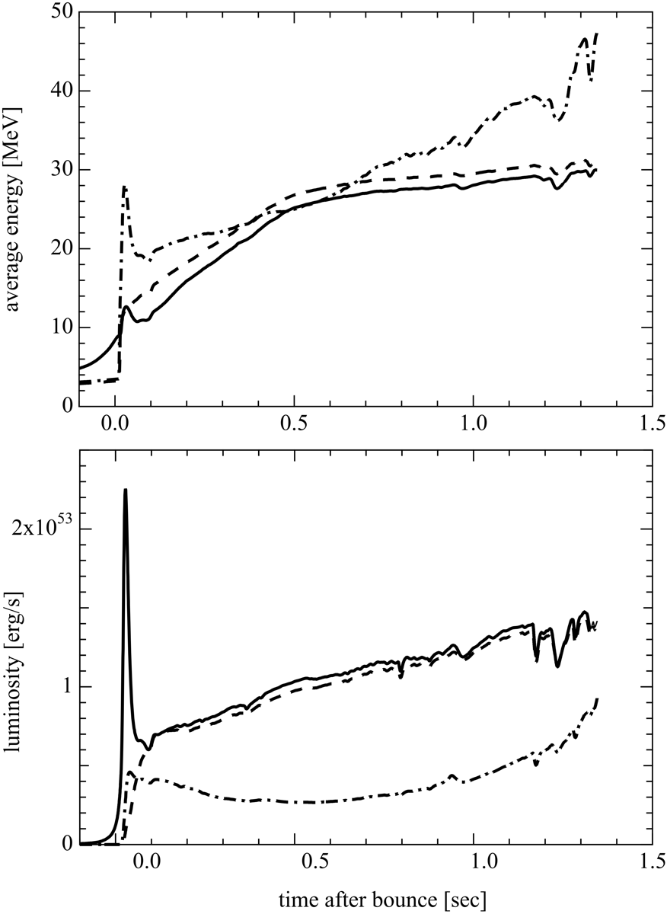
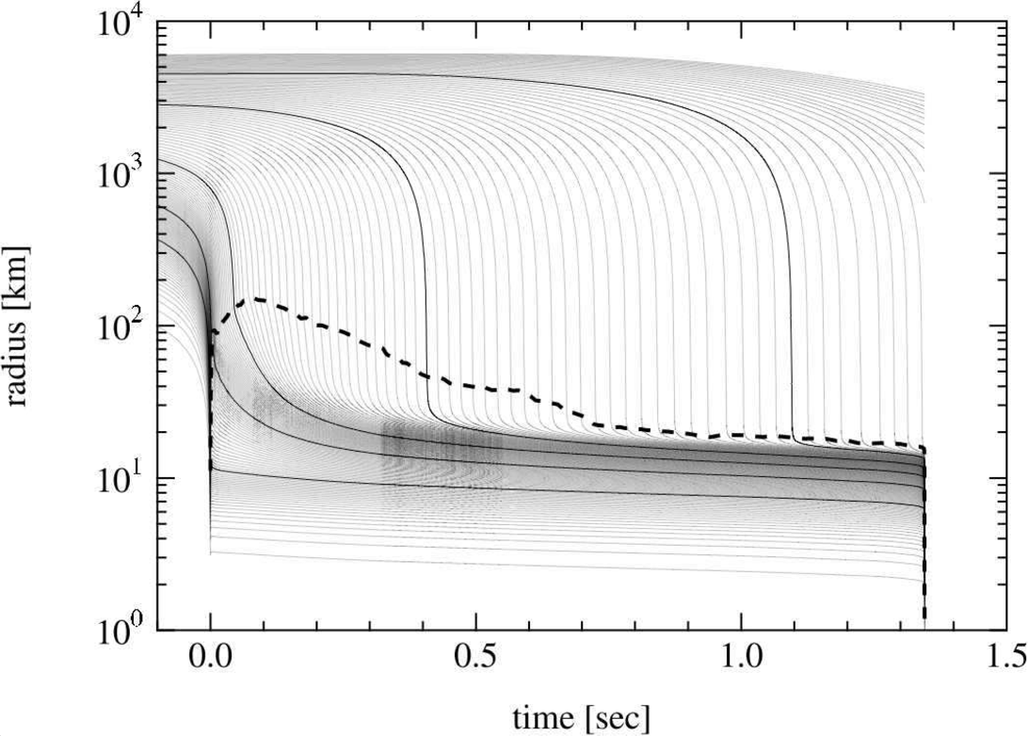
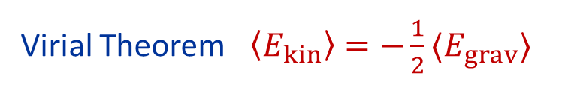
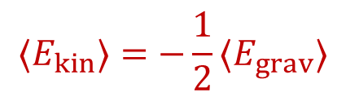
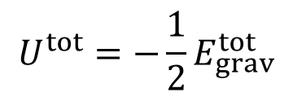
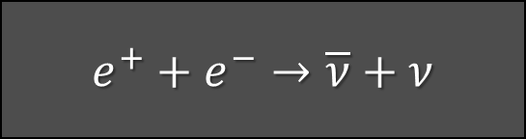


Neutrino Signal of a Failed Supernova (40 M_{SUN})
$$ν_{x}$$
$${\overline{ν}}_{e}$$
$$ν_{e}$$
Shock front
Prompt $ν_{e}$ burst
$$ν_{e}$$
Collapse to
black hole
$${\overline{ν}}_{e}$$
$$ν_{x}$$
Sumiyoshi, Yamada & Suzuki, arXiv:0706.3762

Slide 30
Neutrinos from Supernova 1987A
Neutrinos from Supernova 1987A

Slide 31




Sanduleak -69 202
Sanduleak −69 202
Supernova 1987A
23 February 1987
Tarantula Nebula
Large Magellanic Cloud
Distance 50 kpc
(160.000 light years)

Slide 32

Sanduleak before and after

Slide 33


Neutrino Signal of Supernova 1987A
Irvine-Michigan-Brookhaven (US)
Water Cherenkov detector
6800 tons
Clock uncertainty ±50 ms
Kamiokande-II (Japan)
Water Cherenkov detector
2140 tons
Clock uncertainty ±1 min
BKG
Baksan Scintillator Telescope
(Soviet Union), 200 tons (280 tons we)
Random event cluster $\sim$ 0.7/day
Clock uncertainty +2/−54 s
Liquid Scintillator Detector (Mont Blanc)
90 tons (126 tons we)
Minimal background
Clock uncertainty ±2 ms
Unexplaind burst few hours earlier
Fiorillo+, arXiv:2308.01403

Slide 34



Irvine-Michigan-Brookhaven (IMB) Detector
6800 m³
SN 1987A

Slide 35


SN 1987A Event No.9 in Kamiokande
Kamiokande-II Detector
(2140 tons of water)
Hirata et al., PRD 38 (1988) 448

Slide 36

Evolution of Water Cherenkov Detectors
Slide from
Mark Vagins

Slide 37

Continuing Interest in SN 1987A Neutrinos
• Hirata et al (Kamiokande-II), PRL 58 (1987) 1490
Observation of a neutrino burst from the supernova SN1987A
• Bionta et al (IMB), PRL 58 (1987) 1494, Observation of a Neutrino Burst
in Coincidence with Supernova 1987A in the Large Magellanic Cloud
Superluminal Nus
June
2024

Slide 38


Generic Time-Integrated Analysis
Assume quasi-thermal ${\overline{ν}}_{e}$flux (Maxwell-Boltzmann spectrum)
Distance 50 kpc
Likelihood fit with parameters
• Total emitted energy at source
• Average ${\overline{ν}}_{e}$ energy
Fiorillo, Heinlein, Janka, Raffelt, Vitagliano & Bollig, arXiv:2308.01403

Slide 39


Time-Integrated Analysis with Pinched Spectra
With late events
Without late events
Quasi-thermal spectrum (“pinched spectrum”)
$$f_{ν}\left(ϵ\right)∝\frac{ε^{α}}{{\overline{ε}}^{ 1+α}}e^{−{(1+α)}/{\overline{ε}}}$$
Average energy $〈ε〉=\overline{ε}$
Maxwell-Boltzmann spectrum for $α=2$
Fiorillo, Heinlein, Janka, Raffelt, Vitagliano & Bollig, arXiv:2308.01403

Slide 40
Particle-Physics Constraints
Particle-Physics Constraints

Slide 41





Neutrino Limits by Intrinsic Signal Dispersion
Time of flight delay by neutrino mass
“Milli charged” neutrinos
G. Zatsepin, JETP Lett. 8:205, 1968
Path bent by galactic magnetic field,
inducing a time delay
$$Δt=2.57\text{s} \frac{D}{50 kpc} {\left(\frac{10 MeV}{E_{ν}}\right)}^{2}{\left(\frac{m_{ν}}{10 eV}\right)}^{2}$$
$$\frac{Δt}{t}=\frac{e_{ν}^{2}{\left(B_{⊥}d_{B}\right)}^{2}}{6E_{ν}^{2}}<3×{10}^{−12}$$
SN 1987A signal duration implies
SN 1987A signal duration implies
$$m_{ν_{e}}≲20 \text{eV}$$
$$\frac{e_{ν}}{e}<3×{10}^{−17} \frac{1μG}{B_{⊥}} \frac{1 kpc}{d_{B}}$$
Loredo & Lamb
Ann N.Y. Acad. Sci. 571 (1989) 601
find 23 eV (95% CL limit) from detailed
maximum-likelihood analysis
Barbiellini & Cocconi,
Nature 329 (1987) 21
Bahcall, Neutrino Astrophysics (1989)
At the time of SN 1987A
competitive with tritium end-point
Today $m_{ν}<0.45 eV$from tritium
Cosmological limit today $m_{ν}≲0.1 \text{eV}$
Assuming charge conservation in
neutron decay yields a more
restrictive limit of about 3×10⁻²¹ e

Slide 42



Do Neutrinos Gravitate?
Early light curve of SN 1987A
Shapiro time delay for particles
moving in a gravitational potential
$Δt=−2\int_{A}^{B}{dt}Φ\left[r\left(t\right)\right]$
For trip from LMC to us, depending
on galactic model,
$Δt≈1$–5 months
Neutrinos and photons respond to
gravity the same to within
1–$4×{10}^{−3}$
Longo, PRL 60:173, 1988
Krauss & Tremaine, PRL 60:176, 1988
• Neutrinos arrived several hours
before photons as expected
• Transit time for $ν$ and $γ$ same
($160.000$ yr) within a few hours

Slide 43


GW vs Gamma-Ray Shapiro Time Delay
ApJ Lett. 848 (2017) L12
NS-NS Merger
• GW170817
• GRB 170817A
GWs & $γ$ arrive within 2 s
Equal Shapiro time delay
within $∼10^{−7}$
(Shoemaker & Murase
arXiv:1710.06427)

Slide 44

Impact of New Particles
Next Generation Large-Scale Detectors (2020+)
Progenitor Star
Energy and lepton transport
within PNS
PNS
Energy transport beyond neutrino sphere
(directly or decay products)
• Explosion
• Nucleosynthesis
Detection (direct or decay products)
• SN 1987A, next nearby SN
• Diffuse background from all past SNe

Slide 45

Supernova 1987A Energy-Loss Argument
SN 1987A neutrino signal
Neutrino
sphere
Volume emission
of new particles
Neutrino
diffusion
Emission of very weakly interacting
particles would “steal” energy from the
neutrino burst and shorten it.
(Early neutrino burst powered by accretion,
not sensitive to volume energy loss.)
Late-time signal most sensitive observable

Slide 46
Axion Emission from a Nuclear Medium
Axion-nucleon interaction: $ℒ_{int}=\frac{C_{N}}{2f_{a}} {\overline{Ψ}}_{N}γ_{μ}γ_{5}Ψ_{N}∂^{μ}a=\frac{C_{N}}{2f_{a}}J_{μ}^{A}∂_{a}^{μ}$
a
N
N
+ ...
Axial-vector interaction implies
dominance of spin-dependent process
V
N
N
Nucleon-Nucleon
Bremsstrahlung
• Interaction potential (one-pion exchange OPE often used, but too simplistic)
• In-medium coupling constants
• In-medium effective nucleon properties
• Correlation effects (static and dynamical spin-spin correlations)
→ For latest discussion see Carenza et al. arXiv:1906.11844
Thermal $π^{−}$ contribute significant (dominant?)
$$π^{−}$$
a
p
n
→ For latest discussion see Carenza et al. arXiv:2010.02943

Slide 47




SN 1987A Axion Limits from Burst Duration
• Raffelt, Lect. Notes Phys. 741 (2008) 51 hep-ph/0611350
Burst duration calibrated by early numerical studies
“Generic” emission rates inspired by OPE rates
$f_{a}≳4×{10}^{8} GeV$ and $m_{a}≲16 meV$ (KSVZ, based on proton coupling)
• Chang, Essig & McDermott, JHEP 1809 (2018) 051 1803.00993
Various correction factors to emission rates, specific SN core models
$f_{a}≳1×{10}^{8} GeV$ and $m_{a}≲60 meV$ (KSVZ, based on proton coupling)
• Carenza, Fischer, Giannotti, Guo, Martínez-Pinedo & Mirizzi,
JCAP 10 (2019) 016 & Erratum 1906.11844
Beyond OPE emission rates, specific SN core models: similar to Chang et al.
$f_{a}≳4×{10}^{8} GeV$ and $m_{a}≲15 meV$ (KSVZ, based on proton coupling)
• Carenza, Fore, Giannotti, Mirizzi & Reddy 2010.02943
Including thermal pions $π^{−}+p→n+a$ (factor 3 larger emission)
$f_{a}≳5×{10}^{8} GeV$ and $m_{a}≲11 meV$ (KSVZ, based on proton coupling)
• Bar, Blum & D'Amico, Is there a supernova bound on axions? 1907.05020
Alternative picture of SN explosion (thermonuclear event)
Observed signal not PNS cooling. SN1987A neutron star (or pulsar) not yet found.
(but see “NS 1987A in SN 1987A”, Page et al. arXiv:2004.06078)

Slide 48


Where is the Neutron Star of SN 1987A?
No pulsar or neutron star has been seen until now (35 years later)
• Infra-red excess observed by ALMA: In “the blob” strong indication for NS
Expected position, remnant hidden by dust [Cigan+ arXiv:1910.02960]
• Most plausible model: Thermally cooling non-pulsar NS [Page+ arXiv:2004.06078]
https://www.bbc.com/news/science-environment-50473482
Atacama Large Millimeter/Submillimeter Array (ALMA) at ESO in Chile
1.5×10¹² km

Slide 49

SN 1987A Signal Duration Too Long?
Fiorillo+ arXiv:2308.01403
Expected Signal & BKG
Expected Signal & BKG
Expected Signal & BKG
● In a suite of Garching models (no axions), expected signal always too short
(PNS convection!)
● Deserves dedicated study

Slide 50



Cooling Simulations of Five Neutron Stars
Cooling of J1605 with KSVZ axions,
BSk22 EOS, SBF-0-0 superfluidity
model, $M_{NS} = 1.0 M_{⊙}$
Upper Limit on the QCD Axion Mass from Isolated Neutron Star Cooling
Buschmann, Dessert, Foster, Long & Safdi, 2111.09892

Slide 51

Astrophysical Axion Bounds
The 2024 Edition, Caputo & Raffelt, arXiv:2401.13728, 24 Jan 2024
• Many improvements over the years, but overall picture the same
• Specific QCD axion signatures hard to expect from cooling effects
• Best stellar detection opportunity probably (Baby)IAXO

Slide 52


Astrophysical Axion Bounds and Opportunities
m_{Planck}
f_{a}
10¹⁸
10¹⁵
10¹²
10⁹
10⁶
GeV
peV
neV
μeV
meV
eV
m_{a}
Super
Radiance
Opportunities for detection
Astrophysical Bounds
(Energy loss of stars)
Black
Hole
IAXO Solar
Axion Telescope
Axion conversion in neutron star magnetospheres

Slide 53




Supernova Bounds on Radiative Particle Decays
Adds to
Explosion
energy
Collapsed
SN core
Cosmic gamma ray background
from all past supernovae
Solar Maximum Mission
Progenitor
mantle
No excess gamma rays
@ SN 1987A neutrino burst

Slide 54


Gamma-Ray Observations of SMM Satellite
Counts in the GRS instrument on the Solar Maximum Mission Satellite
10 s fluence limit 0.9 cm⁻²
SN 1987A
0.4 cm⁻²
0.6 cm⁻²
SN 1987A neutrino fluence $∼{10}^{10}{\text{cm}}^{−2}$
$<{10}^{−10}$ of neutrinos have decayed to photons on their way to Earth

Slide 55




Low-Energy Supernovae
Next Generation Large-Scale Detectors (2020+)
arXiv:2201.09890 (24 Jan 2022)
Production of
axion-like particles
$$G_{aγγ}$$
ALP decay
Typical SN explosion energy 1–2 B
Some SNe have very small observed
explosion energies < 0.1 B
(e.g. subluminous type II-P SNe)
Restrictive limits on energy deposition
in progenitor star by particle decays!
1 B (bethe) = 10⁵¹ erg
Neutron-star binding energy 200–400 B
(0.11–0.22 M_{SUN})

Slide 56
Neutrinos from Next Nearby SN
Neutrinos from Next Nearby SN

Slide 57

Operational Detectors for Next Galactic SN Neutrinos
HALO (30)
SNO+ (300)
ORCA (100)
LVD (300)
Baksan
(100)
Super-K (4000)
KamLAND (300)
NovA
(4000 + BKG)
MicroBooNE
(17 ν_{e})
+ Other small
detectors
with some
SN sensitivity
In brackets events
for a “fiducial SN”
at distance 10 kpc
IceCube (10⁶)

Slide 58


IceCube Neutrino Telescope at the South Pole
Digital
Optical
Module

Slide 59



IceCube as a Supernova Neutrino Detector
SN signal at 10 kpc
10.8 M_{sun} simulation
of Basel group
[arXiv:0908.1871]
Accretion
Cooling
• Each optical module (OM) picks up Cherenkov light from its neighborhood
• $\sim$ 300 Cherenkov photons per OM from SN at 10 kpc, bkgd rate in one OM < 300 Hz
• SN appears as “correlated noise” in $\sim$ 5000 OMs
• Significant energy information from time-correlated hits
Pryor, Roos & Webster, ApJ 329:355, 1988. Halzen, Jacobsen & Zas, astro-ph/9512080.
Demirörs, Ribordy & Salathe, arXiv:1106.1937.

Slide 60



SASI Detection Perspectives
Neutrino signal variations from hydro instabilities detectable!
Neutrino mass time of flight sensitivity
if observing these modulations
$m_{ν}≲0.14 eV$
arXiv:1202.0248
Optimistic observer direction
E.g. Lund+ arXiv:1006.1889
Tamborra+ arXiv:1307.7936
Walk+ arXiv:1807.02366
Pessimistic observer direction
Includes
shot noise

Slide 61

SuperNova Early Warning System (SNEWS)
Super-K
Kamland
KM3NeT
Coincidence
Server
Alert
HALO
SNO+
No𝜈a
https://snews2.org/
IceCube
Others?
• Neutrinos arrive several hours before optical outburst
• Issue an alert to astronomical community
• Trigger to LIGO, NOvA, GCN

Slide 62





Next Generation Very-Large-Scale Detectors (2025+)
IceCube Gen-2
- Dense infill (PINGU)
- Larger volume (statistics for high-E events)
Doubling the number of optical modules
Megaton-class water Cherenkov detector
Hyper-Kamiokande (260 kt), under construction
SN nu statistics comparable to IceCube,
but with event-by-event energy information
Scintillator detectors (20 kiloton scale)
- JUNO in China for reactor nus (commissioning 2025)
- Jinping Liquid Scintillator Detector (4 kt, early studies)
- Baksan Large Volume Scintillator Detector (10 kt)
(Russia, early studies)
Liquid argon time projection chamber (>2028)
For long-baseline oscillation experiment DUNE
- Unique SN capabilities (CC $ν_{e}$ signal)
- But cross sections poorly known

Slide 63



Xenon Dark Matter Detectors
• Coherent scattering of low-E
nus on Xe (77 neutrons)
• All 6 nu species contribute
Pinning down SN neutrino
flux and average energy
See for example
Horowitz et al. (astro-ph/0302071)
Chakraborty et al. (arXiv:1309.4492)
XMASS Collaboration (arXiv:1604.01218)
Lang et al. (arXiv:1606.09243)

Slide 64

Local Group of Galaxies
With Hyper-K (5 x SK)
few events from Andromeda
Current and most next-generation
neutrino detectors
sensitive out to few 100 kpc

Slide 65
Core-Collapse SN Rate in the Milky Way
SN statistics in
external galaxies
van den Bergh & McClure (1994)
Cappellaro & Turatto (2000)
Gamma rays from
²⁶Al (Milky Way)
Diehl et al. (2006)
Historical galactic
SNe (all types)
Core collapse only
Strom (1994)
Tammann et al. (1994)
Adams et al. (2013)
No galactic
neutrino burst
90 % CL (37 years)
Alekseev et al. (1993)
and updates
0
1
2
3
4
5
6
7
8
9
10
Core-collapse SNe per century
van den Bergh & McClure, ApJ 425 (1994) 205. Cappellaro & Turatto, astro-ph/0012455.
Diehl et al., Nature 439 (2006) 45. Strom, A&A 288 (1994) L1.
Tammann et al., ApJ 92 (1994) 487. Adams et al., ApJ 778 (2013) 164.
Alekseev et al., JETP 77 (1993) 339.

Slide 66

The Red Supergiant Betelgeuse (Alpha Orionis)
First resolved
image of a star
other than Sun
Distance
(Hipparcos)
130 pc (425 lyr)
If Betelgeuse goes Supernova:
6 ×10⁷ neutrino events in Super-Kamiokande
2.4 ×10³ neutrons /day from Si burning phase
(few days warning!), need neutron tagging
[Odrzywolek, Misiaszek & Kutschera, astro-ph/0311012]

Slide 67


Five Phases – Many Physics Opportunities
Li, Roberts & Beacom [arXiv:2008.04340]

Slide 68
Looking forward to the next galactic supernova
Many large detectors online for next decades
Every year a 3% chance
I am optimistic to see more supernova neutrinos!

Slide 69
Thanks

Slide 70
Diffuse SN Neutrino Background
Diffuse SN Neutrino Background

Slide 71

Three Detection Regimes

Slide 72



Diffuse Supernova Neutrino Background (DSNB)
• A few core collapses/sec
in the visible universe
• Emitted $ν$ energy density
∼ extra galactic background light
∼ 10% of CMB density
• Detectable ${\overline{ν}}_{e}$ flux at Earth
$∼10 {\text{cm}}^{−2} {\text{s}}^{−1}$
mostly from redshift $z∼1$
• Confirm star-formation rate
• Nu emission from average core
collapse & black-hole formation
• Pushing frontiers of neutrino
astronomy to cosmic distances!
Beacom & Vagins,
PRL 93:171101,2004
Window of opportunity between
reactor ${\overline{ν}}_{e}$and atmospheric $ν$ bkg

Slide 73

Grand Unified Neutrino Spectrum (GUNS) at Earth
Vitagliano, Tamborra & Raffelt, arXiv:1910.11878

Slide 74


DSNB Predictions and Limits
Kresse+
Stellar Collapse Diversity and DSNB
arXiv:2010.04728
Current limits, in this form taken
from Saki Fujita @ Mainz Workshop

Slide 75


Cosmic Star Formation Rate
Cosmic star formation rate
(per comoving volume)
Redshift distribution after
including cosmological model
Ando+ arXiv:2306.16076
Vitagliano+ arXiv:1910.11878

Slide 76

Super-K Results
Slide from
Saki Fujita

Slide 77

DSNB Expectation
Credit
Mark Vagins

Slide 78
Thanks

