Slide 1
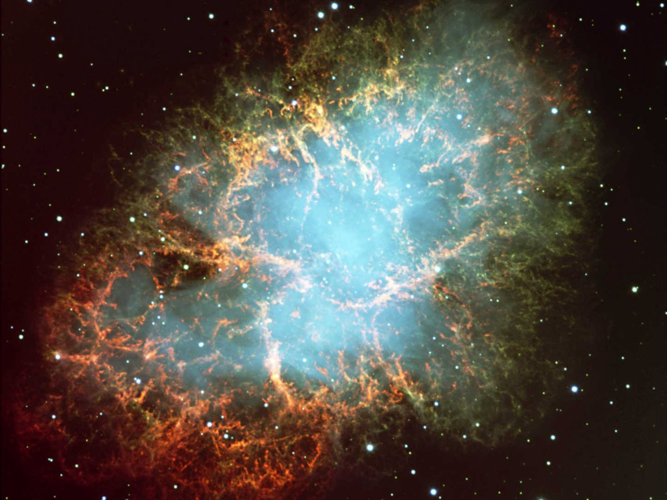




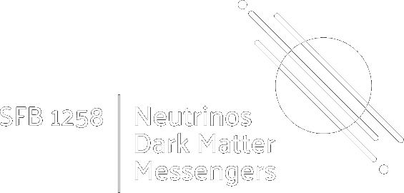
Neutrino Astrophysics
Neutrino
strophysics
Dark Matter and Neutrinos, IHP, Paris, 5−9 May 2025
Georg G. Raffelt, Max-Planck-Institut für Physik, Garching

Slide 2
Crab Nebula – Remnant of SN 1054
I. Neutrinos and the Stars
II. Supernova neutrinos
III. Neutrinos in cosmology

Slide 3




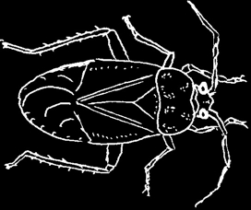
Demystifying the ghost particles
Flavor oscillations, New properties, …
Masses (limits, toward cosmo measurement)
Astrophysical messengers
Solar interior, Geonus & Reactors, Supernovae
Cosmic-ray sources, Dark matter annihilation
Workers in astrophysics & cosmology
Stellar cooling, Supernova explosions
Big-bang nucleosynthesis, Leptogenesis
Hot dark matter
Role model
Axions and other feebly interacting particles
(FIPs, WISPs, ALPs, …) can do similar things
Astrophysical constraints
Pest
Background for dark matter searches

Slide 4
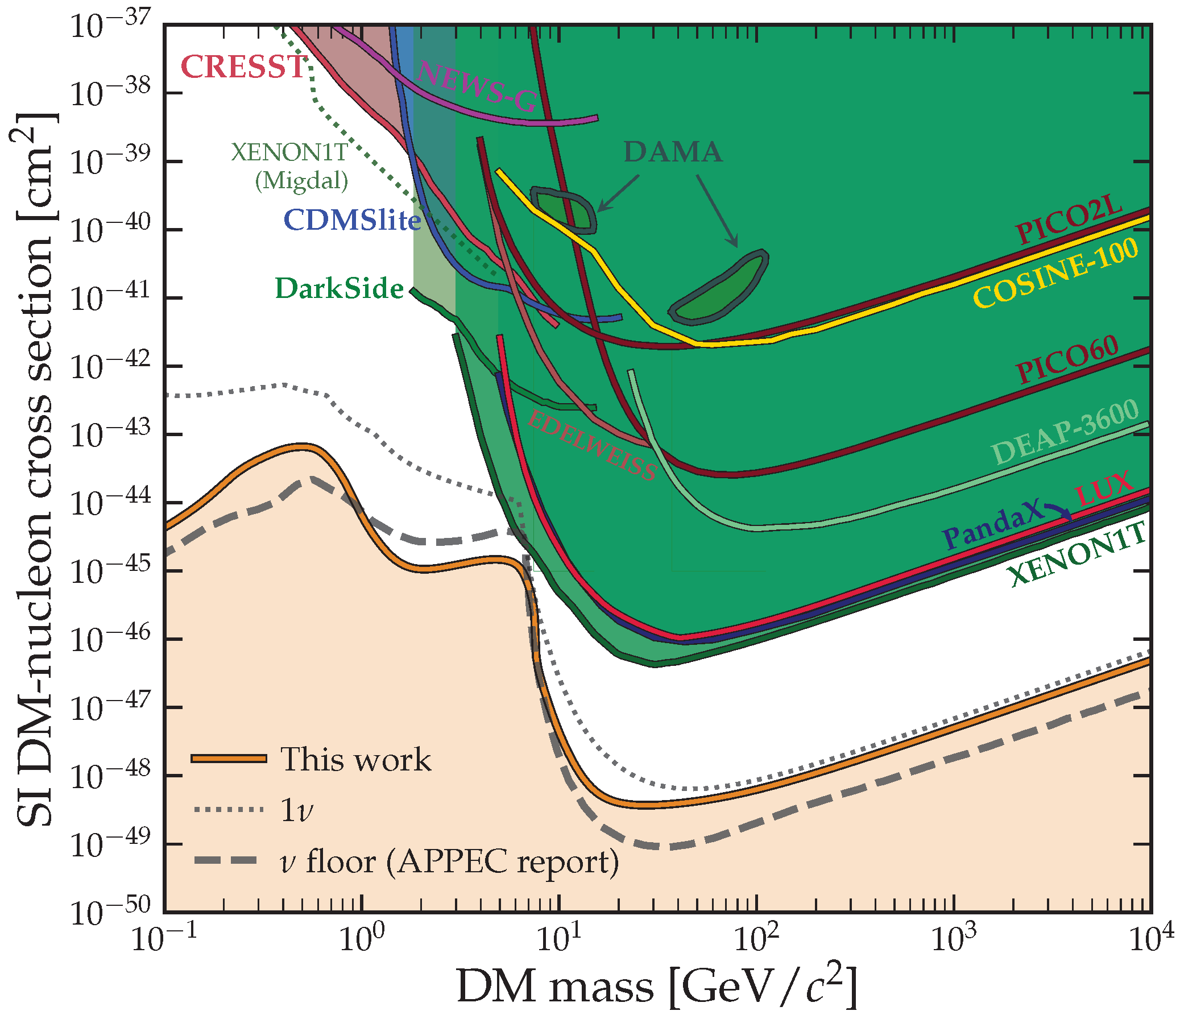
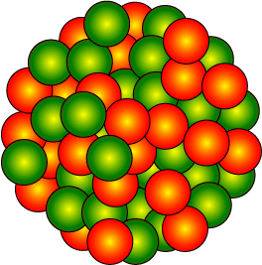
Neutrino Fog for WIMP Dark Matter Detection
Yesterday’s sensation
is today’s calibration —R.Feynman
… and tomorrow’s background —V.Telegdi
Ciaran O’Hare, arXiv:2109.03116
1 event/(kg d)
1 event/(ton d)
Solar Nus
1 event/(ton y)
Atmospheric Nus

Slide 5
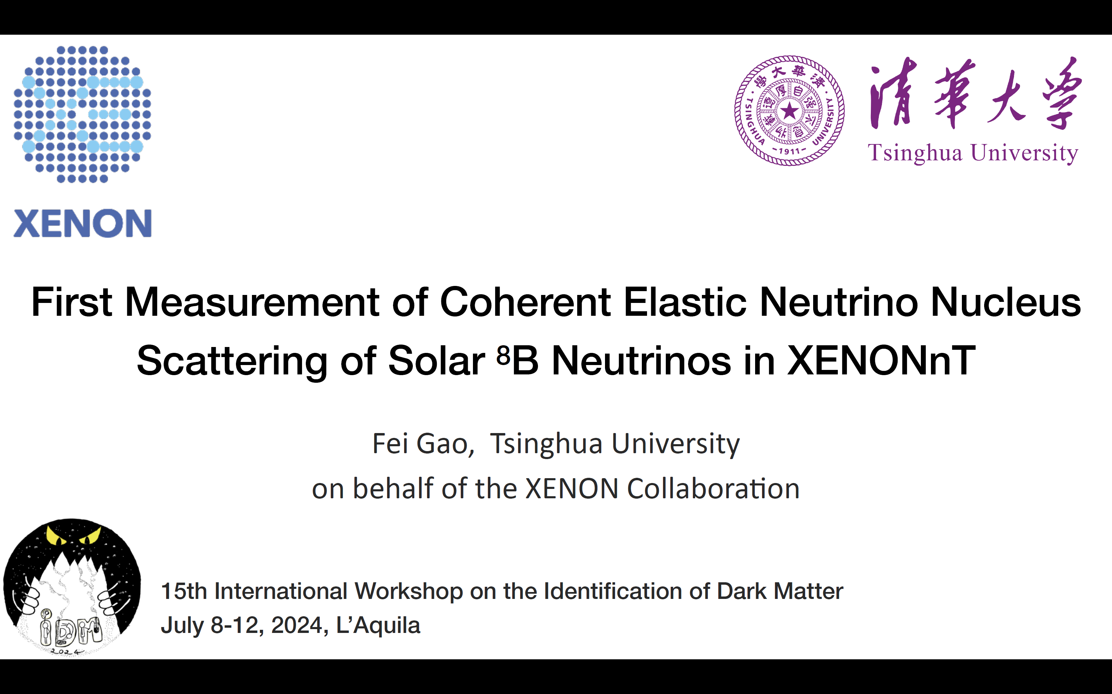
Aprile+, Xenon Collaboration, arXiv:2408.02877
Dark Matter & Neutrinos, Paris IHP, 5−9 May 2025

Slide 6





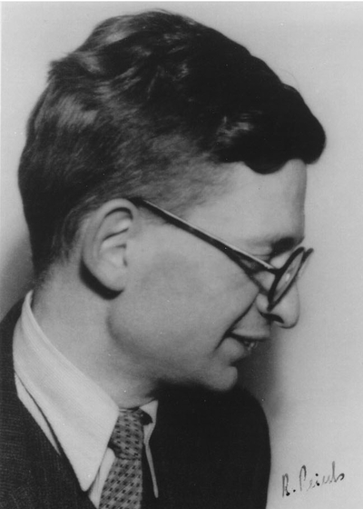
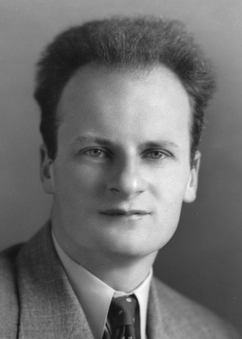
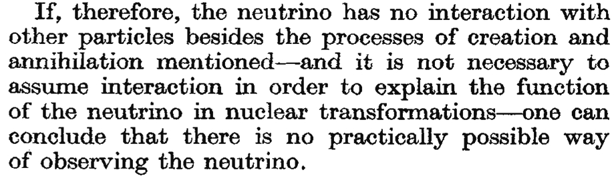



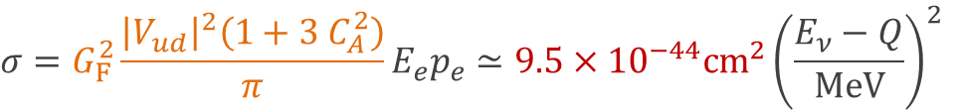
How feebly do neutrinos interact?
Neutron decay (β decay)
$$\frac{1}{τ}=G_{F}^{2}\frac{{\left|V_{ud}\right|}^{2}\left(1+3 C_{A}^{2}\right)}{π}Q^{5}\frac{f_{Phase−Space}}{2π}≃\frac{1}{15 min}$$
Inverse β decay (IBD)
+
$$σ=G_{F}^{2}\frac{{\left|V_{ud}\right|}^{2}\left(1+3 C_{A}^{2}\right)}{π}E_{e}p_{e}≃9.5×{10}^{−44}cm^{2}{\left(\frac{E_{ν}−Q}{MeV}\right)}^{2}$$
$$Q=m_{n}−m_{p}$$
$$=1.297 MeV$$
Mean free path of ${\overline{ν}}_{e}$ (5 MeV) in water
$$λ≃1×{10}^{14} km≃12 light years$$
Bethe & Peierls
The “Neutrino”
Nature 133 (1934) 532
Rudolf Peierls
1907–1995
Hans Bethe
1906–2005

Slide 7
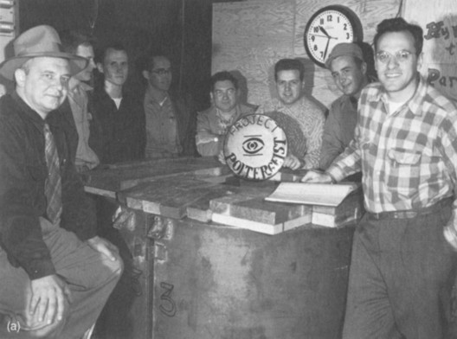
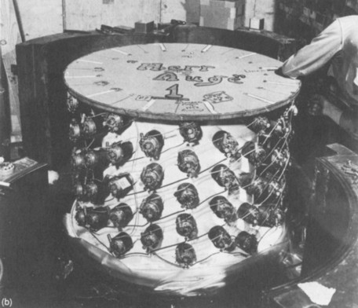

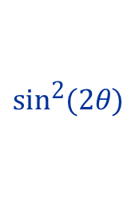

First Detection (1954 – 1956)
Clyde Cowan
(1919 – 1974)
Fred Reines
(1918 – 1998)
Nobel prize 1995
Detector prototype
Anti-Electron
Neutrinos
from
Hanford
Nuclear Reactor
& Savannah River
γ
3 Gammas
in coincidence
n
Cd
$${\overline{ν}}_{e}$$
p
γ
$${\text{e}}^{+}$$
$${\text{e}}^{−}$$
γ

Slide 8



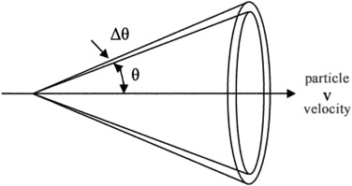
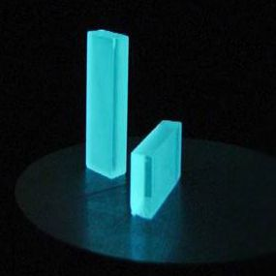
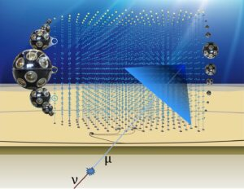
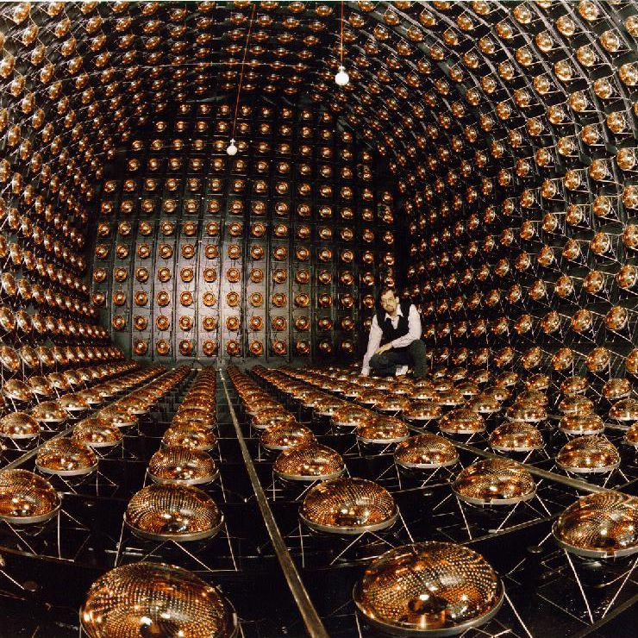


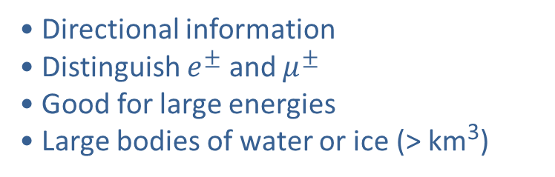
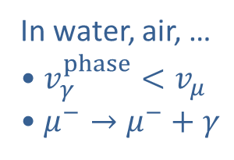

How do we see neutrinos? Let there be light!
$$ν_{μ}$$
$$μ$$
$$W$$
Cherenkov Light
Scintillation Light
In water, air, …
• $v_{γ}^{phase}<v_{μ}$
• $μ^{−}→μ^{−}+γ$
Ionizing radiation:
Some materials “scintillate”
Organic compounds dissolved
in mineral oil → Large volume
• Directional information
• Distinguish $e^{±}$ and $μ^{±}$
• Good for large energies
• Large bodies of water or ice (> km³)
• More light (better energy resolution)
• No directional information
• Low-energy nus (reactor, geo, solar)
• JUNO (20 kt) commissioning (2025)
LSND Detector
(Water-based scintillator and
combining with Cherenkov
under development)
KM3NeT

Slide 9
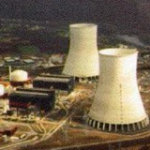
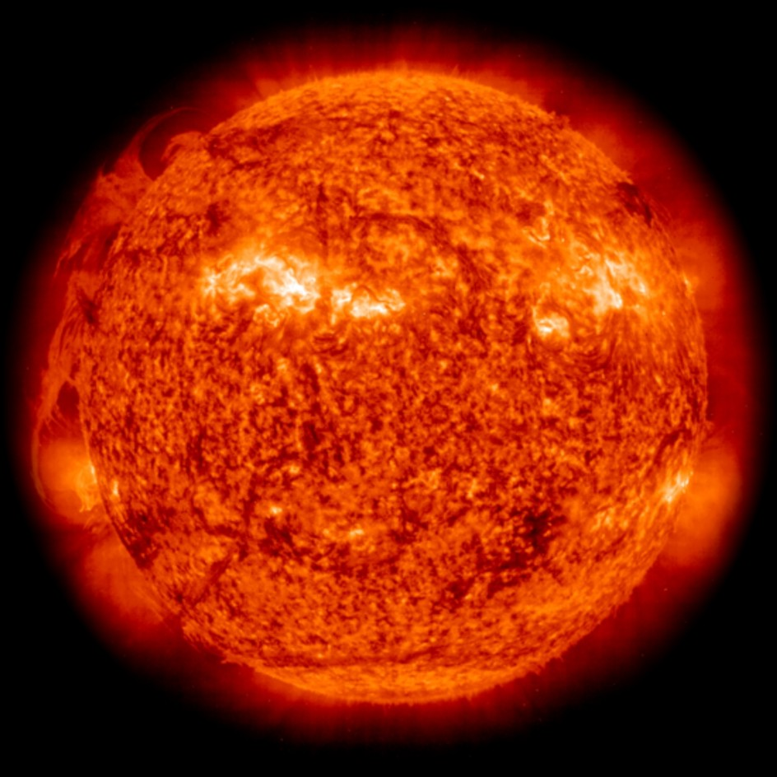

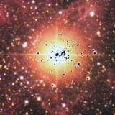

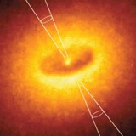
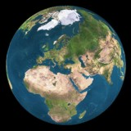
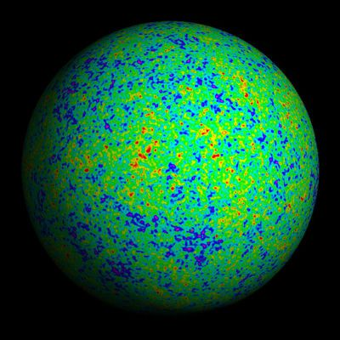
Where do Neutrinos Appear in Nature?
Ordinary stars
Indirect Evidence
✓
Nuclear Reactors
✓
Sun
Supernovae
(Stellar Collapse)
SN 1987A
✓
✓
Particle Accelerators
Earth Atmosphere
(Cosmic Rays)
Astrophysical
Accelerators ✓
✓
Cosmic Big Bang
(Today 330 ν/cm³)
Indirect Evidence
Earth Crust
(Natural Radioactivity)
✓

Slide 10












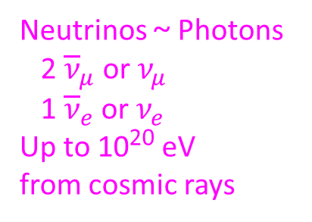
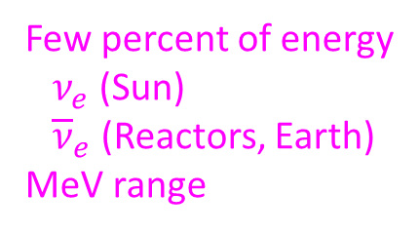

How are Neutrinos Produced?
Nuclear transmutation (stars, reactors, Earth)
Fusion (H burning stars)
$4p→{}_{ }^{4}{He}+2e^{+}+2ν_{e}$
$$e^{−}+p→n+ν_{e}$$
Few percent of energy
$ν_{e}$ (Sun)
${\overline{ν}}_{e}$ (Reactors, Earth)
MeV range
Fission (Reactors, Earth)
$n+{}_{ }^{235}U→{}_{ }^{90}{Kr}+{}_{ }^{143}{Ba}+3n$
β decay of neutron-rich isotopes
$$n→p+e^{−}+{\overline{ν}}_{e}$$
Pair production (“thermal” neutrinos from stars)
Bremsstrahlung
$$N+N→N+N+ν+\overline{ν}$$
Neutrinos (all flavors)
dominant energy loss
sub-MeV – tens MeV
$$e^{−}+ion→ion+e^{−}+ν+\overline{ν}$$
Pair annihilation
$$e^{−}+e^{+}→ν+\overline{ν}$$
Pion decay (from high-energy primary protons)
$p+target→X+pions (π^{0},π^{±})$
$$(m_{π}=135 MeV)$$
Neutrinos ~ Photons
2 ${\overline{ν}}_{μ}$ or$ν_{μ}$
1 ${\overline{ν}}_{e}$ or$ν_{e}$
Up to 10²⁰ eV
from cosmic rays
$$π^{0}→2γ$$
$$π^{−}→μ^{−}+{\overline{ν}}_{μ}→e^{−}+{\overline{ν}}_{e}+ν_{μ}+{\overline{ν}}_{μ}$$
$$(m_{μ}=106 MeV)$$
$$π^{+}→μ^{+}+ν_{μ}→e^{+}+ν_{e}+ν_{μ}+{\overline{ν}}_{μ}$$

Slide 11
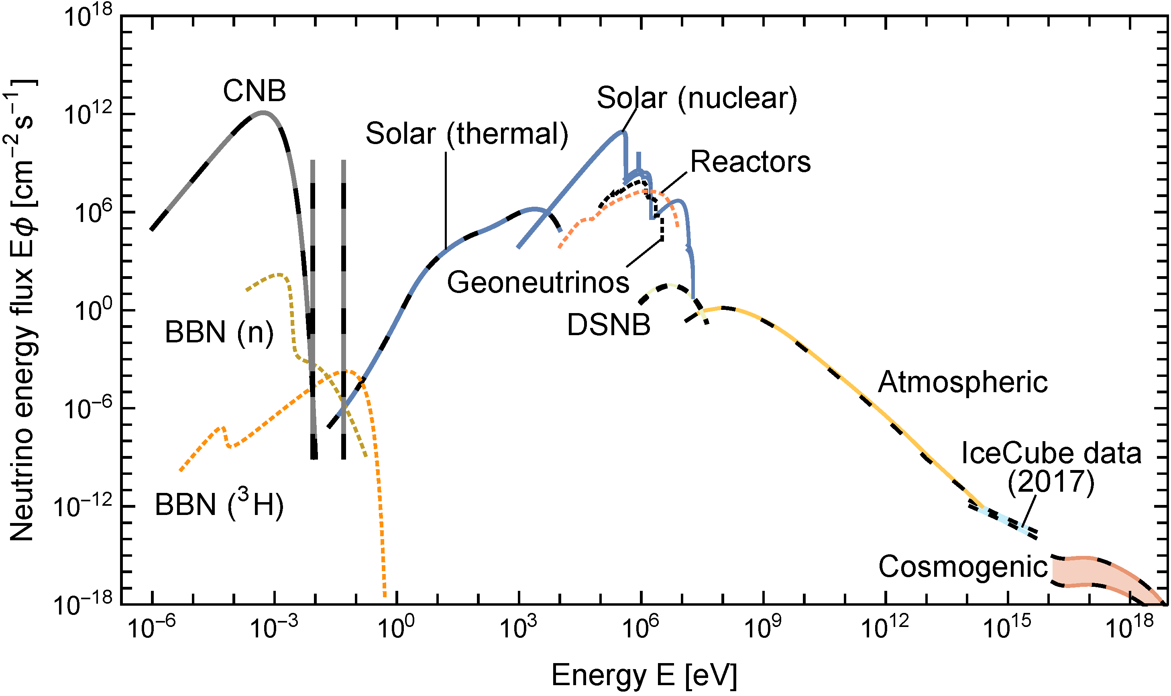
Grand Unified Neutrino Spectrum (GUNS) at Earth
Vitagliano, Tamborra & Raffelt, arXiv:1910.11878
km^{–2} y^{–1}
200 PeV
Neutrino with largest-ever energy
13 Feb 2023, KM3-230213A

Slide 12
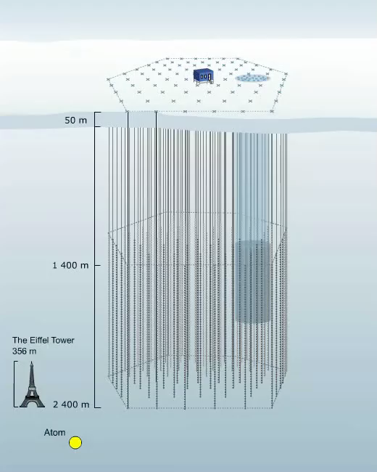
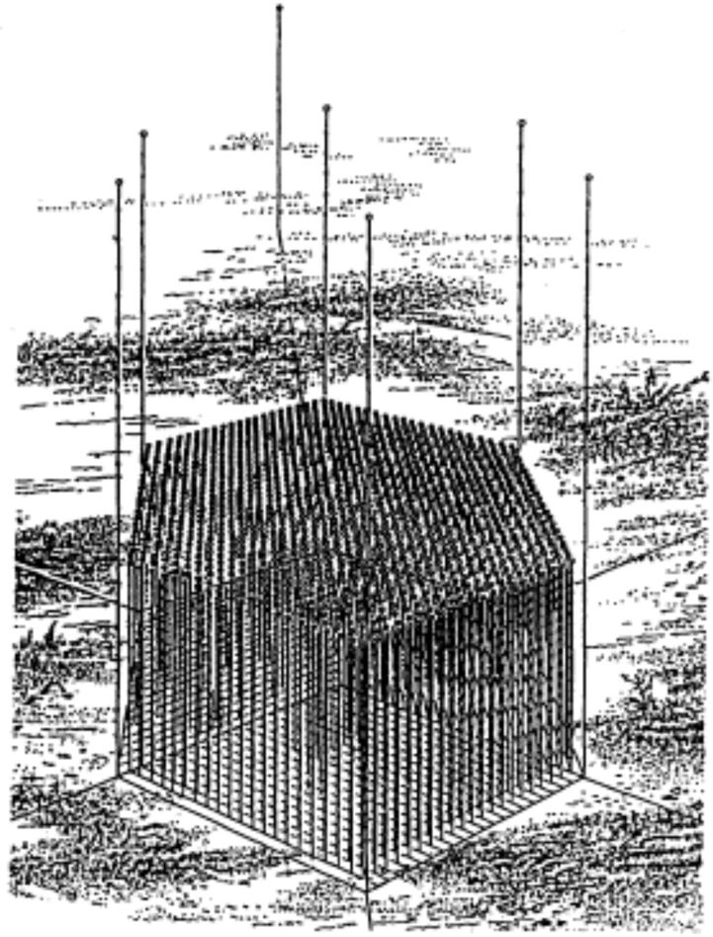
IceCube Neutrino Telescope at the South Pole
IceCube completed December 2010
Idea for DUMAND under sea
Cherenkov detector (1978)
1.26 km³, 22 698 Optical Modules
(discontinued 1995 after 1 string
pilot phase)
1 km³
86 strings
5160 OMs

Slide 13
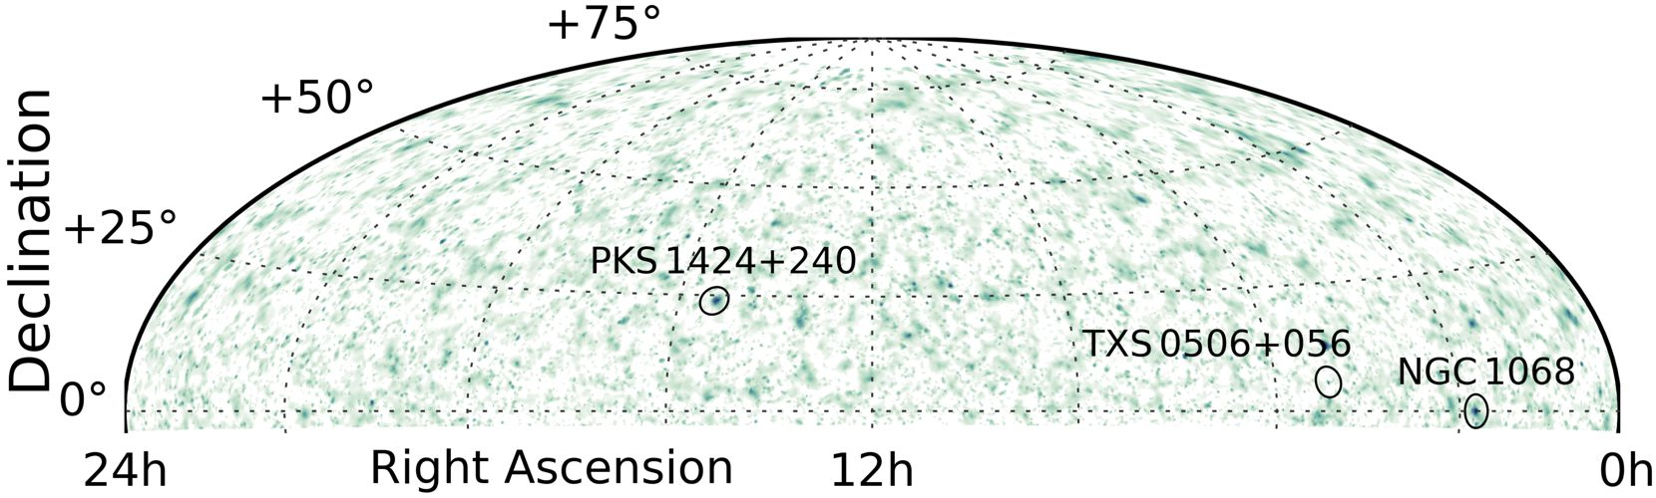
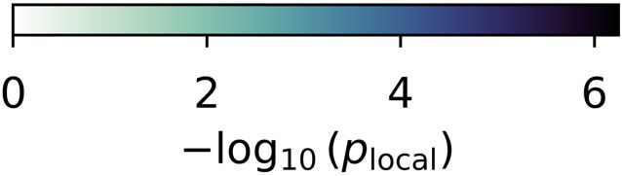
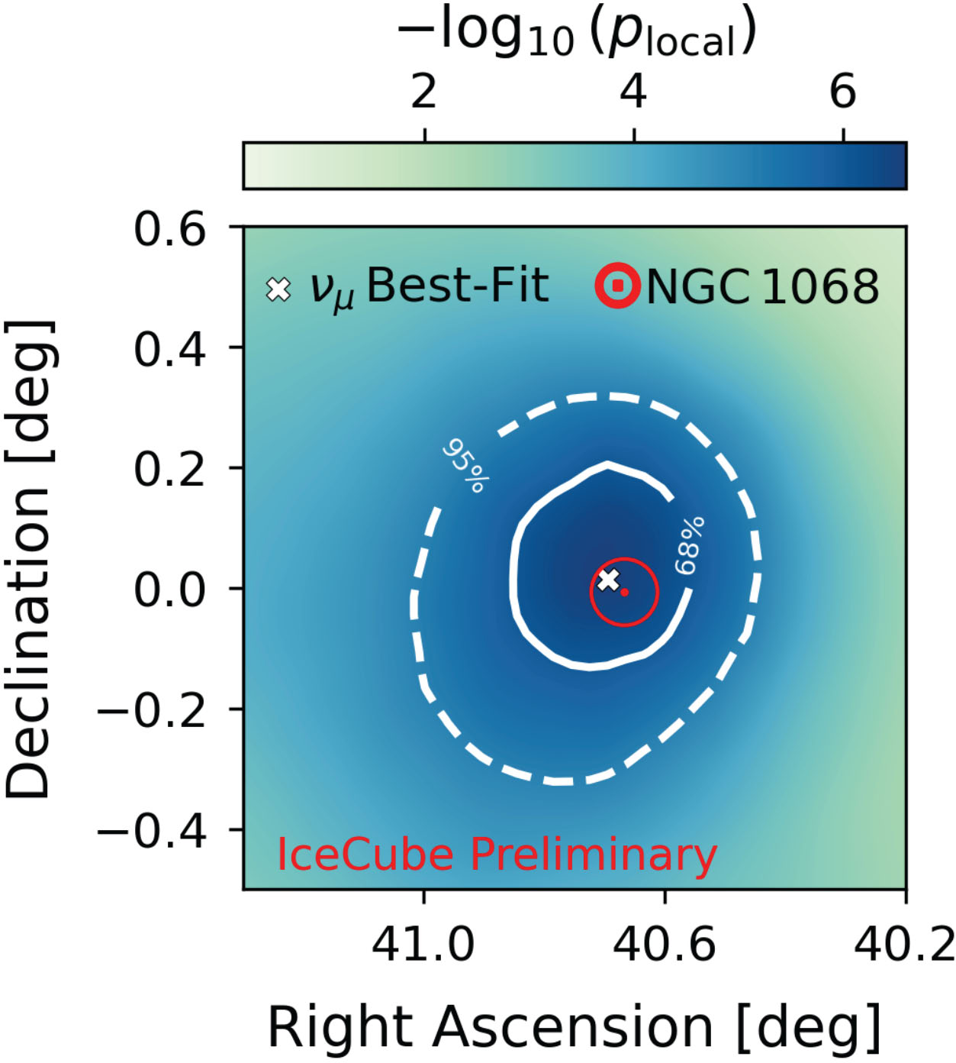
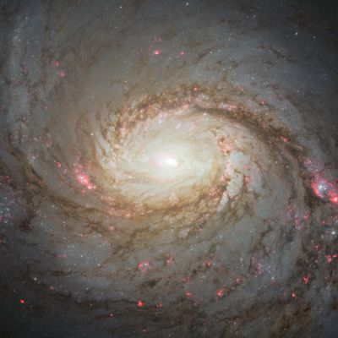
First Astrophysical Point Sources at IceCube
Neutrino event IC-170922A
(22 Sept 2017)
290 TeV
Neutrino emission from the nearby
Active Galaxy NGC 1068 (14.4 Mpc)
AGN obscured by accretion torus
NGC 1068
Hot spot at NGC 1068
Global Significance 4.0 σ
~ 80 excess events, 13 years data
IceCube @ Neutrino 2024
Update of Science 378 (2022) 538

Slide 14

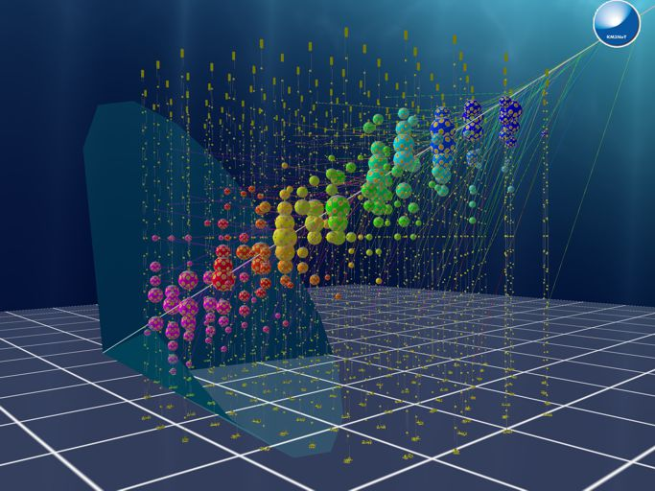

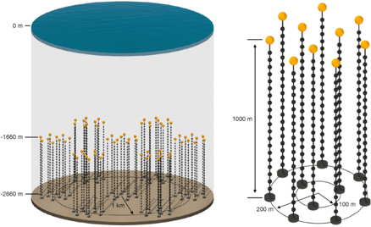

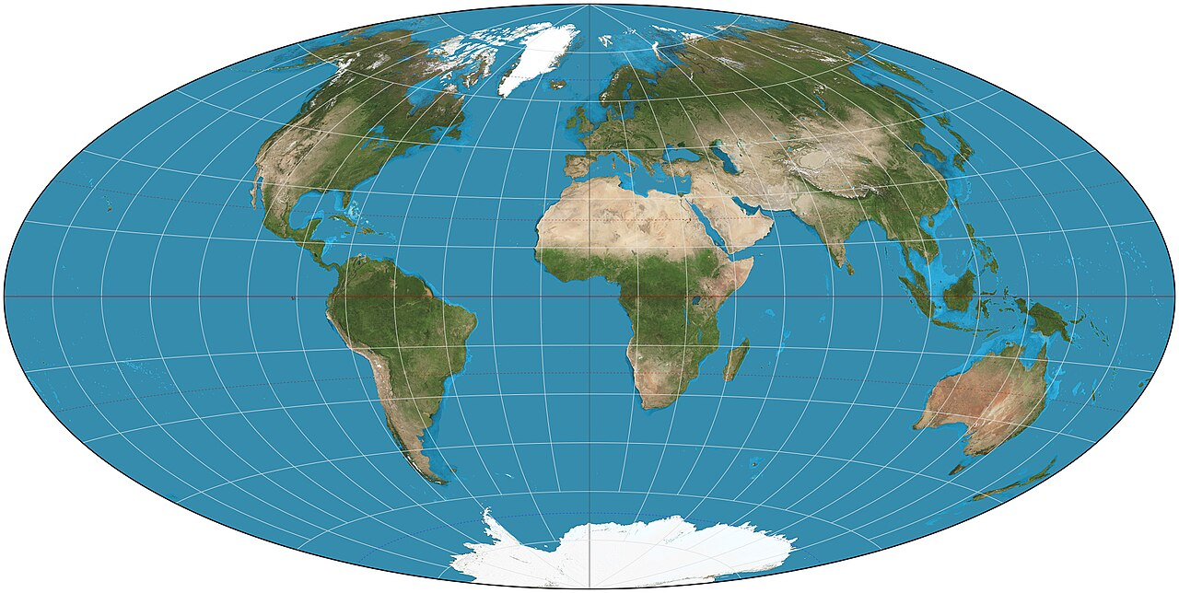
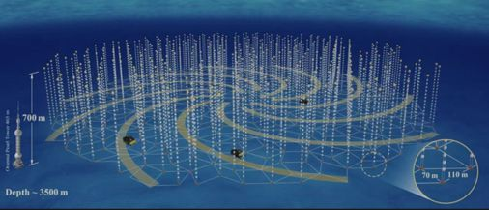


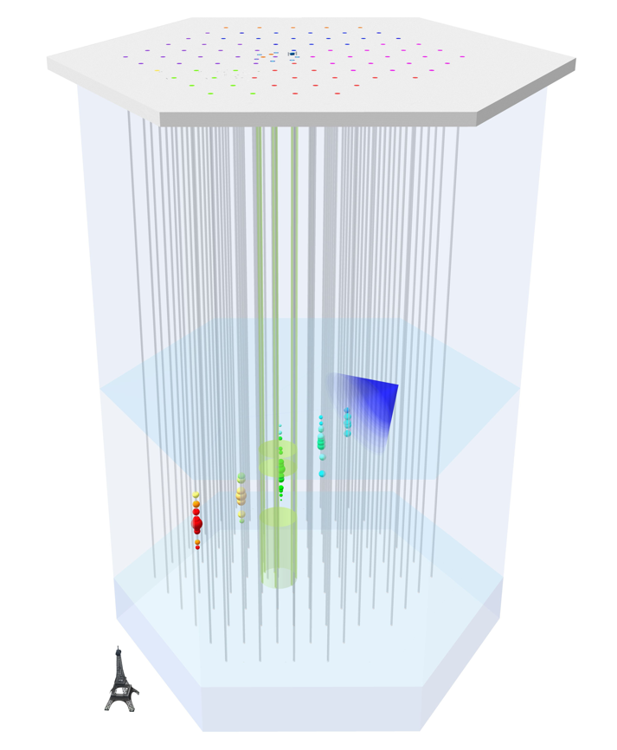
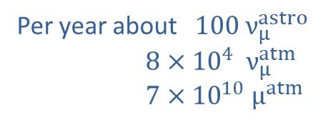
Cherenkov High-Energy Neutrino Telescopes
Growing
200 PeV event
13 Feb 2023
Baikal-GVD
Growing
Site chosen
Pathfinder string
Per year about $100 ν_{μ}^{astro}$
$8×{10}^{4} ν_{μ}^{atm}$
$7×{10}^{10} μ^{atm}$
• Full size since 2010
• Diffuse flux (2013), first sources
• Extension planned (Gen2)

Slide 15
Grand Unified Neutrino Spectrum (GUNS) at Earth
Vitagliano, Tamborra & Raffelt, arXiv:1910.11878

Slide 16
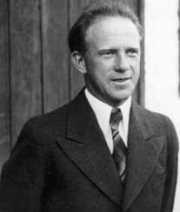
Predicting Atmospheric Neutrinos (1936)
Instead [of protons and neutrons] Pauli's hypothetical 'neutrinos' should contribute substantially to the penetrating radiation. This is because in each shower ... neutrinos should be generated which then would lead to the generation of small secondary showers. The cross section for the generation of these secondary showers would likely not be much smaller than 10⁻²⁶ cm². Contrary to the low-energy neutrinos from β decay one should be able to detect the energetic neutrinos from cosmic rays via their interactions.
Werner Heisenberg
Zur Theorie der Schauerbildung in der Höhenstrahlung
Zeitschrift für Physik 101 (1936) 533
Slide adapted from Christian Spiering

Slide 17
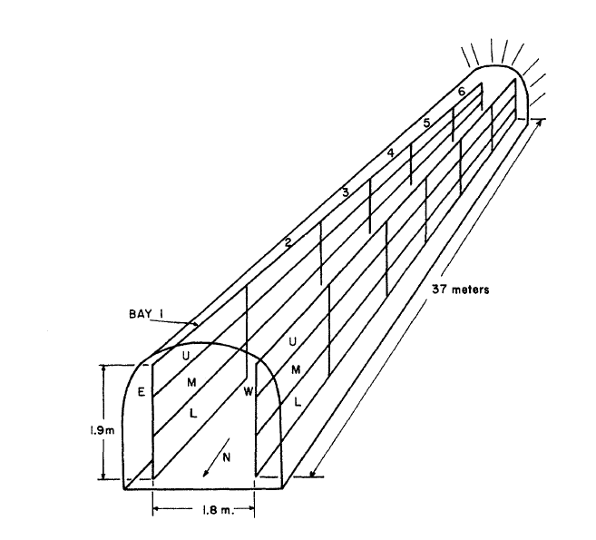
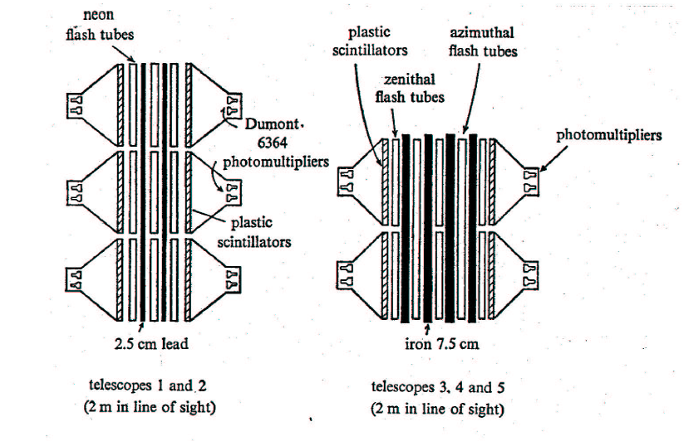
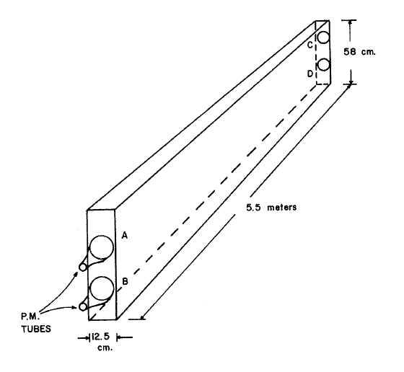
Detection of First Atmospheric Neutrinos 1965
Chase-Witwatersrand-Irvine (CWI) Coll.
Mine in South Africa, 8800 mwe
• Liquid scintillator
• Horizontal tracks
Kolar Gold Field (KGF) Collaboration
(Japan-India-UK group), 7500 mwe
• Plastic scintillator
• Flash tubes
Slide adapted from Christian Spiering

Slide 18
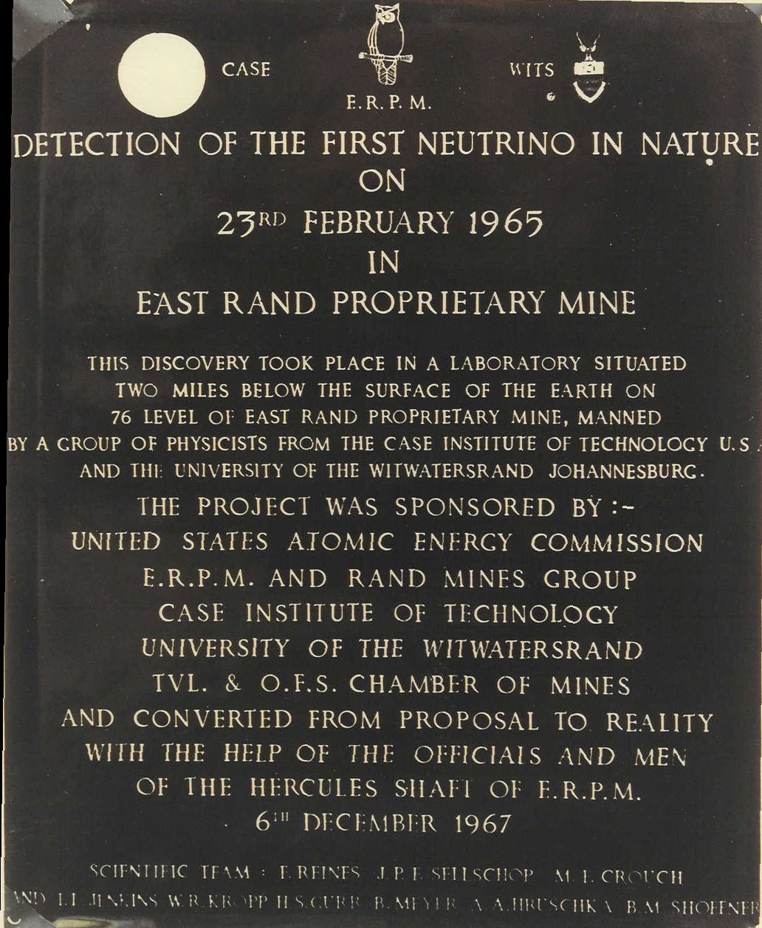
East Rand Neutrino Plaque

Slide 19
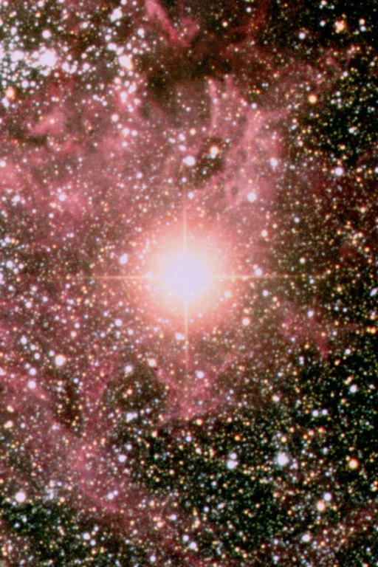
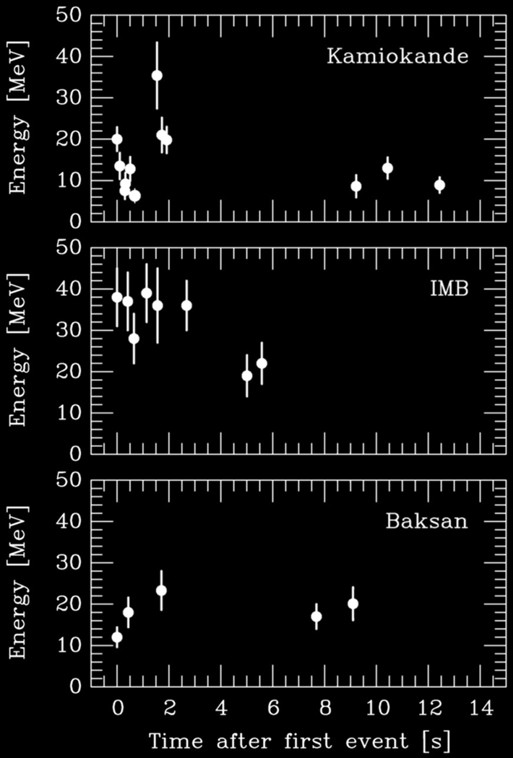
Supernova 1987A
Supernova 1987A
23 February 1987

Slide 20
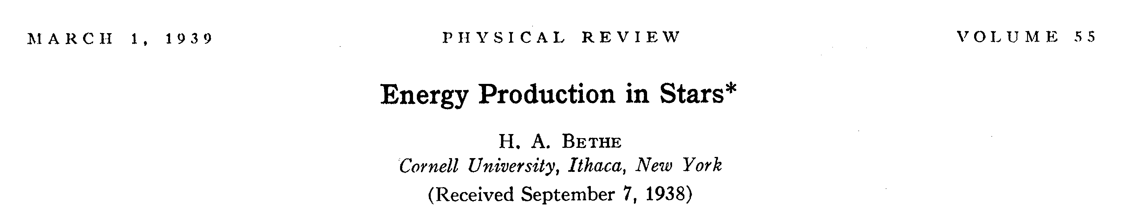
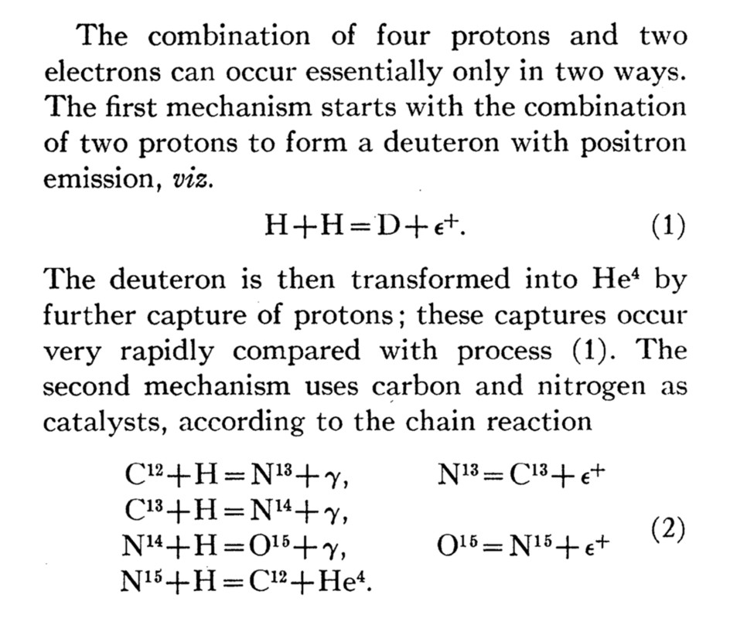
Bethe’s Classic Paper on Nuclear Reactions in Stars
Hans Bethe
1906–2005
• First mention of neutrino
emission from stars
• Neutrino losses discussed,
although overestimated

Slide 21
Crab Nebula – Remnant of SN 1054
Dark Matter and Neutrinos, IHP, Paris, 5−9 May 2025
Neutrinos
and the Stars
Georg G. Raffelt, Max-Planck-Institut für Physik, Garching

Slide 22
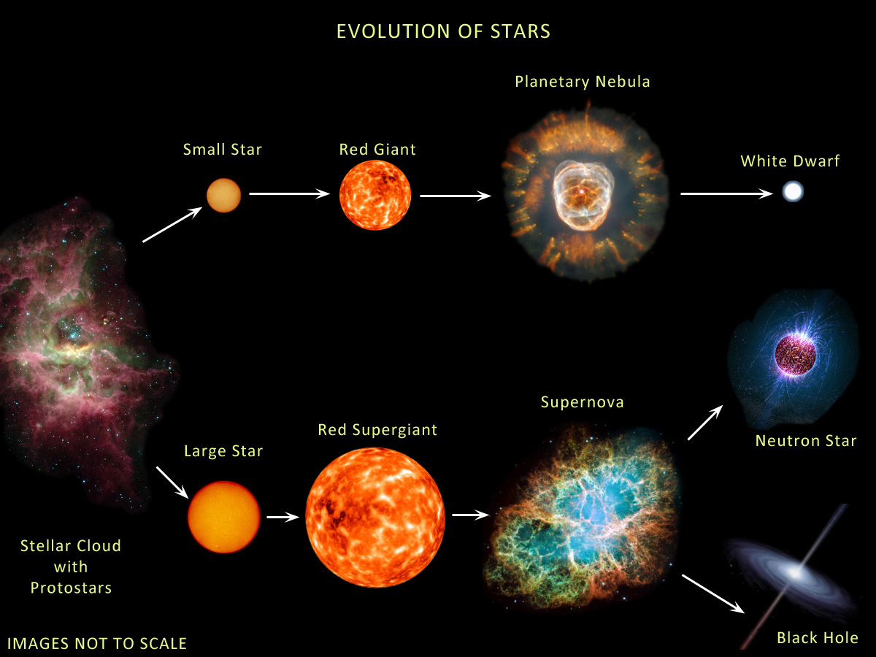





Evolution of Stars
Compact
Remnants:
$$M≲8 M_{⊙}$$
$1 M_{⊙}=2×{10}^{30}$kg
$$M∼0.6 M_{⊙}$$
R $∼$5000 km
Surface T ~ keV
Nuclear density
Surface T ~ eV (IR to UV)
Inner T ~ 1–100 keV
$M$ = 1–2$M_{⊙}$
R $∼$12 km
$$M≳8 M_{⊙}$$
Inner T ~ 30 MeV
few-tens $M_{⊙}$
few km
BR ≈ 25% (?)
http://earthspacecircle.blogspot.com/2013/07/stellar-evolution.html

Slide 23
Evolution of Stars
Particles from the Sun:
• Direct search
• Back-reaction on Sun
• Number counts in globular clusters
• Brightness of tip of red-giant branch (TRGB)
• White dwarf luminosity function
• Period decrease of variable WDs
• WD Initial-final mass function
• EoS w/ axions
DM axion conversion in
pulsar magnetosphere
• Nus from SN 1987A & future SN
• Explosion energy
• Radiation from all past SNe
• Cooling speed
• EoS w/ axions
Superradiance
Core-collapse supernova

Slide 24




Particles from the Sun
2002 Solar Neutrinos (R.Davis, M.Koshiba)
2015 Solar Nu Oscillations (A.McDonald)
Search for solar axions
with CAST and future IAXO
No excess in XENONnT
arXiv:2207.11330
Bounds on axions,
dark photons, neutrino
dipole moments

Slide 25




Hydrogen Burning
PP-I Chain
CNO Cycle
4p + 2e →
+ 2$ν_{e}$ + 26.7 MeV
Image Wikipedia

Slide 26

Solar Neutrinos from Nuclear Reactions
Vitagliano, Tamborra & Raffelt, arXiv:1910.11878
All components of pp
chains (blue) have
been measured
Very recently direct
experimental evidence
for CNO fluxes (orange)
in Borexino
arXiv:2006.15115 (06/2020)
Nature 587 (2020) 577
and arXiv:2205.15975
Favors higher flux,
and thus “high” CNO
abundance

Slide 27




“Nuclear” vs. Thermal Neutrinos
• Hydrogen burning
Effectively proton-neutron conversion
$$4p+2e→{}_{ }^{4}{He}+2ν_{e}$$
Charged-current electron-neutrino production
Other flavors (or sterile) by flavor conversion
• Advanced burning phases
Effectively combine alpha particles (${}_{ }^{4}{He}$) to larger nuclei, eg helium burning
$$3α→{}_{ }^{12}C$$
No proton-neutron conversion necessary, no “nuclear” neutrinos
• Neutrinos from neutral-current processes in pairs of all flavors
eg photo production
$$γ+e→e+ν+\overline{ν}$$
• Analogous for axions or other particles
$$γ+e→e+a$$

Slide 28

Thermal Neutrinos: Production Processes
Vitagliano, Redondo & Raffelt, arXiv:1708.02248

Slide 29
Grand Unified Neutrino Spectrum (GUNS) at Earth
Vitagliano, Tamborra & Raffelt, arXiv:1910.11878

Slide 30




Temperature in the Sun
Virial Theorem $〈E_{kin}〉=−\frac{1}{2}〈E_{grav}〉$
Approximate Sun as a homogeneous
sphere with
Mass $M_{sun}=1.99×{10}^{33}g$
Radius $R_{sun}=6.96×{10}^{10}cm$
Gravitational potential energy of a
proton near center of the sphere
$〈E_{grav}〉=−\frac{3}{2}\frac{G_{N}M_{sun}m_{p}}{R_{sun}}=−3.2 keV$
Thermal velocity distribution
$〈E_{kin}〉=\frac{3}{2}k_{B}T=−\frac{1}{2}〈E_{grav}〉$
Estimated temperature
$T=1.1 keV$
Central temperature from
standard solar models
$$T_{c}=1.56×{10}^{7}K=1.34 keV$$

Slide 31

Virial Theorem – Dark Matter in Galaxy Clusters
A gravitationally bound
system of many particles
obeys the virial theorem
$$2〈E_{kin}〉=−〈E_{grav}〉$$
$$2\left\langle \frac{mv^{2}}{2}\right\rangle =\left\langle \frac{G_{N}M_{r}m}{r}\right\rangle$$
$$\left\langle v^{2}\right\rangle ≈G_{N}M_{r}\left\langle r^{−1}\right\rangle$$
Velocity dispersion
from Doppler shifts
and geometric size
Total Mass
Coma Cluster

Slide 32



Experimental Tests of Invisible Axions
● Large coherence length overcomes
small coupling
● Axion-photon conversion in B-field similar to
neutrino flavor oscillation, PRD 37 (1988) 1237
● Can be enhanced with gas filling
van Bibber+ PRD 39 (1989) 2089
Primakoff
https://cajohare.github.io/IAXOmass/

Slide 33






Pointing a Magnet to the Sun
Rochester-Brookhaven-FermiLab
Lazarus+ PRL 69 (1992) 2333
Few hours of data, fixed magnet
$G_{aγγ}<0.77×{10}^{−8} GeV^{−1}$
© Sebastian Baum
Tokyo Helioscope (Sumico)
Fully stearable, 2.3 m long, 4 Tesla
Moriyama+ [hep-ex/9805026]
$G_{aγγ}<0.60×{10}^{−9} GeV^{−1}$
See also Ohta+ [1201.4622]
CAST (1998–2021)
Stearable, 9.26 m long, 9 Tesla
Anastassopoulos+ [1705.02290]
$$G_{aγγ}<0.66×{10}^{−10} GeV^{−1}$$
CAST Movie on YouTube
https://youtu.be/XY2lFDXz8aQ

Slide 34



(Baby) IAXO Sensitivity Forecast
Discovery potential
for QCD axions
Physics potential of the International Axion Observatory (IAXO)
JCAP 1906 (2019) 047, arXiv:1904.09155

Slide 35





Solar Neutrino Limit on Solar Energy Losses
Self-consistent models of the present-day Sun provide a simple power-law connection
between a new energy loss L_{a} (e.g. axions) and the solar neutrino flux from B⁸
Schlattl, Weiss & Raffelt, hep-ph/9807476
Gondolo & Raffelt, arXiv:0807.2926
$$T_{c,a}^{ }=T_{c,0}^{ }{\left(\frac{L_{⊙}+L_{a}}{L_{⊙}}\right)}^{0.22}$$
$$Φ_{B8}^{ }∝T_{c}^{18 }$$
$$Φ_{B8,a}^{ }=Φ_{B8,a}^{ }{\left(\frac{L_{⊙}+L_{a}}{L_{⊙}}\right)}^{4.6}$$
Solar models with SNO all-flavor
measurements imply roughly
$$L_{a}≲0.1 L_{⊙}$$
$$L_{a}={\left(\frac{g_{aγ}^{ }}{{10}^{−10}GeV^{−1}}\right)}^{2}1.85×{10}^{−3}L_{⊙} ⇒ g_{aγ}≲7×{10}^{−10}GeV^{−1}$$

Slide 36

Solar Observables Modified by Axion Losses
New
opacity
Old
opacity
Surface He abundance
Depth Convective Zone
Boron neutrinos
Beryllium neutrinos
Vinyoles, Serenelli, Villante, Basu, Redondo & Isern, arXiv:1501.01639

Slide 37

Hidden Photon Limits
Sun
TRGB
HB Stars
Dolan, Hiskens & Volkas, arXiv:2306.13335

Slide 38

Hertzsprung Russell Diagram
Luminosity (compared with Sun)
Surface Temperature (Kelvin)
https://www.eso.org/public/images/eso0728c/

Slide 39



Equations of Stellar Structure
Assume spherical symmetry and static structure (neglect kinetic energy)
Excludes: Rotation, convection, magnetic fields, supernova-dynamics, …
Hydrostatic equilibrium
$$\frac{dP}{dr}=−\frac{G_{N}M_{r}ρ}{r^{2}}$$
Energy conservation
$$\frac{dL_{r}}{dr}=4πr^{2}ερ$$
Energy transfer
$$L_{r}=\frac{4πr^{2}}{3κρ}\frac{d\left(aT^{4}\right)}{dr}$$
Literature
Clayton: Principles of stellar evolution and
nucleosynthesis (Univ. Chicago Press 1968)
Kippenhahn & Weigert: Stellar structure
and evolution (Springer 1990)
$r$
$P$
$GN$
$ρ$
$M_{r}$
$L_{r}$
$ε$
$$κ$$
$$κ_{γ}$$
$$κ_{c}$$
Radius from center
Pressure
Newton’s constant
Mass density
Integrated mass up to r
Luminosity (energy flux)
Local rate of energy
generation $[erg g^{−1}s^{−1}]$
$$ε=ε_{nuc}+ε_{grav}−ε_{ν}$$
Opacity
$$κ^{−1}=κ_{γ}^{−1}+κ_{c}^{−1}$$
Radiative opacity
$$κ_{γ}ρ={〈λ_{γ}〉}_{Rosseland}^{−1}$$
Electron conduction

Slide 40


Self-Regulated Nuclear Burning
Virial Theorem: $〈E_{kin}〉=−\frac{1}{2}〈E_{grav}〉$
Small Contraction
Heating
Increased nuclear burning
Increased pressure
Expansion
Additional energy loss (“cooling”)
Loss of pressure
Contraction
Heating
Increased nuclear burning
Hydrogen burning at nearly fixed T
Gravitational potential nearly fixed:
${G_{N}M}/R∼constant$
$R∝M$ (More massive stars bigger)
Main-Sequence
Star

Slide 41


Nuclear Binding Energy
Fe
Mass Number

Slide 42

Hydrogen Burning in Stars
pp-I Chain
CNO Cycle
Picture credit Wikipedia

Slide 43




Thermonuclear Reactions and Gamow Peak
Coulomb repulsion prevents nuclear
reactions, except for Gamow tunneling
Tunneling probability
$$p∝E^{−1/2}e^{−2πη}$$
where the Sommerfeld parameter is
$$η={\left(\frac{m}{2E}\right)}^{1/2}Z_{1}Z_{2}e^{2}$$
Parameterize cross section with
astrophysical S-factor
$S\left(E\right)=σ\left(E\right) E e^{2πη\left(E\right)}$
$${}_{ }^{3}{He}+{}_{ }^{3}{He}→{}_{ }^{4}{He}+2p$$
LUNA Collaboration, nucl-ex/9902004

Slide 44




Main Nuclear Burning Stages
Hydrogen burning $4p+2e^{−}→{}_{ }^{4}{He}+2ν_{e}$
Proceeds by pp chains and CNO cycle
No higher elements are formed because
no stable isotope with mass number 8
Neutrinos from p → n conversion
Typical temperatures: 10⁷ K ($∼$1 keV)
Each type of burning occurs
at a very different T but a
broad range of densities
Never co-exist in the same
location
Helium burning
$${}_{ }^{4}{He}+{}_{ }^{4}{He}+{}_{ }^{4}{He}↔{}_{ }^{8}{Be}+{}_{ }^{4}{He}→{}_{ }^{12}C$$
“Triple alpha reaction” because $8Be$ unstable,
builds up with concentration $∼{10}^{−9}$
$${}_{ }^{12}C+{}_{ }^{4}{He}→{}_{ }^{16}O$$
$${}_{ }^{16}O+{}_{ }^{4}{He}→{}_{ }^{20}{Ne}$$
Typical temperatures: ${10}^{8} K$ ($\sim$10 keV)
Carbon burning
Many reactions, for example
${}_{ }^{12}C+{}_{ }^{12}C→{}_{ }^{23}{Na}+p$ or ${}_{ }^{20}{Ne}+{}_{ }^{4}{He}$ etc
Typical temperatures: $109 K$ $(\sim 100 keV)$

Slide 45

Hydrogen Exhaustion
Main-sequence star
Helium-burning star
Hydrogen Burning
Helium
Burning
Hydrogen
Burning

Slide 46






Giant Stars
Main-sequence star 1M⊙
(Hydrogen burning)
Helium-burning star 1M⊙
Large surface area
→ low temperature
→ “red giant”
Large luminosity
→ mass loss
Envelope
convective
$$1 R_{⊙}$$
$ε_{nuc}\left(He\right)$ depends on
$T∝Φ_{grav}$ $∝M/R$
of core
$$10 R_{⊙}$$
$$0.3 R_{⊙}$$
$ε_{nuc}\left(H\right)$ depends on
$$T∝Φ_{grav}∝M/R$$
of entire star
$ε_{nuc}\left(H\right)$ depends on
$T∝Φ_{grav}$ of core
→ huge $L(H)$

Slide 47






Burning Phases of a 15 Solar-Mass Star
L_{γ} [10⁴ L_{sun}]
Burning Phase
Dominant
Process
T_{c}
[keV]
ρ_{c}
[g/cm³]
L_{ν}/L_{γ}
Duration
[years]
Hydrogen
H → He
3
5.9
2.1
−
1.2×10⁷
Helium
He → C, O
14
1.3×10³
6.0
1.7×10⁻⁵
1.3×10⁶
Carbon
C → Ne, Mg
53
1.7×10⁵
8.6
1.0
6.3×10³
Neon
Ne → O, Mg
110
1.6×10⁷
9.6
1.8×10³
7.0
Oxygen
O → Si
160
9.7×10⁷
9.6
2.1×10⁴
1.7
Silicon
Si → Fe, Ni
270
2.3×10⁸
9.6
9.2×10⁵
6 days

Slide 48





Neutrinos from Thermal Processes
Photo (Compton)
Plasmon decay
Pair annihilation
Bremsstrahlung
These processes were first
discussed in 1961−63
after V−A theory

Slide 49




Plasmon Decay vs. Cherenkov Effect
Photon dispersion in
a medium can be
“Time-like”
ω² − k² > 0
“Space-like”
ω² − k² < 0
Refractive index n
(k = n ω)
n < 1
n > 1
Example
Ionized plasma
Normal matter for
large photon energies
Water (n ≈ 1.3),
air, glass
for visible frequencies
Allowed process
that is forbidden
in vacuum
Plasmon decay to
neutrinos
$$γ→ν\overline{ν}$$
Cherenkov effect
$$e→e+γ$$

Slide 50



Enhanced Plasmon Decay by Dipole Moments
Standard Plasmon Decay
Neutrino dipole moment
Left
Left
G_{F}
Left
Right
• Photons “shake” electrons
of the medium
• These emit neutrino pairs
• No direct photon coupling
• Dipole $μ_{ν}$ moment possible
• Enhances plasmon decay

Slide 51

Neutrino Electromagnetic Form Factors
$$L_{eff}=−F_{1}\overline{Ψ}γ_{μ}Ψ A^{μ}$$
$$−G_{1}\overline{Ψ}γ_{μ}γ_{5}Ψ ∂_{ν}F^{μν}$$
$$−\frac{1}{2}F_{2} \overline{Ψ}σ_{μν}Ψ F^{μν}$$
$$−\frac{1}{2}G_{2} \overline{Ψ}σ_{μν}γ_{5}Ψ F^{μν}$$
Effective
coupling of
electromagnetic
field to a
neutral fermion
Charge e_{ν} = F₁(0) = 0
Anapole moment G₁(0)
Magnetic dipole moment μ = F₂(0)
Electric dipole moment ε = G₂(0)
Charge form factor F₁(q²) & anapole G₁(q²) are short-range if charge F₁(0) = 0
Connect states of equal helicity
In the standard model they represent radiative corrections to weak interaction
Dipole moments connect states of opposite helicity
Violation of individual flavor lepton numbers (neutrino mixing)
→ Magnetic or electric dipole moments can connect different flavors
or different mass eigenstates (“Transition moments”)
Usually measured in “Bohr magnetons” μ_{B} = e/2m_{e}
Giunti et al., Neutrino electromagnetic properties, arXiv:2411.03122
Giunti & Studenikin, Neutrino electromagnetic interactions: a window to new physics, arXiv:1403.6344

Slide 52








Consequences of Neutrino Dipole Moments
Spin precession
in external
E or B fields
$$i\frac{∂}{∂t}\left(\begin{matrix}ν_{L} \\ ν_{R}\end{matrix}\right)=\left(\begin{matrix}0 & μ_{ν}B_{⊥} \\ μ_{ν}B_{⊥} & 0\end{matrix}\right)\left(\begin{matrix}ν_{L} \\ ν_{R}\end{matrix}\right)$$
Scattering
$$\frac{dσ}{dT}=\frac{G_{F}^{2}m_{e}}{2π}\left[{\left(C_{V}+C_{A}\right)}^{2}+{\left(C_{V}−C_{A}\right)}^{2}{\left(1−\frac{T}{E}\right)}^{2}+\left(C_{V}^{2}−C_{A}^{2}\right)\frac{m_{e}T}{E^{2}}\right]$$
$$+αμ_{ν}^{2}\left(\frac{1}{T}+\frac{1}{E}\right)$$
T electron recoil energy
Plasmon
decay in
stars
$$Γ=\frac{μ_{ν}^{2}}{24π} ω_{pl}^{3}$$
Decay or
Cherenkov
effect
$$Γ=\frac{μ_{ν}^{2}}{8π}{\left(\frac{m_{2}^{2}−m_{1}^{2}}{m_{2}}\right)}^{3}$$

Slide 53





Standard Dipole Moments for Massive Neutrinos
Standard electroweak model:
Neutrino dipole and
transition moments
are induced at higher order
Massive neutrinos $ν_{i}$ ($i=1, 2, 3$)
mixed to form weak eigenstates
$$ν_{ℓ}=\sum_{i=1}^{3}{U_{ℓi}ν_{i}}$$
Explicitly for Dirac neutrinos
Magnetic moments $μ_{ij}$
Electric moments $ε_{ij}$
$$μ_{ij}=\frac{{e\sqrt{2}G}_{F}}{{\left(4π\right)}^{2}}\left(m_{i}+m_{j}\right)\sum_{ℓ=e,μ,τ}{U_{ℓj}U_{ℓi}^{∗}}f\left(\frac{m_{ℓ}}{m_{W}}\right)$$
$$ε_{ij} = …\left(m_{i}−m_{j}\right) …$$
$$f\left(\frac{m_{ℓ}}{m_{W}}\right)=−\frac{3}{2}+\frac{3}{4} {\left(\frac{m_{ℓ}}{m_{W}}\right)}^{2}+𝒪{\left(\frac{m_{ℓ}}{m_{W}}\right)}^{4}$$

Slide 54





Standard Dipole Moments for Massive Neutrinos
Diagonal case:
Magnetic moments
of Dirac neutrinos
$$μ_{ii}=\frac{3e\sqrt{2}G_{F}}{{\left(4π\right)}^{2}}m_{i}=3.20×{10}^{−19}μ_{B}\frac{m_{i}}{eV}$$
$$ε_{ii} =0$$
$$μ_{B}=\frac{e}{2m_{e}}$$
Off-diagonal case
(Transition moments)
First term in $f({m_{ℓ}}/{m_{W}})$
does not contribute:
“GIM cancellation”
$$μ_{ij}=\frac{3e\sqrt{2}G_{F}}{{4\left(4π\right)}^{2}}{(m}_{i}+m_{j}){\left(\frac{m_{τ}}{m_{W}}\right)}^{2}\sum_{ℓ=e,μ,τ}{U_{ℓj}U_{ℓi}^{∗}{\left(\frac{m_{ℓ}}{m_{τ}}\right)}^{2}}$$
$$=3.96×{10}^{−23}μ_{B}\frac{m_{i}+m_{j}}{eV} \sum_{ℓ=e,μ,τ}{U_{ℓj}U_{ℓi}^{∗}{\left(\frac{m_{ℓ}}{m_{τ}}\right)}^{2}}$$
Largest neutrino mass eigenstate $0.05 eV < m < 0.2 eV$
For Dirac neutrino expect
$$1.6×{10}^{−20}μ_{B}<μ_{ν}<6.4×{10}^{−20}μ_{B}$$

Slide 55





Plasmon Decay and Stellar Energy Loss Rates
Photon dispersion relation like a
massive particle (nonrelativistic plasma)
$$E_{γ}^{2}−p_{γ}^{2}=ω_{p}^{2}=\frac{4παn_{e}}{m_{e}}$$
$$Γ\left(γ→ν\overline{ν}\right)=\frac{4π}{3E_{γ}}×\left\{\begin{matrix} { α}_{ν} \left({ω_{p}^{2}}/{4π}\right) \\ \left({μ_{ν}^{2}}/2\right){ \left({ω_{p}^{2}}/{4π}\right)}^{2} \\ \left({C_{V}^{2}G_{F}^{2}}/α\right){ \left({ω_{p}^{2}}/{4π}\right)}^{3}\end{matrix}\right.$$
Millicharge
Dipole moment
Standard model
Photon decay rate
(transverse plasmon)
with energy E_{γ}
$$C_{V}^{2}=±\frac{1}{2}+\sin^{2}Θ_{W}≈0.93 \left(ν_{e}\right) or 0.012 \left(ν_{μ,τ}\right)$$
Summed over flavors: $C_{V}^{2}≈1$
Energy-loss rate
of stellar plasma
$$Q\left(γ→ν\overline{ν}\right)=\int{\frac{2d^{3}p}{{\left(2π\right)}^{3}}}\frac{E_{γ}Γ_{γ→ν\overline{ν}}}{e^{{E_{γ}}/T}−1}=\frac{8ζ_{3}T^{3}}{3π}×\left\{\begin{matrix} α_{ν} \left({ω_{p}^{2}}/{4π}\right) \\ \left({μ_{ν}^{2}}/2\right) {\left({ω_{p}^{2}}/{4π}\right)}^{2} \\ \left({G_{F}^{2}}/α\right) {\left({ω_{p}^{2}}/{4π}\right)}^{3}\end{matrix}\right.$$
$$\frac{Q_{dipole}}{Q_{SM}}≈\frac{2παμ_{ν}^{2}}{G_{F}^{2}ω_{p}^{2}}=0. 30{\left(\frac{μ_{ν}}{{{10}^{−12}μ}_{B}}\right)}^{2}{\left(\frac{10 keV}{ω_{p}}\right)}^{2}$$
RG before He ignition: Assume neutrino emission known within 10%, $ω_{p}≈20 keV$
$μ_{ν}≲{10}^{−12}μ_{B}$ (Scale of the sensitivity to be expected)

Slide 56

Electromagnetic Properties of Neutrinos

Slide 57


Galactic Globular Cluster M55

Slide 58

Color-Magnitude Diagram for Globular Clusters
H
Particle emission
delays He ignition, i.e.
core mass increased
H
He
C O
He
Asymptotic Giant
Red Giant
H
Particle emission reduces
helium burning lifetime,
i.e. number of HB stars
H
He
C O
White
Dwarfs
Horizontal Branch
Main-Sequence
Hot, blue
cold, red
Color-magnitude diagram synthesized from several low-metallicity globular
clusters and compared with theoretical isochrones (W.Harris, 2000)

Slide 59



Helium Ignition for Low-Mass Red Giants
Brightness increase at He ignition by nonstandard neutrino losses
$$\log\left(L/L_{sun}\right)$$
$$\log\left(T_{eff}\right)$$
Neutrino magnetic dipole moment
[${10}^{−12}μ_{B}]$
Viaux, Catelan, Stetson, Raffelt, Redondo, Valcarce & Weiss, arXiv:1308.4627

Slide 60

TRGB in 46 Globular Clusters [Cerny+ 2012.09701]

Slide 61




New TRGB Calibration from 21 Globular Clusters
Straniero+ arXiv:2010.03833 and https://www.ggi.infn.it/talkfiles/slides/slides6554.pdf
Emission of axions & friends
with direct electron coupling
$$g_{ae}$$
Theoretical Prediction
TRGB in 21 GCs
$g_{ae}<0.96×{10}^{−13}$ (95% CL)
Bremsstrahlung emission by
degenerate electrons
Metallicity [M/H]
Estimated bound for neutrino dipole moments
Plasmon decay
$\sqrt{\sum_{i}{{|μ}_{i}{\left.​\right|}^{2}}}<0.92×{10}^{−12}μ_{B}$ (95% CL)

Slide 62


Tip of the Red-Giant Branch in the Galaxy NGC 4258
I-Band Brightness (HST)
Color (HST Filters)
NGC 4258 hosts a water megamaser
→ Quasi-geometric distance determination
Among the best absolute TRGB calibrations
One rung in cosmic distance ladder

Slide 63



Hubble Tension
See also Riess+
arXiv:2112.04510
Freedman ApJ 919 (2021) 16 [2106.15656]
Di Valentino+ arXiv:2103.01183

Slide 64





Neutrino Radiative Lifetime Limits
$$Γ_{ν→ν^{′}γ}=\frac{μ_{eff}^{2}}{8π} m_{ν}^{3}$$
Radiative
decay
$$ν→ν^{′}+γ$$
$$Γ_{γ→ν\overline{ν}}=\frac{μ_{eff}^{2}}{24π}ω_{pl}^{3}$$
Plasmon
decay
$$γ_{pl}→ν+\overline{ν}$$
For low-mass neutrinos, plasmon decay in globular cluster stars
yields the most restrictive limits

Slide 65

Bounds on neutrino dipole moments
XENONnT, arXiv:2207.1133
Solar
Neutrinos
Latest Globular Cluster

Slide 66

Astrophysical Axion Bounds
The 2024 Edition, Caputo & Raffelt, arXiv:2401.13728, 24 Jan 2024
• Many improvements over the years, but overall picture the same
• Specific QCD axion signatures hard to expect from cooling effects
• Best stellar detection opportunity probably (Baby)IAXO

Slide 67


Neutrinos and the Stars
• Strongest local neutrino flux
• Long history of detailed measurements
• Crucial for flavor oscillation physics
• Resolve solar metal abundance problem in future?
• Use Sun as source for other particles (especially axions)
Sun
• Neutrino energy loss crucial in stellar evolution theory
• Backreaction on stars provides limits,
e.g. neutrino magnetic dipole moments
and other particles, notably axions
Globular Cluster
• Collapsing stars most powerful neutrino sources
• Once observed from SN 1987A
• Provides well-established particle-physics constraints
• Next galactic supernova: learn about astrophyiscs of core collapse
• Diffuse Supernova Neutrino Background (DSNB) is detectable
Supernova 1987A

Slide 68
Thanks

Slide 69
End
Bonus
Topics

Slide 70
White Dwarfs
Luminosity (compared with Sun)
Surface Temperature (Kelvin)
https://www.eso.org/public/images/eso0728c/

Slide 71


White Dwarfs
20 km
200 km
6000 km
C/O core
He
H
if present
= DA WDs
Heat
Reservoir
Photon
emission
Energy flux control
Cooling much slower for
DA type (with H layer)
$R ≃6000 km$ (Size of the Earth)
$T_{eff}≃10,000$–$30,000K$ (Sun 6000 K)
$L ≃{10}^{−4}\text{–}{10}^{−1}L_{⊙}$
$$M ≃0.5\text{–}0.8M_{⊙}$$
$ρ ≃{10}^{6}g/cm^{3}$ (very degenerate)

Slide 72




Degenerate Stars (“White Dwarfs”)
Assume temperature very small
→ No thermal pressure
→ Electron degeneracy is pressure source
Pressure ~ Momentum density × Velocity
Electron density $n_{e}={p_{F}^{3}}/{\left(3π^{3}\right)}$
Momentum $p_{F}$ (Fermi momentum)
Velocity $v∝{p_{F}}/{m_{e}}$
Pressure $P∝p_{F}^{5}∝ρ^{5/3}∝M^{5/3}R^{−5}$
Density $ρ∝MR^{−3}$
Hydrostatic equilibrium
$$\frac{dP}{dr}=−\frac{G_{N}M_{r}ρ}{r^{2}}$$
With ${dP}/{dr}∼−P/R$ we have
$$P∝G_{N}MρR^{−1}∝G_{N}M^{2}R^{−4}$$
Inverse mass radius relationship
$R∝M^{−1/3}$
$$R=10,500 km {\left(\frac{0.6 M_{⊙}}{M}\right)}^{1/3}{\left(2Y_{e}\right)}^{5/3}$$
($Y_{e}$ electrons per nucleon)
For sufficiently large stellar mass $M$,
electrons become relativistic
Velocity = speed of light
Pressure
$$P∝p_{F}^{4}∝ρ^{4/3}∝M^{4/3}R^{−4}$$
No stable configuration
Chandrasekhar mass limit
$$M_{Ch}=1.457 M_{⊙} {\left(2Y_{e}\right)}^{2}$$

Slide 73

Degenerate Stars (“White Dwarfs”)
$$R=10,500 km {\left(\frac{0.6 M_{⊙}}{M}\right)}^{1/3}{\left(2Y_{e}\right)}^{5/3}$$
($Y_{e}$ electrons per nucleon)
For sufficiently large stellar mass $M$,
electrons become relativistic
Velocity = speed of light
Pressure
$$P∝p_{F}^{4}∝ρ^{4/3}∝M^{4/3}R^{−4}$$
No stable configuration
Chandrasekhar mass limit
$$M_{Ch}=1.457 M_{⊙} {\left(2Y_{e}\right)}^{2}$$

Slide 74










Chandrasekhar Mass for Particle Physicists
Degeneracy pressure balances gravity
• $N$ nucleons, nucleon mass $m_{N}$
• $M_{star}=N m_{N}$
$$E_{deg}≃−E_{grav}≃\frac{{GM}_{star}^{2}}{R_{star}}≃\frac{N^{2}m_{N}^{2}}{{m_{Planck}^{2}R}_{star}}$$
• Semirelativistic particles (mass $m$): $E_{F} ≃p_{F}≃m$
• Degeneracy energy: $E_{deg}≃Nm$
• Number density: $n ≃p_{F}^{3}≃m^{3}$
$$R_{star}≃\frac{m_{Planck}}{m_{N}m}$$
$$M_{star}≃m_{N}n≃\frac{m_{Planck}^{3}}{m_{N}^{2}}=3.75×{10}^{33}g≃M_{⊙}$$
$$M_{⊙}=2×{10}^{33}g$$
• Neutron Star (NS):
Degenerate particle: Nucleon, $m=m_{N}$
$$R_{NS}≃\frac{m_{Planck}}{m_{N}^{2}}=2.8 km$$
(in reality 12–14 km)
• White Dwarf (WD):
Degenerate particle: Electron, $m=m_{e}≃m_{N}/2000$
$$R_{WD}≃\frac{m_{Planck}}{m_{e}m_{N}}=\frac{m_{N}}{m_{e}}R_{NS}=5000 km$$

Slide 75








White Dwarf Luminosity Function (WDLF)
$$1$$
$$10^{−1}$$
$$10^{−2}$$
$$10^{−3}$$
$$10^{−4}$$
$$L/L_{⊙}$$
Stars formed in the past Gyr
Oldest
WDs
$$M_{bol}=4.74−\frac{5}{2}\log_{10}{\frac{L}{L_{⊙}}}$$
Mestel’s cooling law (photons)
Dip from neutrino
cooling
Miller Bertolami, Melendez, Althaus & Isern, arXiv:1406.7712

Slide 76

Axion Bounds from WD Luminosity Function
Limits on axion-electron coupling and mass limit in DFSZ model:
$g_{ae}≲3×{10}^{−13}$ $m_{a}\cos^{2}{β}≲10 meV$
Miller Bertolami, Melendez, Althaus & Isern, arXiv:1406.7712, 1410.1677
For extensions and review see: Isern, arXiv:2002.08069

Slide 77

Pulsating Stars
https://www.eso.org/public/images/eso0728c/
https://scienceatyourdoorstep.com/2021/01/04/what-are-variable-stars/

Slide 78




Non-Radial g-Modes
• Long period waves
(100 – 1000 s)
• Gravity is the restoring force
From a talk by J. Isern
• Period decreases as
the star cools
• Characteristic rate ${10}^{−15} s/s$
• Measures cooling speed
of a single star
$$\frac{d\log{Π}}{dt}∝−\frac{d\log{T}}{dt}$$

Slide 79




Pulsating White Dwarf G117–B15A
Kepler+ ApJ 254 (1982) 676
Kepler+ ApJ 906 (2021) 7
$$D=57.5±0.1 pc$$
$$T=12,400 K$$
$$M=0.69 M_{⊙}$$
Period 215.2 s
“Most stable optical clock”, slipped by 26 s (of 215.2 s period) in 45 years
$${\dot{P}}/P=\left(5.12±0.82\right)×{10}^{−15} s/s$$

Slide 80





G117–B15A Period Decrease: Hint for Axion Cooling?
Kepler+ ApJ 906 (2021) 7
Emission of axions & friends
with direct electron coupling
$$g_{ae}$$
Bremsstrahlung emission by
degenerate electrons
Case of DFSZ Axion
$$g_{ae}= 0.28×{10}^{−13} \frac{m_{a}\cos^{2}{β}}{meV}$$
Nominal cooling signal
$$g_{ae}=\left(5.7±0.6\right)×{10}^{−13}$$
$${\dot{P}}/P=\left(5.12±0.82\right)×{10}^{−15} s/s$$

Slide 81





White-Dwarf Bounds on Axion-Electron Coupling
0
1
2
3
4
5
6
7
$$\frac{g_{ae}}{{10}^{−13}}$$
NGC 4258
TRGB,
“Cooling hints” in strong
tension with TRGB limits
Probably issue of systematics
TRGB,
21 GCs
WDLF
$$\dot{Π}$$
L 19-2
$$\dot{Π}$$
PG1351+489
$$\dot{Π}$$
R548
$$\dot{Π}$$
G117-B15A
White Dwarfs as Physics Laboratories: Lights and Shadows, arXiv:2202.02052
J. Isern, S. Torres & A. Rebassa-Mansergas
Stellar Evolution Confronts Axion Models, arXiv:2109.10368
L. Di Luzio, M. Fedele, M. Giannotti, F. Mescia & E. Nardi

Slide 82
Astrophysical Axion Bounds
The 2024 Edition, Caputo & Raffelt, arXiv:2401.13728, 24 Jan 2024
• Many improvements over the years, but overall picture the same
• Specific QCD axion signatures hard to expect from cooling effects
• Best stellar detection opportunity probably (Baby)IAXO

Slide 83

Geo Neutrinos
Geo-Neutrinos

Slide 84


Geo Neutrinos: What is it all about?
We know surprisingly little about
the Earth’s interior
Deepest drill hole $\sim$ 12 km
Samples of crust for chemical
analysis available (e.g. vulcanoes)
Reconstructed density profile
from seismic measurements
Heat flux from measured
temperature gradient 45−50 TW
Neutrinos escape unscathed
Carry information about chemical composition, radioactive energy
production or even a hypothetical reactor in the Earth’s core

Slide 85



Plate Tectonics, Convection, Geo-Dynamo
• Potassium-40 (Half life 1.25 billion years)
• Thorium-232 (14 billion years)
• Uranium-238 (4.5 billion years)
Radioactive decays
provide the engine!

Slide 86



Geo-Neutrino Fluss
Glenn Jocher (Neutrino Geoscience, Paris 2015)

Slide 87



Geoneutrino Spectrum at Gran Sasso (LNGS)
${\overline{ν}}_{e}$ flux
[$s^{−1}cm^{−2 }MeV^{−1}$]
IBD Signal
$${\overline{ν}}_{e}+p→n+e^{+}$$
Reduction by
flavor conversion
Potassium-40
Half life
1.3 billion years
Thorium-232
14 billion
years
Uranium-238
4.5 billion
years
• ⁴⁰K geoneutrinos can not be detected by IBD
• ²³⁸U and ²³²Th distinguished by different end points
• Flavor oscillation for 3 MeV antineutrinos ~100 km
• In detection range, no relevant deformation
L.Ludhova, Geoneutrinos, Plenary @ Neutrino 2024

Slide 88


Neutrinos for Peace
Reactor neutrino flux
arXiv:2112.12593
• Neutrino detectors could monitor
(undeclared) reactors
• Verification about plutonium content etc.
• Present generation too small,
but eg Watchman development
Bernstein+, Neutrino Detectors as Tools for
Nuclear Security, arXiv:1908.07113

Slide 89





Geo-Neutrino Detektoren
SNO+
(800 t)
since 2023
Borexino (300 t)
2007−2021
KamLAND
(1000 t)
since 2002
JUNO (20 000 t)
commissioning 2025

Slide 90




Reactor and Geoneutrinos in KamLAND (Japan)
Tsunami (11/3/2011)
Reactors switched off
Reactors
Exposure (~14 years)
$6.39×1032$proton-years
${183}_{−28}^{+29}$ Geoneutrinos
Total ${\overline{ν}}_{e}$ flux ${3.4}_{−0.5}^{+0.5}×{10}^{6} cm^{−2 }s^{−1}$
KamLAND Collaboration, arXiv:2205.14934

Slide 91


Expected Geoneutrino Signal at JUNO
JUNO Collaboration, arXiv:2204.13249
Geoneutrinos 1.2 day^{–1}
Reactors (53 km) 43.2
Reactors world 1
Accidentals 0.8
Reactors
Nu mass ordering
“wiggles” from
3-flavor oscillations
20 kt Scintillator Detector
Commissioning 2025
Geoneutrinos
Expected precision 10 years
232-Th 35%
238-U 30%
sum 15% (anticorrelation!)
ratio 55%
South China
C.Morales, Neutrino 2024

Slide 92
Thanks

