Slide 1
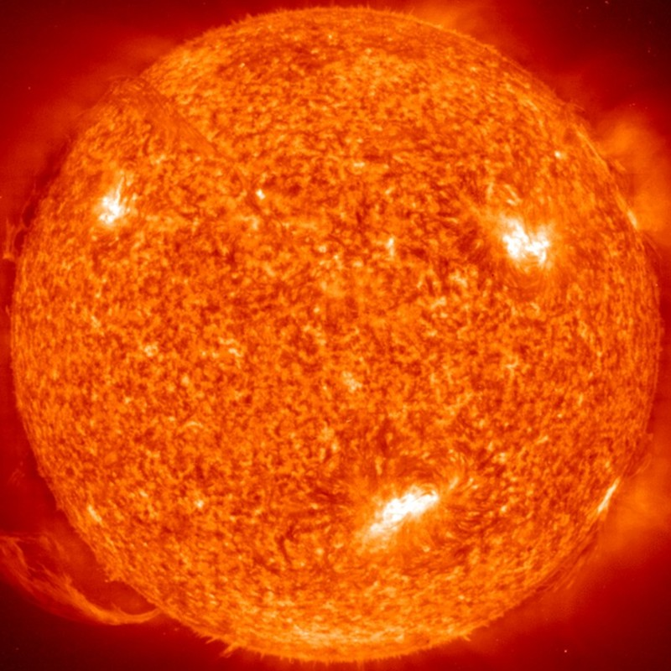
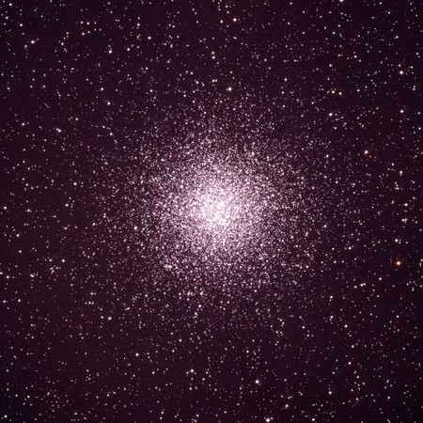
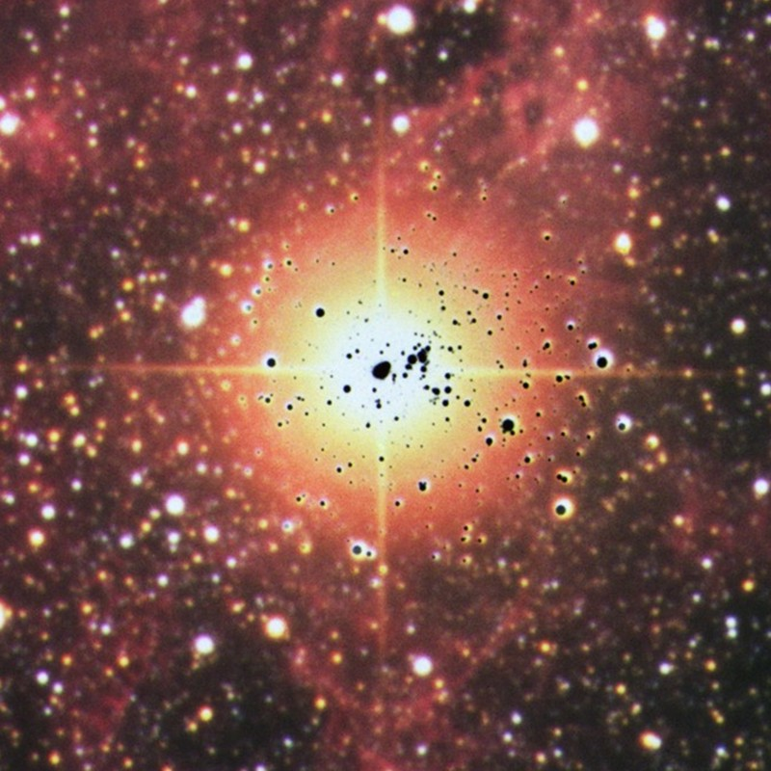
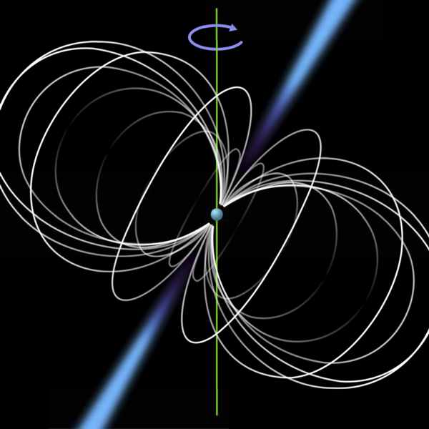
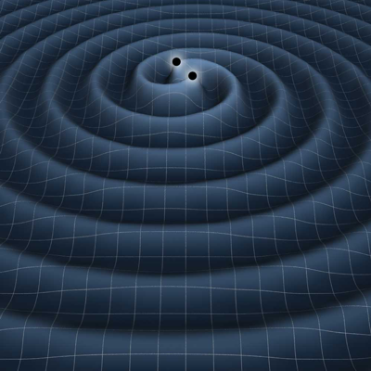
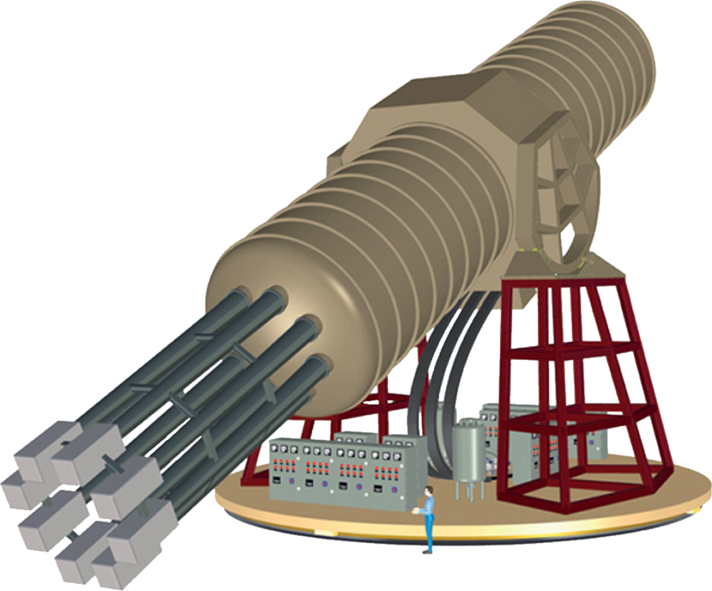



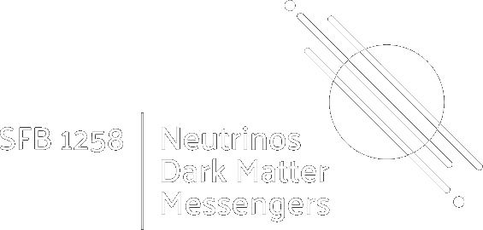
Axions and the Stars
Old Ideas and New Developments
Ringberg Castle, IMPRS Workshop, 4 June 2024
Solar Axions
Globular Clusters
Supernova 1987A
Neutron Stars
Gravitational Waves
Georg G. Raffelt, Max-Planck-Institut für Physik, Garching

Slide 2
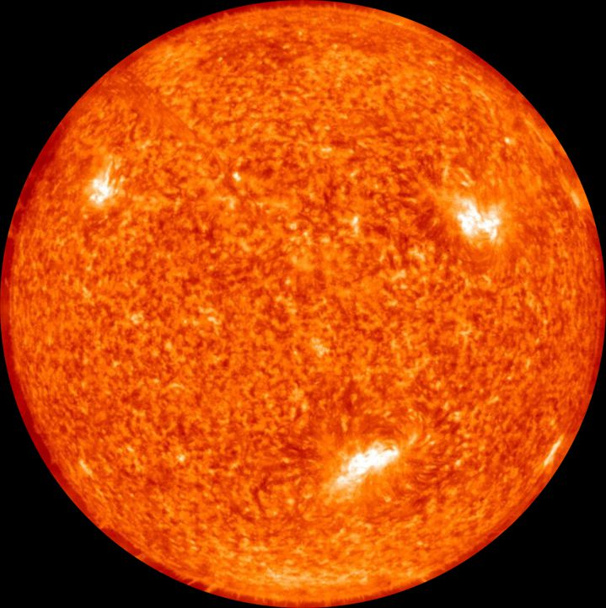

Particles and Stars
Low-mass particles are
produced in stellar interiors
• Detection opportunity
(Sun or Supernovae)
• Backreaction on stellar
properties
→ Which particles?
→ Which stars?

Slide 3






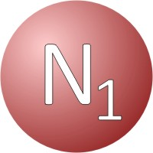
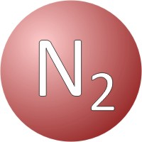
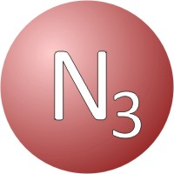
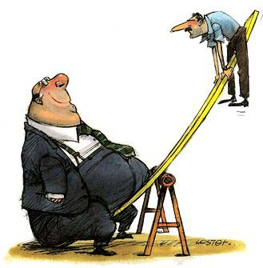










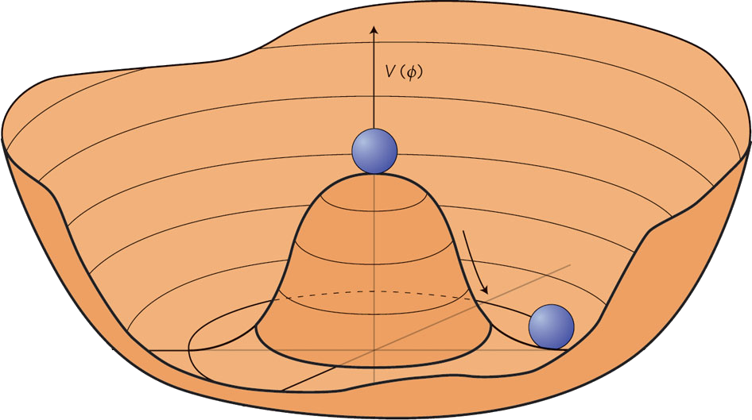





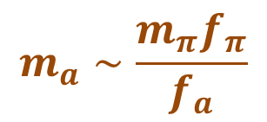


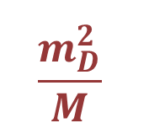










High- and Low-Energy Frontiers in Particle Physics
Cosmological
constant
QCD
scale
Electroweak
scale
GUT
scale
Planck
mass
Cosmic rays
$${10}^{−6}$$
$${10}^{−3}$$
$$1$$
$${10}^{3}$$
$${10}^{6}$$
$${10}^{9}$$
$${10}^{12}$$
$${10}^{15}$$
$${10}^{18}$$
$${10}^{21}$$
$${10}^{24}$$
$${10}^{27}$$
eV
Heavy right-handed
neutrinos
(see-saw mechanism)
$$\frac{m_{D}^{2}}{M}$$
$$m_{D}$$
$$M$$
WIMP dark matter
(related to EW scale, perhaps SUSY)
Axion dark matter (related to Peccei-Quinn symmetry)
$$m_{a}∼\frac{m_{π}f_{π}}{f_{a}}$$
$$m_{π}{, f}_{π}$$
$$f_{a}$$

Slide 4
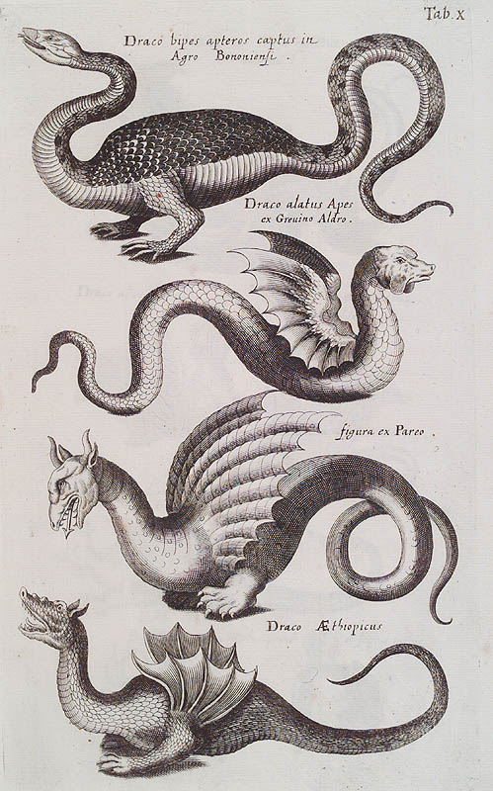
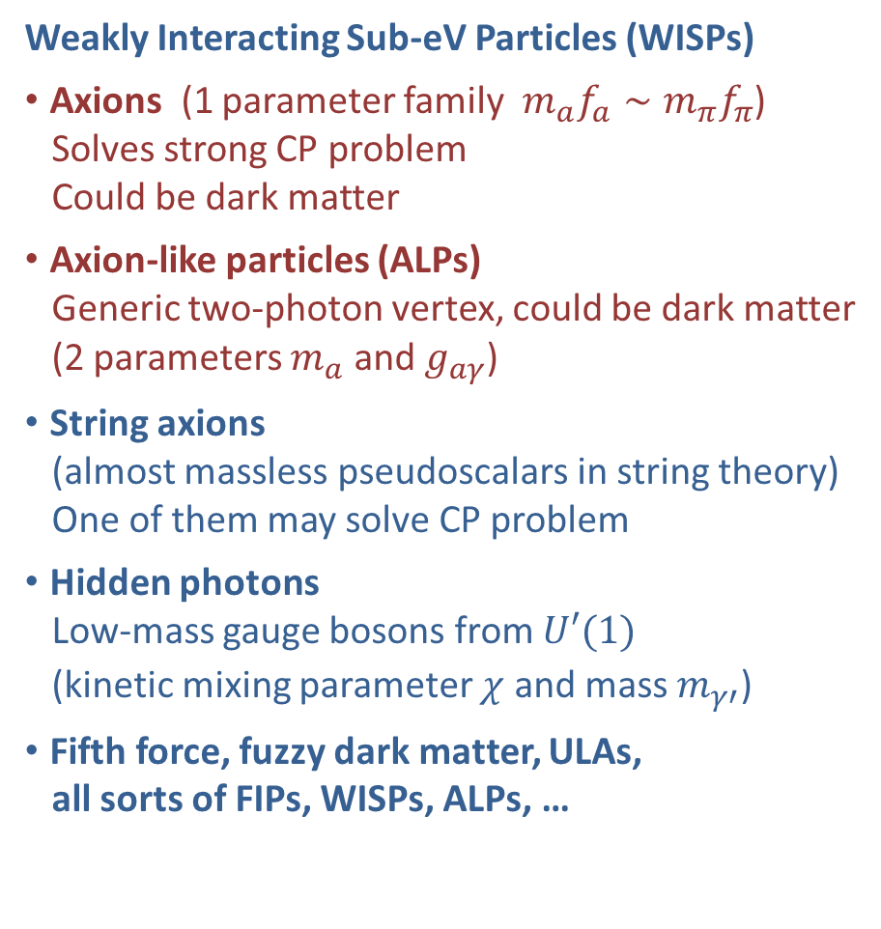
Bestiarium of Low-Mass Bosons
Weakly Interacting Sub-eV Particles (WISPs)
• Axions (1 parameter family $m_{a}f_{a}∼m_{π}f_{π}$)
Solves strong CP problem
Could be dark matter
• Axion-like particles (ALPs)
Generic two-photon vertex, could be dark matter
(2 parameters $m_{a}$ and $g_{aγ}$)
• String axions
(almost massless pseudoscalars in string theory)
One of them may solve CP problem
• Hidden photons
Low-mass gauge bosons from $U′(1)$
(kinetic mixing parameter $χ$ and mass $m_{γ′}^{}$)
• Fifth force, fuzzy dark matter, ULAs,
all sorts of FIPs, WISPs, ALPs, …
e.g. CERN 2022 workshop report, arXiv:2305.01715

Slide 5
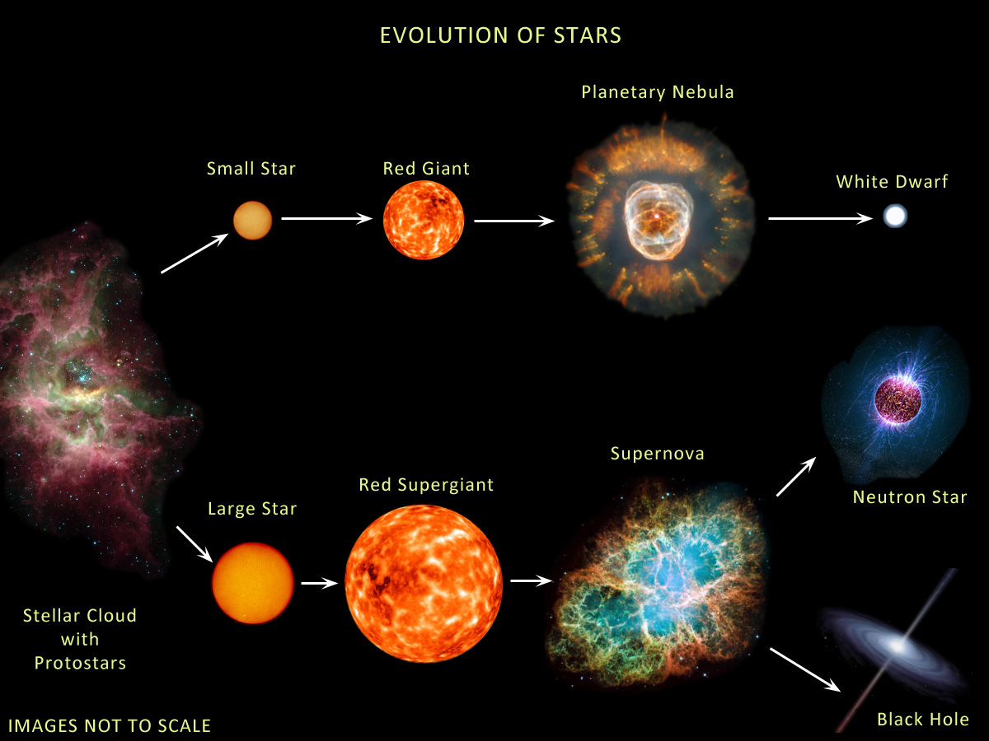





Evolution of Stars
Compact
Remnants:
$$M≲8 M_{⊙}$$
$1 M_{⊙}=2×{10}^{30}$kg
$$M∼0.6 M_{⊙}$$
R $∼$5000 km
Surface T ~ keV
Nuclear density
Surface T ~ eV (IR to UV)
Inner T ~ 1–100 keV
$M$ = 1–2$M_{⊙}$
R $∼$12 km
$$M≳8 M_{⊙}$$
Inner T ~ 30 MeV
few-tens $M_{⊙}$
few km
BR ≈ 25% (?)
http://earthspacecircle.blogspot.com/2013/07/stellar-evolution.html

Slide 6
Evolution of Stars
Particles from the Sun:
• Direct search
• Back-reaction on Sun
• Lifetime of horizontal-branch stars in globular clusters
• Brightness of tip of red-giant branch (TRGB)
• White dwarf luminosity function
• Period decrease of variable WDs
• WD Initial-final mass function
• EoS w/ axions
DM axion conversion in
pulsar magnetosphere
• Nus from SN 1987A & future SN
• Explosion energy
• Radiation from all past SNe
• Cooling speed
• EoS w/ axions
Superradiance
Core-collapse supernova

Slide 7
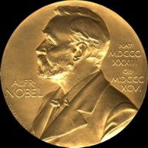

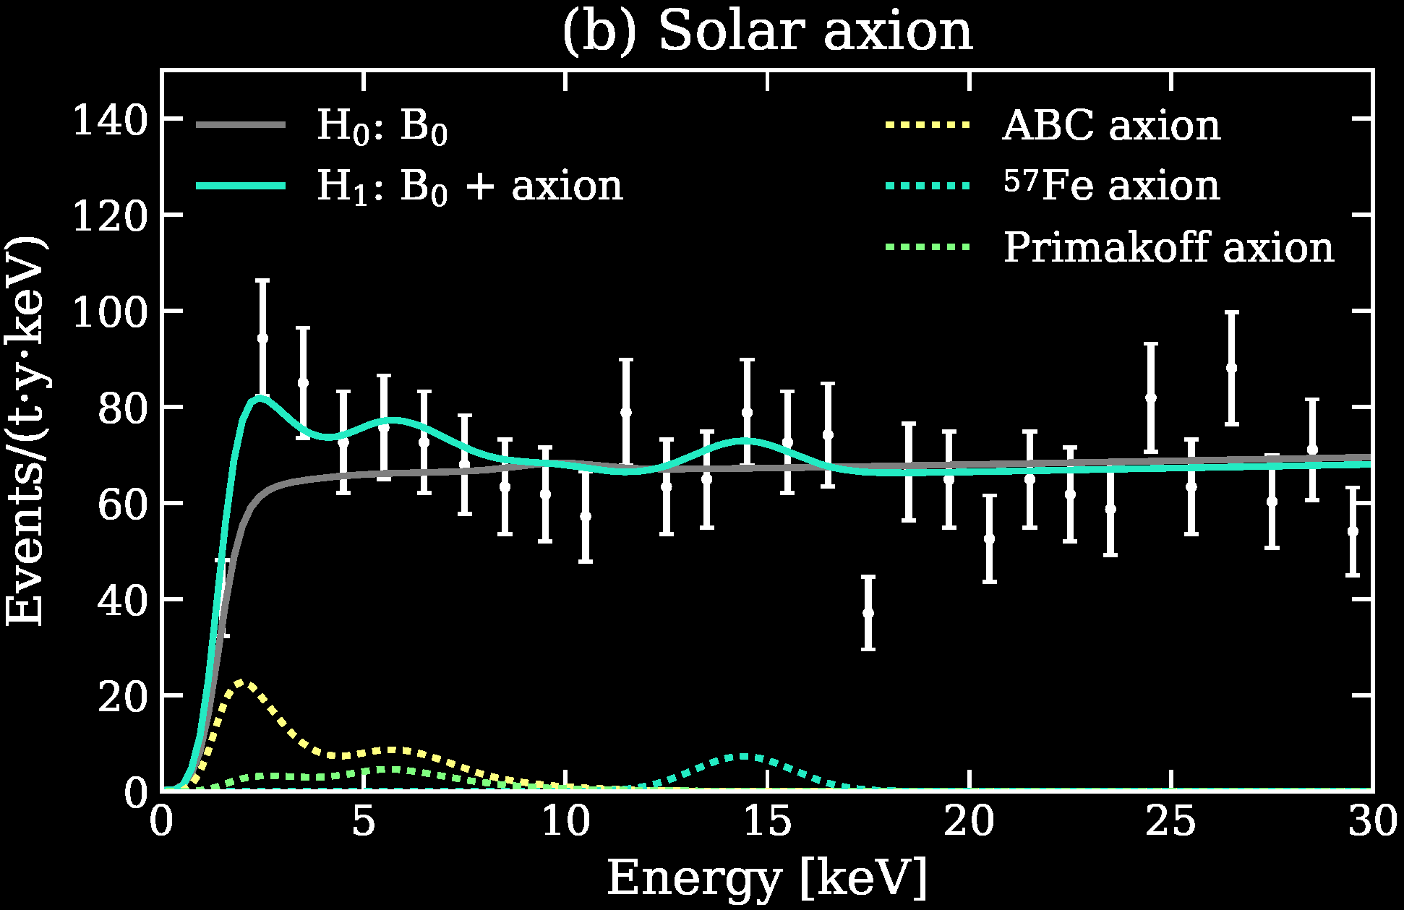
Particles from the Sun
2002 Solar Neutrinos (R.Davis, M.Koshiba)
2015 Solar Nu Oscillations (A.McDonald)
Search for solar axions
with CAST and future IAXO
Excess events in
XENON1T DM search.
Solar axions?
arXiv:2006.09721
XENONnT: no signal
arXiv:2207.11330

Slide 8
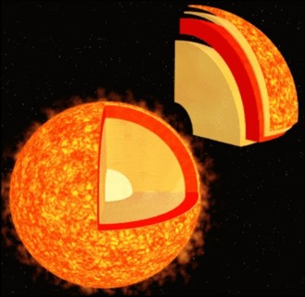
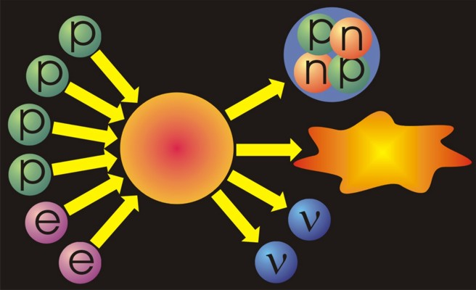
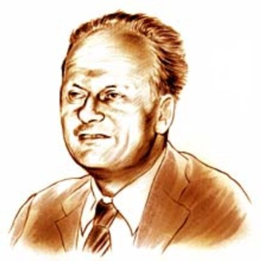
Neutrinos from the Sun
Helium
Reaction-
chains
Energy
26.7 MeV
Solar radiation: 98 % light (photons)
2 % neutrinos
At Earth 66 billion neutrinos/cm² sec
Hans Bethe (1906−2005, Nobel prize 1967)
Thermonuclear reaction chains (1938)

Slide 9
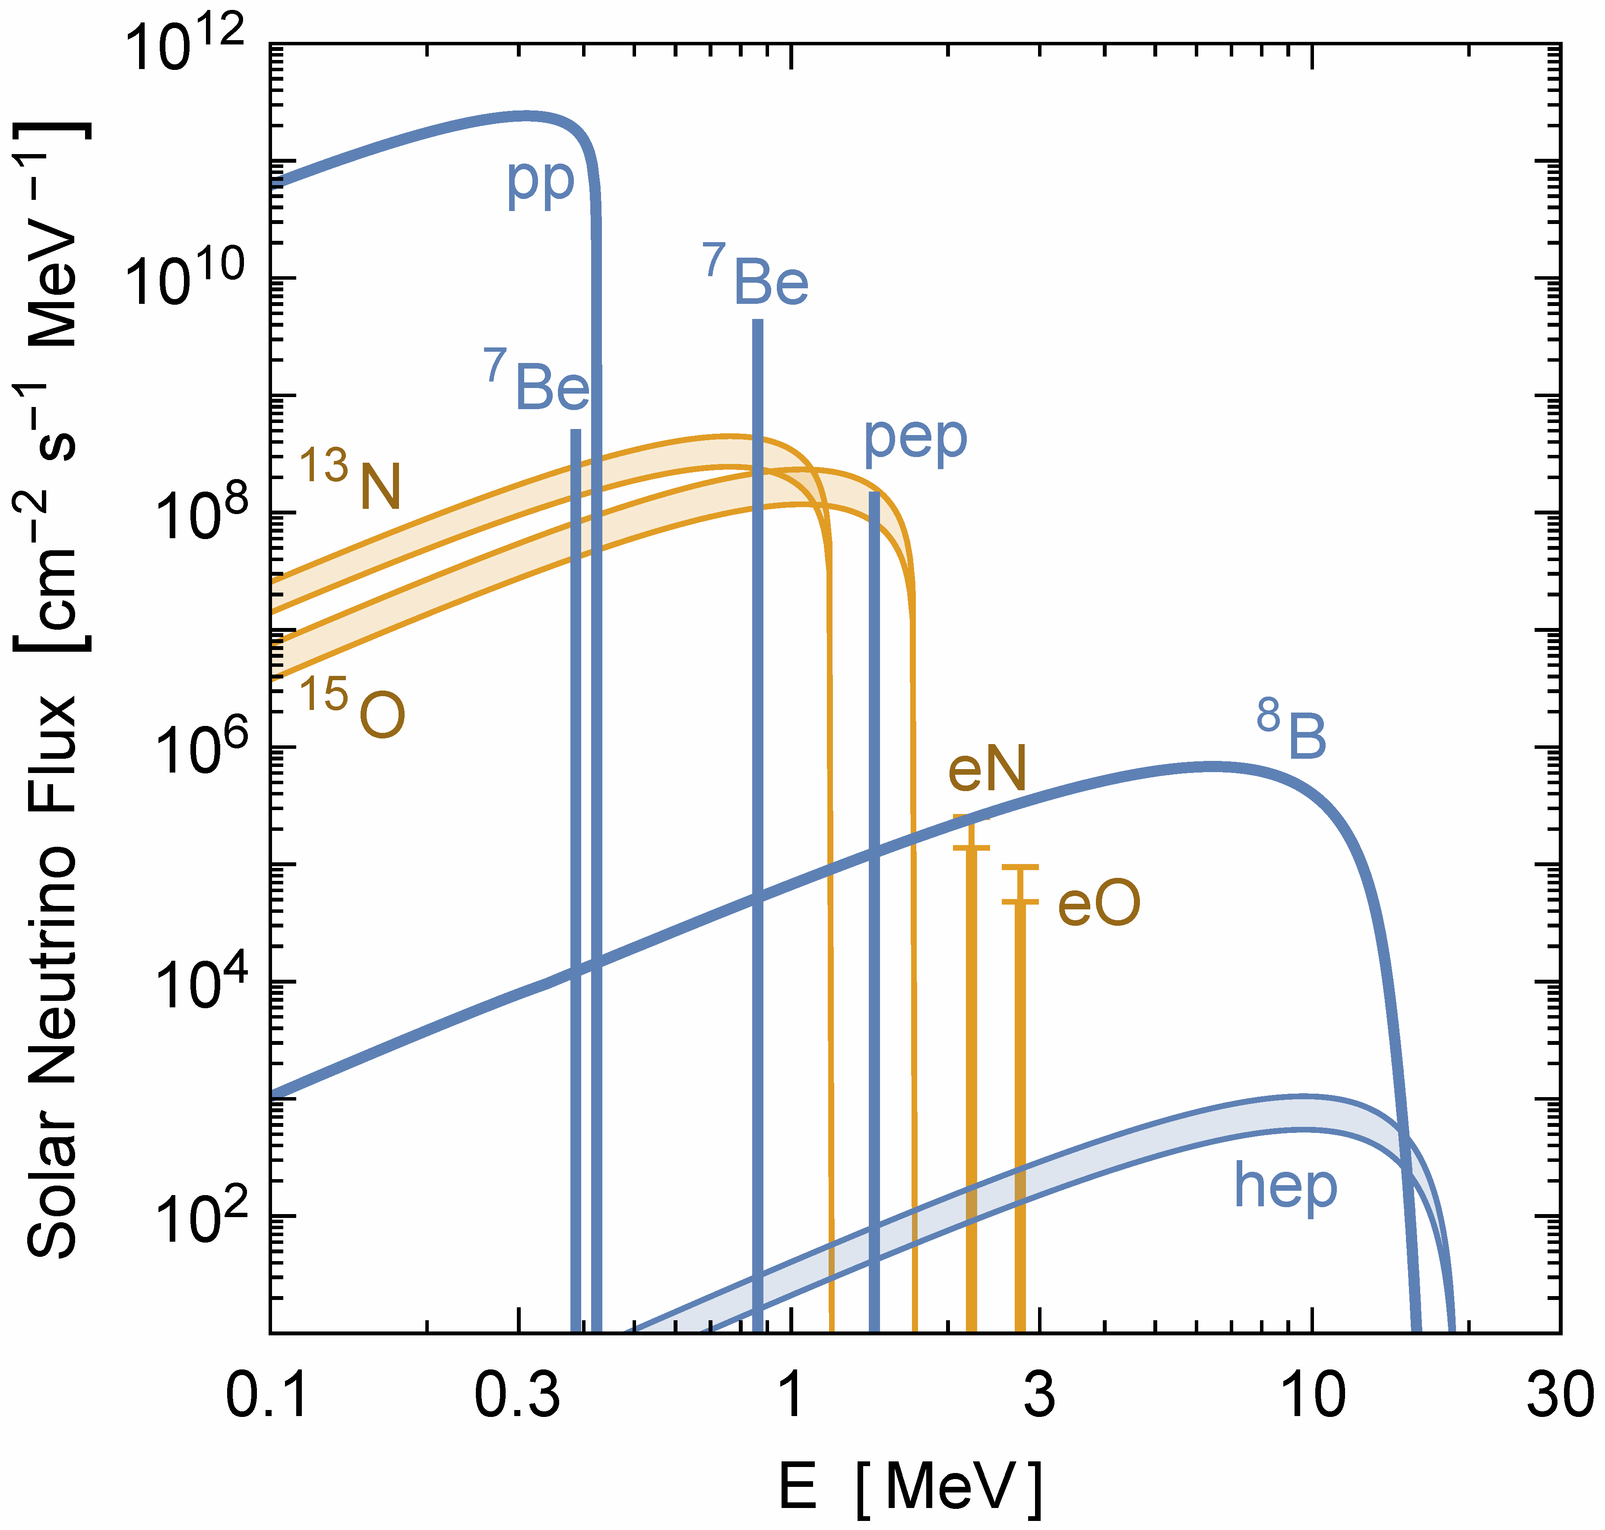
Solar Neutrinos from Nuclear Reactions
Vitagliano, Tamborra & Raffelt, arXiv:1910.11878
All components of pp
chains (blue) have
been measured
Very recently direct
experimental evidence
for CNO fluxes (orange)
in Borexino
arXiv:2006.15115 (06/2020)
Nature 587 (2020) 577
and arXiv:2205.15975
Favors higher flux,
and thus “high” CNO
abundance

Slide 10
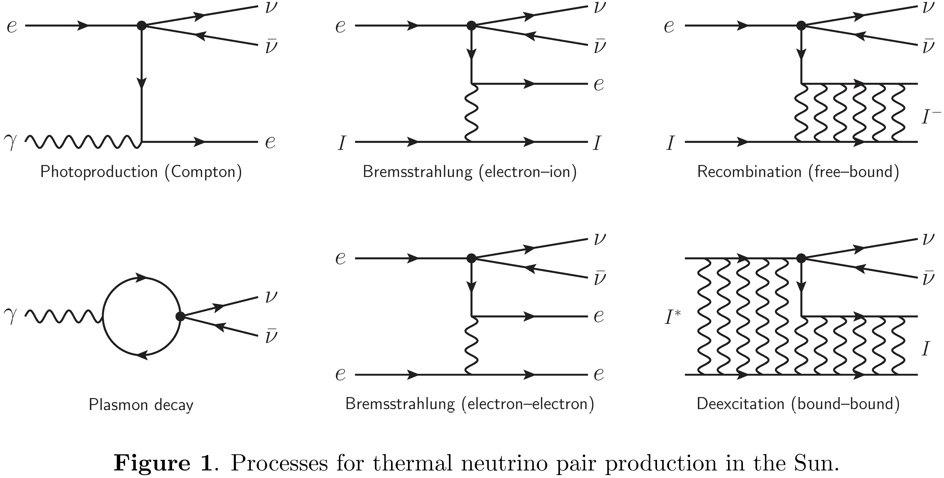
Thermal Neutrinos: Production Processes
Vitagliano, Redondo & Raffelt, arXiv:1708.02248

Slide 11
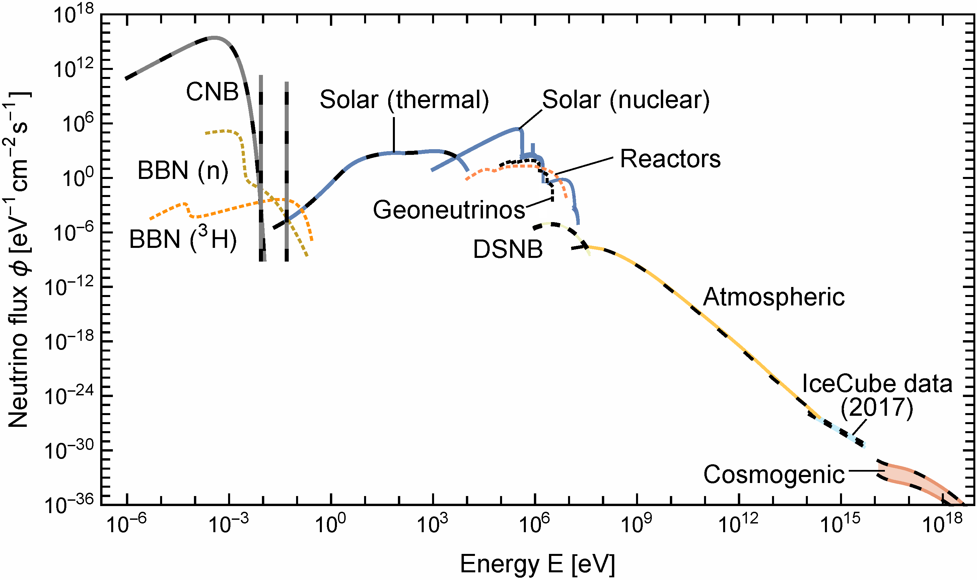
Grand Unified Neutrino Spectrum (GUNS) at Earth
Vitagliano, Tamborra & Raffelt, arXiv:1910.11878
You can design your own version with data and/or Mathematica notebook attached to arXiv paper

Slide 12

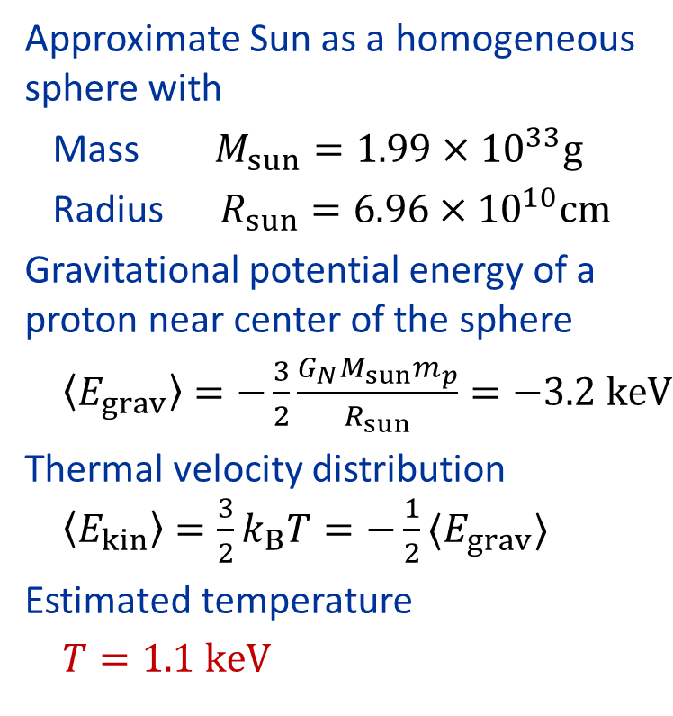

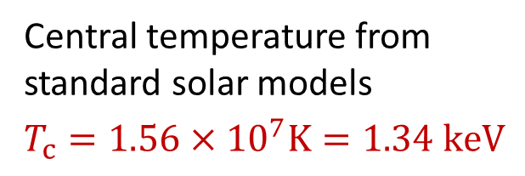
Temperature in the Sun
Virial Theorem $〈E_{kin}〉=−\frac{1}{2}〈E_{grav}〉$
Approximate Sun as a homogeneous
sphere with
Mass $M_{sun}=1.99×{10}^{33}g$
Radius $R_{sun}=6.96×{10}^{10}cm$
Gravitational potential energy of a
proton near center of the sphere
$〈E_{grav}〉=−\frac{3}{2}\frac{G_{N}M_{sun}m_{p}}{R_{sun}}=−3.2 keV$
Thermal velocity distribution
$〈E_{kin}〉=\frac{3}{2}k_{B}T=−\frac{1}{2}〈E_{grav}〉$
Estimated temperature
$T=1.1 keV$
Central temperature from
standard solar models
$$T_{c}=1.56×{10}^{7}K=1.34 keV$$

Slide 13
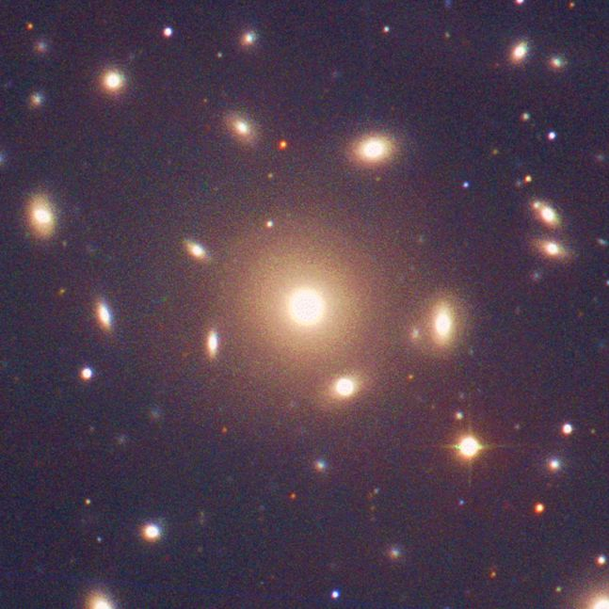
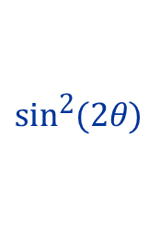
Virial Theorem – Dark Matter in Galaxy Clusters
A gravitationally bound
system of many particles
obeys the virial theorem
$$2〈E_{kin}〉=−〈E_{grav}〉$$
$$2\left\langle \frac{mv^{2}}{2}\right\rangle =\left\langle \frac{G_{N}M_{r}m}{r}\right\rangle$$
$$\left\langle v^{2}\right\rangle ≈G_{N}M_{r}\left\langle r^{−1}\right\rangle$$
Velocity dispersion
from Doppler shifts
and geometric size
Total Mass
Coma Cluster

Slide 14
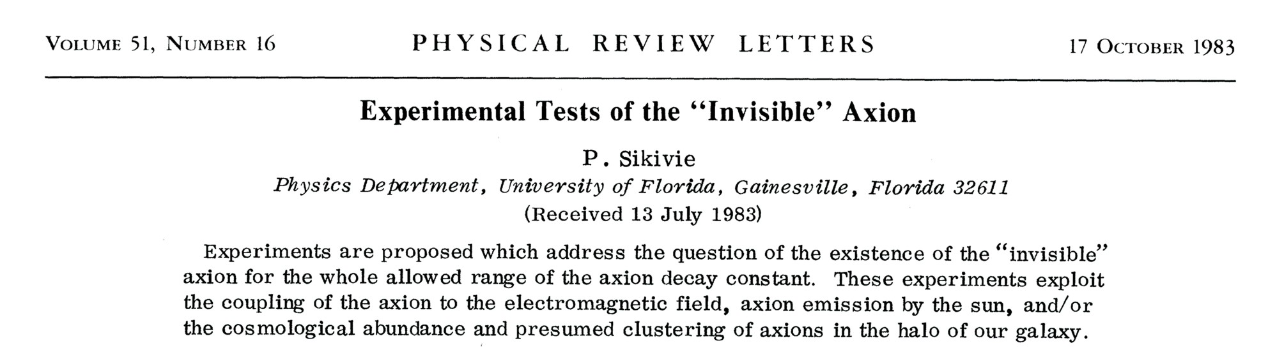
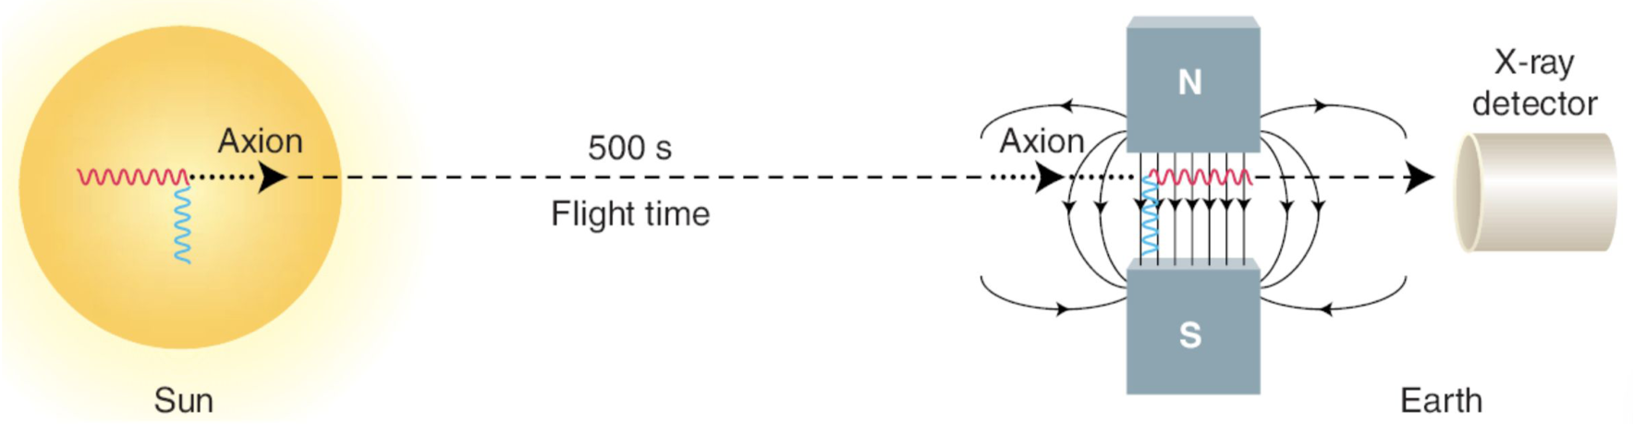
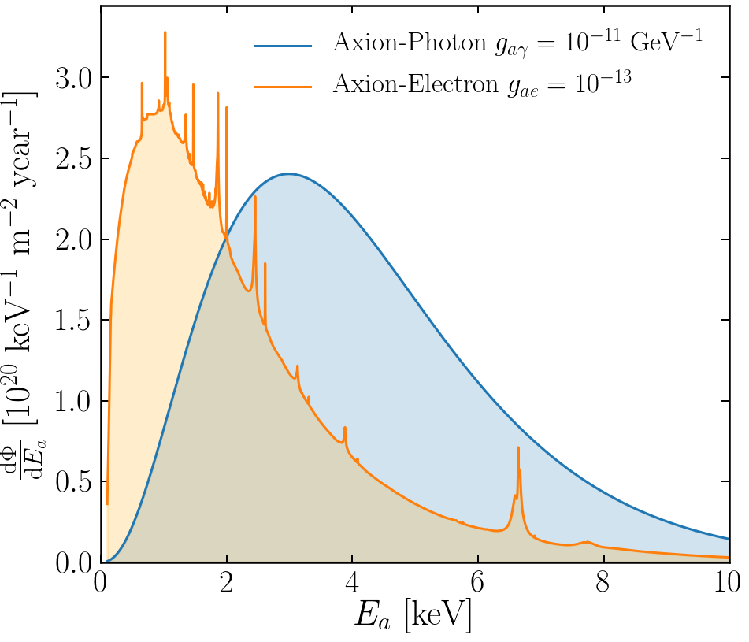
Experimental Tests of Invisible Axions
● Large coherence length overcomes
small coupling
● Axion-photon conversion in B-field similar to
neutrino flavor oscillation, PRD 37 (1988) 1237
● Can be enhanced with gas filling
van Bibber+ PRD 39 (1989) 2089
Primakoff
https://cajohare.github.io/IAXOmass/

Slide 15
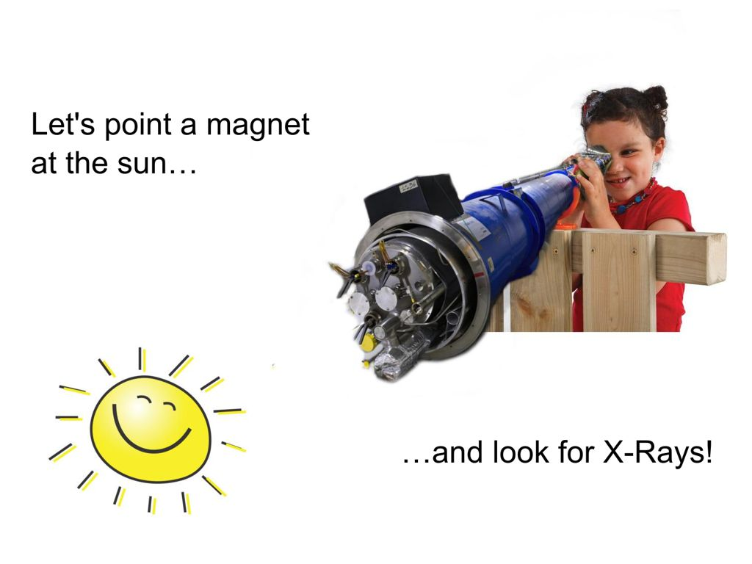
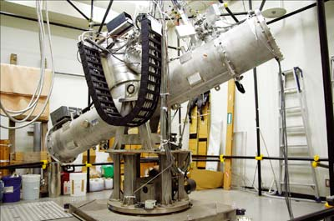
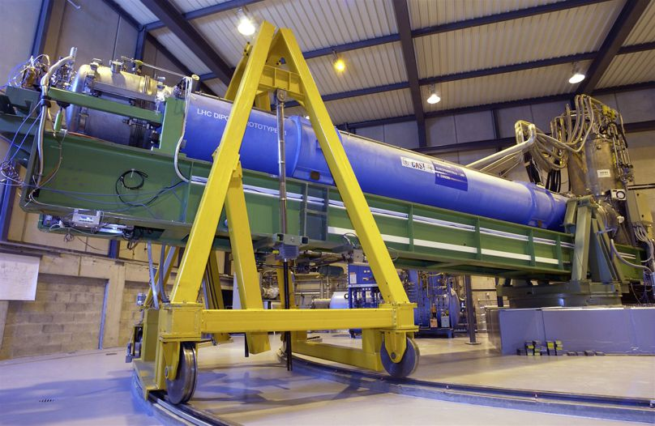
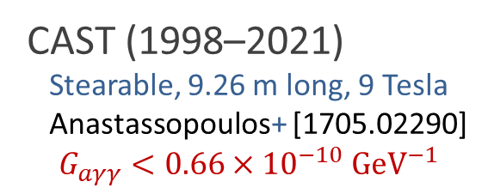
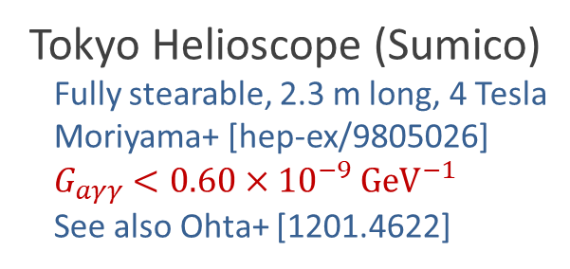
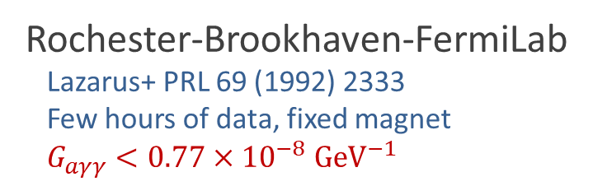
Pointing a Magnet to the Sun
Rochester-Brookhaven-FermiLab
Lazarus+ PRL 69 (1992) 2333
Few hours of data, fixed magnet
$G_{aγγ}<0.77×{10}^{−8} GeV^{−1}$
© Sebastian Baum
Tokyo Helioscope (Sumico)
Fully stearable, 2.3 m long, 4 Tesla
Moriyama+ [hep-ex/9805026]
$G_{aγγ}<0.60×{10}^{−9} GeV^{−1}$
See also Ohta+ [1201.4622]
CAST (1998–2021)
Stearable, 9.26 m long, 9 Tesla
Anastassopoulos+ [1705.02290]
$$G_{aγγ}<0.66×{10}^{−10} GeV^{−1}$$
CAST Movie on YouTube
https://youtu.be/XY2lFDXz8aQ

Slide 16
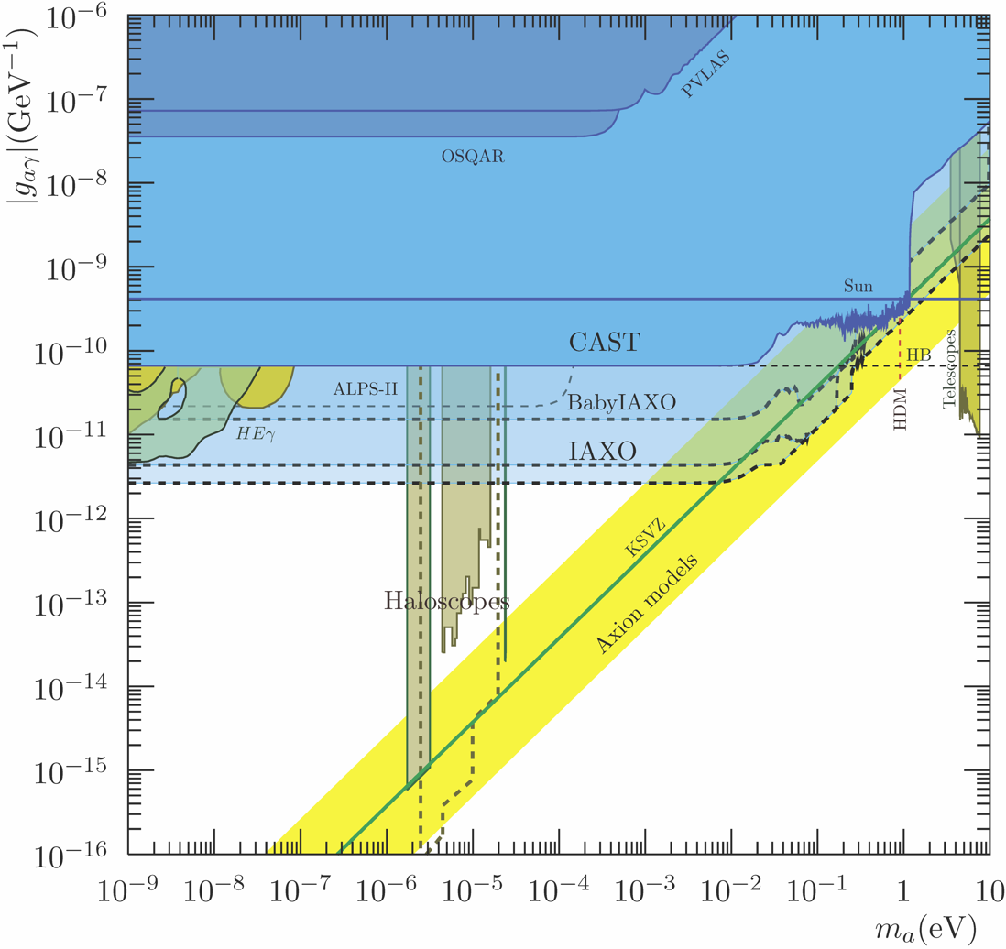

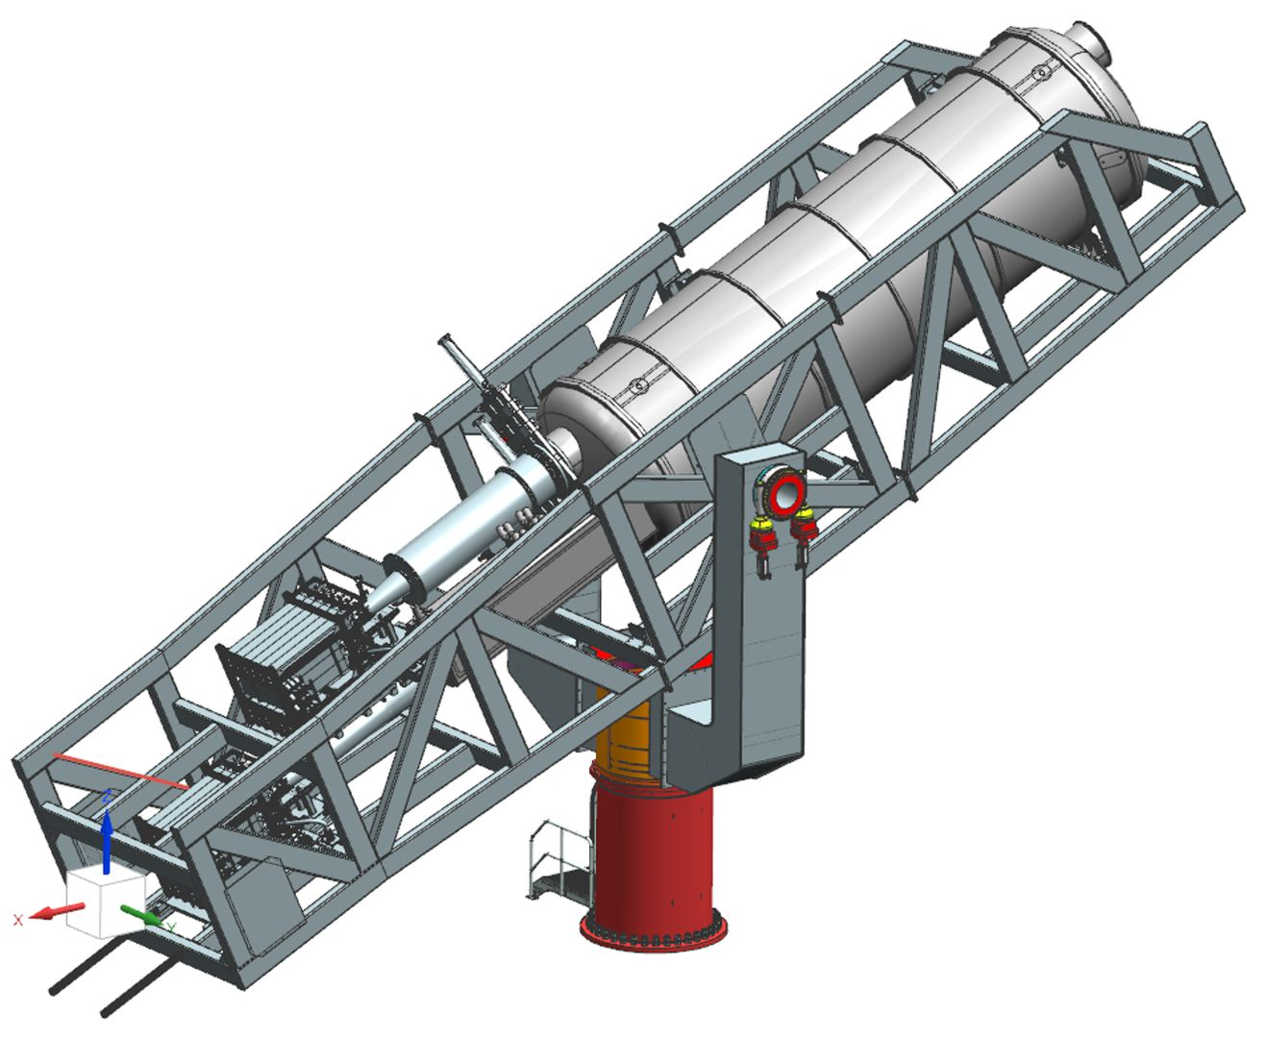
(Baby) IAXO Sensitivity Forecast
Discovery potential
for QCD axions
Physics potential of the International Axion Observatory (IAXO)
JCAP 1906 (2019) 047, arXiv:1904.09155

Slide 17
Grand Unified ALP Scape
Ciaran O'Hare @ Github

Slide 18
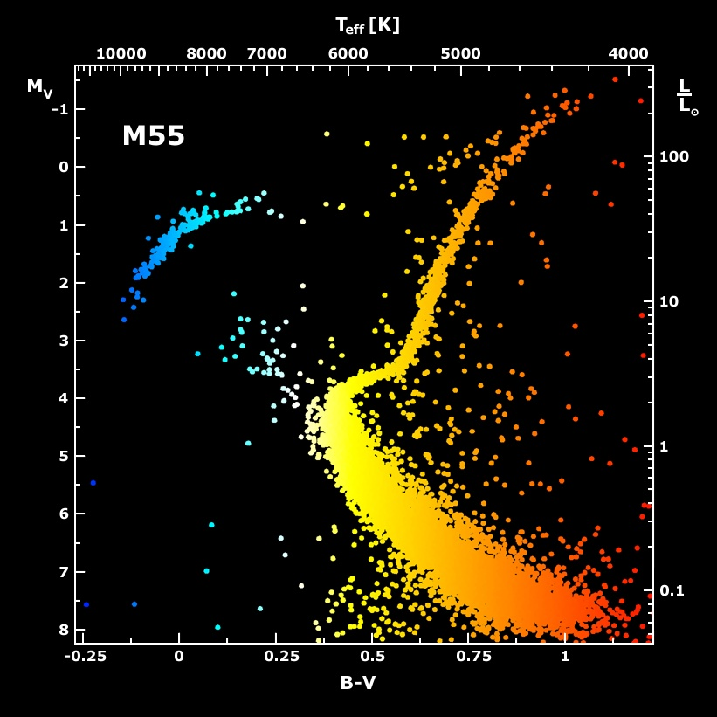
Galactic Globular Cluster M55

Slide 19
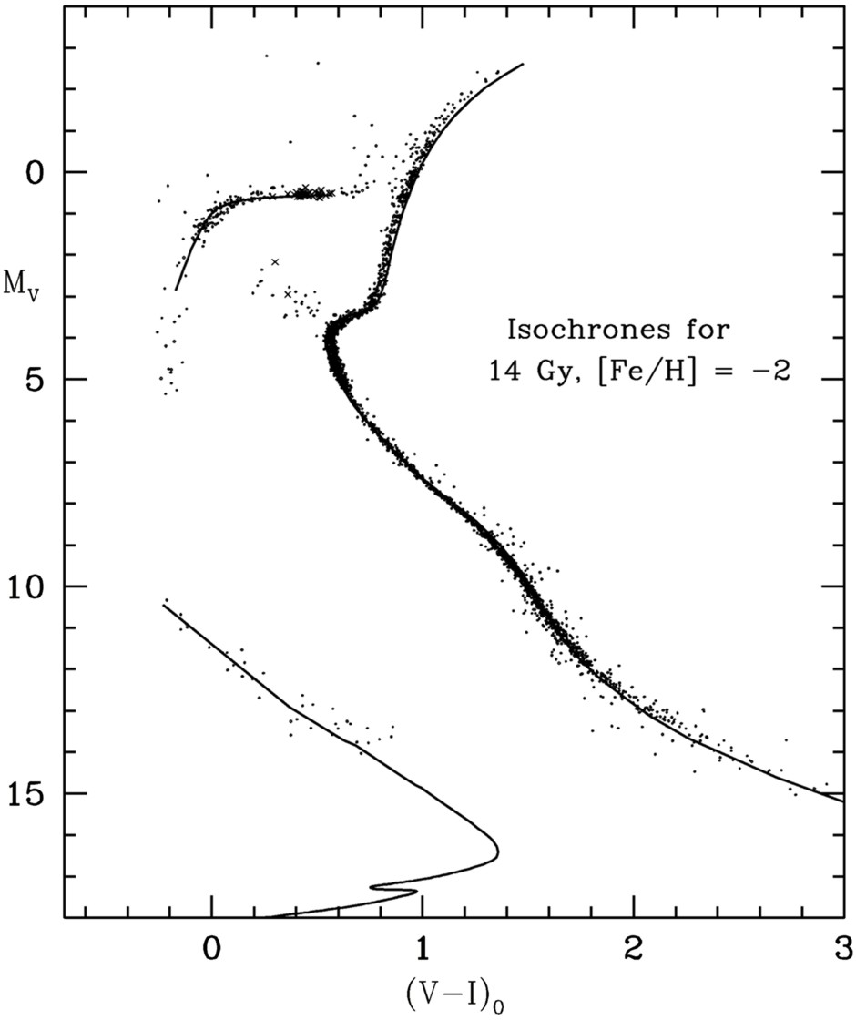
Color-Magnitude Diagram for Globular Clusters
H
H
He
C O
He
Asymptotic Giant
Red Giant
H
H
He
C O
White
Dwarfs
Horizontal Branch
Main-Sequence
Hot, blue
cold, red
Color-magnitude diagram synthesized from several low-metallicity globular
clusters and compared with theoretical isochrones (W.Harris, 2000)

Slide 20
Color-Magnitude Diagram for Globular Clusters
H
H
He
C O
He
Asymptotic Giant
Red Giant
H
Particle emission reduces
helium burning lifetime,
i.e. number of HB stars
H
He
C O
White
Dwarfs
Horizontal Branch
Main-Sequence
Hot, blue
cold, red
Color-magnitude diagram synthesized from several low-metallicity globular
clusters and compared with theoretical isochrones (W.Harris, 2000)

Slide 21
Color-Magnitude Diagram for Globular Clusters
H
Particle cooling delays
He ignition, makes stars
at tip of RGB brighter
H
He
C O
He
Asymptotic Giant
Red Giant
H
H
He
C O
White
Dwarfs
Horizontal Branch
Main-Sequence
Hot, blue
cold, red
Color-magnitude diagram synthesized from several low-metallicity globular
clusters and compared with theoretical isochrones (W.Harris, 2000)

Slide 22
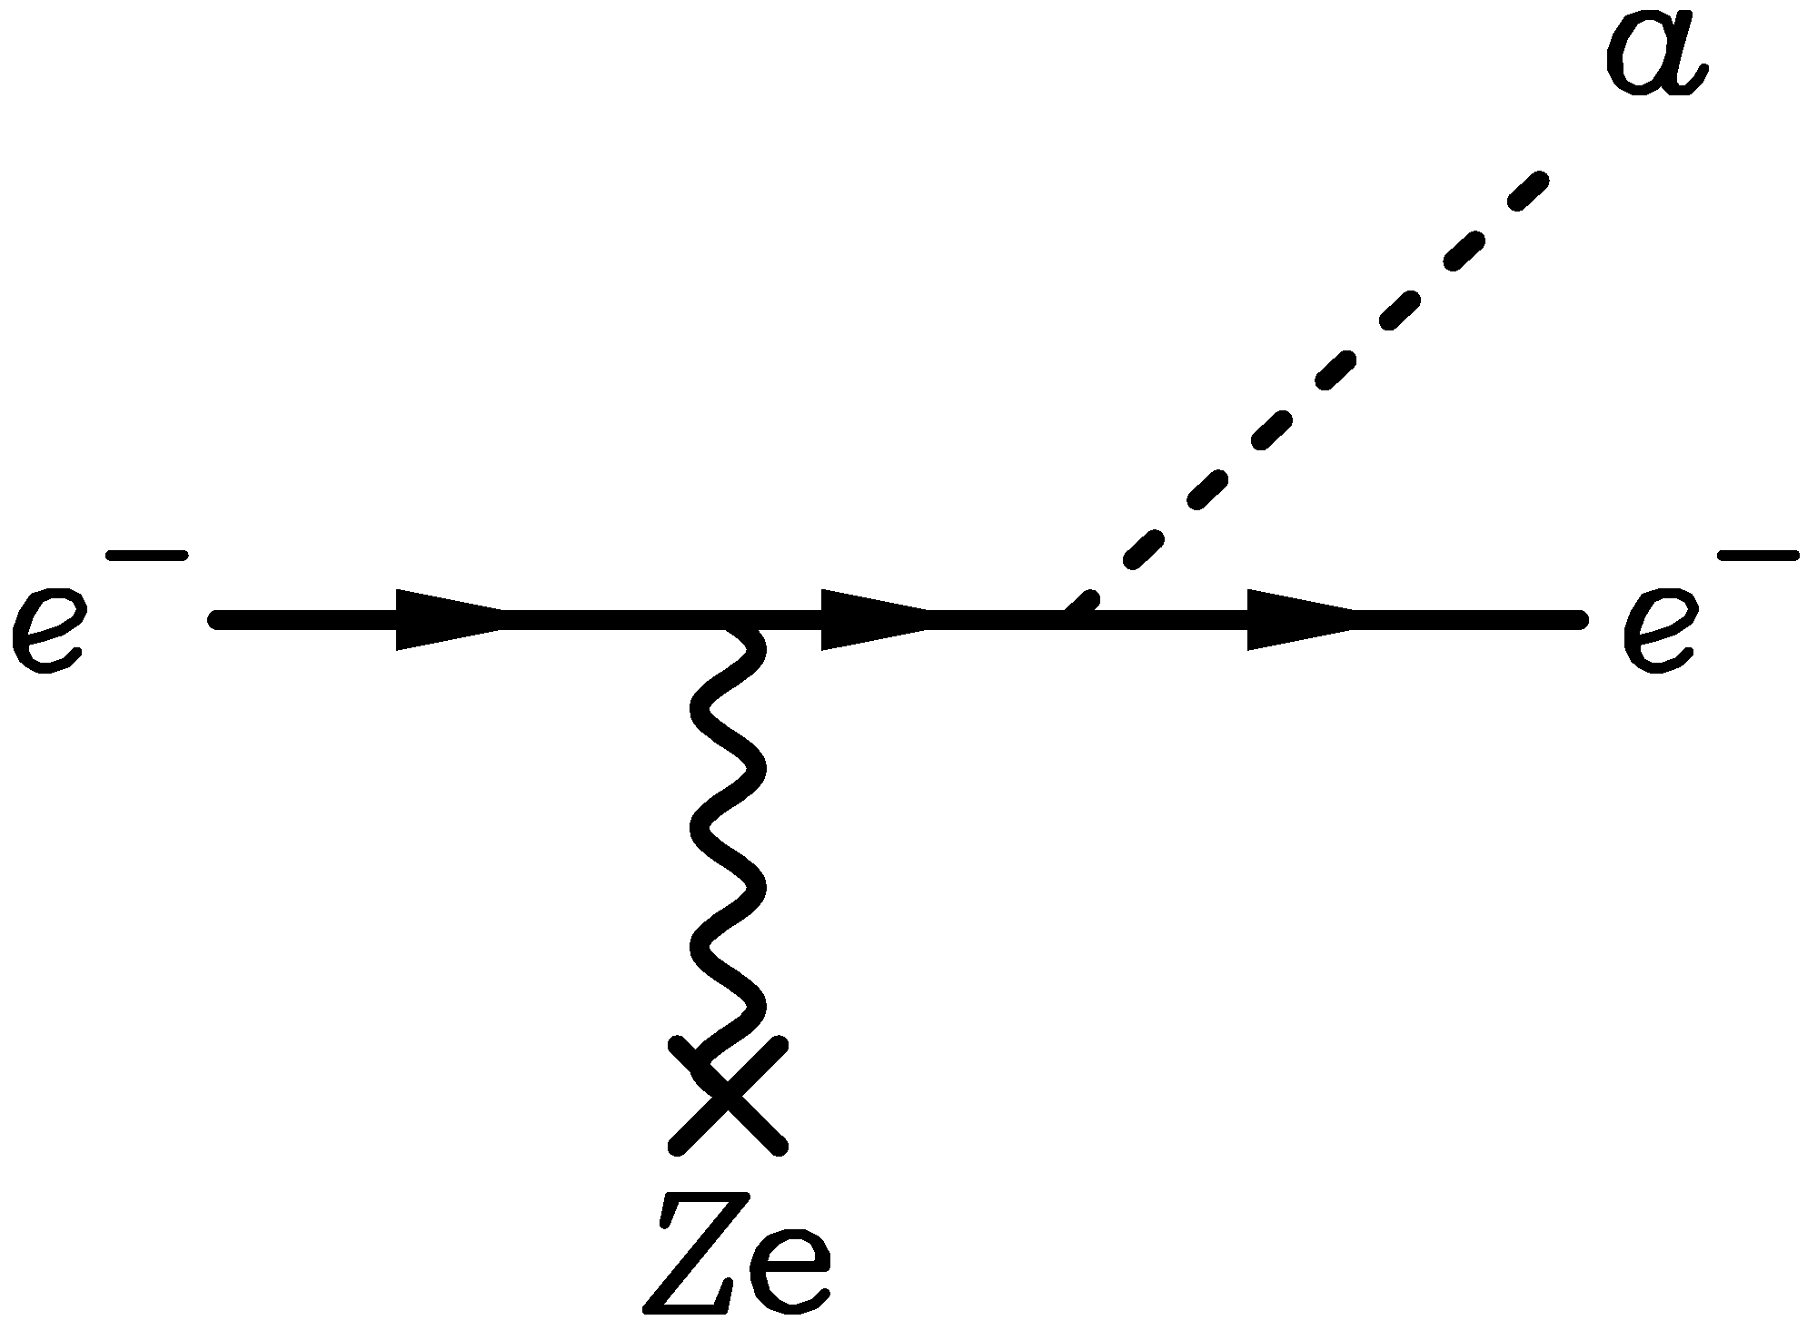

Color-Magnitude Diagram for Globular Clusters
Emission of axions & friends
with direct electron coupling
H
H
He
C O
He
$$g_{ae}$$
Asymptotic Giant
Red Giant
Bremsstrahlung emission by
degenerate electrons
H
H
He
C O
White
Dwarfs
Horizontal Branch
Main-Sequence
Hot, blue
cold, red
Color-magnitude diagram synthesized from several low-metallicity globular
clusters and compared with theoretical isochrones (W.Harris, 2000)

Slide 23
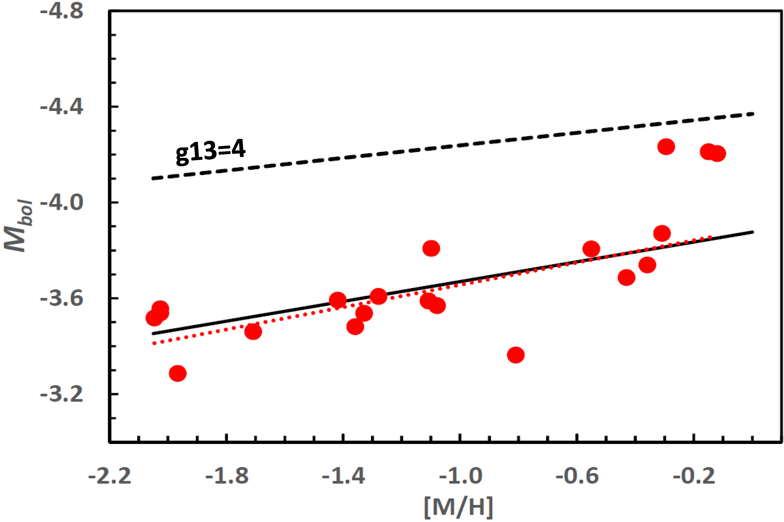
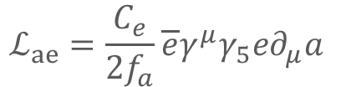

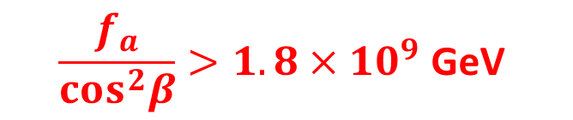

New TRGB Calibration from 21 Globular Clusters
Straniero+ arXiv:2010.03833 and https://www.ggi.infn.it/talkfiles/slides/slides6554.pdf
Emission of axions & friends
with direct electron coupling
$$g_{ae}$$
Theoretical Prediction
TRGB in 21 GCs
$g_{ae}<0.96×{10}^{−13}$ (95% CL)
Bremsstrahlung emission by
degenerate electrons
Metallicity [M/H]
DFSZ Axions
$$m_{a}=6 meV\frac{{10}^{9}GeV}{f_{a}}$$
}
$$g_{ae}=\frac{m_{e}C_{e}}{f_{a}}$$
$$\frac{f_{a}}{cos^{2}β}>1.8×{10}^{9} \text{GeV}$$
$$ℒ_{ae}=\frac{C_{e}}{2f_{a}}\overline{e}γ^{μ}γ_{5}e∂_{μ}a$$
$$C_{e}=\frac{\cos^{2}{β}}{3}$$

Slide 24
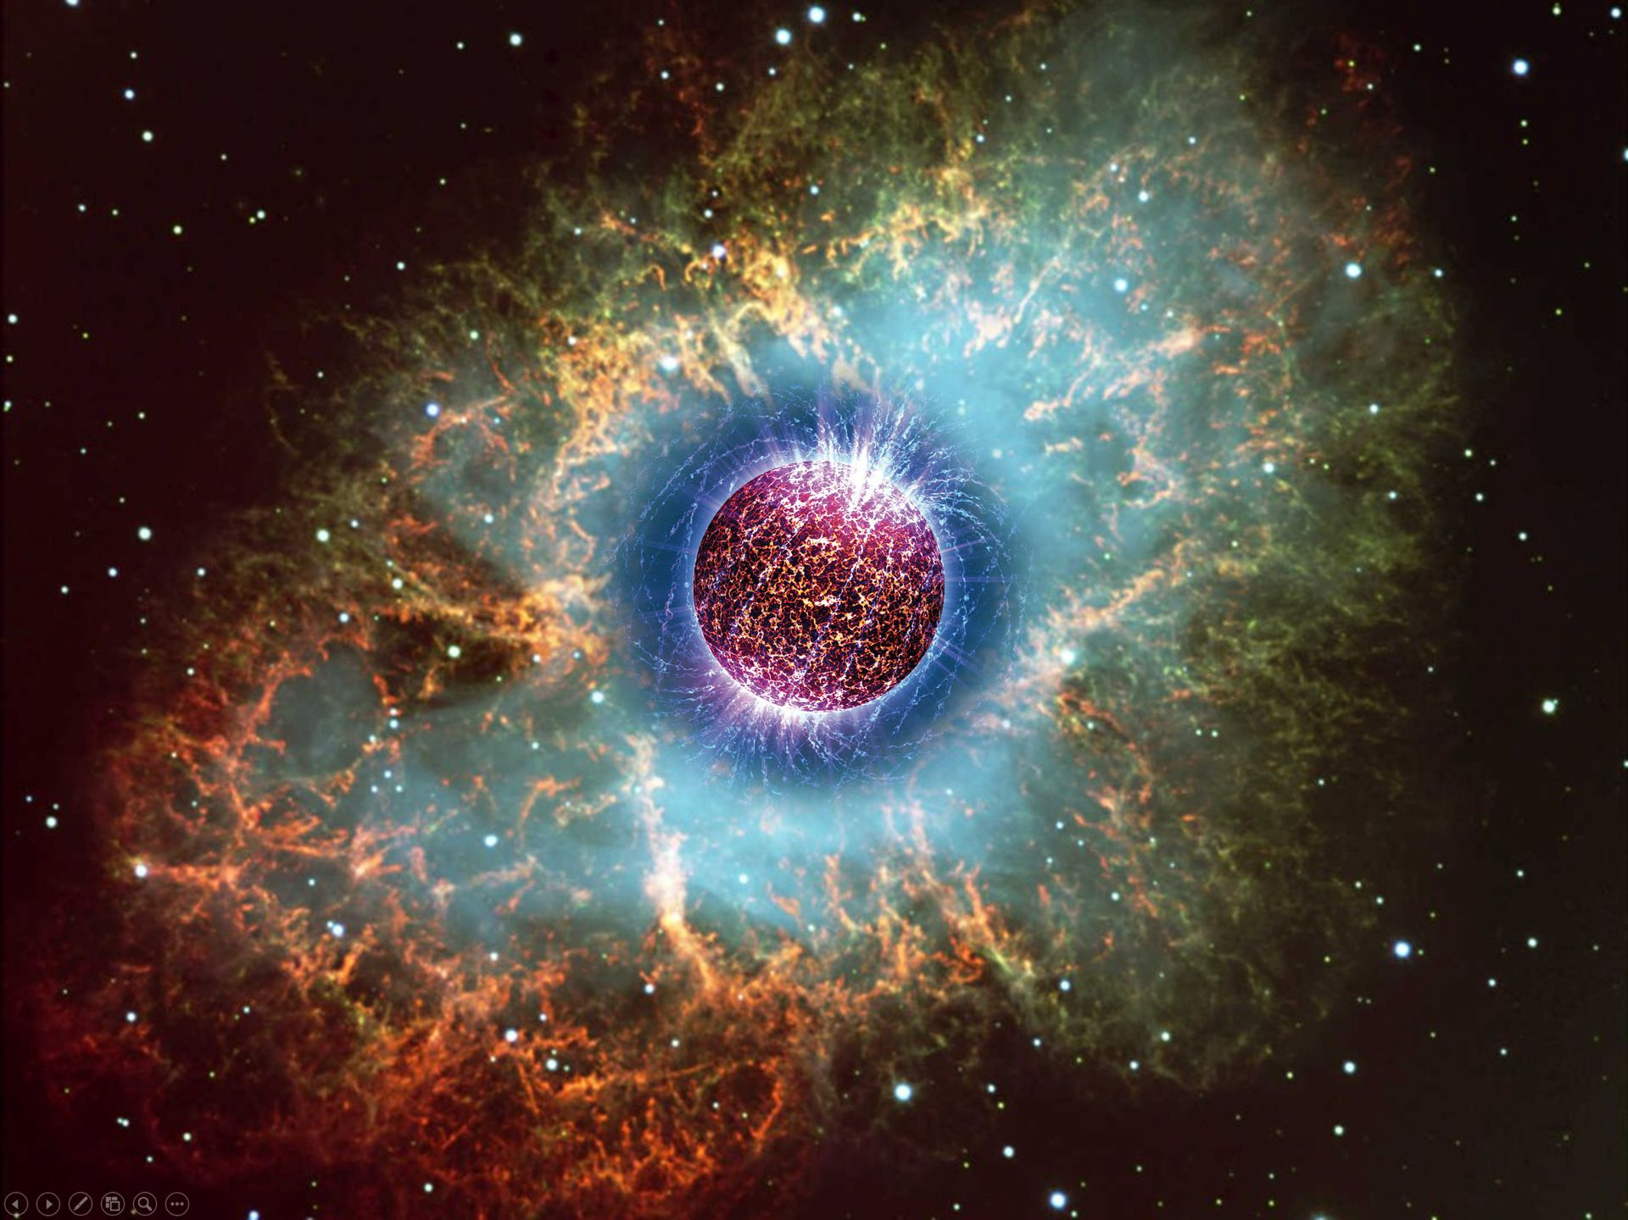
Crab Nebula – Remnant of SN 1054
Supernovae and
Neutron Stars

Slide 25
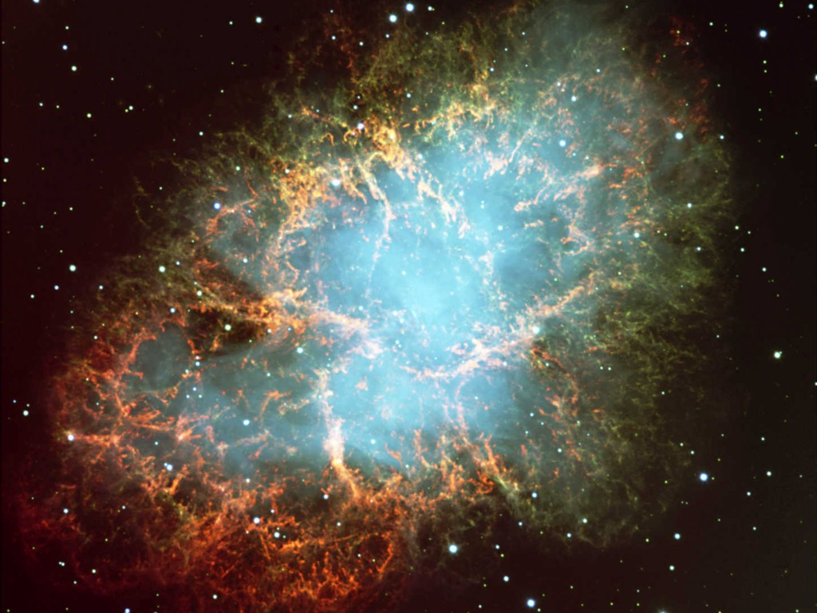
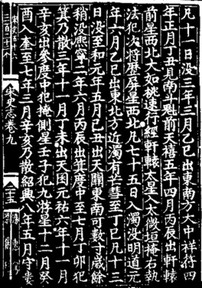

Crab Nebula – Remnant of SN 1054
Crab Nebula – Remnant of SN 1054
Crab Pulsar
Chandra X-ray composite image

Slide 26




Stellar Collapse and Supernova Explosion
Onion structure
Collapse (implosion)
Main-sequence star
Helium-burning star
Degenerate iron core:
ρ ≈ 10⁹ g cm⁻³
T ≈ 10¹⁰ K
M_{Fe} ≈ 1.5 M_{sun}
R_{Fe} ≈ 3000 km
Hydrogen Burning
Helium
Burning
Hydrogen
Burning

Slide 27



Stellar Collapse and Supernova Explosion
Newborn Neutron Star
Collapse (implosion)
Explosion
$\sim$ 50 km
Proto-Neutron Star
ρ $\sim$ ρ_{nuc} = 3 × 10¹⁴ g cm⁻³
T $\sim$ 10 MeV

Slide 28
Stellar Collapse and Supernova Explosion
Newborn Neutron Star
$\sim$ 50 km
Gravitational binding energy
E_{b} ≈ 3 × 10⁵³ erg ≈ 17% M_{SUN} c²
This shows up as
99% Neutrinos
1% Kinetic energy of explosion
0.01% Photons, outshine host galaxy
Neutrino luminosity
L_{ν} $\sim$ 3 × 10⁵³ erg / 3 sec
$\sim$ 3 × 10¹⁹ L_{SUN}
While it lasts, outshines the entire
visible universe
Neutrino
cooling by
diffusion
Proto-Neutron Star
ρ $\sim$ ρ_{nuc} = 3 × 10¹⁴ g cm⁻³
T $\sim$ 10 MeV

Slide 29
Neutrino-Driven Mechanism – Modern Version
• Stalled accretion shock pushed out
to ~150 km as matter piles up on the PNS
• Heating (gain) region develops within
some tens of ms after bounce
• Convective overturn & shock
oscillations (SASI) enhance efficiency
of ν-heating, finally revives shock
• Successful explosions in 1D and 2D
for different progenitor masses
• Details important (treatment of GR,
ν interaction rates, etc.)
• Self-consistent 3D studies are
performed, successful explosions
Shock oscillations
(SASI)
ν heating
Convection
ν cooling
Gain
radius
Shock
3D Model of Princeton Group:
https://youtu.be/i-Ly8aCoF7E
Adapted from B. Müller

Slide 30


Sanduleak -69 202
Sanduleak −69 202
Supernova 1987A
23 February 1987
in the Tarantula Nebula
in the Large Magellanic Cloud
Distance 50 kpc
(160.000 light years)

Slide 31

Supernova 1987A Energy-Loss Argument
SN 1987A neutrino signal
Neutrino
sphere
Volume emission
of new particles
Neutrino
diffusion
Emission of very weakly interacting
particles would “steal” energy from the
neutrino burst and shorten it.
(Early neutrino burst powered by accretion,
not sensitive to volume energy loss.)
Late-time signal most sensitive observable

Slide 32






New Interest in SN 1987A as Particle Lab

Slide 33

SN 1987A Signal Duration Too Long?
Fiorillo+ arXiv:2308.01403
Expected Signal & BKG
Expected Signal & BKG
Expected Signal & BKG
● In a suite of Garching models (no axions), expected signal always too short
(PNS convection!)
● Deserves dedicated study

Slide 34


Where is the Neutron Star of SN 1987A?
No pulsar or neutron star has been seen until now (35 years later)
• Infra-red excess observed by ALMA: In “the blob” strong indication for NS
Expected position, remnant hidden by dust [Cigan+ arXiv:1910.02960]
• Most plausible model: Thermally cooling non-pulsar NS [Page+ arXiv:2004.06078]
https://www.bbc.com/news/science-environment-50473482
Atacama Large Millimeter/Submillimeter Array (ALMA) at ESO in Chile
1.5×10¹² km

Slide 35

Axion Emission from a Nuclear Medium
Axion-nucleon interaction: $ℒ_{int}=\frac{C_{N}}{2f_{a}} {\overline{Ψ}}_{N}γ_{μ}γ_{5}Ψ_{N}∂^{μ}a=\frac{C_{N}}{2f_{a}}J_{μ}^{A}∂_{a}^{μ}$
a
N
N
+ ...
Axial-vector interaction implies
dominance of spin-dependent process
V
N
N
Nucleon-Nucleon
Bremsstrahlung
• Interaction potential (one-pion exchange OPE often used, but too simplistic)
• In-medium coupling constants
• In-medium effective nucleon properties
• Correlation effects (static and dynamical spin-spin correlations)
→ For latest discussion see Carenza et al. arXiv:1906.11844
Thermal $π^{−}$ contribute significant (dominant?)
$$π^{−}$$
a
p
n
→ For latest discussion see Carenza et al. arXiv:2010.02943

Slide 36

Axion Couplings in Dense Nuclear Medium
KSVZ Axions
Values from
Grilli di Cortona et al.
arXiv:1511.02867
S. Stelzl, Cosmic Wispers Workshop, Bari
Work in preparation, Balkin, Serra, Springmann, Stadlbauer, Stelzl & Weiler

Slide 37




SN 1987A Axion Limits from Burst Duration
• Raffelt, Lect. Notes Phys. 741 (2008) 51 hep-ph/0611350
Burst duration calibrated by early numerical studies
“Generic” emission rates inspired by OPE rates
$f_{a}≳4×{10}^{8} GeV$ and $m_{a}≲16 meV$ (KSVZ, based on proton coupling)
• Chang, Essig & McDermott, JHEP 1809 (2018) 051 1803.00993
Various correction factors to emission rates, specific SN core models
$f_{a}≳1×{10}^{8} GeV$ and $m_{a}≲60 meV$ (KSVZ, based on proton coupling)
• Carenza, Fischer, Giannotti, Guo, Martínez-Pinedo & Mirizzi,
JCAP 10 (2019) 016 & Erratum 1906.11844
Beyond OPE emission rates, specific SN core models: similar to Chang et al.
$f_{a}≳4×{10}^{8} GeV$ and $m_{a}≲15 meV$ (KSVZ, based on proton coupling)
• Carenza, Fore, Giannotti, Mirizzi & Reddy 2010.02943
Including thermal pions $π^{−}+p→n+a$ (factor 3 larger emission)
$f_{a}≳5×{10}^{8} GeV$ and $m_{a}≲11 meV$ (KSVZ, based on proton coupling)
• Bar, Blum & D'Amico, Is there a supernova bound on axions? 1907.05020
Alternative picture of SN explosion (thermonuclear event)
Observed signal not PNS cooling. SN1987A neutron star (or pulsar) not yet found.
(but see “NS 1987A in SN 1987A”, Page et al. arXiv:2004.06078)

Slide 38

Neutron Star Cooling

Slide 39




Cooling Simulations of Five Neutron Stars
Cooling of J1605 with KSVZ axions,
BSk22 EOS, SBF-0-0 superfluidity
model, $M_{NS} = 1.0 M_{⊙}$
Bounds similar to SN1987A
$$m_{a}<10−20 meV$$
Upper Limit on the QCD Axion Mass from Isolated Neutron Star Cooling
Buschmann, Dessert, Foster, Long & Safdi, 2111.09892

Slide 40

Local Group of Galaxies
With megatonne class (30 x SK)
60 events from Andromeda
Current and most next-generation
neutrino detectors
sensitive out to few 100 kpc

Slide 41

Operational Detectors for Supernova Neutrinos
HALO (30)
SNO+ (300)
ORCA (100)
LVD (400)
Borexino (100)
Baksan
(100)
Super-K (4000)
KamLAND (400)
NovA
(4000 + BKG)
MicroBooNE
(17 ν_{e})
+ Other small
detectors
with some
SN sensitivity
In brackets events
for a “fiducial SN”
at distance 10 kpc
IceCube (10⁶)

Slide 42





Next Generation Very-Large-Scale Detectors (2020+)
IceCube Gen-2
- Dense infill (PINGU)
- Larger volume (statistics for high-E events)
Doubling the number of optical modules
Megaton-class water Cherenkov detector
Notably Hyper-Kamiokande
SN neutrino statistics comparable to IceCube,
but with event-by-event energy information
Scintillator detectors (20 kilotons)
- JUNO in China for reactor nus (construction)
- RENO-50 in Korea for reactor nus (plans)
- Baksan Large Volume Scintillator Detector
(discussions in Russia)
Liquid argon time projection chamber
For long-baseline oscillation experiment DUNE
- Unique SN capabilities (CC $ν_{e}$ signal)
- But cross sections poorly known

Slide 43


Superradiance
Extraction of rotational energy
from spinning object by
low-frequency modes $ω<Ω$
of an external bosonic field
• Bosons with mass get
gravitationally bound
• Superradiant run-away mode
$φ=Y_{lm}\left(θ,φ\right)ψ_{lmn}\left(r\right)e^{Γt}$
• “Bosonic atom”
• Transitions → Gravitational waves
Superradiance: New Frontiers in Black Hole Physics (2020 edition)
R. Brito, V. Cardoso & P. Pani, 1501.06570v8 (8 Jan 2021)
Adapted from Jamie McDonald

Slide 44



Signatures
• Constraints on light particles from BH spin
Exploring the string axiverse with precision black hole physics
Arvanitaki & Dubovsky, 1004.3558
Discovering the QCD axion with black holes and gravitational
waves, Arvanitaki, Baryakhtar & Huang, 1411.2263
• Gravitational waves from “atomic transitions”
• Effects on binaries
Probing Ultralight Bosons with Binary Black Holes
Baumann, Chia & Porto, 1804.03208
Adapted from Jamie McDonald

Slide 45


Constraints from Black Hole Spins
Arvanitaki, Baryakhtar & Huang, 1411.2263

Slide 46

Dark Matter Axion-Photon Conversion in
Neutron Star Magnetospheres
Dark matter axions
$m_{a}∼μeV$, $v_{a}∼{10}^{−3}c$
Pshirkov & Popov 2007
arXiv:0711.1264
Many papers recently
Very narrow
radio line
Axion mass and plasma frequency
Degenerate near NS surface
→ Resonant conversion

Slide 47



Axion Bounds from Breakthrough Survey
2202.08274
• Green Bank Telescope Archival Data
• Breakthrough Listen Project (Search for ET Life)
• State-of-the-art ray tracing simulations
• Galactic Center Region
− Many pulsars
− Enhanced dark matter density
100 m dish

Slide 48

Dark Matter Axion Radiowaves from Pulsars
2303.11792
This work
PSR J2144−3933
Galactic Center Pulsars
Breakthrough Listen
$$m_{a}/μeV$$
CAST
SKA forecast
Galactic Center Magnetar
SKA forecast
CAPP
ADMX

Slide 49
Astrophysical Axion Bounds and Opportunities
m_{Planck}
f_{a}
10¹⁸
10¹⁵
10¹²
10⁹
10⁶
GeV
peV
neV
μeV
meV
eV
m_{a}
Super
Radiance
Opportunities for detection
Astrophysical Bounds
(Energy loss of stars)
Black
Hole
IAXO Solar
Axion Telescope
Axion conversion in neutron star magnetospheres

Slide 50

Particles from Stars: What to expect?
New Ideas ...
Extension & refinements of existing arguments
(ordinary stars, Red Giants, (variable) white dwarfs, neutron star cooling, ...)
Search for solar axions: (baby) IAXO, XENON n tonne, ...
Search for magnetically converted ALPs
from magnetic white dwarfs & neutron stars (x-ray satellites)
Radio search for axion dark matter conversion in neutron star magnetospheres
(new detetectors SKA, ...)
Next galactic supernova observation (3% chance every year!)
Theoretical developments in collective neutrino flavor evolution
Diffuse Supernova Neutrino Background observation (Super-K (Gd), JUNO)
Gravitational-wave evidence for superradiance from black holes

Slide 51
Solar Axions
Globular Clusters
Supernova 1987A
Neutron Stars
Gravitational Waves
Some
Literature

Slide 52
Axion Reviews: Theory & Cosmology
• Axion Dark Matter (Snowmass 2021 White Paper), 2203.14923
C.B. Adams, et al.
• Axion dark matter: What is it and why now? 2105.01406
F. Chadha-Day, J. Ellis & D.J.E. Marsh
• Recent Progress in the Physics of Axions and Axion-Like Particles, 2012.05029
K. Choi, S.H. Im & C.S. Shin
• The Landscape of QCD Axion Models, 2003.01100
L. Di Luzio, M. Giannotti, E. Nardi & L. Visinelli
• Small-Scale Structure of Fuzzy and Axion-Like Dark Matter, 1912.07064
J.C. Niemeyer
• Axion Cosmology, 1510.07633
D.J.E. Marsh
• Axions: Theory and Cosmological Role, 1301.1123
M. Kawasaki & K. Nakayama
• Axions and the Strong CP Problem, 0807.3125
J.E. Kim & G. Carosi

Slide 53
Axion Reviews: Experiments & Searches
• The Search for Ultralight Bosonic Dark Matter, doi:10.1007/978-3-030-95852-7
D.F. Jackson Kimball & K. van Bibber (eds.), (Springer, 2023, open access)
• Invisible Axion Search Methods, 2003.02206
P. Sikivie
• New Experimental Approaches in the Search for Axion-Like Particles, 1801.08127
I.G. Irastorza & J. Redondo
• Experimental Searches for the Axion and Axion-Like Particles, 1602.00039
P.W. Graham, I.G. Irastorza, S.K. Lamoreaux, A. Lindner & K.A. van Bibber
• Searches for astrophysical and cosmological axions,
doi:10.1146/annurev.nucl.56.080805.140513
S.J. Asztalos, L.J. Rosenberg, K. van Bibber, P. Sikivie & K. Zioutas (2006)
• Microwave cavity searches for dark-matter axions, doi:10.1103/RevModPhys.75.777
R. Bradley, J. Clarke, D. Kinion, L.J. Rosenberg, K. van Bibber, S. Matsuki,
M. Mück & P. Sikivie (2003)
• Searches for invisible axions, doi:10.1016/S0370-1573(99)00045-9
L.J. Rosenberg & K.A. van Bibber (2000)

Slide 54
Axion Reviews: Astrophysical Methods
Stellar Evolution
• White Dwarfs as Physics Laboratories: Lights and Shadows, 2202.02052
J. Isern, S. Torres & A. Rebassa-Mansergas
• Stellar Evolution Confronts Axion Models, 2109.10368
L. Di Luzio, M. Fedele, M. Giannotti, F. Mescia & E. Nardi
• Astrophysical Axion Bounds: The 2024 Edition, 2401.13728
A. Caputo & G. Raffelt
• Stars as Particle Physics Laboratories, (Univ. Chicago Press, 1996)
G. Raffelt
CAST in the Sky (Axion-Photon Conversion in B-fields)
• Axion-Like Particles Implications for High-Energy Astrophysics, 2205.00940
G. Galanti & M. Roncadelli
• Axion-Like Particle Searches with IACTs, 2106.03424
I. Batković, A. De Angelis, M. Doro & M. Manganaro
Brand New

Slide 55

Astrophysical Axion Bounds
Brand New
The 2024 Edition, Caputo & Raffelt, arXiv:2401.13728, 24 Jan 2024
• Many improvements over the years, but overall picture the same
• Specific QCD axion signatures hard to expect from cooling effects
• Best stellar detection opportunity probably (Baby)IAXO

Slide 56


Bounds on Low-Mass Bosons
https://github.com/cajohare
Many constraint plots and the latest
references

Slide 57
Thanks
Solar Axions
Globular Clusters
Supernova 1987A
Neutron Stars
Gravitational Waves
Thanks!

Slide 58
End

