Slide 1
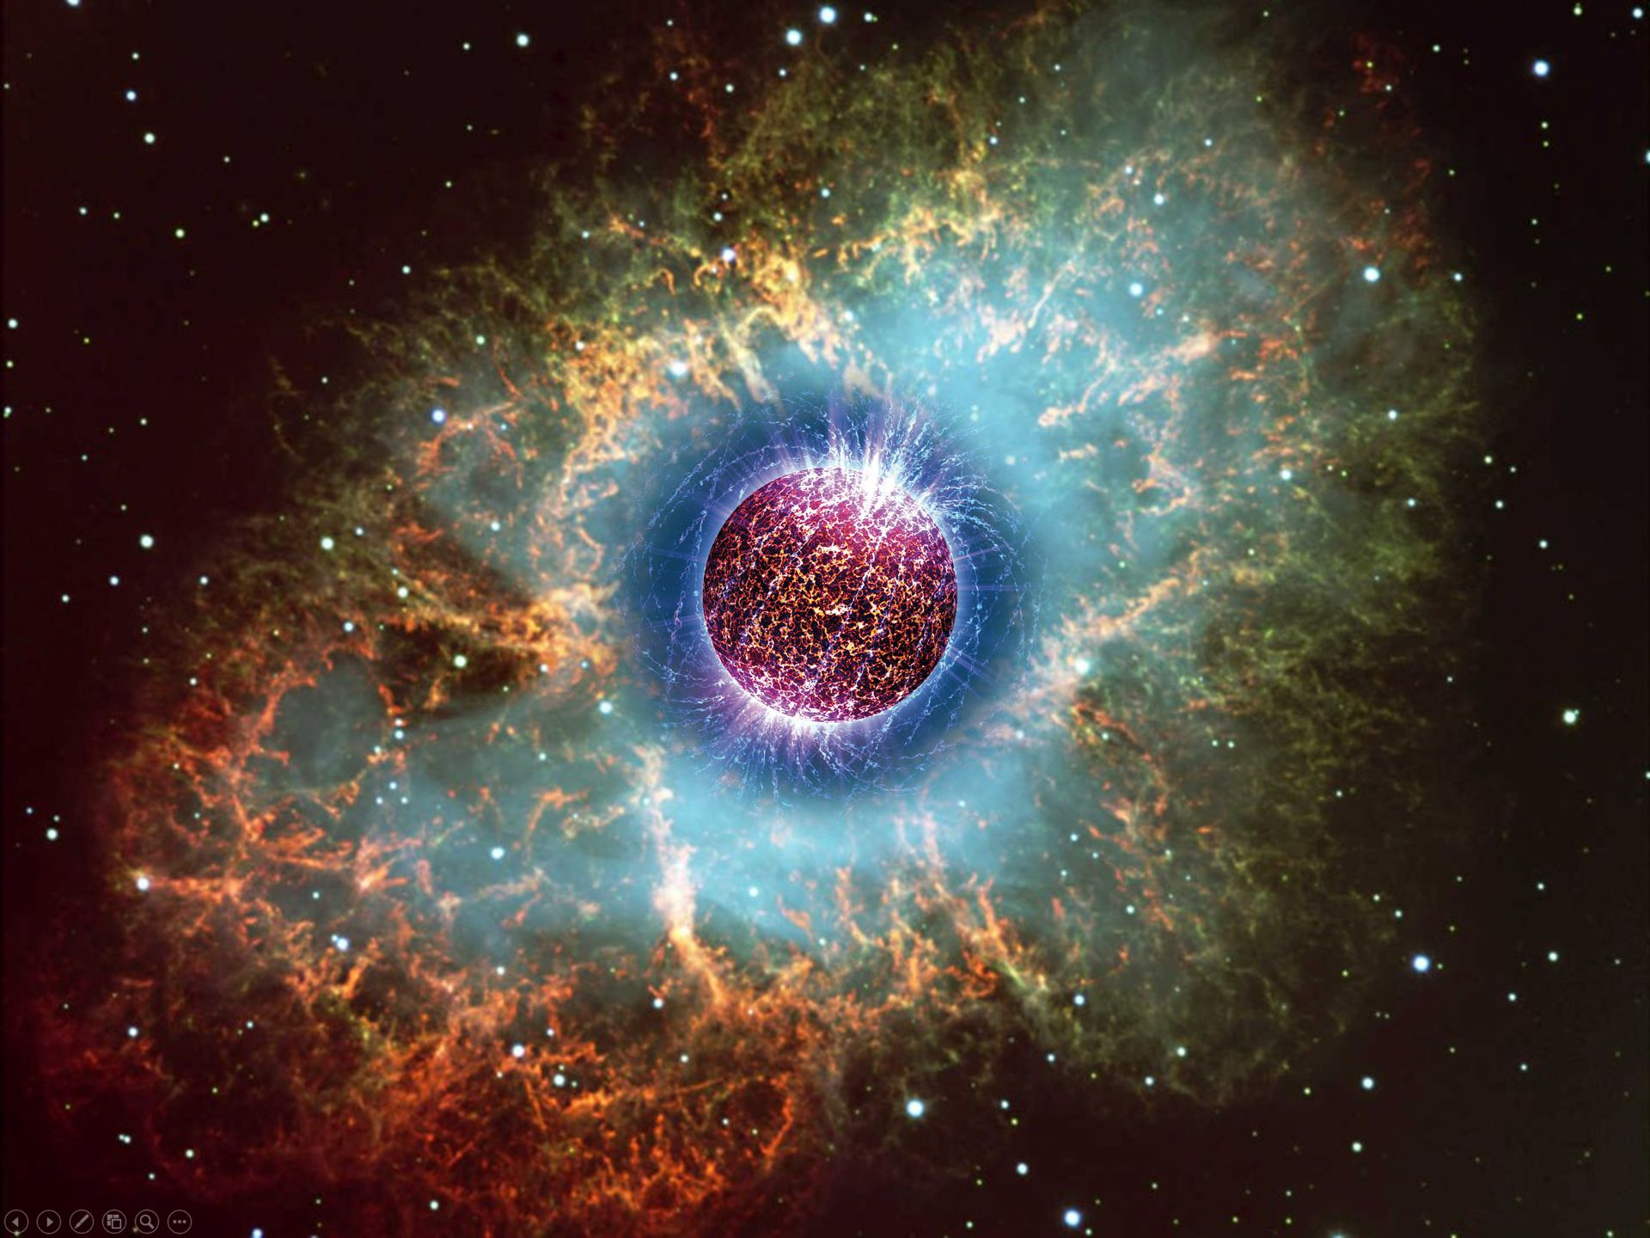
Crab Nebula – Remnant of SN 1054
Supernovae and
Neutron Stars

Slide 2
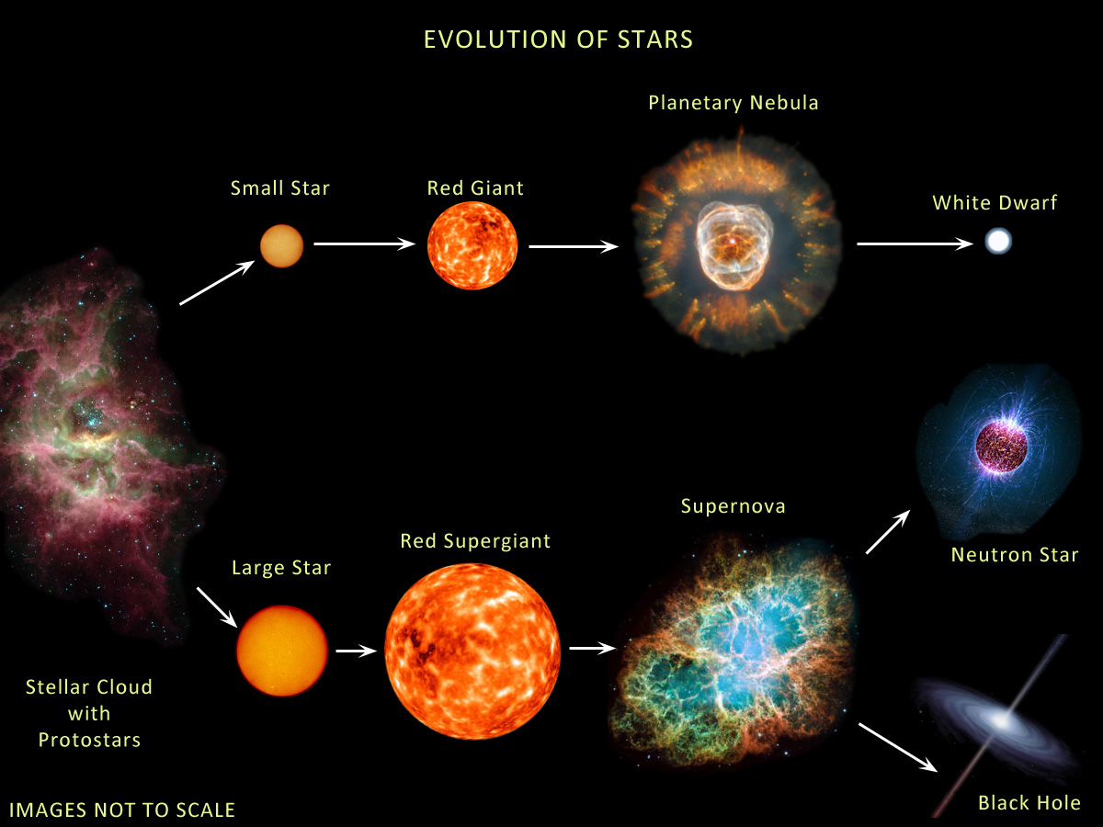
Evolution of Stars
Compact
Remnants:
$$M≲8 M_{⊙}$$
$1 M_{⊙}=2×{10}^{30}$kg
$$M∼0.6 M_{⊙}$$
R $∼$5000 km
$M$ = 1–2$M_{⊙}$
R $∼$12 km
$$M≳8 M_{⊙}$$
few-tens $M_{⊙}$
few km
BR ≈ 25% (?)
http://earthspacecircle.blogspot.com/2013/07/stellar-evolution.html

Slide 3
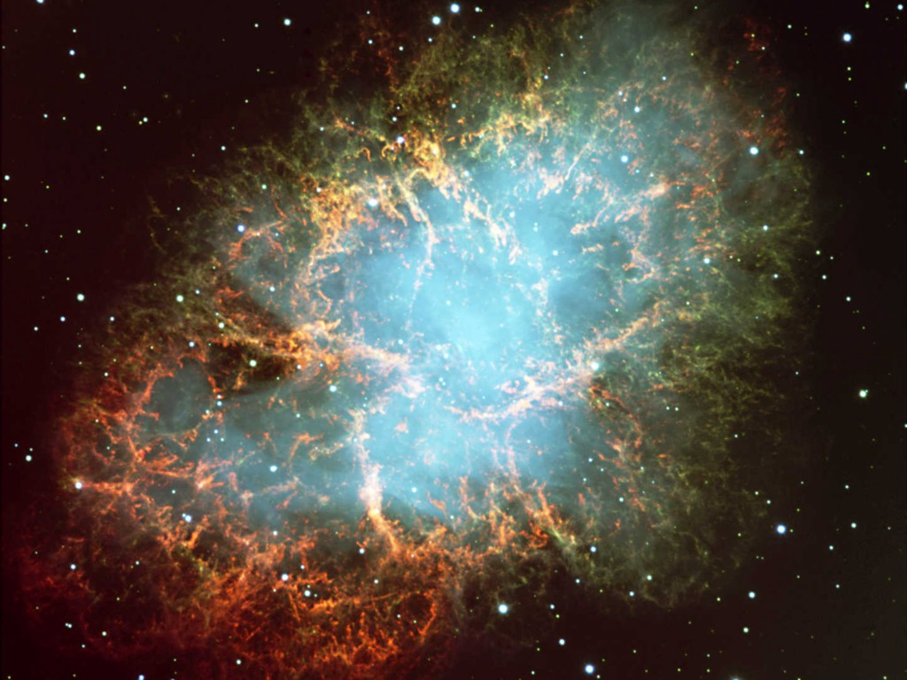
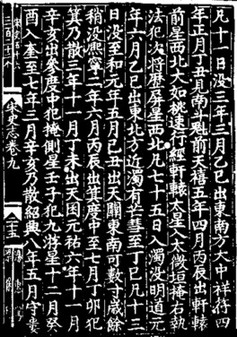
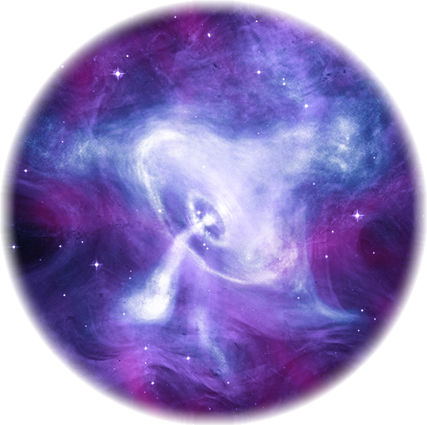
Crab Nebula – Remnant of SN 1054
Crab Nebula – Remnant of SN 1054
Crab Pulsar
Chandra X-ray composite image

Slide 4
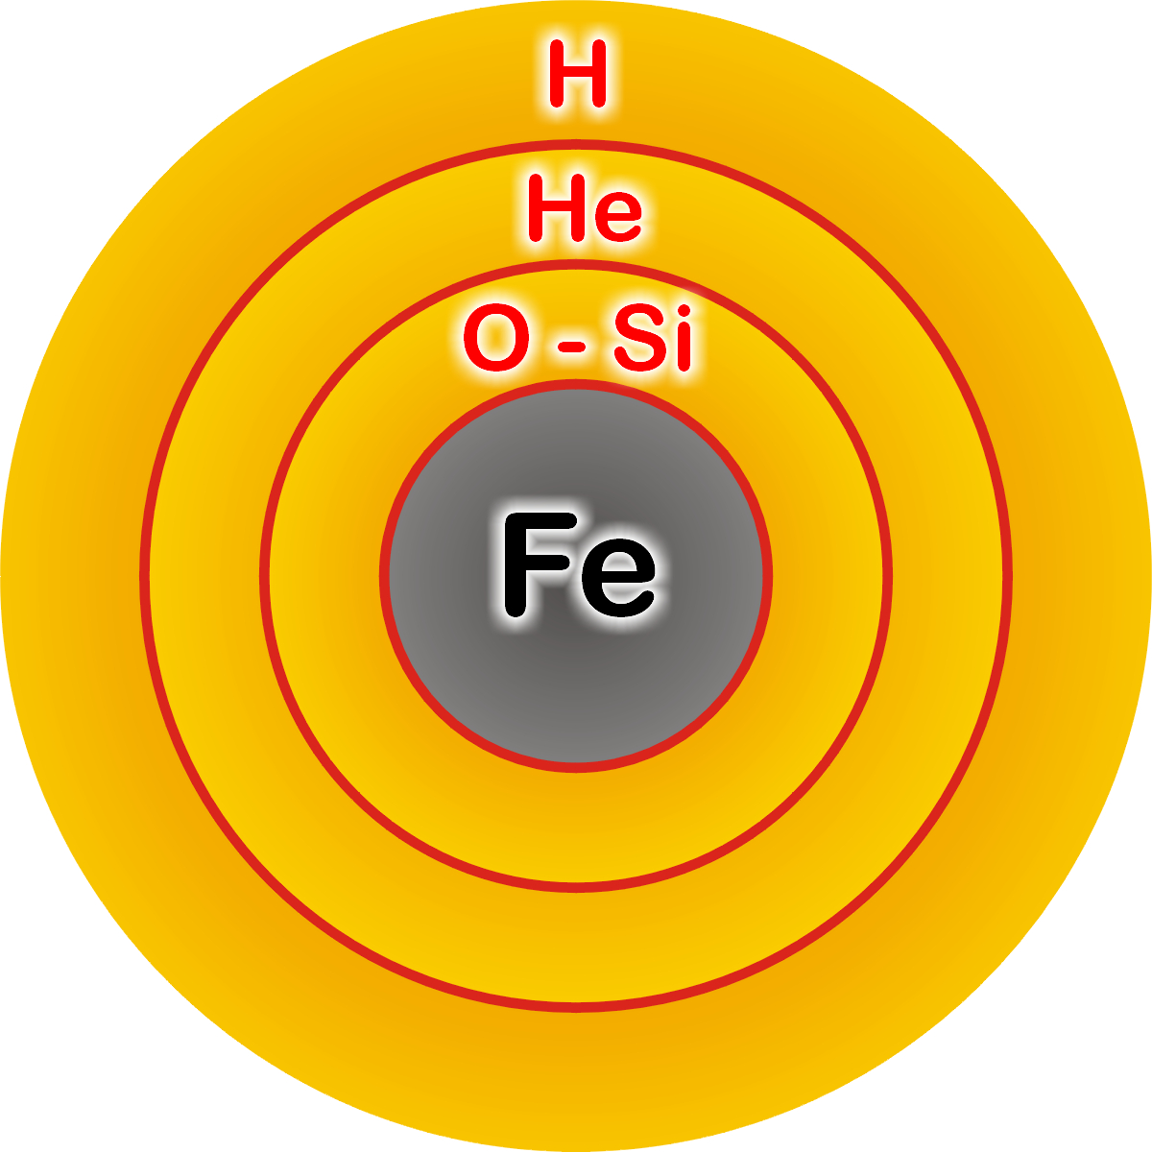
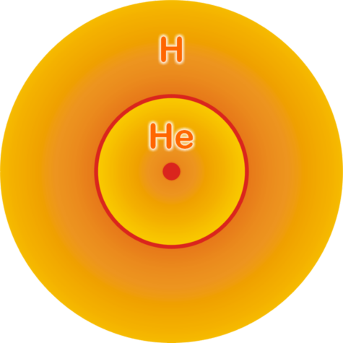
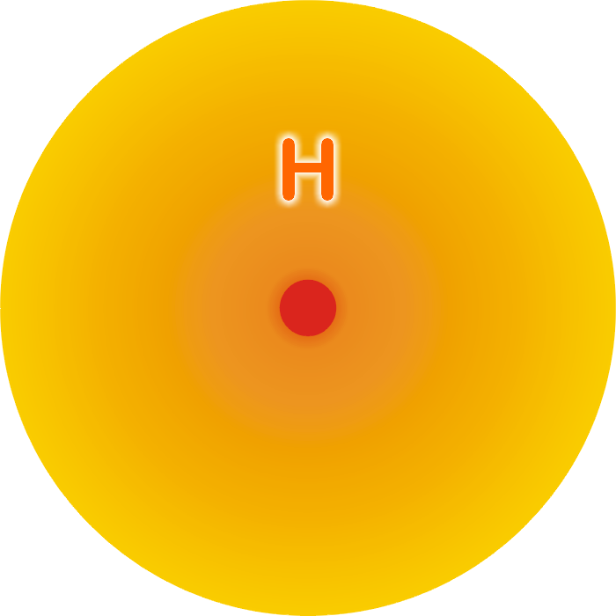
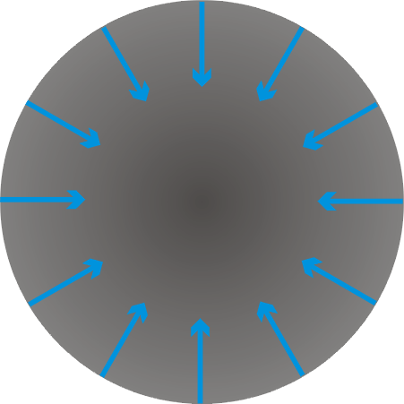
Stellar Collapse and Supernova Explosion
Onion structure
Collapse (implosion)
Main-sequence star
Helium-burning star
Degenerate iron core:
ρ ≈ 10⁹ g cm⁻³
T ≈ 10¹⁰ K
M_{Fe} ≈ 1.5 M_{sun}
R_{Fe} ≈ 3000 km
Hydrogen Burning
Helium
Burning
Hydrogen
Burning

Slide 5
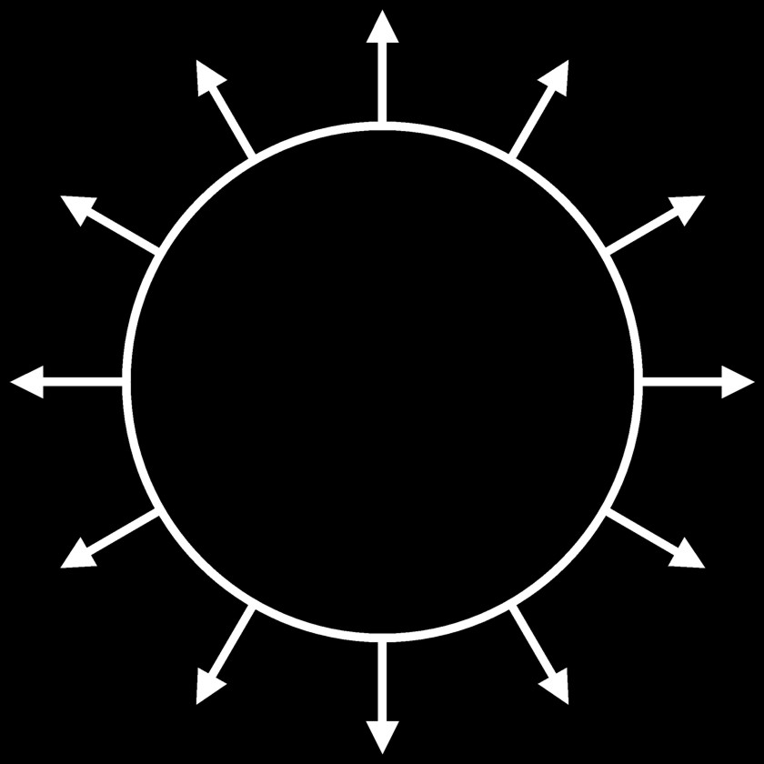
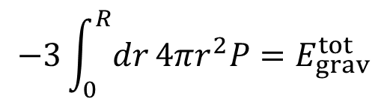

Stellar Collapse and Supernova Explosion
Newborn Neutron Star
Collapse (implosion)
Explosion
$\sim$ 50 km
Proto-Neutron Star
ρ $\sim$ ρ_{nuc} = 3 × 10¹⁴ g cm⁻³
T $\sim$ 10 MeV

Slide 6
Stellar Collapse and Supernova Explosion
Newborn Neutron Star
$\sim$ 50 km
Gravitational binding energy
E_{b} ≈ 3 × 10⁵³ erg ≈ 17% M_{SUN} c²
This shows up as
99% Neutrinos
1% Kinetic energy of explosion
0.01% Photons, outshine host galaxy
Neutrino luminosity
L_{ν} $\sim$ 3 × 10⁵³ erg / 3 sec
$\sim$ 3 × 10¹⁹ L_{SUN}
While it lasts, outshines the entire
visible universe
Neutrino
cooling by
diffusion
Proto-Neutron Star
ρ $\sim$ ρ_{nuc} = 3 × 10¹⁴ g cm⁻³
T $\sim$ 10 MeV

Slide 7
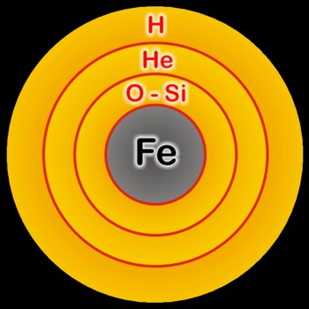
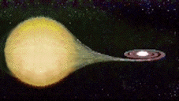
Thermonuclear vs. Core-Collapse Supernovae
Thermonuclear (Spectral type Ia)
Core collapse (Spectral type II, Ib/c)
Carbon-oxygen white dwarf
(remnant of
low-mass star)
Accretes matter
from companion
Degenerate iron core
of evolved massive star
Accretes matter
by nuclear burning
at its surface
Chandrasekhar limit is reached — M_{Ch} ≈ 1.5 M_{sun} (2Y_{e})²
C O L L A P S E S E T S I N
Nuclear burning of C and O ignites
→ Nuclear deflagration
(“Fusion bomb” triggered by collapse)
Collapse to nuclear density
Bounce & shock
Implosion → Explosion
Powered by nuclear binding energy
Powered by gravity
Gain of nuclear binding energy
$\sim$ 1 MeV per nucleon
Gain of gravitational binding energy
$\sim$ 100 MeV per nucleon
99% into neutrinos
Comparable “visible” energy release of $\sim$ 3 × 10⁵¹erg

Slide 8
Why No Prompt Explosion?
0.1 M_{sun} of iron has a
nuclear binding energy
≈ 1.7 × 10⁵¹ erg
Comparable to
explosion energy
Undissociated Iron
Collapsed Core
Shock Wave
Dissociated
Material
(n, p, e, ν)
Shock wave forms
within the iron core
Dissipates its energy
by dissociating the
remaining layer of
iron

Slide 9
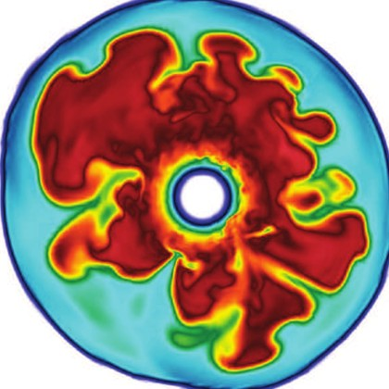
Shock Revival by Neutrinos
Stalled shock wave must
receive energy to start re-expansion against ram pressure of
infalling stellar core
Shock can receive
fresh energy from
neutrinos!
S
O
Si
ν
ν
PNS
ν
Shock
wave
Si
Supernova Neutrinos, ISAPP 2017, 13–24 June 2017
Georg Raffelt, MPI Physics, Munich

Slide 10
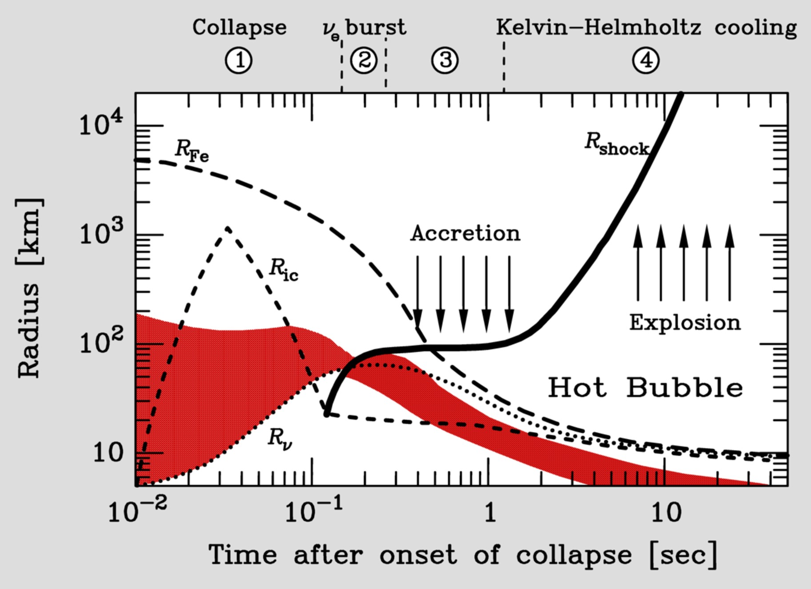
Supernova Delayed Explosion Scenario

Slide 11
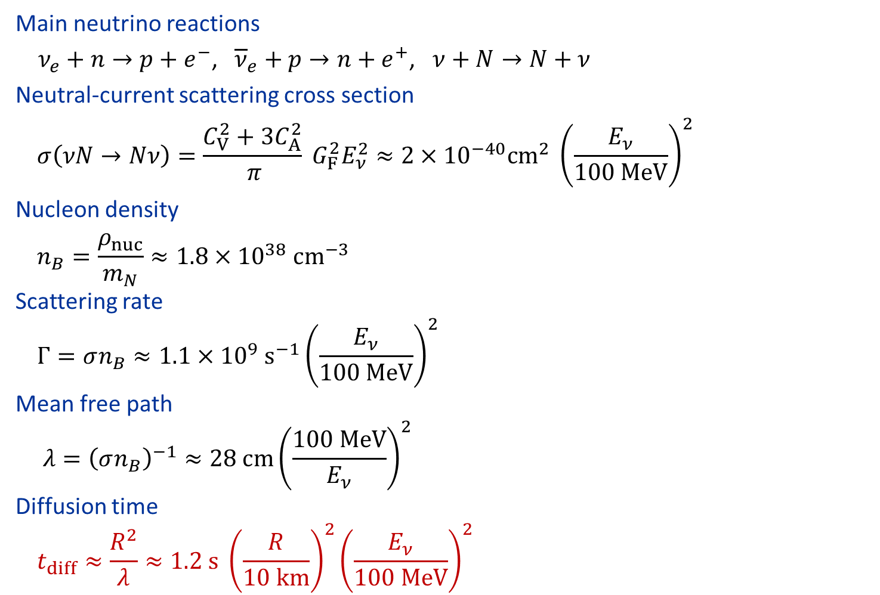
What determines the time scale?
Main neutrino reactions
$ν_{e}+n→p+e^{−}$, ${\overline{ν}}_{e}+p→n+e^{+}$, $ν+N→N+ν$
Neutral-current scattering cross section
$$σ\left(νN→Nν\right)=\frac{C_{V}^{2}+3C_{A}^{2}}{ π} G_{F}^{2}E_{ν}^{2}≈2×{10}^{−40}cm^{2} {\left(\frac{E_{ν}}{100 MeV}\right)}^{2}$$
Nucleon density
$$n_{B}=\frac{ρ_{nuc}}{m_{N}}≈1.8×{10}^{38} cm^{−3}$$
Scattering rate
$$Γ=σn_{B}≈1.1×{10}^{9} s^{−1}{\left(\frac{E_{ν}}{100 MeV}\right)}^{2}$$
Mean free path
$$λ={\left(σn_{B}\right)}^{−1}≈28 cm{\left(\frac{100 MeV}{E_{ν}}\right)}^{2}$$
Diffusion time
$$t_{diff}≈\frac{R^{2}}{λ}≈1.2 s {\left(\frac{R}{10 km}\right)}^{2}{\left(\frac{E_{ν}}{100 MeV}\right)}^{2}$$

Slide 12
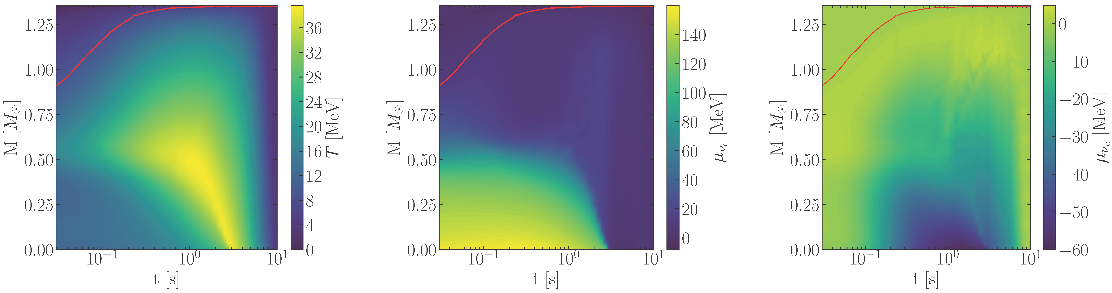


Inner Structure of a Typical Supernova Model
Muonic SN model from Garching group, used in 2005.07141 and 2109.03244
Temperature
$ν_{e}$ Chem. Potential
$ν_{μ}$ Chem. Potential
SN core starts cold and heats up from outside in as in contracts and deleptonizes
Fiorillo, Raffelt & Vitagliano (arXiv:2209.11773)

Slide 13
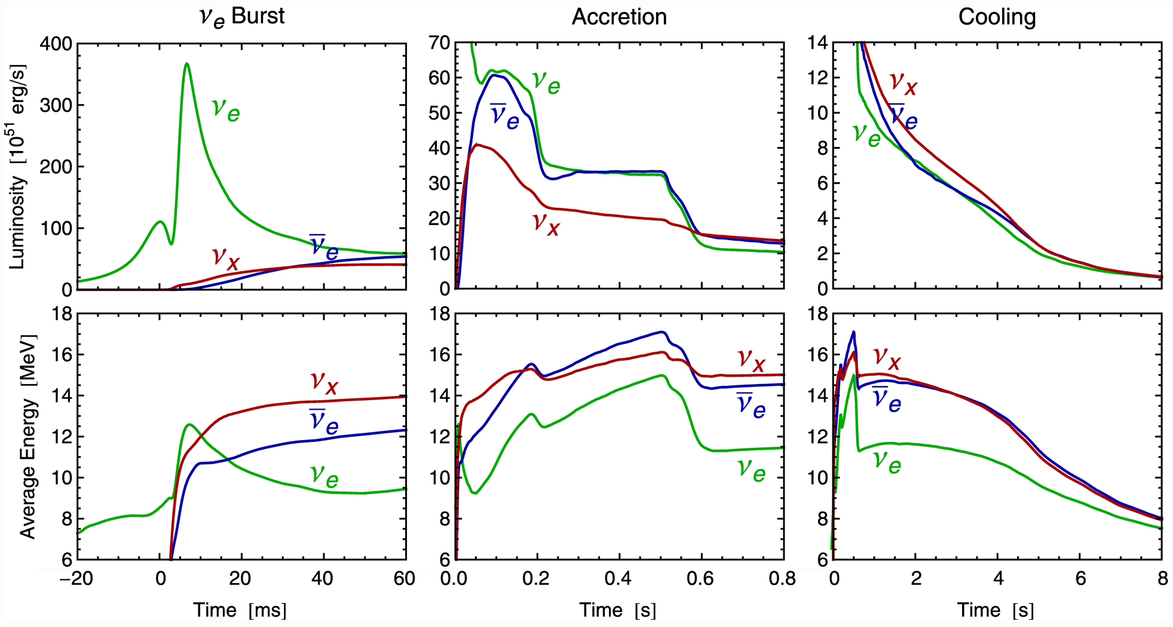
Three Phases of Neutrino Emission
Explosion
triggered
Cooling on neutrino
diffusion time scale
Shock breakout
De-leptonization of
outer core layers
Shock stalls $\sim$ 150 km
Neutrinos powered by
infalling matter
Spherically symmetric Garching model (25 M⊙) with Boltzmann neutrino transport

Slide 14
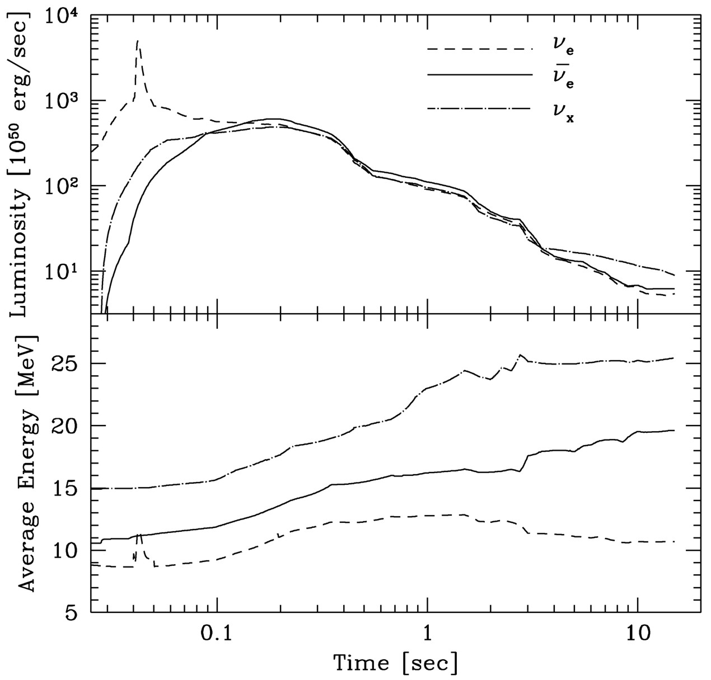

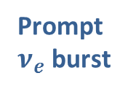



Livermore Fluxes and Spectra
Livermore numerical model, ApJ 496 (1998) 216
Pioneering work, but today
only of historical interest
Transport of ν_{μ} and ν_{τ}
only schematic
Incomplete microphysics
Schematic numerics to couple
nu transport with hydro code
Prompt
$ν_{e}$ burst
$$ν_{x}$$
Unphysical
behavior
$${\overline{ν}}_{e}$$
$$ν_{e}$$

Slide 15
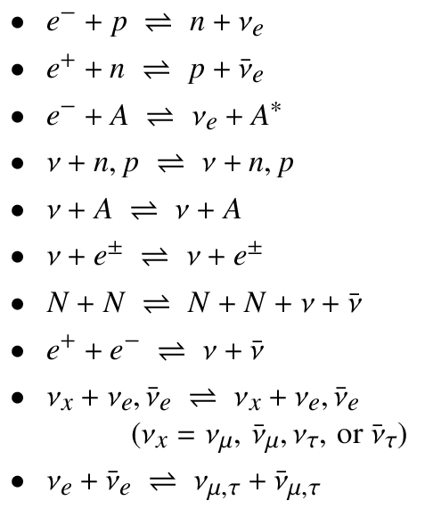
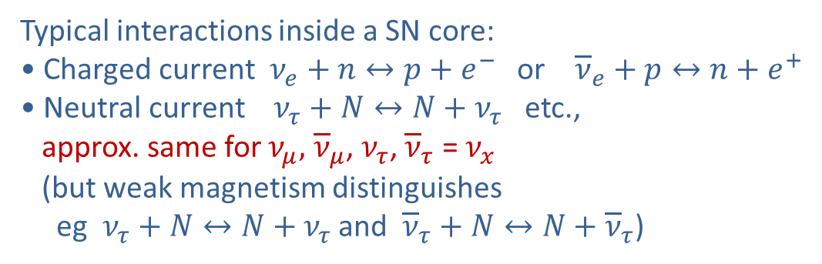
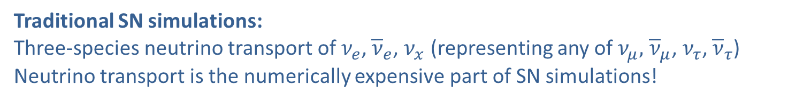
What is an x-neutrino?
SN core: Large trapped e-lepton number (many electrons & electron neutrinos)
No trapped muon or tau lepton number
Typical interactions inside a SN core:
• Charged current $ν_{e}+n↔p+e^{−}$ or ${\overline{ν}}_{e}+p↔n+e^{+}$
• Neutral current $ν_{τ}+N↔N+ν_{τ}$ etc.,
approx. same for $ν_{μ},$ ${\overline{ν}}_{μ}$, $ν_{τ}$, ${\overline{ν}}_{τ}$ = $ν_{x}$
(but weak magnetism distinguishes
eg $ν_{τ}+N↔N+ν_{τ}$ and ${\overline{ν}}_{τ}+N↔N+{\overline{ν}}_{τ}$)
Traditional SN simulations:
Three-species neutrino transport of $ν_{e}$, ${\overline{ν}}_{e}$, $ν_{x}$ (representing any of $ν_{μ},$ ${\overline{ν}}_{μ}$, $ν_{τ}$, ${\overline{ν}}_{τ}$)
Neutrino transport is the numerically expensive part of SN simulations!
Flavor oscillations:
Typically studied in 2-flavor limit
(But anyway not included in numerical SN simulations)

Slide 16
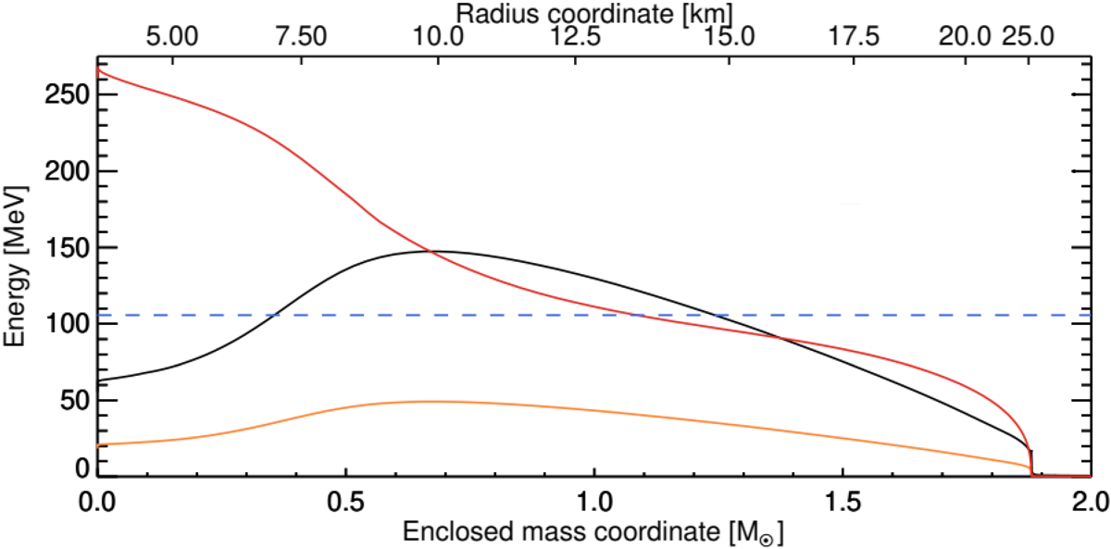


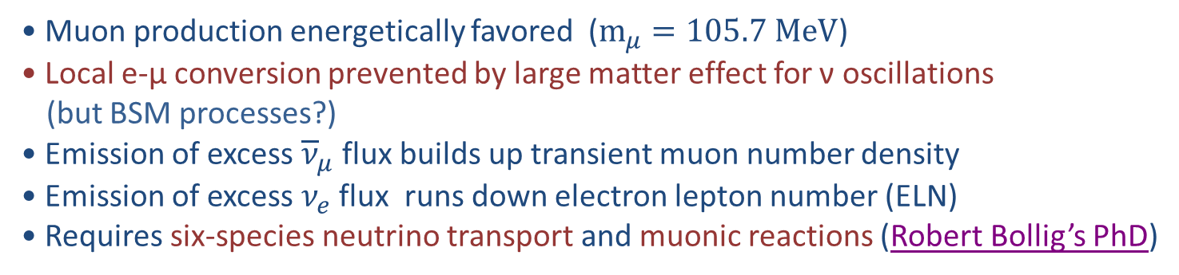
Muonisation of a Supernova Core
• Muon production energetically favored ($m_{μ}=105.7 MeV$)
• Local e-μ conversion prevented by large matter effect for ν oscillations
(but BSM processes?)
• Emission of excess ${\overline{ν}}_{μ}$ flux builds up transient muon number density
• Emission of excess $ν_{e}$ flux runs down electron lepton number (ELN)
• Requires six-species neutrino transport and muonic reactions (Robert Bollig’s PhD)
Proto neutron star
(PNS) profile
350 ms postbounce
Electron chemical
potential
$$〈E_{ν}〉∼3T$$
$$m_{μ}=105.7 MeV$$
Temperature

Slide 17
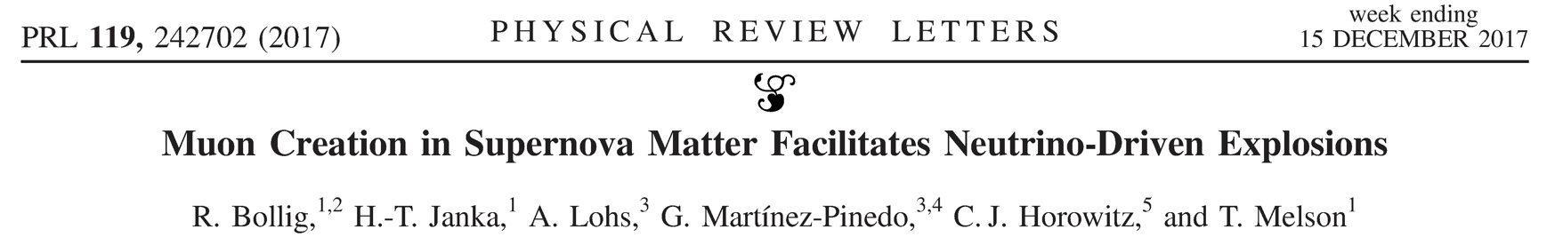
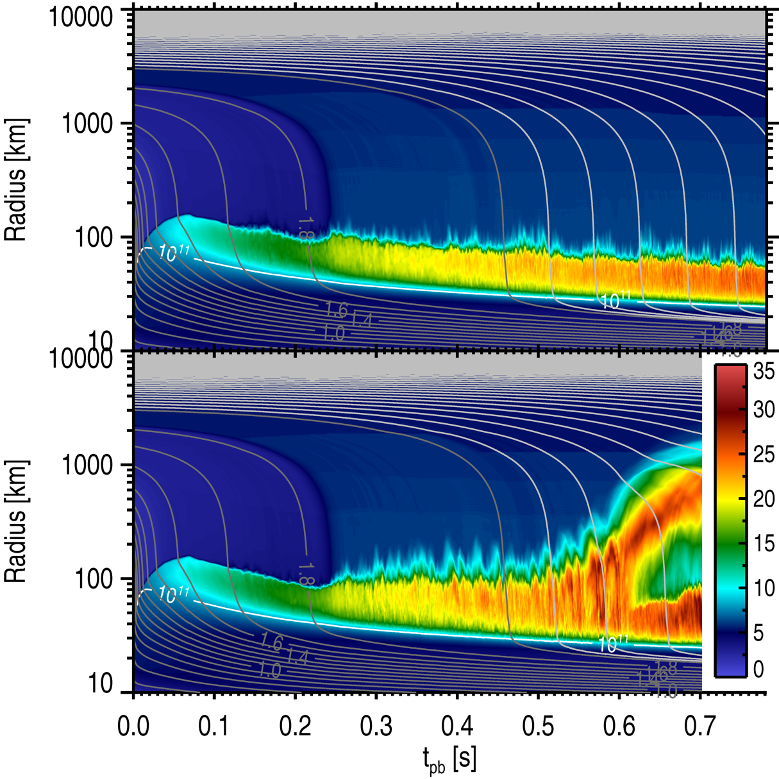
Muons in Supernovae
Average entropy/nucleon (2D model)
Muons
• Facilitate neutrino-driven explosion
• Affect compactness of hot NSs
• Change neutrino emission
• May affect ν oscillations / nucleosynthesis
• Affect grav. instability of hot NS → BH
• Should be included in SN
and NS-NS/BH merger simulations
• Require six-species neutrino transport
with coupling of different flavors
Standard
With muons

Slide 18

Flavor Conversion in Core-Collapse Supernovae
Next Generation Large-Scale Detectors (2020+)
MSW region
• Adiabatic flavor
conversion
Flavor eigenstates are
propagation eigenstates
Neutrino
sphere
• Slow self-induced
flavor conversion?
(Spectral splits …)
$$ν, \overline{ν}$$
• Fast self-induced
flavor conversion?
(Flavor equilibration?)
Shock wave
SN Neutrinos at the Cross Roads, Trento, 13–17 May 2019
Georg Raffelt, MPI Physics, Munich

Slide 19
Neutrino-Driven Mechanism – Modern Version
• Stalled accretion shock pushed out
to ~150 km as matter piles up on the PNS
• Heating (gain) region develops within
some tens of ms after bounce
• Convective overturn & shock
oscillations (SASI) enhance efficiency
of ν-heating, finally revives shock
• Successful explosions in 1D and 2D
for different progenitor masses
• Details important (treatment of GR,
ν interaction rates, etc.)
• Self-consistent 3D studies are
performed, successful explosions
Shock oscillations
(SASI)
ν heating
Convection
ν cooling
Gain
radius
Shock
3D Model of Princeton Group:
https://youtu.be/i-Ly8aCoF7E
Adapted from B. Müller

Slide 20
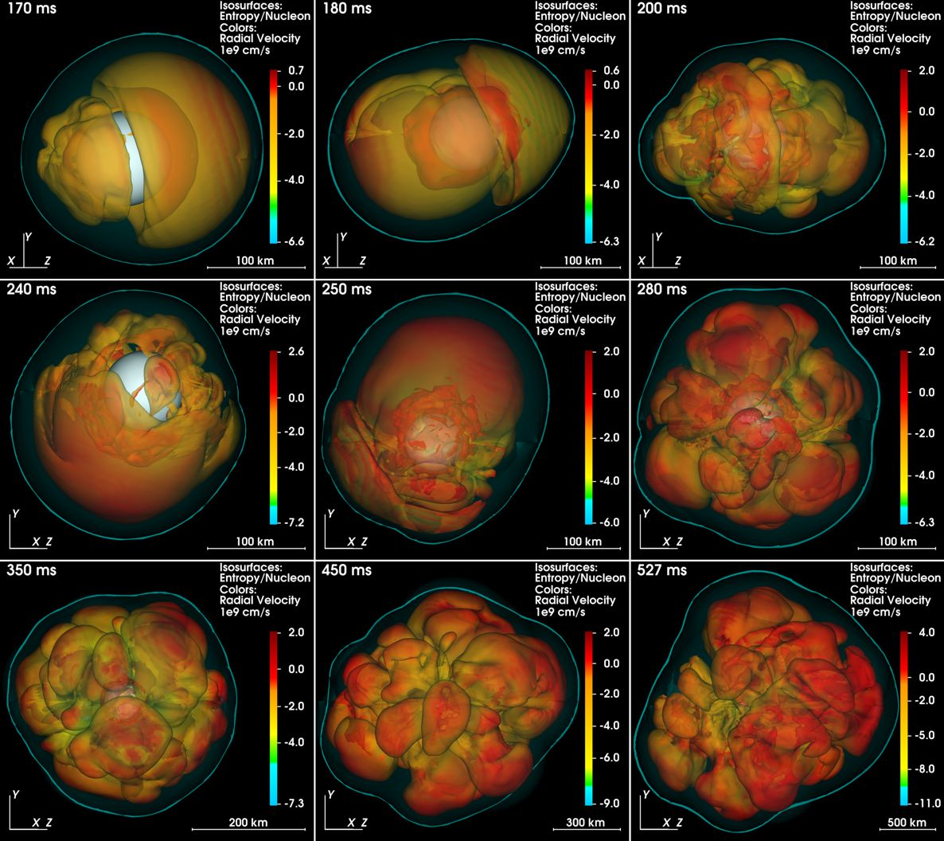
Breaking Spherical Symmetry (3D Effects)
Melson, Janka, Bollig, Hanke, Marek & Müller, arXiv:1504.07631

Slide 21
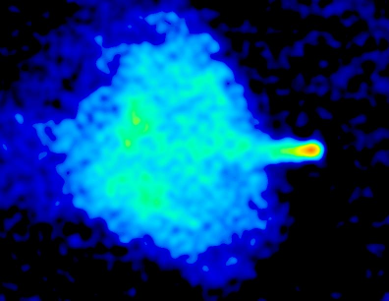
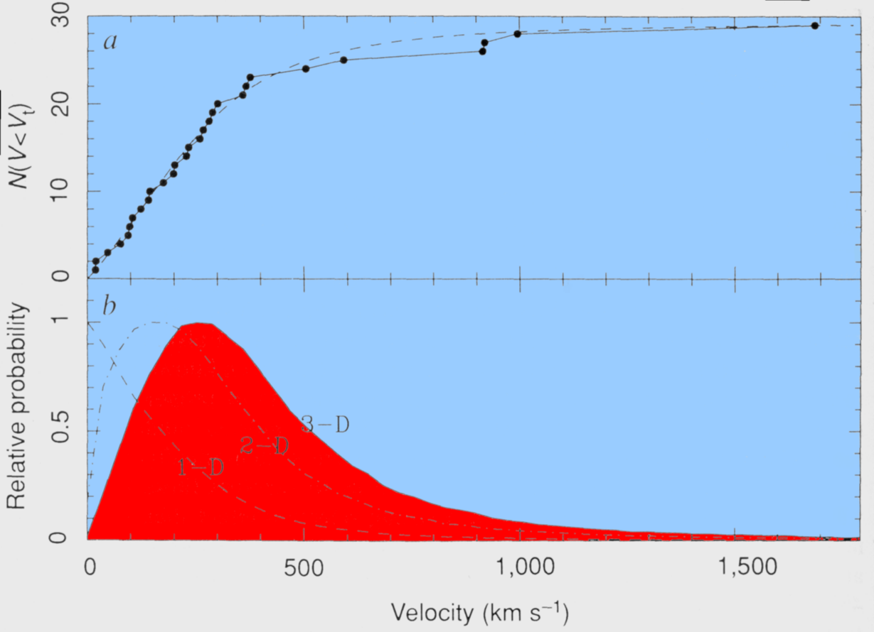
High-Velocity Pulsars
False-color radio image of the SNR G5.4-1.2
and the young radio pulsar PSR 1757-24
(v = 1300–1700 km/s away from the galactic plane)
Galactic escape velocity
approx. 600 km/s
Pulsar velocity
distribution
Lyne & Lorimer,
Nature 369 (1994) 127

Slide 22
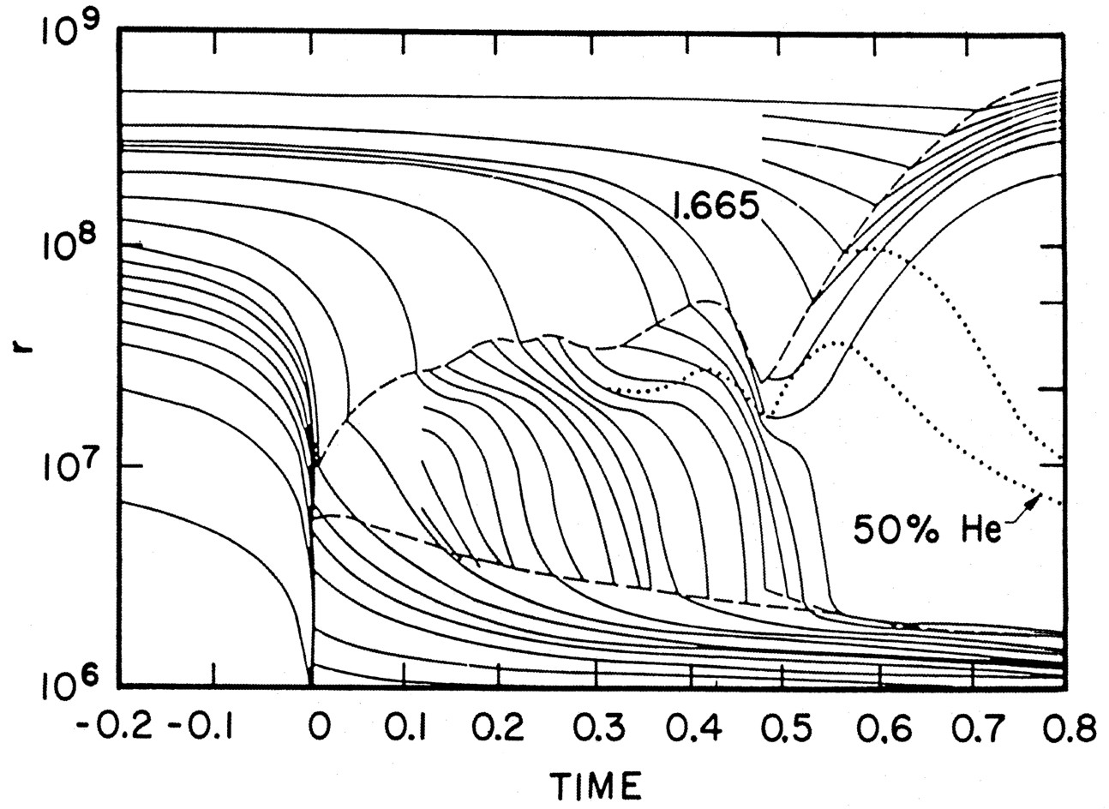
Delayed (Neutrino-Driven) Explosion
Wilson, Proc. Univ. Illinois Meeting on Num. Astrophys. (1982)
Bethe & Wilson, ApJ 295 (1985) 14

Slide 23
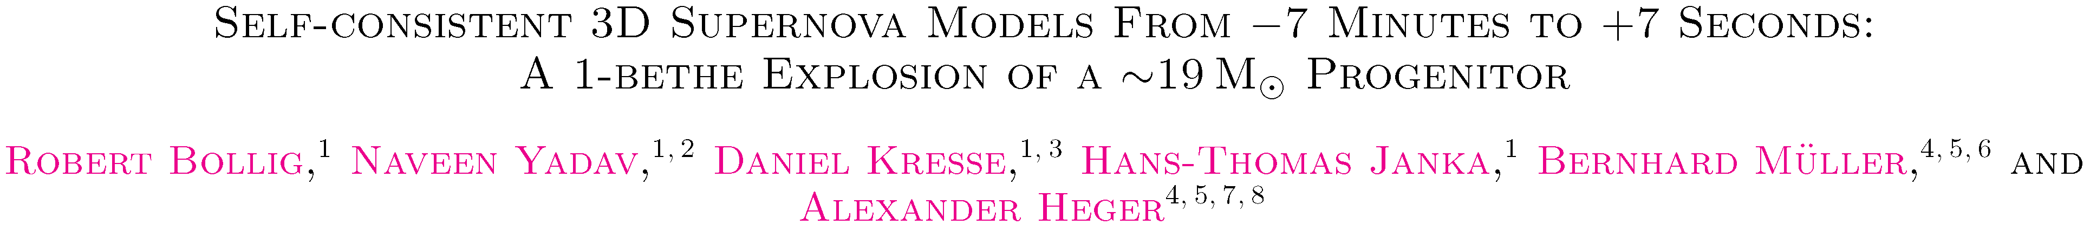
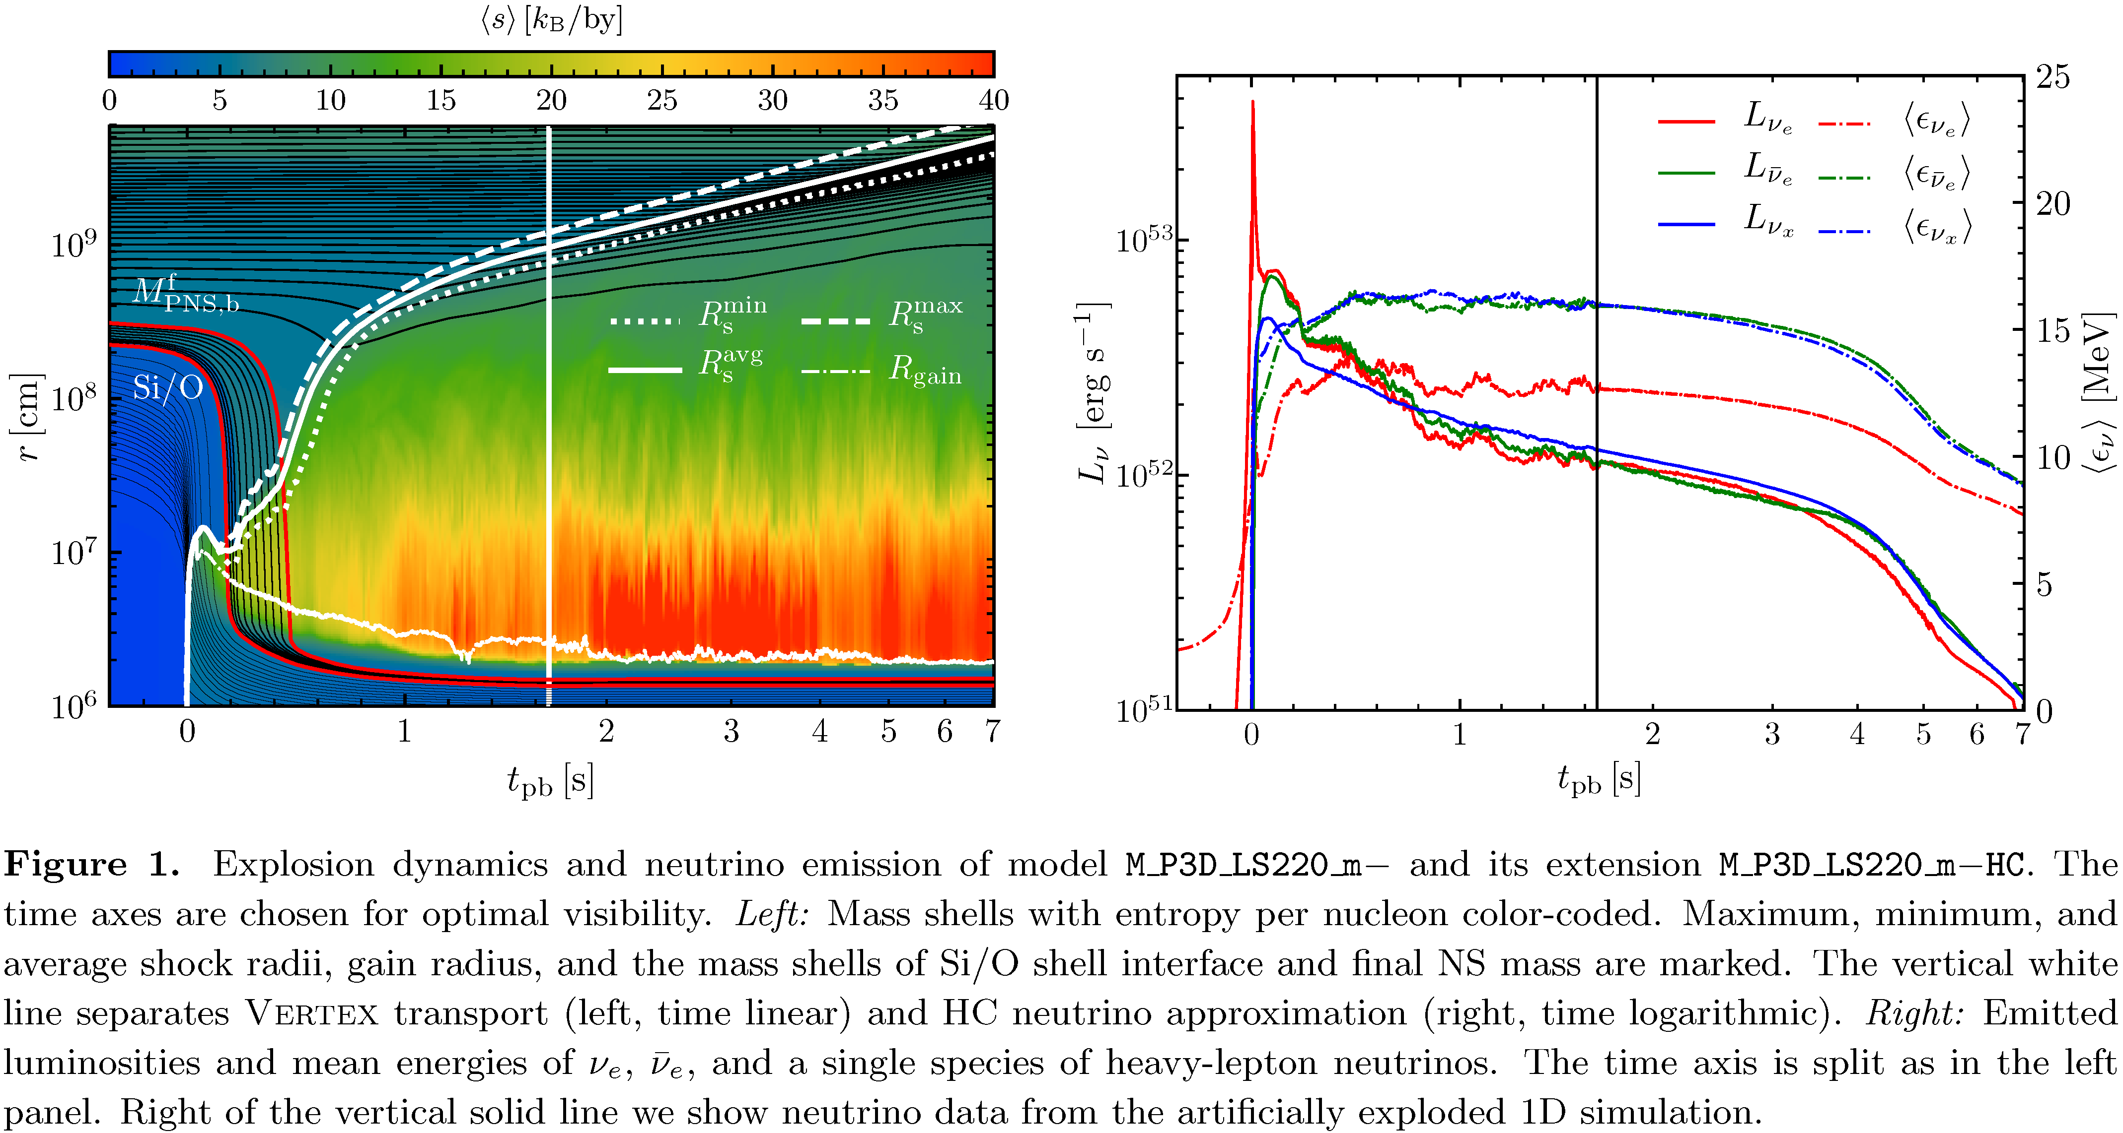
Successful 3D Explosion
ar
arXiv:2010.10506

Slide 24
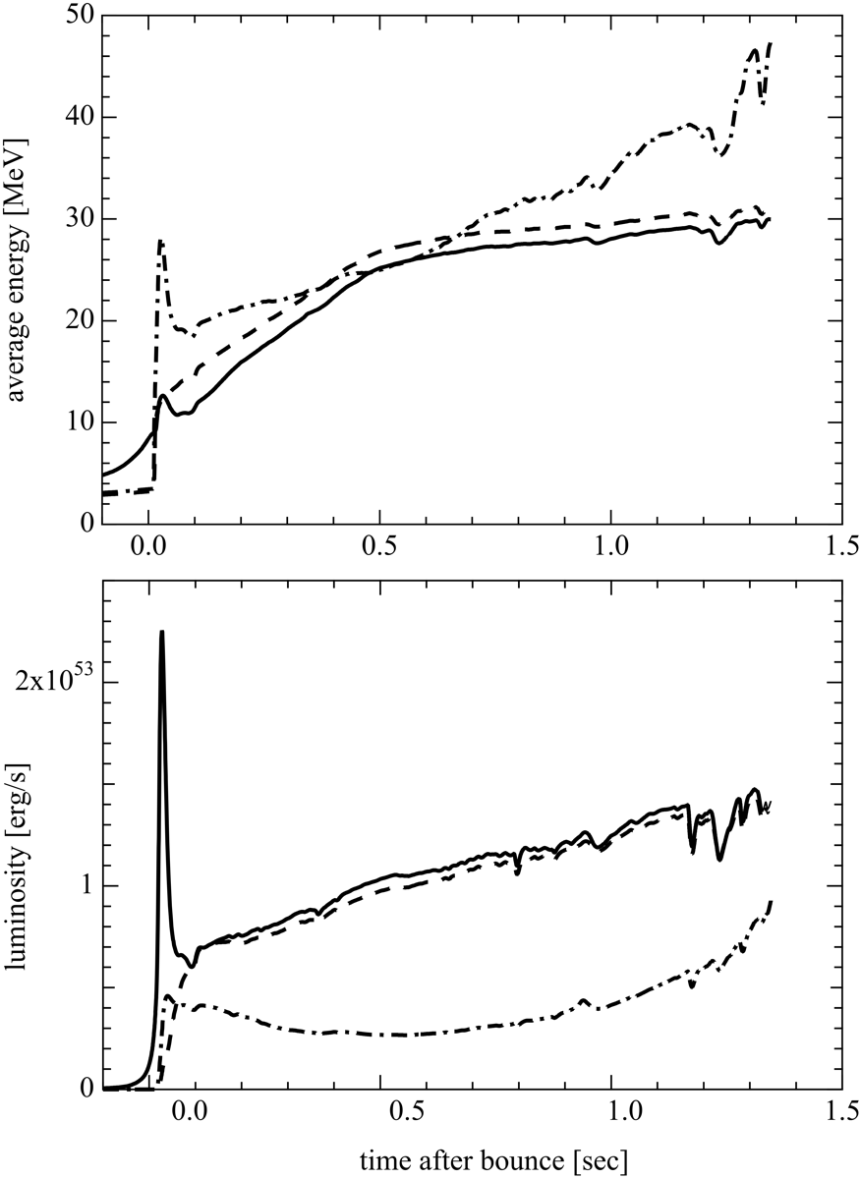
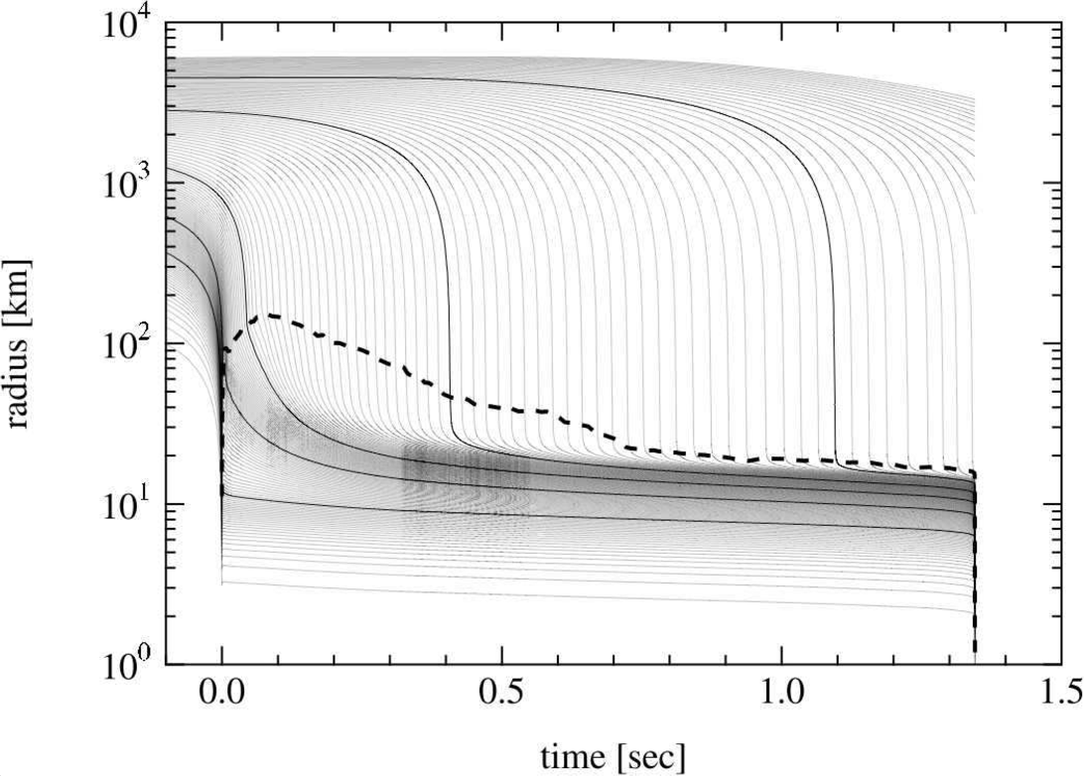

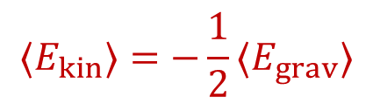
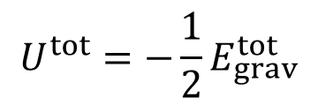
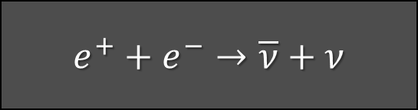

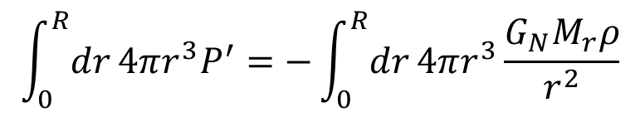

Neutrino Signal of a Failed Supernova (40 M_{SUN})
$$ν_{x}$$
$${\overline{ν}}_{e}$$
$$ν_{e}$$
Shock front
Prompt $ν_{e}$ burst
$$ν_{e}$$
Collapse to
black hole
$${\overline{ν}}_{e}$$
$$ν_{x}$$
Sumiyoshi, Yamada & Suzuki, arXiv:0706.3762

Slide 25
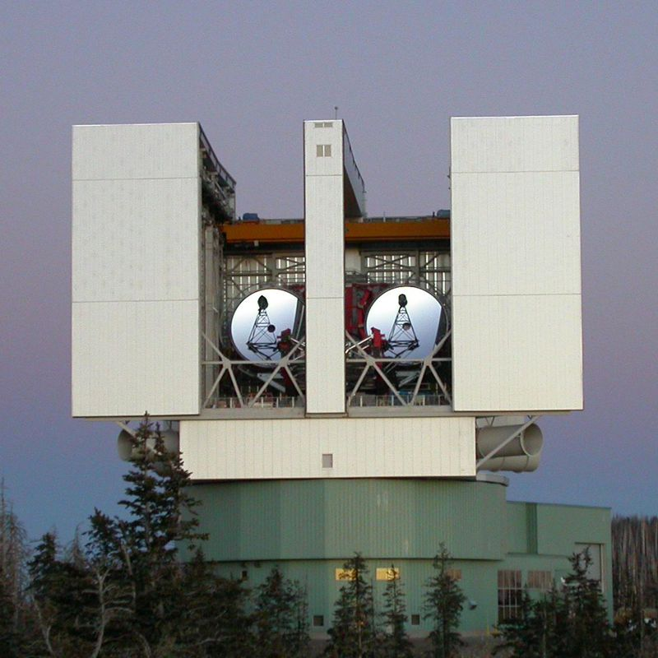
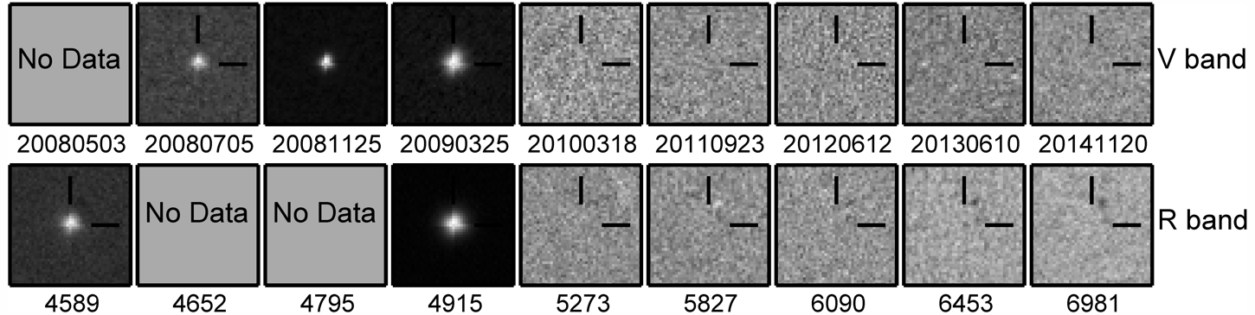
Death Watch of a Million Supergiants
• Monitoring 27 galaxies within 10 Mpc for many years
• Visit typically twice per year
• 10⁶ supergiants (lifetime 10⁶ years)
• Combined SN rate: about 1 per year
First 7 years of survey:
• 6 successful core-collapse SNe
• 1 candidate failed SN
Large Binocular Telescope
Mt Graham, Arizona
Gerke, Kochanek & Stanek, arXiv:1411.1761
Adams, Kochanek, Gerke, Stanek (& Dai), arXiv:1610.02402 (1609.01283)

Slide 26
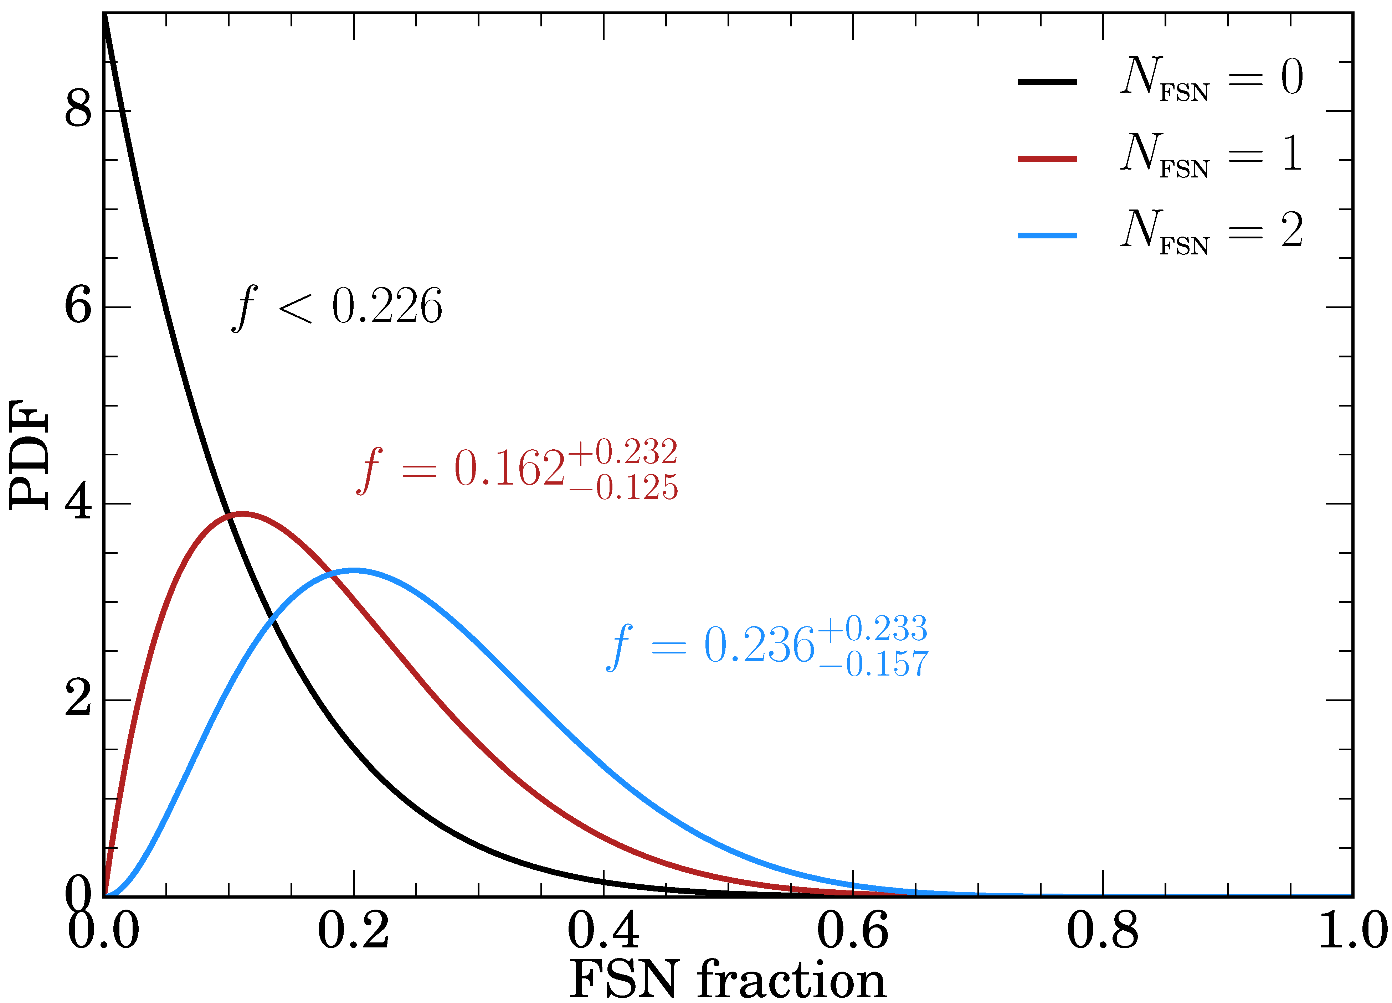
Empirical Fraction of Black-Hole Formation
2020 update: 11 yr baseline, 8 SNe, 1 old & 1 new candidate for failed SN
Neustadt, Kochanek, Stanek, et al., arXiv:2104.03318
Roughly a quarter of all core-collapses could lead to BH formation,
in agreement with theory estimates!

Slide 27
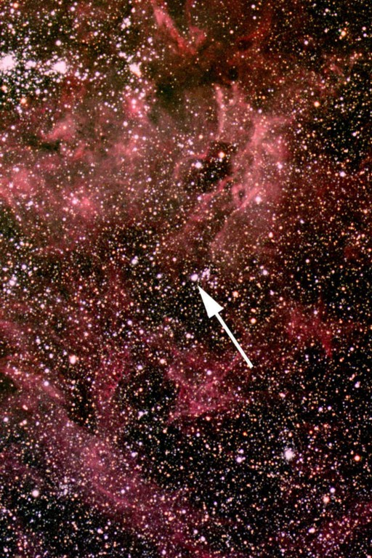
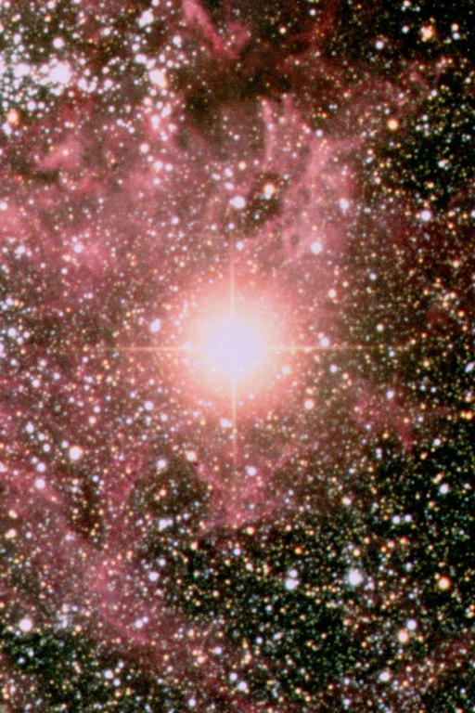
Sanduleak -69 202
Sanduleak −69 202
Supernova 1987A
23 February 1987
in the Tarantula Nebula
in the Large Magellanic Cloud
Distance 50 kpc
(160.000 light years)

Slide 28
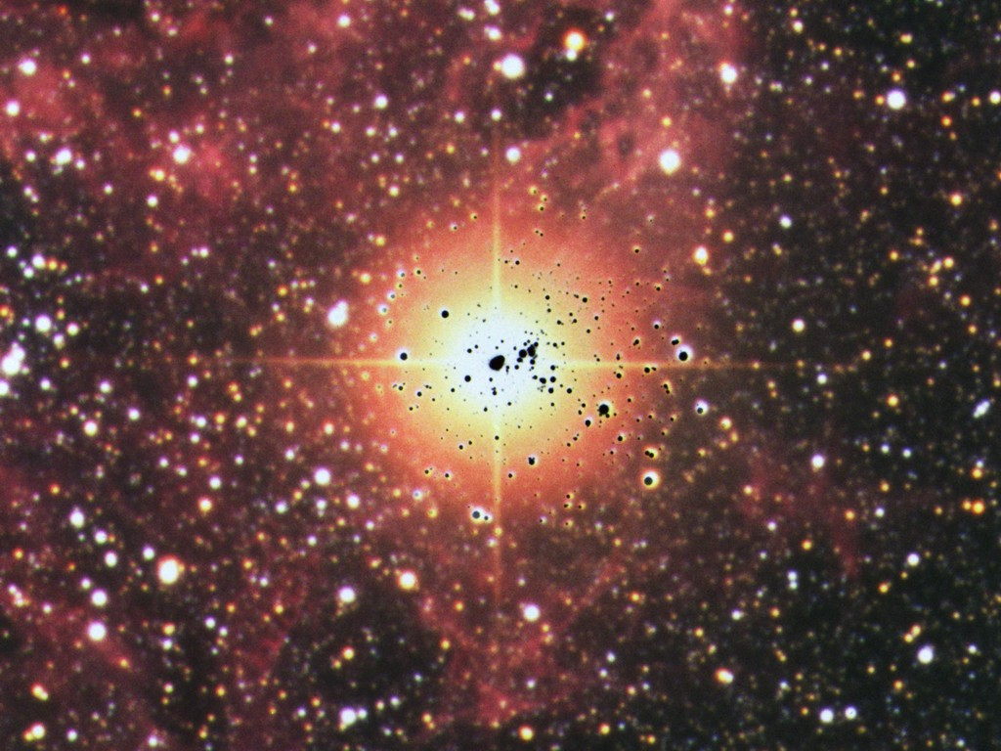
Sanduleak before and after

Slide 29
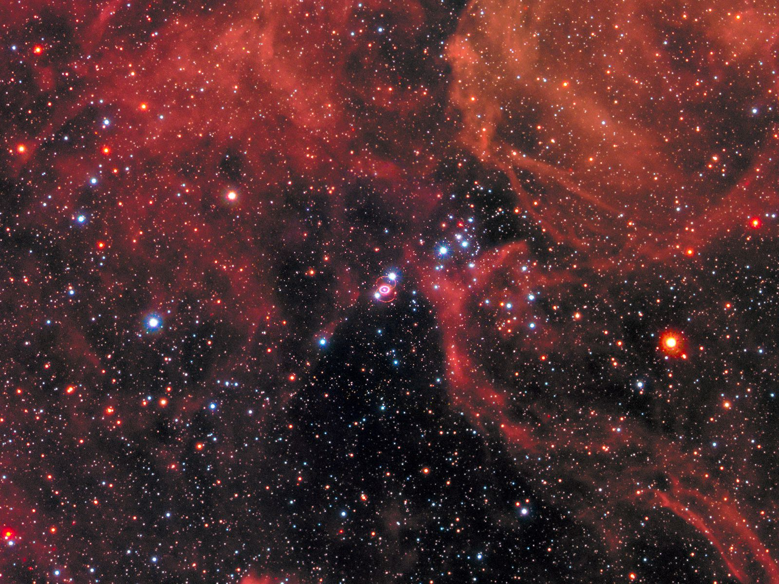
HST SN 1987A
https://hubblesite.org/contents/media/images/2017/08/3987-Image.html?page=1&keyword=1987A
http://www.eso.org/public/images/eso1032a/

Slide 30
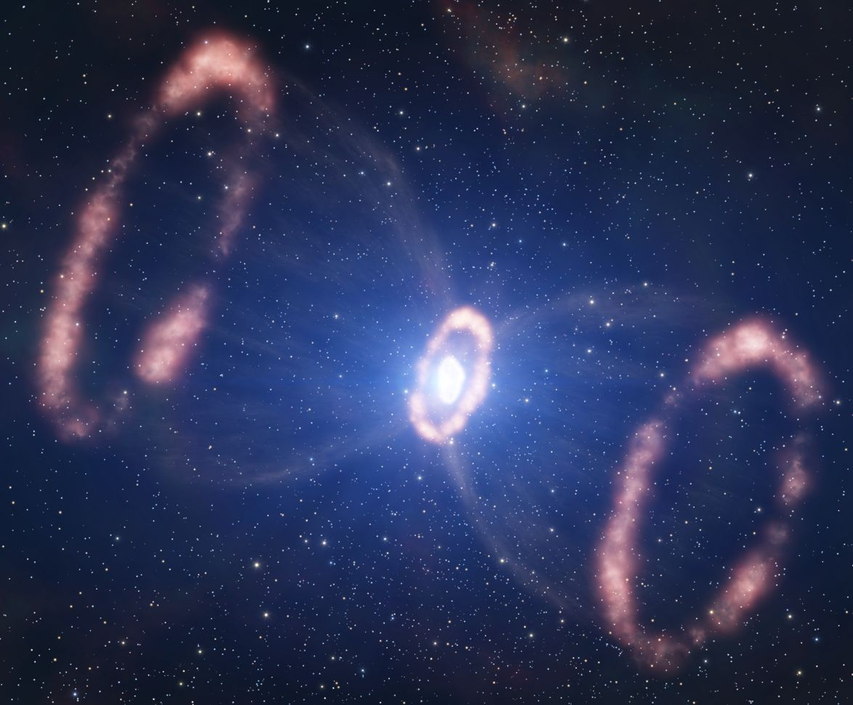
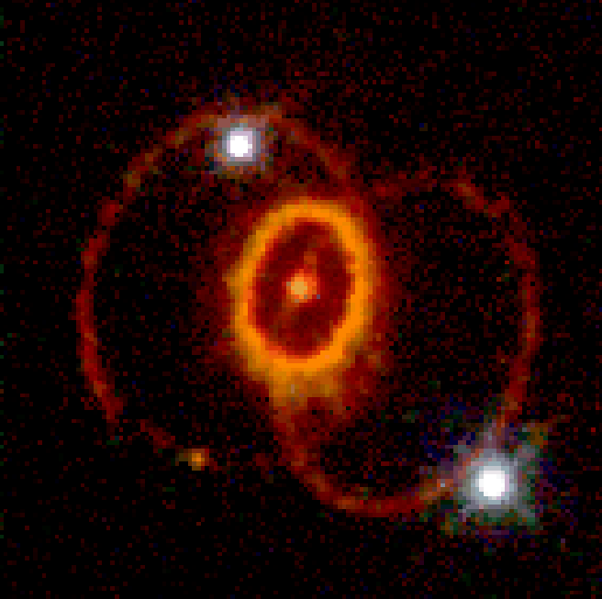
SN 1987A Rings (Hubble Space Telescope 4/1994)
Foreground Star
Artist’s impression
http://www.eso.org/public/images/eso1032a
Supernova Remnant
(SNR) 1987A
500 Light-days
Ring system consists of material ejected from
the progenitor star,
illuminated by UV flash from SN 1987A
Foreground Star

Slide 31
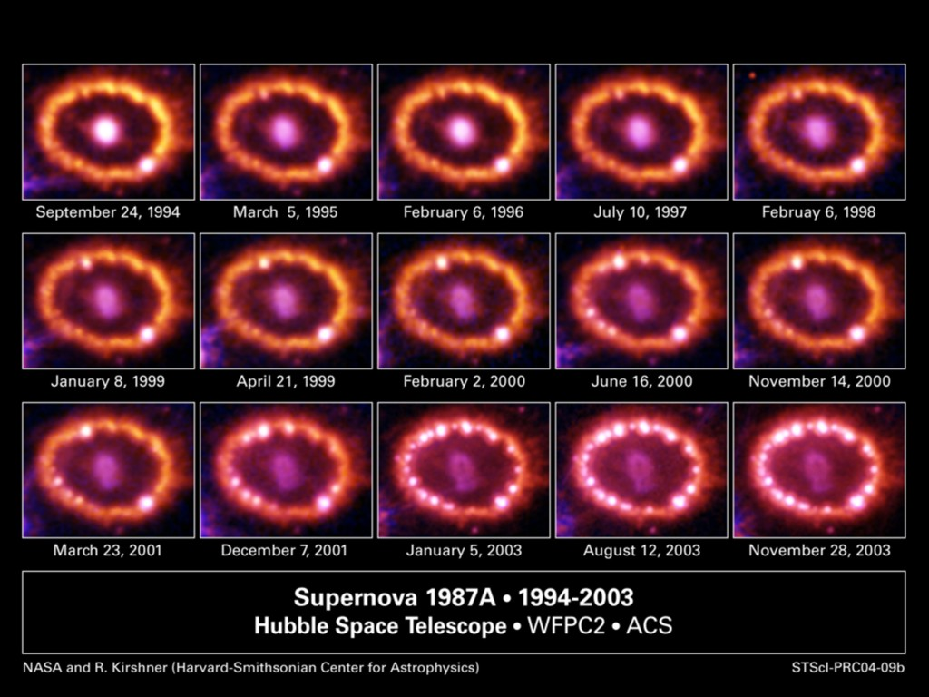
SN 1987A Explosion Hits Inner Ring

Slide 32
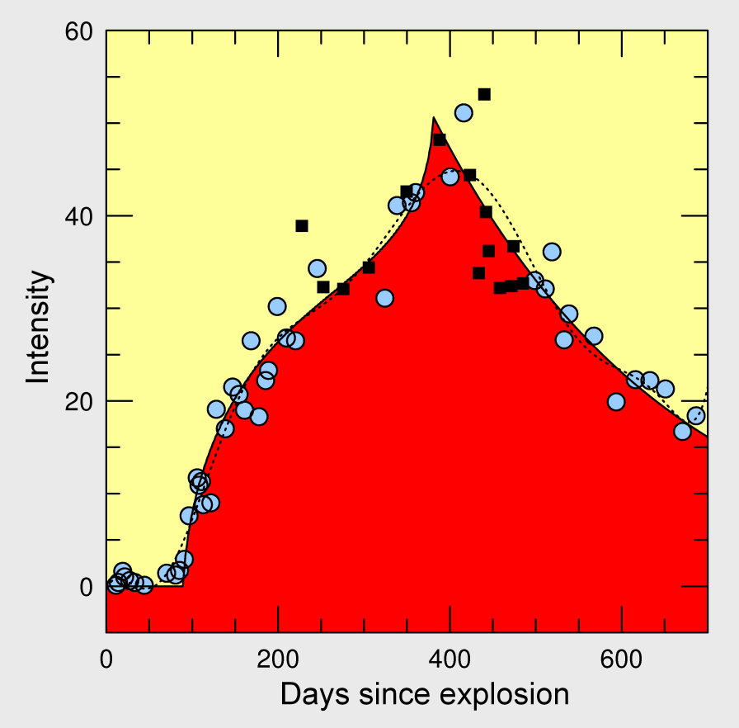
Distance Determination with Inner Ring
Δt₁ ≈ 80 days
Θ = (1.242 ± 0.022)”
500 light-days
Δt₂ ≈ 380 days
≈ 50 kpc ≈ 170,000 light-years
Angular diameter Θ₊ = (1.716 ± 0.022)”
measured by HST on 24-8-1990
Δt₁ and Δt₂ measured in UV by IUE satellite
Distance to SN 1987A
51.2 ± 3.1 kpc Panagia et al.,
ApJ 380 (1991) L23
51.4 ± 1.2 kpc Panagia,
IAU Symposium 190 (1999)
47.2 ± 0.9 kpc Gould & Uza,
ApJ 494 (1998) 118
Ni III] light curve SN 1987A ring, measured by IUE
[Sonneborn et al. ApJ 477 (1997) 848,
fit by Gould & Uza, ApJ 494 (1998) 118]

Slide 33


SN 1987A Rings (Hubble Space Telescope 4/1994)

Slide 34




Neutrino Signal of Supernova 1987A
Irvine-Michigan-Brookhaven (IMB), US
• Water Cherenkov
• High threshold
• Essentially no background
Kamiokande-II, Japan
• Water Cherenkov
• Bkg $0.187 Hz$ for $E≲7.5 MeV$
BUST (Baksan Underground Scintillator
Telescope), Soviet Union
• 200 tons scintillator (280 tons w.e.)
• Bkg $0.034 Hz$ in signal region
• Upward signal/bkg fluctuation
Liquid Scintillator Detector (LSD)
Mont Blanc Tunnel (Italy/France)
• 90 tons scintillator (126 tons w.e.)
• Bkg $0.012 Hz$ in signal region
• Low threshold (expect 2/3 BUST events)
Fiorillo+, arXiv:2308.01403

Slide 35



Irvine-Michigan-Brookhaven (IMB) Detector
6800 m³
SN 1987A

Slide 36


SN 1987A Event No.9 in Kamiokande
Kamiokande-II Detector
(2140 tons of water)
Hirata et al., PRD 38 (1988) 448

Slide 37


SN 1987A Data
Masayuki Nakahata’s notes after
the analysis
(since April 2022 director of
ICRR at University of Tokyo)

Slide 38

Neutrino Signal of Supernova 1987A
Fiorillo+, arXiv:2308.01403

Slide 39


Generic Time-Integrated Analysis
Assume quasi-thermal ${\overline{ν}}_{e}$flux (Maxwell-Boltzmann spectrum)
Distance 50 kpc
Likelihood fit with parameters
• Total emitted energy at source
• Average ${\overline{ν}}_{e}$ energy
Fiorillo, Heinlein, Janka, Raffelt, Vitagliano & Bollig, arXiv:2308.01403

Slide 40


Time-Integrated Analysis with Pinched Spectra
Quasi-thermal spectrum (“pinched spectrum”)
$$f_{ν}\left(ϵ\right)∝\frac{ε^{α}}{{\overline{ε}}^{ 1+α}}e^{−{(1+α)}/{\overline{ε}}}$$
Average energy $〈ε〉=\overline{ε}$
Maxwell-Boltzmann spectrum for $α=2$
Fiorillo, Heinlein, Janka, Raffelt, Vitagliano & Bollig, arXiv:2308.01403

Slide 41




IMB and Kam-II SN 1987A Neutrino Observations

Slide 42



Do Neutrinos Gravitate?
Early light curve of SN 1987A
Shapiro time delay for particles
moving in a gravitational potential
$Δt=−2\int_{A}^{B}{dt}Φ\left[r\left(t\right)\right]$
For trip from LMC to us, depending
on galactic model,
$Δt≈1$–5 months
Neutrinos and photons respond to
gravity the same to within
1–$4×{10}^{−3}$
Longo, PRL 60:173, 1988
Krauss & Tremaine, PRL 60:176, 1988
• Neutrinos arrived several hours
before photons as expected
• Transit time for $ν$ and $γ$ same
($160.000$ yr) within a few hours

Slide 43

Supernova 1987A Energy-Loss Argument
SN 1987A neutrino signal
Neutrino
sphere
Volume emission
of new particles
Neutrino
diffusion
Emission of very weakly interacting
particles would “steal” energy from the
neutrino burst and shorten it.
(Early neutrino burst powered by accretion,
not sensitive to volume energy loss.)
Late-time signal most sensitive observable

Slide 44

SN 1987A Axion Limits
Excluded
Free streaming
Trapping
Volume emission
of new particles
Axion
diffusion
Neutrino
diffusion
Neutrino
diffusion

Slide 45

Axion Emission from a Nuclear Medium
Axion-nucleon interaction: $ℒ_{int}=\frac{C_{N}}{2f_{a}} {\overline{Ψ}}_{N}γ_{μ}γ_{5}Ψ_{N}∂^{μ}a=\frac{C_{N}}{2f_{a}}J_{μ}^{A}∂_{a}^{μ}$
a
N
N
+ ...
Axial-vector interaction implies
dominance of spin-dependent process
V
N
N
Nucleon-Nucleon
Bremsstrahlung
• Interaction potential (one-pion exchange OPE often used, but too simplistic)
• In-medium coupling constants
• In-medium effective nucleon properties
• Correlation effects (static and dynamical spin-spin correlations)
→ For latest discussion see Carenza et al. arXiv:1906.11844
Thermal $π^{−}$ contribute significant (dominant?)
$$π^{−}$$
a
p
n
→ For latest discussion see Carenza et al. arXiv:2010.02943

Slide 46






Axion-Nucleon Couplings
Axion-nucleon coupling (model-dependent numerical factors $C_{N}$)
$${ ℒ}_{aN}=C_{N} {\overline{Ψ}}_{N}γ^{μ}γ_{5}Ψ_{N}\frac{∂_{μ}a}{2f_{a}}$$
Axion-electron coupling in non-hadronic models is analogous with $C_{e}$
$$f$$
• Axial-vector current
• Spin-dependent int’n
$$a$$
$$f$$
Values from
Grilli di Cortona et al.
arXiv:1511.02867
Coupling to neutron could be very small!

Slide 47
New Analysis
Brand New
S. Stelzl, Cosmic Wispers Workshop, Bari
Work in preparation, Balkin, Serra, Springmann, Stadlbauer, Stelzl & Weiler

Slide 48

Axion Couplings in Dense Nuclear Medium
Brand New
KSVZ Axions
Values from
Grilli di Cortona et al.
arXiv:1511.02867
S. Stelzl, Cosmic Wispers Workshop, Bari
Work in preparation, Balkin, Serra, Springmann, Stadlbauer, Stelzl & Weiler

Slide 49




SN 1987A Axion Limits from Burst Duration
• Raffelt, Lect. Notes Phys. 741 (2008) 51 hep-ph/0611350
Burst duration calibrated by early numerical studies
“Generic” emission rates inspired by OPE rates
$f_{a}≳4×{10}^{8} GeV$ and $m_{a}≲16 meV$ (KSVZ, based on proton coupling)
• Chang, Essig & McDermott, JHEP 1809 (2018) 051 1803.00993
Various correction factors to emission rates, specific SN core models
$f_{a}≳1×{10}^{8} GeV$ and $m_{a}≲60 meV$ (KSVZ, based on proton coupling)
• Carenza, Fischer, Giannotti, Guo, Martínez-Pinedo & Mirizzi,
JCAP 10 (2019) 016 & Erratum 1906.11844
Beyond OPE emission rates, specific SN core models: similar to Chang et al.
$f_{a}≳4×{10}^{8} GeV$ and $m_{a}≲15 meV$ (KSVZ, based on proton coupling)
• Carenza, Fore, Giannotti, Mirizzi & Reddy 2010.02943
Including thermal pions $π^{−}+p→n+a$ (factor 3 larger emission)
$f_{a}≳5×{10}^{8} GeV$ and $m_{a}≲11 meV$ (KSVZ, based on proton coupling)
• Bar, Blum & D'Amico, Is there a supernova bound on axions? 1907.05020
Alternative picture of SN explosion (thermonuclear event)
Observed signal not PNS cooling. SN1987A neutron star (or pulsar) not yet found.
(but see “NS 1987A in SN 1987A”, Page et al. arXiv:2004.06078)

Slide 50


Where is the Neutron Star of SN 1987A?
No pulsar or neutron star has been seen until now (35 years later)
• Infra-red excess observed by ALMA: In “the blob” strong indication for NS
Expected position, remnant hidden by dust [Cigan+ arXiv:1910.02960]
• Most plausible model: Thermally cooling non-pulsar NS [Page+ arXiv:2004.06078]
https://www.bbc.com/news/science-environment-50473482
Atacama Large Millimeter/Submillimeter Array (ALMA) at ESO in Chile
1.5×10¹² km

Slide 51






New Interest in SN 1987A as Particle Lab

Slide 52

New Analysis
Brand New
arXiv:2308.01403

Slide 53

Signal Duration of Suite of Garching Models
Signal duration (95% expected events)
for 20 Garching models
PNS
Cooling
Other
Cause?
Fiorillo+ arXiv:2308.01403

Slide 54

Cumulative Event Distributions
Fiorillo, Heinlein, Janka, Raffelt, Vitagliano & Bollig, arXiv:2308.01403

Slide 55


Long-Term Cooling of EC SN (Garching 2009)
Neutrino opacities with strong
NN correlations and nucleon
recoil in neutrino-nucleon scattering.
Neutrino opacities without these effects
Much longer cooling times
L. Hüdepohl et al. (Garching Group), arXiv:0912.0260

Slide 56

Proto-Neutron Star Convection
H.-Th. Janka, K. Kifonidis, M. Rampp, arXiv:astro-ph/0103015

Slide 57


Proto-Neutron Star Convection
Count rate in a detector
like Kamiokande, 50 kt

Slide 58




Supernova Bounds on Radiative Particle Decays
Adds to
Explosion
energy
Collapsed
SN core
Cosmic gamma ray background
from all past supernovae
Solar Maximum Mission
Progenitor
mantle
No excess gamma rays
@ SN 1987A neutrino burst

Slide 59


Gamma-Ray Observations of SMM Satellite
Counts in the GRS instrument on the Solar Maximum Mission Satellite
10 s fluence limit 0.9 cm⁻²
SN 1987A
0.4 cm⁻²
0.6 cm⁻²
SN 1987A neutrino fluence $∼{10}^{10}{\text{cm}}^{−2}$
$<{10}^{−10}$ of neutrinos have decayed to photons on their way to Earth

Slide 60




Low-Energy Supernovae
Next Generation Large-Scale Detectors (2020+)
arXiv:2201.09890 (24 Jan 2022)
Brand New
Production of
axion-like particles
$$G_{aγγ}$$
ALP decay
Typical SN explosion energy 1–2 B
Some SNe have very small observed
explosion energies < 0.1 B
(e.g. subluminous type II-P SNe)
Restrictive limits on energy deposition
in progenitor star by particle decays!
1 B (bethe) = 10⁵¹ erg
Neutron-star binding energy 200–400 B
(0.11–0.22 M_{SUN})

Slide 61

Constraints on Massive ALPs
Brand New
Investigating the gamma-ray burst from decaying MeV-scale axion-like
particles produced in supernova explosions 2304.01060
E.Müller, F.Calore, P.Carenza, C.Eckner & M.C.D.Marsh

Slide 62


Fireballs
Brand New
2303.11395
• Massive ALPs form a fireball outside progenitor star
• Downgrades photons, conserves total energy
• sub-MeV photons would have been seen by
Pioneer Venus Orbiter (PVO) from SN 1987A
• Exclusion window remains

Slide 63


Strong Supernova 1987A Constraints on Bosons Decaying to Neutrinos
Brand New
Fiorillo, Raffelt & Vitagliano, arXiv.2209.11773
• BSM particles escaping from inner SN core
• Decay to active neutrinos, 100 MeV range
• No such events in the detectors
• Majoron-like particles $φ$
$$ℒ_{int}=gφ{ ψ}_{ν}^{T}σ_{2}ψ_{ν}$$
• Production by coalescence
$ν_{e}+ν_{e}→φ$
• Decay outside SN to all flavors
$φ→νν$ or $\overline{ν} \overline{ν}$

Slide 64



Cosmic Star Formation and Core Collapse Rates
Star-formation rate (1)
Core-collapse distribution
(1)
(2)
(3)
(4)
(1) Yüksel+ arXiv:0804.4008
(2) Mathews+ arXiv:1405.0458
(3) Robertson+ arXiv:1502.02024
(4) Madau+ arXiv:1403.0007
Total core collapse density
$$0.6−1×{10}^{7} Mpc^{−3}$$

Slide 65


DSNB Prediction
Kresse+, arXiv:2010.04728
For latest Super-K limits see arXiv:2109.11174
Super-K
Limits
In the detection window, essentially $\frac{dΦ}{dE}∝e^{−E/E_{0}}$

Slide 66



Search for the Diffuse SN Neutrino Background
Water Cherenkov
22.5 kt fiducial
Sk-Gd since 2020
Li, Vagins & Wurm:
Prospects for the detection of the DSNB with the experiments SK-Gd and JUNO
arXiv:2201.12920
JUNO
Liquid Scintillator
17 kt fiducial
Commissioning 2024

Slide 67

Neutron Star Cooling

Slide 68

Neutron Star Cooling
Potekhin & Chabrier: Magnetic neutron star cooling and microphysics [1711.07662]

Slide 69



Axion Limits from Neutron Star Cooling
Selection of pulsars at different age:
• Umeda, Iwamoto, Tsuruta, Qin & Nomoto, astro-ph/9806337
• A. Sedrakian, arXiv:1512.07828 (hadronic axions)
• A. Sedrakian, arXiv:1810.00190 (non-hadronic axions)
Supernova Remnant Cas A (320 years)
• Leinson, arXiv:1405.6873, 2105.14745
• Hamaguchi, Nagata, Yanagi & Zheng, arXiv:1806.07151
Supernova Remnant HESS J1731-347 (27 kyears)
• Beznogov, Rrapaj, Page & Reddy, arXiv:1806.07991
$g_{an}^{2}<0.77×{10}^{−19}$
• Leinson, arXiv:1909.03941
$g_{an}^{2}<1.1×{10}^{−19}$
$$C_{n}m_{a}≲2 meV$$
Limits broadly comparable to SN 1987A bounds ($m_{a}$ tens of meV range)
• Protons can be superconducting – bremsstrahlung from neutrons
• Neutron-axion coupling can be very small or vanish

Slide 70



Cooling of Neutron Star in Cas A
Chandrax-ray
image of
non-pulsar
compact
remnant
Limiting value
$${C_{n}m}_{a}∼4 meV$$
Measured surface temperature over 20 years reveals unusually fast cooling rate
• Neutron Cooper pair breaking and formation (PBF) as neutrino emission process?
• Evidence for extra cooling (by axions)?
Leinson, 2105.14745

Slide 71



Cooling Simulations of Five Neutron Stars
Cooling of J1605 with KSVZ axions,
BSk22 EOS, SBF-0-0 superfluidity
model, $M_{NS} = 1.0 M_{⊙}$
Upper Limit on the QCD Axion Mass from Isolated Neutron Star Cooling
Buschmann, Dessert, Foster, Long & Safdi, 2111.09892

Slide 72




Neutron-Star Cooling Bounds
DFSZ Axions
$$ℒ_{af}=C_{f} {\overline{Ψ}}_{f}γ^{μ}γ_{5}Ψ_{f}\frac{∂_{μ}a}{2f_{a}}$$
$$C_{n}=−0.160±0.025+0.414\cos^{2}{β}$$
$$C_{p}=−0.182±0.025−0.435\cos^{2}{β}$$
$$C_{e}=\frac{1}{3}\cos^{2}{β}$$
KSVZ
DFSZ
$\cot{β}$
Notice that in this paper a different
convention is used where
$$\tan{β}→\cot{β}$$
as advocated by the PDG
Upper Limit on the QCD Axion Mass from Isolated Neutron Star Cooling
Buschmann, Dessert, Foster, Long & Safdi, 2111.09892

Slide 73


Astrophysical Axion Bounds and Opportunities
m_{Planck}
f_{a}
10¹⁸
10¹⁵
10¹²
10⁹
10⁶
GeV
peV
neV
μeV
meV
eV
m_{a}
Super
Radiance
Opportunities for detection
Astrophysical Bounds
(Energy loss of stars)
Black
Hole
IAXO Solar
Axion Telescope
Axion conversion in neutron star magnetospheres

Slide 74

Particles from Stars: What to expect?
New Ideas ...
Extension & refinements of existing arguments
(ordinary stars, Red Giants, (variable) white dwarfs, neutron star cooling, ...)
Search for solar axions: (baby) IAXO, XENON n tonne, ...
Search for magnetically converted ALPs
from magnetic white dwarfs & neutron stars (x-ray satellites)
Radio search for axion dark matter conversion in neutron star magnetospheres
(new detetectors SKA, ...)
Next galactic supernova observation (3% chance every year!)
Theoretical developments in collective neutrino flavor evolution
Diffuse Supernova Neutrino Background observation
Gravitational-wave evidence for superradiance from black holes

Slide 75
End
Some
Literature

Slide 76
Axion Reviews: Theory & Cosmology
• Axion Dark Matter (Snowmass 2021 White Paper), 2203.14923
C.B. Adams, et al.
• Axion dark matter: What is it and why now? 2105.01406
F. Chadha-Day, J. Ellis & D.J.E. Marsh
• Recent Progress in the Physics of Axions and Axion-Like Particles, 2012.05029
K. Choi, S.H. Im & C.S. Shin
• The Landscape of QCD Axion Models, 2003.01100
L. Di Luzio, M. Giannotti, E. Nardi & L. Visinelli
• Small-Scale Structure of Fuzzy and Axion-Like Dark Matter, 1912.07064
J.C. Niemeyer
• Axion Cosmology, 1510.07633
D.J.E. Marsh
• Axions: Theory and Cosmological Role, 1301.1123
M. Kawasaki & K. Nakayama
• Axions and the Strong CP Problem, 0807.3125
J.E. Kim & G. Carosi

Slide 77
Axion Reviews: Experiments & Searches
• The Search for Ultralight Bosonic Dark Matter, doi:10.1007/978-3-030-95852-7
D.F. Jackson Kimball & K. van Bibber (eds.), (Springer, 2023, open access)
• Invisible Axion Search Methods, 2003.02206
P. Sikivie
• New Experimental Approaches in the Search for Axion-Like Particles, 1801.08127
I.G. Irastorza & J. Redondo
• Experimental Searches for the Axion and Axion-Like Particles, 1602.00039
P.W. Graham, I.G. Irastorza, S.K. Lamoreaux, A. Lindner & K.A. van Bibber
• Searches for astrophysical and cosmological axions,
doi:10.1146/annurev.nucl.56.080805.140513
S.J. Asztalos, L.J. Rosenberg, K. van Bibber, P. Sikivie & K. Zioutas (2006)
• Microwave cavity searches for dark-matter axions, doi:10.1103/RevModPhys.75.777
R. Bradley, J. Clarke, D. Kinion, L.J. Rosenberg, K. van Bibber, S. Matsuki,
M. Mück & P. Sikivie (2003)
• Searches for invisible axions, doi:10.1016/S0370-1573(99)00045-9
L.J. Rosenberg & K.A. van Bibber (2000)

Slide 78
Axion Reviews: Astrophysical Methods
Stellar Evolution
• White Dwarfs as Physics Laboratories: Lights and Shadows, 2202.02052
J. Isern, S. Torres & A. Rebassa-Mansergas
• Stellar Evolution Confronts Axion Models, 2109.10368
L. Di Luzio, M. Fedele, M. Giannotti, F. Mescia & E. Nardi
• Astrophysical axion bounds, hep-ph/0611350
G. Raffelt
• Stars as Particle Physics Laboratories, (Univ. Chicago Press, 1996)
G. Raffelt
CAST in the Sky (Axion-Photon Conversion in B-fields)
• Axion-Like Particles Implications for High-Energy Astrophysics, 2205.00940
G. Galanti & M. Roncadelli
• Axion-Like Particle Searches with IACTs, 2106.03424
I. Batković, A. De Angelis, M. Doro & M. Manganaro

Slide 79


Bounds on Low-Mass Bosons
https://github.com/cajohare
Many constraint plots and the latest
references

Slide 80
Some Reviews on Supernova Neutrinos
• Mirizzi, Tamborra, Janka, Saviano & Scholberg:
Supernova Neutrinos: Production, Oscillations and Detection
→ arXiv:1508.00785
• Burrows & Vartanyan: Core-Collapse Supernova Explosion Theory
→ arXiv:2009.14157
• Janka: Neutrino Emission from Supernovae
→ arXiv:1702.08713
• Beacom: The Diffuse Supernova Neutrino Background
→ arXiv:1004.3311
• Himmel & Scholberg: Supernova Neutrino Detection
→ arXiv:1205.6003

Slide 81
End
Bonus
Topics

Slide 82
Axions and Stellar Structure
Coupled systems are coupled:
Stars destabilize axions, axions destabilize stars
Neutron Star
White Darf
Scalar Field
Axion condensation
(aka axion sourcing,
bubble formation)
Adapted from Andi Weiler

Slide 83

Axion Potential in Vacuum
Non-perturbative effects
generate $Λ_{QCD}$
$$\frac{g_{s}^{2}}{32π^{2}}\frac{φ}{f_{a}} G\tilde{G}$$
UV
$$V\left(φ\right)=−m_{π}^{2}f_{π}^{2}\sqrt{1−\frac{4m_{u}m_{d}}{{\left(m_{u}+m_{d}\right)}^{2}}\sin^{2}\left(\frac{φ}{2f_{a}}\right)}$$
$$≃−\frac{m_{π}^{2}f_{π}^{2}}{4}\left[\cos\left(\frac{φ}{f_{a}}\right)−1\right]$$
IR
$2πf_{a}$ periodic potential
}
$$m_{a}^{2}f_{a}^{2}$$
Adapted from Weiler & Springmann

Slide 84
Axion Potential in Dense Medium
Nuclear chiral perturbation theory with QCD axion
$$ℒ_{chiral}=Tr\left[U M_{q}e^{{iφ}/{f_{a}}}+h.c. \right] \overline{N}N+…$$
Leads to non-derivative nucleon couplings
$$ℒ ⊃−\left[m_{N}+σ_{πN}\left(\cos{\frac{φ}{f_{a}}}−1\right)\right]\overline{N}N$$
$$σ_{πN}≃50 MeV$$
For nonvanishing nucleon density $n_{N}=〈\overline{N}N〉$ an axion potential
$$V\left(φ\right)=−\frac{m_{π}^{2}f_{π}^{2}}{4}\left(1−\frac{{4σ}_{πN}n_{N}}{m_{π}^{2}f_{π}^{2}}\right)\left(\cos{\frac{φ}{f_{a}}}−1\right)$$
}
$𝒪\left(1\right)$ at nuclear density
Hook & Huang 1708.08464, Balkin+ 2105.13354
Adapted from Weiler & Springmann

Slide 85


Light QCD Axions at Finite Density
$$V\left(φ\right)=−\frac{m_{π}^{2}f_{π}^{2}}{4}\left(ε−\frac{{4σ}_{πN}n_{N}}{m_{π}^{2}f_{π}^{2}}\right)\left(\cos{\frac{φ}{f_{a}}}−1\right)$$
Axions with smaller mass
$$n<n_{c}=ε \frac{m_{π}^{2}f_{π}^{2}}{{4σ}_{πN}}$$
}
$${\left(2.1 fm\right)}^{−3}$$
New minima appear at large density
$$n>n_{c}=ε \frac{m_{π}^{2}f_{π}^{2}}{{4σ}_{πN}}$$
Hook & Huang 1708.08464, Balkin+ 2105.13354
$$−πf_{a}$$
$$+πf_{a}$$
Adapted from Weiler & Springmann

Slide 86

Axion Profile of a Neutron Star
Nucleon mass shifted
$$m_{N}→m_{N}−σ_{πN}$$
Hook & Huang 1708.08464
Balkin+ 2105.13354
Adapted from Weiler & Springmann

Slide 87

Binary Neutron Star Merger GW 170817
https://physics.aps.org/articles/v10/114

Slide 88


Binary Neutron Star Merger GW 170817
First Constraints on Nuclear Coupling of Axionlike Particles from the Binary Neutron Star Gravitational Wave Event GW 170817
J.Zhang+, 2105.13963
LIGO & Virgo, 1710.05832

Slide 89

Changed Equation of State (EoS)
Energy/nucleon
Pressure
$$m_{N}$$
$$m_{N}−σ_{πN}$$
Adapted from Weiler & Springmann

Slide 90

White-Dwarf Mass-Radius Relation
$$ε={10}^{−11}$$
$$λ_{φ}≫R_{WD}$$
R. Balkin, J. Serra, K. Springmann, S. Stelzl & A. Weiler, 2211.02661

Slide 91

Axion Bounds from Stellar Structure
Not dense enough
Not
large
enough
R. Balkin, J. Serra, K. Springmann, S. Stelzl & A. Weiler, 2211.02661

Slide 92

Peccei-Quinn Scale vs. Axion Mass
Ciaran O'Hare @ Github

Slide 93

Superradiance
Superradiance: New Frontiers in Black Hole Physics (2020 edition)
R. Brito, V. Cardoso & P. Pani, 1501.06570v8 (8 Jan 2021)

Slide 94



Rotational Superradiance
0711.4416
Gravitational Collapse: The Role of General Relativity
Riv. Nuovo Cim., Num. Spez. 1 (1969) 257
Reprinted in Gen. Rel. Grav. 34 (2002) 1141
Roger Penrose
Generation of Waves by a Rotating Body
JETP Lett. 14 (1971) 180
Amplification of Cylindrical Electromagnetic Waves Reflected
from a Rotating Body
Zh. Eksp. Teor. Fiz. 62 (1972) 2076
Yakov B. Zeldovich

Slide 95




Superradiance
Extraction of rotational energy
from spinning object by
low-frequency modes $ω<Ω$
of an external bosonic field
• Bosons with mass get
gravitationally bound
• Superradiant run-away mode
$φ=Y_{lm}\left(θ,φ\right)ψ_{lmn}\left(r\right)e^{Γt}$
• “Bosonic atom”
• Transitions → Gravitational waves
Superradiance: New Frontiers in Black Hole Physics (2020 edition)
R. Brito, V. Cardoso & P. Pani, 1501.06570v8 (8 Jan 2021)
Adapted from Jamie McDonald

Slide 96



Signatures
• Constraints on light particles from BH spin
Exploring the string axiverse with precision black hole physics
Arvanitaki & Dubovsky, 1004.3558
Discovering the QCD axion with black holes and gravitational
waves, Arvanitaki, Baryakhtar & Huang, 1411.2263
• Gravitational waves from “atomic transitions”
• Effects on binaries
Probing Ultralight Bosons with Binary Black Holes
Baumann, Chia & Porto, 1804.03208
Adapted from Jamie McDonald

Slide 97

Impact on Black Hole Spins
Discovering the QCD axion with black holes and gravitational waves
Arvanitaki, Baryakhtar & Huang, 1411.2263

Slide 98


Constraints from Black Hole Spins
Arvanitaki, Baryakhtar & Huang, 1411.2263

Slide 99

Gravitational Wave Signals
Arvanitaki, Baryakhtar, Dimopoulos, Dubovsky & Lasenby, arXiv:1604.03958
Masha Baryakhtar, Talk at Invisibles 2016, https://indico.cern.ch/event/464402/

Slide 100


LIGO Limits
Superradiance limits from LIGO O2 all-sky search for periodic GWs
See also:
Search for ultralight bosons in Cygnus X-1 with Advanced LIGO, arXiv:1909.11267

Slide 101

Superradiance in Neutron Stars
• Crucial issue is absorption of bosons within neutron star
• Not enough absorption for axions in nuclear matter?
Superradiance in rotating stars and pulsar-timing constraints on dark photons
V.Cardoso, P.Pani & T.-T.Yu, 1704.06151
Axion superradiance in rotating neutron stars
F.V.Day & J.I.McDonald, 1904.08341
Superradiance in stars: non-equilibrium approach to damping of fields in stellar media
F.Chadha-Day, B.Garbrecht & J.I.McDonald, 2207.07662

Slide 102
Peccei-Quinn Scale vs. Axion Mass
Ciaran O'Hare @ Github

Slide 103

Looking forward to the next galactic supernova
Neutrinos from the Next Galactic Supernova

Slide 104

Operational Detectors for Supernova Neutrinos
HALO (30)
SNO+ (300)
ORCA (100)
LVD (400)
Borexino (100)
Baksan
(100)
Super-K (4000)
KamLAND (400)
NovA
(4000 + BKG)
MicroBooNE
(17 ν_{e})
+ Other small
detectors
with some
SN sensitivity
In brackets events
for a “fiducial SN”
at distance 10 kpc
IceCube (10⁶)

Slide 105

Local Group of Galaxies
With megatonne class (30 x SK)
60 events from Andromeda
Current and most next-generation
neutrino detectors
sensitive out to few 100 kpc

Slide 106
Core-Collapse SN Rate in the Milky Way
SN statistics in
external galaxies
van den Bergh & McClure (1994)
Cappellaro & Turatto (2000)
Gamma rays from
²⁶Al (Milky Way)
Diehl et al. (2006)
Historical galactic
SNe (all types)
Core collapse only
Strom (1994)
Tammann et al. (1994)
Adams et al. (2013)
No galactic
neutrino burst
90 % CL (37 years)
Alekseev et al. (1993)
and updates
0
1
2
3
4
5
6
7
8
9
10
Core-collapse SNe per century
van den Bergh & McClure, ApJ 425 (1994) 205. Cappellaro & Turatto, astro-ph/0012455.
Diehl et al., Nature 439 (2006) 45. Strom, A&A 288 (1994) L1.
Tammann et al., ApJ 92 (1994) 487. Adams et al., ApJ 778 (2013) 164.
Alekseev et al., JETP 77 (1993) 339.

Slide 107


High and Low Supernova Rates in Nearby Galaxies
M31 (Andromeda) D = 780 kpc
NGC 6946 D = (6.9 ± 2.4) Mpc
(Fireworks Galaxy)
Last Observed Supernova: 1885A
Observed Supernovae:
1917A, 1939C, 1948B, 1968D, 1969P,
1980K, 2002hh, 2004et, 2008S, 2017eaw
N6946-BH1 (failed SN 2009/10)

Slide 108

SuperNova Early Warning System (SNEWS)
Super-K
Kamland
KM3NeT
Coincidence
Server @ BNL
Alert
HALO
SNO+
No𝜈a
https://snews2.org/
IceCube
• Neutrinos arrive several hours before optical outburst
• Issue an alert to astronomical community
• Trigger to LIGO, NOvA, GCN

Slide 109


IceCube Neutrino Telescope at the South Pole
Digital
Optical
Module

Slide 110



IceCube as a Supernova Neutrino Detector
SN signal at 10 kpc
10.8 M_{sun} simulation
of Basel group
[arXiv:0908.1871]
Accretion
Cooling
• Each optical module (OM) picks up Cherenkov light from its neighborhood
• $\sim$ 300 Cherenkov photons per OM from SN at 10 kpc, bkgd rate in one OM < 300 Hz
• SN appears as “correlated noise” in $\sim$ 5000 OMs
• Significant energy information from time-correlated hits
Pryor, Roos & Webster, ApJ 329:355, 1988. Halzen, Jacobsen & Zas, astro-ph/9512080.
Demirörs, Ribordy & Salathe, arXiv:1106.1937.

Slide 111


SASI Detection Perspectives (27 M_{SUN} Model)
Optimistic Observer
Direction
(along SASI dipole)
Pessimistic Observer
Direction
With
shot
noise
Tamborra, Hanke, Müller, Janka & Raffelt, arXiv:1307.7936. See also Lund, Marek, Lunardini, Janka & Raffelt, arXiv:1006.1889

Slide 112





Next Generation Very-Large-Scale Detectors (2020+)
IceCube Gen-2
- Dense infill (PINGU)
- Larger volume (statistics for high-E events)
Doubling the number of optical modules
Megaton-class water Cherenkov detector
Notably Hyper-Kamiokande
SN neutrino statistics comparable to IceCube,
but with event-by-event energy information
Scintillator detectors (20 kilotons)
- JUNO in China for reactor nus (construction)
- RENO-50 in Korea for reactor nus (plans)
- Baksan Large Volume Scintillator Detector
(discussions in Russia)
Liquid argon time projection chamber
For long-baseline oscillation experiment DUNE
- Unique SN capabilities (CC $ν_{e}$ signal)
- But cross sections poorly known

Slide 113



Xenon Dark Matter Detectors
• Coherent scattering of low-E
nus on Xe (77 neutrons)
• All 6 nu species contribute
Pinning down SN neutrino
flux and average energy
See for example
Horowitz et al. (astro-ph/0302071)
Chakraborty et al. (arXiv:1309.4492)
XMASS Collaboration (arXiv:1604.01218)
Lang et al. (arXiv:1606.09243)

Slide 114


Five Phases – Yet More Opportunities
Li, Roberts & Beacom [arXiv:2008.04340]

Slide 115
Shifting Targets
Important questions circa 1987
• How many neutrino flavors? (Z decay width early 1990s)
• What are neutrino masses?
• Do neutrinos oscillate? (MSW effect 1985)
• How do core-collapse SNe explode? (Bethe-Wilson 1982–1985)
Status circa 2022
• Mass: restrictive cosmo limits, measurement “in the sky” foreseen
• KATRIN: sub-eV limit, new experiments foreseen
• Large mixing between three flavors (θ₁₃ not small, 2012)
• Mass ordering and CP violation foreseen in the lab (JUNO, ...)
• Collective flavor conversion needs to be fully understood
• Modern SN models now in 3D, explosions probably ok
• Significant fraction of black-hole formation
• Huge amount of relevant astro observations

