Slide 1
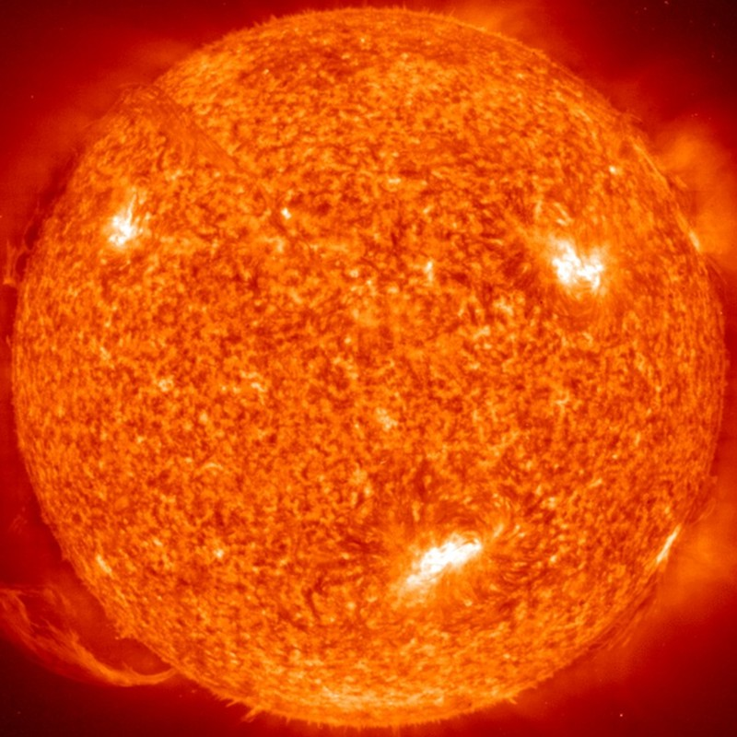
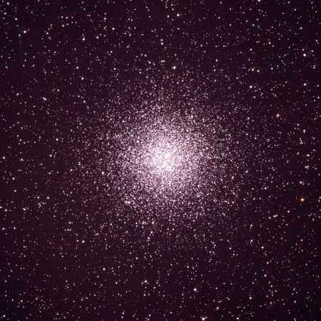
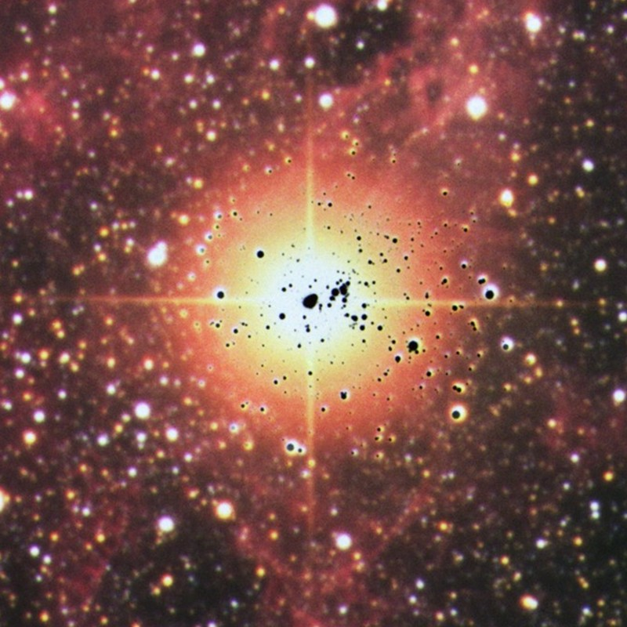
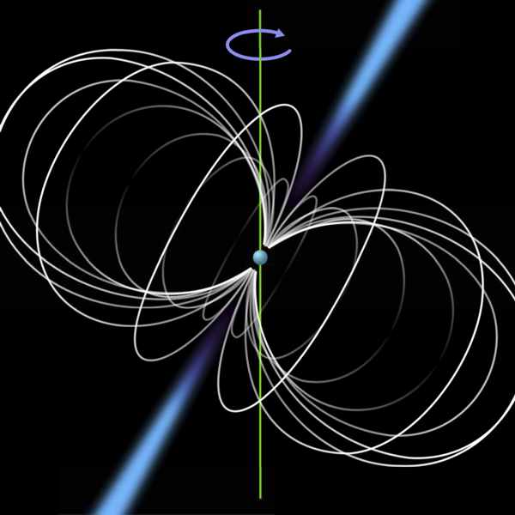
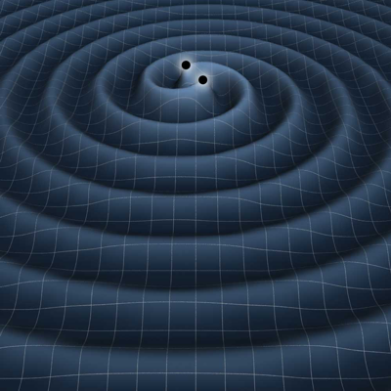
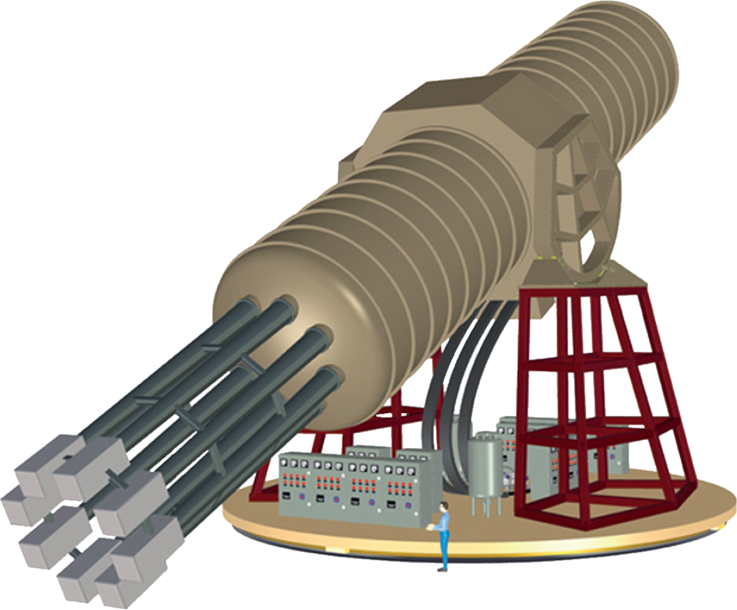



Particle-Physics Constraints from Stars
Solar Axions
Globular Clusters
Supernova 1987A
Neutron Stars
Gravity Waves
Georg G. Raffelt, Max-Planck-Institut für Physik, München

Slide 2
Particle-Physics Constraints from Stars
Low-mass particles (neutrinos, axions and friends, hidden photons,
low-mass carriers of new forces, ...) can be probed by stars.
• Particles from the Sun and their detection
• Impact of new energy-loss channels on low-mass stars
• Supernova 1987A
• Neutron-star cooling
• Axion conversion in pulsar magnetospheres
• Superradiance of ultra-light bosons from black holes
In this lecture focus on the astrophysics of these arguments
(often not so clear to particle physicists) and not so much on the latest results for all types of particles

Slide 3
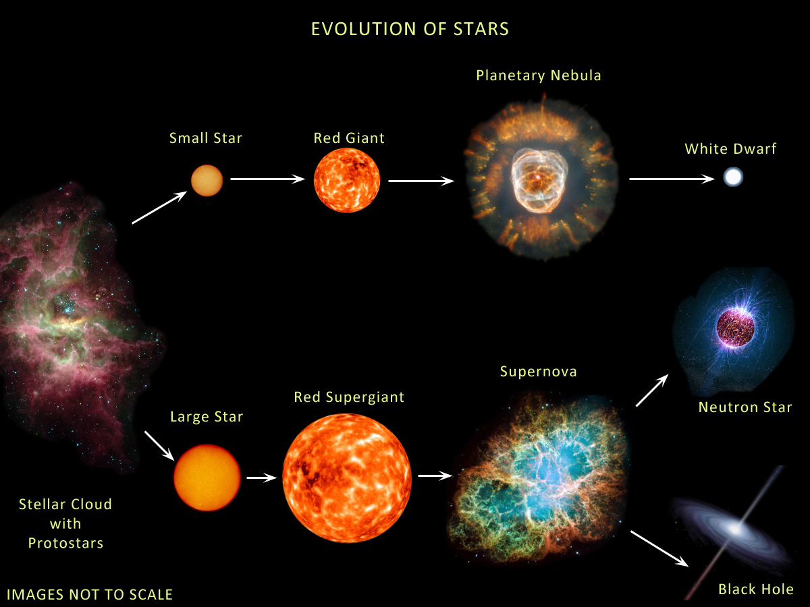
Evolution of Stars
http://earthspacecircle.blogspot.com/2013/07/stellar-evolution.html

Slide 4








Evolution of Stars
Compact
Remnants
$$M∼0.6 M_{⊙}$$
$$M≲8 M_{⊙}$$
R $∼$5000 km
$1 M_{⊙}=2×{10}^{30}$kg
$M$ = 1–2$M_{⊙}$
$$M≳8 M_{⊙}$$
R $∼$12 km
few–tens $M_{⊙}$
few km

Slide 5
Evolution of Stars
Very low energies by particle-physics standards
Mostly of interest at the “intensity frontier” for
feebly interacting particles
• Neutrino physics
• Axions and relatives
• Low-mass carriers of new forces, …
Surface T ~ keV
Surface T ~ eV (IR to UV)
Inner T ~ 1–100 keV
Nuclear density
Inner T ~ 30 MeV

Slide 6
Evolution of Stars
Particles from the Sun:
• Direct search
• Back-reaction on Sun
• Lifetime of HB stars in globular clusters
• Brightness of tip of red-giant branch (TRGB)
• White dwarf luminosity function
• Period decrease of variable WDs
White Dwarf
DM axion conversion in
pulsar magnetosphere
Neutrino signal
from SN 1987A
Cooling speed
Superradiance
Core-collapse supernova

Slide 7
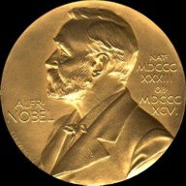

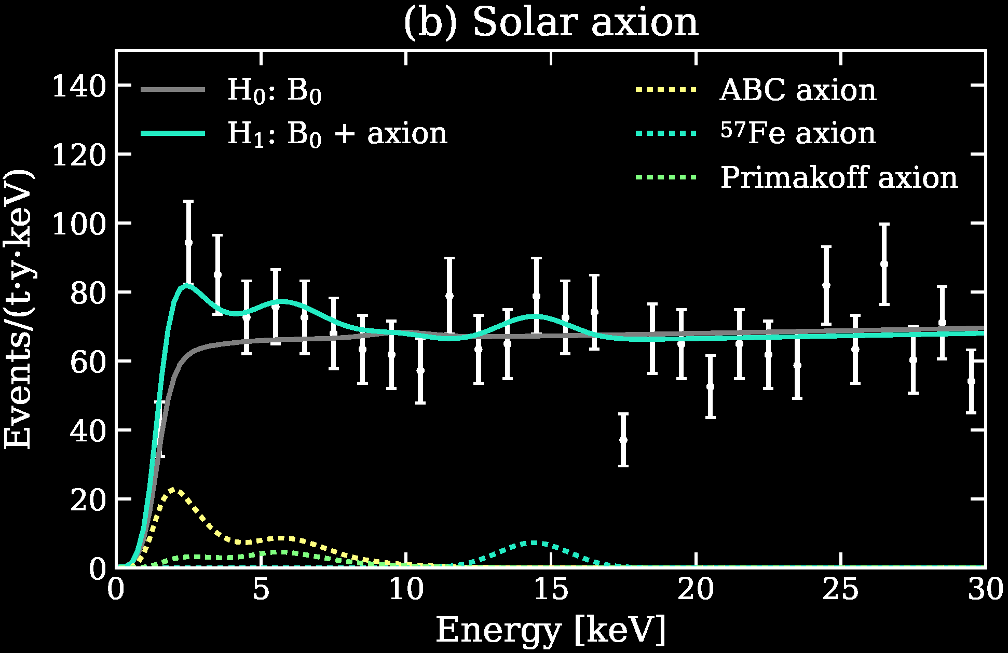
Particles from the Sun
2002 Solar Neutrinos (R.Davis, M.Koshiba)
2015 Solar Nu Oscillations (A.McDonald)
Search for solar axions
with CAST and future IAXO
Excess events in
XENON1T DM search.
Solar axions?
arXiv:2006.09721

Slide 8
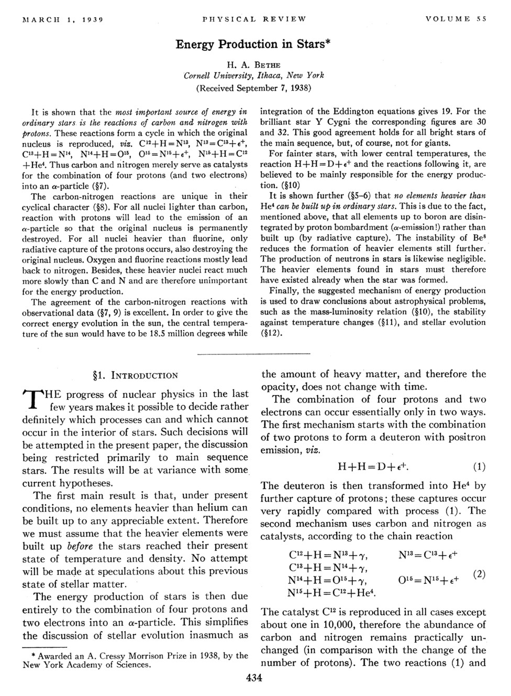
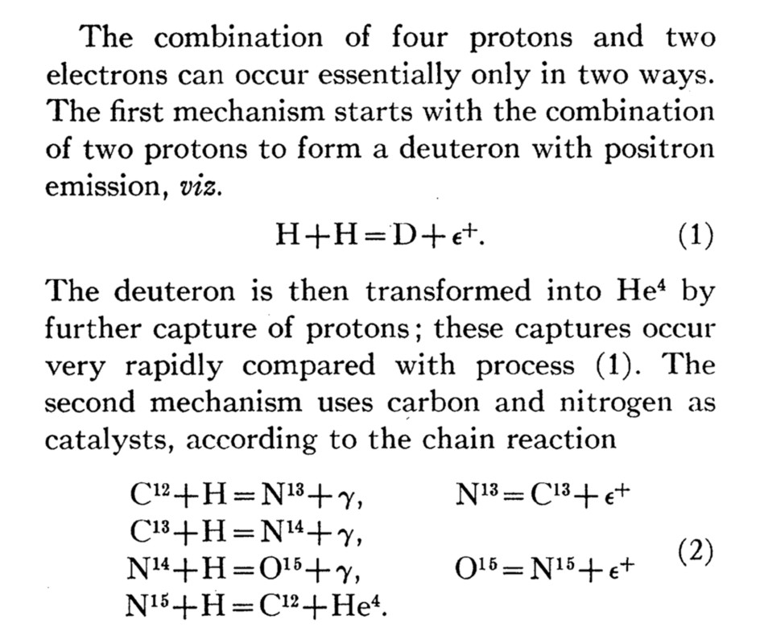
Bethe’s Classic Paper on Nuclear Reactions in Stars
No neutrinos
from nuclear reactions
in 1938 …

Slide 9
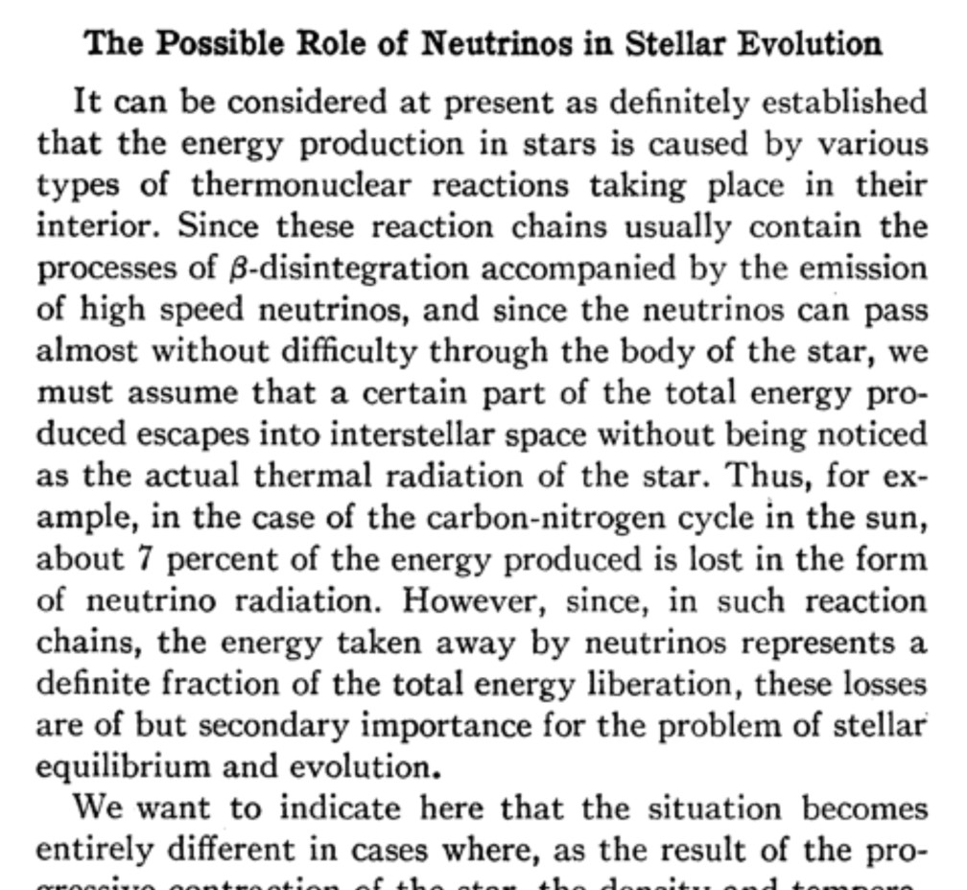
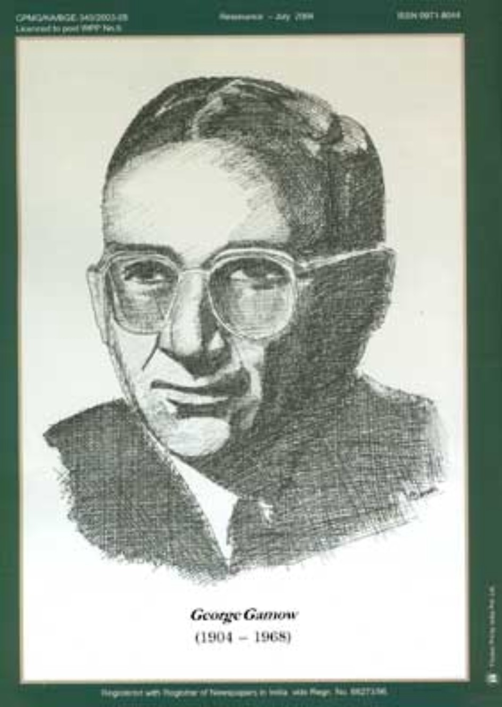
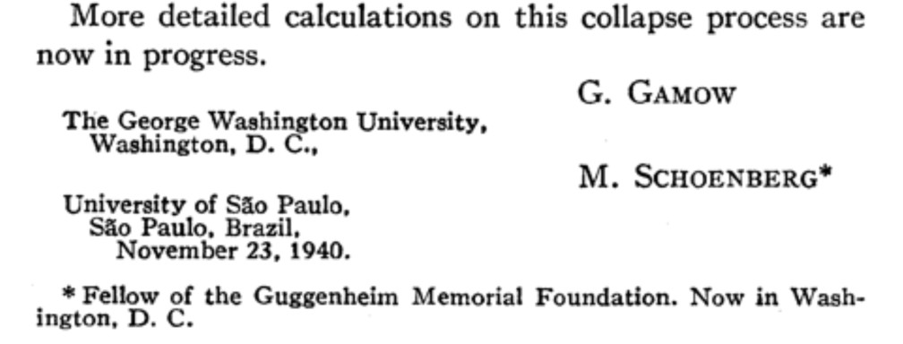
Predicting Neutrinos from Stars
Phys. Rev. 58:1117 (1940)

Slide 10
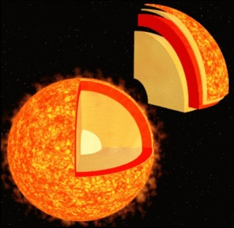
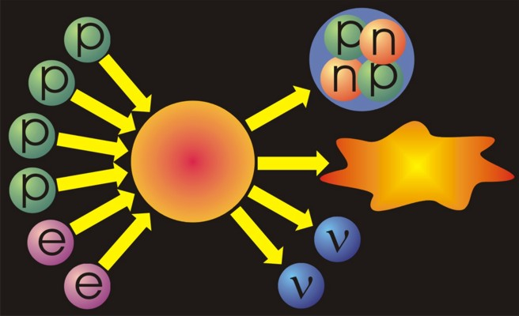
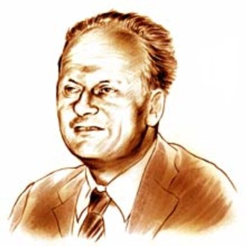
Neutrinos from the Sun
Helium
Reaction-
chains
Energy
26.7 MeV
Solar radiation: 98 % light (photons)
2 % neutrinos
At Earth 66 billion neutrinos/cm² sec
Hans Bethe (1906−2005, Nobel prize 1967)
Thermonuclear reaction chains (1938)

Slide 11
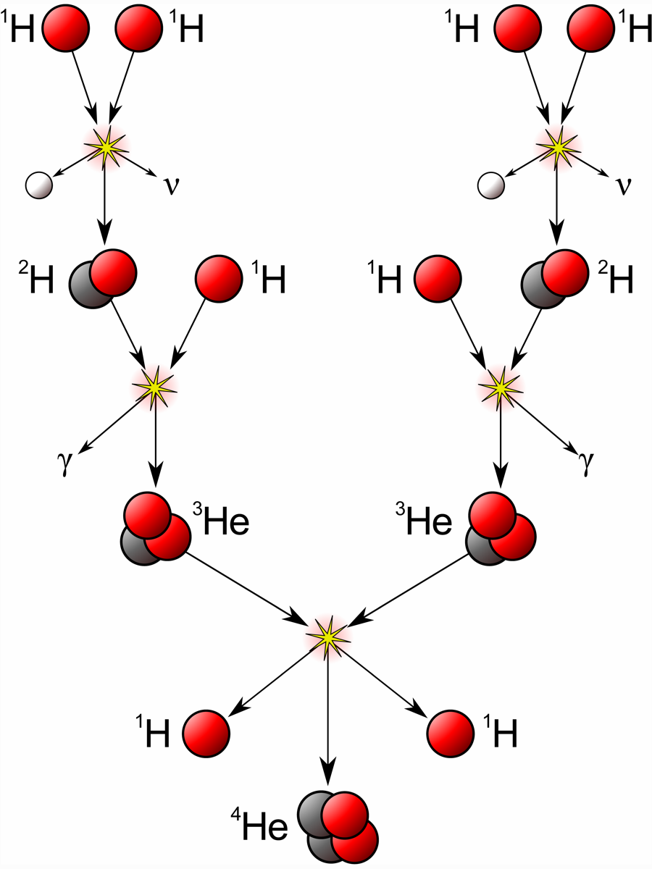
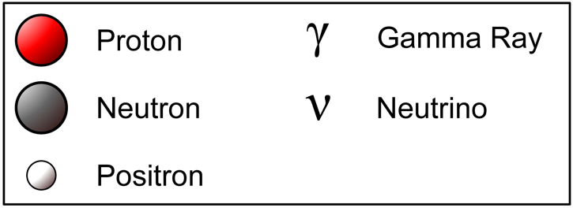
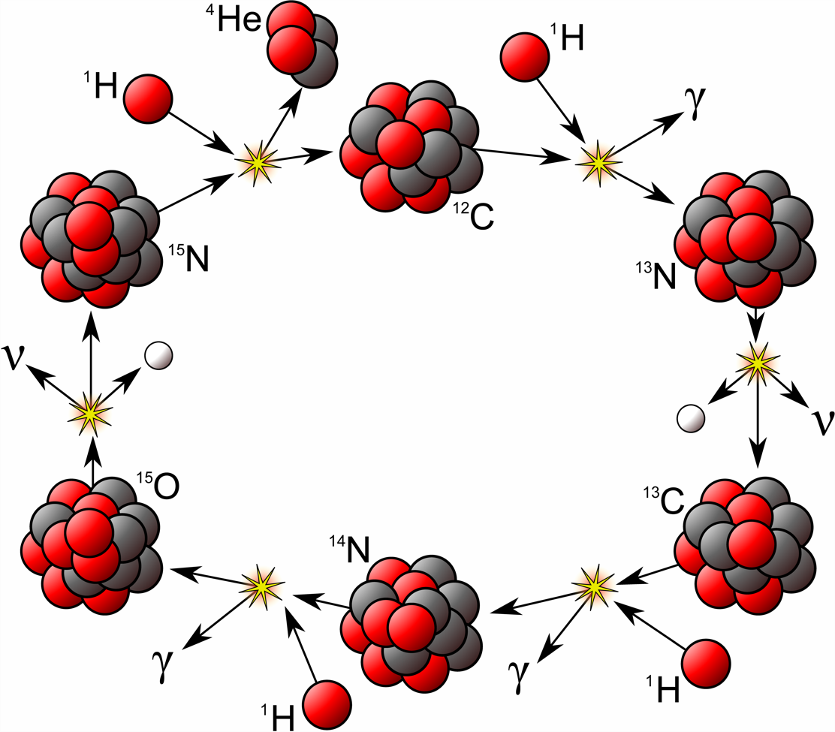
Hydrogen Burning
PP-I Chain
CNO Cycle

Slide 12
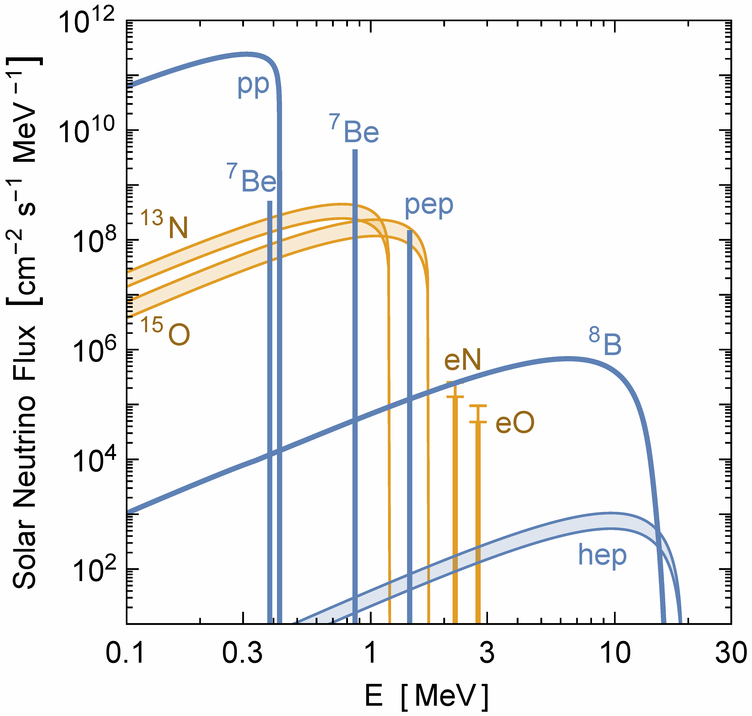
Solar Neutrinos from Nuclear Reactions
Vitagliano, Tamborra & Raffelt, arXiv:1910.11878
All components of pp
chains (blue) have
been measured
Very recently direct
experimental evidence
for CNO fluxes (orange)
in Borexino
arXiv:2006.15115 (06/2020)

Slide 13
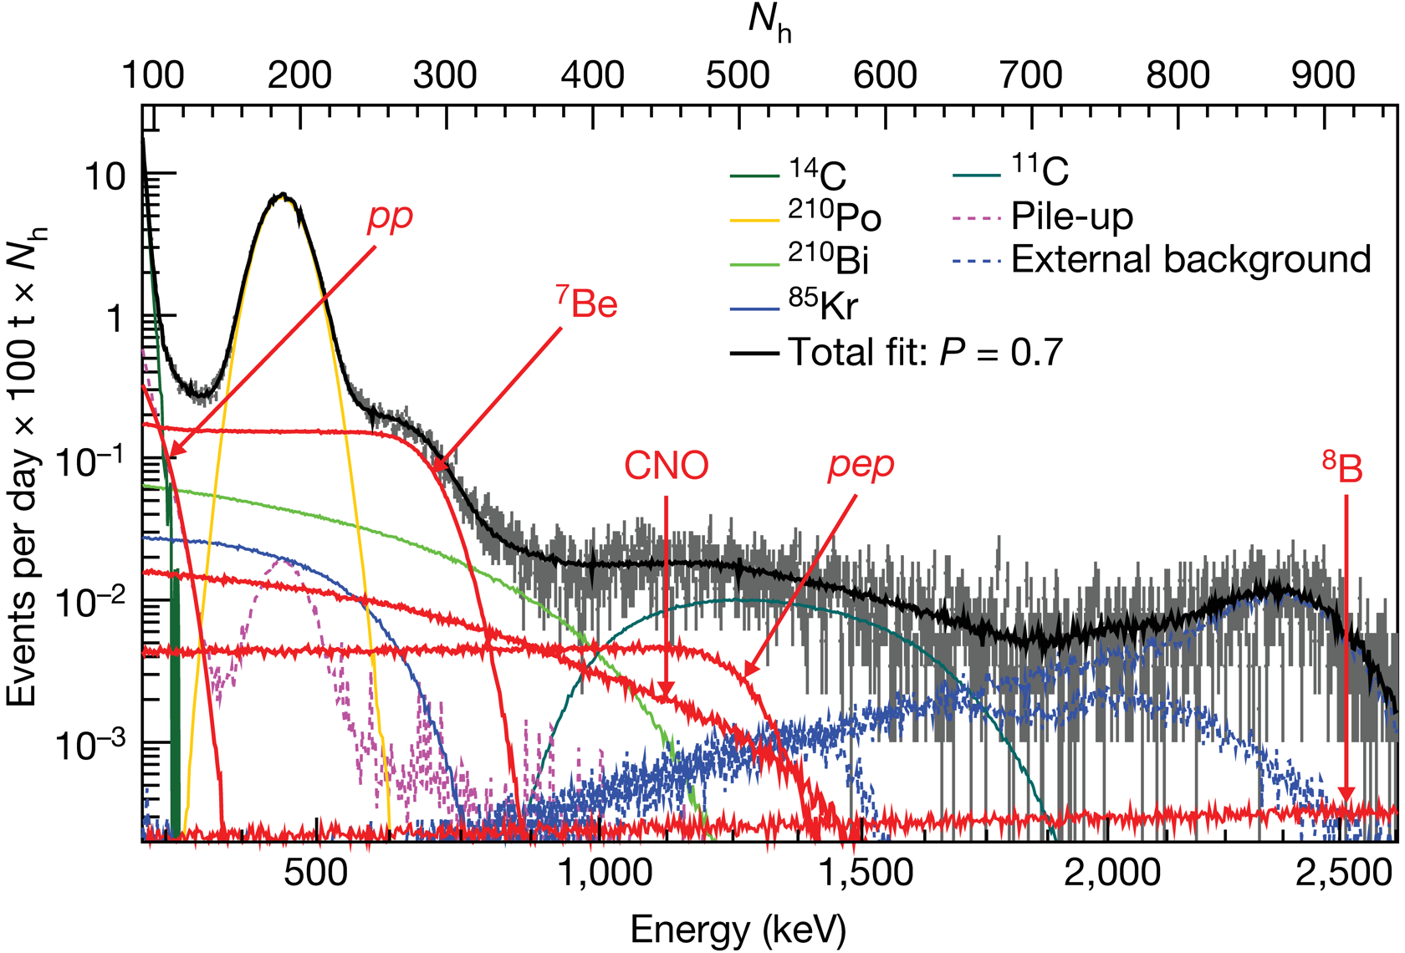
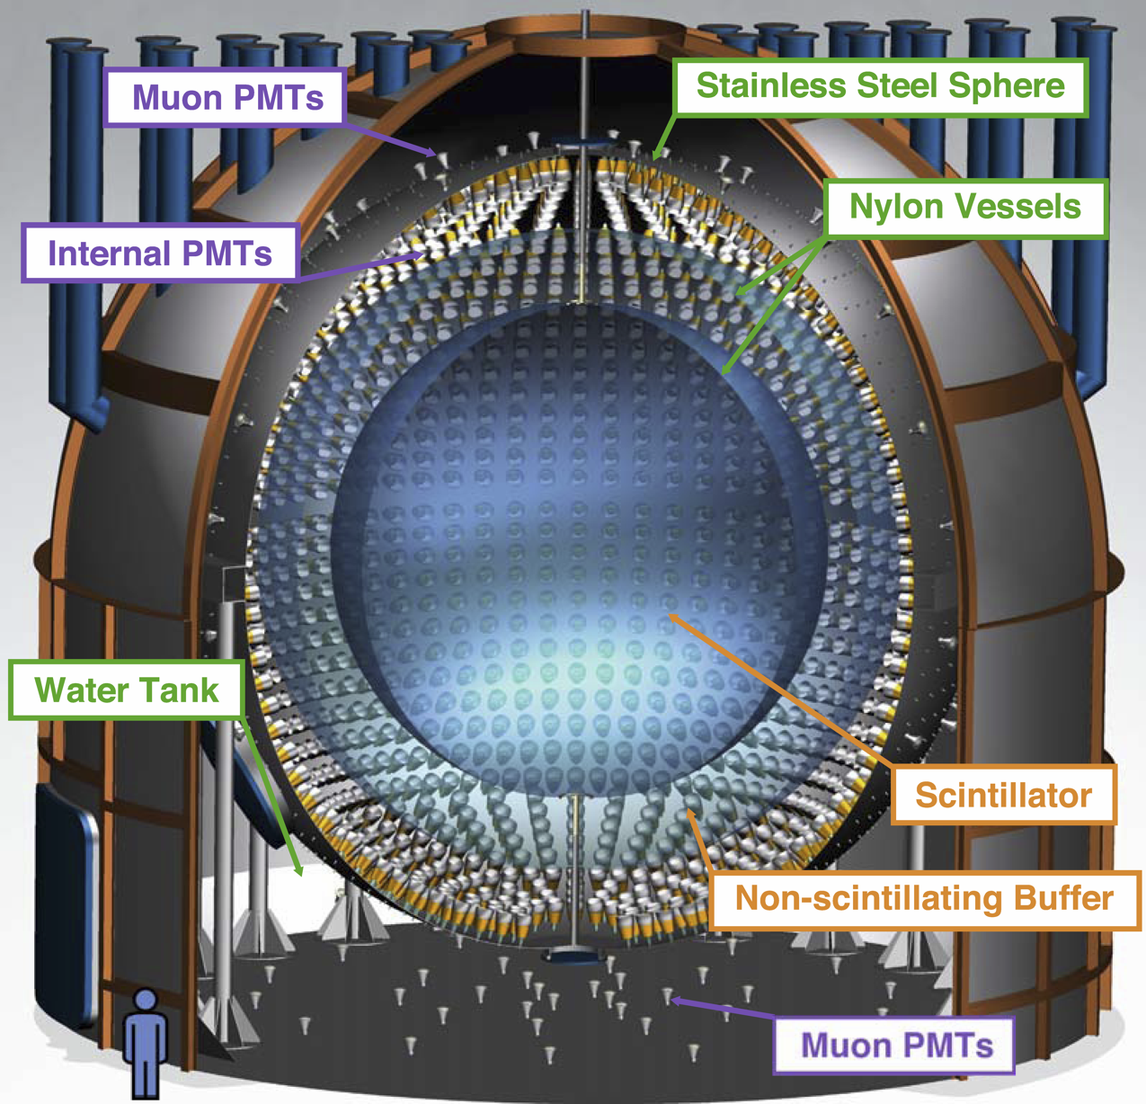
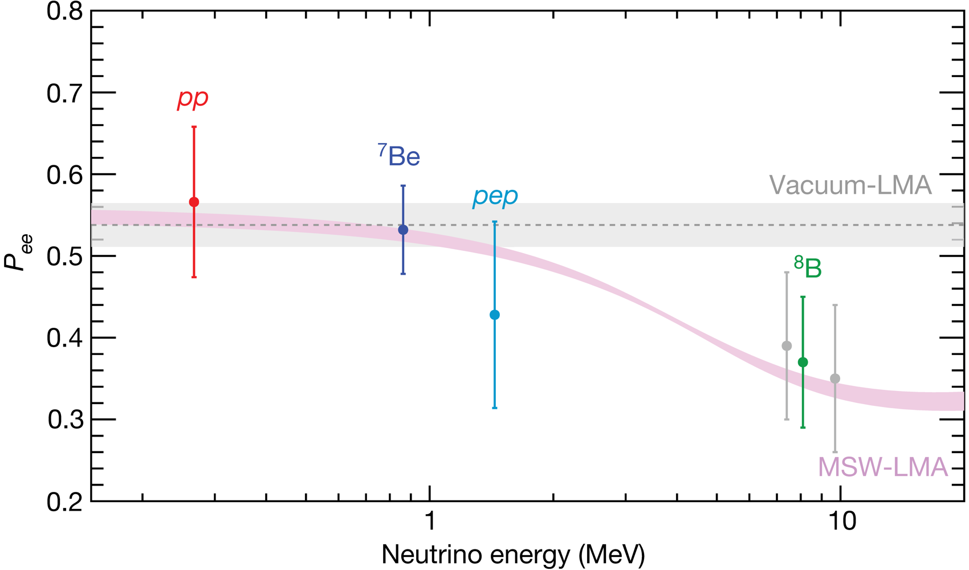
Solar Neutrino Spectroscopy with Borexino
Borexino Collaboration:
Comprehensive measurement of
pp-chain solar neutrinos
Nature 562 (2018) 505
Matter effect in the Sun

Slide 14
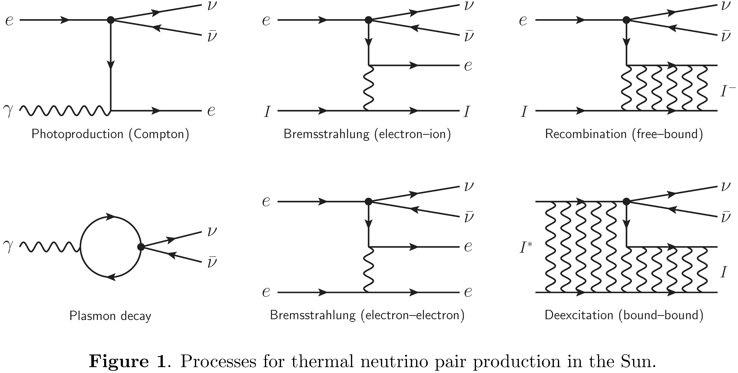
Thermal Neutrinos: Production Processes
Vitagliano, Redondo & Raffelt, arXiv:1708.02248

Slide 15
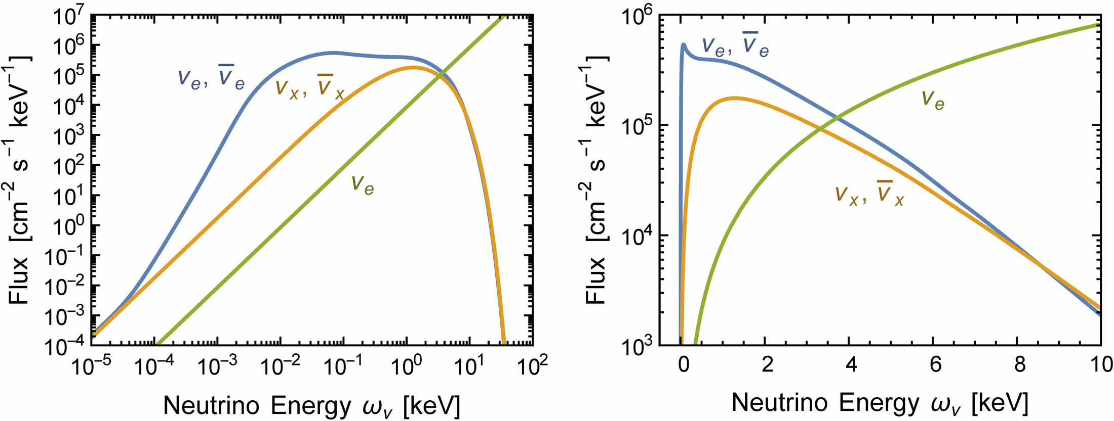
Solar neutrino flux at keV energies
• Thermally produced neutrinos and antineutrinos dominate at keV energies
• Future detection opportunities?
pp neutrinos
Vitagliano, Raffelt & Redondo, JCAP 1712 (2017) 010 [arXiv:1708.02248]

Slide 16
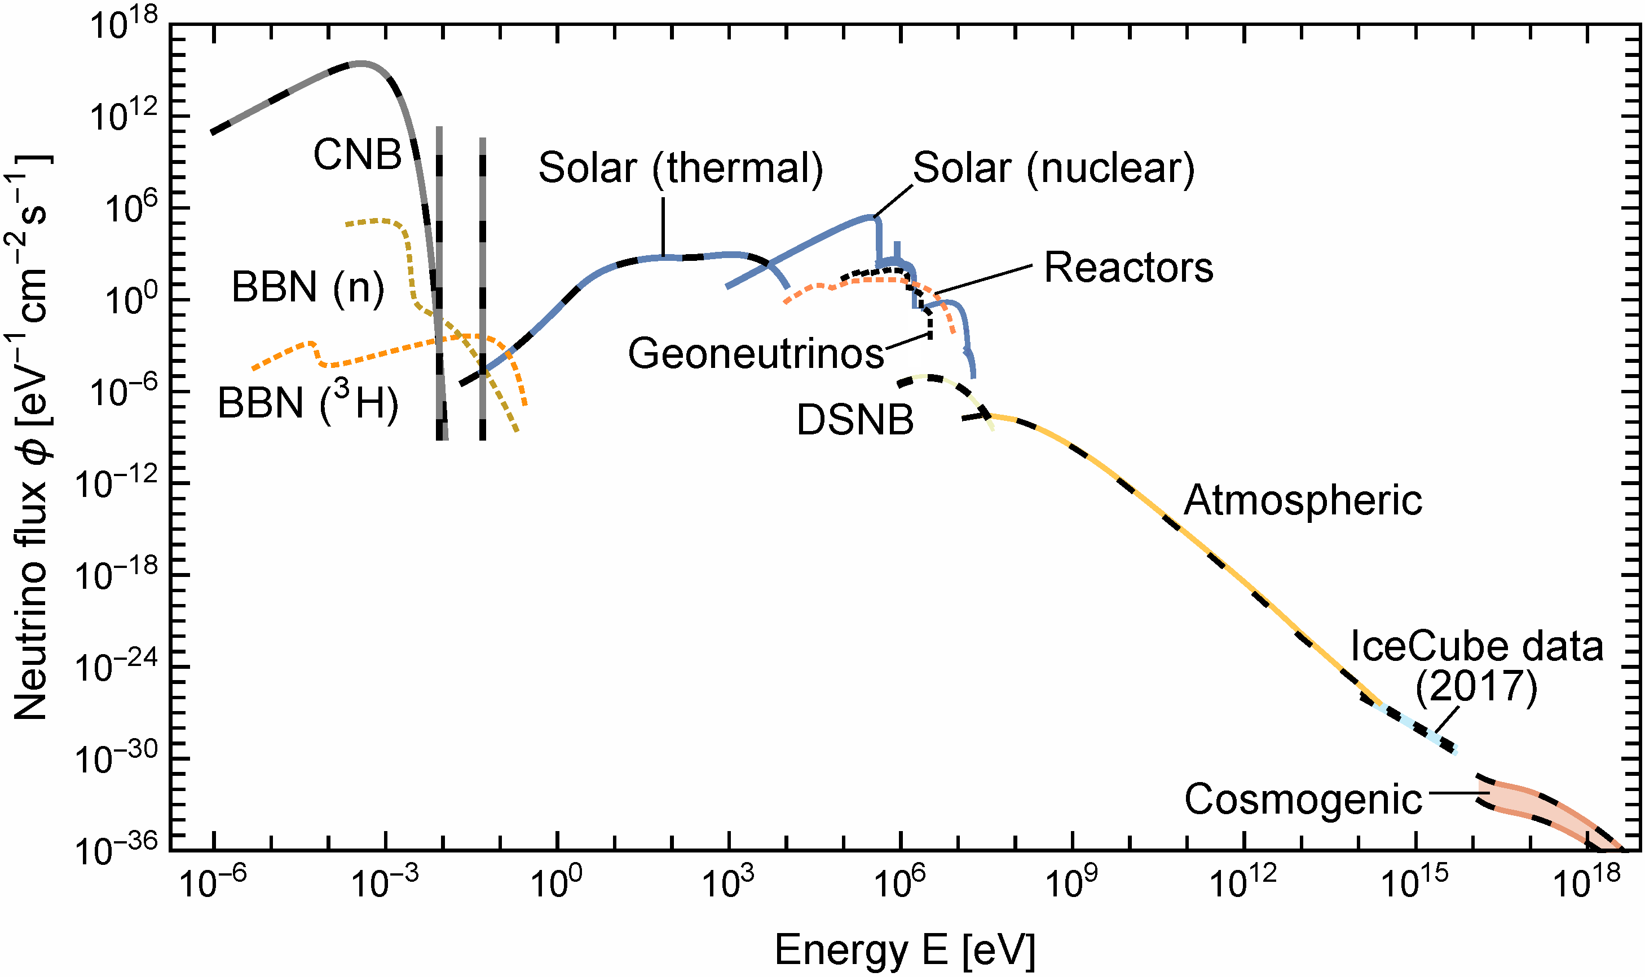
Grand Unified Neutrino Spectrum (GUNS) at Earth
Vitagliano, Tamborra & Raffelt, arXiv:1910.11878
Why keV energies
in the solar interior?

Slide 17
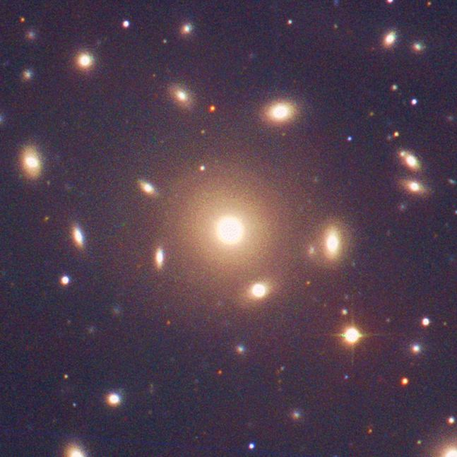
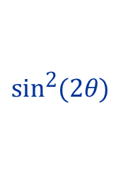
Virial Theorem – Dark Matter in Galaxy Clusters
A gravitationally bound
system of many particles
obeys the virial theorem
$$2〈E_{kin}〉=−〈E_{grav}〉$$
$$2\left\langle \frac{mv^{2}}{2}\right\rangle =\left\langle \frac{G_{N}M_{r}m}{r}\right\rangle$$
$$\left\langle v^{2}\right\rangle ≈G_{N}M_{r}\left\langle r^{−1}\right\rangle$$
Velocity dispersion
from Doppler shifts
and geometric size
Total Mass
Coma Cluster

Slide 18

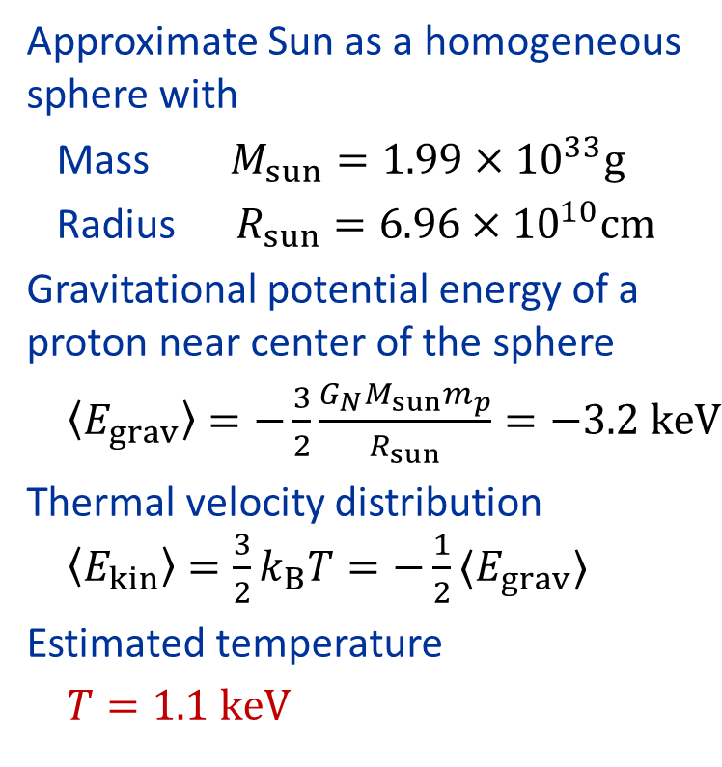

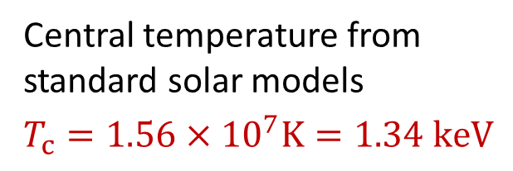
Virial Theorem Applied to the Sun
Virial Theorem $〈E_{kin}〉=−\frac{1}{2}〈E_{grav}〉$
Approximate Sun as a homogeneous
sphere with
Mass $M_{sun}=1.99×{10}^{33}g$
Radius $R_{sun}=6.96×{10}^{10}cm$
Gravitational potential energy of a
proton near center of the sphere
$〈E_{grav}〉=−\frac{3}{2}\frac{G_{N}M_{sun}m_{p}}{R_{sun}}=−3.2 keV$
Thermal velocity distribution
$〈E_{kin}〉=\frac{3}{2}k_{B}T=−\frac{1}{2}〈E_{grav}〉$
Estimated temperature
$T=1.1 keV$
Central temperature from
standard solar models
$$T_{c}=1.56×{10}^{7}K=1.34 keV$$

Slide 19
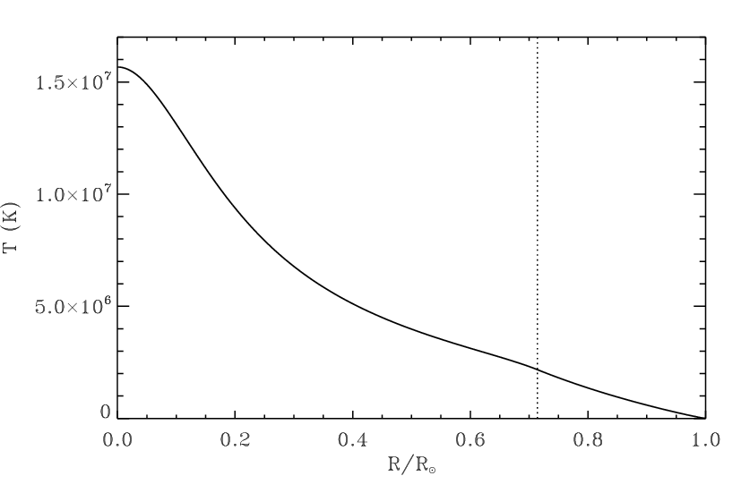
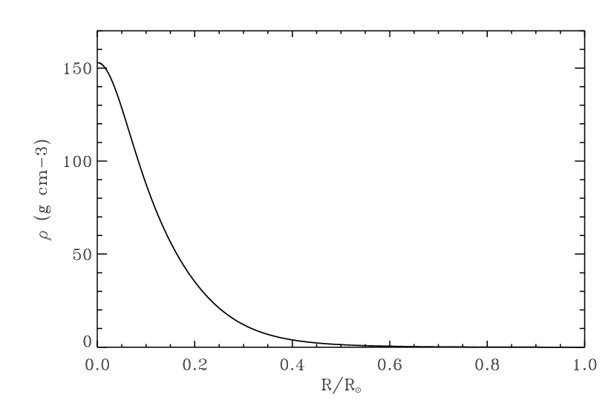
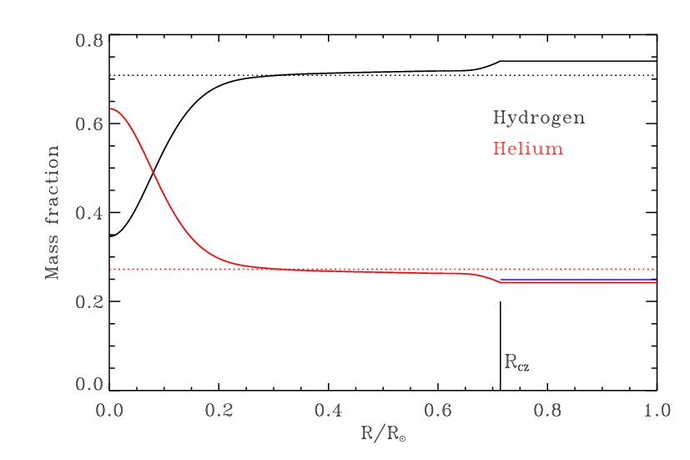
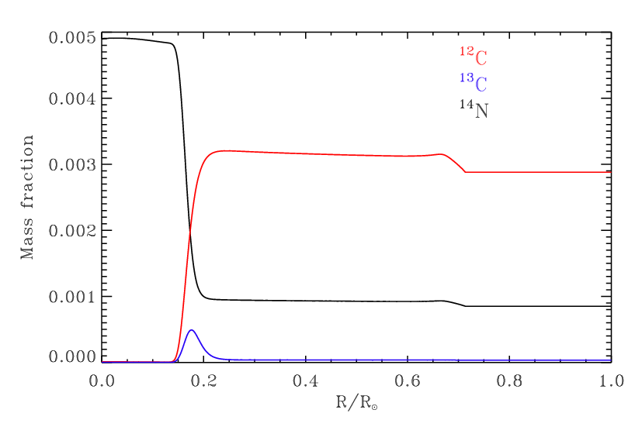
Standard Solar Model: Internal Structure
Temperature
Mass density
Hydrogen
¹⁴N
¹²C
Helium
Convection
Convection
R_{CZ}
¹³C

Slide 20
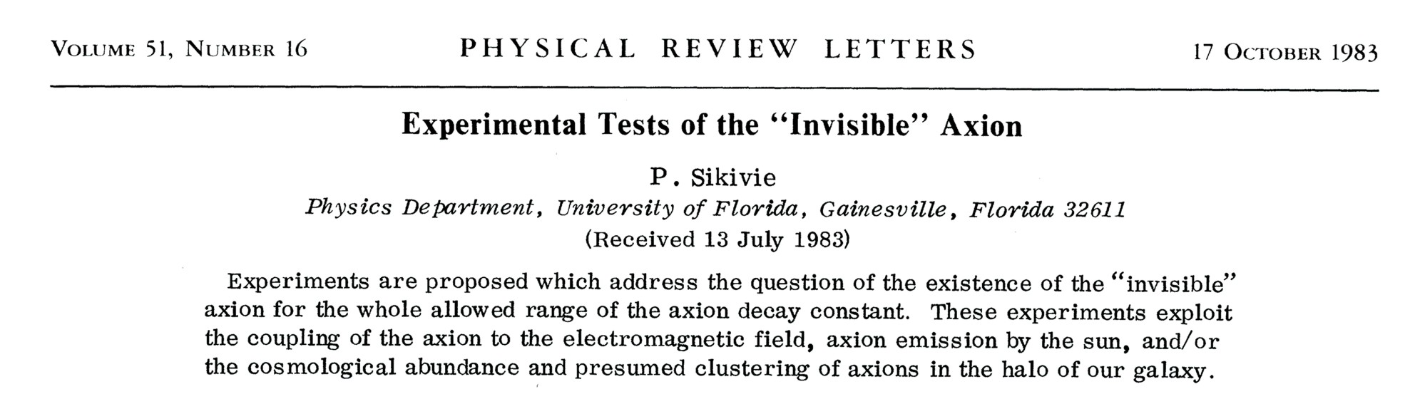
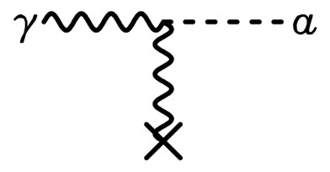

Experimental Tests of Invisible Axions
Primakoff effect:
Axion-photon transition in external
static E or B field
(Originally discussed for $π^{0}$
by Henri Primakoff 1951)
Pierre Sikivie:
Macroscopic B-field can provide a
large coherent transition rate over
a big volume (low-mass axions)
Axion helioscope:
Look at the Sun through a dipole magnet
Axion haloscope:
Look for dark-matter axions with
A microwave resonant cavity

Slide 21
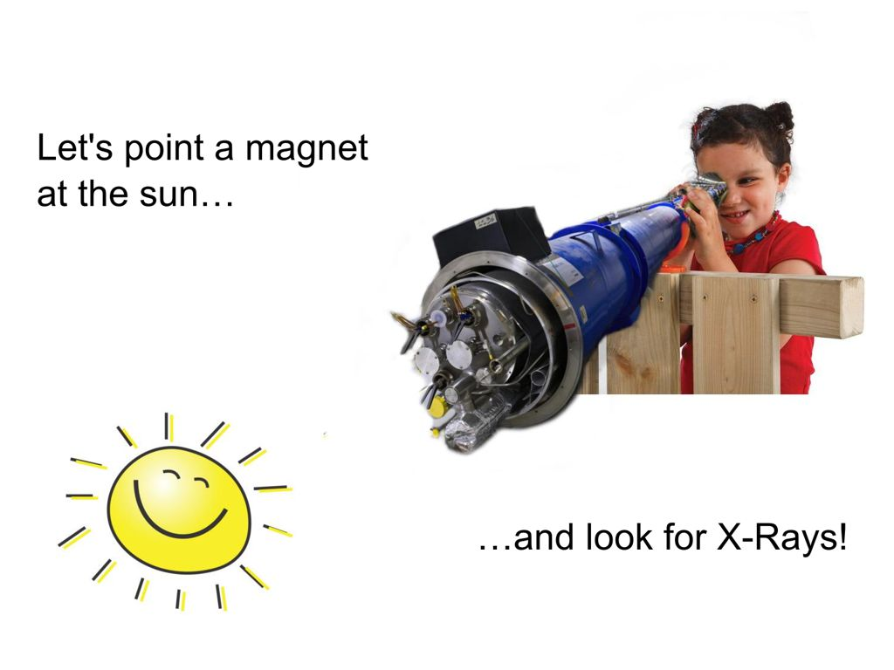
Pointing a Magnet to the Sun
By CAST student Sebastian Baum

Slide 22
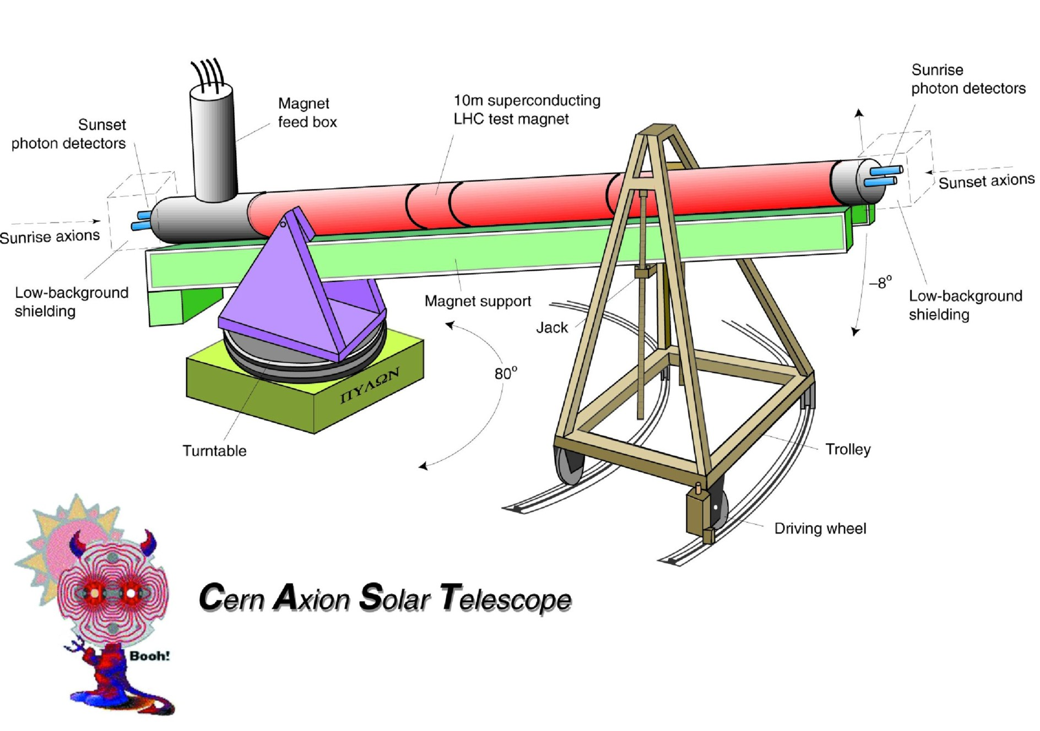
LHC Magnet Mounted as a Telescope to Follow the Sun
→ CAST Movie

Slide 23
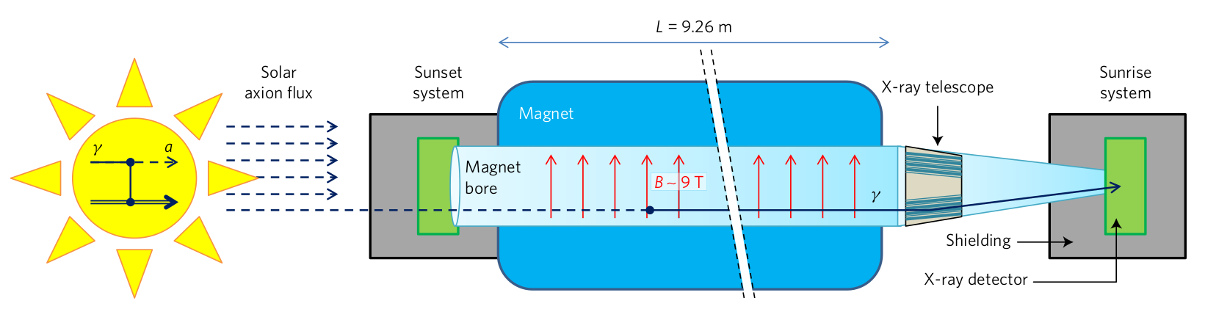
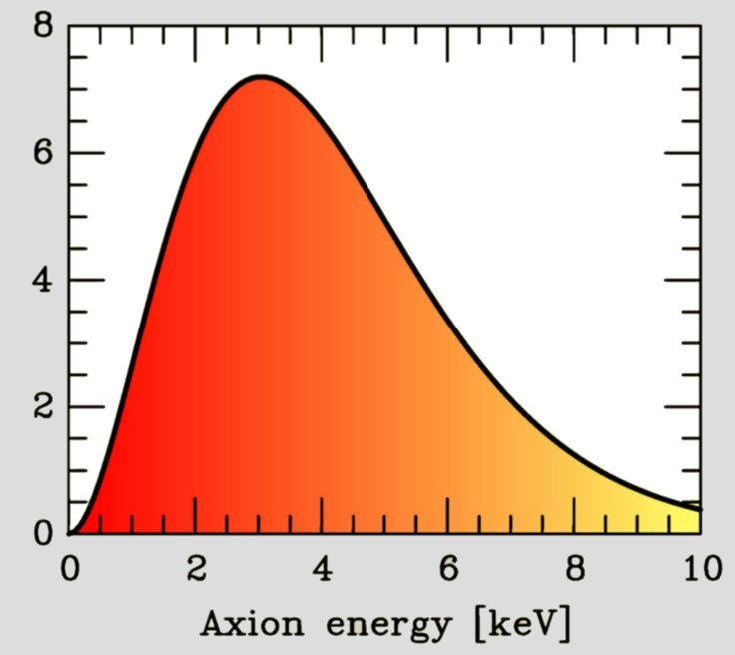
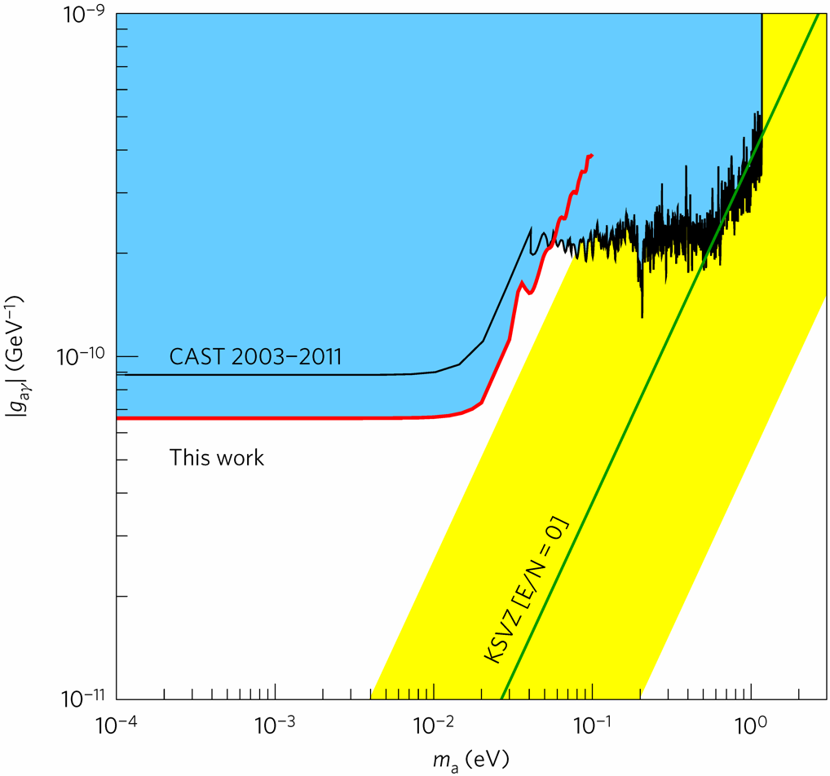

Searching for Solar Axions with CAST
95% Exclusion
(2003–2015)
2013–15 data
Flux: $g_{10}^{2} 3.7×{10}^{11} cm^{−2}s^{−1}$
New CAST limit on the axion-photon interaction, Nature Physics 13 (2017) 584 [1705.02290]

Slide 24
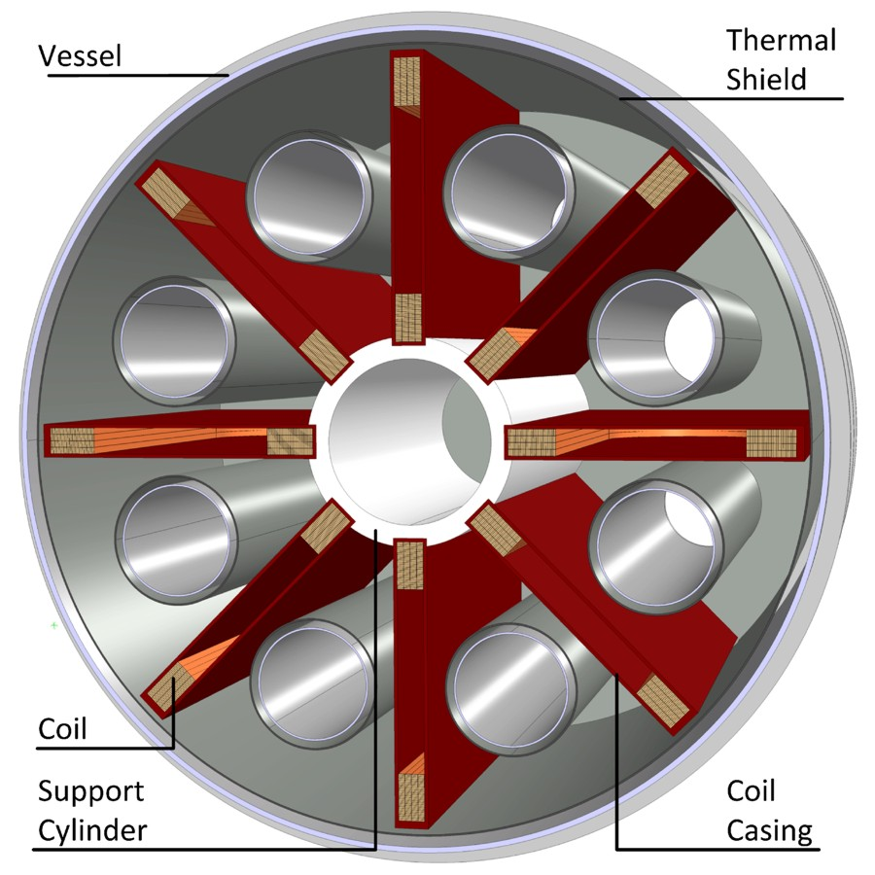
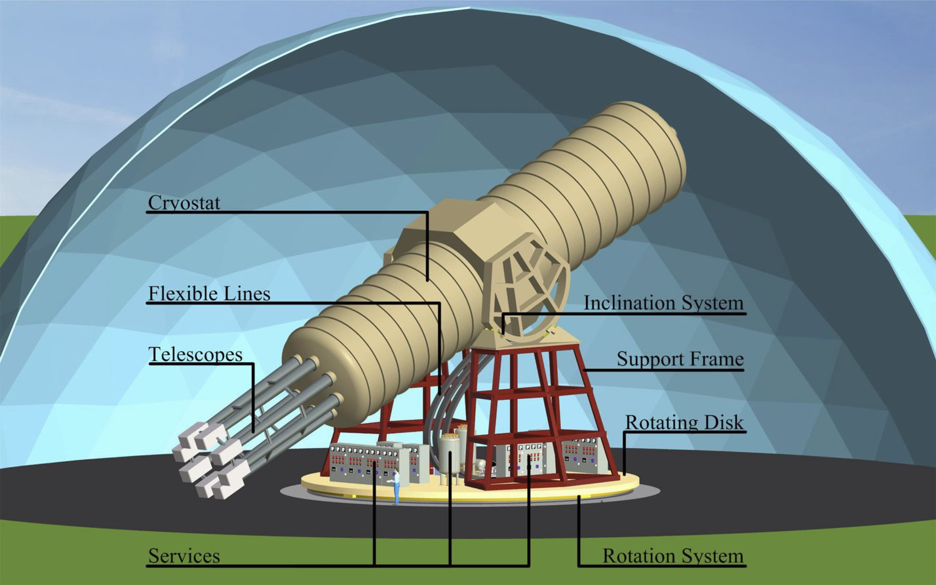
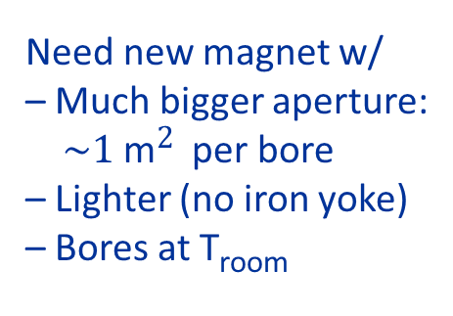
Next Generation Axion Helioscope (IAXO)
Need new magnet w/
– Much bigger aperture:
$\sim 1 \text{m}2$ per bore
– Lighter (no iron yoke)
– Bores at T_{room}
• Irastorza et al.: Towards a new generation axion helioscope, arXiv:1103.5334
• Armengaud et al.:
Conceptual Design of the International Axion Observatory (IAXO), arXiv:1401.3233

Slide 25
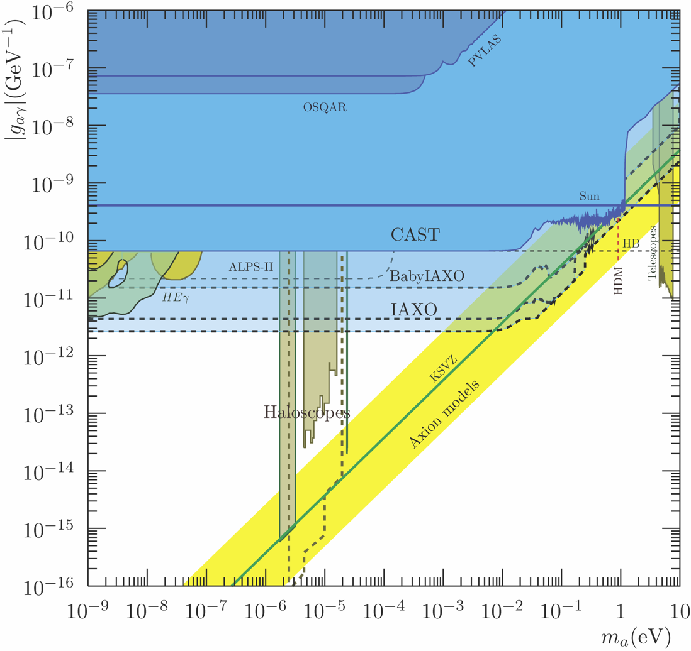
IAXO Sensitivty Forecast
Physics potential of the International Axion Observatory (IAXO)
JCAP 1906 (2019) 047, arXiv:1904.09155

Slide 26
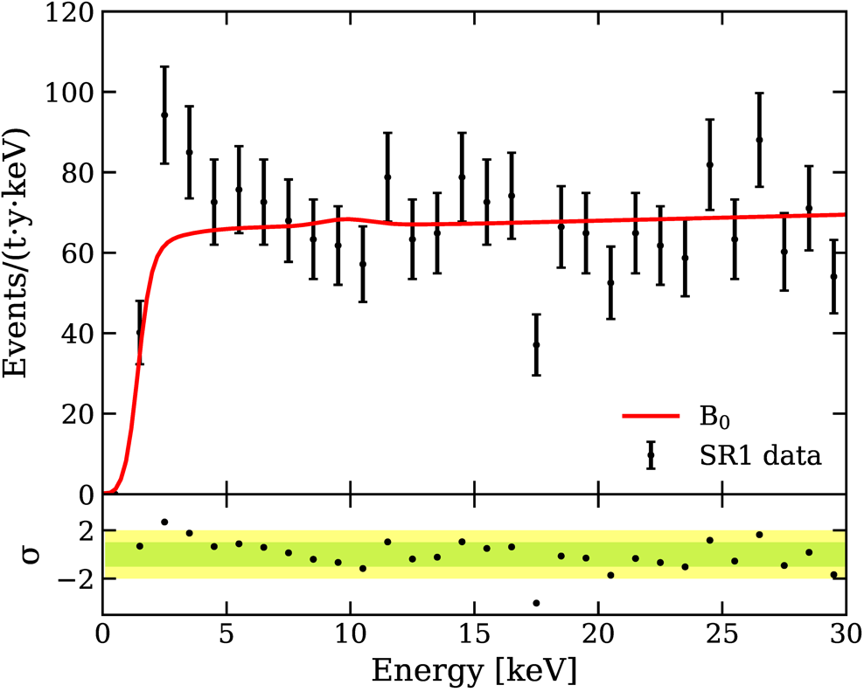
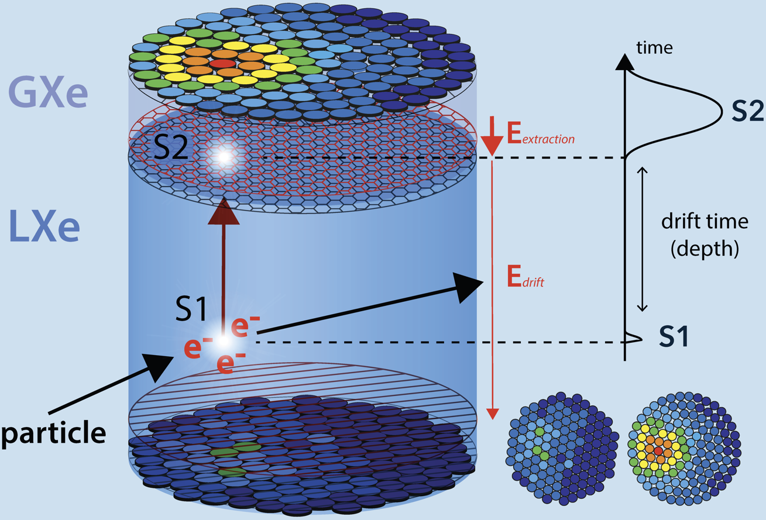
Observation of Excess Electronic Recoil Events in XENON1T
arXiv:2006.09721 (17 June 2020)
~ 150 citations
3.5σ excess
Caused by solar axions or other particles from the Sun?

Slide 27
Some Quick Blog Links
17 June
Resonannes, Particle Physics Blog: Hail the XENON excess
http://resonaances.blogspot.com/
The Reference Frame https://motls.blogspot.com/2020/06/xenon1t-our-excess-is-due-to-tritium.html
XENON1T: our excess is due to tritium junk, axions, or magnetic neutrinos
CosmoQuest: Observation of Excess Events in the XENON1T Dark Matter Experiment
https://cosmoquest.org/x/2020/06/observation-of-excess-events-in-the-xenon1t-dark-matter-experiment/
physicsworld, Particle and nuclear
XENON1T may have detected something very interesting, or maybe not
https://physicsworld.com/a/xenon1t-may-have-detected-something-very-interesting-or-maybe-not/
Centrales Forschungsnetz Aussergewöhnlicher Himmels-Phänomene
Astronomie: Observation of Excess Events in the XENON1T Dark Matter Experiment
https://www.hjkc.de/_blog/2020/06/22/15595-astronomie-observation-of-excess-events-in-the-xenon1t-dark-matter-experiment/
ParticleBites: The high energy physics reader's digest
The XENON1T Excess : The Newest Craze in Particle Physics
https://www.particlebites.com/?p=7260
AlphaGalileo
Observation of Excess Events in the XENON1T Dark Matter Experiment
https://www.alphagalileo.org/en-gb/Item-Display/ItemId/194613
18 June
19 June
22 June
30 June

Slide 28
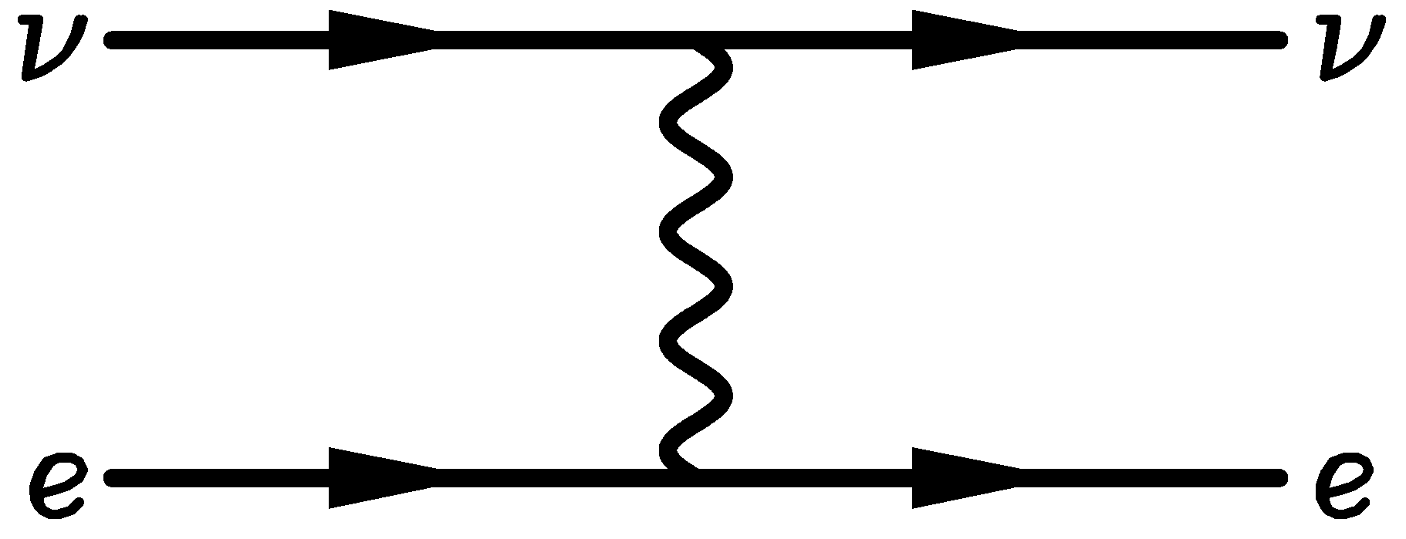

keV-Range Energy Depositions
Nuclear recoil
Electronic recoil (ER)
Solar neutrinos with large
dipole moments
a
e
e
Dark-matter WIMPs
Solar axions (keV energies)
keV-mass bosonic DM particles
(ALP-like, hidden photons, …)
Coherent scattering of
10 MeV solar neutrinos

Slide 29


Observation of Excess Electronic Recoil Events in XENON1T
arXiv:2006.09721 (17 June 2020), accepted in PRD

Slide 30









Solar Axions/ALPs
$$g_{aγ}$$
Redondo, arXiv:1310.0823
$$g_{ae}$$
a
e
$$g_{ae}$$
Xe
Xe⁺
XENON Collab. 2006.09721
a
γ
$$g_{aγ}$$
Dent+ 2006.15118, Gao+ 2006.14598

Slide 31


XENON1T Results for Solar Axions/ALPs
Gao+ 2006.14598
XENON Collab. 2006.09721
Including Primakoff detection
Only axio-electric detection
XENON1T excess cannot be due to solar axions/ALPs by a large margin

Slide 32
IAXO Sensitivity Forecast
XENON1T
Excess
Physics potential of the International Axion Observatory (IAXO)
JCAP 1906 (2019) 047, arXiv:1904.09155

Slide 33
Summary on XENON1T Excess
Electron-recoil excess events in XENON1T (3.5 σ) can be attributed to
• Statistical fluctuation
(“extraordinary claims require extraordinary evidence”)
• Tritium contamination (~3 atoms per kg xenon)
– strong conflict with estimated purification
– but not proven or disproven
• Dark matter signal (MANY scenarios, e.g. keV-range hidden photons)
• Solar neutrinos with non-standard interactions
Solar axion or neutrino MDM interpretation in strong conflict with
CAST and/or stellar energy-loss limits
Solar hidden photons provide poor spectral fit

Slide 34

PRL Paper
What are these astrophysical limits?
Where do they come from?

Slide 35



Equations of Stellar Structure
Assume spherical symmetry and static structure (neglect kinetic energy)
Excludes: Rotation, convection, magnetic fields, supernova-dynamics, …
Hydrostatic equilibrium
$$\frac{dP}{dr}=−\frac{G_{N}M_{r}ρ}{r^{2}}$$
Energy conservation
$$\frac{dL_{r}}{dr}=4πr^{2}ερ$$
Energy transfer
$$L_{r}=\frac{4πr^{2}}{3κρ}\frac{d\left(aT^{4}\right)}{dr}$$
Literature
Clayton: Principles of stellar evolution and
nucleosynthesis (Univ. Chicago Press 1968)
Kippenhahn & Weigert: Stellar structure
and evolution (Springer 1990)
$r$
$P$
$GN$
$ρ$
$M_{r}$
$L_{r}$
$ε$
$$κ$$
$$κ_{γ}$$
$$κ_{c}$$
Radius from center
Pressure
Newton’s constant
Mass density
Integrated mass up to r
Luminosity (energy flux)
Local rate of energy
generation $[erg g^{−1}s^{−1}]$
$$ε=ε_{nuc}+ε_{grav}−ε_{ν}$$
Opacity
$$κ^{−1}=κ_{γ}^{−1}+κ_{c}^{−1}$$
Radiative opacity
$$κ_{γ}ρ={〈λ_{γ}〉}_{Rosseland}^{−1}$$
Electron conduction

Slide 36

Convection in Main-Sequence Stars
Sun
Kippenhahn & Weigert, Stellar Structure and Evolution

Slide 37


Self-Regulated Nuclear Burning
Virial Theorem: $〈E_{kin}〉=−\frac{1}{2}〈E_{grav}〉$
Small Contraction
Heating
Increased nuclear burning
Increased pressure
Expansion
Additional energy loss (“cooling”)
Loss of pressure
Contraction
Heating
Increased nuclear burning
Hydrogen burning at nearly fixed T
Gravitational potential nearly fixed:
${G_{N}M}/R∼constant$
$R∝M$ (More massive stars bigger)
Main-Sequence
Star

Slide 38


Nuclear Binding Energy
Fe
Mass Number

Slide 39




Thermonuclear Reactions and Gamow Peak
Coulomb repulsion prevents nuclear
reactions, except for Gamow tunneling
Tunneling probability
$$p∝E^{−1/2}e^{−2πη}$$
where the Sommerfeld parameter is
$$η={\left(\frac{m}{2E}\right)}^{1/2}Z_{1}Z_{2}e^{2}$$
Parameterize cross section with
astrophysical S-factor
$S\left(E\right)=σ\left(E\right) E e^{2πη\left(E\right)}$
$${}_{ }^{3}{He}+{}_{ }^{3}{He}→{}_{ }^{4}{He}+2p$$
LUNA Collaboration, nucl-ex/9902004

Slide 40




Main Nuclear Burning Stages
Hydrogen burning $4p+2e^{−}→{}_{}^{4}{He}+2ν_{e}$
Proceeds by pp chains and CNO cycle
No higher elements are formed because
no stable isotope with mass number 8
Neutrinos from p → n conversion
Typical temperatures: 10⁷ K ($∼$1 keV)
Each type of burning occurs
at a very different T but a
broad range of densities
Never co-exist in the same
location
Helium burning
$${}_{}^{4}{He}+{}_{}^{4}{He}+{}_{}^{4}{He}↔{}_{}^{8}{Be}+{}_{}^{4}{He}→{}_{}^{12}C$$
“Triple alpha reaction” because $8Be$ unstable,
builds up with concentration $∼{10}^{−9}$
$${}_{}^{12}C+{}_{}^{4}{He}→{}_{}^{16}O$$
$${}_{}^{16}O+{}_{}^{4}{He}→{}_{}^{20}{Ne}$$
Typical temperatures: ${10}^{8} K$ ($\sim$10 keV)
Carbon burning
Many reactions, for example
${}_{}^{12}C+{}_{}^{12}C→{}_{}^{23}{Na}+p$ or ${}_{}^{20}{Ne}+{}_{}^{4}{He}$ etc
Typical temperatures: $109 K$ $(\sim 100 keV)$

Slide 41

Hydrogen Exhaustion
Main-sequence star
Helium-burning star
Hydrogen Burning
Helium
Burning
Hydrogen
Burning

Slide 42






Burning Phases of a 15 Solar-Mass Star
L_{γ} [10⁴ L_{sun}]
Burning Phase
Dominant
Process
T_{c}
[keV]
ρ_{c}
[g/cm³]
L_{ν}/L_{γ}
Duration
[years]
Hydrogen
H → He
3
5.9
2.1
−
1.2×10⁷
Helium
He → C, O
14
1.3×10³
6.0
1.7×10⁻⁵
1.3×10⁶
Carbon
C → Ne, Mg
53
1.7×10⁵
8.6
1.0
6.3×10³
Neon
Ne → O, Mg
110
1.6×10⁷
9.6
1.8×10³
7.0
Oxygen
O → Si
160
9.7×10⁷
9.6
2.1×10⁴
1.7
Silicon
Si → Fe, Ni
270
2.3×10⁸
9.6
9.2×10⁵
6 days

Slide 43




Degenerate Stars (“White Dwarfs”)
Assume temperature very small
→ No thermal pressure
→ Electron degeneracy is pressure source
Pressure ~ Momentum density × Velocity
Electron density $n_{e}={p_{F}^{3}}/{\left(3π^{3}\right)}$
Momentum $p_{F}$ (Fermi momentum)
Velocity $v∝{p_{F}}/{m_{e}}$
Pressure $P∝p_{F}^{5}∝ρ^{5/3}∝M^{5/3}R^{−5}$
Density $ρ∝MR^{−3}$
Hydrostatic equilibrium
$$\frac{dP}{dr}=−\frac{G_{N}M_{r}ρ}{r^{2}}$$
With ${dP}/{dr}∼−P/R$ we have
$$P∝G_{N}MρR^{−1}∝G_{N}M^{2}R^{−4}$$
Inverse mass radius relationship
$R∝M^{−1/3}$
$$R=10,500 km {\left(\frac{0.6 M_{⊙}}{M}\right)}^{1/3}{\left(2Y_{e}\right)}^{5/3}$$
($Y_{e}$ electrons per nucleon)
For sufficiently large stellar mass $M$,
electrons become relativistic
Velocity = speed of light
Pressure
$$P∝p_{F}^{4}∝ρ^{4/3}∝M^{4/3}R^{−4}$$
No stable configuration
Chandrasekhar mass limit
$$M_{Ch}=1.457 M_{⊙} {\left(2Y_{e}\right)}^{2}$$

Slide 44

Degenerate Stars (“White Dwarfs”)
$$R=10,500 km {\left(\frac{0.6 M_{⊙}}{M}\right)}^{1/3}{\left(2Y_{e}\right)}^{5/3}$$
($Y_{e}$ electrons per nucleon)
For sufficiently large stellar mass $M$,
electrons become relativistic
Velocity = speed of light
Pressure
$$P∝p_{F}^{4}∝ρ^{4/3}∝M^{4/3}R^{−4}$$
No stable configuration
Chandrasekhar mass limit
$$M_{Ch}=1.457 M_{⊙} {\left(2Y_{e}\right)}^{2}$$

Slide 45

Galactic Globular Cluster M55

Slide 46

Color-Magnitude Diagram for Globular Clusters
Stars with M so
large that they
have burnt out
in a Hubble time
No new star
formation in
globular clusters
Mass
H
Main-Sequence
Hot, blue
cold, red
Color-magnitude diagram synthesized from several low-metallicity globular
clusters and compared with theoretical isochrones (W.Harris, 2000)

Slide 47
Color-Magnitude Diagram for Globular Clusters
H
H
He
C O
He
Asymptotic Giant
Red Giant
H
H
He
C O
White
Dwarfs
Horizontal Branch
Main-Sequence
Hot, blue
cold, red
Color-magnitude diagram synthesized from several low-metallicity globular
clusters and compared with theoretical isochrones (W.Harris, 2000)

Slide 48


Planetary Nebulae
Hour
Glass
Nebula
Planetary
Nebula IC 418
Helix Nebula
Eskimo
Nebula
Planetary
Nebula NGC 3132

Slide 49
Evolution of Stars
M < 0.08 M_{sun}
Never ignites hydrogen → cools
(“hydrogen white dwarf”)
Brown dwarf
0.08 < M ≲ 0.8 M_{sun}
Hydrogen burning not completed
in Hubble time
Low-mass
main-squence star
0.8 ≲ M ≲ 2 M_{sun}
Degenerate helium core
after hydrogen exhaustion
Carbon-oxygen
white dwarf
Planetary nebula
2 ≲ M ≲ 8 M_{sun}
Helium ignition non-degenerate
8 M_{sun} ≲ M < ???
All burning cycles
Onion skin
structure with
degenerate iron
core
Core
collapse
supernova
Neutron star
(often pulsar)
Sometimes
black hole
Supernova
remnant (SNR),
e.g. crab nebula

Slide 50
Color-Magnitude Diagram for Globular Clusters
H
Particle emission
delays He ignition, i.e.
core mass increased
H
He
C O
He
Asymptotic Giant
Red Giant
H
Particle emission reduces
helium burning lifetime,
i.e. number of HB stars
H
He
C O
White
Dwarfs
Horizontal Branch
Main-Sequence
Hot, blue
cold, red
Color-magnitude diagram synthesized from several low-metallicity globular
clusters and compared with theoretical isochrones (W.Harris, 2000)

Slide 51





Neutrinos from Thermal Processes
Photo (Compton)
Plasmon decay
Pair annihilation
Bremsstrahlung
These processes were first
discussed in 1961−63
after V−A theory

Slide 52


Brightness and Core Mass at TRGB
Raffelt & Weiss, Astron. Astrophys. 264 (1992) 536
Parametric study: Vary standard neutrino losses with a fudge factor $F_{ν}$
($F_{ν}=1$ standard, $F_{ν}=0$ no losses at all, etc.)
• Helium ignition point (mass coordinate $ℳ_{ig}$)
• Core mass at ignition $ℳ_{tip}$
• Bolometric brightness at ignition $M_{tip}$

Slide 53




Particle Emission from Red-Giant Core or White Dwarf
Large Neutrino Dipole Moment
• Requires BSM physics
• Direct coupling to EM field
• Enhances plasmon decay
Axions (or friends) with direct
coupling to electrons
• Bremsstrahlung emission by
degenerate electrons
$μ_{ν}<1.5×{10}^{−12}μ_{B}$ (95% CL)
$g_{ae}<1.6×{10}^{−13}$ (95% CL)

Slide 54




Helium Ignition for Low-Mass Red Giants
Brightness increase at He ignition by nonstandard neutrino losses
(increased plasmon decay by neutrino dipole moment)
$$\log\left(L/L_{sun}\right)$$
$$\log\left(T_{eff}\right)$$
Neutrino magnetic dipole moment
[${10}^{−12}μ_{B}]$
Viaux, Catelan, Stetson, Raffelt, Redondo, Valcarce & Weiss, arXiv:1308.4627

Slide 55


Upper Red Giant Branch of Globular Clusters
Brightest red giant
measures nonstandard energy loss
Beccari et al., arXiv:astro-ph/0610289
M5
Straniero et al., arXiv:2010.03833
Viaux et al., arXiv:1308.4627

Slide 56




Limits on Axion-Electron Coupling from GC M5
I-band brightness
of tip of red-giant branch
[magnitudes]
Detailed account of theoretical and observational uncertainties
• Uncertainty dominated
by distance
• Can be improved in
future (GAIA mission)
Axion-electron Yukawa $g_{ae}×{10}^{13}$
Limit on axion-electron Yukawa
Mass limit in DFSZ model
$$g_{ae}<\left\{\begin{matrix}2.6×{10}^{−13} & (68\% CL) \\ 4.3×{10}^{−13} & (95\% CL)\end{matrix}\right.$$
$$m_{a}\cos^{2}{β}<\left\{\begin{matrix} 9.3 meV & (68\% CL) \\ 15.4 meV & (95\% CL)\end{matrix}\right.$$
Viaux, Catelan, Stetson, Raffelt, Redondo, Valcarce & Weiss, arXiv:1311.1669

Slide 57


New TRGB Calibration from 22 Globular Clusters
Straniero et al., arXiv:2010.03833 (8 Oct. 2020)
Including axion losses $g_{13}=4$
(XENON1T needs
$g_{13}∼30$)
Theoretical
Prediction
Metallicity [M/H]
Their final axion limit: $g_{ae}<1.2×{10}^{−13}$ (95% CL)

Slide 58


Tip of the Red-Giant Branch in the Galaxy NGC 4258
I-Band Brightness (HST)
Color (HST Filters)
NGC 4258 hosts a water megamaser
→ Quasi-geometric distance determination
→ Among the best absolute TRGB calibrations

Slide 59

TRGB in Different Filters
Freedman et al., ApJ 891 (2020) 57
• Upper RGB for different
metallicities in different
color filters
• The TRGB is practically
horizontal in the (I,V–I)
color-magnitude diagram (CMD)

Slide 60


Determinations of the Hubble Constant
Freedman et al. 2019,
ApJ 882:34
Freedman et al. 2020
ApJ 891:57

Slide 61



Axion Bounds from TRGB Calibrations
Hubble tension
Bounds from “water megamaser”
galaxy NGC 4258, compared with
stellar evolution theory (95% CL)
$$g_{ae}<1.6×{10}^{−13}$$
$$μ_{ν}<1.5×{10}^{−12}μ_{B}$$
XENON1T interpretation:
$$g_{ae}∼30×{10}^{−13}$$
$${ μ}_{ν}∼20×{10}^{−12}μ_{B}$$
Updated TRGB Calibrations
Capozzi & Raffelt, arXiv:2007.03694

Slide 62
Color-Magnitude Diagram for Globular Clusters
H
H
He
C O
He
Asymptotic Giant
Red Giant
H
Particle emission reduces
helium burning lifetime,
i.e. number of HB stars
H
He
C O
White
Dwarfs
Horizontal Branch
Main-Sequence
Hot, blue
cold, red
Color-magnitude diagram synthesized from several low-metallicity globular
clusters and compared with theoretical isochrones (W.Harris, 2000)

Slide 63

ALP Limits from Globular Clusters
Helium abundance and energy loss rate
from modern number counts HB/RGB
in 39 globular clusters
Planck
Ayala, Dominguez, Giannotti, Mirizzi & Straniero, arXiv:1406.6053

Slide 64

White Dwarf Luminosity Function
Stars formed in the past Gyr
Systematic deviations between
WDLFs beyond stated errors
Miller Bertolami, Melendez, Althaus & Isern, arXiv:1406.7712

Slide 65


Axion Bounds from WD Luminosity Function
Limits on axion-electron coupling and mass limit in DFSZ model:
$g_{ae}≲3×{10}^{−13}$ $m_{a}\cos^{2}{β}≲10 meV$
Miller Bertolami, Melendez, Althaus & Isern, arXiv:1406.7712, 1410.1677
For extensions and review see: Isern, arXiv:2002.08069

Slide 66




Period Change of Variable White Dwarfs
Period change $\dot{Π}$ of pulsating white darfs depends on cooling speed
White dwarf G117−B15A
White dwarf PG 1351+489
Favored by $\dot{Π}$
Limited by $\dot{Π}$
Córsico et al., arXiv:1205.6180
Battich et al., arXiv:1605.07668
Córsico, Althaus, Miller Bertolami & Kepler: Pulsating white dwarfs: new insights, Astron. Astrophys. Rev. 27 (2019) 7 [1907.00115]

Slide 67




White Dwarf Bounds or Cooling Hint?
Isern: White dwarfs as advanced physics laboratories. The Axion case [2002.08069]
Physics potential of the International
Axion Observatory (IAXO) [1904.09155]
$$α_{26}=\frac{g_{ae}^{2}}{4π}×{10}^{26}$$
All results improve with a bit of extra cooling …

Slide 68



Photon Dispersion Relation in Stars
Non-relativistic plasma of electrons and nuclei
Light cone
Plasma frequency
$$ω_{P}^{2}=\frac{4πα n_{e}}{m_{e}}$$
Effective
photon
mass
$$ω_{P}$$
Landau damping
(Cherenkov absorption
on electrons)
Electron velocities

Slide 69




Resonant Production of Hidden Photons & Friends
Non-relativistic plasma of electrons and nuclei
Resonant mixing
with L plasmon
Scalar or vector
with mass
$m<ω_{P}$
$$ω_{P}$$
$$m$$
Hardy & Lasenby, arXiv:1611.05852

Slide 70
Hidden Photon Bounds
An, Pospelov, Pradler & Ritz, arXiv:2006.13929 (24 June 2020)

Slide 71
Evolution of Stars
Particles from the Sun:
• Direct search
• Back-reaction on Sun
• Lifetime of HB stars in globular clusters
• Brightness of tip of red-giant branch (TRGB)
• White dwarf luminosity function
• Period decrease of variable WDs
White Dwarf
DM axion conversion in
pulsar magnetosphere
Neutrino signal
from SN 1987A
Cooling speed
Superradiance
Core-collapse supernova

Slide 72


Crab Nebula – Remnant of SN 1054
Crab Nebula – Remnant of SN 1054

Slide 73

Crab Nebula
The Crab Pulsar
Crab Pulsar
Chandra x-ray images

Slide 74

Supernova Remnant in Cas A (SN 1680 ?)
Chandra
x-ray image
Non-pulsar
compact remnant

Slide 75


Stellar Collapse and Supernova Explosion
Onion structure
Collapse (implosion)
Main-sequence star
Helium-burning star
Degenerate iron core:
ρ ≈ 10⁹ g cm⁻³
T ≈ 10¹⁰ K
M_{Fe} ≈ 1.5 M_{sun}
R_{Fe} ≈ 3000 km
Hydrogen Burning
Helium
Burning
Hydrogen
Burning

Slide 76



Stellar Collapse and Supernova Explosion
Newborn Neutron Star
Collapse (implosion)
Explosion
$\sim$ 50 km
Proto-Neutron Star
ρ $\sim$ ρ_{nuc} = 3 × 10¹⁴ g cm⁻³
T $\sim$ 10 MeV

Slide 77
Stellar Collapse and Supernova Explosion
Newborn Neutron Star
$\sim$ 50 km
Gravitational binding energy
E_{b} ≈ 3 × 10⁵³ erg ≈ 17% M_{SUN} c²
This shows up as
99% Neutrinos
1% Kinetic energy of explosion
0.01% Photons, outshine host galaxy
Neutrino luminosity
L_{ν} $\sim$ 3 × 10⁵³ erg / 3 sec
$\sim$ 3 × 10¹⁹ L_{SUN}
While it lasts, outshines the entire
visible universe
Neutrino
cooling by
diffusion
Proto-Neutron Star
ρ $\sim$ ρ_{nuc} = 3 × 10¹⁴ g cm⁻³
T $\sim$ 10 MeV

Slide 78
Why No Prompt Explosion?
0.1 M_{sun} of iron has a
nuclear binding energy
≈ 1.7 × 10⁵¹ erg
Comparable to
explosion energy
Undissociated Iron
Collapsed Core
Shock Wave
Dissociated
Material
(n, p, e, ν)
Shock wave forms
within the iron core
Dissipates its energy
by dissociating the
remaining layer of
iron

Slide 79

Supernova Delayed Explosion Scenario

Slide 80


Three Phases of Neutrino Emission
Explosion
triggered
Cooling on neutrino
diffusion time scale
Shock breakout
De-leptonization of
outer core layers
Shock stalls $\sim$ 150 km
Neutrinos powered by
infalling matter
Spherically symmetric Garching model (25 M⊙) with Boltzmann neutrino transport

Slide 81
Neutrino-Driven Mechanism – Modern Version
• Stalled accretion shock pushed out
to ~150 km as matter piles up on the PNS
• Heating (gain) region develops within
some tens of ms after bounce
• Convective overturn & shock
oscillations (SASI) enhance efficiency
of ν-heating, finally revives shock
• Successful explosions in 1D and 2D
for different progenitor masses
(e.g. Garching group)
• Details important (treatment of GR,
ν interaction rates, etc.)
• First self-consistent 3D studies being
performed, sometimes successful
explosions
Shock oscillations
(SASI)
ν heating
Convection
ν cooling
Gain
radius
Shock
→ 3D Model of Princeton Group
Adapted from B. Müller

Slide 82

Exploding 3D Simulation (20 ${\text{M}}_{⊙}$ Garching Group)

Slide 83


Death Watch of a Million Supergiants
• Monitoring 27 galaxies within 10 Mpc for many years
• Visit typically twice per year
• 10⁶ supergiants (lifetime 10⁶ years)
• Combined SN rate: about 1 per year
First 7 years of survey:
• 6 successful core-collapse SNe
• 1 candidate failed SN
Large Binocular Telescope
Mt Graham, Arizona
Gerke, Kochanek & Stanek, arXiv:1411.1761
Adams, Kochanek, Gerke, Stanek (& Dai), arXiv:1610.02402 (1609.01283)

Slide 84




Sanduleak -69 202
Sanduleak −69 202
Supernova 1987A
23 February 1987
Tarantula Nebula
Large Magellanic Cloud
Distance 50 kpc
(160.000 light years)

Slide 85


SN 1987A Rings (Hubble Space Telescope 4/1994)
Foreground
Star
Artist’s impression
http://www.eso.org/public/images/eso1032a
Foreground
Star
Supernova Remnant
(SNR) 1987A

Slide 86


SN 1987A Rings (Hubble Space Telescope 4/1994)

Slide 87


Neutrino Signal of Supernova 1987A
Kamiokande-II (Japan)
Water Cherenkov detector
2140 tons
Clock uncertainty ±1 min
Irvine-Michigan-Brookhaven (US)
Water Cherenkov detector
6800 tons
Clock uncertainty ±50 ms
Baksan Scintillator Telescope
(Soviet Union), 200 tons
Random event cluster $\sim$ 0.7/day
Clock uncertainty +2/−54 s
Within clock uncertainties,
all signals are contemporaneous

Slide 88


SN 1987A Data
M.Nakahata’s notes after the analysis
(now director of Kamioka Observatory)

Slide 89


SN 1987A Event No.9 in Kamiokande
Kamiokande-II Detector
(2140 tons of water)
Hirata et al., PRD 38 (1988) 448

Slide 90



Irvine-Michigan-Brookhaven (IMB) Detector
6800 m³
SN 1987A

Slide 91


2002 Physics Nobel Prize for Neutrino Astronomy
Ray Davis Jr.
(1914–2006)
Masatoshi Koshiba
(*1926)
“for pioneering contributions to astrophysics, in
particular for the detection of cosmic neutrinos”

Slide 92

Early Lightcurve of SN 1987A
Expected bolometric
brightness evolution
Expected visual
brightness evolution
Neutrinos several
hours before light
Adapted from
Arnett et al.,
ARAA 27 (1989)

Slide 93


Do Neutrinos Gravitate?
Early light curve of SN 1987A
Shapiro time delay for particles
moving in a gravitational potential
$Δt=−2\int_{A}^{B}{dt}Φ\left[r\left(t\right)\right]$
For trip from LMC to us, depending
on galactic model,
$Δt≈1$–5 months
Neutrinos and photons respond to
gravity the same to within
1–$4×{10}^{−3}$
Longo, PRL 60:173, 1988
Krauss & Tremaine, PRL 60:176, 1988
• Neutrinos arrived several hours
before photons as expected
• Transit time for $ν$ and $γ$ same
($160.000$ yr) within a few hours

Slide 94





Interpreting SN 1987A Neutrinos
Assume
• Thermal spectra
• Equipartition of
energy between
$ν_{e}$, ${\overline{ν}}_{e}$, $ν_{μ}$, ${\overline{ν}}_{μ}$, $ν_{τ}$
and ${\overline{ν}}_{τ}$
Contours at CL
68.3%, 90% and 95.4%
Recent long-term
simulations
(Basel, Garching)
Binding Energy [${10}^{53}$ erg]
Jegerlehner,
Neubig & Raffelt,
PRD 54 (1996) 1194
Theory
Spectral ${\overline{ν}}_{e}$ temperature [MeV]

Slide 95
SN 1987A Burst of Neutrino Papers
inSPIRE: Citations of the papers reporting the neutrino burst
Superluminal neutrinos
in the OPERA experiment

Slide 96
Supernova 1987A Energy-Loss Argument
SN 1987A neutrino signal
Neutrino
sphere
Volume emission
of new particles
Neutrino
diffusion
Emission of very weakly interacting
particles would “steal” energy from the
neutrino burst and shorten it.
(Early neutrino burst powered by accretion,
not sensitive to volume energy loss.)
Late-time signal most sensitive observable

Slide 97

Cooling Time Scale
Exponential cooling model: T = T₀ e^{−t/4τ}, constant radius, L = L₀ e^{−t/τ}
Fit parameters are T₀, τ, radius, 3 offset times for KII, IMB & BST detectors
Loredo and Lamb, Bayesian analysis
astro-ph/0107260

Slide 98

Axion Emission from a Nuclear Medium
Axion-nucleon interaction: $ℒ_{int}=\frac{C_{N}}{2f_{a}} {\overline{Ψ}}_{N}γ_{μ}γ_{5}Ψ_{N}∂^{μ}a=\frac{C_{N}}{2f_{a}}J_{μ}^{A}∂_{a}^{μ}$
a
N
N
+ ...
Axial-vector interaction implies
dominance of spin-dependent process
V
N
N
Nucleon-Nucleon
Bremsstrahlung
• Interaction potential (one-pion exchange OPE often used, but too simplistic)
• In-medium coupling constants
• In-medium effective nucleon properties
• Correlation effects (static and dynamical spin-spin correlations)
→ For latest discussion see Carenza et al. arXiv:1906.11844v3 (28 May 2020)
Thermal $π^{−}$ contribute significantly (dominantly?)
$$π^{−}$$
a
p
n
→ For latest discussion see Carenza et al. arXiv:2010.02943 (06 Oct 2020)

Slide 99




SN 1987A Axion Limits from Burst Duration
• Raffelt, Lect. Notes Phys. 741 (2008) 51 [hep-ph/0611350]
Burst duration calibrated by early numerical studies
“Generic” emission rates inspired by OPE rates
$f_{a}≳4×{10}^{8} GeV$ and $m_{a}≲16 meV$ (KSVZ, based on proton coupling)
• Chang, Essig & McDermott, JHEP 1809 (2018) 051 [1803.00993]
Various correction factors to emission rates, specific SN core models
$f_{a}≳1×{10}^{8} GeV$ and $m_{a}≲60 meV$ (KSVZ, based on proton coupling)
• Carenza, Fischer, Giannotti, Guo, Martínez-Pinedo & Mirizzi,
JCAP 10 (2019) 016 & Erratum [1906.11844v3]
Beyond OPE emission rates, specific SN core models: similar to Chang et al.
$f_{a}≳4×{10}^{8} GeV$ and $m_{a}≲15 meV$ (KSVZ, based on proton coupling)
• Carenza, Fore, Giannotti, Mirizzi & Reddy [arXiv:2010.02943]
Including thermal pions $π^{−}+p→n+a$ (factor 3 larger emission)
$f_{a}≳5×{10}^{8} GeV$ and $m_{a}≲11 meV$ (KSVZ, based on proton coupling)
• Bar, Blum & D'Amico, Is there a supernova bound on axions? [1907.05020]
Alternative picture of SN explosion (thermonuclear event)
Observed signal not PNS cooling. SN1987A neutron star (or pulsar) not yet found.
(but see “NS 1987A in SN 1987A”, Page et al. arXiv:2004.06078)

Slide 100

Operational Detectors for Supernova Neutrinos
HALO (30)
SNO+ (300)
LVD (400)
Borexino (100)
Baksan
(100)
Daya Bay
(100)
Super-K (4000)
KamLAND (400)
NovA
(4000 + BKG)
MicroBooNE
(17 ν_{e})
+ Other small
detectors
with some
SN sensitivity
In brackets events
for a “fiducial SN”
at distance 10 kpc
IceCube (10⁶)

Slide 101

Local Group of Galaxies
With megatonne class (30 x SK)
60 events from Andromeda
Current and most next-generation
neutrino detectors
sensitive out to few 100 kpc

Slide 102


Looking forward to the next galactic supernova
Many large detectors online for next decades
Every year a 3% chance
I am optimistic to see more SN neutrinos!

Slide 103

Neutron Star Cooling
Potekhin & Chabrier: Magnetic neutron star cooling and microphysics [1711.07662]

Slide 104



Axion Limits from Neutron Star Cooling
Selection of pulsars at different age:
• Umeda, Iwamoto, Tsuruta, Qin & Nomoto, astro-ph/9806337
• A. Sedrakian, arXiv:1512.07828 (hadronic axions)
• A. Sedrakian, arXiv:1810.00190 (non-hadronic axions)
Supernova Remnant Cas A (320 years)
• Leinson, arXiv:1405.6873
• Hamaguchi, Nagata, Yanagi & Zheng, arXiv:1806.07151
Supernova Remnant HESS J1731-347 (27 kyears)
• Beznogov, Rrapaj, Page & Reddy, arXiv:1806.07991
$g_{an}^{2}<0.77×{10}^{−19}$
• Leinson, arXiv:1909.03941
$g_{an}^{2}<1.1×{10}^{−19}$
$$C_{n}m_{a}≲2 meV$$
Limits broadly comparable to SN 1987A bounds ($m_{a}$ tens of meV range)
• Protons superconducting – bremsstrahlung from neutrons
• Neutron-axion coupling can be very small or vanish

Slide 105


Cooling of Neutron Star in Cas A
Chandra
x-ray
image of
non-pulsar
compact
remnant
$${C_{n}m}_{a}∼2.4 meV$$
Measured surface temperature over 10 years reveals unusually fast cooling rate
• Neutron Cooper pair breaking and formation (PBF) as neutrino emission process?
• Evidence for extra cooling (by axions)?
Leinson, arXiv:1405.6873

Slide 106



Axion Bounds from Magnetic WDs and NSs
Magnetic White Dwarf
Magnificent Seven Neutron Stars
X-Ray limits and excess
● Buschmann, Co, Dessert & Safdi:
X-Ray Search for Axions from Nearby Isolated Neutron Stars, arXiv:1910.04164
● Dessert, Long & Safdi: X-Ray Signatures of Axion Conversion in Magnetic White Dwarf Stars,
PRL 123 (2019) 061104, arXiv:1903.05088

Slide 107

Radio Search for Axion Dark Matter in Pulsars
See Josh Foster, 9 Oct 2020, https://indico.cern.ch/event/950670/

Slide 108

Radio Search for Axion Dark Matter in Pulsars
See Josh Foster, 9 Oct 2020, https://indico.cern.ch/event/950670/

Slide 109

Radio Search for Axion Dark Matter in Pulsars
See Josh Foster, 9 Oct 2020, https://indico.cern.ch/event/950670/

Slide 110

Radio Search for Axion Dark Matter in Pulsars
See Josh Foster, 9 Oct 2020, https://indico.cern.ch/event/950670/

Slide 111

Super-Radiance
Masha Baryakhtar, Talk at Invisibles 2016, https://indico.cern.ch/event/464402/

Slide 112

Super-Radiance
Arvanitaki , Baryakhtar & Huang, arXiv:1411.2263, PRD 91 (2015) 084011
But see Fernandez, Ghalsasi & Profumo, arXiv:1911.07862
Masha Baryakhtar, Talk at Invisibles 2016, https://indico.cern.ch/event/464402/

Slide 113

Gravitational Wave Signals
Arvanitaki, Baryakhtar, Dimopoulos, Dubovsky & Lasenby, arXiv:1604.03958
Masha Baryakhtar, Talk at Invisibles 2016, https://indico.cern.ch/event/464402/

Slide 114


LIGO Limits
Superradiance limits from LIGO O2 all-sky search for periodic GWs
See also:
Search for ultralight bosons in Cygnus X-1 with Advanced LIGO, arXiv:1909.11267

Slide 115

Axions and Stars
m_{Planck}
f_{a}
10¹⁸
10¹⁵
10¹²
10⁹
10⁶
GeV
peV
neV
μeV
meV
eV
m_{a}
Opportunities for detection
Astrophysical Bounds
(Energy loss of stars)
Super
Radiance
IAXO Solar
Axion Telescope
Black
Hole
Axion conversion in neutron star magnetospheres

