Slide 1
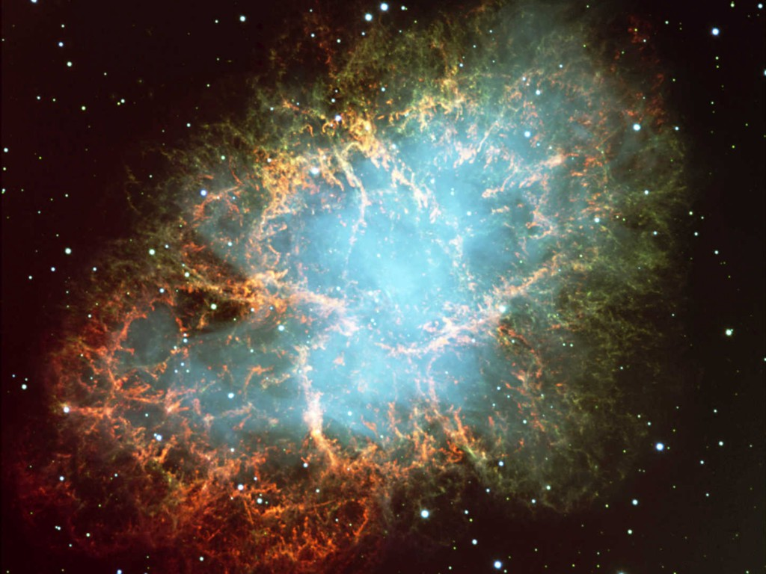
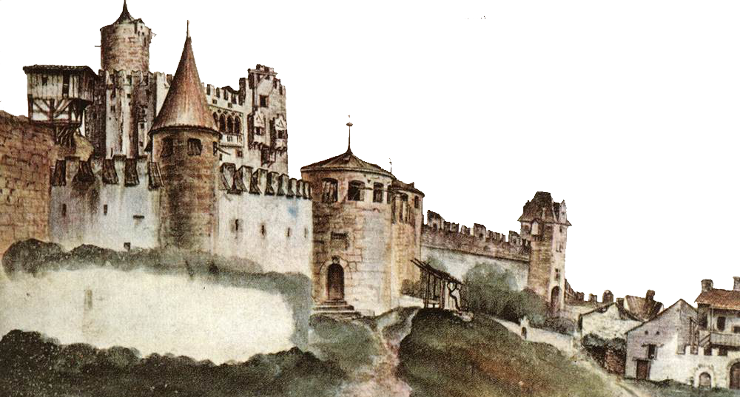
Flavor evolution of dense neutrinos as an emergent phenomenon
Georg Raffelt
Max-Planck-Institut für Physik, München

Slide 2
Flavor Conversion in Core-Collapse Supernovae
Next Generation Large-Scale Detectors (2020+)
MSW region
• Adiabatic flavor
conversion
Flavor eigenstates are
propagation eigenstates
Neutrino
sphere
• Slow self-induced
flavor conversion?
(Spectral splits …)
$$ν, \overline{ν}$$
• Fast self-induced
flavor conversion?
(Flavor equilibration?)
Shock wave
SN Neutrinos at the Cross Roads, Trento, 13–17 May 2019
Georg Raffelt, MPI Physics, Munich

Slide 3
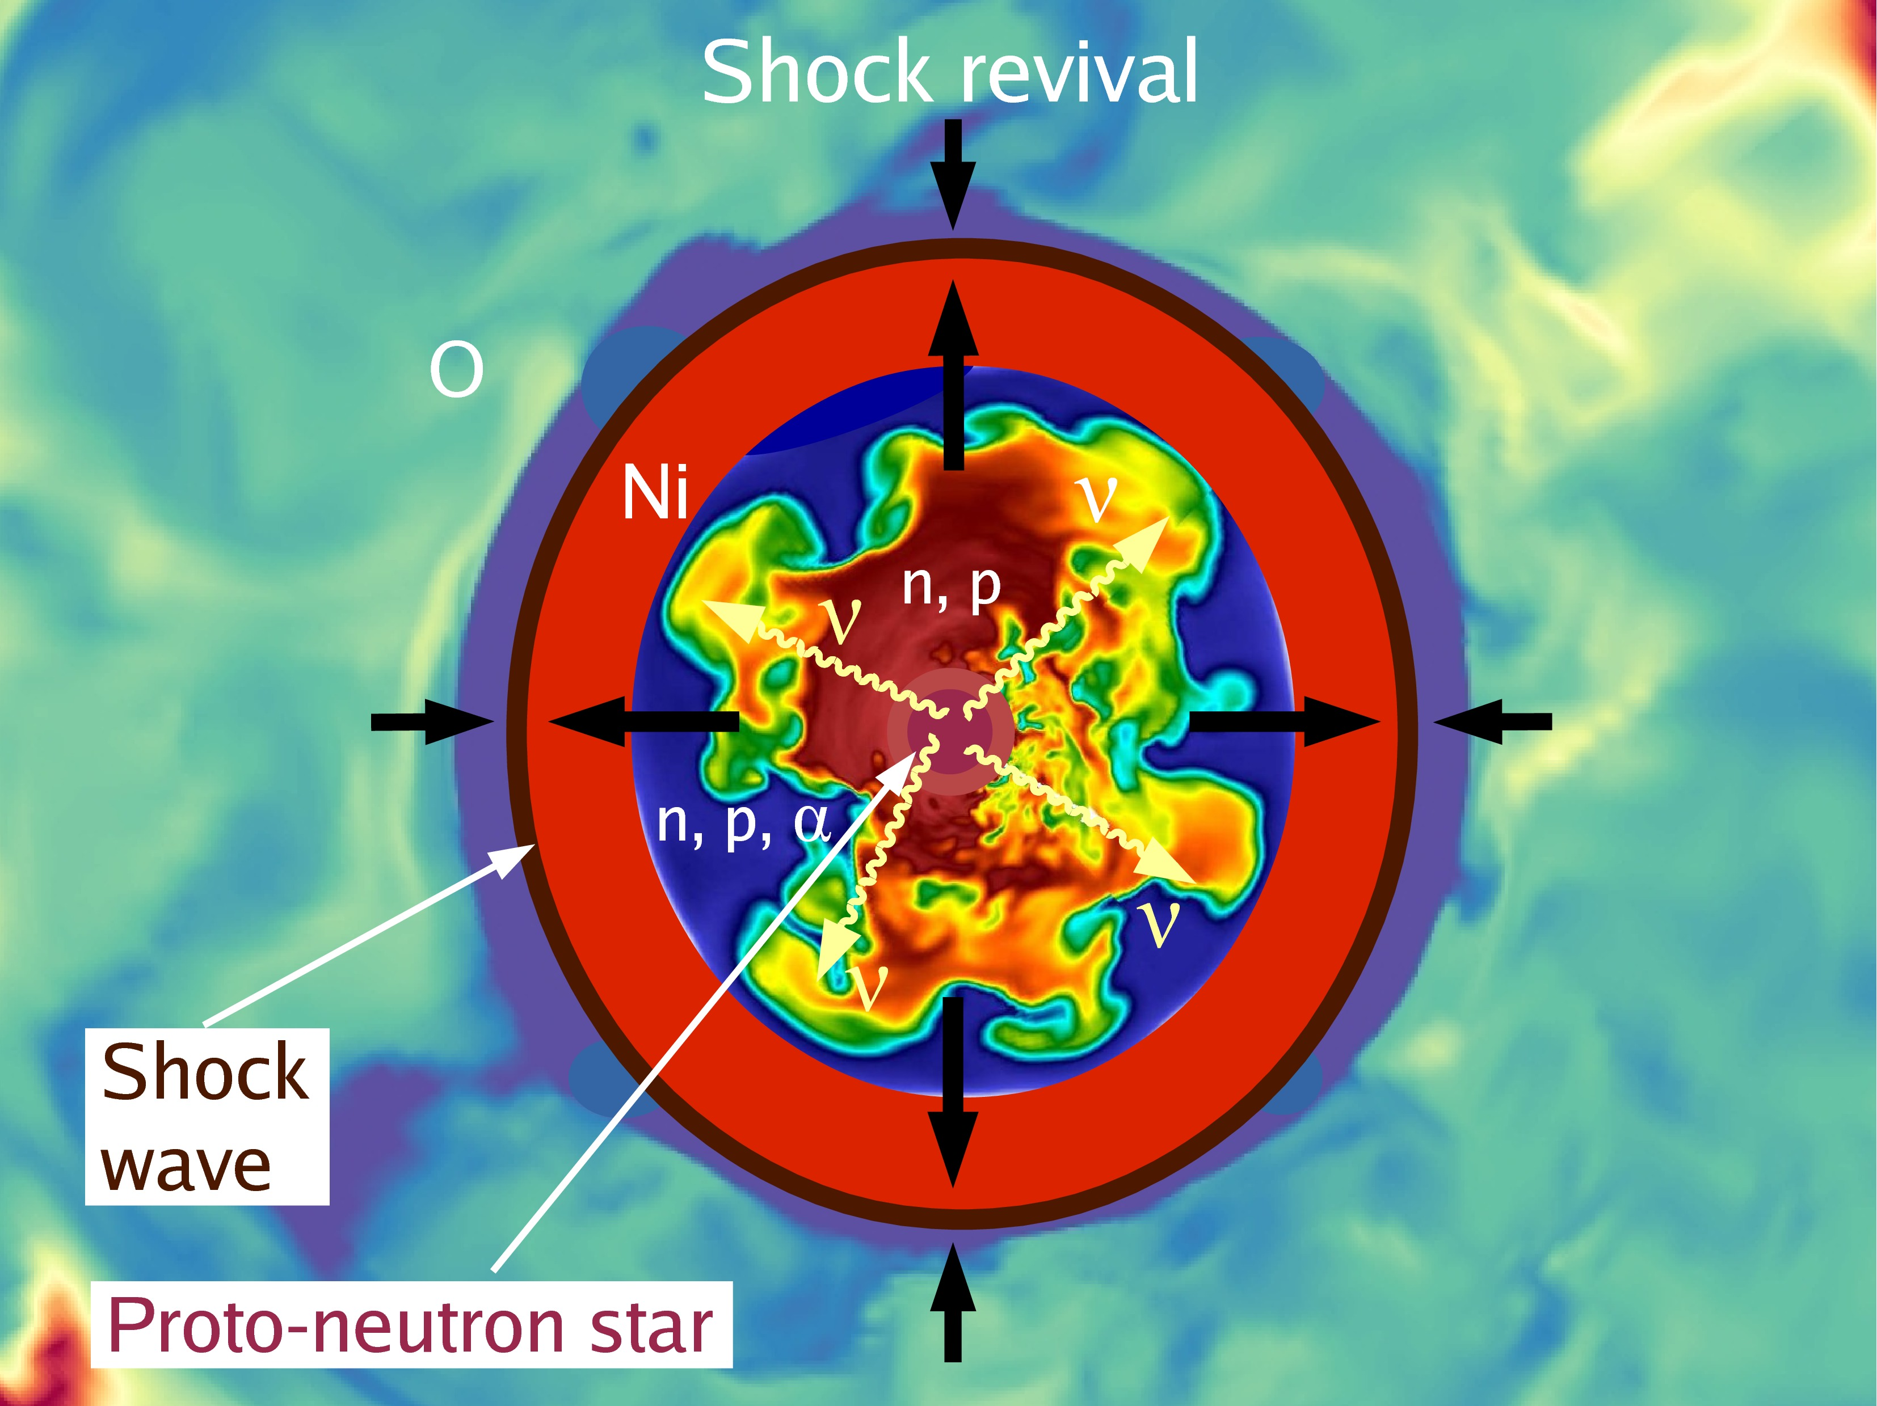
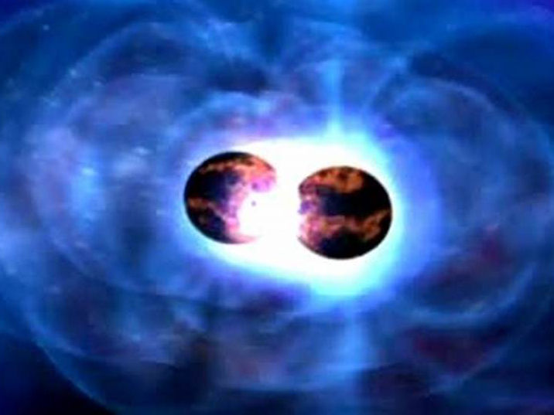
Why worry about detailed neutrino transport?
• Explosion mechanism:
Shock-wave revival by nu energy deposition
• Nucleosynthesis in neutrino irradiated
outflows in SNe and NS-mergers
depends on flavor (beta reactions!)
• Signal interpretation of DSNB and
next nearby SN
• Collective flavor conversion:
interesting theoretical problem
in its own right
NS-NS binary merger

Slide 4
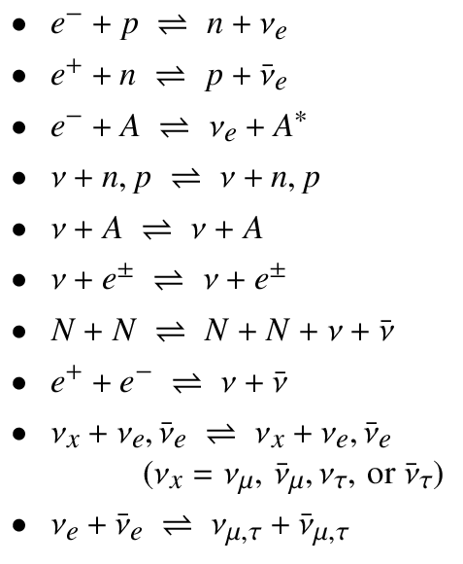
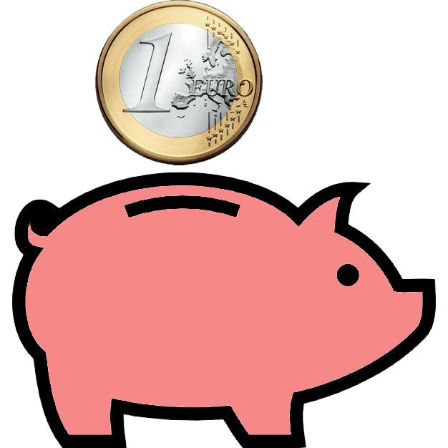
Kinetic Equation for Neutrino Transport
Flavor-dependent phase-space densities (occupation number matrices)
$$ρ=\left(\begin{matrix}f_{ν_{e}} & f_{〈ν_{e}|ν_{μ}〉} & f_{〈ν_{e}|ν_{τ}〉} \\ f_{〈ν_{μ}|ν_{e}〉} & f_{ν_{μ}} & f_{〈ν_{μ}|ν_{τ}〉} \\ f_{〈ν_{τ}|ν_{e}〉} & f_{〈ν_{τ}|ν_{μ}〉} & f_{ν_{τ}}\end{matrix}\right)$$
Diagonal: Usual occupation numbers
Off-diag: Flavor coherence information
and similar for $\overline{ν}$
Transport equation
$$\left(∂_{t}+\vec{v}⋅{\vec{∇}}_{x}−\vec{F}⋅{\vec{∇}}_{p}\right) ρ\left(t, \vec{x},\vec{p}\right)=−\text{i} \left[ℋ\left(t,\vec{x},\vec{p}\right),ρ\left(t,\vec{x},\vec{p}\right)\right]+𝒞\left[ρ\left(t,\vec{x},\vec{p}\right)\right]$$
Streaming
Gravitational forces
(redshift, deflection)
Flavor oscillations
(vacuum, matter, $νν$)
Collisions
β
Typical approximations in numerical simulations:
• Reducing 6+1 dimensions
(Angular moments, ray-by-ray, …)
• No gravitational deflection
• No flavor conversion (large matter effect!)
• No muons
• 3-species transport: $ν_{e}, {\overline{ν}}_{e}, ν_{x}$

Slide 5
Kinetic Equation for Neutrino Transport
Flavor-dependent phase-space densities (occupation number matrices)
$$ρ=\left(\begin{matrix}f_{ν_{e}} & f_{〈ν_{e}|ν_{μ}〉} & f_{〈ν_{e}|ν_{τ}〉} \\ f_{〈ν_{μ}|ν_{e}〉} & f_{ν_{μ}} & f_{〈ν_{μ}|ν_{τ}〉} \\ f_{〈ν_{τ}|ν_{e}〉} & f_{〈ν_{τ}|ν_{μ}〉} & f_{ν_{τ}}\end{matrix}\right)$$
Diagonal: Usual occupation numbers
Off-diag: Flavor coherence information
and similar for $\overline{ν}$
Transport equation
$$\left(∂_{t}+\vec{v}⋅{\vec{∇}}_{x}−\vec{F}⋅{\vec{∇}}_{p}\right) ρ\left(t, \vec{x},\vec{p}\right)=−\text{i} \left[ℋ\left(t,\vec{x},\vec{p}\right),ρ\left(t,\vec{x},\vec{p}\right)\right]+𝒞\left[ρ\left(t,\vec{x},\vec{p}\right)\right]$$
Streaming
Gravitational forces
(redshift, deflection)
Flavor oscillations
(vacuum, matter, $νν$)
Collisions
Flavor evolution governed by “Hamiltonian matrix” (here for 2 flavors)
$$ℋ=\frac{Δm^{2}}{4E}\left(\begin{matrix}\cos{2θ} & \sin{2θ} \\ \sin{2θ} & −\cos{2θ}\end{matrix}\right) + \sqrt{2}G_{F}\left(\begin{matrix}n_{e} & 0 \\ 0 & 0\end{matrix}\right) + \sqrt{2}G_{F}\int{\frac{d^{3}\vec{p}}{{\left(2π\right)}^{3}}}\left(ρ+\overline{ρ}\right)$$
Vacuum oscillations
MSW effect
Nu-nu interactions,
nus feed back on each other
• Flavor evolution is caused by off-diagonal $𝓗$ elements (vacuum or nu-nu term)
• For $Δm^{2}=0$, nu-nu term can still cause run-away modes!

Slide 6
Self-Induced Flavor Conversion
Flavor conversion (vacuum or MSW)
for a neutrino of given momentum $p$
• Requires lepton flavor violation
by masses and mixing
$$ν_{e}(p)→ν_{μ}(p)$$
$$\frac{Δm_{atm}^{2}}{2E}={10}^{−10}eV=0.5 km^{−1}$$
Pair-wise flavor exchange
by $ν$–$ν$ refraction (forward scattering)
• No net flavor change of pair
• Requires dense neutrino medium
(collective effect of interacting neutrinos)
• Can occur without masses/mixing
(and then does not depend on $Δm^{2}/2E$)
• Familiar as neutrino pair process $𝒪(G_{F}^{2})$
Here as coherent refractive effect $𝒪(G_{F}^{})$
$$ν_{e}\left(p\right)+{\overline{ν}}_{e}(k)→ν_{μ}\left(p\right)+{\overline{ν}}_{μ}(k)$$
$$ν_{e}\left(p\right)+ν_{μ}\left(k\right)→ν_{μ}\left(p\right)+ν_{e}\left(k\right)$$
$$\sqrt{2}G_{F}n_{ν}={10}^{−5}eV=0.5 cm^{−1}$$
$$E =12.5 MeV$$
$$R = 80 km$$
$$L_{ν}=40×{10}^{51}erg/s$$

Slide 7
Transport of Particles and Flavor Coherence
How to interpret the Liouville operator (advection term)?
$$𝒟 ρ\left(t, \vec{x},\vec{p}\right)=−\text{i} \left[ℋ\left(t,\vec{x},\vec{p}\right),ρ\left(t,\vec{x},\vec{p}\right)\right]+𝒞\left[ρ\left(t,\vec{x},\vec{p}\right)\right]$$
• Flavor evolution along trajectories (of individual neutrinos or wave packets)
$$\frac{d}{ds}ρ\left(t, \vec{x},\vec{p}\right)=−\text{i} \left[ℋ\left(t,\vec{x},\vec{p}\right),ρ\left(t,\vec{x},\vec{p}\right)\right]+𝒞\left[ρ\left(t,\vec{x},\vec{p}\right)\right]$$
Time and space coordinates related by neutrino velocity along trajectory
• Flavor evolution in space and time (of neutrino radiation field)
$$∂_{t}ρ+\frac{1}{2}\left\{{\vec{∇}}_{p}ℋ,{\vec{∇}}_{x}ρ\right\}−\frac{1}{2}\left\{{\vec{∇}}_{x}ℋ,{\vec{∇}}_{p}ρ\right\}=−\text{i} \left[ℋ,ρ\right]+𝒞\left[ρ\right]$$
Velocity operator (matrix in flavor space)
Neutrino quantum field obeys the Dirac equation
Kinetic equation for $ρ$ is always an approximation / simplification / expansion
Different intuitive pictures should give the same answer for observables

Slide 8
Velocity in Advection Term
• Advection term after “separation of scales” between gradients and neutrino $\vec{p}$
• Wigner function $ρ(t,\vec{x},\vec{p})$ makes sense as a phase-space density
$$∂_{t}ρ+\frac{1}{2}\left\{{\vec{∇}}_{p}ℋ,{\vec{∇}}_{r}ρ\right\}−\frac{1}{2}\left\{{\vec{∇}}_{x}ℋ,{\vec{∇}}_{p}ρ\right\}=−\text{i} \left[ℋ,ρ\right]+𝒞\left[ρ\right]$$
$${\vec{∇}}_{p}E_{kin}={\vec{∇}}_{p}\sqrt{{\vec{p}}^{2}+m^{2}}=\frac{\vec{p}}{E}=\vec{v}$$
Velocity operator (matrix in flavor space)
Ultrarelativistic limit and ignore gravity or refractive deflection
$$∂_{t}ρ+\vec{v}⋅{\vec{∇}}_{r}ρ=−\text{i} \left[\frac{ℳ^{2}}{2E}+ℋ_{matter}+ℋ_{νν},ρ\right]+𝒞\left[ρ\right]$$
Unit vector
$$E=|\vec{p}|$$
Leading-order effect of $ν$ masses on the rhs in the usual oscillation term
Stirner, Sigl & Raffelt: Liouville term for neutrinos: Flavor structure and wave interpretation, JCAP 1805 (2018) 016 [arXiv:1803.04693]

Slide 9
Kinetic equations for flavor transport
Rudszky: Kinetic equations for neutrino spin- and type-oscillations in a medium,
Astrophys. Space Sci. 165 (1990) 65
Raffelt & Sigl: General kinetic description of relativistic mixed neutrinos,
NPB 406 (1993) 423
Sirera & Perez: Relativistic Wigner function approach to neutrino propagation in matter,
PRD 59 (1999) 125011 [hep-ph/9810347]
Yamada: Boltzmann equations for neutrinos with flavor mixings,
PRD 62 (2000) 093026 [astro-ph/0002502]
Cardall: Liouville equations for neutrino distribution matrices,
PRD 78 (2008) 085017 [arXiv:0712.1188]
Vlasenko, Fuller & Cirigliano: Neutrino quantum kinetics,
PRD 89 (2014) 105004 [arXiv:1309.2628]
Serreau & Volpe: Neutrino-antineutrino correlations in dense anisotropic media,
PRD 90 (2014) 125040 [arXiv:1409.359]
Hansen & Smirnov: The Liouville equation for flavour evolution of neutrinos and neutrino wave packets, JCAP 1612 (2016) 019 [arXiv:1610.00910]
Stirner, Sigl & Raffelt: Liouville term for neutrinos: Flavor structure and wave interpretation, JCAP 1805 (2018) 016 [arXiv:1803.04693]

Slide 10
Correlated Trajectories vs. Field of Flavor Coherence
Assume globally spherically symmetric
neutrino emission from SN core
• Every $ν$ meets every
other $ν$ at most once
• Nonlinear feedback
on flavor evolution?
• Oscillating (or unstable)
field $ρ(r)$ of flavor coherence,
acting back upon itself
• Do not worry about individual
neutrinos

Slide 11
Evolution of the Questions
Bulb model of neutrino emission:
• Nu-nu interaction determined by aspect ratio of emission surface
• Instability as a function of radius – adiabatic conversion possible
• Flavor pendulum, spectral splits, multi-angle matter effect, three-flavor effects, …
• Spurious instabilities (need many angle bins in numerical studies)
• Instability in the transverse direction: Spontaneous symmetry breaking

Slide 12
Evolution of the Questions
Halo effect:
• Small re-scattered flux, much larger angular leverage
• Impact on collective effects?
• How to deal with backward flux?

Slide 13
Evolution of the Questions
Non-stationarity:
• Time-variation (of SN emission) in source region?
• Self-induced time variation, “pulsating modes” more unstable than stationary ones?
• Neutrino field begins to look like
an anisotropic “gas” or “medium”,
not a “beam”
• Look for full space-time dependent
solution $ρ(t,\vec{x})$

Slide 14
Fast Flavor Conversion
Flavor evolution governed by “Hamiltonian matrix” (here for 2 flavors)
$${ ℋ}_{\vec{p}}=\frac{Δm^{2}}{4E}\left(\begin{matrix}\cos{2θ} & \sin{2θ} \\ \sin{2θ} & −\cos{2θ}\end{matrix}\right) +ℋ_{mat}+\sqrt{2}G_{F}\int{\frac{d^{3}{\vec{p}}^{′}}{{\left(2π\right)}^{3}}\left(1−\vec{v}⋅{\vec{v}}^{′}\right)}\left(\begin{matrix}f_{ν_{e}} & f_{〈ν_{e}|ν_{x}〉} \\ f_{〈ν_{x}|ν_{e}〉} & f_{ν_{x}}\end{matrix}\right)$$
Flavor conversion caused by off diagonals
Energy scales of the problem:
$μ=\sqrt{2} G_{F} n_{ν\overline{ν}}$ Required for any collective effects
$ω_{E}=Δm^{2}/2E$ Vacuum oscillation frequency
$λ=\sqrt{2} G_{F} n_{e}$ Matter effect
Slow modes:
Require $ω_{E}≠0$
Possible growth rate: $κ∼\sqrt{μω_{E}}$, requires “crossing” of $ω_{E}$ distribution
Fast modes:
Dynamical even for $ω_{E}=0$
Growth rate: $κ∼\sqrt{μω_{E}}$ slow growth
$κ∼μ$ fast growth, requires “crossing” of angle distribution

Slide 15
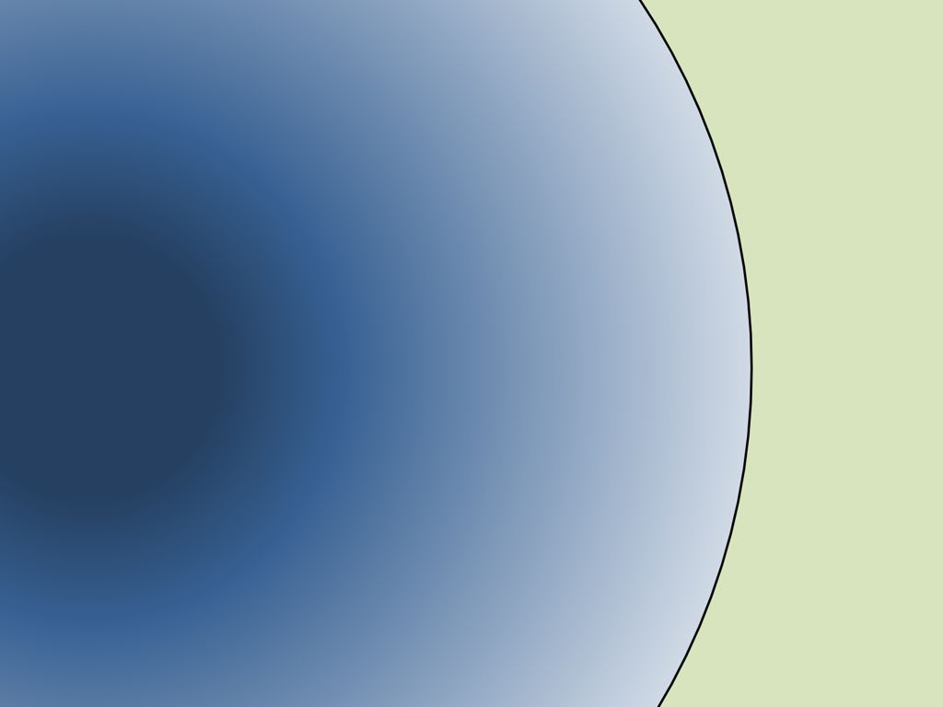
Neutrino gas in the near-free streaming regime
Small test volume for fast modes
• Homogeneous conditions
• Need $f_{ν}(E,θ,φ)$ for all species
• Large mean free path
• What is flavor evolution (t,x,y,z) ?
$$ν\overline{ν}$$
PNS
$$ν\overline{ν}$$
y
x
Shock
z
Linearised problem:
Study dispersion relation of
“flavor waves”
SN Neutrinos at the Cross Roads, Trento, 13–17 May 2019
Georg Raffelt, MPI Physics, Munich

Slide 16
Linearisation for Fast Flavor Modes
Evolution equation: $iv^{α}∂_{α}ρ= \left[ℋ,ρ\right]$ with $v^{α}=\left(1,\vec{v}\right)$
Linearisation to find (propagating or unstable) collective modes:
$$ρ_{ } =\left(\begin{matrix}f_{ν_{e}} & f_{〈ν_{e}|ν_{x}〉} \\ f_{〈ν_{x}|ν_{e}〉} & f_{ν_{x}}\end{matrix}\right)=\frac{f_{ν_{e}}+f_{ν_{x}}}{2}+\frac{f_{ν_{e}}−f_{ν_{x}}}{2} \left(\begin{matrix}s_{ } & S_{ } \\ S_{}^{∗} & {−s}_{ }\end{matrix}\right)$$
Field of flavor
coherence
Linearised EOM for field of flavor coherence
$$iv^{α}∂_{α}S_{\vec{p}}=\left(\frac{Δm^{2}}{2E}+v^{α}Λ_{α}\right)S_{\vec{p}}−μv^{α}\int{\frac{d^{3}{\vec{p}}^{′}}{{\left(2π\right)}^{3}}v_{α}^{′}\left(g_{{\vec{p}}^{′}}S_{{\vec{p}}^{′}}−{\overline{g}}_{{\vec{p}}^{′}}{\overline{S}}_{{\vec{p}}^{′}}\right)}$$
Ignore for fast modes
Same for all $E$ and $ν$ and $\overline{ν}$
Angle distribution of electron lepton number (ELN) carried by neutrinos
$$G_{\vec{v}}=\int{\frac{dE E^{2}}{2π^{2}}} \frac{f_{ν_{e},\vec{p}}−f_{{\overline{ν}}_{e},\vec{p}}−f_{ν_{x},\vec{p}}+f_{{\overline{ν}}_{x},\vec{p}}}{2}$$
Linearised EOM for field of flavor coherence
$$iv^{α}\left(∂_{α}+iΛ_{α}\right)S_{\vec{v}}=−μv^{α}\int{\frac{d{\vec{v}}^{′}}{4π}{v_{α}^{′}G}_{{\vec{v}}^{′}}S_{{\vec{v}}^{′}}}$$
Matter effect, “rotate away” by including it in derivative
if medium is homogeneous and stationary

Slide 17
Dispersion Relation for Fast Flavor Modes
Linearised EOM for field of flavor coherence – a wave equation
$$iv^{α}∂_{α}S_{\vec{v}}=−μv^{α}\int{\frac{d{\vec{v}}^{′}}{4π}{v_{α}^{′}G}_{{\vec{v}}^{′}}S_{{\vec{v}}^{′}}}$$
Plane-wave ansatz
$$S_{\vec{v}}\left(t,\vec{r}\right)=Q_{\vec{v}}\left(Ω,\vec{K}\right) e^{−i\left(Ωt−\vec{K}⋅\vec{r}\right)}$$
EOM in Fourier space
$$\left(Ω−\vec{v}⋅\vec{K}\right)Q_{\vec{v}}=−μ\int{\frac{d{\vec{v}}^{′}}{4π}{\left(1−\vec{v}⋅{\vec{v}}^{′}\right) G}_{{\vec{v}}^{′}}Q_{{\vec{v}}^{′}}}$$
Non-collective solutions:
$(Ω,\vec{K})$ real and “below the light cone”
$\left(Ω−\vec{v}⋅\vec{K}\right)=0$ for some mode $\vec{v}$
Dispersion relation:
$Ω=\vec{v}⋅\vec{K}$
for every $\vec{K}$ continuos infinity of frequencies
Collective solutions:
$\left(Ω−\vec{v}⋅\vec{K}\right)≠0$ for all $\vec{v}$ modes
$(Ω,\vec{K})$ real and “outside the light cone”
or imaginary part
Eigenfunctions $Q_{\vec{v}}∝\frac{\vec{a}⋅\vec{v}+b}{Ω−\vec{v}⋅\vec{K}}$
Dispersion relation: $det Π=0$
$$Π^{μν}=η^{μν}+\int{\frac{d\vec{v}}{4π}} G_{\vec{v}} \frac{v^{μ}v^{ν}}{Ω−\vec{v}⋅\vec{K}}$$

Slide 18
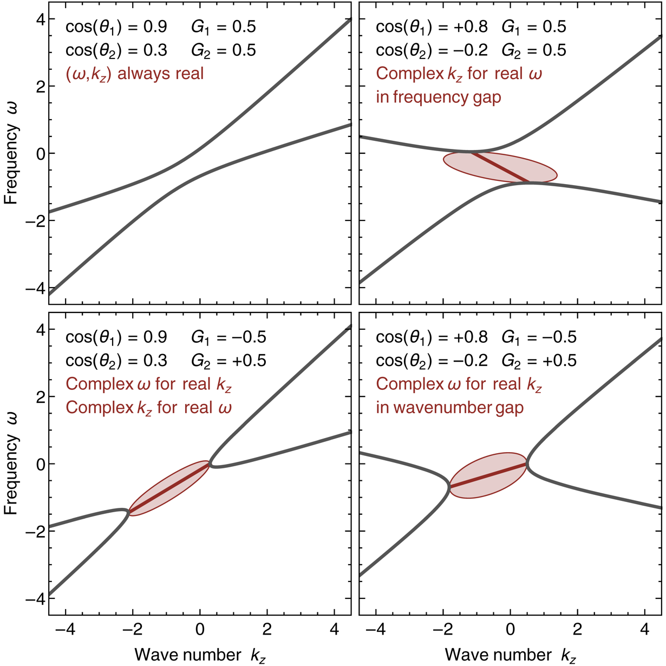
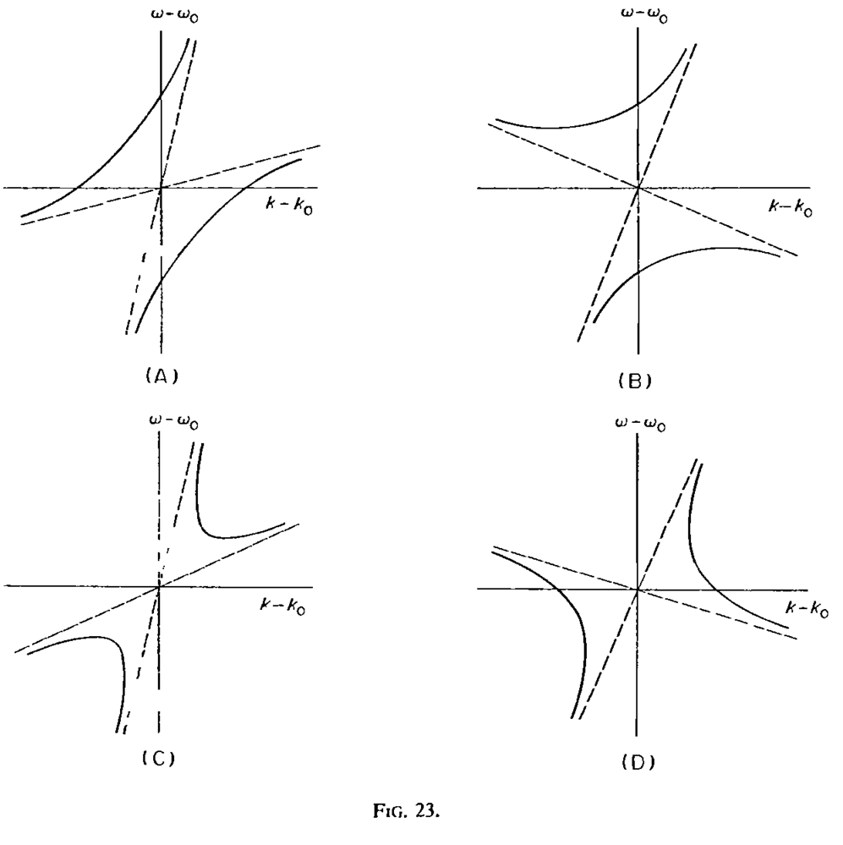
A Dispersion Relation Approach
Classification of instabilities of “flavor waves”
(Two-beam model)
Classification of instabilities of plasma waves
(Two-beam model)
Stable
Particle-like
Tachyon-like
Landau & Lifshitz, Vol.10, Physical Kinetics
Chapter VI, Instability Theory

Slide 19
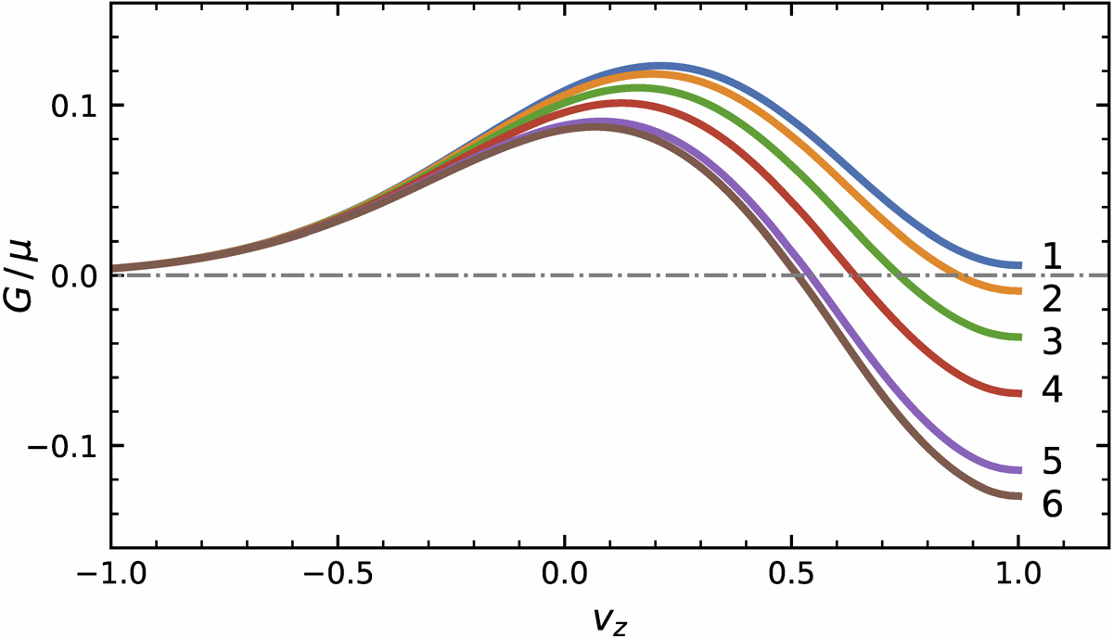
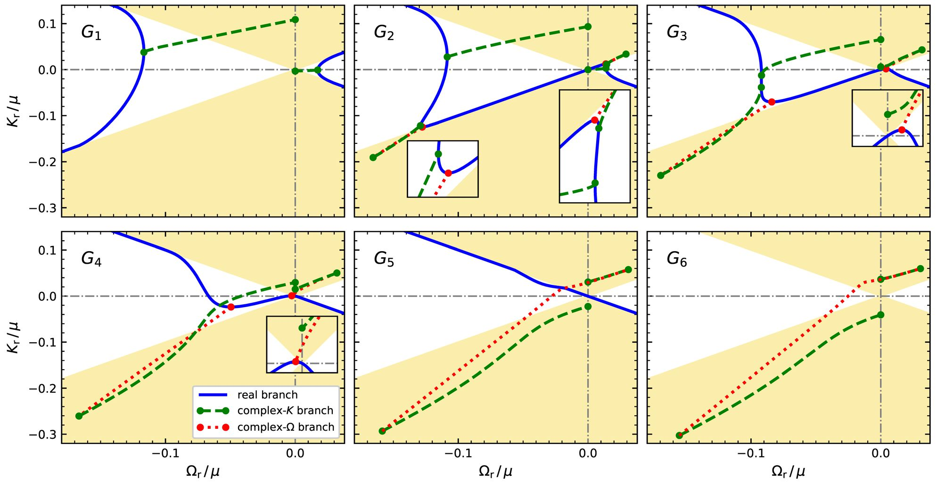
Dispersion Relation for Neutrino Flavor Waves
Dispersion relations for different
angle distributions of neutrino gas
Yi, Ma, Martin & Duan, PRD 99 (2019) 063005 [arXiv:1901.01546]

Slide 20
Fast Flavor Waves
Neutrino velocity
distribution
Flavor wave $\vec{K}$
Non-collective modes: Infinitely many $Ω=\vec{v}⋅\vec{K}$
• Flavor coherence carried by every neutrino mode separately
• Quick kinematical decoherence
Collective modes: $Ω\left(\vec{K}\right)$ according to collective dispersion relation
• Flavor wave (or wave packet) propagates and/or grows

Slide 21
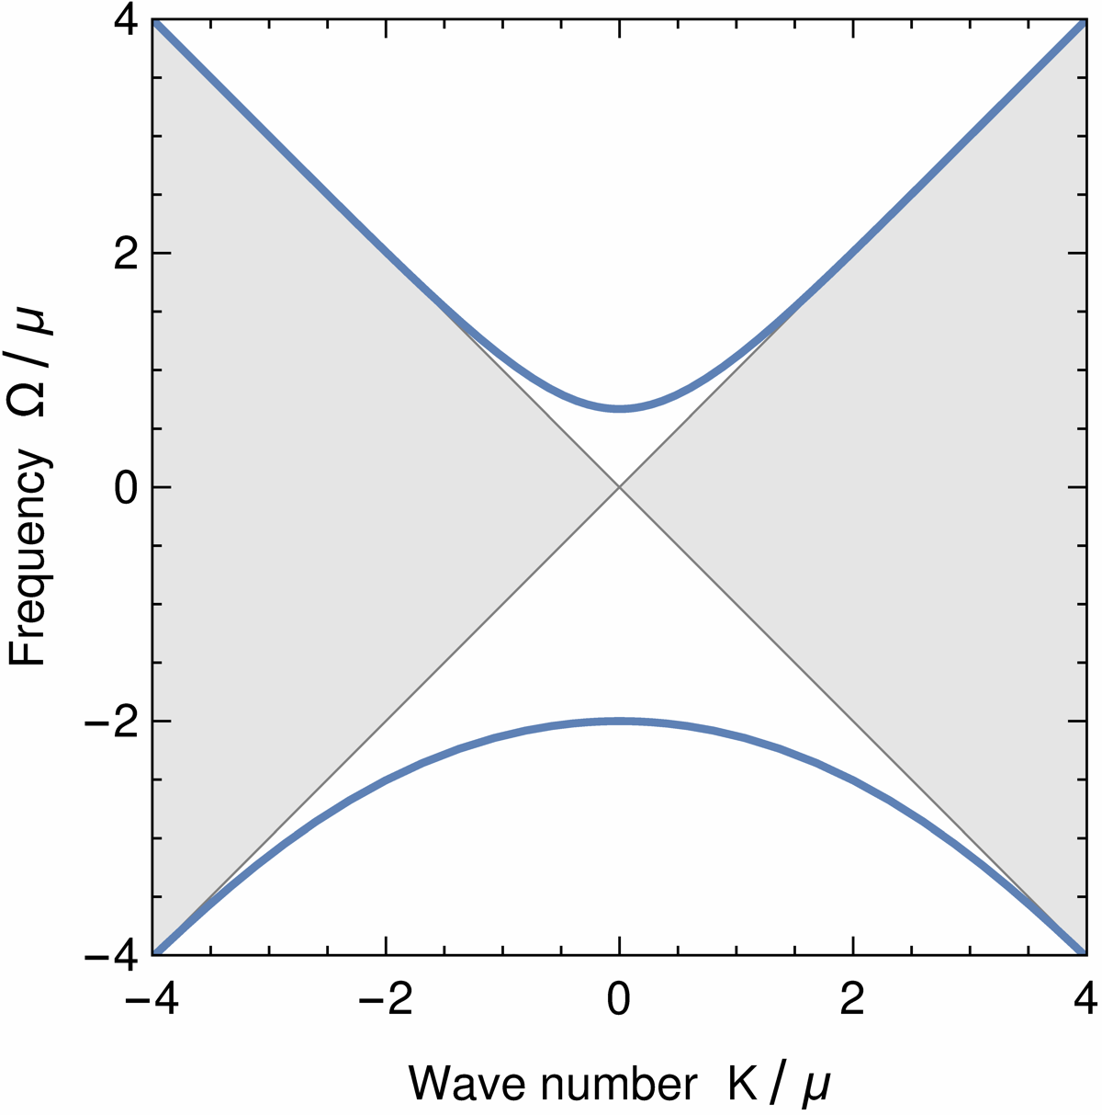
Dispersion Relation for Isotropic Case
No propagating
collective modes
under the
light cone
Collective modes

Slide 22
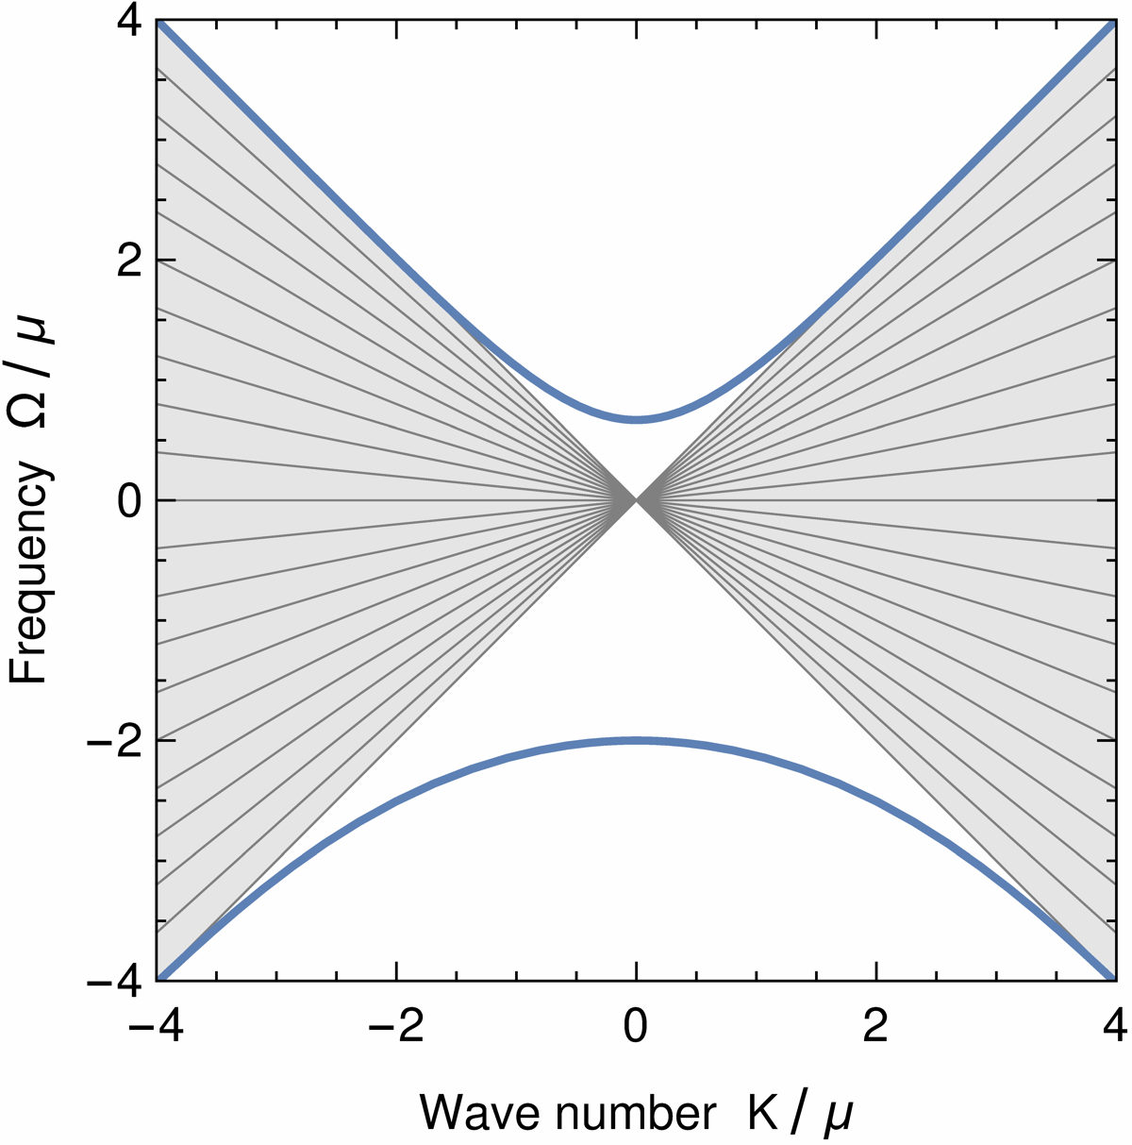
Dispersion Relation for Isotropic Case
Non-collective modes with
$$Ω=\vec{v}⋅\vec{K}$$
carried by neutrino “beams”
Collective modes

Slide 23
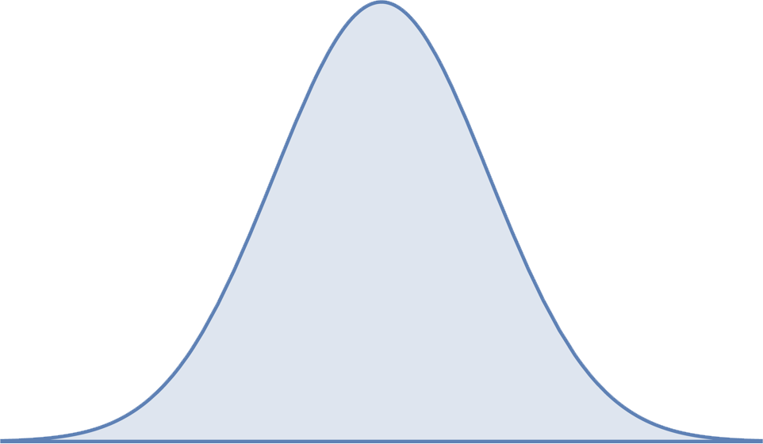
Fast Flavor Waves
Non-collective modes:
• Infinitely many neutrino velocity projections on $\vec{K}$
• Each carries along its initial flavor coherence
• Kinematical decoherence of initial wave packet
(Does not happen in two-beam model)
• Fast dissipation of any initial wave packet
$\vec{K}$ of flavor wave
Collective modes
• Infinitely many neutrino velocity projections on $\vec{K}$
• Move through wave packet
(here taken with vanishing central wave number)
• Wave packet moves in neutrino gas,
independently of velocities of neutrino “beams”
Wave packet of flavor coherence

Slide 24
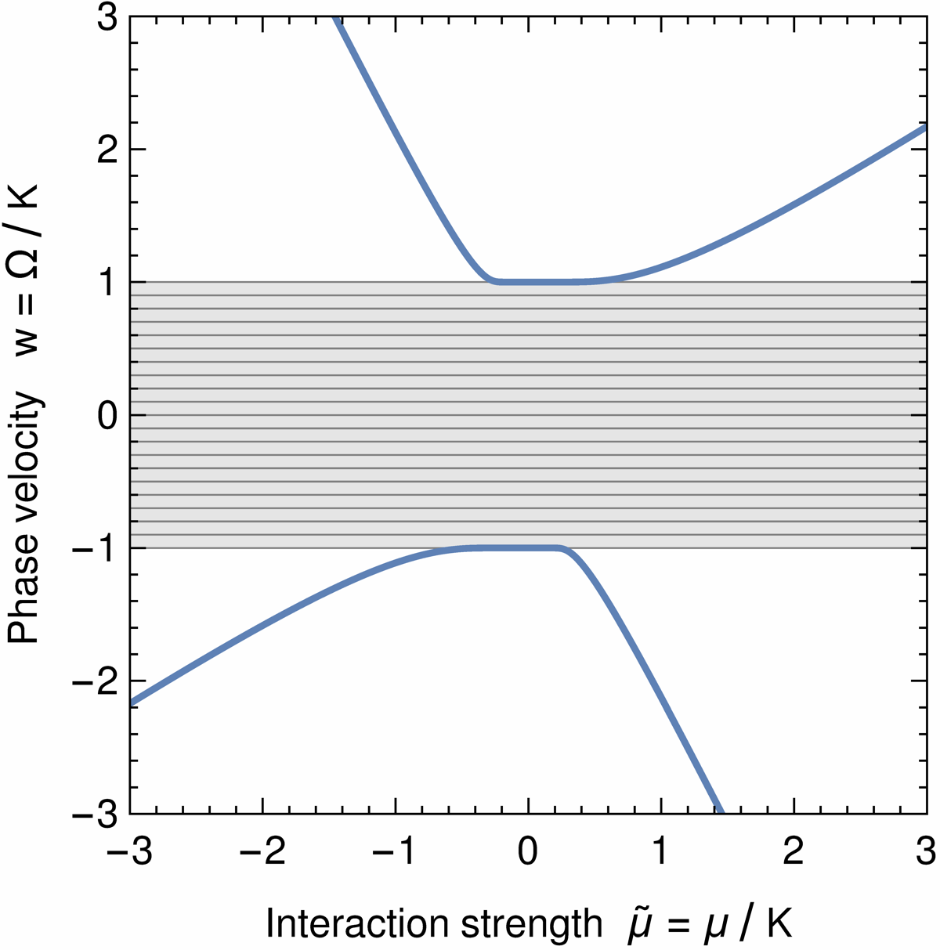
Dispersion Relation vs. Eigenvalues of Hamiltonian
Dispersion relation:
For fixed $μ$ find $Ω\left(K\right)$ from
$$\left(Ω−\vec{v}⋅\vec{K}\right)Q_{\vec{v}}=−μ\int{\frac{d{\vec{v}}^{′}}{4π}{\left(1−\vec{v}⋅{\vec{v}}^{′}\right) G}_{{\vec{v}}^{′}}Q_{{\vec{v}}^{′}}}$$
Eigenvalues of Hamiltonian:
For fixed $K$ find eigenvalues $w=Ω\left(μ\right)/K$ of $ℋ$
$i∂_{t}S_{\vec{v}}\left(t,\vec{K}\right)=$ $ℋ(S_{\vec{v}})$
$$ℋ\left(S_{\vec{v}}\right)=\vec{v}⋅\vec{K} S_{\vec{v}}−μ\int{\frac{d{\vec{v}}^{′}}{4π}{\left(1−\vec{v}⋅{\vec{v}}^{′}\right) G}_{{\vec{v}}^{′}}S_{{\vec{v}}^{′}}}$$

Slide 25
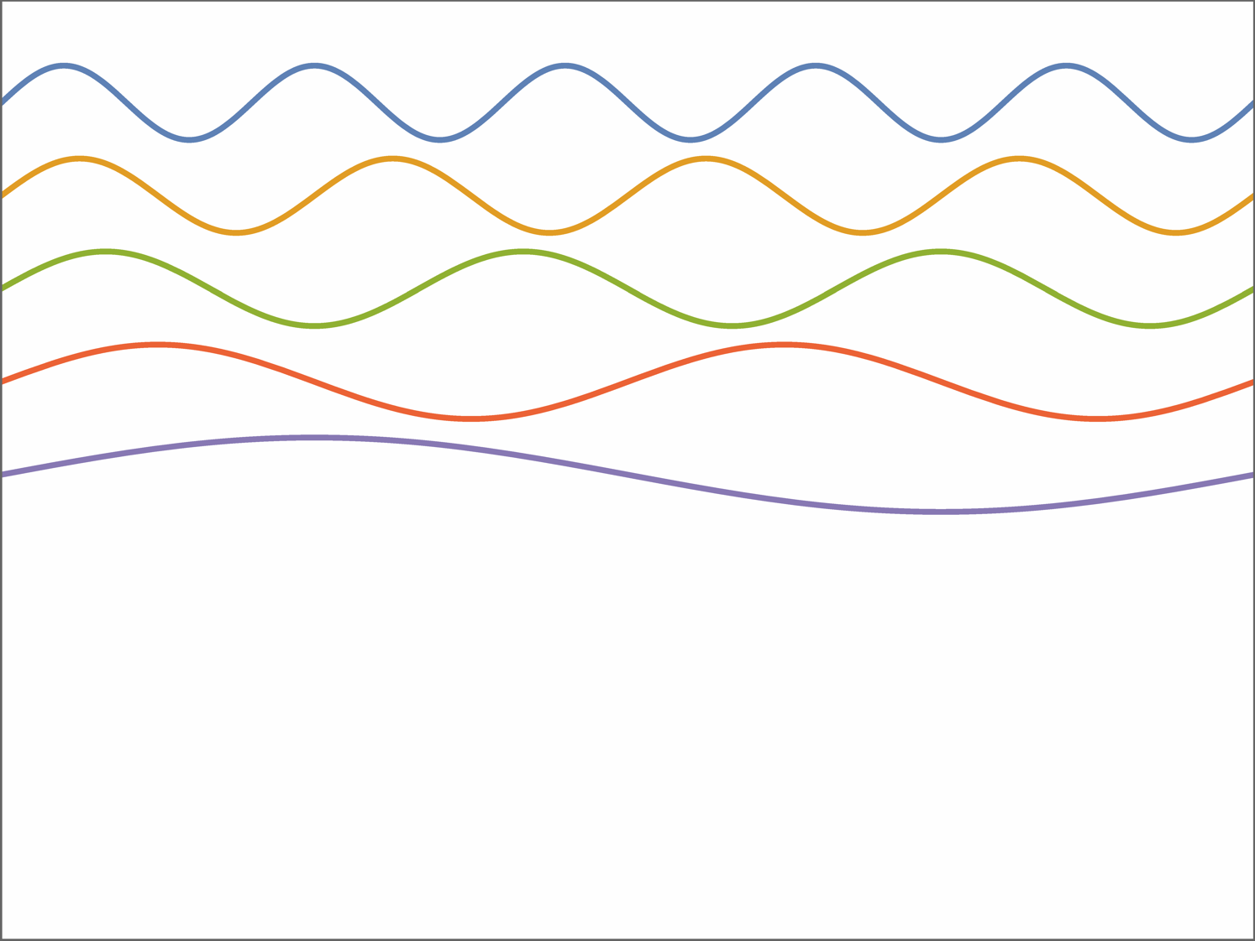
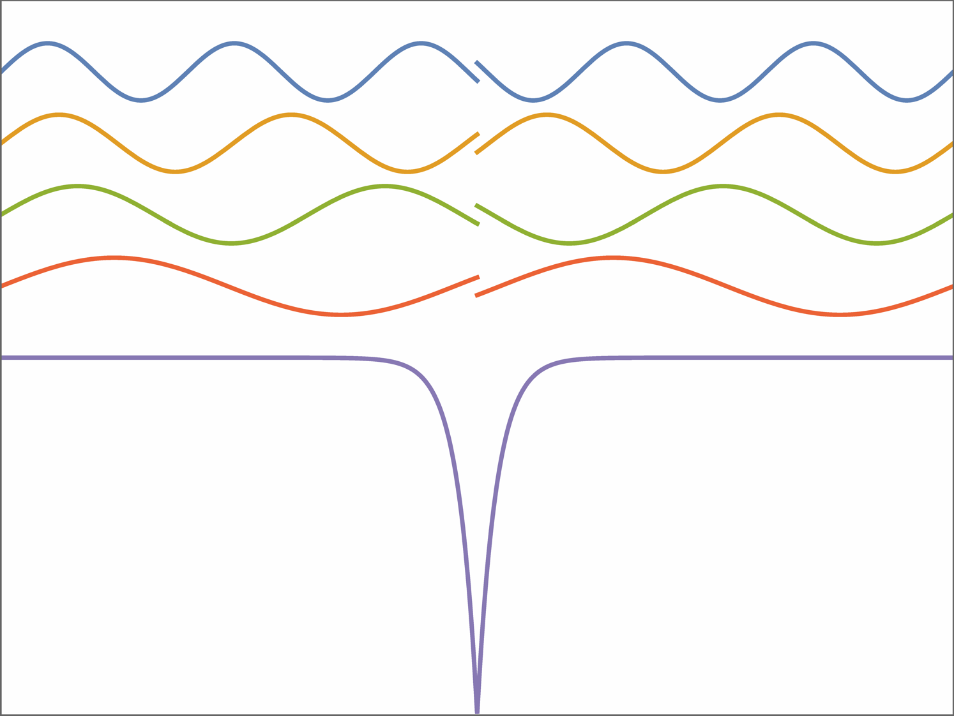
Bound vs Scattering States
Electron waves in a box
Electron waves in a box
Phase shift
Bound
state
Narrow
potential well
in the middle
Continuum limit: Box size → ∞
Continuum of scattering states
Continuum of scattering states
(with phase shifts) + Bound state
Non-collective modes $∼$ Scattering states
Collective modes $∼$ Bound states

Slide 26
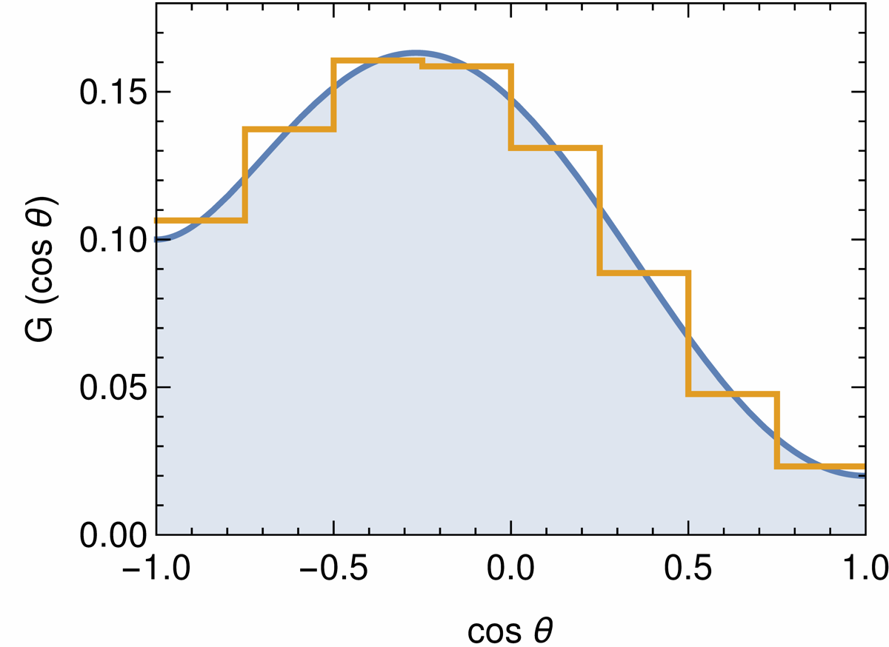
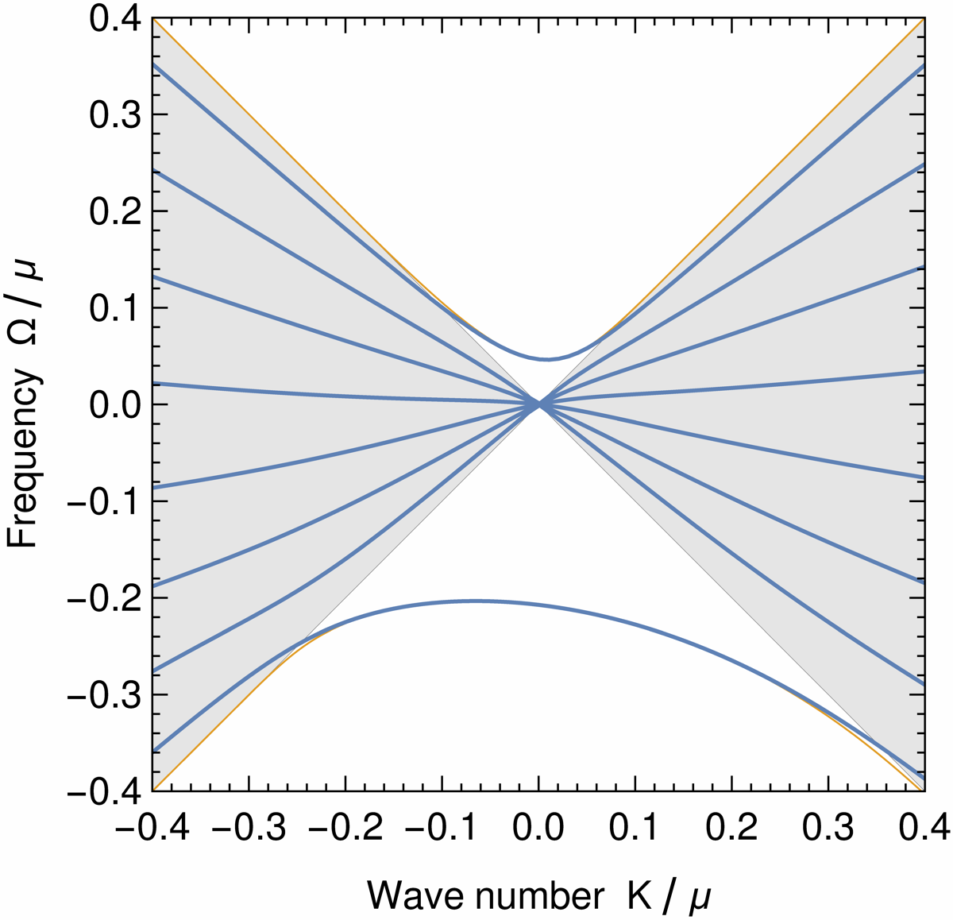
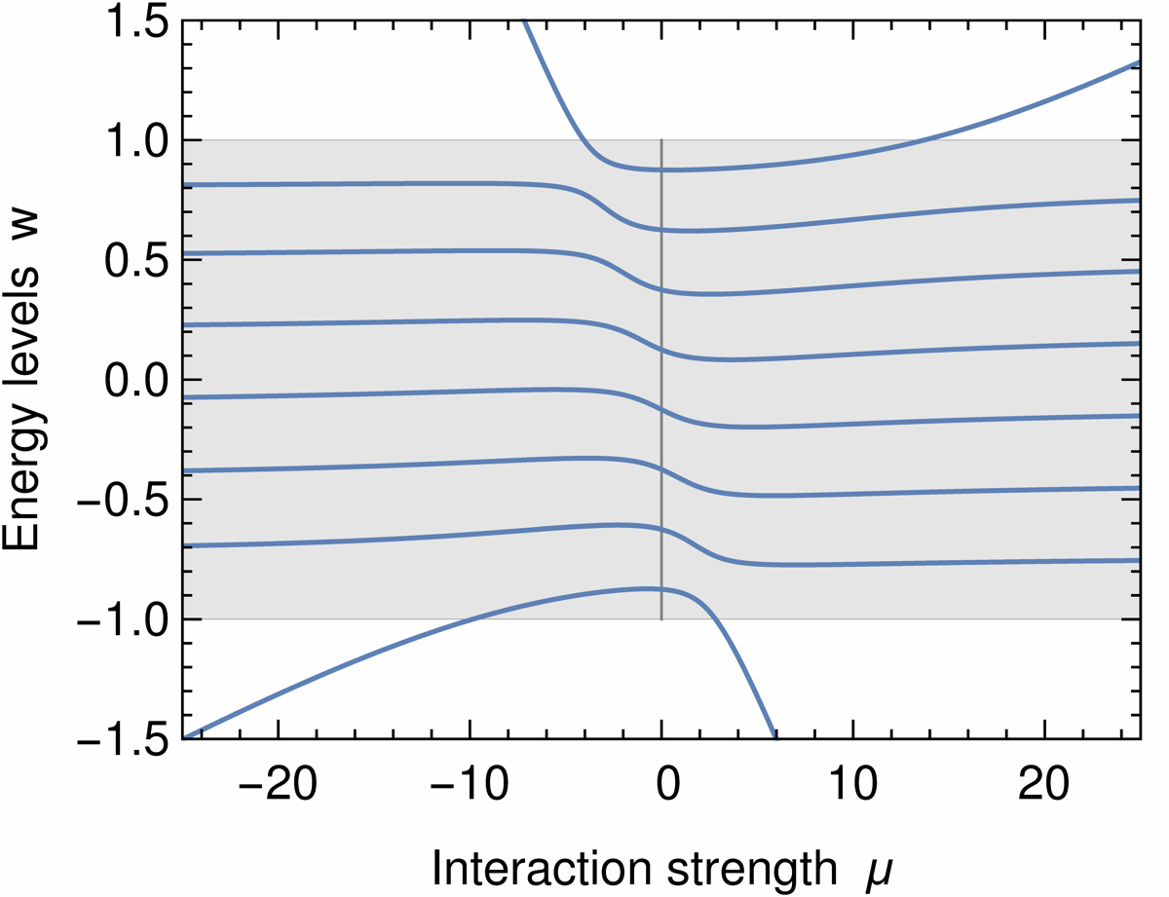
No spectral crossing
ELN angle distribution
Dispersion relation
Collective mode from
continuous solution
Discrete solution
with 8 bins
Energy levels
• Two propagating collective modes
• “Peel off’’ from non-collective modes

Slide 27
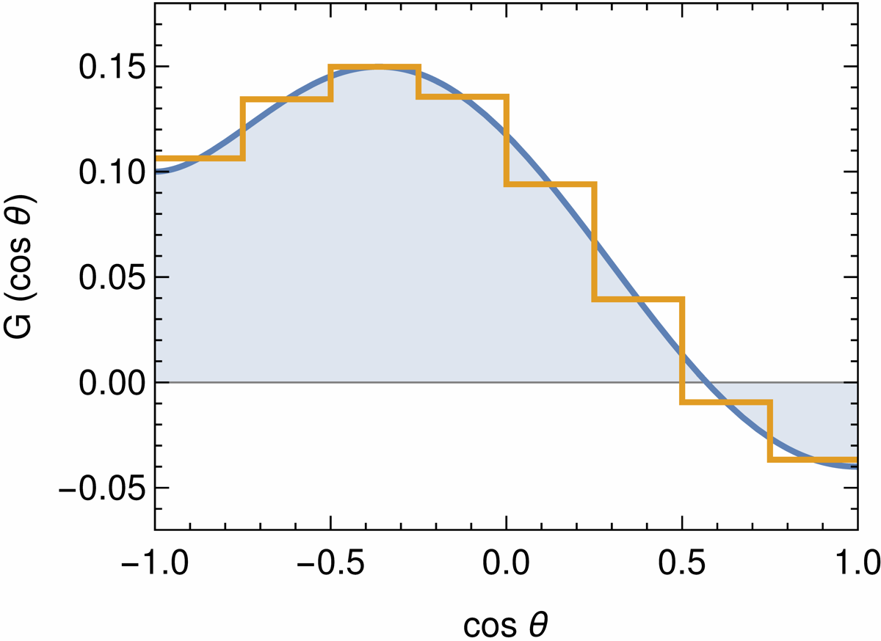
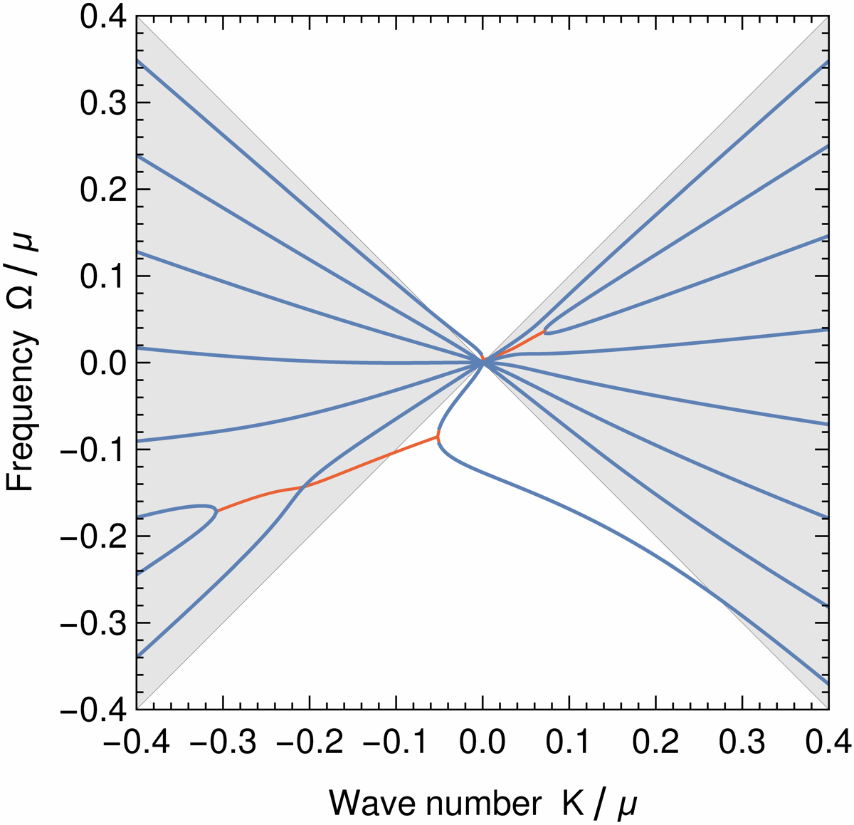
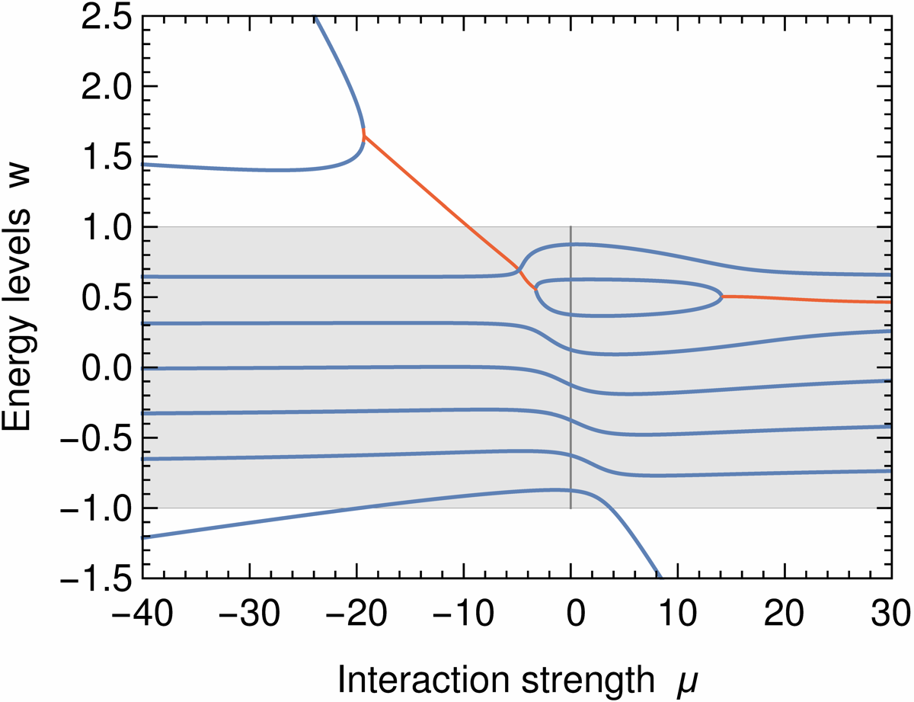
“Weak” spectral crossing
ELN angle distribution
Dispersion relation
Energy levels
Critical
points
Complex solution
• Propagating and unstable collective modes
• Unstable modes begin under the light cone
• No spurious instabilities in discrete case

Slide 28
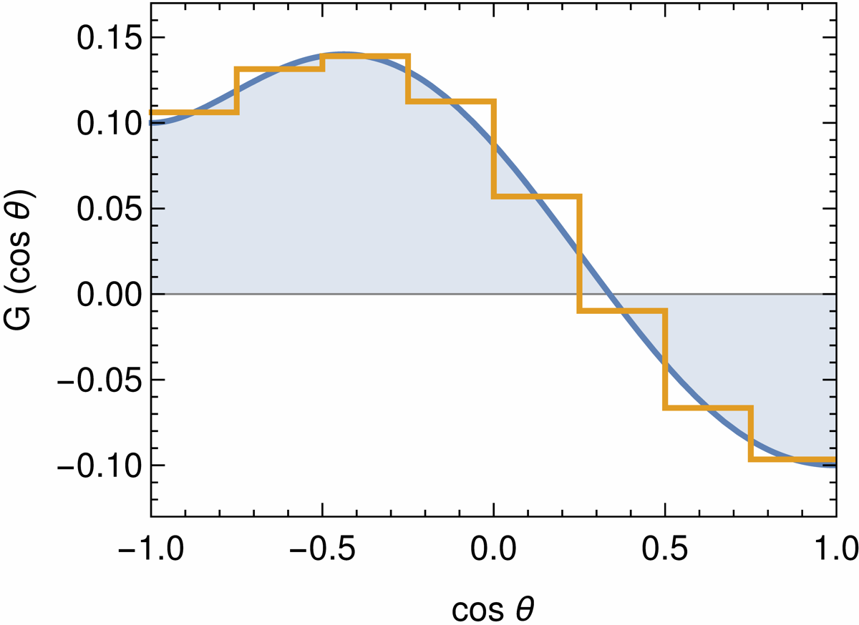
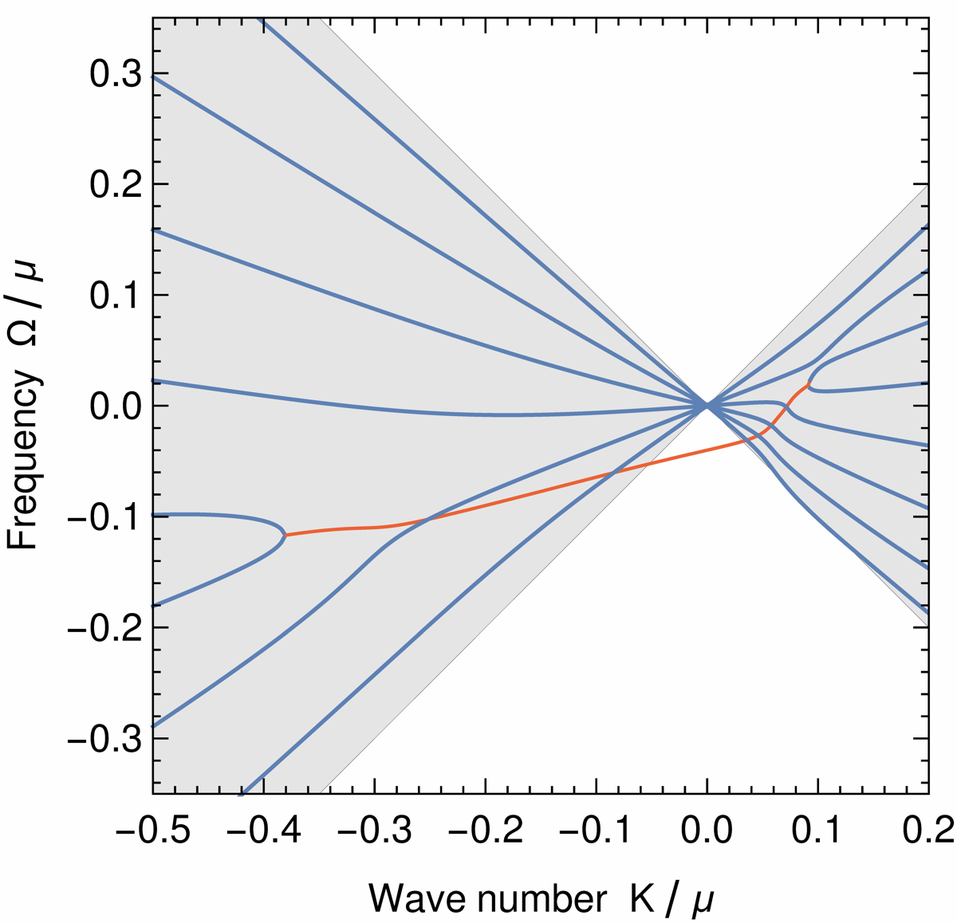
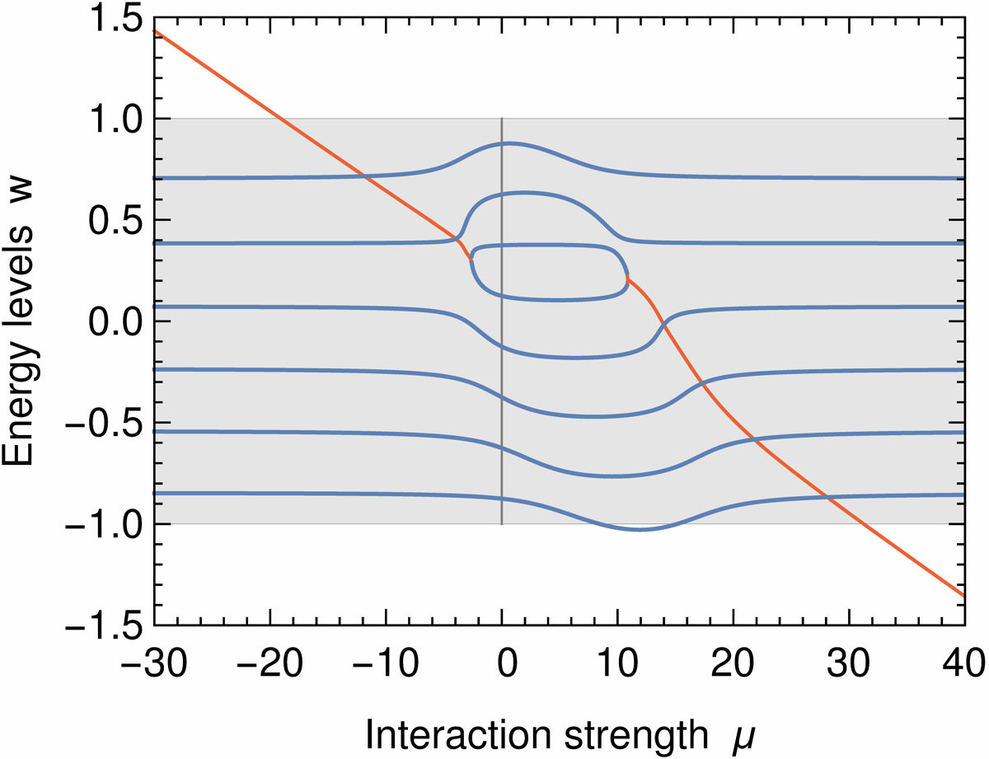
“Strong” spectral crossing
ELN angle distribution
Dispersion relation
Energy levels
• Only unstable collective modes
• Begin and end under the light cone

Slide 29
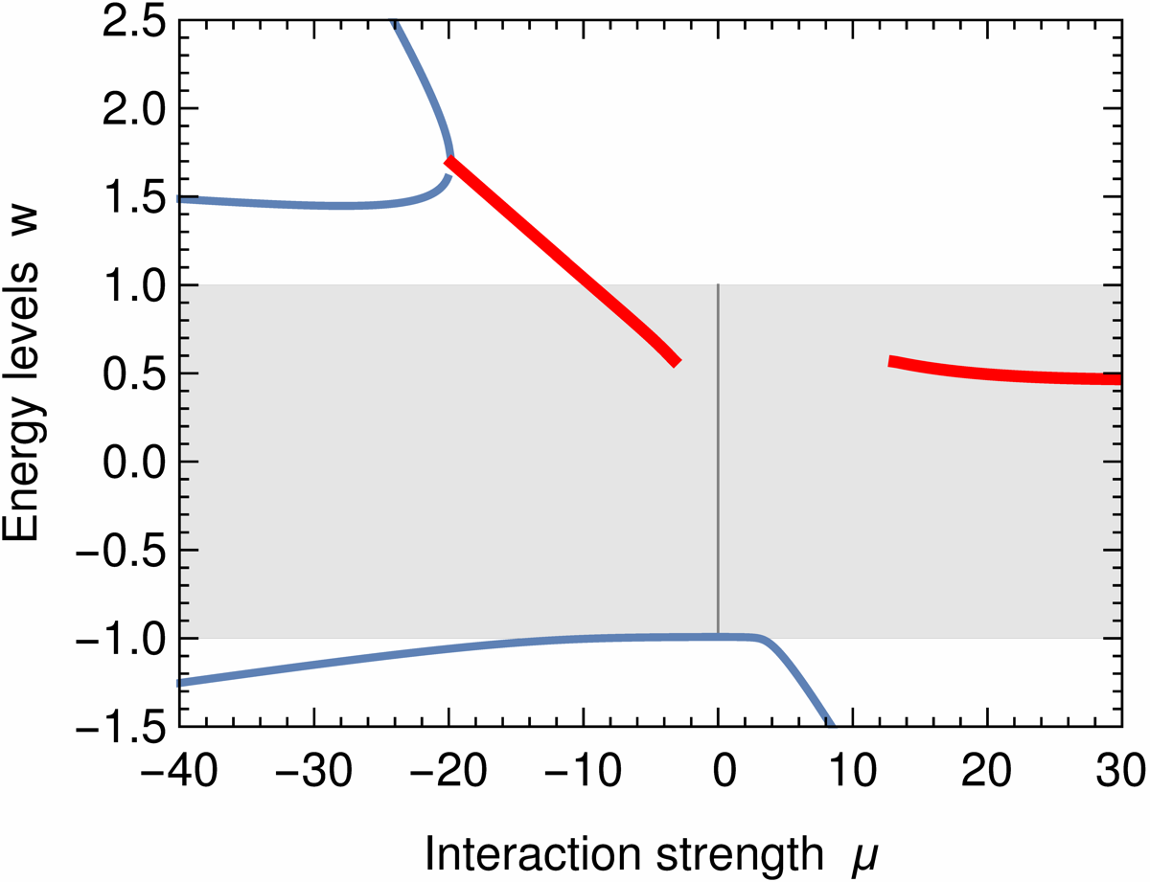
Spectral crossing – Continuous Limit
Energy levels
• Solutions with complex eigenvalues appear as
merging of two real eigenvalues
• With increasing $μ$ must emerge below the light cone
Continuous limit of vanishing mode spacing:
• Critical points at $w=cos\left(θ_{0}\right)$, i.e. at crossing
where $G\left(cos θ_{0}\right)=0$
• Interaction strength $μ_{1,2}$ of critical points follow
easily from $G\left(cos θ\right)$
• Single crossing: Complex solution guaranteed
• Several crossings: Not guaranteed
Critical points
→ See Tobias Stirner’s talk

Slide 30
Summary
• Neutrino-neutrino interactions lead to emergence of
collective modes of flavor coherence (propagating or unstable)
• Need not exist for every $\vec{K}/μ$ (dispersion relations can end)
• Co-exist with non-collective modes
• “Wave packet of flavor coherence” dissipates by kinematical decoherence
between non-collective modes
• Contains non-dissipating (propagating or growing) projection for
sufficiently strong nu-nu interaction effect
• Explicit formulation of eigenfunctions for non-collective modes
leads to simple identification of critical points → Tobias Stirner’s talk
• Stable collective modes “peel off” from the light cone and exist only outside
• Unstable collective modes begin/end under the light cone from
coalescence of non-collective modes
Capozzi, Raffelt & Stirner, work in progress (2019)

Slide 31
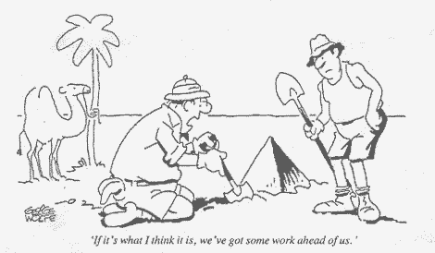
Many Open Questions
Flavor evolution in dense neutrino flows still on the level of
simplified toy models and parametric studies
• Realistic normal-mode analysis without symmetry assumptions?
• Realistic triggering of stable or unstable flavor waves?
• Do tachyonic modes really lead to flavor equilibration?
(Going beyond linearised stability analysis)
• Realistic impact on SN explosion and nucleosynthesis?
It is only the beginning.
A lot more work
ahead of us …

